Slide 1
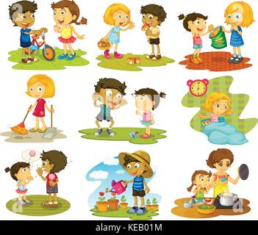
During the month of October we will try to …
Be kind to others

