Slide 1
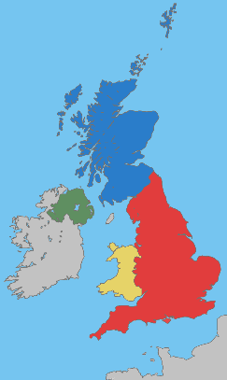
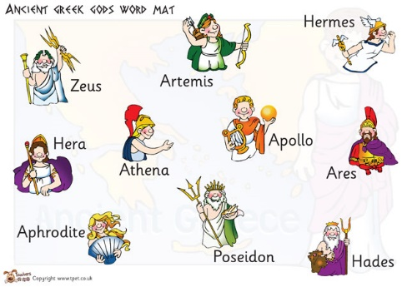
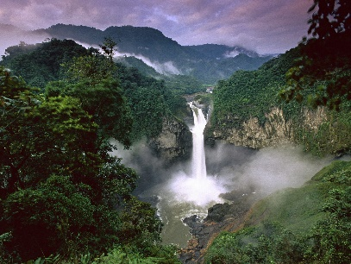
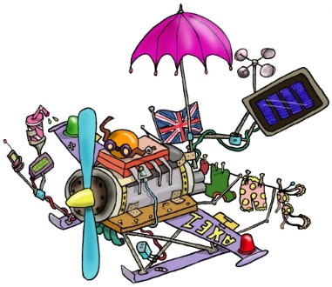
Welcome to Year 5
Class 11 – Mr Batchelor
Class 12 – Mr Knowles

Slide 2
Year 5 Team
Class 12 : Mr Knowles
Class 11: Mr Batchelor
Teaching Assistant – Mrs Tobin

Slide 3
Our Curriculum
 | Autumn 1 | Autumn 2 | Spring 1 | Spring 2 | Summer 1 | Summer 2 | Summer 2
Topic name | Healthy Bodies, Healthy Minds | Our World | We are Explorers! (Space) | Animal Kingdom (Rainforest) | We are Scientists! | We are creative! | We are eco-warriors and we care
RE | Ourselves Judaism | Life Choices Hope | Mission Memorial Sacrifice | Sacrifice | Transformation Islam | Freedom and responsibility | Stewardship (CAFOD)
RSE | ‘I am unique and made in the image of God’ ‘We all accept and respect ourselves’ ‘We are growing and becoming young adults’
English – genres through the curriculum | Legends of the British Isles A selection of British Legend texts Persuasion Adverts & magazines | Non-Chronological reports / information texts Poems with a structure Haiku & Limericks | Science fiction stories Information booklets on Space | Fiction Stories form Other Cultures (Deforestation poem to learn by heart) Debate Deforestation | Stories with historical settings Magazine: Information Text. | Myths Ancient Greece The Osbourne book of Greek Myths. Biographies and Autobiographies Poems with figurative language | Information texts How can we help to reduce plastic waste in our seas and oceans? +Performance poetry linked to being eco-friendly

Slide 4
This term….
Half termly knowledge organiser.
School website and then Year group pages.
https://www.st-annesrc.lancs.sch.uk/

Slide 5
Homework
The children will either receive one piece of English and Maths homework every Friday (occasionally it will be linked to another area of the curriculum.)
The homework will be sent on Class Charts or hard copies. It can be done on paper - nothing needs to be sent into school but via the class chart system and the teachers will mark it on there. If there is a need for it to be printed that can be done in school.
These pieces of homework are due back by the latest the following Friday.
Spellings will be given out on Friday to be returned on Friday, for a test but will be taught during spelling lessons during the week.

Slide 6
READING
Teacher led Guided Reading once a week, using unseen fiction and non-fiction texts .
Whilst other children are being heard read other activities will be being completed which are based around the class text.
There is no day for changing books.

Slide 7
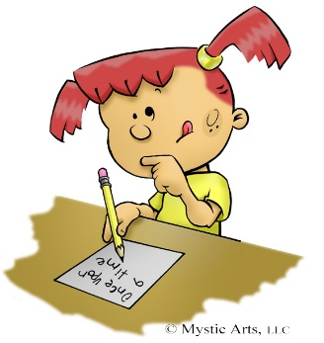
Spelling

Slide 8
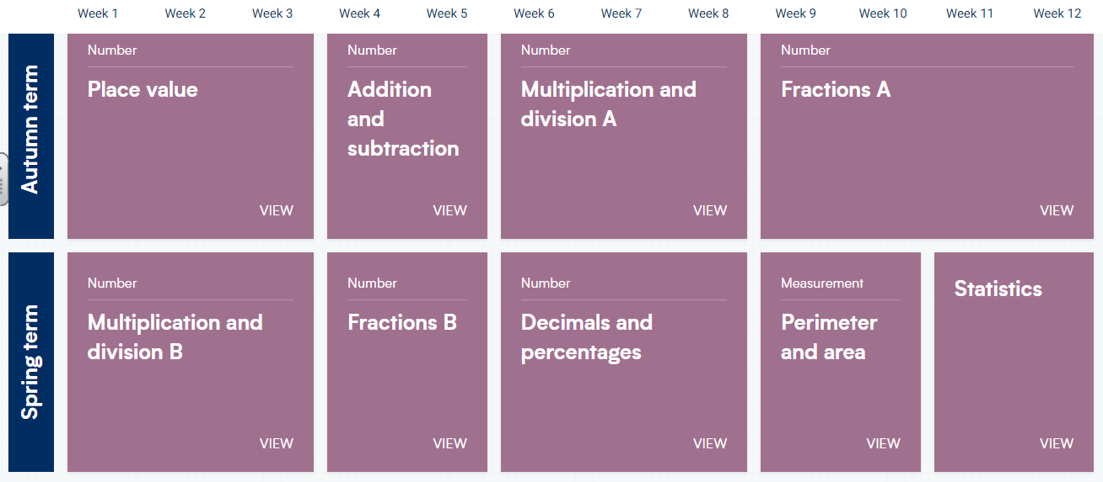
Mathematics – White Rose.

Slide 9
Century.
Each week the children will be set homework on Century. The aspects to be covered will be either in SPAG, Comprehension or Maths.
It helps the teachers to assess the level of the children’s understanding in different areas, therefore highlighting aspects that need to be covered and focused on within the class.

Slide 10
PE
PE will change each term to accommodate the WLSP coaches, tennis lessons at Ormskirk Tennis Club and swimming. In the Autumn Term the PE days are on a Tuesday and Wednesday for Class 11.
Children need to come in their PE kits, with school jumpers and cardigans over their PE tops.
Either the school tracksuit bottoms or dark, plain coloured tracksuit bottoms or legging can be used for warmth.

Slide 11
Children can bring an extra layer to be put on over their PE kit if outside for a PE lesson and the weather is colder.
Children with hair to their shoulders or longer should wear their hair back from their faces on PE days.
No jewellery please. If they must wear earrings, then studs and plasters need to go over them (provided from home).
Year 5 will go swimming in the Spring Term (after Christmas)
The children will get tennis lessons provided by the Tennis coaches at Ormskirk Tennis Club.

Slide 12
Events this year.
Coming up:
Bikeability:.
The Carol concert: December at 6pm in Church.
Swimming: Spring Term, on Thursday afternoons.
Year 5 Residential over two days in the Summer Term, details to still be finalised.

Slide 13
Questions
If you have any questions or queries please get in touch with Mrs Penlington in the office and we can arrange a time to meet or a phone call to help.
We are so looking forward to the year ahead with the children!
Thank you.

