Slide 1



Welcome,
Parents!
SCHOOL YEAR 2024-2025

Slide 2
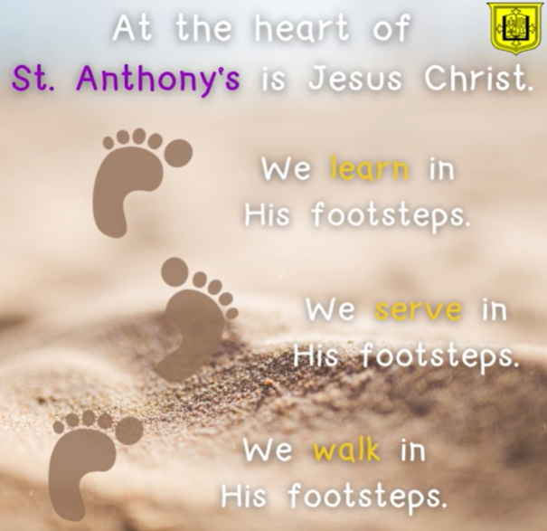

Our mission statement

Slide 3

Meet the teachers
Class teachers: Mr Martin, Mrs Boardman, Mrs Berry and Mrs Woodward
Teaching assistants: Miss Leighton
Mrs Dancer
Mrs McEntee
Mrs Lorden
Miss Duffy
Mrs Livesey
Miss Hill

Slide 4
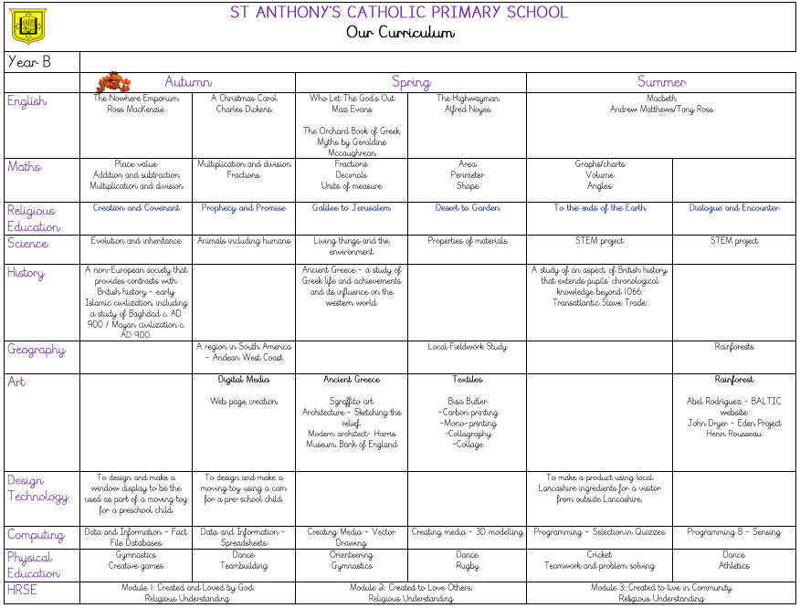


Our Curriculum

Slide 5

Uniform
We would appreciate your support in ensuring the children wear their correct school uniform as outlined on the school website.
Please make sure that all your child’s clothes and belongings are named.
Please see our school policy regarding uniform and personal effects.

Slide 6
PE Kit
  White t-shirt and navy-blue shorts or skort with trainers for indoor and outdoor games and athletic activities. Bare feet for gymnastics and preferable for dance (alternatively sports footwear).
  A dark (black/ purple/ navy blue) sweater and dark (black/ purple/ navy blue) tracksuit trousers can be worn when cold weather but none of the above with large logos.

Slide 7


Homework
  Spellings
  Grammar
  Arithmetic
  Home reader (read with an adult at least four times per week)
  At least 15 minutes on both TTRS and Mathletics

Slide 8
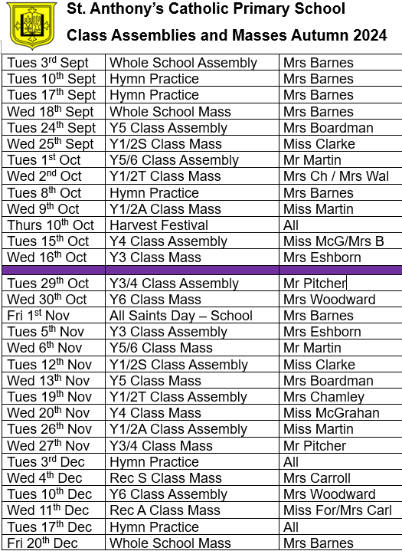
Class Assemblies and Masses - Autumn Term

Slide 9
Important Dates
  Parents’ Evening - Tuesday 30th October
  Harvest Festival - Thursday 10th October
  Year 5/6 Carol Service - Tuesday 17th December at 6pm
  Year 6 SATs - 12th to 15th May 2025

Slide 10
Thank you, Parents!

