Slide 1



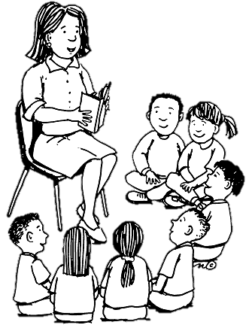


LISTENING TO OUR CHILDREN READ
ABOUT US
“Talk at the heart of our curriculum"
HEAD TEACHER – MRS R BALLARD
DEPUTY TEACHER – MRS V BERRY
ENGLISH LEADER – MISS E CLARKE
PHONICS LEADER (KS1) – MISS S FORBES
PHONICS LEADER (KS2) – MRS S ESHBORN
CONTACT :
PHONE : 01772 726621
EMAIL : E.CLARKE@ST-ANTHONYS.LANCS.SCH.UK
WEBSITE : HTTP://WWW.ST-ANTHONYS.LANCS.SCH.UK/ENGLISH/

Slide 2

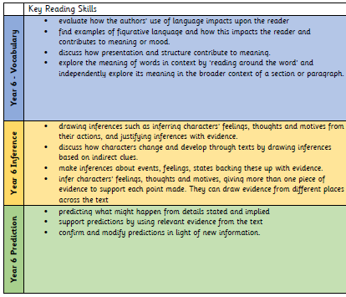
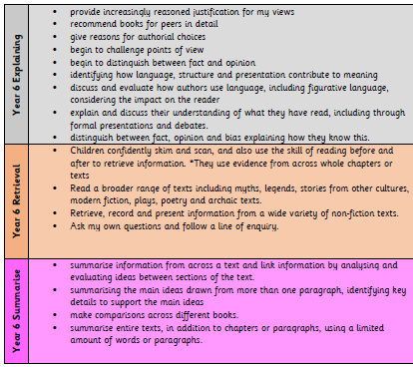
LISTENING TO OUR CHILDREN READ
When you hear a child read, please concentrate on one skill. Other things may be covered but your assessment of that reading session and the comments you make in the child’s reading record and in the class reading record must be in line with your focus. When writing in the reading records it is good practice, although not essential, to title it with the skill covered (decoding; expression/intonation; comprehension) followed by your comment. Let’s try and move away from ‘read confidently’ ‘lovely reading’ etc – we are all guilty of it!
When you hear a child read, you are not just ‘listening to the child read’ you are actually teaching them their own next steps. Please try to be aware of the level of the child that you are listening to and ask them questions / demonstrate skills that are appropriate to that child’s level of reading as much as possible.
I have put together this document to aid you when listening to children read.

Slide 3
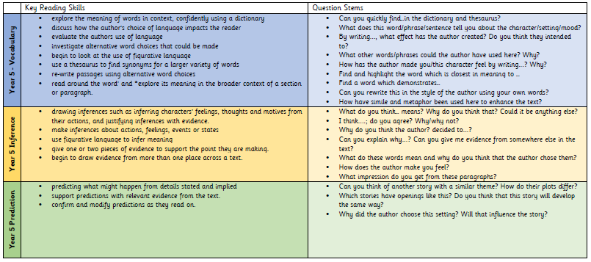
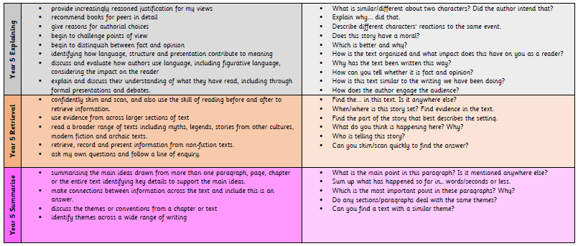
SKILL FOCUS
COMPREHENSION
Children who can read words and the flow of reading is good. Pick a comprehension focus to advance comprehension skills.
TEACHING SEQUENCE
1. Introduce book to child – tell them how much of the book they will read during this session.
2. Share the learning intention with the child (focus this on one part of the comprehension (VIPERS)
3. Spot out any words that the child may struggle with.
4. Child to begin reading – use a mixture of adult reading and child reading (adult to read to the child to aid the comprehension)
5. Stop the child at different points and use questioning to check understanding. Have conversations related to the skill focus – discussion of inference etc.
6. Finish with a discussion about what you have read together and congratulate child.
Write comment relating to skill focus in reading record and class record.

Slide 4
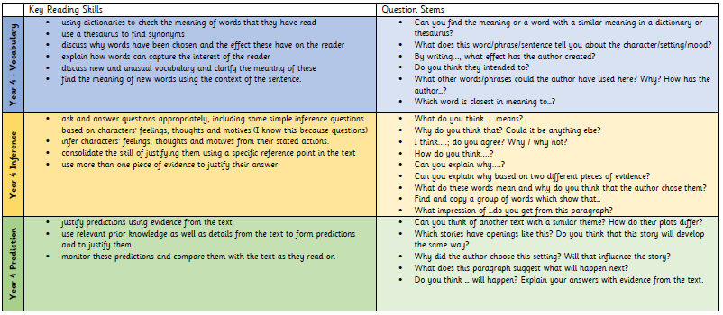
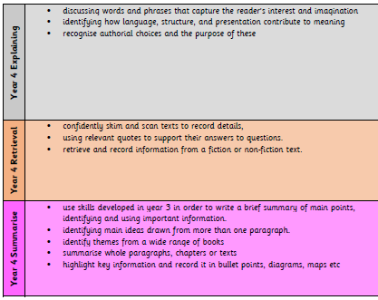
SKILL FOCUS
EXPRESSION
Children who can read words but the tone and speed is lacking to create flow.
TEACHING SEQUENCE
Introduce book to child – tell them how much of the book they will read during this session.
Share the learning intention with the child.
Spot out any words that the child may struggle with.
Demonstrate to child how they will show expression/intonation (this could be spotting out the punctuation, looking for the speech etc) – Adult to model how to do this.
Child to begin reading – use a mixture of adult reading and child reading (adult to model using expression/changing voice etc)
Finish with a discussion about what you have read together and congratulate child.
Write comment relating to skill focus in reading record and class record.

Slide 5
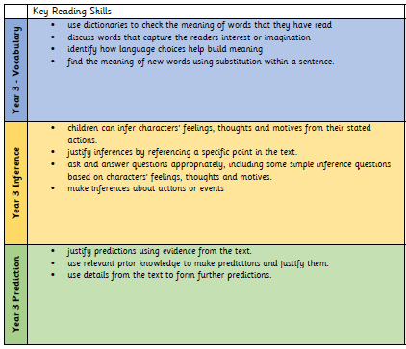
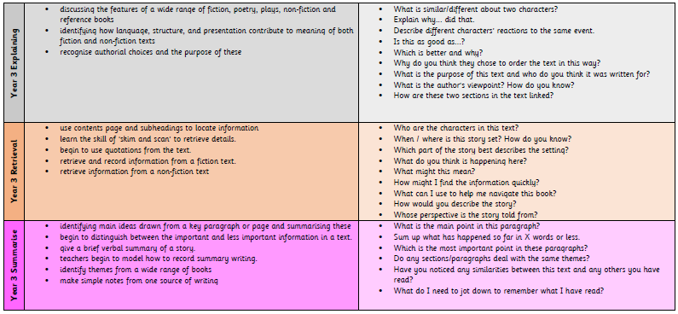
SKILL FOCUS
DECODING
Children who are still learning to ‘sound out words’ – mostly EYFS and KS1 children.
TEACHING SEQUENCE
Introduce book to child – tell them how much of the book they will read during this session.
Look inside front cover (if using a phonic bug book) and point out the sounds evident in this book / high frequency words. If not using a phonic book, spot out any tricky words/sounds within the text they will be reading.
Spot out any words that the child may struggle with.
Child to begin reading – use a mixture of adult reading and child reading (adult to model sounding out word then whole sentence reading)
Finish with a discussion about what you have read together.
Write comment relating to skill focus in reading record and class record.

Slide 6
