Slide 1

Sunderland College Professional Services 14-16 Academy 2026/27 Intake

Slide 2


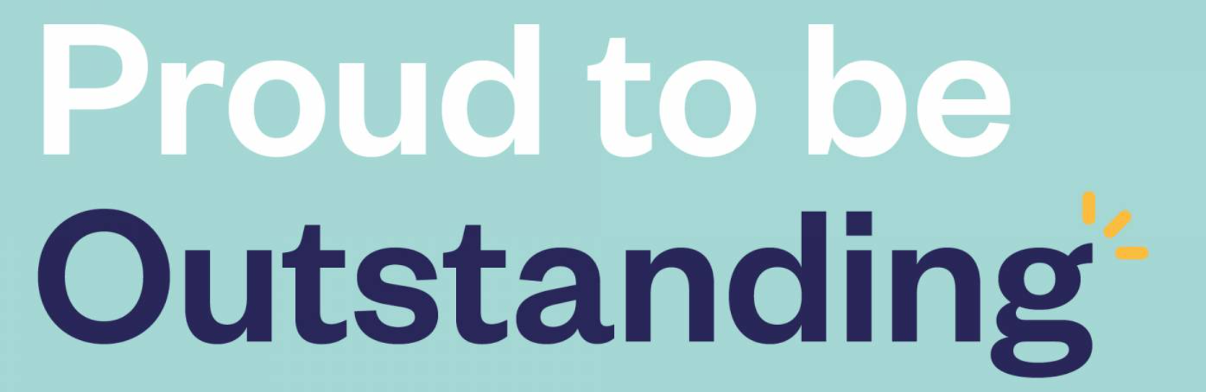
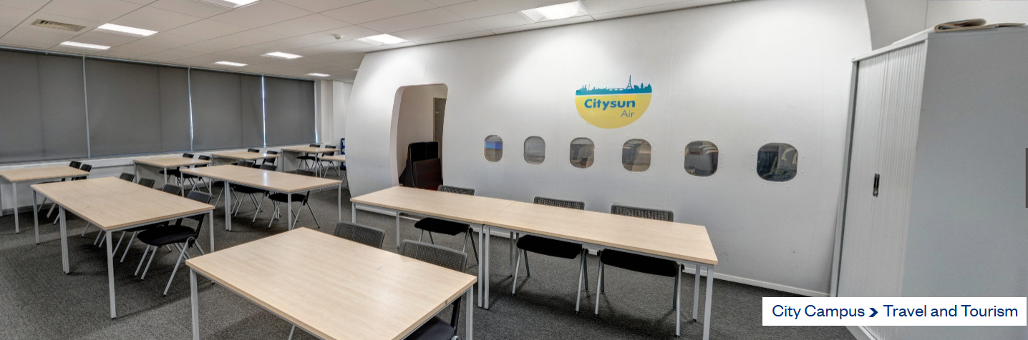
Top Performing
Professional Services 14-16 Academy
Learn • Experience • Lead
A chance to step out of the classroom one day a week, work with real employers, gain hands-on experience, and build skills that give you a head start on your future.
Your journey
Choose a career pathway
Work with a real employer linked to that pathway
Progress to college, sixth form, T Levels or apprenticeships
4 days at school – GCSE subjects (English, maths, science, etc.)
1 day at college – practical, professional learning
This isn’t an easier option, it’s a smarter one if you learn best by doing.​

Slide 3

Top Performing
Professional Services 14-16 Academy
Learn • Experience • Lead
Professional & Work Skills​
Confident communication with adults and customers​
Teamwork and collaboration​
Time management and meeting deadlines​
Professional behaviour and responsibility
How does this count for GCSEs?
Both qualifications count towards Progress 8, giving you:
1GCSE-equivalent grade
1Progress 8 option
Business & Enterprise Skills​
Understanding how organisations work​
Planning ideas and making decisions​
Problem-solving in real situations​
Basic finance and budgeting awareness
Personal Skills for Life​
Confidence and independence​
Presentation and speaking skills​
Organisation and self-management​
Resilience and learning from feedback
sunderlandcollege.ac.uk
These are the skills employers, colleges and apprenticeship providers look for, whatever you do next.

Slide 4

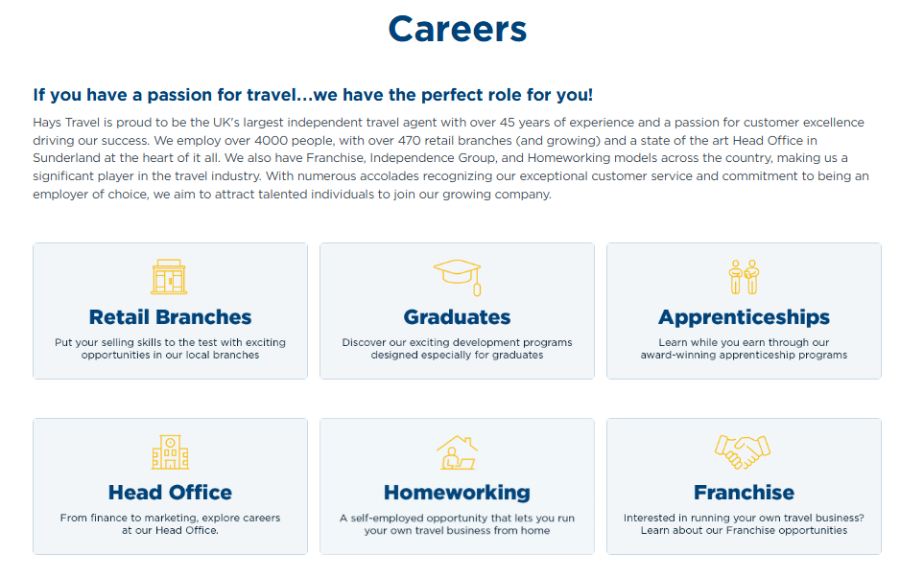

Top Performing
Hays Travel Careers
sunderlandcollege.ac.uk
https://www.facebook.com/HaysTravel

Slide 5

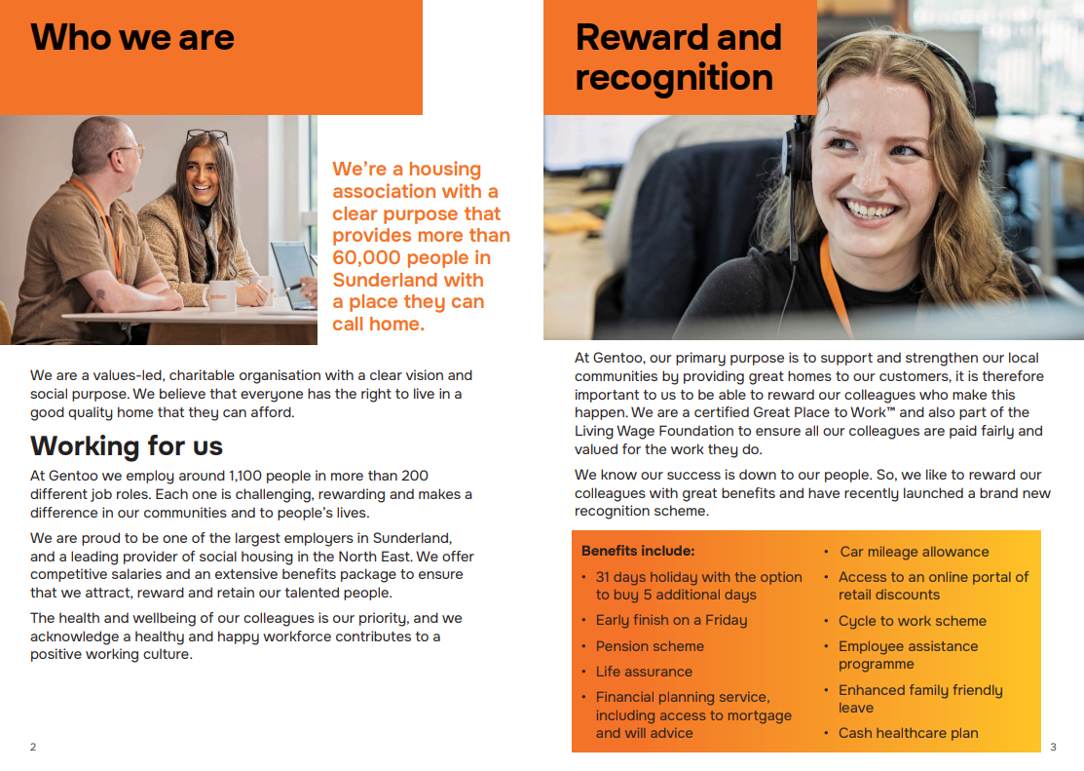
Top Performing
Gentoo Careers
Communities • Business • People • Careers
https://www.gentoogroup.com/about-us/employability-at-gentoo/
sunderlandcollege.ac.uk

Slide 6
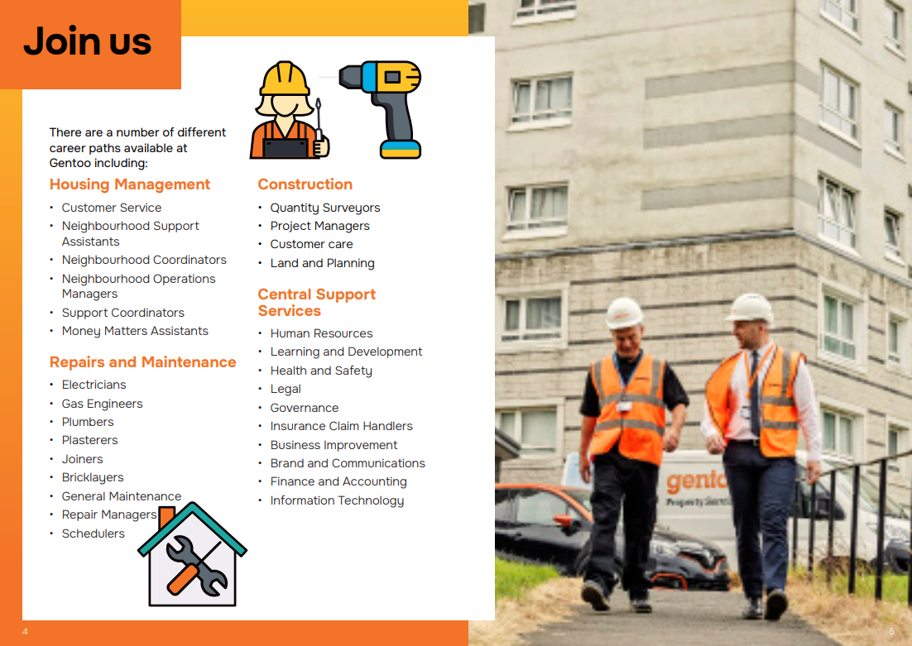
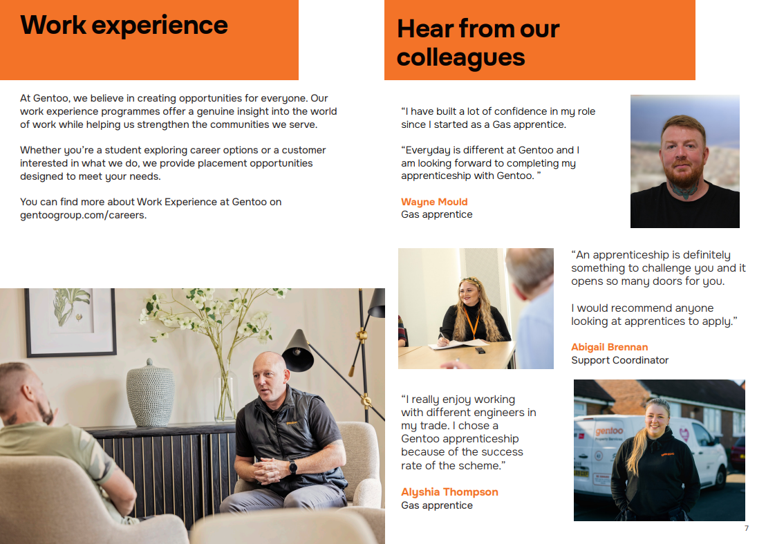
Top Performing
Gentoo Careers
Communities • Business • People • Careers
sunderlandcollege.ac.uk

Slide 7
QUESTIONS?

