Slide 1


Year 9 Options
Information Students
Mr M McDonagh

Slide 2


St. Anthony’s Mercy Ethos
Christ-centred
Faith enlightened
Build communities
Show concern for the poor, especially women and girls
Pursue excellence
“To provide all students with the opportunity to reach their potential and prepare them for post-16 education, employment or training.”

Slide 3

Overview
What KS4 looks like at St. Anthony’s
Importance of options
Our core subjects & types of qualification
The options routes
Choosing options – dos and don’ts
Moving forward
Questions

Slide 4
Key Stage 4 at
St. Anthony’s
Core Subjects
Options: GCSE
Options: Vocational

Slide 5


Options –
why do they matter?
To ensure that students are equipped with the qualifications to move on and be successful
To open doors to as many further/higher education and employment opportunities as possible
To ensure that we build a range of
transferrable skills by studying a variety of subjects

Slide 6
Core Subjects
GCSE Mathematics
GCSE English Language & Literature
GCSE Religious Education
GCSE Combined/Separate Science
Core PE (not examined)
PHSE (not examined)

Slide 7
GCSE
Courses
Graded 9-1
Assessment is usually terminal in the form of examination papers
There is a coursework component in a minority of subjects, which is usually completed under controlled conditions
Require large bulks of knowledge to be recalled and understood

Slide 8
Vocational
Courses
Graded using a vocational system (Distinction*, Distinction, Merit, Pass); one vocational grade at Level 2 is equivalent to a GCSE grades 9-4, a Level 1 is equivalent to a GCSE grades 3-1
Assessment is usually a combination of portfolio work and terminal examination papers
        Often work-related, and are valued by further education institutions and colleges

Slide 9
Curriculum Routes
Y9
Broad
A-Levels
Further Education
Apprenticeships
Employment
Humanities
Open
Study Plus

Slide 10
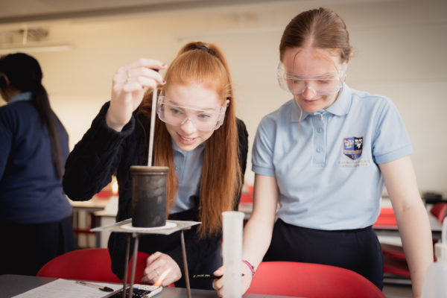
Route One:
Broad

Slide 11
Options
Route One:
Broad
History
Geography
Block A
Core
Spanish
Block B
English Language & Literature
Mathematics
RE
Science
Core PE
PHSE
2nd humanity (History/Geography)
2nd language (French)
BTEC Digital Information Technology ^(1)
Art & Design – Fine Art
Hospitality & Catering Technical Award
Music^(1)
BTEC Business & Enterprise^(1)
BTEC Sport^(1)
BTEC Performing Arts (Dance) ^(1)
Three Dimensional Design
Textile Design
Sociology
*If your child would like to study a different language to the language they have studied in years 7-9 please ask them to see Mrs Robertson (Head of MFL).
A maximum of two class per Block C subject (excluding languages and humanities)unless indicated as 1 class by ^(1)
NB: Auditions maybe required for Dance
Block C

Slide 12
Route one:
Broad
Who is this route suitable for?
Based on a range of data and feedback from subject teachers we will identify which students are suitable for the Broad route
At St Anthony’s all students who have this aptitude will be placed onto this route

Slide 13
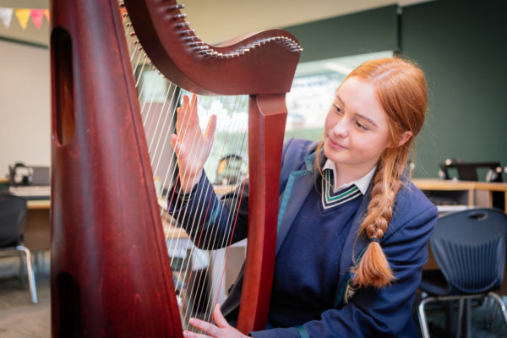
Route Two:
Humanities

Slide 14
Options
Route Two:
Humanities
Core
Block A
History
Geography
English Language & Literature
Mathematics
RE
Science
Core PE
PHSE
Hospitality & Catering Tech Award
Three Dimensional Design
Textile Design
Block B
2nd humanity (History/Geography)
Spanish
2nd language (French)
BTEC Digital Information Technology^(1)
Art & Design – Fine Art
Music^(1)
BTEC Business & Enterprise^(1)
BTEC Sport^(1)
Sociology
Art & Design – Photography
BTEC Performing Arts (Dance) ^(1)
Block C
A maximum of two class per Block C subject (excluding languages and humanities)unless indicated as 1 class by ^(1)
NB: Auditions maybe required for Dance

Slide 15
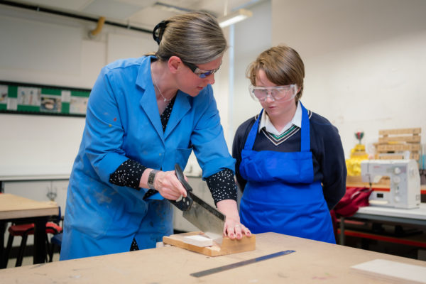
Route Three:
Open

Slide 16
Options
Route Three:
Open
Core
Block A
Art & Design – Photography
English Language & Literature
Mathematics
RE
Science
Core PE
PHSE
Hospitality & Catering Technical Award
Three Dimensional Design
Textile Design
Block B
Spanish
History
Geography
BTEC Digital Information Technology ^(1)
Art & Design – Fine Art
Music^(1)
BTEC Business & Enterprise^(1)
BTEC Sport^(1)
BTEC Performing Arts (Dance) ^(1)
Block C
A maximum of two class per Block C subject (excluding languages and humanities)unless indicated as 1 class by ^(1)
NB: Auditions maybe required for Dance

Slide 17
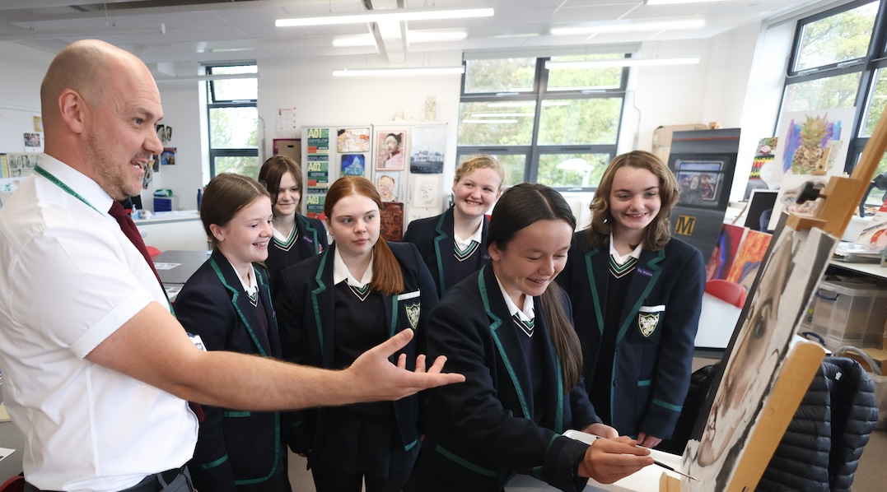
Route Four:
Study Plus

Slide 18
Options
Route Four:
Study Plus
Core
Block A
Study Plus English & Maths
English Language & Literature
Mathematics
RE
Science
Core PE
PHSE
Hospitality & Catering Technical Award
Three Dimensional Design
Textile Design
Block B
History
Geography
BTEC Digital Information Technology ^(1)
Art & Design – Fine Art
Music^(1)
BTEC Business & Enterprise^(1)
BTEC Sport^(1)
BTEC Performing Arts (Dance) ^(1)
Block C
A maximum of two class per Block C subject (excluding languages and humanities)unless indicated as 1 class by ^(1)
NB: Auditions maybe required for Dance

Slide 19
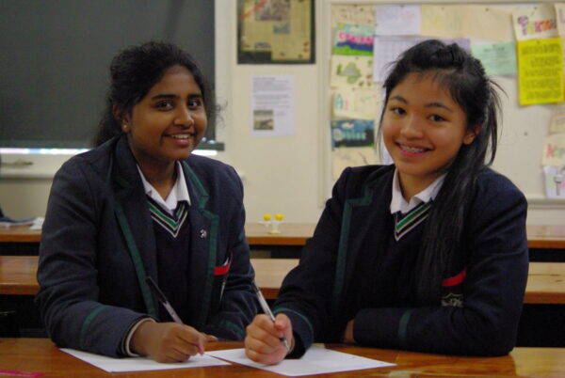
Directing our students along the best path
It is essential that students embark on a path that not only allows them to reach their potential, but also offers them the opportunity to progress their learning post-16.

Slide 20
Directing our students along the best path
To this end, through careful assessment and evaluation, we will steer the students towards a path that fulfils this aim. We use a range of data to support us in making this decision:
Performance in languages
Prior attainment
KS3 cycle assessments
Performance in core subjects
Professional judgement of teaching staff

Slide 21
When will I know which route I will follow?
We plan to let students know which path they will be asked to follow by an email communication to parents on Monday 16th February 2026

Slide 22
Aspiration for all students at St. Anthony’s
A minimum of 5 grades at or above grade 5 or equivalent including English & Mathematics (46% achieved this in 2025)
A minimum of 5 grades at or above grade 4 or equivalent including English & Mathematics (71% achieved this in 2025)
Grade 6 or better in subjects that students wish to study at Post-16
Merit or better in vocational subjects that students wish to study at Post-16

Slide 23
Choosing your options -
do choose courses if…
They fit your interests
You think you will enjoy them
They go well with your other courses
They link to a career aspiration that you have
Will support you to continue studying post-16
Will help you meet entry requirement for courses post-16

Slide 24
Choosing your options -
do not choose courses if…
It’s just because your friends are choosing the same ones
You think it will be easier than another course
You like the teacher that you have now

Slide 25
Completing the On-line Options Form
Broad Route
Block A Geography or History
Block B Spanish (possible to switch to French)
Block C You will be asked to make 2 choices for the one available subject.
The two choices will be 1st and 2nd preference. We will always endeavour to give students their 1st choice, but it cannot be guaranteed. When this is not possible we will speak to the student and parents/carer.

Slide 26
Completing the On-line Options Form
Humanities Route
Block A Geography or History
Block B Three Dimensional Design
or
Textile Design
or
Hospitality & Catering Technical Award
Block C You will be asked to make 2 choices for the one available subject.
The three choices will be 1st and 2nd preference. We will always endeavour to give students their 1st choice, but it cannot be guaranteed. When this is not possible we will speak to the student and parents/carer

Slide 27
Completing the On-line Options Form
Open Route
Block A Photography
Block B Three Dimensional Design
or
Textile Design
or
Hospitality & Catering Technical Award
Block C You will be asked to make 2 choices for the one available subject.
The three choices will be 1st and 2nd preference. We will always endeavour to give students their 1st choice, but it cannot be guaranteed. When this is not possible we will speak to the student and parents/carer

Slide 28
Completing the On-line Options Form
Study Plus Route
Block A Study Plus Maths & English
Block B Three Dimensional Design
or
Textile Design
or
Hospitality & Catering Technical Award
Block C You will be asked to make 2 choices for the one available subject.
The three choices will be 1st and 2nd preference. We will always endeavour to give students their 1st choice, but it cannot be guaranteed. When this is not possible we will speak to the student and parents/carer

Slide 29
Viability of Courses
Sometimes, for whatever reason courses may not recruit enough students to make it educationally viable to run.
In these cases we may choose to withdraw the offer of a course.
Equally we may not be able to offer classes in a subject area due to a staffing change.
In these circumstances parent/carers and the student will be informed and will be allowed to re-choose their option choices.

Slide 30
Options: communication
Your option route will be communicated via email on Monday 16th February 2026.
Options booklets, containing all course information, will be distributed to students on Tuesday 17th February 2026 and can be found online from then.
Options forms – link will be sent via email to both parents and student on Friday 20th February 2026 – a different link for each route.
Options forms must be submitted via Google form by Friday 20th March 2026.
If you have any queries regarding options please contact Mr. McDonagh.

Slide 31
Options: next steps
Read the options booklet for your allocated pathway.
Have in-depth discussions about the subjects that you might like to choose with your parent/carers and teachers, using the information provided in the options booklet and on the academy website to help.

Slide 32
Options: next steps
Research the different courses online.
Students should listen carefully at the assembly when new subjects present information about their subjects
If you are unsure about new courses please contact the subject leads to discuss one to one what the subject entails
Think about what might be needed for post-16 study.

Slide 33
Get your decisions correct
Once we begin the timetabling of classes after Easter we cannot change option choices unless there is an special circumstance.
We cannot change subjects in September when the new year.

Slide 34
Options:
key dates
Options booklets – distributed Tuesday 17th February 2026.
Your child’s options route will be communicated via email on Monday 16th February 2026
Options forms – link will be sent via email to both parents and student on Friday 20th February 2026
Options forms must be submitted via Google form by Friday 20th March 2026.
Confirmation of options will follow via letter. Letters will be sent in June/July.

Slide 35
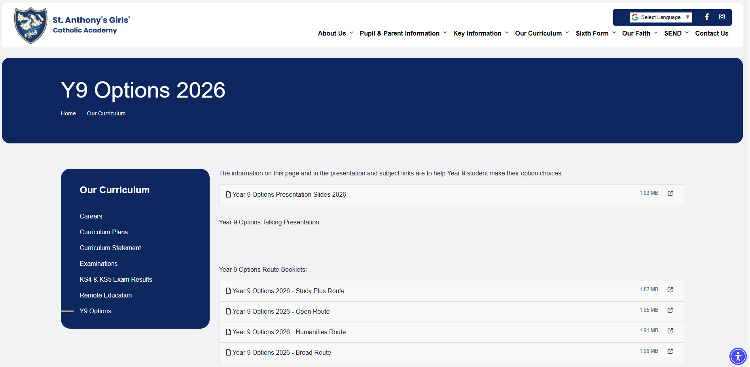
Our Curriculum

Slide 36
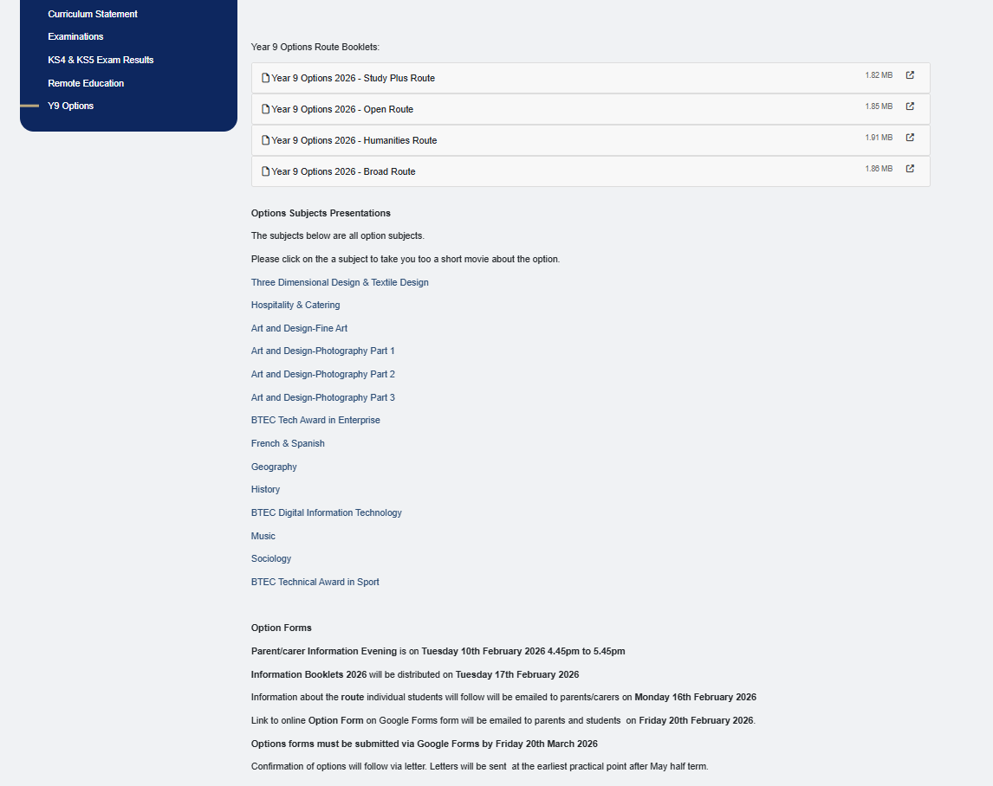

Slide 37
God Bless and Safe Journey
If you have any individual questions,
please don’t hesitate to ask.

