Slide 1

Welcome to
St.Augustine’s
Parent & Guardian meeting
Mrs C. Thompson

Slide 2
Being prepared
(message on Class Dojo if you need anymore information)
Videos – school website (Class Pages – Blossom - Parents / Reception Class Starters 2025). See classroom, ready for school etc.
Letters from the school office with dates etc.
Uniform – Grey trousers/skirt/shorts, white polo shirt, red & white summer dress, red jumper with school logo, black school shoes.
P.E. Kit– come in kit: red t-shirt, black shorts or joggers, black trainers or pumps. Wear with school jumper/cardigan.
No hair colouring or excessive hair decorations.
Earrings – studs only, must be taken out for P.E. If not been in long enough to take out they need to be covered with plasters on PE days.
Wellies – kept in school (optional).
Coat – own pegs – can they put their coat on & do it up?
Book Bag – bring every day – 1:1 reading changes/letters.
Own water bottles allowed – water only please - named.
Please name EVERYTHING! (Jumpers often get mixed up if not named).

Slide 3
Snacks & Lunch
(how it works)
Various fruit (water/milk) are available in class from 9:30am-11am. Children can help themselves and are taught the hygiene/snack routine in school.
Infant school meals are free (from when they start school till the end of year 2)
Blossom Lunch = 11:45 – 12:15 / Outdoor Play 12:15 – 1:15
The school office will post the following week’s menu, on the school class dojo page, every Friday.
Message me your child’s order (i.e. options 2,3,3,4,1)
You may decide on packed lunch some days (i.e. 2,3,PL,4,1)
Lunch includes a drink and dessert (not listed on the school menu).

Slide 4
The Morning Lessons
FIRST WEEK = baselines
From week 2 =
9-9:30am = Phonics
9:30 –11:30am = literacy, maths, & provision.
When the children have been taught all of Phase 2 phonics (by the end of October) they will be assessed and put into 3 different groups – these will be their groups for future phonics, writing, and maths lessons.

Slide 5
Literacy & Maths Groups in Reception
RED GROUP / YELLOW GROUP / GREEN GROUP
Children can change between the groups throughout the year as they are assessed informally every half term and formally at the end of every term.

Slide 6
Afternoon classes
All children will be in Blossom in the afternoons for the Autumn Term to access the EYFS further curriculum.
Understanding the World – Science, Geography, History
RE
Expressive Arts & Design - Art or DT, Music
Physical Development - PE

Slide 7
School Classes
INFANTS
Blossom = reception class
Willow = year 1
Sycamore = year 1 / year 2
Beech = year 2
JUNIORS
Year 3
Year 4
Year 5
Year 5-6
Year 6

Slide 8
Mrs. Bennett
SENDCo & Inclusion Lead
🌟 What is a SENDCo? 🌟
(Special Educational Needs and Disabilities Coordinator)
🧩 The SENDCo is here to help ALL children thrive.
They make sure children with additional needs get the right support.
What the SENDCo Does:
✅ Identifies children who may need extra help
🗣 Works closely with teachers, support staff, and families
📚 Puts support plans in place to help children make progress
🤝 Works with outside professionals (e.g. speech therapists, educational psychologists)
📝 Helps with referrals for extra services or assessments (like EHCPs)
💬 Available to meet with parents to listen and offer guidance
🌟 Also supports children who are gifted and talented – working with teachers and support staff to ensure they are challenged and stretched in their learning

Slide 9
Mrs. Bennett
SENDCo & Inclusion Lead
💊 Medical Needs & Care Plans 💊
We want every child to be safe, comfortable, and cared for.
🩺 The SENDCo helps coordinate support for children with medical conditions
🧾 Works with families to create Individual Healthcare Plans (IHPs)
💉 Supports staff with training for specific medical needs (e.g. asthma, allergies, epilepsy)
📦 Ensures medication is stored safely and administered as needed
🤝 Liaises with school nursing team and health professionals
Please inform us of any medical needs during induction – we're here to help!

Slide 10
Mrs. Bennett
SENDCo & Inclusion Lead
📋 Medication Protocol 📋
If a child requires medication 3 times a day, we ask that it is given at home where possible (before school, after school, and at bedtime).
If medication is needed 4 times a day, or it specifically states it must be taken with food, at lunch or just before food, school can administer it — but:
  A medication consent form must be completed at the school office.
  Only trained staff are allowed to administer medication.
🚫 Very important: 🚫
Medication must NOT be placed in children's bags or handed to them to carry.
Parents MUST bring medication to the school office and hand it to a staff member directly.

Slide 11
Mrs. Bennett
SENDCo & Inclusion Lead
🤔 What If I'm Worried About My Child? 🤔
It’s completely normal to have questions or concerns as your child starts school.
If you think your child may have Special Educational Needs, here’s what to do:
👩‍🏫 Speak to your child’s class teacher first. They know your child best in the classroom.
🚪 We have an open door policy – your concerns will always be listened to.
📱 You can send a Dojo message directly to me (the SENDCo)
☎️ Or telephone the school office to book an appointment for a chat.
We’re here to work together and support your child every step of the way.

Slide 12
About the E.Y.F.S
THE CURRICULUM FOR THEIR
FIRST YEAR AT SCHOOL

Slide 13
PRIME AREAS
Communication & Language [Listening, Attention & Understanding / Speaking]
Personal, Social & Emotional Development [Self-Regulation / Managing Self / Building Relationships]
Physical Development [Gross Motor / Fine Motor]
SPECIFIC AREAS
Literacy [Comprehension / Word Reading / Writing]
Maths [Number / Number Patterns]
Understanding the World [Past & Present / People, Culture & Communities / Natural World]
Expressive Arts & Design [Creating with Materials / Being Imaginative & Expressive]

Slide 14
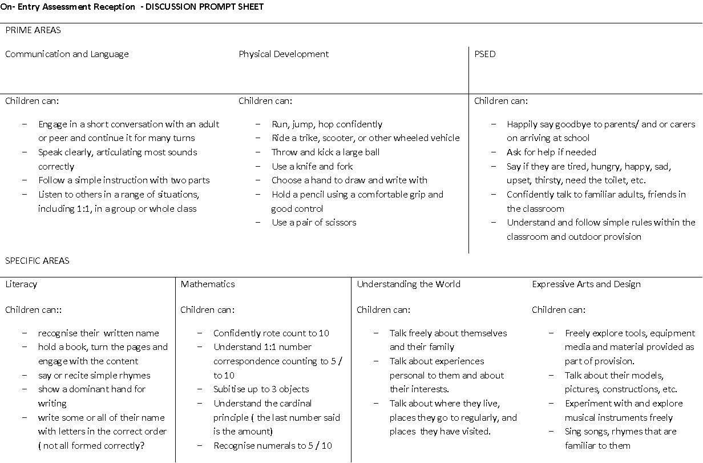

Slide 15
Phonics
Phonics = letters we use for reading and writing and the sounds they make.
Phase 2 = single letters (in order of popular use: s-a-t)
Phase 3 = introduces digraphs & trigraphs – 2 letter and 3 letter sounds (i.e. ‘ee’ ‘igh’)
Phonics lessons daily – a new sound per day, then a language session putting those sounds together.
All taught Phase 2 in Autumn Term.
Most move onto Phase 3 in January.
Phonics can be taught to Phase 4 or 5, depending on the group.
Confident at Phase 3 / 4 is the goal for reception children by the end of the year.

Slide 16
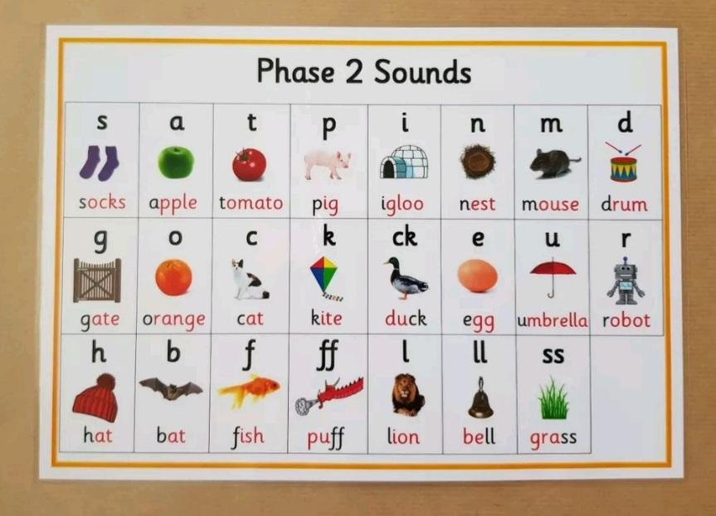

Slide 17
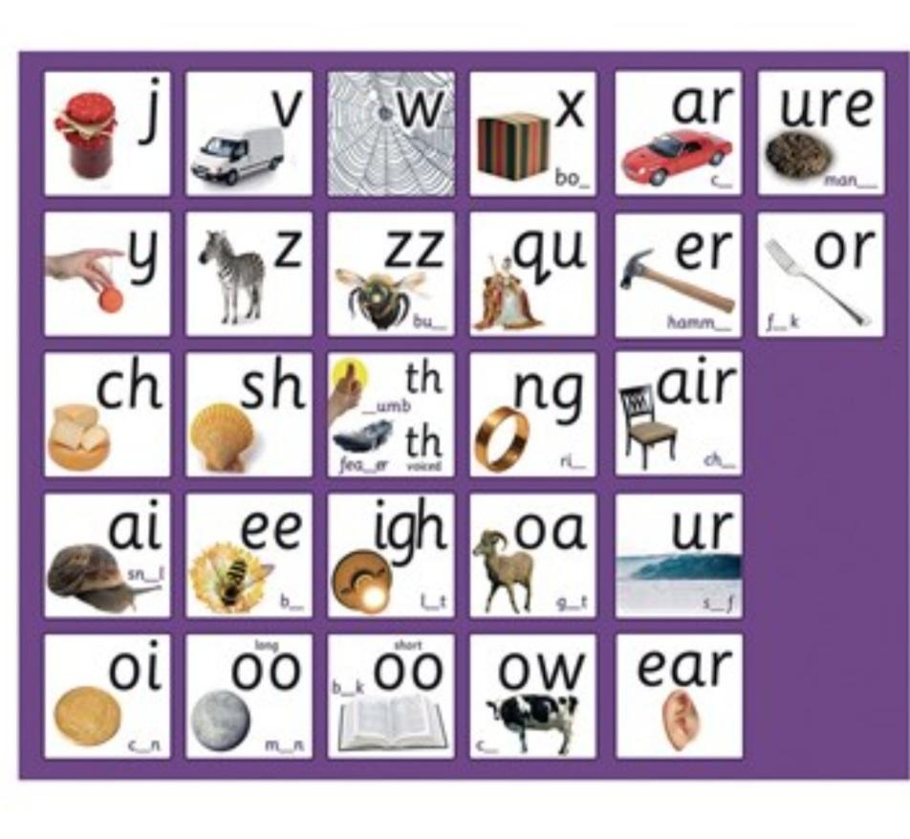

Slide 18
Reading
Please get a book bag with the school logo on.
From the end of week 3 children will get a reading book relevant to the phonemes they have learned. This is changed weekly.
Keep reading book in their book bags as we will do extra reading whenever possible with your child.
Read & ask questions about anything you read – signs, adverts, recipes etc.

Slide 19

Phonics Bug
Phonics Bug is the programme used in school to teach phonics to all children in reception, year 1 and year 2.
Children get their own Phonics Bug account name and password, to access phonics games and books.
Video on the school website to show you how a child’s account works.

Slide 20

Numbots
Home maths development app
Personal log in
Maths curriculum that spans the whole of the infants (first 3 years of school)
Would expect reception children to get to Brass or Copper by the end of the year.

Slide 21
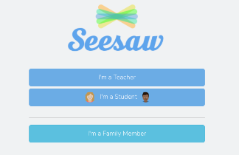
Seesaw
Seesaw app.
Staff will put pictures and videos of your child’s work on there.
You can upload your own photos and videos which we can then link to your child’s journal.

Slide 22

Class Dojo
Main app needed to stay in touch.
Class and school posts will be put on here.
Can send messages to teacher 1:1
Translates into 130 languages – both ways.
Your child’s class dojo is active from the day of the teacher/parent meeting, so you can ask any questions before school starts.

Slide 23
Before Starting School
Transition Days -
Children at St. Augustine’s - parents do not stay for session.
Monday 14th & Tuesday 15th July : 9:30am - 11am
Little Achievers / Little Wonders / Oxford Gems / No Nursery
Thursday 17th & Friday 18th July : 9:30am - 11am
Carey Baptist / Little Sparkles / Stoneygate / Shining Stars
1:1 Parent/Guardian meetings –
To do paperwork & have chance to talk 1:1 to answer any questions. These are replacing home visits. Please sign up.

Slide 24
Keep Communication Open
School working with parents & guardians.
“Show me the child at 7 and I’ll show you the adult” [Aristotle]
The importance of the Infant School Years, for the knock on effect for their whole educational journey.

Slide 25
Summary
School starts Monday 1st September.
Monday & Tuesday = till 11:30am / Wednesday & Thursday till 1pm / From Friday = full days.
Name everything!
Stay in touch via dojo.
Parent/Teacher communication is key to children achieving high.
Read – anything, whenever you can.
Ask your child questions about anything.
Attendance – new phoneme everyday.
Make the adventure of starting school exciting.

