Slide 1
Phonics Workshop
St Augustine’s Primary School

Slide 2
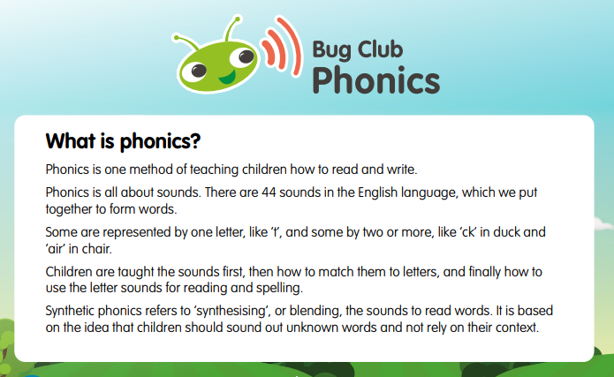

Slide 3

How is it taught at St Augustine’s? https://youtu.be/44mZZQfgkjY

Slide 4
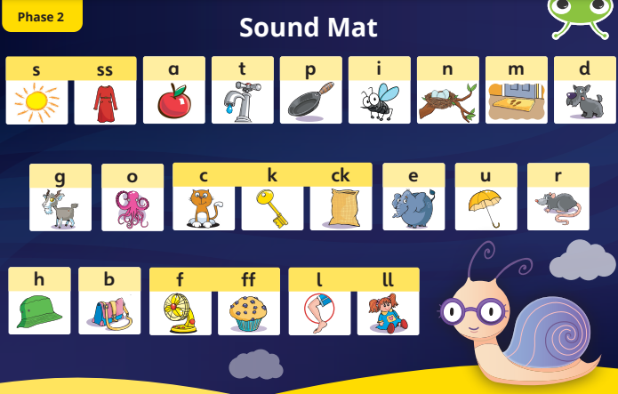
Early Years

Slide 5
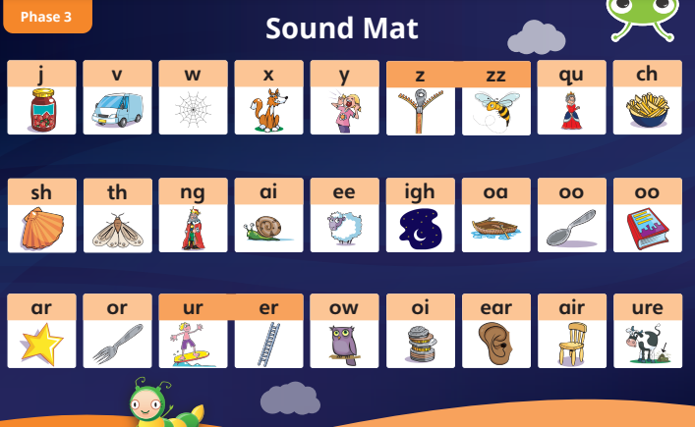
Early Years

Slide 6
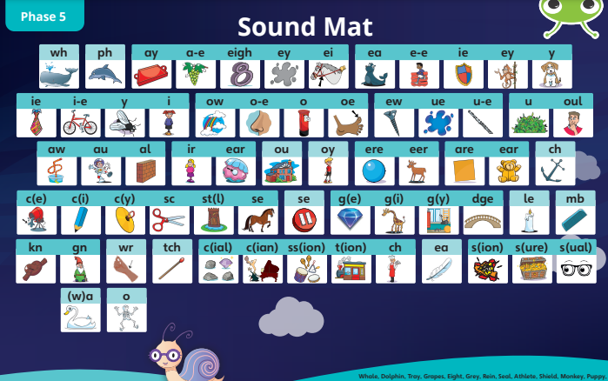
Year 1

Slide 7
Listening to the sounds.
https://www.youtube.com/watch?v=BqhXUW_v-1s

Slide 8
What does a phonics lesson look like?
https://www.activelearnprimary.co.uk/start

Slide 9


Phonics and reading
In Early Years children will come home with 1 book.
Bug book – phonetically decodable.
In Year 1 Children will come home with 2 books.
Bug book – phonetically decodable.
Read with me book.
Online books will be allocated by the class teacher on Bug books.
Reading should be done every night.
Please sign the reading diary every time your child reads. Reading should be done at least 3 times a week.
Rewards and certificates will be given out.

Slide 10
How to support your child at home.
Guide to using Bug club – see handout.
Listen to them read every night for 10 minutes.
Read with them and discuss the book they are reading – reading comprehension skills.
Turn off the I-Pad and make quiet time for reading.
Join the local library.
Encourage reading independently.
You read, I read.

