Slide 1
How can we help our children learn to read ?

Slide 2
Reading has a very high priority in school as it’s an essential life-long skill.
In the infant department the children learn to read.
In the juniors they read to learn.

Slide 3
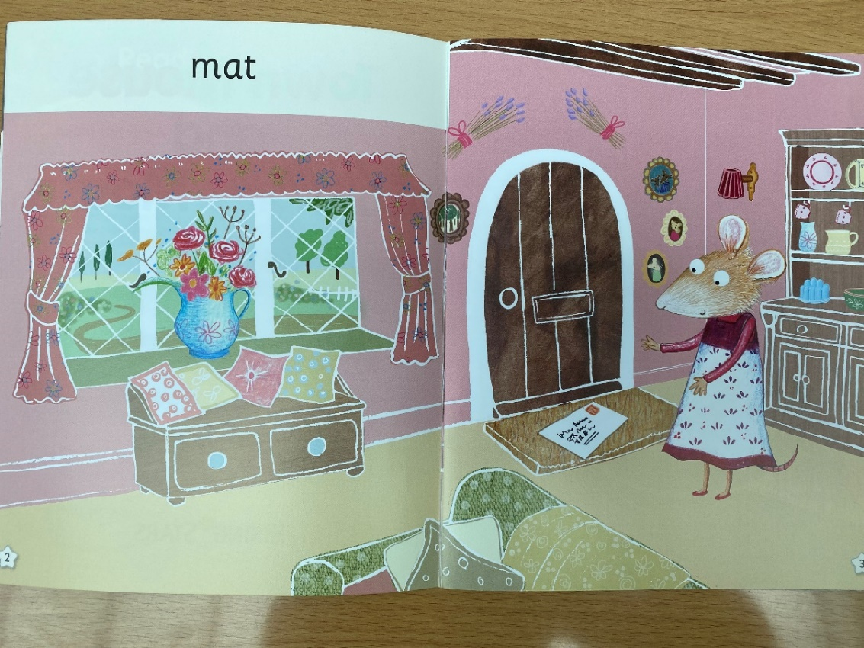
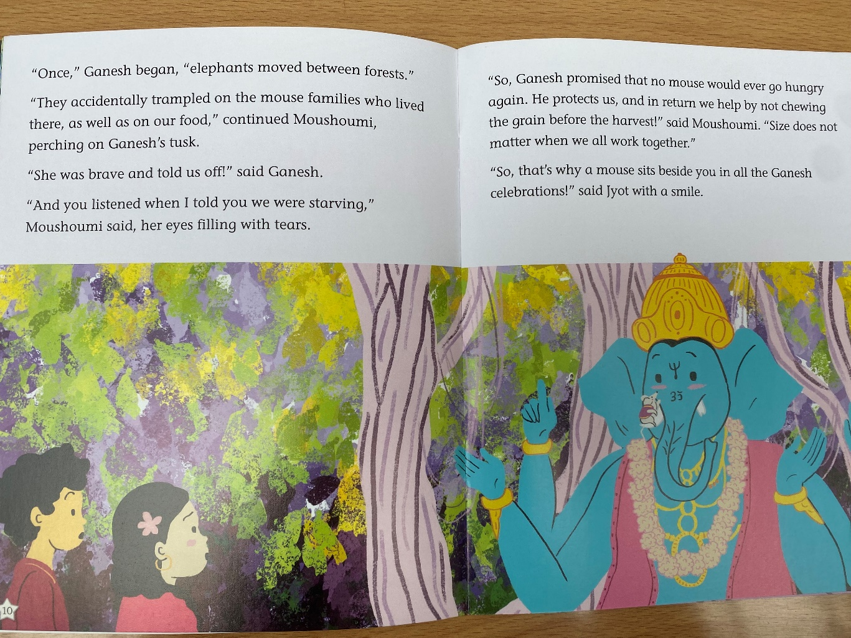
From this………....to this……in just 3 years !

Slide 4
Children need lots of adult time and support on this learning journey.
STEP 1
Before children begin school they learn about reading by listening to stories and rhymes and joining in with repeating phrases.
STEP 2:
As children join the Reception class they continue to enjoy stories and rhymes. They begin to learn individual sounds and letters, and begin to blend them to read independently.
STEP 3:
As children move to Year 1 they learn alternative ways that letters can make the same sounds in written words.
STEP 4:
As children move to Year 2 the focus moves to how grammar can change the way words are spelt, alongside developing comprehension skills and fluency.
STEP 5:
By the end of Year 2 children should be able to read confidently and fluently a book of their choice.

Slide 5
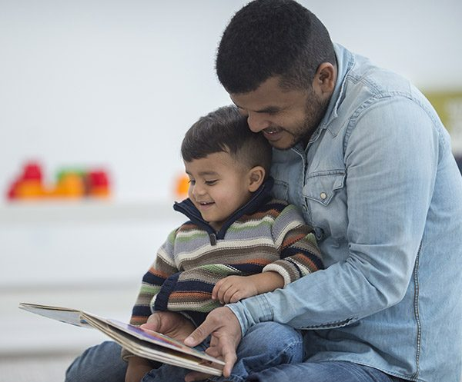

Learning to read is tricky at first. It is easy for children to lose enthusiasm when they are developing this difficult skill.
Spending time supporting your child during this challenging process will have a huge impact on their reading progress, confidence and future success.
Research into the reading development of young children has found that children who enjoy reading books with their family are five times more likely to read above the expected level, compared to those who don’t. They are also better writers and are more likely to be successful in their adult life.

Slide 6
https://www.youtube.com/watch?v=dkNdSB9BRpo

Slide 7
Encourage your child to sound out the words themselves. Children can find this hard at first, but will soon gain speed and accuracy. Your child has a log in stuck in their reading record so they can also access books to read online

Slide 8
VIPERS Stems - Question Stems Pack (1).pdf

Slide 9
The children’s books are very carefully written!
The main reason we chose this scheme is because the books have been painstaking written to ensure that children are only required to read the sounds they have been taught in school .
There are 44 phonemes, which takes all of Reception and Year 1 to teach and learn!
This ensures they have the tools they need to read successfully and independently.

Slide 10
Home readers:
Children should be encouraged read the books over several days to help build their confidence and speed. A small chunk a day is enough. Once they have read the whole book they should then re-read it, building speed and accuracy.
Avoid telling your child the word, or asking them to guess from the pictures. They have learnt the sounds they need for these books in school and should be encouraged to ‘sound out’ themselves before they are helped.
There will be children who did not embed all the sounds they were taught last year, and they will need additional sessions to catch up in school. They will bring home a book that they should be able to attempt independently to build their confidence.

Slide 11
Your child’s reading record:
Please send you child’s book bag to school every day, as they will also practise this book in school independently, or with an adult.
When your child has read at home please note down in their reading record what page they have got to.
You can also add comments, praise, stickers etc if you wish. ☺

Slide 12
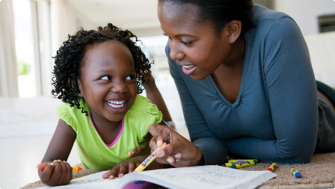


The staff really value the time you take in an evening to hear your child read their decodable phonics book. We know this is repetitive and tricky at first, but it is amazing how much progress children make from regular practise both in and out of school.
Alongside this children also need to see adults read and model how to do it. They need to hear stories and rhymes that they are not yet able to read themselves. To encourage this we would love you to take part in our Snuggle Up With A Book Scheme.

Slide 13
How Snuggle up with a book will work:
Snuggle up and read a book to your child during the week.
Repeating a book over several evenings will enable your child to become familiar with the words and begin to join in with some parts.
Books will range in difficulty, and are chosen to give your child experience of many different stories and information books.
Talk to your child about what they enjoyed about the book. Did they guess what would happen at the end? Were there any characters they didn’t like?
Some children might like to try reading small parts of the book to you.

Slide 14
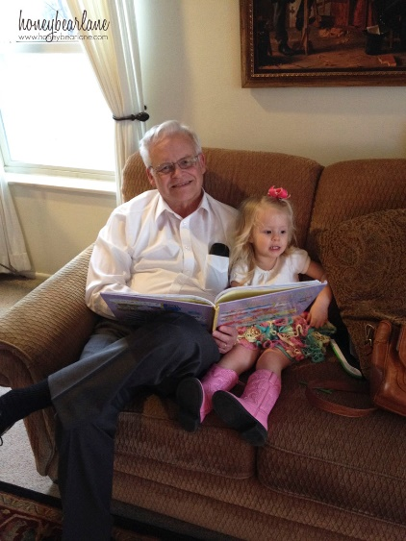
Develop a good reading routine.
Create a quiet space by turning off the TV and screens.
Sit close together in a comfy chair or bed.
Encourage other adults in the family to share a book with your child too.
Have a fun bath time, share a book, then tuck your child into bed- a nice calm end to the day!

Slide 15
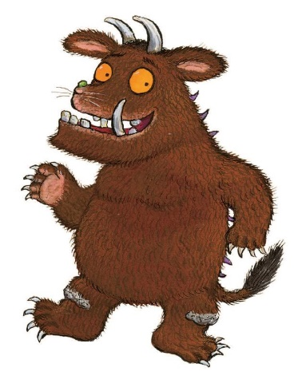
Top tips ☺
Bring the stories alive by using different voices for the characters. You may feel a bit silly but your child will love it!
Ask your child if they can spot any words they think they can read. Praise any attempts to read, and give a little reward when they really impress you.
If your child wants a night off reading that’s fine, but aim to make it something that is rarely missed. It can really settle children down before bedtime.
Allow your child to choose the same book if they wish, and introduce new ones alongside these.

Slide 16

A big THANK YOU from all the staff ………and your children! ☺
Thank you for spending precious time helping your child to embrace reading and develop a lifelong love of books.
Please speak to your child’s class teacher if you would like further information about reading with your child.

