Slide 1
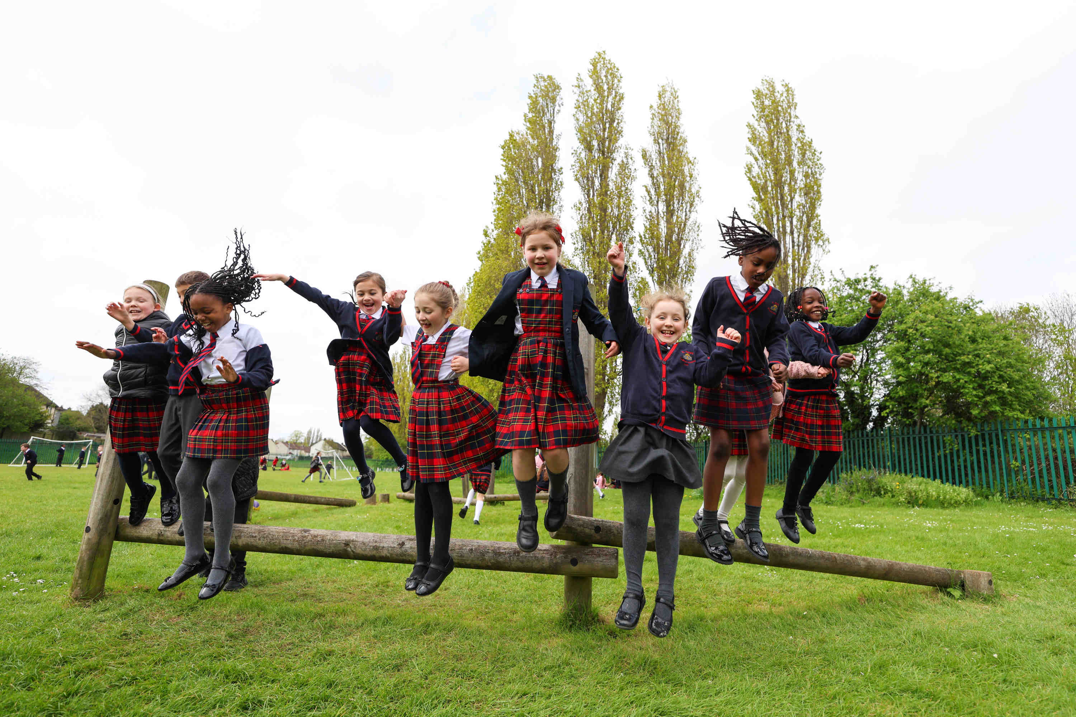
OUR CURRICULUM & CULTURE:
This booklet offers a clear insight into our values and the exceptional education we provide for our children.
BISHOP HOGARTH
Catholic Education Trust
Together with Christ, we grow in faith and knowledge
Notes:
FINISHED – VC 20/02/24

Slide 2
Welcome to St Bede’s
school.
"One measure of poverty is how little you have. Another is how difficult you find it to take advantage of what others try to give you." (Michael Lewis)
At St. Bede's, we understand the impact that limited access to a high-quality education and quality first teaching has on disadvantaged children. It hampers their ability to seize opportunities and limits their life chances. We believe that every child deserves a fair chance to succeed, regardless of their circumstances.
To ensure equity over equality, we must confront the soft bigotry of low expectations. We must be bold and unyielding in our approach to improving access to a high-quality education. It demands a ferocious commitment to ensuring that every child is present and engaged in their learning.
We understand that this is a robust and difficult challenge. It requires us to confront barriers and push against the status quo. But we are resolute in our mission. We want to create an environment where children feel seen, valued, and supported. We reject the notion that their circumstances should limit their dreams and aspirations.
Let us be the heroes who refuse to accept anything less than excellence. Postcodes will not dictate life chances at St. Bede's. We are committed to providing every child with the unwavering support, nurturing environment, and boundless opportunities they need to flourish.
In all that we do, we are guided by our faith, committed to cultivating compassionate individuals who will make a positive impact on the world around them.
Together with Christ, we grow in faith and knowledge
Notes:
FINISHED – VC 20/02/24

Slide 3
CONTENTS
SECTION | PAGE NUMBER
WELCOME | 03
SAFEGUARDING CULTURE | 05
ATTENDANCE CULTURE | 06 - 07
BEHAVIOUR AND ATTITUDES CULTURE | 08 - 09
OUR CURRICULUM VISION | 10 - 16
CURRICULUM IMPLEMENTATION | 17 - 18
CURRICULUM IMPACT | 19
TEACHING AND LEARNING | 20 - 22
ADAPTIVE TEACHING | 23
CURRICULUM AND ASSESSMENT | 24 - 27
QUALITY ASSURANCE | 28
TIMETABLING | 29
TERMLY PLANNING | 30
READING, WRITING AND COMMUNICATION | 31 - 32
MATHEMATICS AND NUMERACY | 33 - 34
EARLY YEARS | 35 - 36
MIXED YEARGROUP TEACHING | 37 - 38
DEFINITION OF TERMS | 39
WORKLOAD | 40
ARTIFICIAL INTELLIGENCE(AI) | 41
APPENDICES | 00
Together with Christ, we grow in faith and knowledge

Slide 4
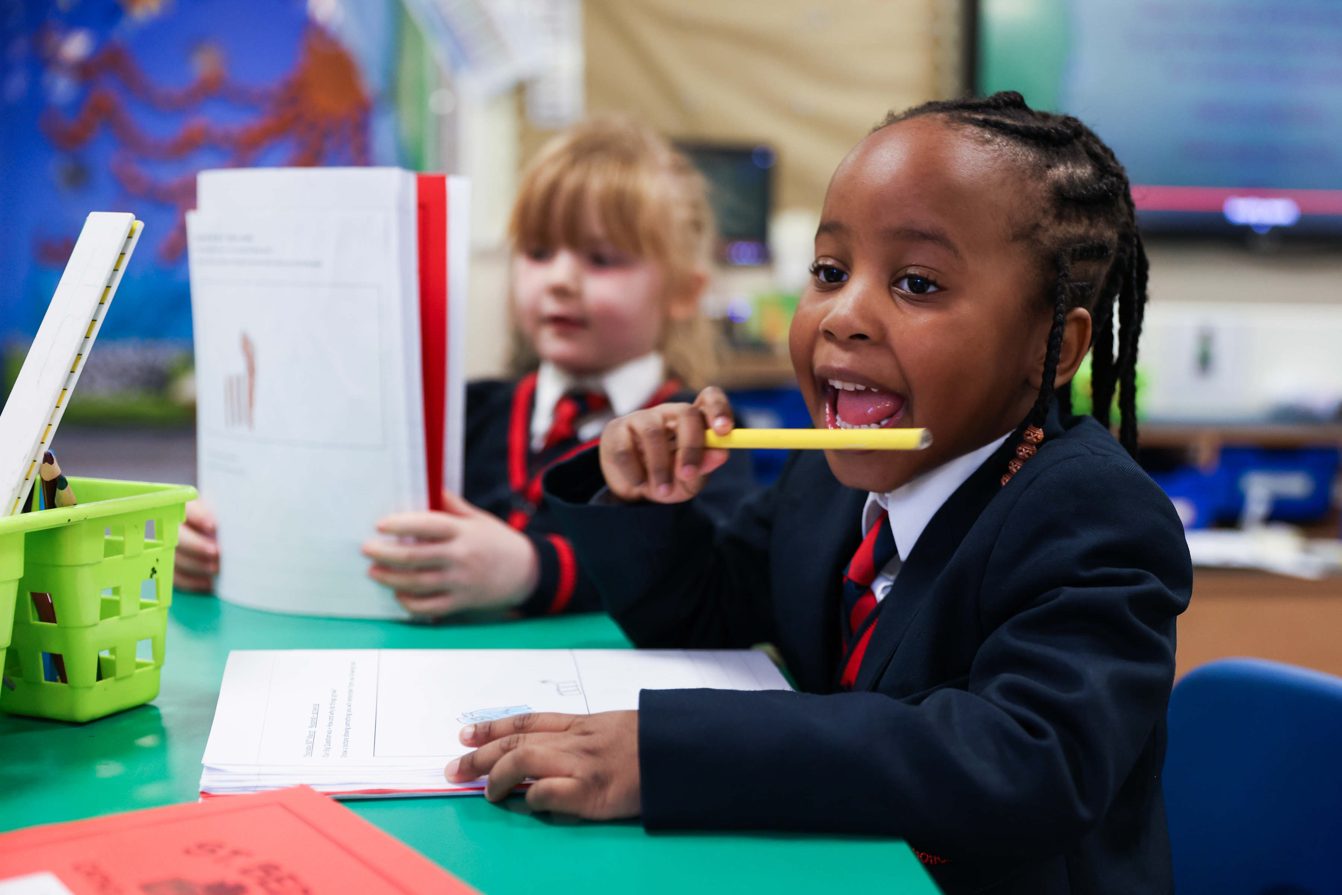
WELCOME
Bishop Hogarth Catholic Education and St Bede’s school is a community where all are provided with the opportunity to achieve their full potential in a way that is rooted firmly in the values of the Gospel.
Our Catholic ethos and support for one another as a family of schools drives all that we do. Our mission is guided by a collective culture and vision where:
‘Our schools are places of excellence – providing service and witness to children, their families, and
the wider Catholic community. By adding value as a family of schools, we will enrich the learning and
experience of all our young people so they may achieve their full potential.’
“Catholic schools evangelise culture because they address the deepest questions about what it is to be human and live in society. They open pupils’ minds to the transcendent dimension of life and the reality of God revealed in Jesus Christ. The Catholic school enables each child to develop their God-given gifts in order to engage in building a better society
which is characterised by justice, truth and love.”
Hexham and Newcastle Diocese Education
Our curriculum is carefully planned and designed to provide academic, spiritual and cultural opportunity for all our children in order to develop their character through a focus on virtues and Catholic Social teaching. It is based on the needs of the children and the context of their communities .
Together with Christ, we grow in faith and knowledge
Notes:
FINISHED – VC 20/02/24

Slide 5
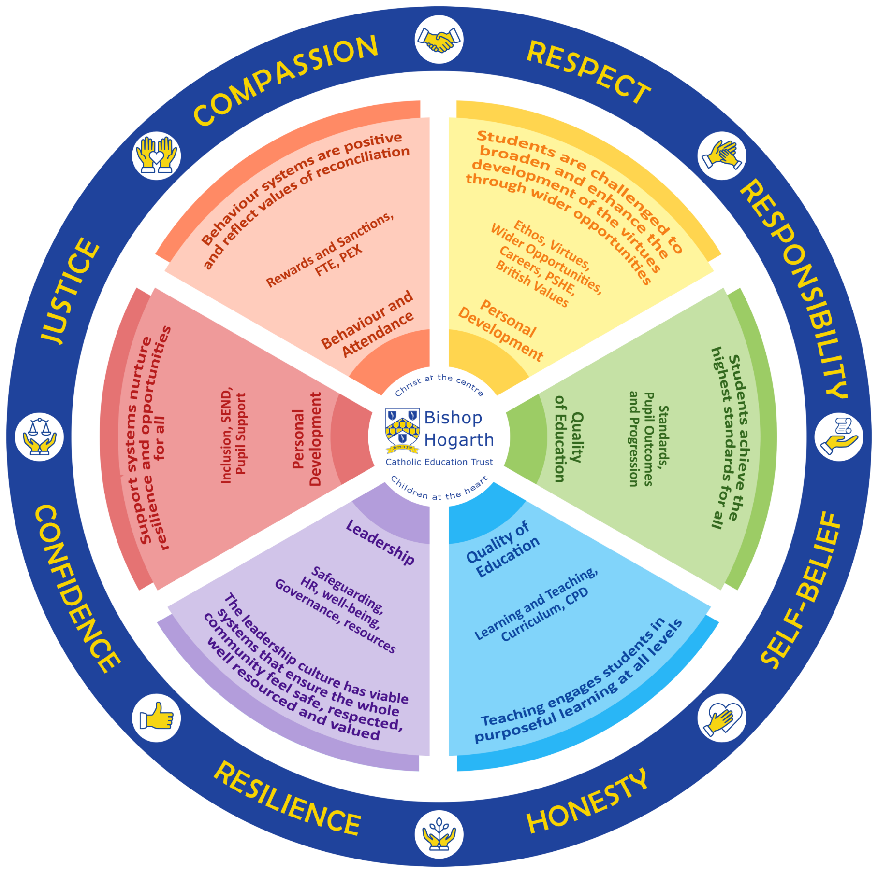
TRUST VIRTUES
We are committed to providing culture, opportunities, and high-quality experiences to our students. We develop their character by modelling, teaching and shaping the Virtues of:
• Justice and Compassion
• Honesty and Responsibility
• Respect and Self belief
• Confidence and Resilience
These virtues run through our curriculum and everyday life of the school. They are designed to help pupils develop their sense of self and be ready to move with confidence onto their next chapter. Our behaviour and reward systems are based around the promotion and celebration of these virtues.
“I came so that they may have life and have it to the full”
Jn 10:10
In all that we do, we are guided by our faith, committed to cultivating compassionate individuals who will make a positive impact on the world around them.
Together with Christ, we grow in faith and knowledge
Notes:
FINISHED – VC 20/02/24

Slide 6
SAFEGUARDING CULTURE
It could happen here…
St Bede’s will:
Be a safe environment for all
Keep one fully up to date Single Central Record (SCR)
Clearly publicise DSL/DDSL and all key contacts
Act in the best interests of the child, always
Have fully trained DSL and DDSLs
Have a nominated governor for safeguarding
Induct all new members of staff in safeguarding procedures
Ensure safer recruitment procedures are followed
Respond to the Trust online filtering and monitoring system ‘Lightspeed’
Trust Expectations at school level. Annually, leaders will ensure they:
Have a safeguarding policy – ratified by Governors by the first full week in September
Publish a safeguarding plan
Ensure DBS declaration is completed by all and quality assured by leaders
Complete the Safeguarding Audit – moderated by external consultants
All staff/governors undertake KCSIE training
Staff will:
Adhere to the Safeguarding Policy
Know who the DSL/DDSLs are in the school they are working in
Listen to and take seriously disclosures or information that a child may be at risk
Undertake appropriate training related to contextual safeguarding.
What staff should do if they have a concern about a child/ risk of harm?
Clarify the information with open questions
Record only what the pupil says
Explain that we cannot keep secrets
Reassure they will be taken seriously
Listen to the child’s wishes/feelings
Explain what will happen next
Reassure those who ‘need to know’ will be told
Ensure referrals are made to the DSLs
Record the incident in accordance with policy
Concerns about staff:
If about a member of staff refer to HT
If about the HT, refer to the CEO
If about the CEO, refer to Chair of Directors
Trust Safeguarding Lead
Trust Expectations at School Improvement level:
Report to Governors and Directors with an accurate view of safeguarding
Work with individual schools where safeguarding support is needed
SAFEGUARDING IS EVERYONE’S RESPONSIBILITY
Together with Christ, we grow in faith and knowledge
Notes:
FINISHED – VC 20/02/24
Culture (need to add in a vision for Culture) - Pastoral Behaviour Guiding Principles
Add in page for Attendance Add in page for Safeguarding Add in page for Wider Opportunities/Enrichment

Slide 7
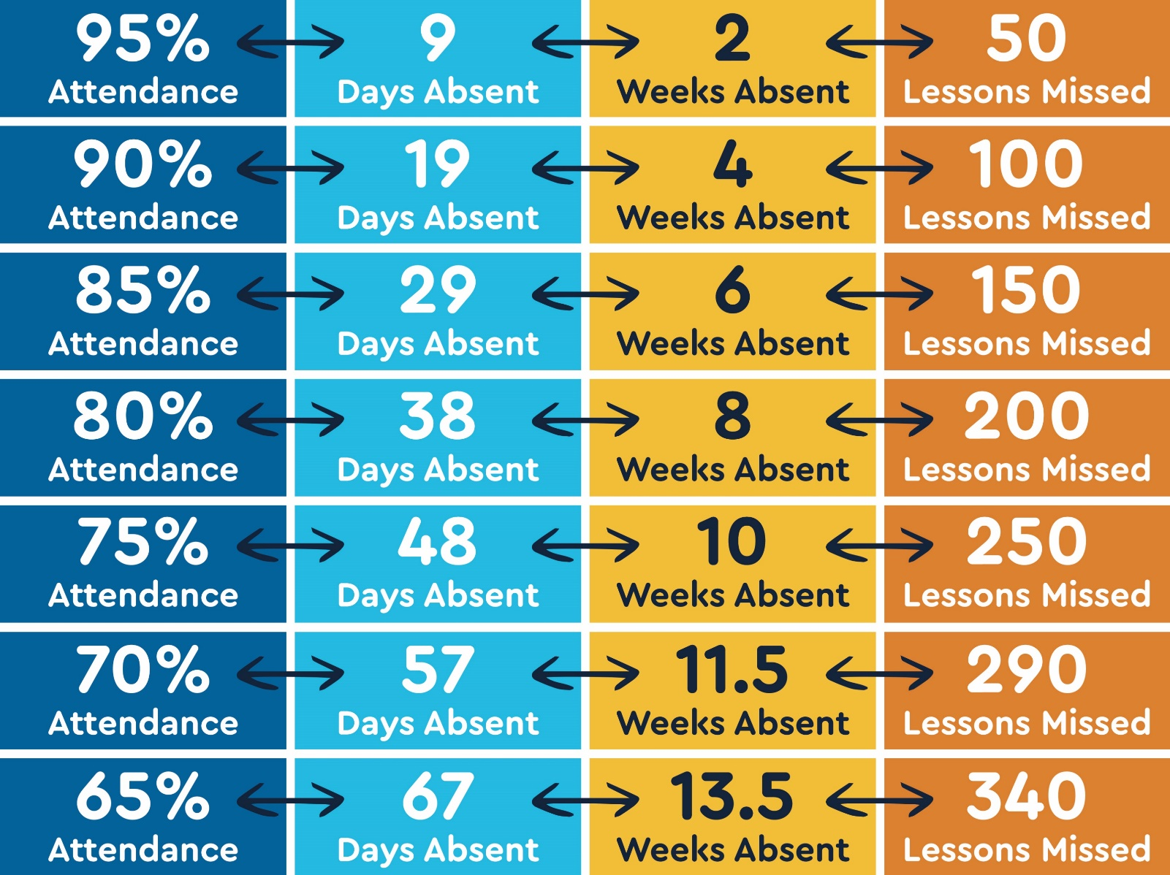
ATTENDANCE CULTURE
We are proud that St Bede's has been appointed as a national attendance hub and are pleased to support schools nationally in improving attendance. Our significant contribution the DFE schools attendance toolkit has meant that our policies, procedures and practice is accessible to all schools. Our curriculum is engaging, purposeful and motivational. We will have a no excuse approach to good attendance and punctuality. Where this is not happening, our role is to remove any barrier. A robust strategy will ensure regular and punctual school attendance which is proven to have a direct impact on children’s outcomes and life chances. Our aspiration is for all pupil to be at, or beyond, national averages. We pay particular attention to the attendance levels of our most disadvantaged pupils.
St Bede’s will:
Have positive relationships, with a fair and consistent approach that pays particular attention to our disadvantaged pupils.
Breakdown barriers
Ensure pupils feel safe, secure, and valued
Adhere to statutory guidance
Have robust procedures and a policy that is understood by all.
98% - 100% | Expected. Celebrate pupil attendance
95% - 97% | Start informal monitoring
95% - 90% | At risk of persistent absence. Start trust attendance intervention
Below 90% | Persistent absence. Implement trust attendance intervention
Below 50% | Severe. Implement trust attendance intervention
“Attendance needs to be everyone’s business, we must do everything we can ... to make sure children are in school, every day, and ready to learn. Not just for their future, but for their wellbeing and safety too.”
- Rachel De Souza
The greatest impact of high rates of attendance:
The removal of barriers
Swift intervention
Strong relationships with parents
Pupils develop exceptional routines and habits
Pupils ready to succeed in the next phase of their journey
Together with Christ, we grow in faith and knowledge
Notes:
FINISHED – VC 20/02/24

Slide 8
ATTENDANCE CULTURE
Trust Expectations at School Level:
Dedicated senior leader with clearly assigned responsibilities for attendance.
Attendance evaluation to be a weekly SLT agenda item.
Pupils are prioritised for first day calls (vulnerable groups for attendance).
Weekly reports to staff across the school from attendance leaders.
Consistently reward and incentivise attendance.
Prompt action with parents where attendance is below expectations.
Stepped/ personalised approach to communication with parents.
Attendance leads monitor the impact of attendance interventions.
Forensic analysis of data to identify and act on trends and patterns.
Engage with external agencies where safeguarding or other concerns.
“Tenacity is very important ... It’s about parents knowing that we are not going to let go.”
- DfE May 2022 Improving School Attendance
Impact
Pupils have high attendance. They come to school on time and are punctual to lessons. When this is not the case, the school takes appropriate, swift and effective action.
School Expectations from Trust:
Whole Trust data analysis.
Report to Governors and Directors with accurate view of school attendance.
Work with individual schools where attendance is highlighted as low.
Media teams will highlight attendance on social media.
We listen, understand, empathise and support but we do not tolerate.
Together with Christ, we grow in faith and knowledge
Notes:
FINISHED – VC 20/02/24

Slide 9
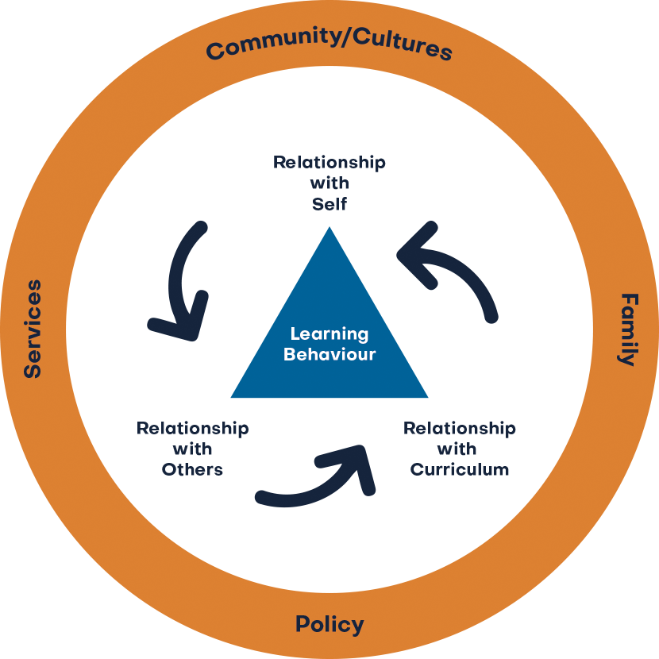
BEHAVIOUR AND
ATTITUDES CULTURE
Pupils and staff thrive in an environment in which they feel safe, valued and respected. We have high expectations and are committed to ensuring a positive approach to behaviour. We accept that positive praise, recognition, and restorative practice are more effective than disciplinary measures. Behaviour in school is inseparable from academic achievement, safety, welfare and well-being.
We have a behaviour culture that that frames behaviour in terms of three relationships:
Relationship with self
Relationship with others
Relationship with curriculum
Through our behaviour culture, we:
Empower our pupils to take responsibility for their actions
Foster mutual respect, clear expectations, and consistent consequences.
Encourage positive relationships for learning.
Create a foundation for effective teaching.
Nurture a supportive and positive relationship with the curriculum.
Encourage pupils to engage and find meaning in their learning.
“Encouraging a positive self-concept enhances resilience, motivation and confidence, contributing to a conducive learning environment.”
- EEF
St Bede’s has:
A Christ centred approach that ensures a calm, safe and supportive environment for all.
A culture that is free from fear, discrimination, and bullying, where all know they belong.
The highest expectations of pupil behaviour to ensure all excel.
A no tolerance approach to all bullying, where pupils accept responsibility for their actions.
An active partnership with families to encourage a shared approach to excellent behaviour.
A curriculum to develop excellent learning habits to be successful.
Independent pupils with high self-esteem.
A culture focused on attaining excellence.
A clear and concise behaviour policy that links to our reward system.
Together with Christ, we grow in faith and knowledge
Notes:
FINISHED – VC 20/02/24

Slide 10
BEHAVIOUR AND
ATTITUDES CULTURE
Implementation
Our strategies are designed to prevent undesirable behaviour.
Good relationships mean pupils want to behave.
We encourage simple, approaches and expect pupils to be known individually.
We recognise the importance of consistency and coherence when managing behaviour.
We establish the rationale for implementing behaviour strategies, then ensure it is embedded.
For pupils who find regulation difficult, we use personalised approaches and supportive interventions.
Staff are trained in specific strategies for dealing with pupils with high behaviour needs.
Our curriculum teaches the importance of behaviour for learning.
Pupils' self-perception and confidence influences their ability to navigate challenges.
We foster a collaborative atmosphere which promotes collective learning.
Peer interactions are encouraged to influence behaviour and attitude towards learning.
Teamwork and mutual support enhance the social fabric of the classroom.
Our curriculum is adapted which will lead to the experience of success for all.
By cultivating a positive curriculum, we create an environment where behaviour for learning thrives and is expected.
Improvements to behaviour will be evidenced in pupil voice, staff voice, behaviour incidents recorded and parent feedback.
Leaders in school are expected to analyse behaviour termly to inform further actions.
Impact
Through a clear behaviour policy that is routed in the eight virtues and key principles of catholic social teaching behaviour at St Bede's is excellent .
We have an establish a culture where relationships impact positively on behaviour for learning and attitudes and attendance
The children feel they have status and voice within St Bede’s.
Incidents of low level disruption in lessons is minimal and poor behaviour for learning is rare.
All staff have created a safe, calm, orderly and positive environment.
Behaviour is exceptional because positive attitudes to learning are strong.
Pupils feel safe from bullying. If it takes place, it is dealt with quickly, consistently, effectively.
Pupils are ready to succeed in their next phase of their journey.
Together with Christ, we grow in faith and knowledge
Notes:
FINISHED – VC 20/02/24

Slide 11
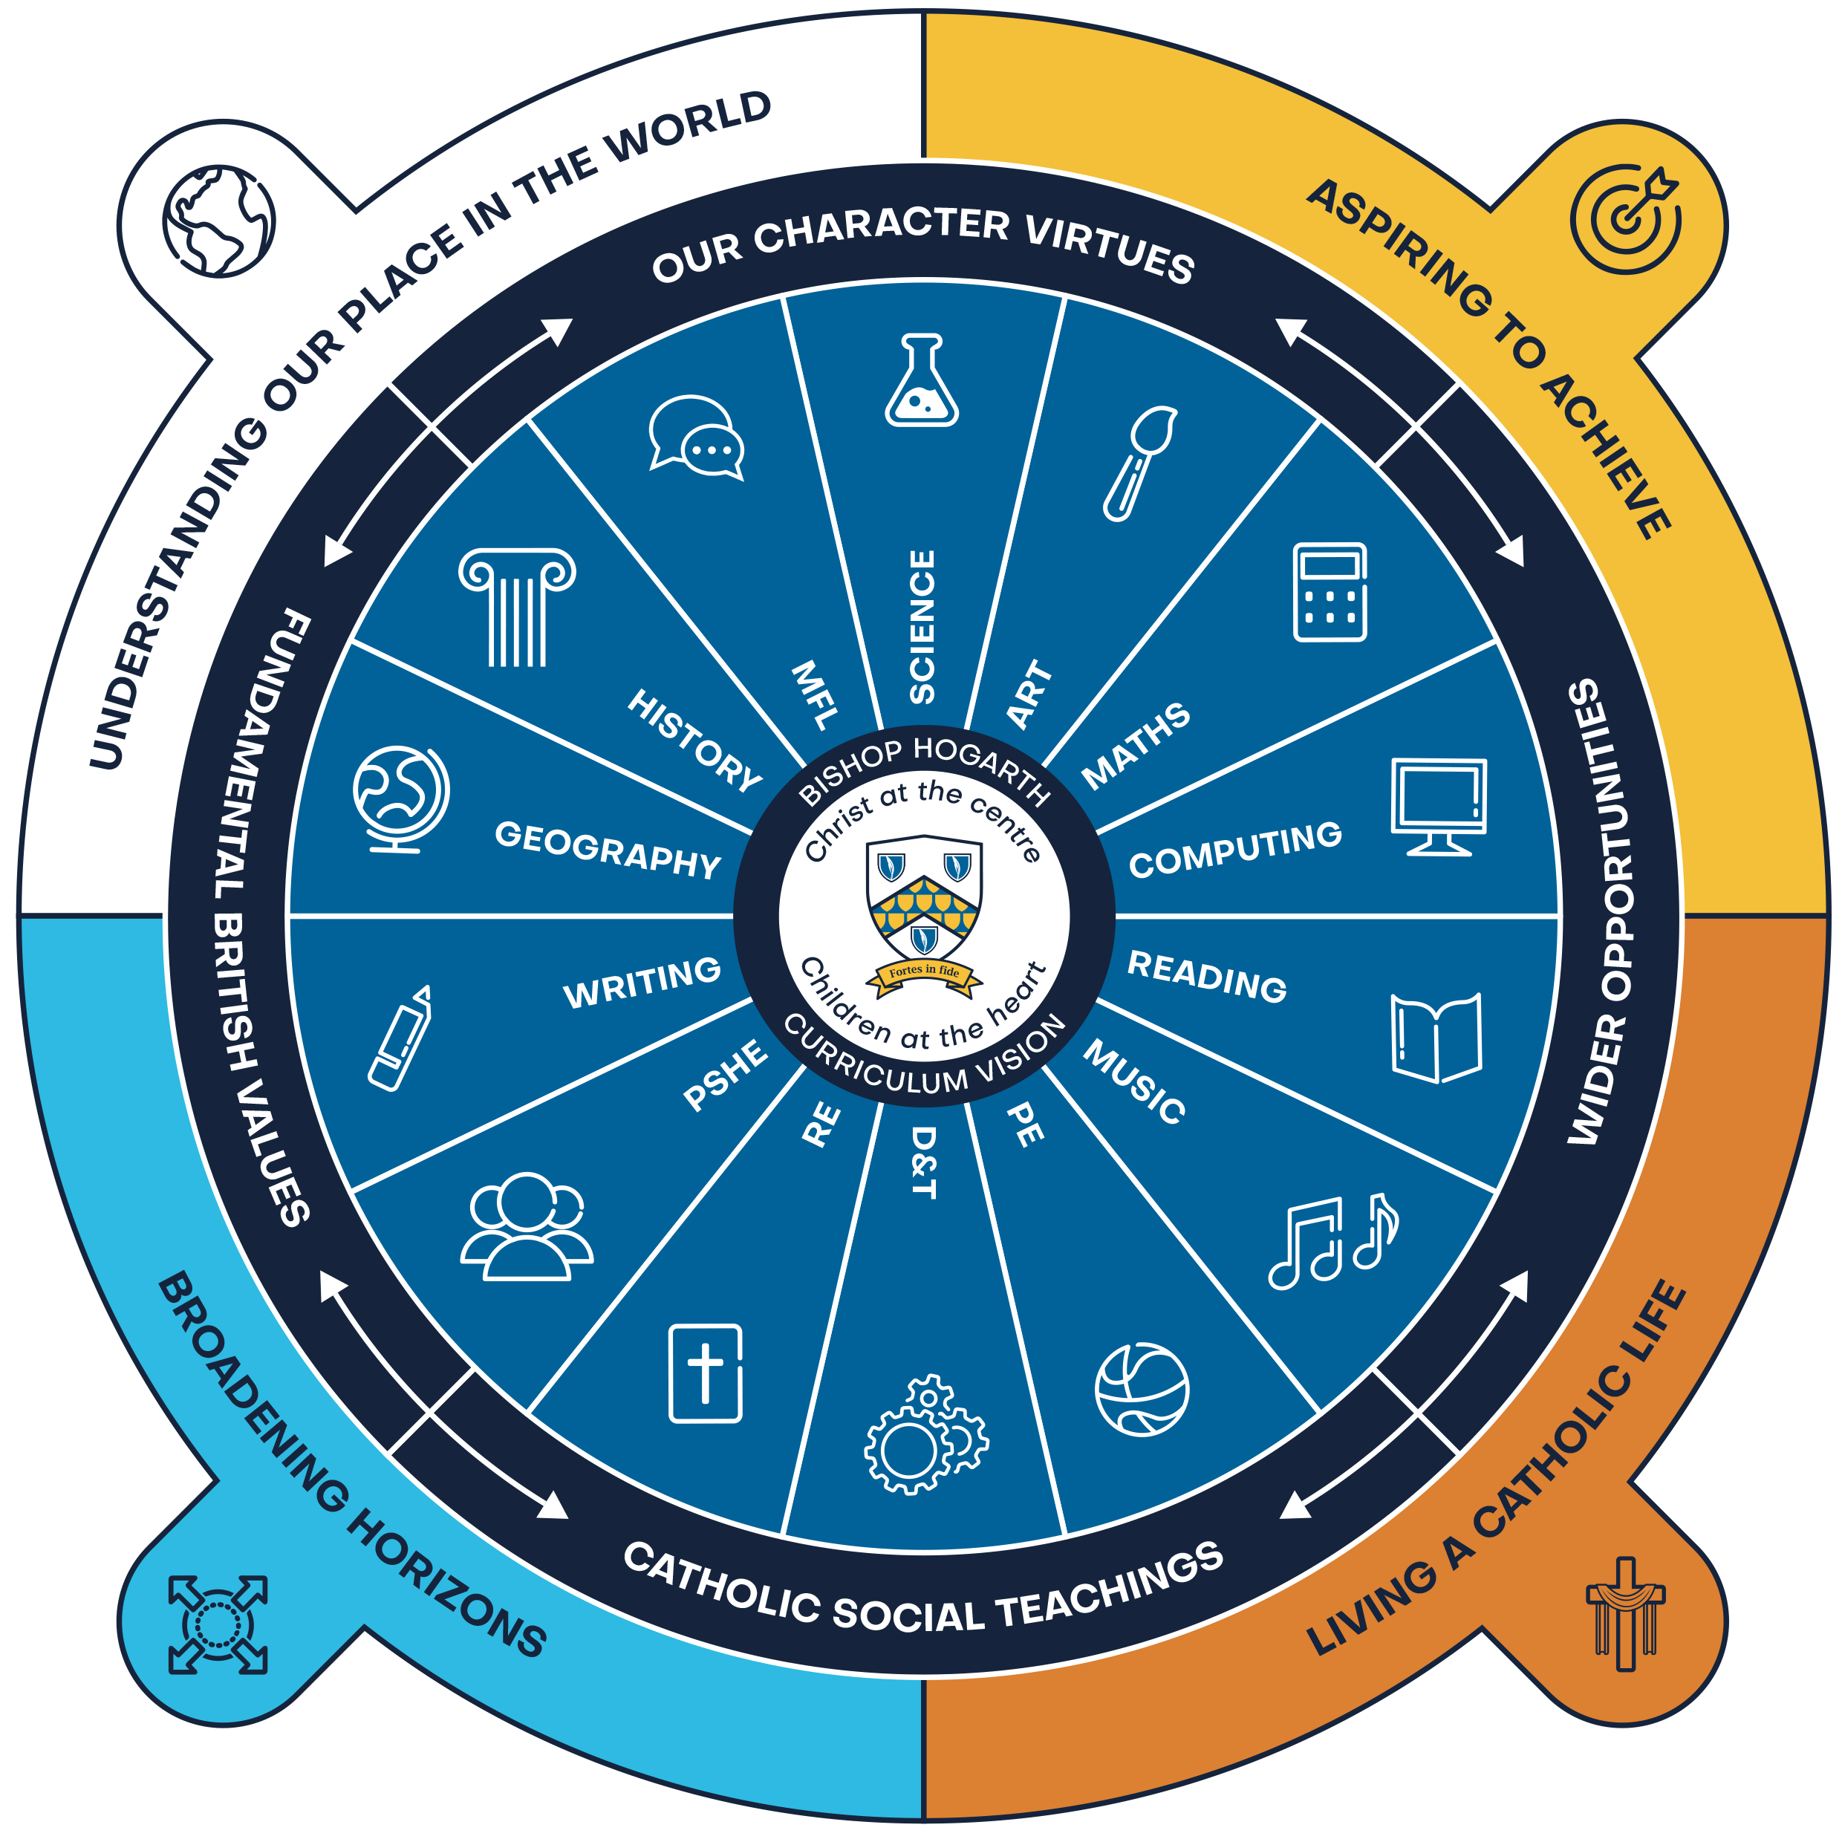
CURRICULUM VISION
St Bede’s is a community where all are provided with the opportunity to achieve their full potential in a way that is rooted firmly in the values of the Gospel. We are committed to a cohesive, purposeful, progressive and inclusive curriculum . We celebrate diversity of experience, need, interest and achievement.
Our curriculum celebrates our local heritage and nurtures pupil’s understanding of the communities in which they live. It fully prepares pupils for the next steps in their learning journey and opens the doors to the wider world as life-long learners. We have created a cohesive curriculum with broadening horizons, living a Catholic life, understanding our place and time in the world and aspiring to achieve as the golden threads that runs through all that we do.
Together with Christ, we grow in faith and knowledge
Notes:
FINISHED – VC 20/02/24

Slide 12
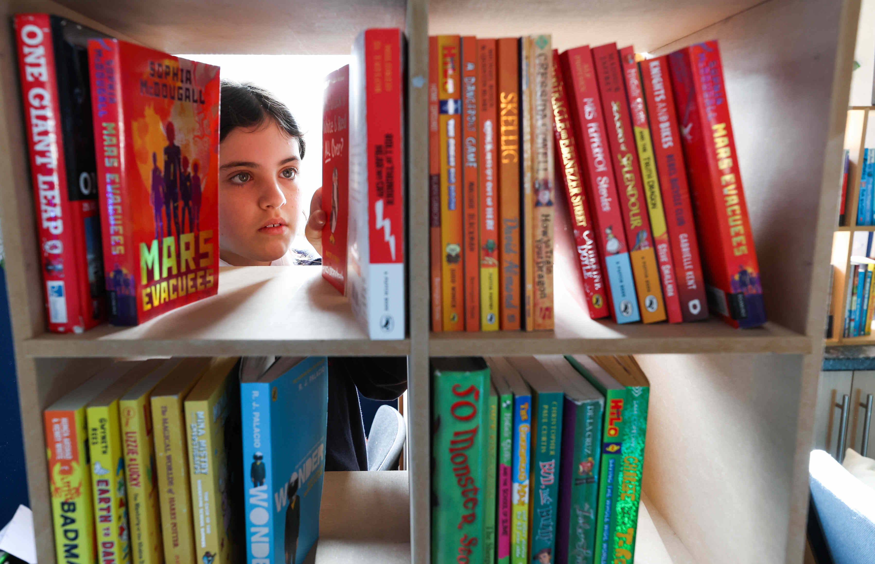
CURRICULUM VISION
“The Curriculum is not just one of the many things that Head teachers have responsibility for – it defines the purposes of a school and the journey leaders want its pupils to take.”
At St Bede’s our curriculum celebrates our local heritage and context of the pupils’ lives and experiences.
- Michael Young
UNDERSTANDING OUR PLACE IN THE WORLD
ASPIRING TO ACHIEVE
BROADENING HORIZONS
LIVING A CATHOLIC LIFE
Everything begins with our curriculum drivers.
They are woven through all that we do and underpin our shared belief that our role is to support children in understanding their place as a global citizen, having aspirations to achieve, broadening horizons and living the Gospel of life through Catholic Social Teaching.
Together with Christ, we grow in faith and knowledge
Notes:
FINISHED – VC 20/02/24

Slide 13
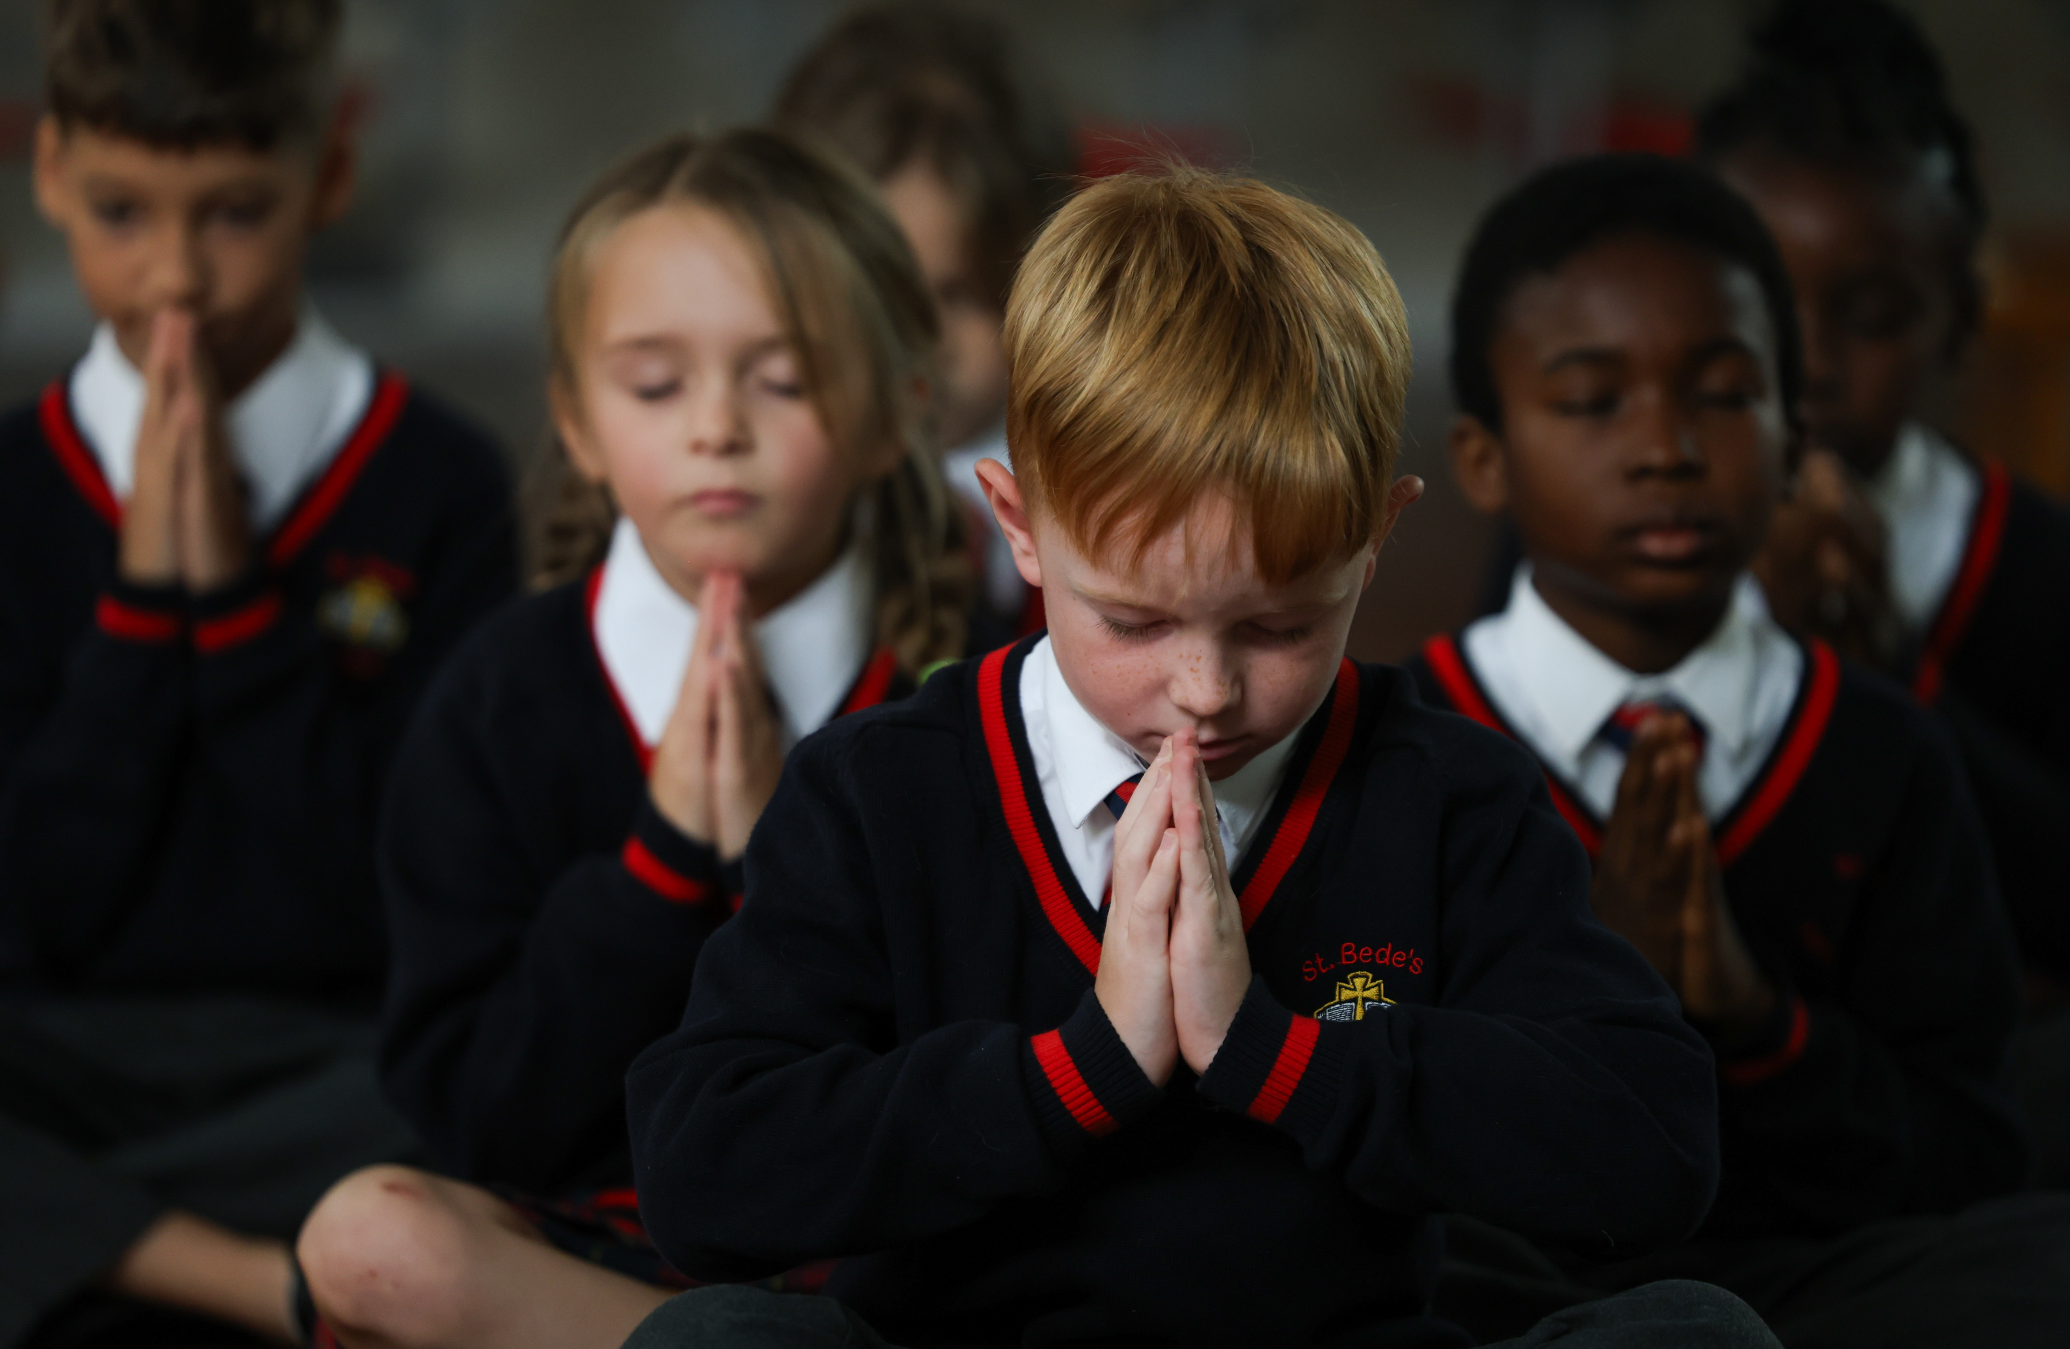
CURRICULUM VISION
The curriculum is underpinned and driven by an understanding and response to:
• The culture and diversity of the school population and community in Stockton on Tees
• The unique needs of the children in our care
The school’s distinctive ethos as a Catholic primary school is highlighted in the principals of Catholic social teaching below.
Together with Christ, we grow in faith and knowledge
Notes:
FINISHED – VC 20/02/24

Slide 14
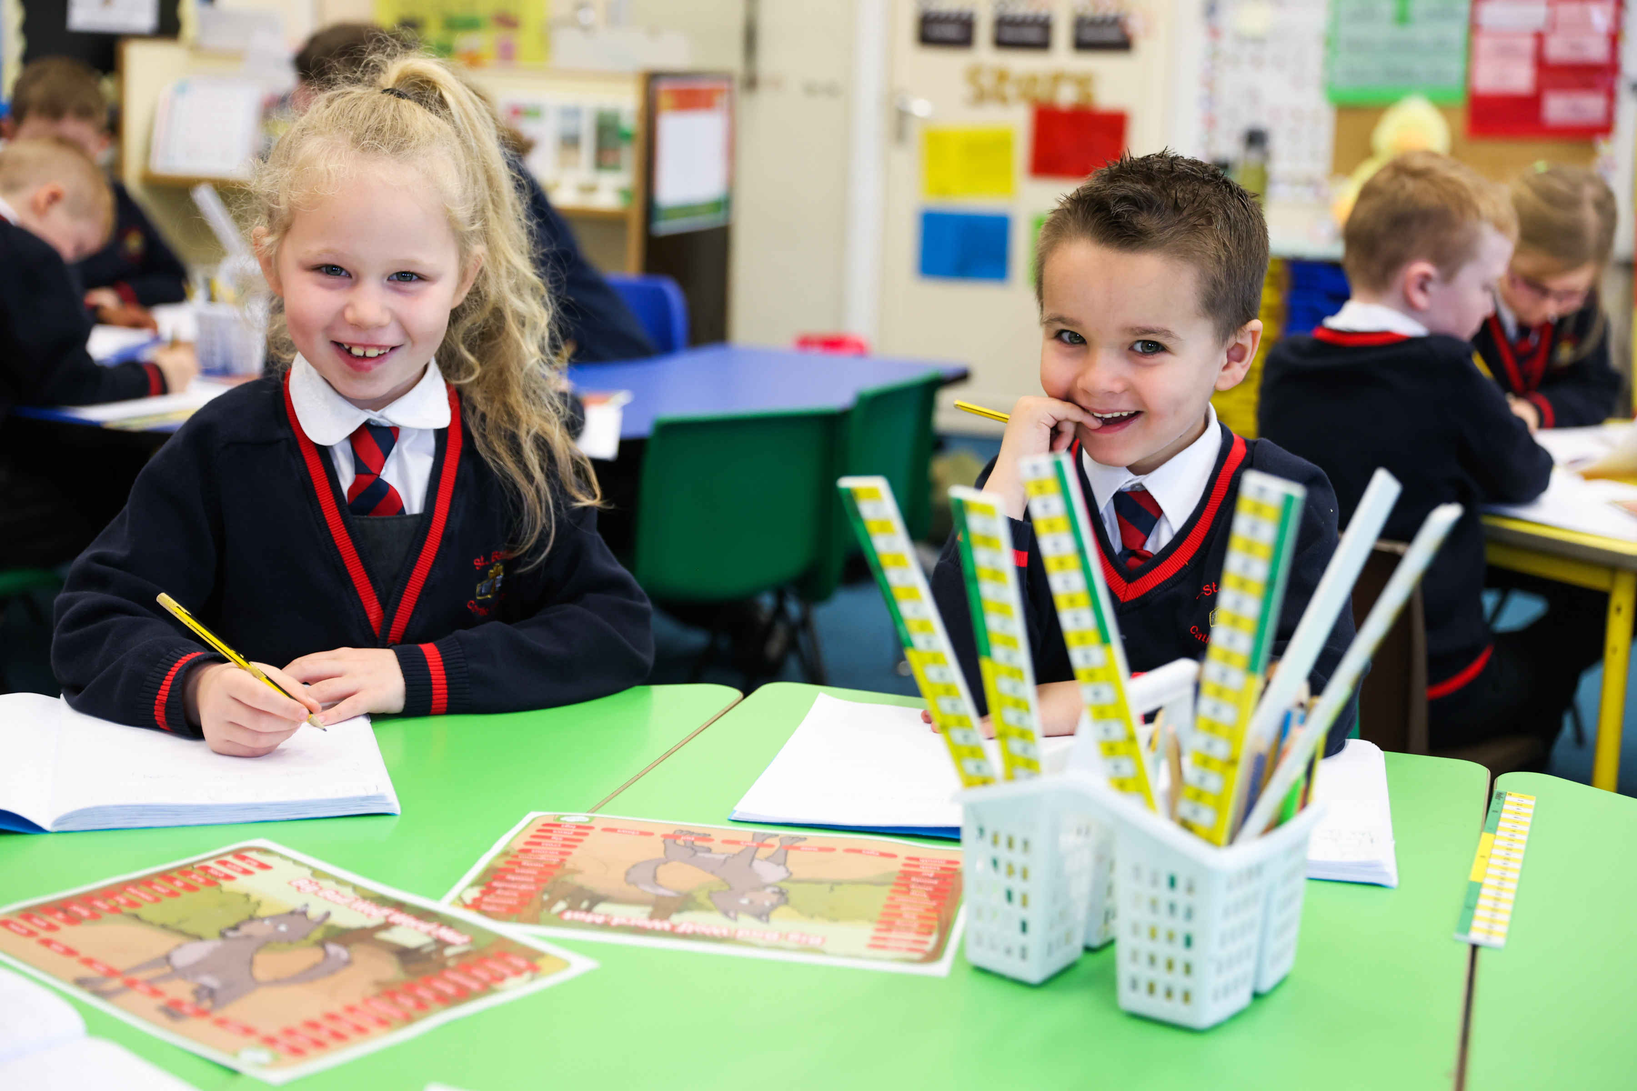
CURRICULUM VISION
The virtues of respect and responsibility, justice and compassion, confidence and resilience, honesty and self-belief, run through our curriculum and underpins our behaviour policy. The focus of these virtues are designed to help pupils develop their sense of self and be ready to move with confidence onto their next chapter.
Together with Christ, we grow in faith and knowledge
Notes:
FINISHED – VC 20/02/24

Slide 15
CURRICULUM VISION
To promote fundamental British Values and Citizenship we have embedded democracy, the rule of law, individual liberty, mutual respect and tolerance of those with different faiths and beliefs within our sequences of learning. We link these with our virtues, principles of Catholic social teaching and are interleaved into out Catholic liturgies.
DEMOCRACY
RULE OF LAW
INDIVIDUAL LIBERTY
MUTUAL RESPECT & TOLERANCE
Careers Education is woven into our curriculum design, enabling pupils from the earliest age to develop an understanding of pathways into education, careers and independence.
Our ambitious curriculum provides a continuous progression model with seamless transition from EYFS to KS2, with clear progression to secondary education. End points for each phase have been designed around the requirements of the National Curriculum. Robust collaboration occurs between primary and secondary phases ensuring it is progressive.
Together with Christ, we grow in faith and knowledge
Notes:
FINISHED – VC 20/02/24

Slide 16
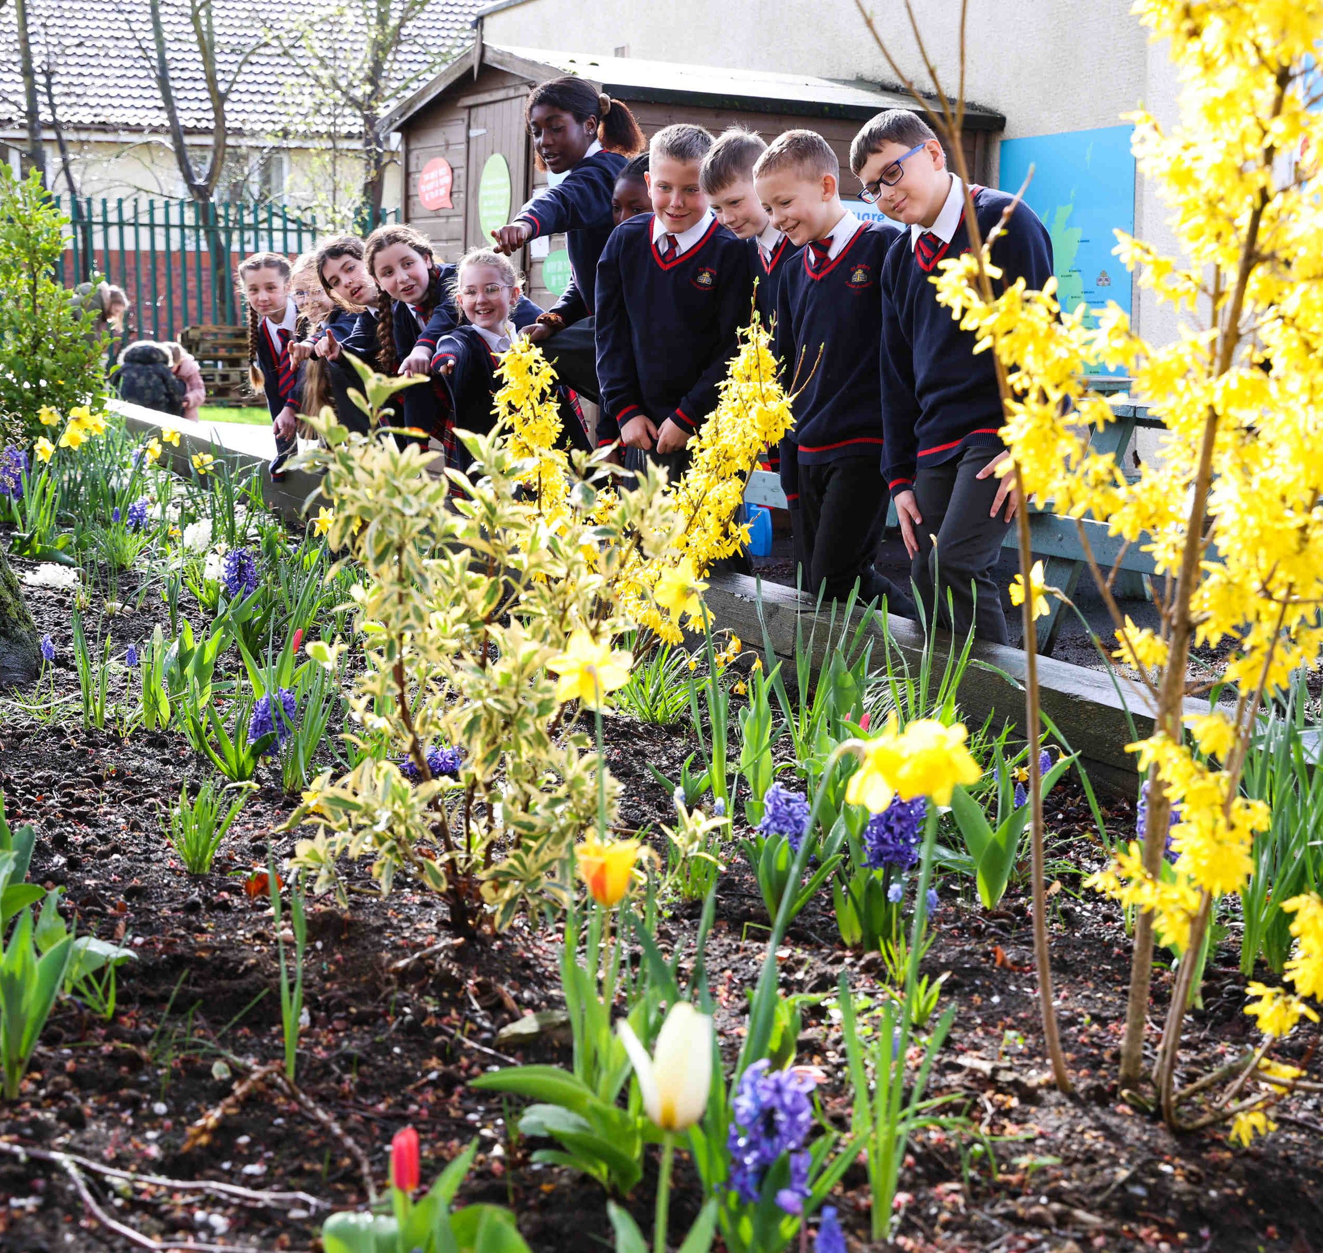
CURRICULUM VISION
Individual subject disciplines are taught explicitly with coherent links created.
Our curriculum is sequenced to ensure that knowledge is cumulative. Its cohesively designed arranged in an order which is securely based in evidence associated with age-related progression.
We have developed a fully comprehensive curriculum framework that meets the requirements of the National Curriculum. Our curriculum is systematic and builds upon prior knowledge. We see our curriculum as not set in stone but alive and dynamic. Our school community is committed to continually improving and refreshing our curriculum over time in response to feedback from stakeholders (especially our pupils!), best practice, current research, key legislation and changes in society and our demographics. At St Bede’s Catholic Academy, we are proud to have a knowledge-based curriculum, which stimulates our children into asking searching questions, develop good oracy skills shapes and enables them to develop into independent thinkers, become aware of the career opportunities available to them and ultimately be successful learners and good citizens of the United Kingdom.
Substantive and disciplinary knowledge is at the heart of each subject and linked areas of study are exploited to consolidate and embed learning, meaning that mental models are developed over time.
Together with Christ, we grow in faith and knowledge
Notes:
FINISHED – VC 20/02/24

Slide 17
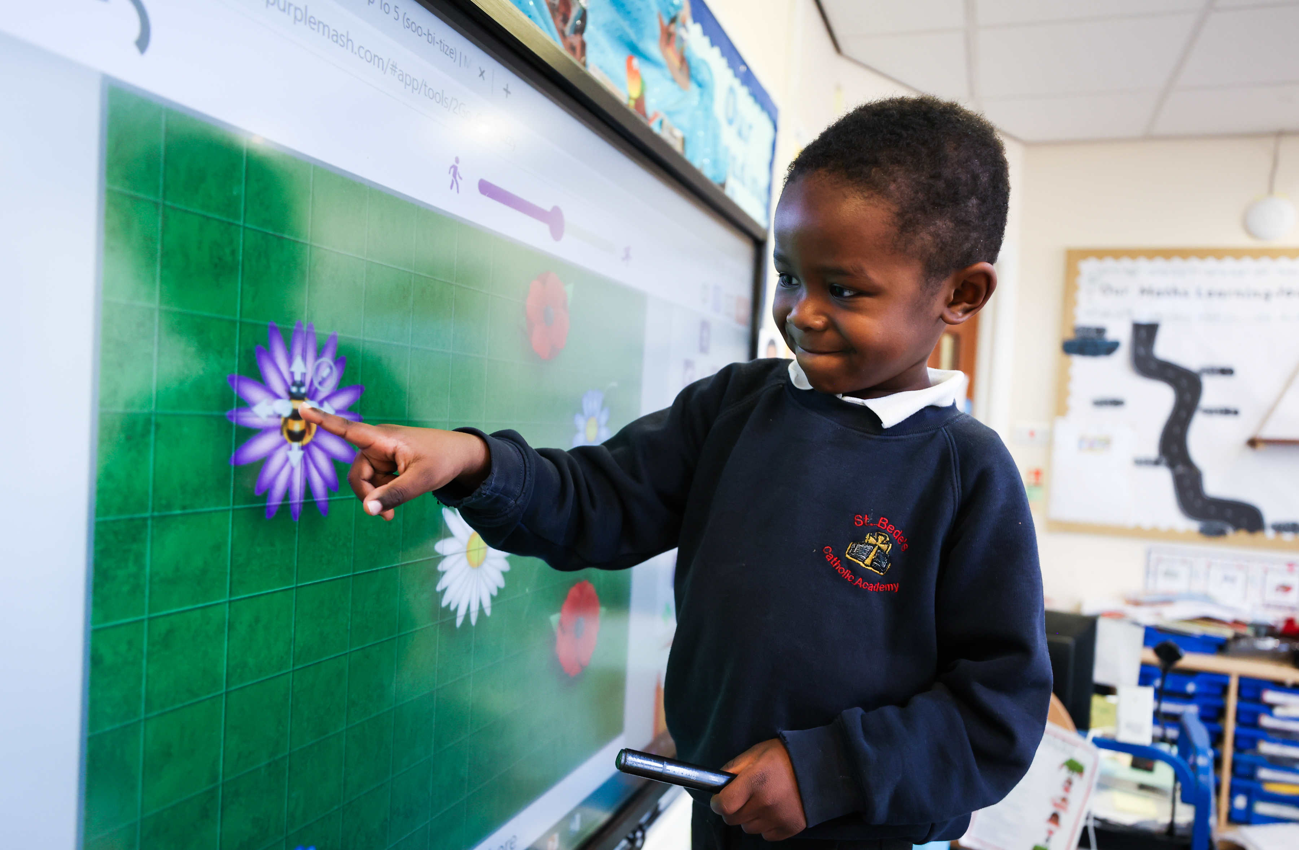
CURRICULUM VISION
At St Bede's we define learning as “the movement of information and skills into long term memory that can be used and drawn upon repeatedly to gain a further knowledge of the world around them.”
The curriculum is underpinned and driven by an understanding and response to:
• the school’s distinctive ethos as a Catholic primary school
• the culture and diversity of the school population and community in Stockton on Tees
• the unique needs of the children in our care
Our curriculum is purposeful and responsive - it aims to:
Create a positive and supportive environment for all pupils without exception;
Build an ongoing, holistic understanding of our pupils and their needs;
Ensure all have access to high quality teaching with strong pedological cohesion and access all areas of the curriculum;
Ensure that the fundamental skills of reading, writing, oracy, listening and numeracy are well established in all subjects from EYFS with academic rigour that challenges all.
Exposure to the richness of English language so that pupils can access the pleasure of reading, the excitement of writing and to explore new learning concepts.
Take a metacognitive approach to learning to reduce cognitive load and provide opportunities across the curriculum to engage in debate and critical thinking.
We expect consistency in the quality of teaching and learning across our school so that children make good progress – our children deserve nothing less. We aim for “gapless learning” through high quality teaching and adaptation.
Together with Christ, we grow in faith and knowledge
Notes:
FINISHED – VC 20/02/24

Slide 18
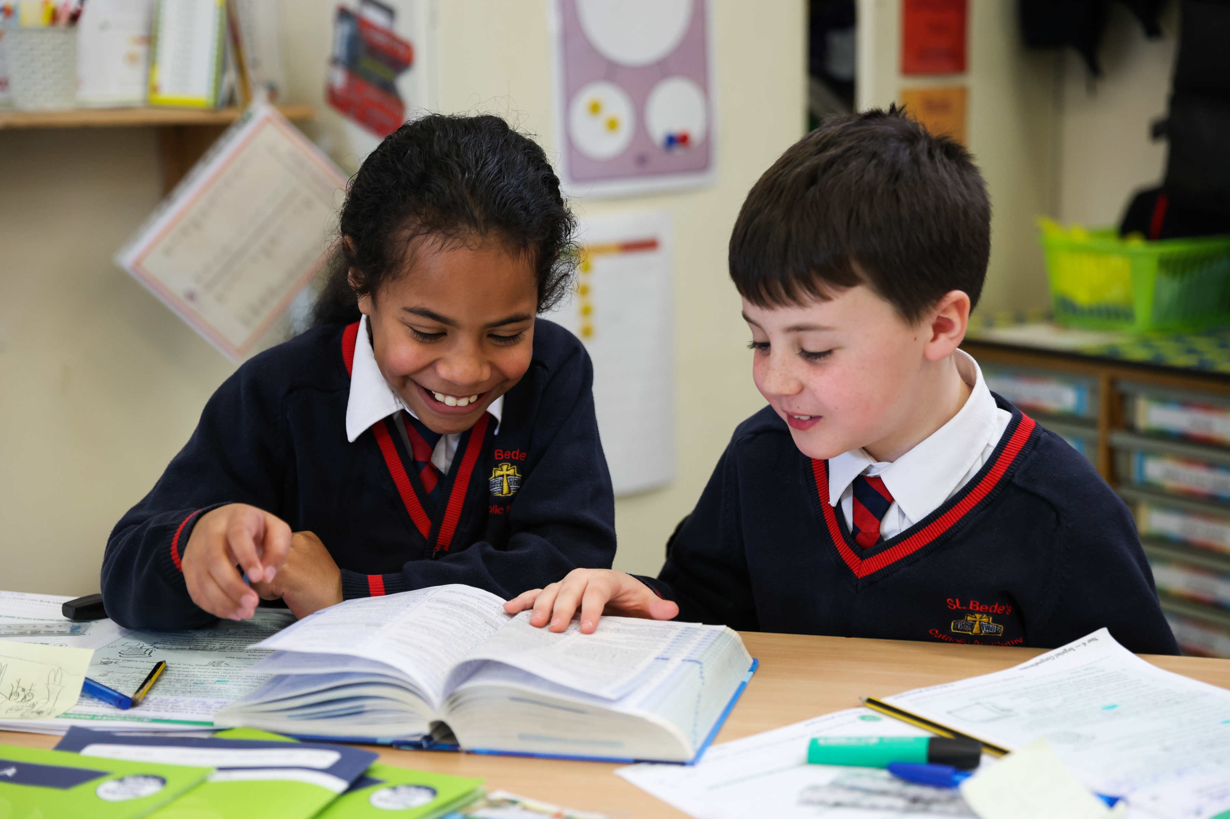
CURRICULUM IMPLEMENTATION
Carefully sequenced progression documents clearly outline the knowledge and skills developed in each subject area of study. Dedicated time for revisiting key knowledge is carved into each lesson and planning builds in time to recap previous learning to then build on knowledge and understanding in new, related areas of study. Careful consideration has been given to the amount of time each subject is taught.
We value the power of authentic experience; learning is brought to life. We have built into our sequence of learning, curriculum continuity learning and peer networks with our secondary schools. These opportunities enable our pupils to achieve successful transition. Trips, excursions and in-school events, are carefully mapped to ensure a balance of coastal, urban and rural experiences, ensuring equitable cultural capital is essential
We have outlined fundamental guiding principles, which are implemented to ensure consistency of approach. At the heart of our collective teaching pedagogy lies evidence-informed practice.
Our mantra is “rarely equality always equity” to ensure that barriers are removed that prevent vulnerable learners from achieving their full potential.
“It doesn’t matter how great an educational idea or intervention is in principle; what really matters is how it manifests itself in the day-to-day work of people in schools.”
Sir Kevan Collins
People - not policies create success.
Together with Christ, we grow in faith and knowledge
Notes:
FINISHED – VC 20/02/24

Slide 19
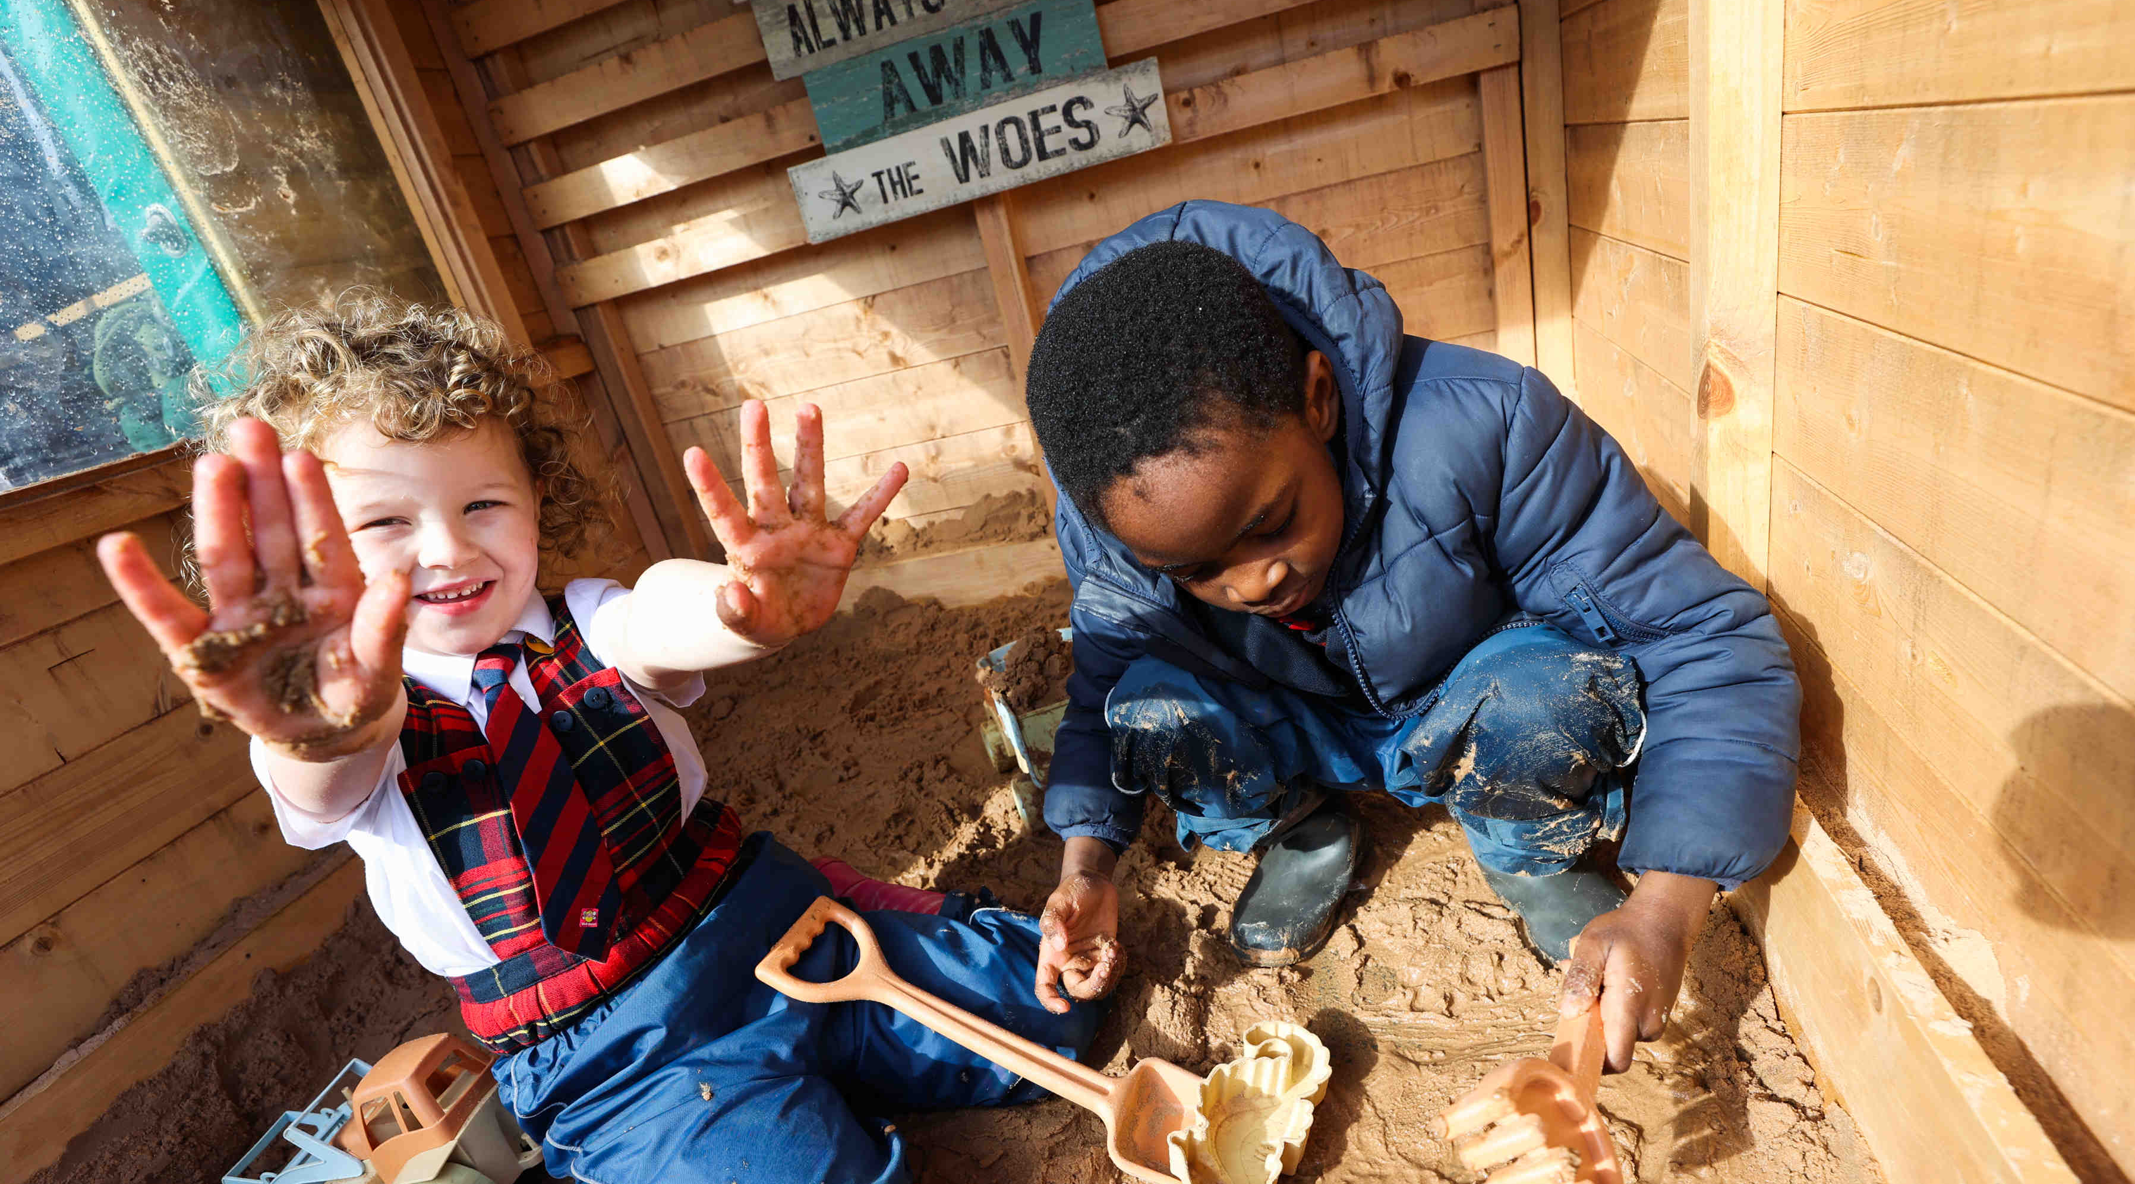
CURRICULUM IMPLEMENTATION
“Curriculum is the key lever and our best bet for disadvantaged learners.
This long-term investment is the golden ticket.”
- Dan Nichols
Pedagogy: Our Method And Practice Of Teaching
Consistency is key in our teaching approach. We ensure that our methods and approaches are consistent, regardless of the age of the students. Learning is defined as a lasting change in long-term memory. Progress means acquiring and remembering more knowledge and skills. When new knowledge connects with existing knowledge, understanding is formed.
These are the key elements we expect to see in all lessons:
Exceptional teaching, leads to outstanding learning outcomes.
All have a responsibility to deliver lessons where teaching and learning is of the highest quality and where learning needs are met.
The single most important factor in how a child learns in the classroom is how well a teacher teaches.
Together with Christ, we grow in faith and knowledge
Notes:
FINISHED – VC 20/02/24

Slide 20
CURRICULUM IMPACT
Pupils know that in knowledge lies opportunity and so, they value education and love learning. Learning is revisited and built upon to ensure a breadth and depth within and across subjects. Skills are improved over time and used as a means to access new knowledge.
Our bespoke curriculum has been designed to ensure all excel and achieve the outcomes they need. Pupils are resilient, hardworking and driven. They have been taught to be respectful; how to value the responses offered by peers, and how to politely disagree. They stretch their thinking by asking challenging questions. The faith journey of each child is unique. Our curriculum enables each child to determine their own personal understanding of spirituality; to value themselves and others; to develop social skills and understand society. They are able to build a firm set of personal morals allowing them to engage in the culture they live in and celebrate diversity in Britain and the wider world.
Exceptional teaching, leads to outstanding learning outcomes.
Curriculum and assessment are intrinsically linked.
Accurate assessment strategies enable an informed and systematic judgement to be made about a pupil’s knowledge, understanding, skills and attitude and ensure that next steps are specifically planned to develop deep understanding.
All assessment is underpinned by the pillars of assessment: it will be purposeful, valid, reliable and valuable. The purpose of assessment is to always improve pupils’ learning and inform teaching.
Quality assurance processes are robust and developmental, ensuring professional development enhances teaching and learning and impacts positively on progress and learning.
Children leave St Bede’s knowing that they belong to and make a significant difference to society and wider world. The progress they make from their starting points to the end of each key stage, equips them with the academic ability to do exceptionally well as they move on through the next steps in their life.
“Knowledge is something that “escapes its origins; it’s there for everybody.
It isn’t just the preserve of the people who hold it.”
- Michael Young
Together with Christ, we grow in faith and knowledge
Notes:
FINISHED – VC 20/02/24

Slide 21
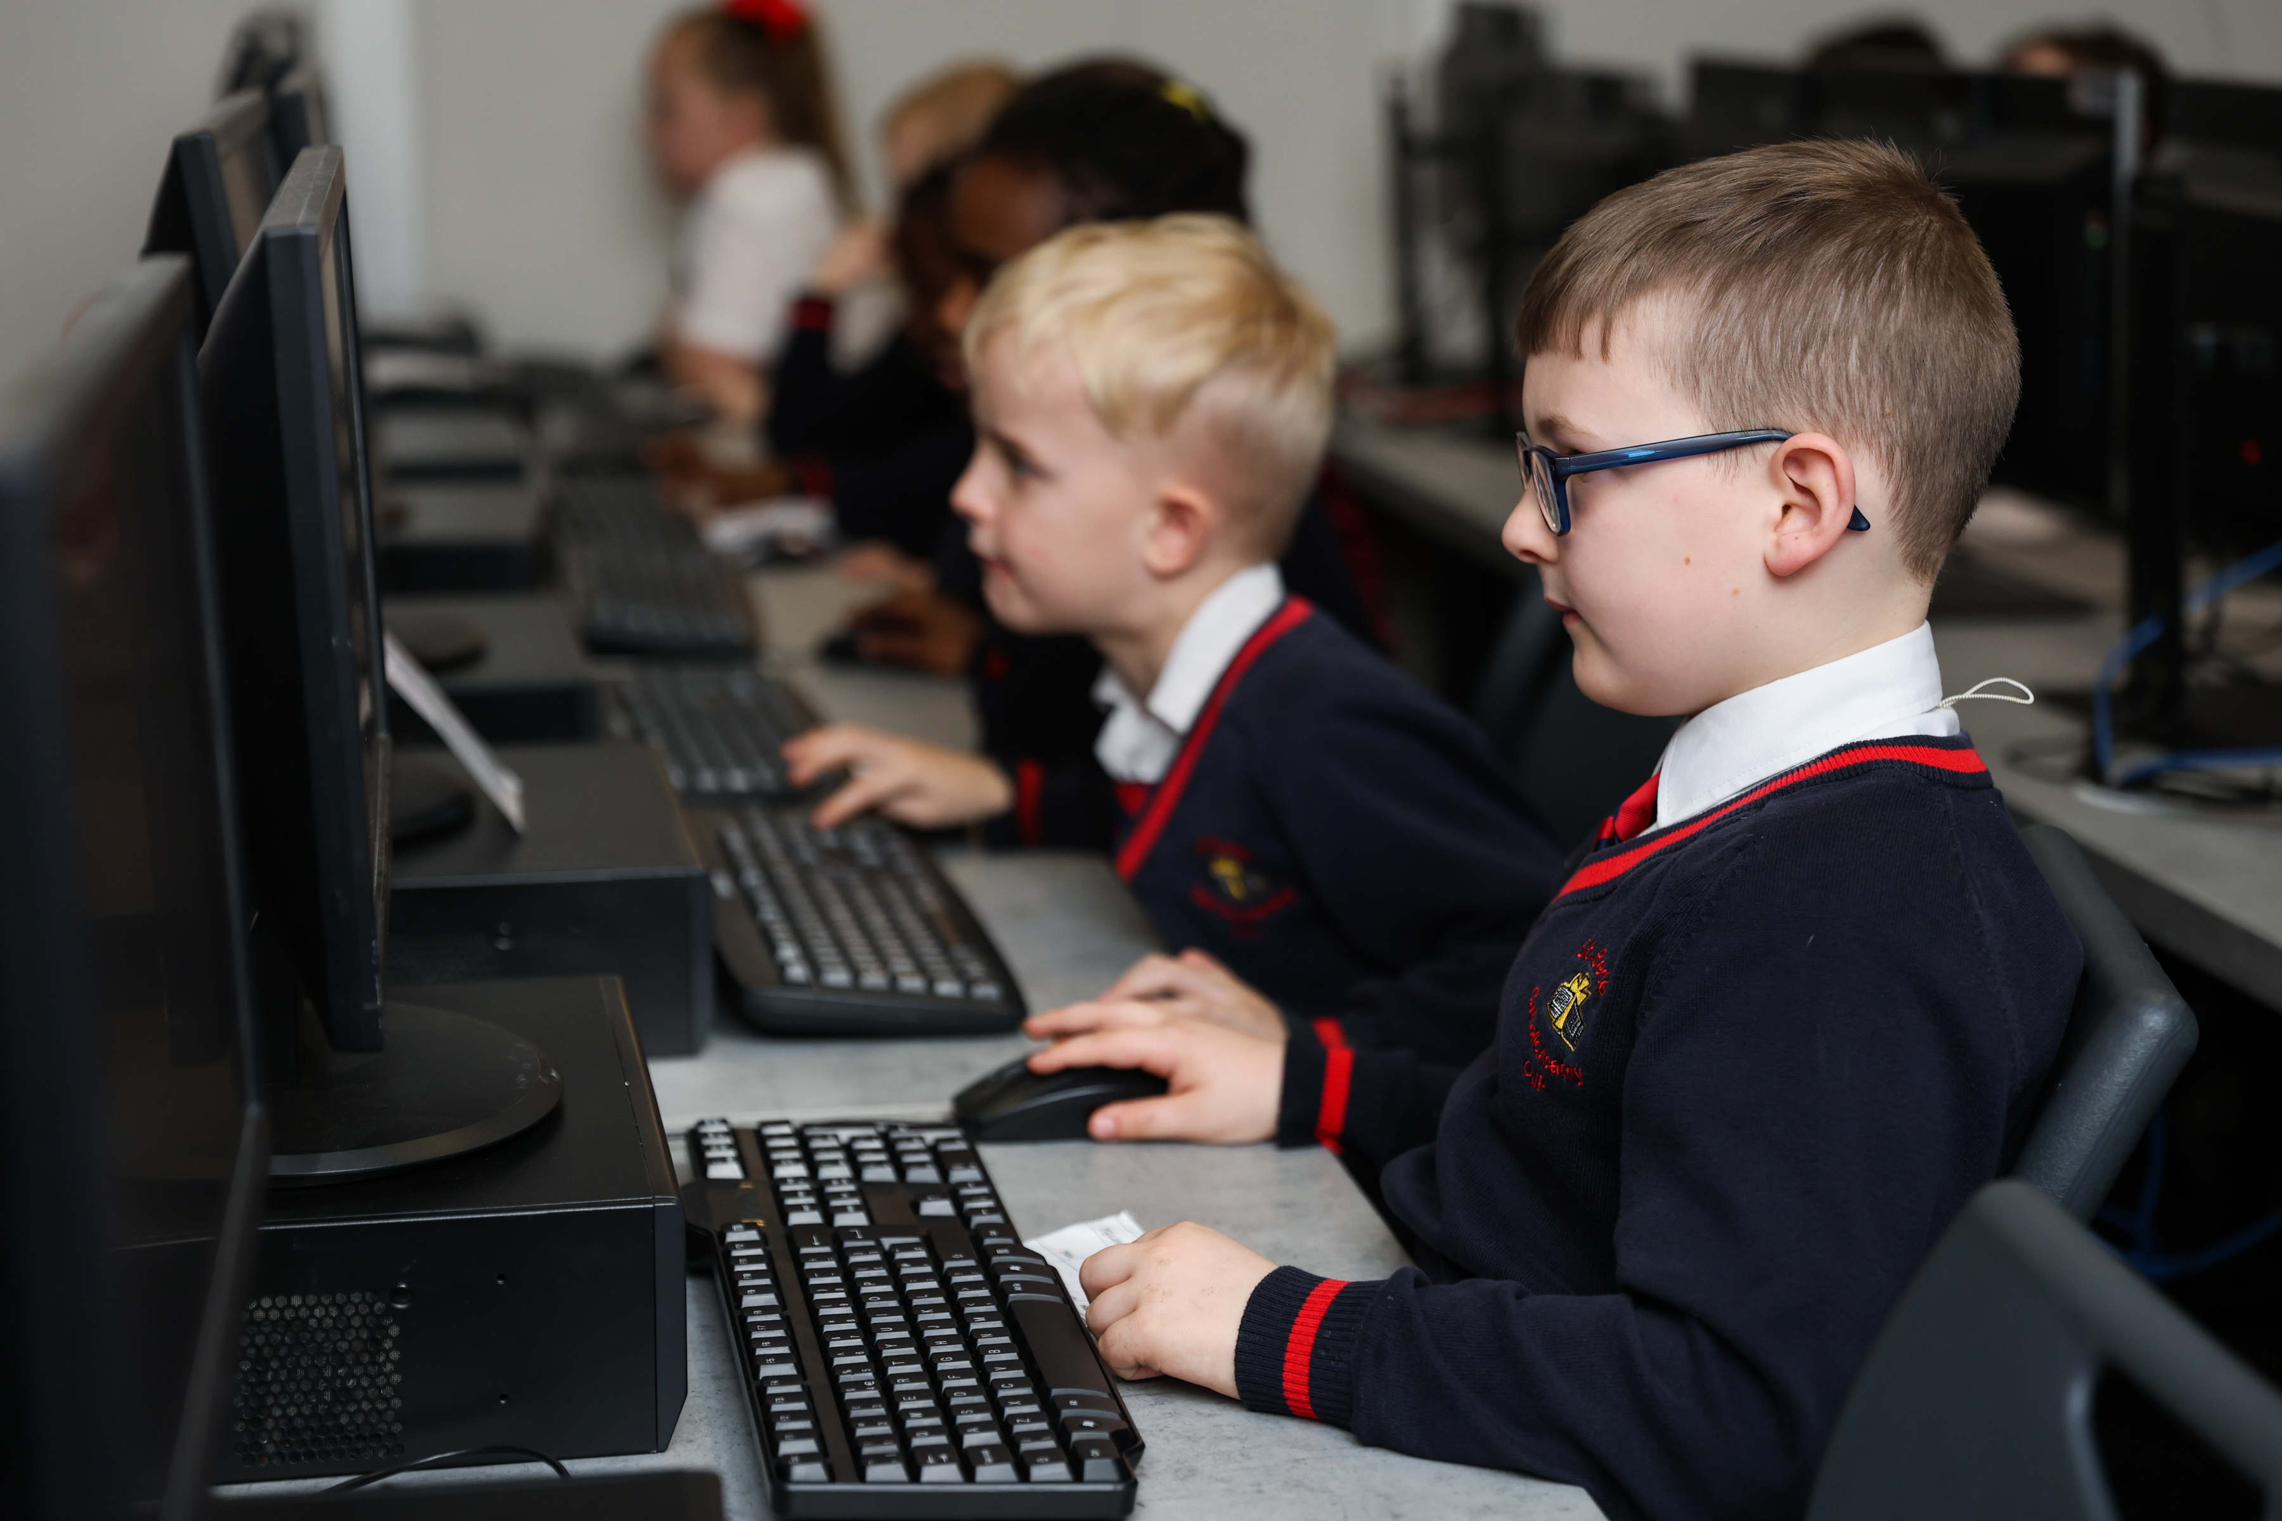
TEACHING AND LEARNING
Deliberate teacher habits enable pupils to develop independent learning behaviours. At every stage of learning pupils can be supported to achieve if they are able to choose strategies. They develop self-sufficiency by being taught a process through explicit modelling and teaching. Pupils develop strategies for themselves by recognising similarities and differences. When this move from dependence to independence occurs, pupils are successful and better equipped to face challenges.
We expect all teachers to aim for quality first teaching based on our pedological principles . This supports teachers in developing pupil independence. This framework helps teachers explicitly plan, deliberately shifting the responsibility from themselves to the pupil during a lesson or over a series of lessons and can be applied to different subject content at all phases and ages. We want the children to must of the thinking in lessons!
Interleaving/Retrieval
New Learning
Making Links
Regular review of learning
Together with Christ, we grow in faith and knowledge
Notes:
FINISHED – VC 20/02/24

Slide 22
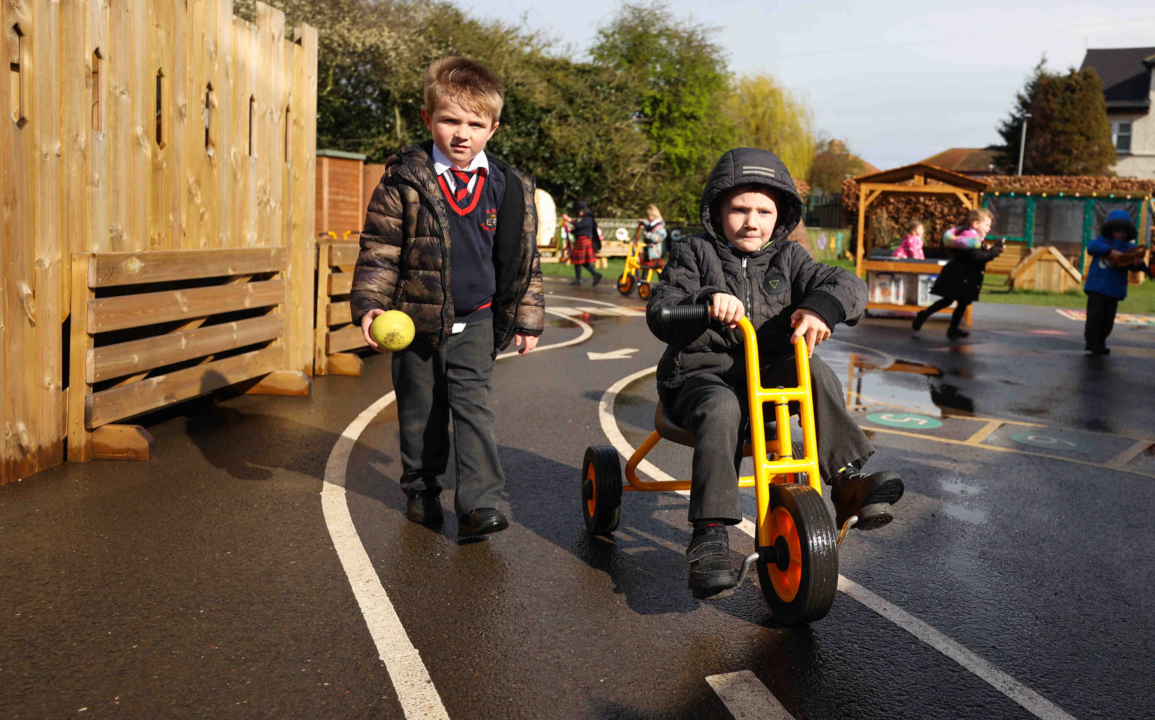
CURRICULUM IMPLEMENTATION
“Curriculum is the key lever and our best bet for disadvantaged learners.
This long-term investment is the golden ticket.”
- Dan Nichols
Pedagogy: Our Method And Practice Of Teaching at St Bede’s.
Effective adaptation which is scaffolding to meet the needs of all pupils.
Clear explanations and instructions, anticipating misconceptions from pupils.
High quality teacher input and modelling of working examples
Lessons build on prior knowledge and reference next steps. (interleaving and recall)
Reference to future learning so that children know how this lesson will help them in their future work.
A clear learning objective shared with the children visually and orally. (including new vocabulary)
Questioning to actively engage children through approaches such as Cold Calling; No opt Out; Say it again, better. These strategies include the use of signs, visual symbols, songs, rhymes, repetition (I say/you say) and mnemonics.
A clear and defined outcome (end point) which will be achieved by the end of the lesson.
Strategies of knowledge retrieval to help children know more and remember more.
A recap of learning throughout the lesson.
Making connections to prior learning and reflection of learning
Challenge for all children, and the expectation that all children can succeed, through guided practice. (groups, pairs and independently)
High expectations of behaviour for learning and all children being ‘learning ready’ at the beginning of, and throughout each lesson.
Children engaged in their learning throughout the whole lesson, no waiting or early finishers.
Transitions which are seamless and so that no learning time is lost.
Together with Christ, we grow in faith and knowledge
Notes:
FINISHED – VC 20/02/24

Slide 23
TEACHING AND LEARNING
“Narrowing of the curriculum for less able pupils … clearly runs counter to the definition of breadth.”
- A Spielman
We expect to see these principles in every lesson. Lesson drop -ins and observations proformas explicitly reference these key principle of highly effective lessons.
Lessons are to have these key elements to reduce cognitive load/ help pupils to know more and remember more:
Lessons build on prior knowledge and reference next steps. (interleaving and recall)
Challenge for all children, and the expectation that all children can succeed, through guided proactive and adaptive teaching.
High quality teacher input with reference to objective and new learning with excellent modelling of working.
Questioning to actively engage children through approaches such as Cold Calling; No opt Out; Say it again, better. These strategies include the use of signs, visual symbols, songs, rhymes, repetition (I say/you say) and mnemonics.
Making connections to prior learning and reflection of learning
A recap of learning throughout the lesson.
Together with Christ, we grow in faith and knowledge
Notes:
FINISHED – VC 20/02/24

Slide 24
TEACHING AND LEARNING
Presentation & Handwriting
High expectations need to be maintained including the use of cursive writing. Where necessary, there needs to be opportunities to practice and develop fluency and speed writing in pen when they have demonstrated proficiency. Correct spelling, punctuation, and good grammar will be expected and corrected using the marking criteria. All work should be dated, titled and underlined(by teacher or pupil). All pupils should practice using a ruler The following principles apply to all pupils but some adaptations are made based on their age and abilities. Subject specific guidelines are within our teaching and learning policy.
In all written work, pupils should be reminded to:
• Write the long date on the top line of the page in regular sized writing: e.g., Tuesday 1st September 2023.
• LO and title are not required.
• A line is left between date and title/LO.
• A line is left between title/LO and start of work.
• Start writing from the left-hand side/next to the margin on every page.
• A learning objective should not be written by the child in KS1 or SEND children in KS2.
• Poor letter formation will be always be addressed by teacher/TA.
• Teachers to model correct handwriting style in books and on board.
• Practise and improve their ruler and underlining skills on a regular basis.
• Draw one straight line through any mistakes made, ensuring they don’t cross out or scribble over any errors and ensure they don’t use an eraser on their work. Teachers/TA will rub out only.
• Children will write neatly, following the school’s handwriting formation from ‘Letter-join’ in all their work.
• Complete all their written work in pen, once they have been awarded their pen license for neat and sustained and fluent formation.
• Always use pencil when drawing, constructing tables, diagrams and charts.
• No free drawing in science, geography or history books.
Homework
Homework must be purposeful, relevant, and designed to support learning. It should be carefully planned to consolidate understandings positively, and not overly burden pupils.
Common homework activities are reading, practice in spellings and number facts. Other effective strategies include extended activities to develop inquiry skills. The quality of the tasks is more important than the quantity of work required. Homework, on most occasions, must relate closely to learning during school time.
“The highest effects are associated with rote learning, practice or rehearsal of subject matter.”
-Tom Sherrington and John Hattie
Together with Christ, we grow in faith and knowledge
Notes:
FINISHED – VC 20/02/24

Slide 25
TEACHING AND LEARNING
Learning Environment
Our classrooms reflect our Catholic identity and our high expectations.
The focal point of each room is the sacred space, which is changed according to the Liturgical year.
An attractive and high-quality reading area illustrates our commitment to promoting the children’s love of reading.
Our classrooms are tidy, well organised, and clutter-free and set the culture for high quality learning.
Children’s tables are arranged so that children can work in groups. However, in certain circumstances, it is appropriate for them to be arranged differently-and there is a clear rationale behind this.
Displays are current, interactive, aspirational and attractive with a reasonable balance between displaying children’s work and providing prompts for learning. We use artefact to support learning where possible.
All classrooms have: ‘Working Walls’, English prompts (e.g.: letter formation, vocabulary, and grammar prompts), Maths prompts (e.g.: number bonds, times tables, place value). They will also display question prompts and fundamental of lesson design. We also have boards relating to the current history , geography and science topics.
All classrooms will have quality reading areas and a display of the classes reading spine/river.
All resources should be motivating, attractive and accessible. Teachers do not rely heavily on worksheets.
Shared Areas
All shared areas are tidy, well organised, and clutter-free.
Displays in corridors and other shared areas should be current and reflect the curriculum.
“The highest effects are associated with rote learning, practice or rehearsal of subject matter.”
-Tom Sherrington and John Hattie
Together with Christ, we grow in faith and knowledge
Notes:
FINISHED – VC 20/02/24

Slide 26
TEACHING AND LEARNING
Marking and Feedback and a assessmnet
Timely and constructive feedback in the learning process is crucial. Feedback practices that are specific and actionable contribute significantly to a pupil's overall success. The primary purpose of marking and feedback is to enhance learning and progress by providing constructive guidance.
Fidelity through consistent and effective practices across all phases is essential. Summative pieces of work will be marked promptly, allowing pupils to reflect on feedback and apply it to future assignments. We ensure that feedback is acted upon.
Formative and summative assessments will be used to evaluate pupil progress. Formative assessments provide ongoing feedback, while summative assessments measure overall achievement.
A balanced approach ensures a comprehensive understanding of pupil performance. In summative pieces of work teachers will highlight strengths, identify areas for improvement, and suggest strategies for enhancement. Comments will be clear and encouraging, fostering a positive learning environment.
Formal assessments in literacy and numeracy are completed termly, termly pupil progress meetings monitor the progress and attainment of all pupils. Termly predictions are made for children based on are related expectations and attainment of disadvantaged children is always compared to non disadvantaged children. We deliver timely and bespoke interventions for those children who are identified as not making sufficient progress.
Assessment in the foundation subjects is less formal . We have core knowledge that we use to check the children's learning . We revisit and retrieve previous knowledge in each lesson. We adapt where appropriate . Our curriculum and close monitoring of teaching standards helps tries to ensure “gapless instruction”
“The highest effects are associated with rote learning, practice or rehearsal of subject matter.”
-Tom Sherrington and John Hattie
Together with Christ, we grow in faith and knowledge
Notes:
FINISHED – VC 20/02/24

Slide 27
ADAPTIVE TEACHING
EEF’s Five-a-Day principles:
The curriculum is designed for whole-class delivery but is adapted by teachers to meet individual needs, particularly for pupils with SEND. These pupils are exposed to the same learning as their peers, with adaptations made to how they demonstrate their understanding. Scaffolding strategies, such as sentence starters, writing frames, vocabulary banks, and visual prompts, are employed to ensure all pupils can access and meet the same learning objectives. Both reactive and proactive adaptations are used to make the curriculum achievable for everyone, allowing all pupils to reach ambitious end points and enhance their knowledge retention.
A comprehensive list of adaptation techniques and suggestions is available for teachers to utilise.
Scaffolding
A metaphor for temporary support that is removed when it is no longer required. This requires effective assessment to gain a precise understanding of the pupil’s current capabilities.
Examples: support can be visual, verbal, or written; writing frames, partially completed examples, knowledge organisers, sentence starters; reminders of what equipment is needed and classroom routines. Scaffolding discussion: promoting prediction, questioning, clarification and summarising.
Use of Technology
Can assist teacher modelling. Technology, as a method to provide feedback to pupils and/ or parents can be effective, especially when the pupil can act on this feedback.
Examples: use a visualizer to model worked examples. Technology applications, such as online quizzes; speech generating apps to enable note-taking and extended writing can be helpful.
We are exploring the use of AI within the classroom currently. We see the use of AI by staff and children as inevitable. AI would be used as curator not as a creator of content.
Cognitive and Metacognitive Strategies
Skills like memorisation techniques or subject specific strategies like methods to solve problems in maths. Metacognitive strategies help pupils plan, monitor and evaluate their learning
Examples: chunking the task will support pupils with additional needs – this may be through provision of checklists, instructions on a whiteboard or providing one question at a time. This helps reduce distractions to avoid overloading working memory. Prompt sheets that help pupils to evaluate their progress, with ideas for further support.
Explicit Instruction
A range of teacher-led approaches, focused on teacher demonstration followed by guided then independent practice, for example.
Examples: worked examples with the teacher modelling self-regulation and thought processes is helpful; a teacher might teach a strategy for summarising a paragraph by initially ‘thinking aloud’ while identifying the topic of the paragraph to model this process to the pupil. They would then give the pupil the opportunity to practise this skill; using visual aids and concrete examples promotes discussion and links in learning.
Flexible Grouping
When pupils are allocated to smaller groups based on individual needs that they currently share with others. Such groups are formed for an explicit purpose/disbanded when that purpose is met
Examples: allocating temporary groups can allow teachers to set up opportunities for collaborative learning, for example to read and analyse source texts, complete graphic organisers, independently carry out a skill, remember a fact, or understand a concept. Pre-teaching key vocabulary, is a useful technique.
Together with Christ, we grow in faith and knowledge
Notes:
FINISHED – VC 20/02/24

Slide 28
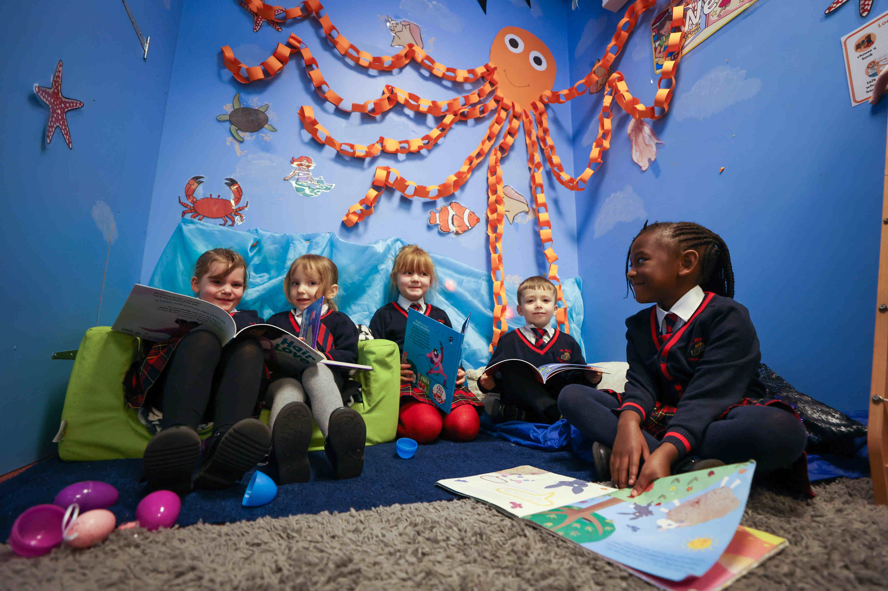
CURRICULUM & ASSESSMENT GUIDING PRINCIPLES
“Among the conditions we would routinely provide for our pupils are a clear and sequenced curriculum that sets out the learning aims, diagnostic assessment to ensure prerequisites are secure, models of excellent performance, scaffolding, guidance, opportunities for practice and, crucially, feedback that guides next steps and indicates progress.”
- The Great Teaching Toolkit
The curriculum is the sum of all the pupils' experience. This encompasses all of the activities which take place in schools, including the formal programme of educational provision, the informal programme of extra-curricular activities and those aspects of organisation and interpersonal relationships, which contribute to the development of the whole child.
We are committed to ensuring each school develops a highly ambitious, broad, and balanced curriculum that prepares learners to take an active part in society, in line with Catholic Social Teaching and develop a love of learning. The curriculum will be tailored around a school’s local context and rooted in our faith. This will be underpinned by a robust assessment strategy to support all learners in developing a deep understanding of the taught curriculum, ensuring pupils know more and can remember more. Our approach will be evidence informed. Our curriculum extends the National Curriculum and will show coherence in a planned sequence of learning, identifying threshold concepts within subjects.
Together with Christ, we grow in faith and knowledge
Notes:
FINISHED – VC 20/02/24

Slide 29
CURRICULUM & ASSESSMENT GUIDING PRINCIPLES
Assessment comprises two linked processes:
Formative Assessment:
provides Assessment for Learning and Assessment as Learning. It is a continuous process and an integral part of teaching and learning; informal observations, dialogue/effective use of questioning, consolidation activities, low stakes quizzing, routine marking; and pupil/peer assessment all contribute to the developing profile of progress.
Summative Assessment:
provides Assessment of Learning and is a judgement of attainment at key points throughout the year- using past knowledge to measure attainment and progress. Examples of this are standardised tests, tasks and end of term/annual assessments which include a sample of pupil’s prior learning.
Assessment is a continuous process which is integral to
teaching and learning, which:
Enables an informed judgement to be made about a pupil’s understanding, skills, attitude to learning and successful acquisition of knowledge as they move through the curriculum.
Provides feedback recognising achievement, increasing pupil confidence/motivation.
Incorporates a wide range of assessment techniques to be used in different contexts/purposes.
Allows leaders and staff to make timely adaptations to the curriculum.
Supports learning by making clear to pupils: what they are trying to achieve; what they have achieved; what the learning gaps and misconceptions are and what the next steps in learning are.
Allows regular subject specific extended writing and access to high quality text/ reading.
Should be moderated and standardised to ensure purposeful, meaningful, and timely feedback.
Includes feedback to pupils to help them understand what they need to improve, challenging them to achieve their target rather than a grade.
Is accompanied by clear assessment criteria that enables effective marking and feedback, a reliable progress evaluation to be given and demonstrates clearly what a pupil must do to improve.
Together with Christ, we grow in faith and knowledge
Notes:
FINISHED – VC 20/02/24

Slide 30
CURRICULUM & ASSESSMENT
We consider the greatest impact of the curriculum to be high rates of pupil achievement as evidenced by pupils’ classroom work, their ability to articulate their learning, balanced with performance data.
Our Curriculum Aims To Develop And Instil In Pupils:
Values, motivation, aspirations, and the moral imperatives in line with Gospel values and Catholic Social Teaching that inform their choices and actions.
The development of knowledge; progress in knowing more and remembering more.
The ability to apply; progress in knowledge applied in more challenging, relevant, and engaging ways, evidenced through pupils’ classroom work.
The acquisition of 21st century skills to translate knowledge into actions for success.
An understanding of how well they are doing and what they have to do to improve.
A love of reading for pleasure and the ability to read well.
Knowledge of, and the confidence to, articulate their learning.
Readiness and motivation to succeed in their next phase of learning.
The ability to write confidently in all subjects for a range of audiences, drawing upon a range of high-quality texts.
Monitoring Progress:
Formative Assessment:
All formative assessment must inform planning and ensure adaptive teaching. Assessment must provide a measure of where pupils are in their learning, their knowledge and skill gaps, and provide detailed feedback to pupils on how to close those gaps. Feedback must cause thinking. A grade or score should not be provided to the pupil.
Summative Assessment:
Summative assessments must be graded using examination board / DfE objectives and grade criteria. In primary schools, this includes standardised testing against age related outcomes.
Data will be collected at 3 key points across the academic year as agreed at whole Trust level.
In the secondary phase of education, KS2 scaled scores in Maths, English Reading, Writing and Grammar will be used to determine pupils’ KS4 aspirational targets.
Together with Christ, we grow in faith and knowledge
Notes:
FINISHED – VC 20/02/24
Finished

Slide 31
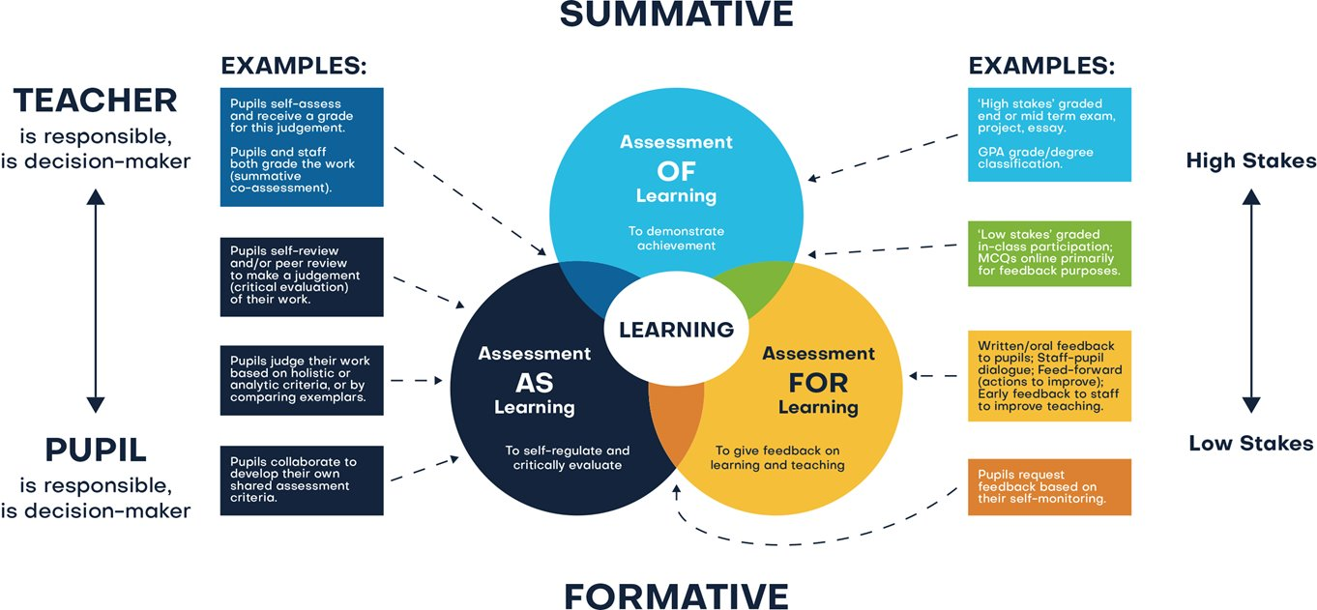
CURRICULUM & ASSESSMENT
We will report pupil progress through the curriculum, the knowledge,
and skills they have acquired, using the agreed terms:
An overview of the taught curriculum.
Pupil’s attitudes to learning.
In EYFS, pupil’s achievement in reaching a Good Level of Development including seventeen areas of development and the effective characteristics of learning.
Pupil’s attainment in KS1 and KS2, using working grades compared to age related expectations (ARE), working towards, expected, greater depth.
In Key Stage 1, pupil’s achievement in the Phonics Screening Check (PSC).
In Year 4, pupil’s achievement in the Multiplication Times Tables Check (MTC).
Pupil’s progress through KS3 using continuous assessment and working grades of Acquiring, Developing, Securing, Extending.
In KS4 and 5, assessment objectives, current working grades, and progress towards target grades.
Together with Christ, we grow in faith and knowledge
Notes:
FINISHED – VC 20/02/24
Finished

Slide 32
QUALITY ASSURANCE Summary
We are committed to continuous improvement inspired by the best evidence.
We expect leaders have a consistent approach to the quality assurance so they set appropriate, actionable feedback to ensure quality outcomes for all pupils.
Great teaching is the most important lever to improve pupil attainment. Ensuring all staff are supported to deliver great teaching is essential to achieving the best outcomes, particularly the disadvantaged, EEF
Quality Assurance activities
Pupil voice
Curriculum planning adapted to meet individual needs
Attainment and progress data analysis
Work sampling
Lesson visits
“True intuitive expertise is learned from prolonged experience with good feedback.”
- Daniel Kahneman
To evaluate teaching and inform professional development.
PROFESSIONAL DEVELOPMENT
Staff are entitled to be celebrated and have areas for development clearly identified, then be provided with access to relevant exceptional professional development.
A professional development programme that will provide opportunities for staff to participate in a variety of learning opportunities building whole school and Trust capacity.
Calendared quality assurance opportunities; two each term. Once per term it will include five key activities, one to four visited a second time each term.
An additional strand to quality assurance process is moderation involving all staff, it is focused on professional development. It takes place at a school and Trust level. The process is designed to allow staff a voice in sharing opinions on pupil work from across the curriculum.
“Professional learning happens when we think hard about our practice
and take full ownership of it.”
- Dr Tristian Stobie
Together with Christ, we grow in faith and knowledge
Notes:
FINISHED – VC 20/02/24

Slide 33
TIMETABLING
At St Bede’ we teach a broad and balanced curriculum for all pupils, which:
Promotes their spiritual, moral, social, cultural, mental and physical development;
Prepares them for the opportunities, responsibilities and experiences of adult life.
Curriculum Content |  | Religious Education |  |  | English |  |  | Mathematics |  | Science
PSHE (including RSE) | Geography |  | History | Physical Education |  | Art and Design | Design and Technology |  | Computing | Music | Languages
We use the National Curriculum as the foundation to our ambitious curriculum subjects, in addition to Religious Education. We customise this basic entitlement to learning to create our own distinctive and unique curriculum, guided by shared principles but personalised to our context and locality of the schools. The curriculum, in its entirety both taught and hidden, represents the whole of a child’s schooling experience.
To achieve effective transition between phases an agreed amount of content is necessary. The aim is to provide a breadth and depth of learning, with each stage building upon earlier learning. English and maths a priority, because they open access to other subjects. Rich and varied learning across all subjects is essential to pupil motivation and progress in school. Leaders decide upon and provide a rationale for the importance they give to all subjects. This is guided by government recommendations and the science of learning. We have a clear steer from current documentation as to the suggested time allocation for subjects.
To maximise children’s learning in a subject it is suggested that:
To have developed a clear and consistent approach completed in a timely manner.
 | RE (Religious Education) 2.5 hr x 39 weeks 97.5 hours / annual |  |  | English 4 lessons x 1.25 hr / wk 195 hours / annual NB: Additional time will be necessary for phonics/reading fluency/spelling teaching |  |  | Maths 4 lessons x 1.25 hr / wk 195 hours / annual NB: Additional time will be necessary for fluency on day 5 (15/20 mins)
Science | PSHE (including RSE) | Geography | History | Physical Education | Art and Design | Design and Technology | Computing | Music | Languages
63 hrs | 25 - 30 hrs | 20 - 24 hrs | 20 - 24 hrs | 78 hrs | 16 - 18 hrs | 16 - 18 hrs | 16 - 18 hrs | 36 hrs | 18 - 20 hrs
1.75hrs x 36 weeks | Weekly (30 - 45 mins) | Weekly/ fortnightly, 9wk block | Weekly/ fortnightly, 9wk block | Weeks (2hrs) | Weekly/ Fortnightly, 6 - 8 wk block | Weekly/ Fortnightly, 6 - 8 wk block | Weekly/ Fortnightly, 6 - 8 wk block | Weekly (45 mins - 1hr) | Weekly/ Fortnightly, 6 - 8 wk block
Some subjects will be taught for 39 weeks (English, Maths, RE, PSHE inc. RSE, PE).
Some subjects will be taught for 36 weeks (Science, MFL, Music).
Some subjects will be taught in blocks/fortnightly (History, Geography, Art, DT, Computing).
"At each stage of education, our school curriculum prepares pupils for adult life by equipping them with the knowledge and skills they need to be responsible, respectful, active citizens who contribute positively to society."
- Matt Bromley
Together with Christ, we grow in faith and knowledge
Notes:
FINISHED – VC 20/02/24

Slide 34
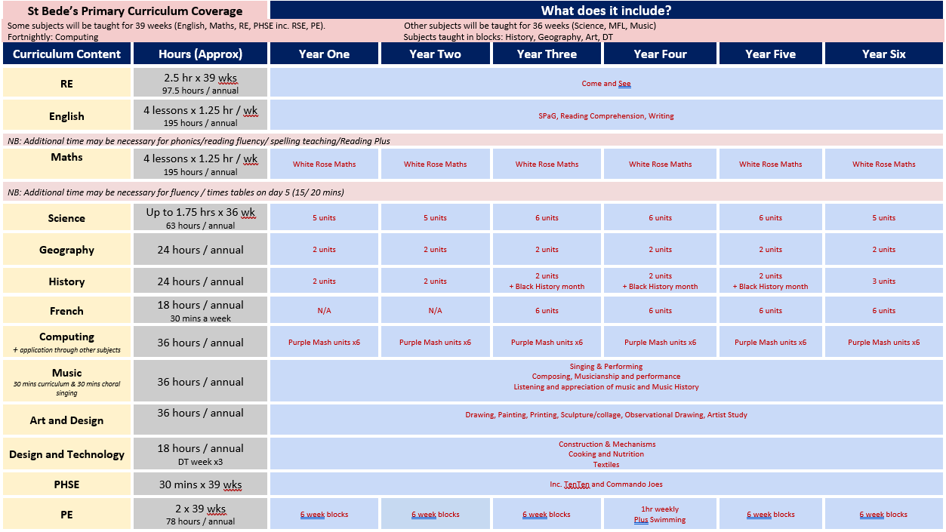
St Bede’s Curriculum coverage.
Together with Christ, we grow in faith and knowledge

Slide 35
TERMLY PLANNER
At St Bede’s we passionately believe that all should excel and so we work together in partnership to achieve great things.
Our schools and central team work collaboratively, we seek to achieve cohesion.
Our workload commitment sets the expectation for what we stand for and sets out our commitment in relation to staff workload and wellbeing.
This supports our overall mission of putting Christ at the Centre, Children at the Heart.
To support our workload commitment, we have worked with colleagues to develop our transparent approach to curriculum design.
We will continue to quality assure staff workload and wellbeing with the aim of being the employer of choice.
We have a whole school curriculum map that oversea the curriculum plan for each year group over the academic year. It identifies links with Catholic Social Teaching, opportunities for field work and explicit reinforcement of fundamental British Values. We identify in our whole school curriculum map links with planned future learning or previous learning.
.
Where possible it is coherently organised ensuring that well organised and purposefully designed to facilitate learning. We believe it is free of academic gaps and needless repetition.
Together with Christ, we grow in faith and knowledge
Notes:
FINISHED – VC 20/02/24

Slide 36
READING, WRITING & ORACY SUMMARY
Reading is one of our most important and vital life skills. Reading allows to access information, understand it and apply it. We use reading, spoken and silent, to develop our communication, writing, presentation. It expands our imagination and creative thinking. Reading teaches us how to listen and be empathetic, it improves our well-being. Teaching children to read is fundamental to their educational achievement. We are committed to giving disadvantaged pupils the same sense of entitlement and opportunity to read for academic purposes and pleasure, as their peers. We have a detailed reading strategy in place that explains how we teach reading across the school.
We will develop academic excellence in all schools through:
A love of reading for pleasure, with a rigorous approach to develop confidence and enjoyment of literacy.
A language-rich environment, in relation to the different tiers of vocabulary.
All staff to confidently model excellent habits in reading, writing and communication.
A highly targeted support programme for pupils who have gaps in reading, writing and communication.
Access to high quality stimulating and challenging reading materials for pupils.
Regular opportunities to develop writing across the sequenced curriculum, linked to quality books.
Seamless transition between key phases.
We explicitly teach and model good oracy skills Pupils encouraged to reason, discuss, debate and present with increasing skill using varied and precise vocabulary. Opportunities for high qukity oracy is evident in most lessons.
“Fluent reading supports comprehension because pupils’ cognitive resources are freed from focusing on word recognition and can be redirected towards comprehending the text.”
- EEF
Reading and writing and oracy are combined. Reading helps pupils gain knowledge, developing comprehension and fluency which leads to better writing. Writing opportunities are provided in all subjects to deepen pupils’ understanding.
Together with Christ, we grow in faith and knowledge
Notes:
FINISHED – VC 21/02/24

Slide 37
READING, WRITING & COMMUNICATION SUMMARY
Learning to read is a highly complex undertaking that is underpinned by two fundamental processes:
Word reading through the decoding of words and recognition of words.
Comprehension of texts through a range of knowledge and skills.
It is the skilled combination of these two dimensions that facilitates all reading success (EEF).
“Reading, writing, vocabulary, speaking, listening, debate…the complex tapestry of great teaching, enacted in every lesson, in every phase and subject domain, by every teacher.”
- Alex Quigley
Teachers strive daily to secure pupils’ understanding of language comprehension and word recognition by:
Having a highly considered reading spine which aligns to the curriculum
Frequent (Tier 2) and complex (Tier 3) vocabulary is prioritised across the taught curriculum
Pupils are given opportunities to apply this vocabulary in writing, in all subjects.
Explicit and systematic teaching of phonics through a DfE validated programme
Daily phonics sessions (EYFS/KS1), pupils who require phonics intervention to enable them to keep up.
Spelling, grammar and punctuation are taught explicitly to improve reading, writing and oracy.
Parents are encouraged to help their children become confident, fluent readers and writers.
“Books expose children to more facts and to a broader vocabulary than virtually any other activity; people who read for pleasure enjoy cognitive benefits throughout their lifetime.”
- Daniel Willingham
All subjects will:
Have a range of non-fiction texts developing subject specific (disciplinary) reading and writing.
Have reading and writing opportunities integrated into sequences of learning.
Have structured questioning to develop reading comprehension and vocabulary.
“Pupils who struggle to read struggle in all subjects.”
- Nick Gibb (DFE)
Impact
Development of reading, writing and communication in relation to starting points.
Pupils’ love of reading and writing for pleasure, having the skills to confidently express themselves.
Outcomes at statutory assessment points.
Together with Christ, we grow in faith and knowledge
Notes:
FINISHED – VC 21/02/24

Slide 38
MATHS SUMMARY
Numeracy means understanding how mathematics is used in the real world and being able to apply it to make the best possible decisions. It involves interpreting charts, data and graphs, processing information, solving problems, understanding and explaining solutions, as well as, making decisions based on logic and reasoning. To thrive in life, all students need to be given the opportunity to master their numeracy skills, not just in mathematics but across the curriculum. All schools are committed to this common goal.
"Good numeracy is the best protection against unemployment, low wages and poor health.”
- OECD
At all phases of education, we will develop academic excellence in schools through:
Rigorous approach to develop learners’ confidence and enjoyment of numeracy.
Coherently sequenced cross-curricular maths.
Forensic approach to ensure highly targeted, adaptive teaching supported by intervention closes gaps.
Consistent approach to teaching efficient mathematical methods and language.
Careful selection of concrete and pictorial representations.
Rigorous mathematical fluency through efficient, accurate recall of number facts and procedures.
Regular opportunities to demonstrate reasoning skills, developing metacognition/ critical thinking
A seamless and aspirational transition between year groups.
Follow a coherent curriculum that builds on the knowledge and skills of the pupil’s prior learning.
Use assessment and prior data to plan for pupil progress
.Use adaptive teaching strategies to ensure that pupils can access the same challenging content.
Use consistent mathematical methods and language
Together with Christ, we grow in faith and knowledge
Notes:
FINISHED – VC 21/02/24

Slide 39
MATHS SUMMARY
All mathematics staff and leaders should:
Provide support and advice to ensure that there is a consistent approach.
Provide information to staff with regards to common misconceptions that pupil’s experience.
Utilise opportunities to include links to mathematical content from other subjects.
Identify pupils that require numeracy intervention and any gaps in knowledge.
All staff should:
Actively participate in whole school numeracy initiatives.
Ensure that they use correct mathematical notation, vocabulary and consistency of approach.
"Mathematics is essential to everyday life, critical to science, technology and engineering and necessary for financial literacy and most forms of employment. A high-quality mathematical education therefore provides a foundation for understanding the world.”
- DfE 2022
Monitoring Progress
Pupils’ progress is monitored through the following strategies:
Calendared quality assurance opportunities.
Progress across phases through use of question level analysis.
Regular assessment resulting in data-driven interventions.
Mathematical moderation at a subject, school and trust level.
Impact:
These principles ensure that all pupils leave education with:
Knowledge and skills which have been built through a coherent curriculum from EYFS to KS2+.
The numeracy skills and confidence necessary to be a full contributor to society and the economy.
A love of numeracy and a full appreciation of its importance in everyday life.
Independence and resilience when facing life situations, particularly those involving finances.
The impact of early life numeracy disadvantage eliminated, and the numeracy gap closed.
Confidence and competency in all forms of mathematical fluency.
Ability to use their reasoning skills and problem-solving strategies in everyday situations.
Together with Christ, we grow in faith and knowledge
Notes:
FINISHED – VC 21/02/24

Slide 40
EYFS GUIDING PRINCIPLES
GUIDING PRINCIPLES FOR THE EARLY YEARS FOUNDATION STAGE (EYFS) BASED ON STRONG FOUNDATIONS
Every child must make progress and no child will be left behind. Research shows that high quality education lays the groundwork for future success, including academic achievement and wellbeing.
Child-Centred Approach:
EYFS curriculum is designed around the child. Every child is unique and learns at their own pace, with regular direct teaching from the adults. Ther is a good mix between this and aqisition of foundational knowledge such as handwriting and writing simple sentences.
Play-Based Learning:
Play is essential for children’s development. The EYFS curriculum encourages learning through play, providing opportunities for children to explore, experiment, and make sense of the world. We are cautious however and understand that many of our children enter school at a great disadvantage. We focus on the acquisition of early literacy and numeracy skills and have a more formal approach at the start of the school day. We are aware of the inappraite use of play based learning. .
Inclusive Practice:
EYFS curriculum promotes equality and diversity. It ensures that all children, regardless of have the opportunity to learn and develop to their full potential.
Partnership with Parents:
Parents and carers are recognised as children’s first and most enduring educators. We have strong partnerships with parents/carers to support children’s learning and development. Our expectations are shared early and attendance of all children in EYFS is monitored, and poor attendance is challenged.
Safe and Secure Environment:
The EYFS curriculum emphasises the importance of providing a safe, secure, and supportive environment where children feel confident to learn and grow.
Holistic Development:
The EYFS curriculum supports the holistic development of children. It covers all areas of learning, including physical, social, emotional, and cognitive development.
STAFFING
Ratio for 2–3-year-olds is
1:5 (Sept 2023 Statutory Framework)
Ratio for 3+ is 1:13 (with classroom teacher/EYT/EYP)
1:8 with level 2+
Ratio for 2–3-year-olds is 1:5
(Sept 2023 Statutory Framework)
ASSESSMENT
Key worker carries out the 2-year check (around 30 months) – assessment sent to Health Visitor and LA.
Together with Christ, we grow in faith and knowledge
Notes:
FINISHED – VC 21/02/24

Slide 41
EYFS GUIDING PRINCIPLES
The Strong Foundations guidance published in October 2024 supports our EYFS offer.
We explicitly teach foundational knowledge children will need later. We do not overload children with activities that do not focus on helping children build fluency in key foundational skills . Learning is not left to chance ; our children enter school at a low level and need intensive support to acquire key skills. We are very aware that where children have the opportunity to choose if they take part in an activity they opt out.
Our EYFS teachers design the curriculum to ensure gaps are closed rapidly.
We offer 30 hours nursery provision
ASSESSMENT:
A baseline assessment will take place within first 6 weeks of entering nursery, we do not over rely on recording evidence. This is detrimental and prevents teachers and Tas delvering high quality lessons
Ongoing Assessment: assessment should be an ongoing process that identifies children’s needs, interests, and achievements. It should inform future teaching.
Holistic Approach: assessment should cover all areas of learning and development in the EYFS. It should consider the child as a whole.
Informed by Observation: assessment should be based on practitioners’ observations of what children are doing in their play, learning, and development, without the burden of recording observations.
Partnership with Parents: parents should be given opportunities to contribute their knowledge and understanding of their child.
Individual Needs: assessment should take into account the individual needs and abilities of each child. We ask do gaps in knowledge for the lowest attaining children persist and what can done about this?
Progress Check: there should be a progress check at age two. This is a statutory requirement and involves practitioners reviewing a child’s progress and providing parents and carers with a written summary.
Early Learning Goals: at the end of the EYFS, practitioners must complete the EYFS Profile for each child.
HEALTH & WELFARE REQUIREMENTS:
Safeguarding and Welfare Requirements: The EYFS framework sets out the legal welfare requirements that everyone registered to provide early years education must follow to safeguard and promote the welfare of children under 5 years old.
Good Health: Children’s health is promoted.
Schools must have an Intimate Care Policy which includes a nappy changing procedure and provide a changing area (preferably within the classroom) with adequate storage for nappies and an appropriate changing unit.
Safe Learning Environment: Children learn best when they are healthy, safe and secure, when their individual needs are met, and when they have positive relationships with the adults caring for them.
Schools must have a Risk Assessment specifically for the EYFS classrooms including outdoors.
Together with Christ, we grow in faith and knowledge
Notes:
FINISHED – VC 21/02/24

Slide 42
GLOSSARY OF TERMS
Interleaving - a short knowledge retrieval session at the start of a lesson The knowledge revisited will have been previously been taught; allowing links between old and new learning. In some cases, interleaving is informed by assessment.
Learning objective - a brief statement that describes what pupils are expected to learn.
Modelling - the foundation of effective teaching; revealing the thought processes of an expert learner helps to develop metacognitive skills. Teachers verbalise their metacognitive thinking (‘What do I know about problems like this? What ways of solving them have I used before?’) as they approach and work through a task. Scaffolded tasks, such as worked examples, allow pupils to develop their metacognitive and cognitive skills without placing too many demands on their working memory.
Guided practice - promotes and sustains confidence once a scaffold is removed. Support is gradually withdrawn, allowing pupils to develop skills and strategies before applying them in independent practice.
Pupils will need varying amounts of guided practice.
Independent Practice - Activities should be designed, to provide adequate time to practice and embed knowledge, understanding and skills securely. This is typically shown in oracy/subject specific writing activities. Lack of challenge can lead to disengagement and conversely pitching a task to high without manageable steps can demotivate learners. Learning needs to be progressively more demanding whilst supporting those at risk of falling behind.
Self-regulated learners - are aware of their strengths, weaknesses and how to improve their learning. Learning tasks are approached with:
• knowledge of ourselves as a learner
• knowledge of strategies
• knowledge of the task
Assessment - the basis for making inferences about the learning and development of pupils.
Formative assessment,- conducted during the learning process, serves as a dynamic tool for continuous improvement. It offers timely feedback, identifies learning gaps, and guides instructional adjustments to meet individual student needs. This ongoing evaluation fosters a responsive and pupil centred environment.
Summative assessment - positioned at the conclusion of a unit or course, provides a comprehensive measure of overall achievement. It serves as a valuable indicator of students' mastery of content, contributing to accountability and grading systems. The combination of formative and summative assessments creates a balanced and effective evaluation system, promoting both real-time learning enhancement and a conclusive measure of academic proficiency. Embracing these assessment strategies ensures a holistic approach to education, catering to the diverse needs of learners while maintaining academic rigor.
Together with Christ, we grow in faith and knowledge
Notes:
FINISHED – VC 21/02/24

Slide 43
CURRICULUM & CULTURE
BISHOP HOGARTH
Catholic Education Trust
Together with Christ, we grow in faith and knowledge

