Slide 1
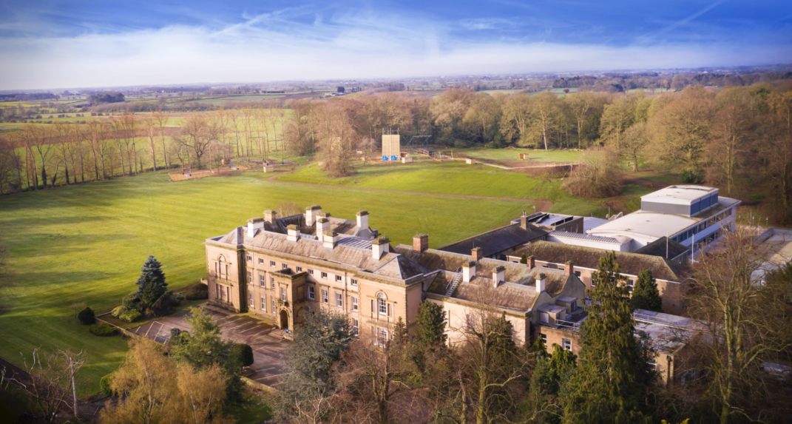
Newby Wiske Hall 6th-8th July
– Y6 Residential

Slide 2
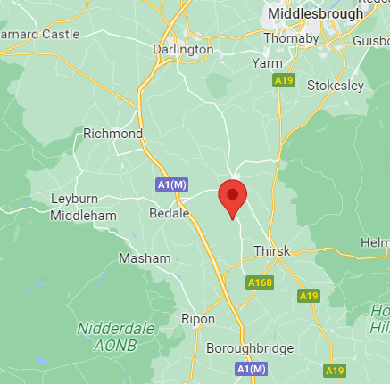
Monday 6th July: Bus leaves at: 12.00 pm approx.
Wednesday 8th July: Bus departs Newby Wiske at 1pm
Centre address
PGL Newby Wiske Hall
Newby Wiske
Northallerton
North Yorkshire
DL7 9EY
Notes:
Sweets for bus ok. These are collected and given out at appropriate times throughout the trip, as well as encouraging children to keep some for the way back, and out evening activities

Slide 3
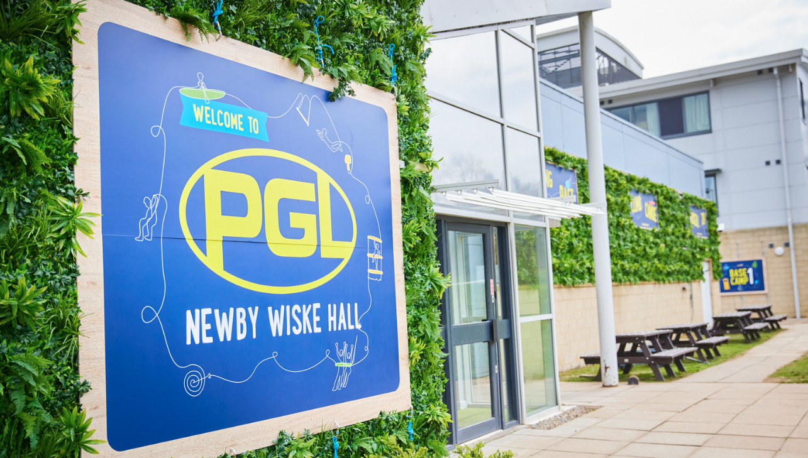
Let’s take a look around the centre:

Slide 4
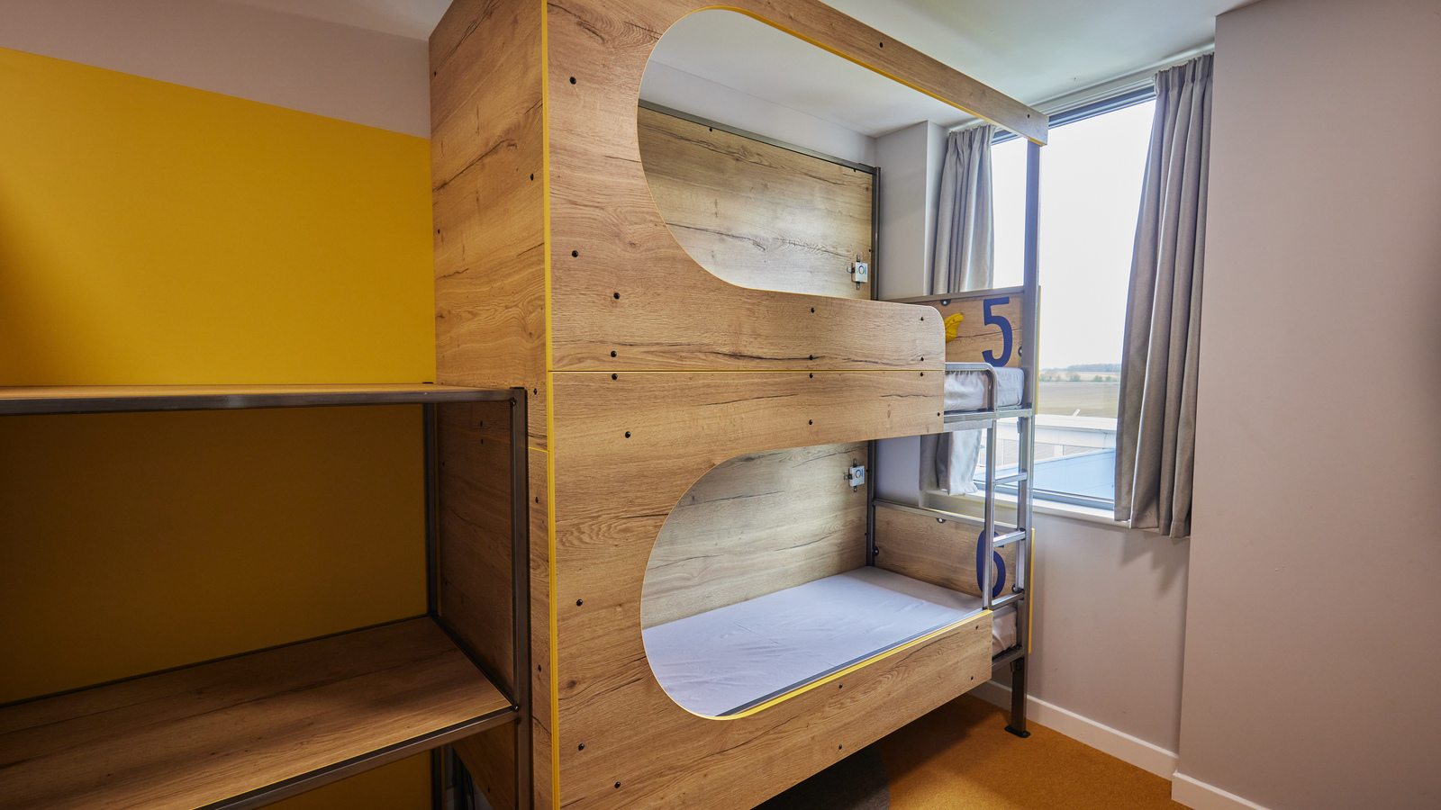
Bunk pods with storage

Slide 5
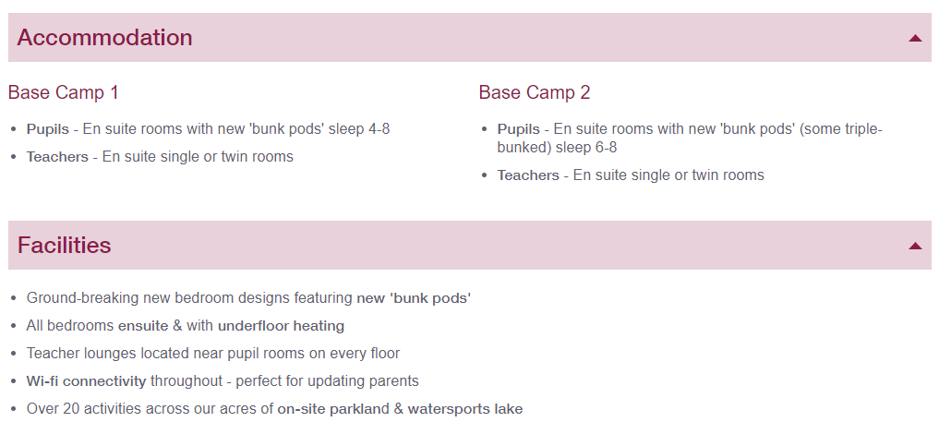

Slide 6
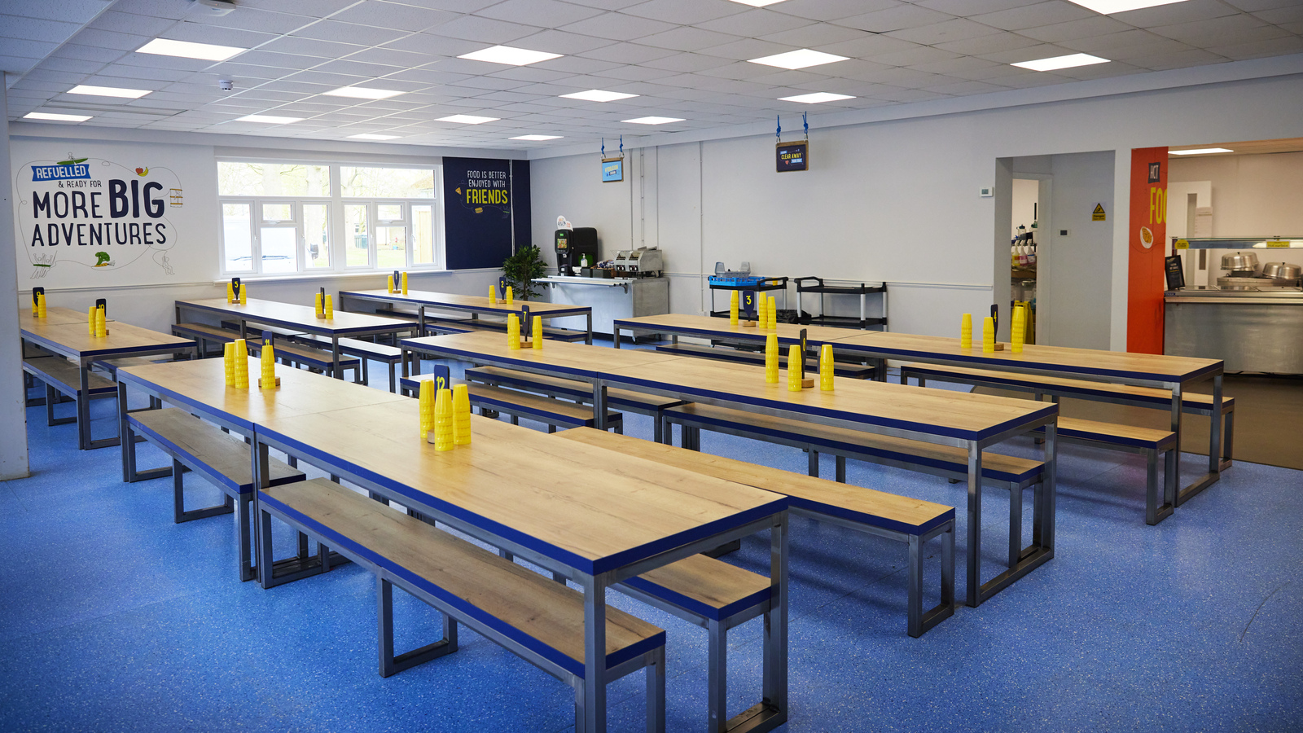
The Dining Room

Slide 7
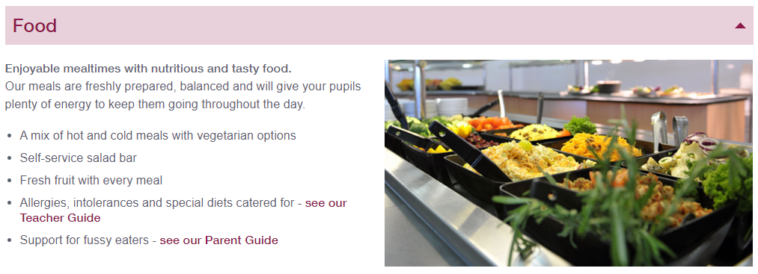
Example menu: https://www.pgl.co.uk/en-gb/school-trips/menus-and-food

Slide 8
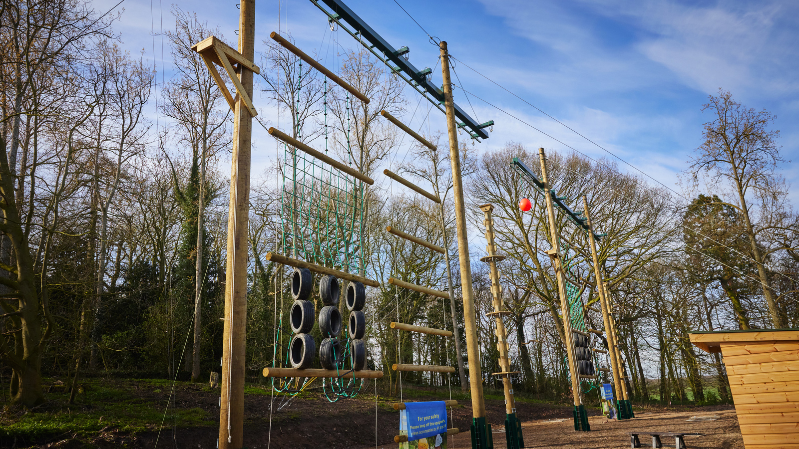
Vertical challenge and trapeze-based activities

Slide 9
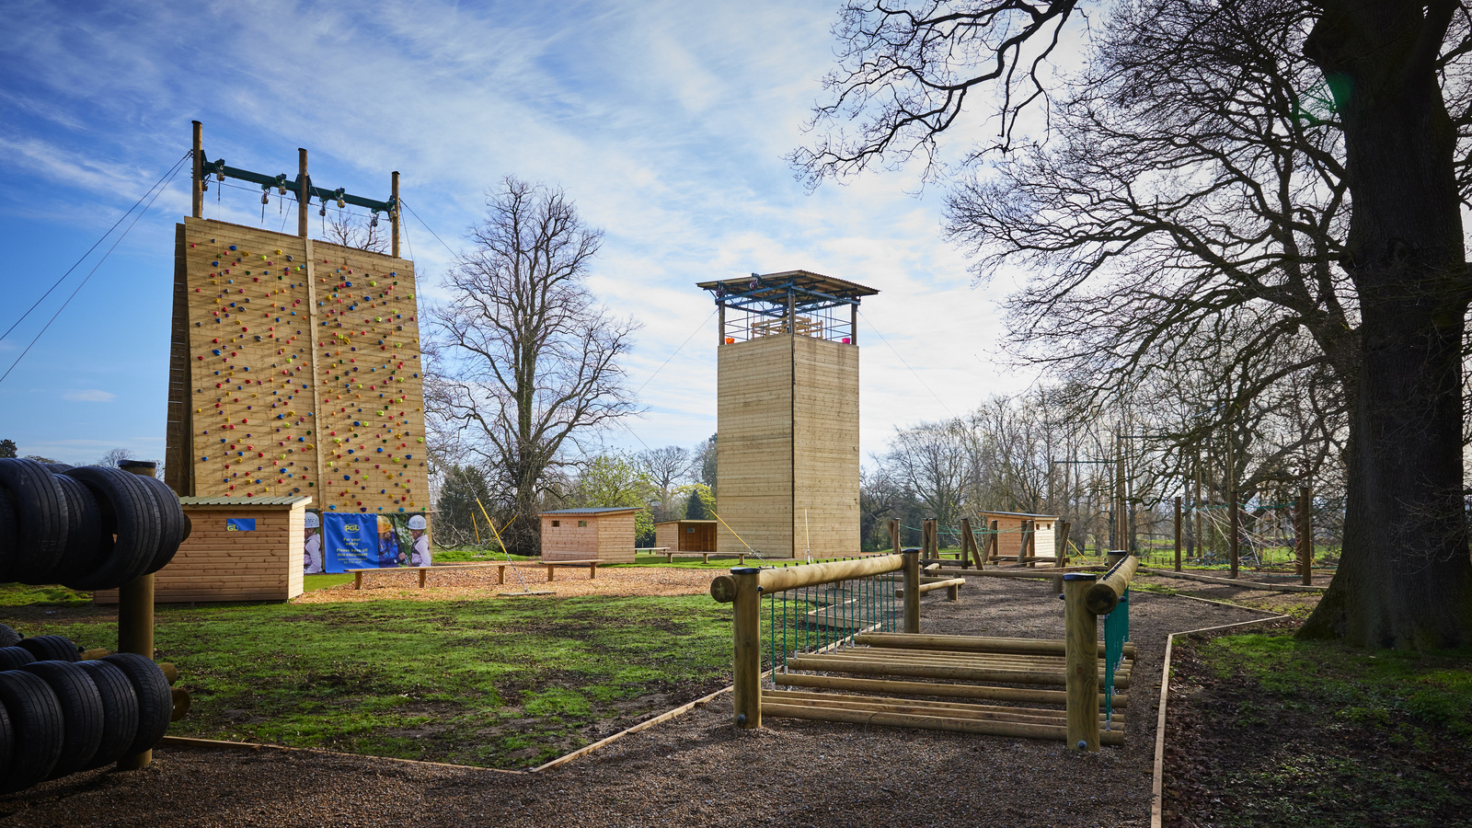
Brand new climbing wall and abseiling tower

Slide 10
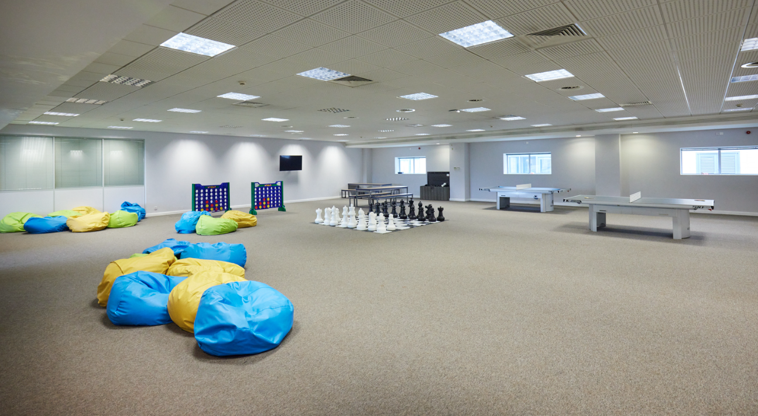
The Hive: one of the indoor activity spaces

Slide 11
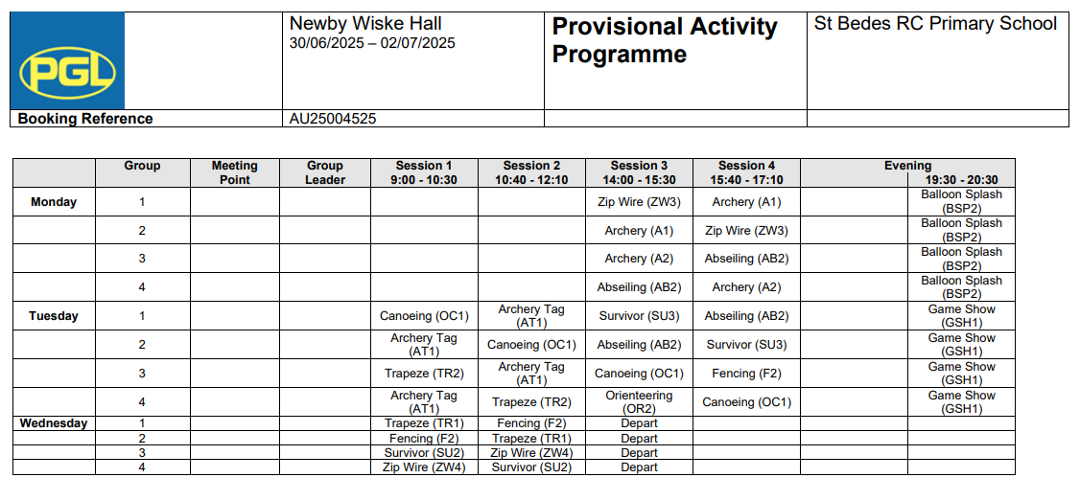
Example Activity Timetable

Slide 12
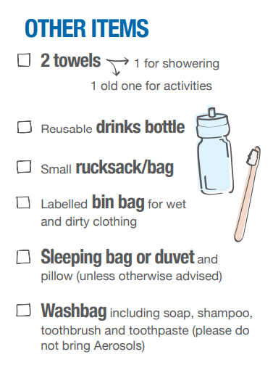
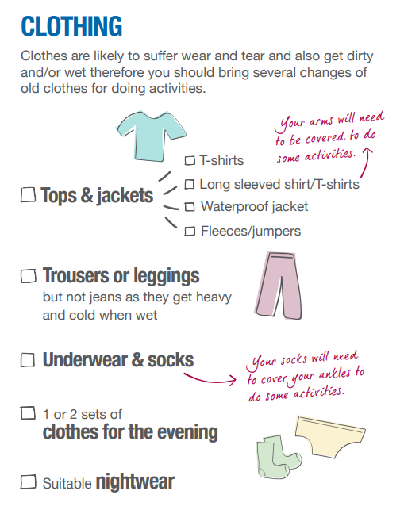
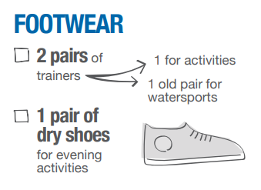

Kit List
In general we recommend old clothes - so it doesn’t matter if they get dirty or muddy!

Slide 13
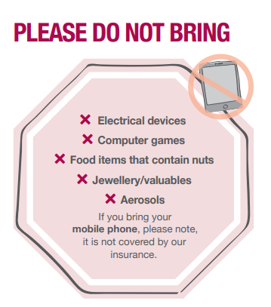
Notes:
We strongly recommend that all valuables such as mobile phones, computer games, jewellery etc. are left at home.
Mobile phones not covered by insurance, and for safeguarding purposes. Y6 staff will give regular updates, and we will send pictures to Facebook page. In case of emergency we have all contacts

Slide 14
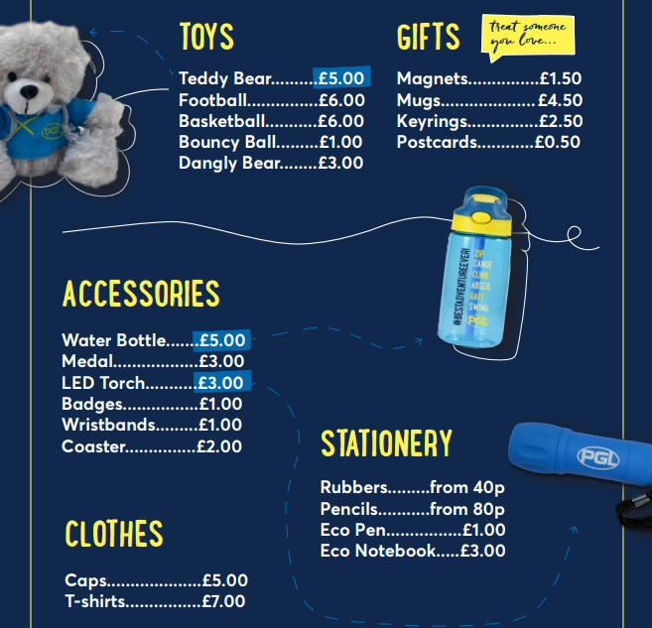
Pocket Money
Children are welcome to bring some pocket money with them for their stay. Our centres provide gift shops where they can purchase branded and non-branded goods, including stationery, T-shirts, caps and confectionery.
Please can we ask that children bring no more than £10.
Notes:
Collect money. Give out at appropriate time.

