Slide 1
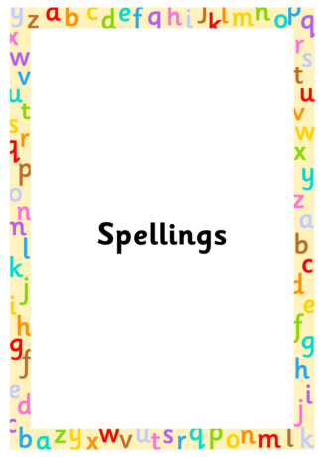

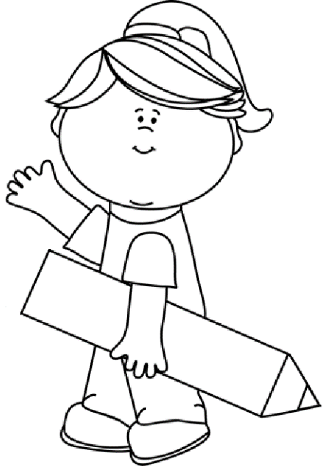
Autumn 1
Year 2
Weekly Spelling Booklet
Name:
Please return this book to school every Thursday.

Slide 2

Note to Parents
This book contains the spelling that your child needs to learn each week for this term. There are ten spellings to learn each week, taken from the phonics sounds that have been taught in class.
This book then needs to be returned to school every Friday, so child can complete their weekly tests in it. The book will then be sent home again on the Friday evening so you can see how well your child has done, and learn the following week’s spellings. Any assistance that you can give your child would be greatly appreciate.
Many Thanks
Mrs McHugh
Don’t forget to use spelling shed, where you can play games connected to each week’s spellings.
https://www.spellingshed.com/en-gb

Slide 3
Week 2
Date of test: Thursday 11th September
Unit 21 /ue/
Look and Say | Cover | Write 1st try | Check and Cover again | Write 2nd try | Check ✓
argue
due
huge
knew
new
stew
after
again
any
bath

Slide 4
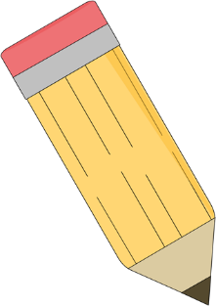
Test Page
This page will be completed at school.
1.
2.
3.
4.
5.
6.
7.
8.
9.
10.
My spelling score is ____
My arithmetic score is____

Slide 5
Week 3
Date of test: Thursday 18th September
Unit 23 /oy/
Look and Say | Cover | Write 1st try | Check and Cover again | Write 2nd try | Check ✓
boil
boy
choice
coin
joy
voice
beautiful
because
behind
both

Slide 6
Test Page
This page will be completed at school.
1.
2.
3.
4.
5.
6.
7.
8.
9.
10.
My spelling score is ____
My arithmetic score is____

Slide 7
Week 4
Date of test: Thursday 25th September
Unit 24 /ar/
Look and Say | Cover | Write 1st try | Check and Cover again | Write 2nd try | Check ✓
almond
Arthur
balm
car
smart
partner
break
busy
child
children

Slide 8
Test Page
This page will be completed at school.
1.
2.
3.
4.
5.
6.
7.
8.
9.
10.
My spelling score is ____
My arithmetic score is____

Slide 9
Week 5
Date of test: Thursday 9th October
Unit 24 /ar/
Look and Say | Cover | Write 1st try | Check and Cover again | Write 2nd try | Check ✓
calm
card
dart
father
jar
palm
Christmas
class
climb
clothes

Slide 10
Test Page
This page will be completed at school.
1.
2.
3.
4.
5.
6.
7.
8.
9.
10.
My spelling score is ____
My arithmetic score is____

Slide 11
Week 6
Date of test: Friday 18th October
Unit 25 /o/
Date of test: Friday 28th June
Look and Say | Cover | Write 1st try | Check and Cover again | Write 2nd try | Check ✓
bottle
cot
swat
wander
want
what
wash
could
cold
door

Slide 12
Test Page
This page will be completed at school.
1.
2.
3.
4.
5.
6.
7.
8.
9.
10.
My spelling score is ____
My arithmetic score is____

Slide 13
Week 7
Unit 27 /ae/ Date of test: Friday 25th October
Date of test: Friday 28th June
Look and Say | Cover | Write 1st try | Check and Cover again | Write 2nd try | Check ✓
aid
Amy
ape
weigh
vein
obey
late
even
everybody
eye

Slide 14
Test Page
This page will be completed at school.
1.
2.
3.
4.
5.
6.
7.
8.
9.
10.
My spelling score is ____
My arithmetic score is____

