Slide 1
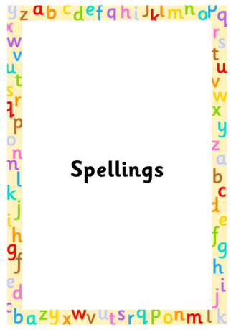
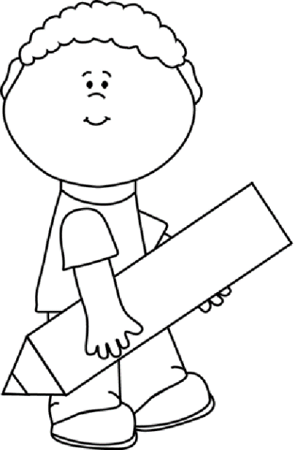
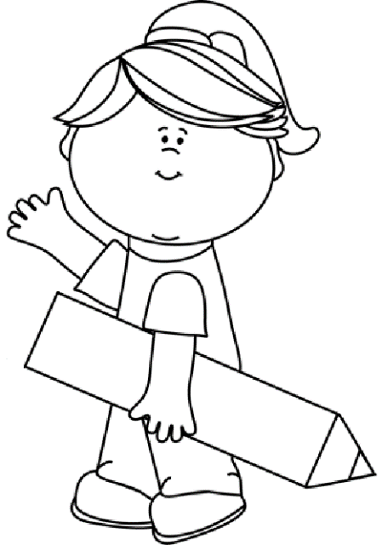
Autumn 2
Year 2
Weekly Spelling Booklet
Name:
Please return this book to school every Friday.

Slide 2

Note to Parents
This book contains the spelling that your child needs to learn each week for this term. There are ten spellings to learn each week, taken from the phonics sounds that have been taught in class.
This book then needs to be returned to school every Friday, so child can complete their weekly tests in it. The book will then be sent home again on the Friday evening so you can see how well your child has done, and learn the following week’s spellings. Any assistance that you can give your child would be greatly appreciate.
Many Thanks
Mrs McHugh
Don’t forget to use spelling shed, where you can play games connected to each week’s spellings.
https://www.spellingshed.com/en-gb

Slide 3
Week 1
/d/
Date of test: Thursday 7th November
Look and Say | Cover | Write 1st try | Check and Cover again | Write 2nd try | Check ✓
band
dressed
fiddle
looked
muddy
made
sound
fast
father
find

Slide 4
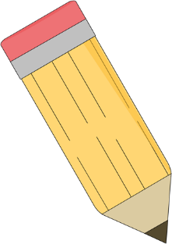
Test Page
This page will be completed at school.
1.
2.
3.
4.
5.
6.
7.
8.
9.
10.
My spelling score is ____
My arithmetic score is____

Slide 5
Week 2
/ee/
Date of test: Friday 14^{th November}
Look and Say | Cover | Write 1st try | Check and Cover again | Write 2nd try | Check ✓
Annie
be
bikini
breathe
bunny
chief
chimney
floor
gold
grass

Slide 6
Test Page
This page will be completed at school.
1.
2.
3.
4.
5.
6.
7.
8.
9.
10.
My spelling score is ____
My arithmetic score is____

Slide 7
Week 3
/ee/
Date of test: Thursday 21st November
Look and Say | Cover | Write 1st try | Check and Cover again | Write 2nd try | Check ✓
donkey
dream
eve
feet
field
flee
freeze
great
half
hold

Slide 8
Test Page
This page will be completed at school.
1.
2.
3.
4.
5.
6.
7.
8.
9.
10.
My spelling score is ____
My arithmetic score is____

Slide 9
Week 4
/i/
Date of test: Friday 28th November 2024
Look and Say | Cover | Write 1st try | Check and Cover again | Write 2nd try | Check ✓
biscuit
bin
build
grin
guilt
gypsy
his
hour
improve
kind

Slide 10
Test Page
This page will be completed at school.
1.
2.
3.
4.
5.
6.
7.
8.
9.
10.
My spelling score is ____
My arithmetic score is____

Slide 11
Week 5
/oe/ Date of test: Friday 5th December
Date of test: Friday 28th June
Look and Say | Cover | Write 1st try | Check and Cover again | Write 2nd try | Check ✓
alone
blow
boast
boat
cloak
cone
dough
last
many
mind

Slide 12
Test Page
This page will be completed at school.
1.
2.
3.
4.
5.
6.
7.
8.
9.
10.
My spelling score is ____
My arithmetic score is____

Slide 13
Week 6
/oe/ Date of test: Thursday 12th December 2025
Date of test: Friday 28th June
Look and Say | Cover | Write 1st try | Check and Cover again | Write 2nd try | Check ✓
Joe
loaf
most
mould
note
open
though
move
Mr
Mrs

Slide 14
Test Page
This page will be completed at school.
1.
2.
3.
4.
5.
6.
7.
8.
9.
10.
My spelling score is ____
My arithmetic score is____

Slide 15
Week 7
/n/ Date of test: Thursday 19th December
Date of test: Friday 28th June
Look and Say | Cover | Write 1st try | Check and Cover again | Write 2nd try | Check ✓
banner
done
gnash
knee
knew
nail
reign
old
only
parents

Slide 16
Test Page
This page will be completed at school.
1.
2.
3.
4.
5.
6.
7.
8.
9.
10.
My spelling score is ____
My arithmetic score is____

