Slide 1
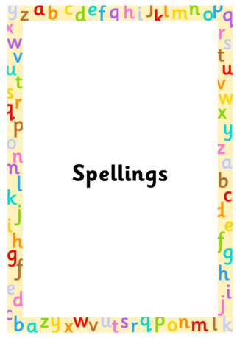

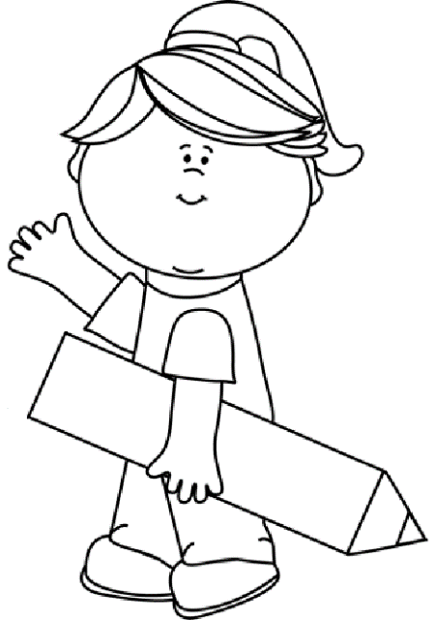
Spring 1
Year 2
Weekly Spelling Booklet
Name:
Please return this book to school every Friday.

Slide 2

Note to Parents
This book contains the spelling that your child needs to learn each week for this term. There are ten spellings to learn each week, taken from the phonics sounds that have been taught in class.
This book then needs to be returned to school every Friday, so child can complete their weekly tests in it. The book will then be sent home again on the Friday evening so you can see how well your child has done, and learn the following week’s spellings. Any assistance that you can give your child would be greatly appreciate.
Many Thanks
Mrs McHugh
Don’t forget to use spelling shed, where you can play games connected to each week’s spellings.
https://www.spellingshed.com/en-gb

Slide 3
Week 1
/n/
Date of test: Thursday 8^{th January}
Look and Say | Cover | Write 1st try | Check and Cover again | Write 2nd try | Check ✓
and
no
new
went
done

Slide 4
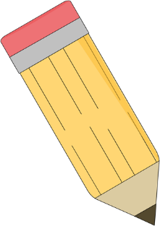
Test Page
This page will be completed at school.
1.
2.
3.
4.
5.
6.
7.
8.
9.
10.
My spelling score is ____
My arithmetic score is____

Slide 5
Week 2
/er/
Date of test: Thursday 15th Jan
Look and Say | Cover | Write 1st try | Check and Cover again | Write 2nd try | Check ✓
burn
burp
early
earn
enter

Slide 6
Test Page
This page will be completed at school.
1.
2.
3.
4.
5.
6.
7.
8.
9.
10.
My spelling score is ____
My arithmetic score is____

Slide 7
Week 3
/er/
Date of test: Thursday 22nd January
Look and Say | Cover | Write 1st try | Check and Cover again | Write 2nd try | Check ✓
first
stir
word
work
worm

Slide 8
Test Page
This page will be completed at school.
1.
2.
3.
4.
5.
6.
7.
8.
9.
10.
My spelling score is ____
My arithmetic score is____

Slide 9
Week 4
Date of test: Friday 29th January 2026
Look and Say | Cover | Write 1st try | Check and Cover again | Write 2nd try | Check ✓
any
bath
both
child
class

Slide 10
Test Page
This page will be completed at school.
1.
2.
3.
4.
5.
6.
7.
8.
9.
10.
My spelling score is ____
My arithmetic score is____

Slide 11
Week 5
/v/ Date of test: Thursday 5th February
Date of test: Friday 28th June
Look and Say | Cover | Write 1st try | Check and Cover again | Write 2nd try | Check ✓
vest
very
van
have
river

Slide 12
Test Page
This page will be completed at school.
1.
2.
3.
4.
5.
6.
7.
8.
9.
10.
My spelling score is ____
My arithmetic score is____

Slide 13
Week 6
/v/ Date of test: Thursday 12th February 2026
Date of test: Friday 28th June
Look and Say | Cover | Write 1st try | Check and Cover again | Write 2nd try | Check ✓
olive
Dave
give
vet
oven

Slide 14
Test Page
This page will be completed at school.
1.
2.
3.
4.
5.
6.
7.
8.
9.
10.
My spelling score is ____
My arithmetic score is____

Slide 15
Week 7
/oo/ Date of test: Thursday 19th February
Date of test: Friday 28th June
Look and Say | Cover | Write 1st try | Check and Cover again | Write 2nd try | Check ✓
you
who
Sue
into
brew

Slide 16
Test Page
This page will be completed at school.
1.
2.
3.
4.
5.
6.
7.
8.
9.
10.
My spelling score is ____
My arithmetic score is____

