Slide 1

Times tables Parent Workshop
Supporting your child at home

Slide 2
Aims for today
National expectations and wider importance
Year 4 times tables check
The teaching approach at St Bega’s
Supporting your child at home
Useful resources

Slide 3
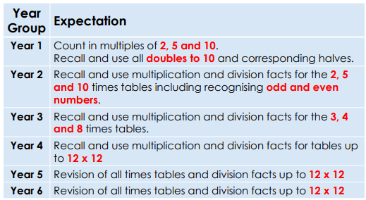
National Expectations
Knowing times tables quickly and fluently means that other areas of Maths taught in Y5 and Y6 are picked up easier.
Fractions, decimals, angles etc.

Slide 4
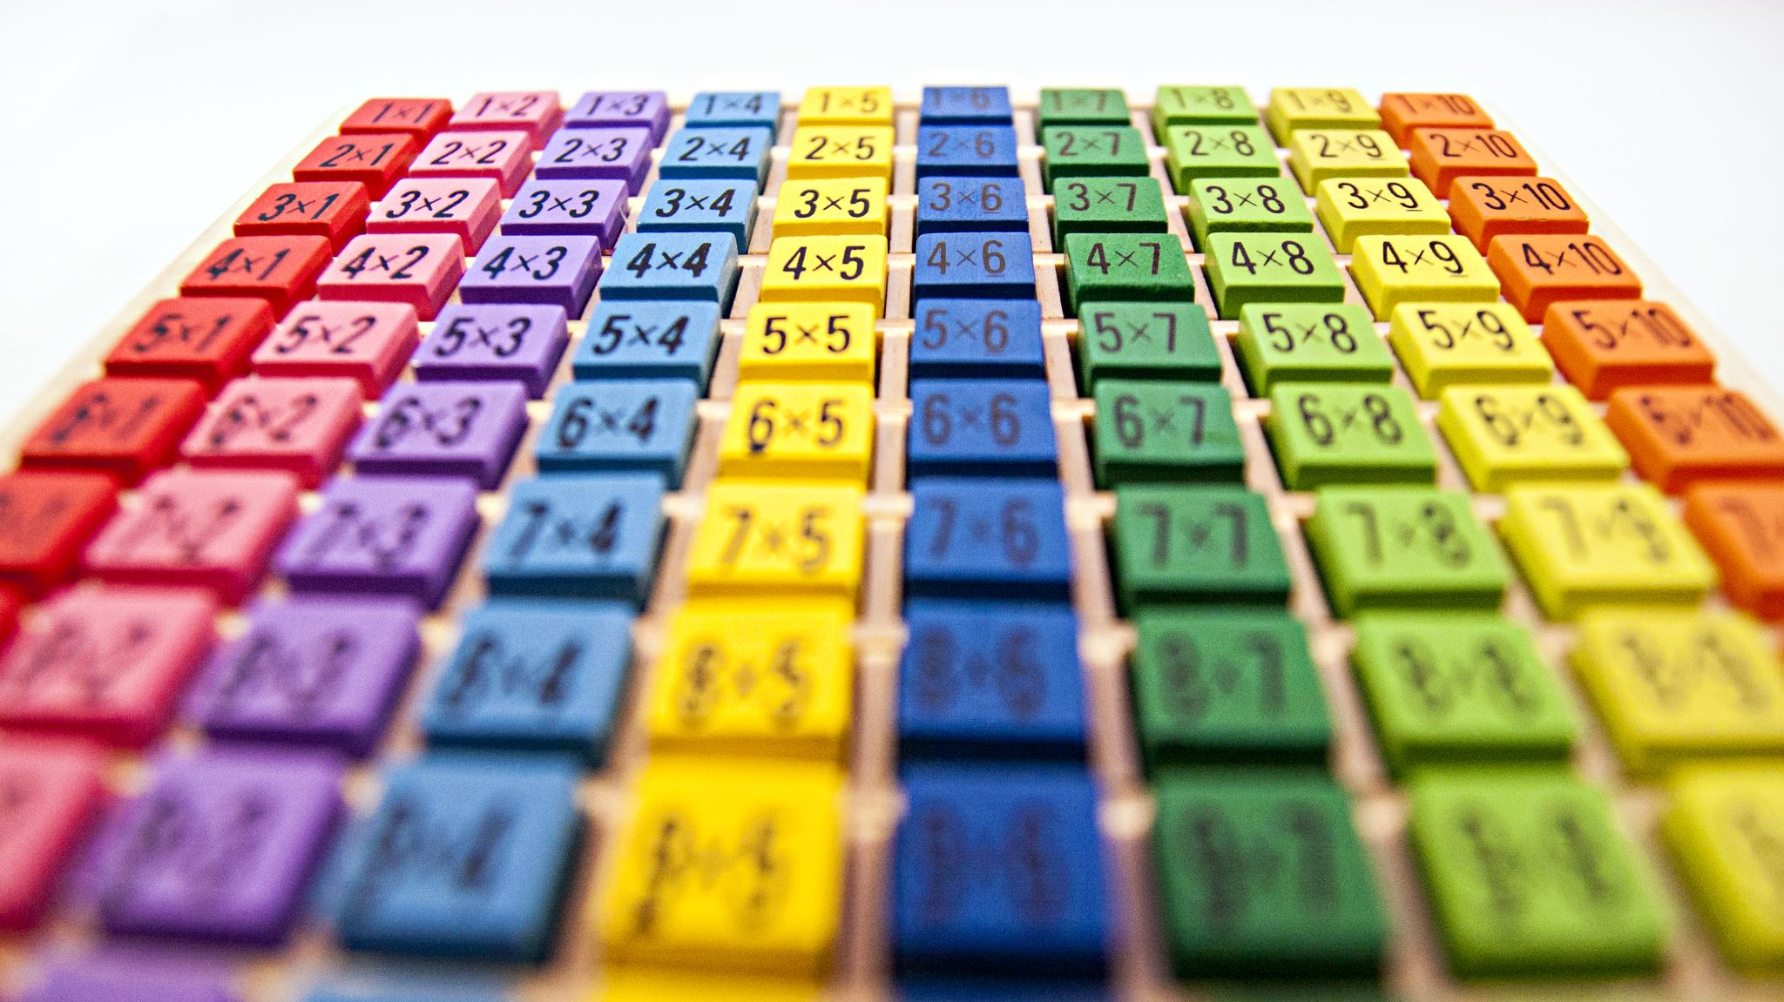
The Multiplication Tables Check (MTC)
The Multiplication Tables Check (MTC) will be administered to children in Year 4, from Monday 1st June. It is a statutory assessment.
The MTC determines whether Year 4 pupils can recall their multiplication tables up to 12 x 12 fluently as outlined in the National Curriculum.
Children will be tested using an ipad, where they will have to answer multiplication questions against a clock. The test will last no longer than 5 minutes; children will have 6 seconds to answer each question in a series of 25.
The results will be reported to the Department of Education.

Slide 5
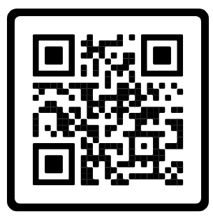
Have a go… https://www.timestables.co.uk/multiplication-tables-check/

Slide 6

Times tables knowledge underpins much of the primary Maths curriculum.
Mastering times tables and having the ability to quickly recall known facts is a necessary step to approaching more challenging topics as they progress through school.

Slide 7
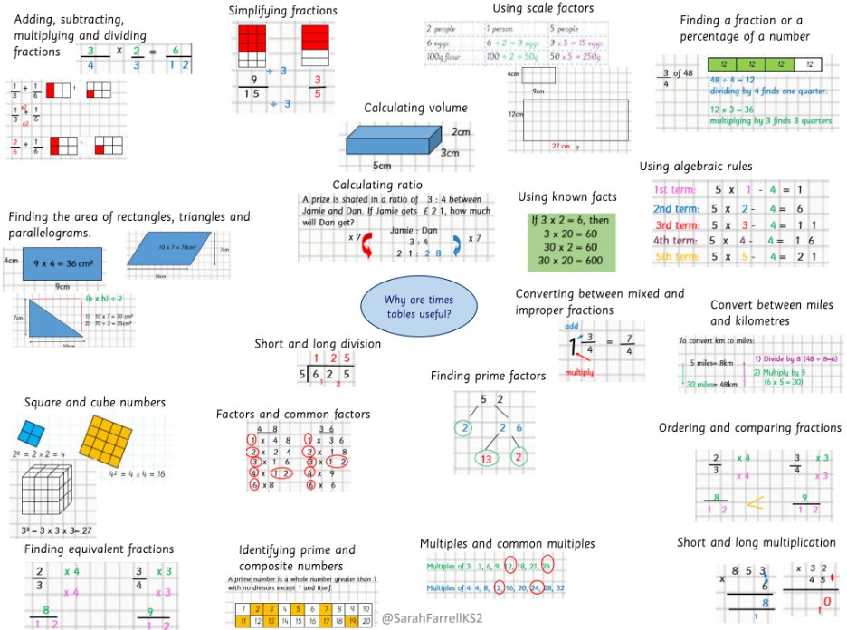
KS2 topics which require times tables knowledge.
Fractions
Decimals
Multiplication
Division
Area
Ratio
Square and cube numbers
Place value
Prime numbers
Common multiples
Factors

Slide 8

Numeracy in everyday adult life
We use numeracy every day in all areas of our lives. Our confidence and ability with numbers impacts us financially, socially, and professionally. It even affects our health and wellbeing.
Some examples of the ways we use Maths every day include:
Increasing a recipe to serve extra guests
Checking we've received the right change
Working out how much to tip in a restaurant
Setting and keeping to a budget
Helping children with homework
Managing our diet and nutrition
Measuring medicine doses
Making sense of statistics and graphs in the news

Slide 9
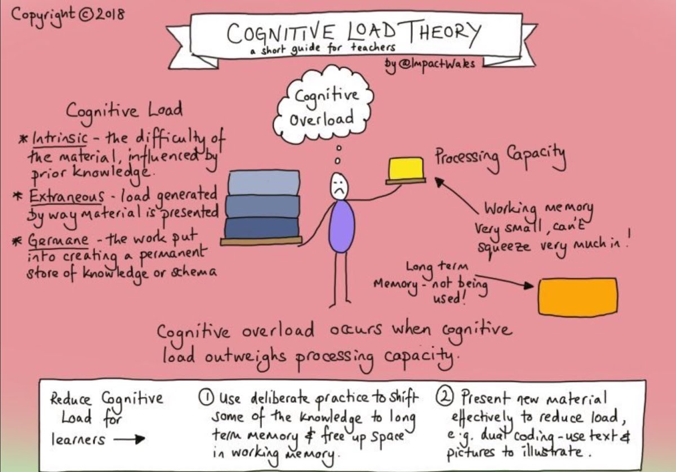

Slide 10
Cognitive Load and Times tables
Cognitive Load Theory states that learners have a limited capacity in their working memory, and we must not overload this.
This means that if pupils are having to work hard to recall or calculate times tables facts, they will have less capacity available to absorb new and more complex information.
Secure times tables knowledge ensures more capacity and a higher level of success when approaching new concepts in mathematics.

Slide 11
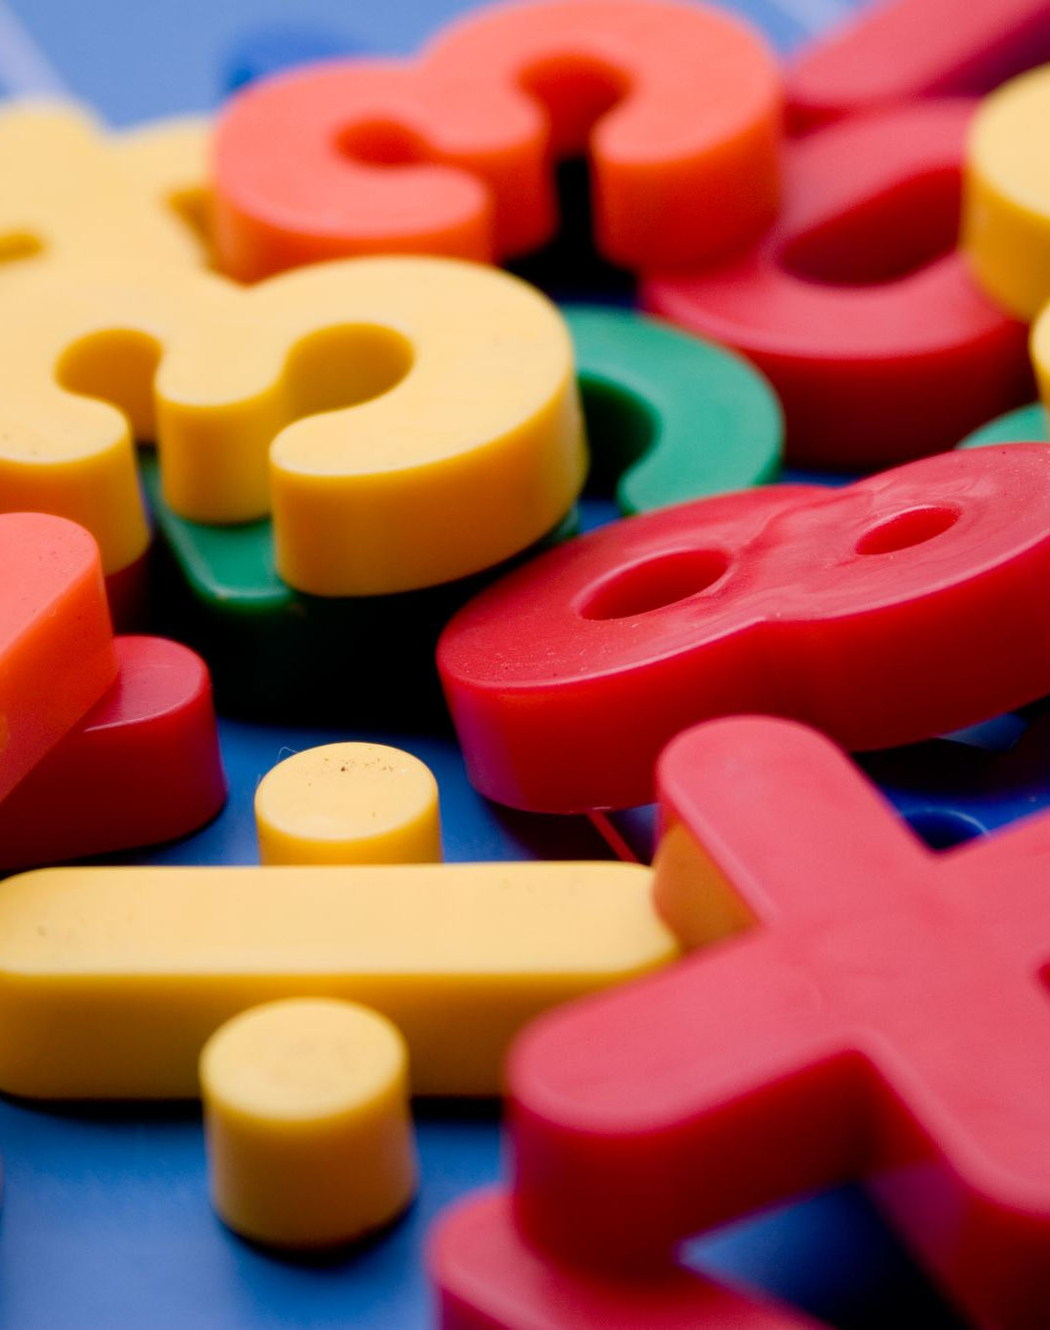
How we teach times tables at St Bega’s.
We use a programme called Mastering Number in EYFS, KS1 and Year 3 in which we aim to develop pupils number sense. This means the ability to spot patterns, use related facts to retrieve other information and be flexible with the knowledge they.
Times tables are taught at the start of every day for at least five minutes – little and often.
We use a range of activities – songs, pattern spotting, chanting, games, online resources – TTRS.
Notes:
If pupils are struggling with times tables knowledge in KS2, they face a real challenge to access the majority of the curriculum and they could be at risk of falling further behind their peers.
This issue will persist into secondary school if not addressed.

Slide 12

The Number Sense Approach
Pupils who find times tables difficult, tend to choose inefficient methods to retrieve facts. This increases cognitive load and slows the pace of learning.
For example: 1 8 X 6
8 x 6 … (unable to recall the fact)
Begins to skip count from zero using their fingers ( 0, 8, 16 …)
They are unsure of 8 x 3 so they count in ones from 16 (16, 17, 18, 19, 20, 21, 22, 23, 24).
This issue repeats until they have a correct answer.
The number of steps increases the likelihood of making a mistake and makes a relatively simple question much more complex.

Slide 13

The Number Sense Approach
By teaching patterns and exploring the relationships between different times tables and by learning all the associated division facts, we aim to equip pupils with the most efficient methods.
The order in which we teach times tables allows pupils to see the links between each times tables.

Slide 14
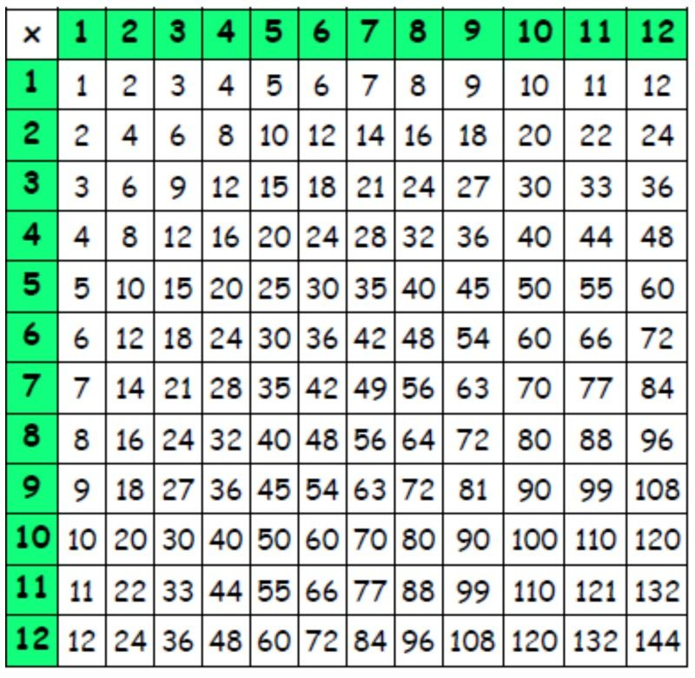
The order of the times tables is important.
When visualised, it can help children chunk their learning so that it is more manageable.

Slide 15
Understanding the meaning of operations and their relationships to each other.
4 x 6 = 24 so 6 x 4 =24
If 4 x 6 = 24 then 24 ÷ 6 =4
4 x 6 = 6+6+6+6
6 x 4 = 4+4+4+4+4+4

Slide 16
Being flexible and efficient
Knowing facts and how they relate to each other
If we know this what else do we know?
4 x 5 = 20 so I know 4 x 50 = 200
Molly has 2 baskets with 6 apples in each. How many apples does she have altogether?
** Do I need to know my 6 times table?**

Slide 17
11 and 12 times tables
If pupils have a secure knowledge of the 10 and 2 times tables, they can use this to help with the 12 times tables.
E.g. 12 x 8 = (10 x 8) + (2 x 8)
80 + 16 = 96

Slide 18
Associated facts 7 x 8 = 56
What associated facts do you know?
8 x 7 = 56
56 ÷ 8 = 7
56 ÷ 7 = 8
560 ÷ 7 = 70
70 x 80 = 5600 etc.

Slide 19
Spotting Patterns
What do you notice when you multiply an even number by 6?
6 X 2 = 12
6 X 4 = 24
6 X 6 = 36
6 X 8 = 48
6 X 10 = 60
6 X 12 = 72

Slide 20
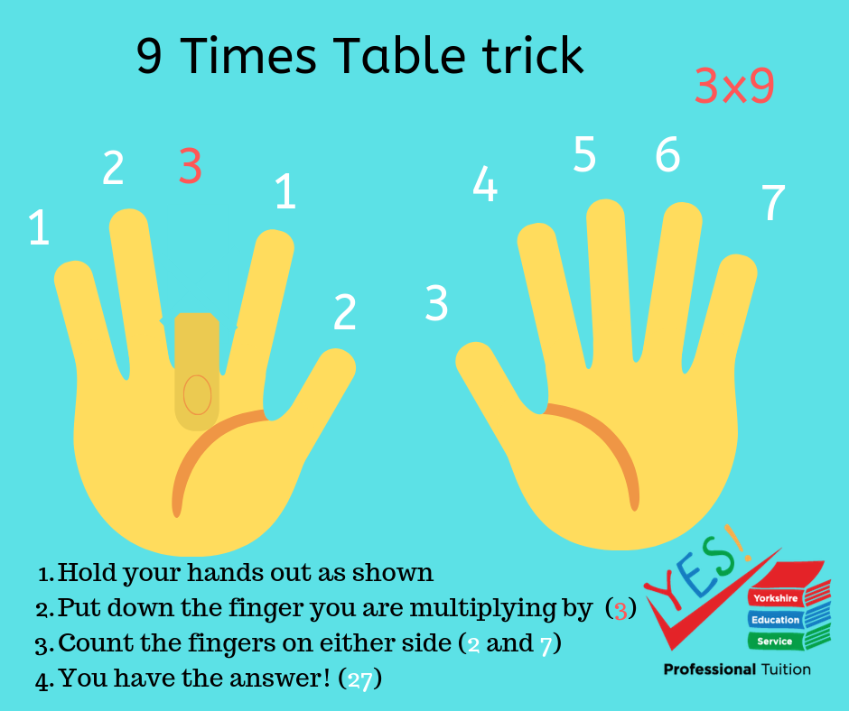
9 Times Tables on fingers

Slide 21
How can you help?
Ensure pupils practise being flexible with their facts.
Skip count backwards and forwards.
Start from different points in the times tables.
Mix in related division facts.
You could use flash cards.
Vary the activities they use to practise. This will help keep it fresh and will help ensure they develop number sentence.

Slide 22

How can you help?
Daily practise – little and often.
Make use of the apps and programmes school provides (TTrockstars).
Make it competitive – can they beat their own score, siblings, you etc.
All the strategies shown are used to build up fluency and get pupils to a point where they can recall all the times tables facts (12 x 12).

Slide 23

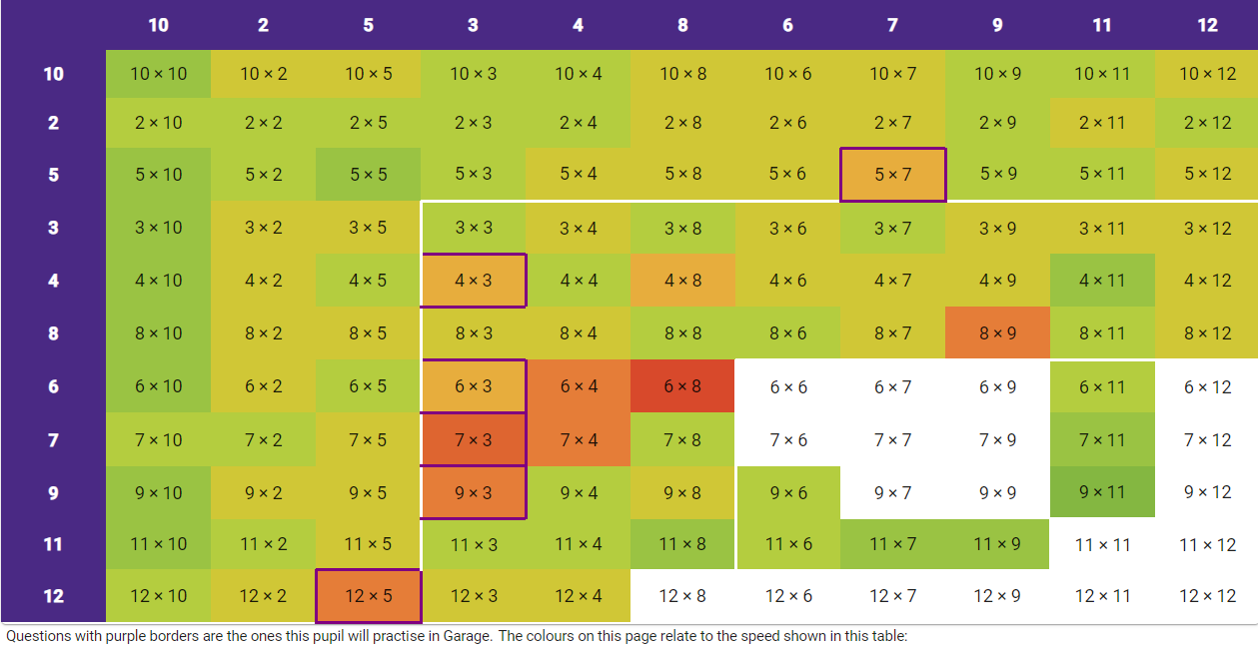
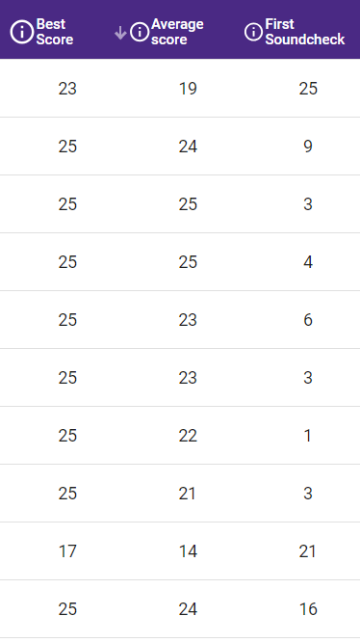
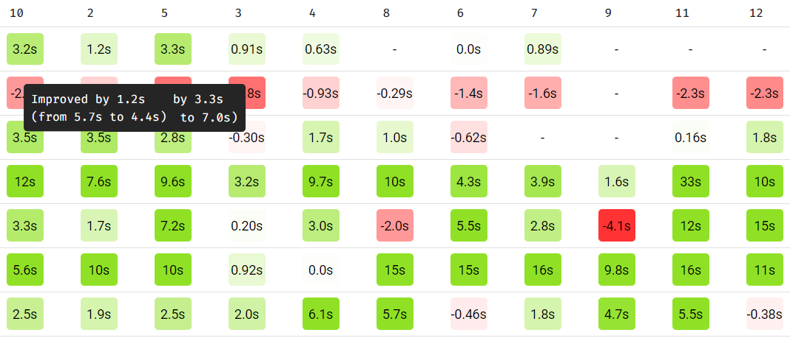
https://www.youtube.com/watch?v=93d7J5-9Ylw
from 1 minute
https://www.youtube.com/watch?v=93d7J5-9Ylw
from 1 minute

Slide 24
Tricky facts
Pupils will often struggle on a few facts.
You can use TTrockstars to help spot the facts they are regularly getting wrong.
Display these facts around the house (fridge, bedroom, living room).
Revise that fact as regularly as possible over the period of a few weeks.
Intensive focus on one fact will help it stick in their memories. E.g. ask on the way to and from school, before dinner, after brushing teeth, waiting to cross the road etc.
When they get more confident revisit it less regularly but don’t forget about it.
You can also help them create a rhyme or saying to help them remember it. I ate and I ate until I was sick on the floor ( 8 x 8 is 64)
5678 Consecutive numbers - 56 = 7 x 8

Slide 25
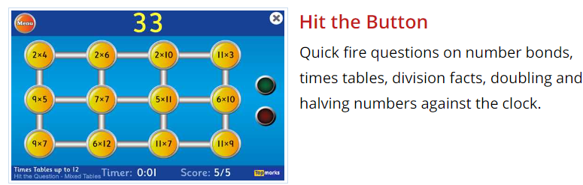
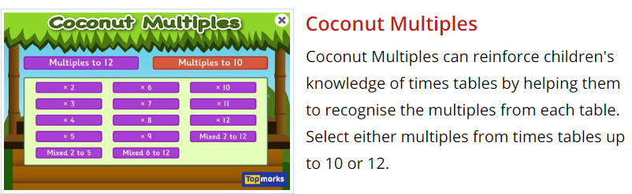
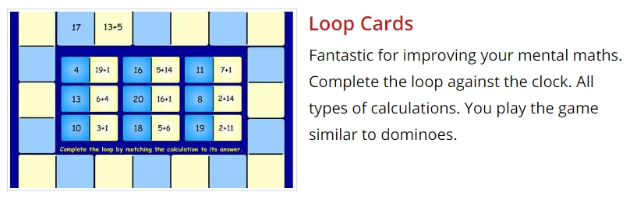
https://www.topmarks.co.uk/maths-games/7-11-years/times-tables

Slide 26
Questions?
Thank you

