Slide 1

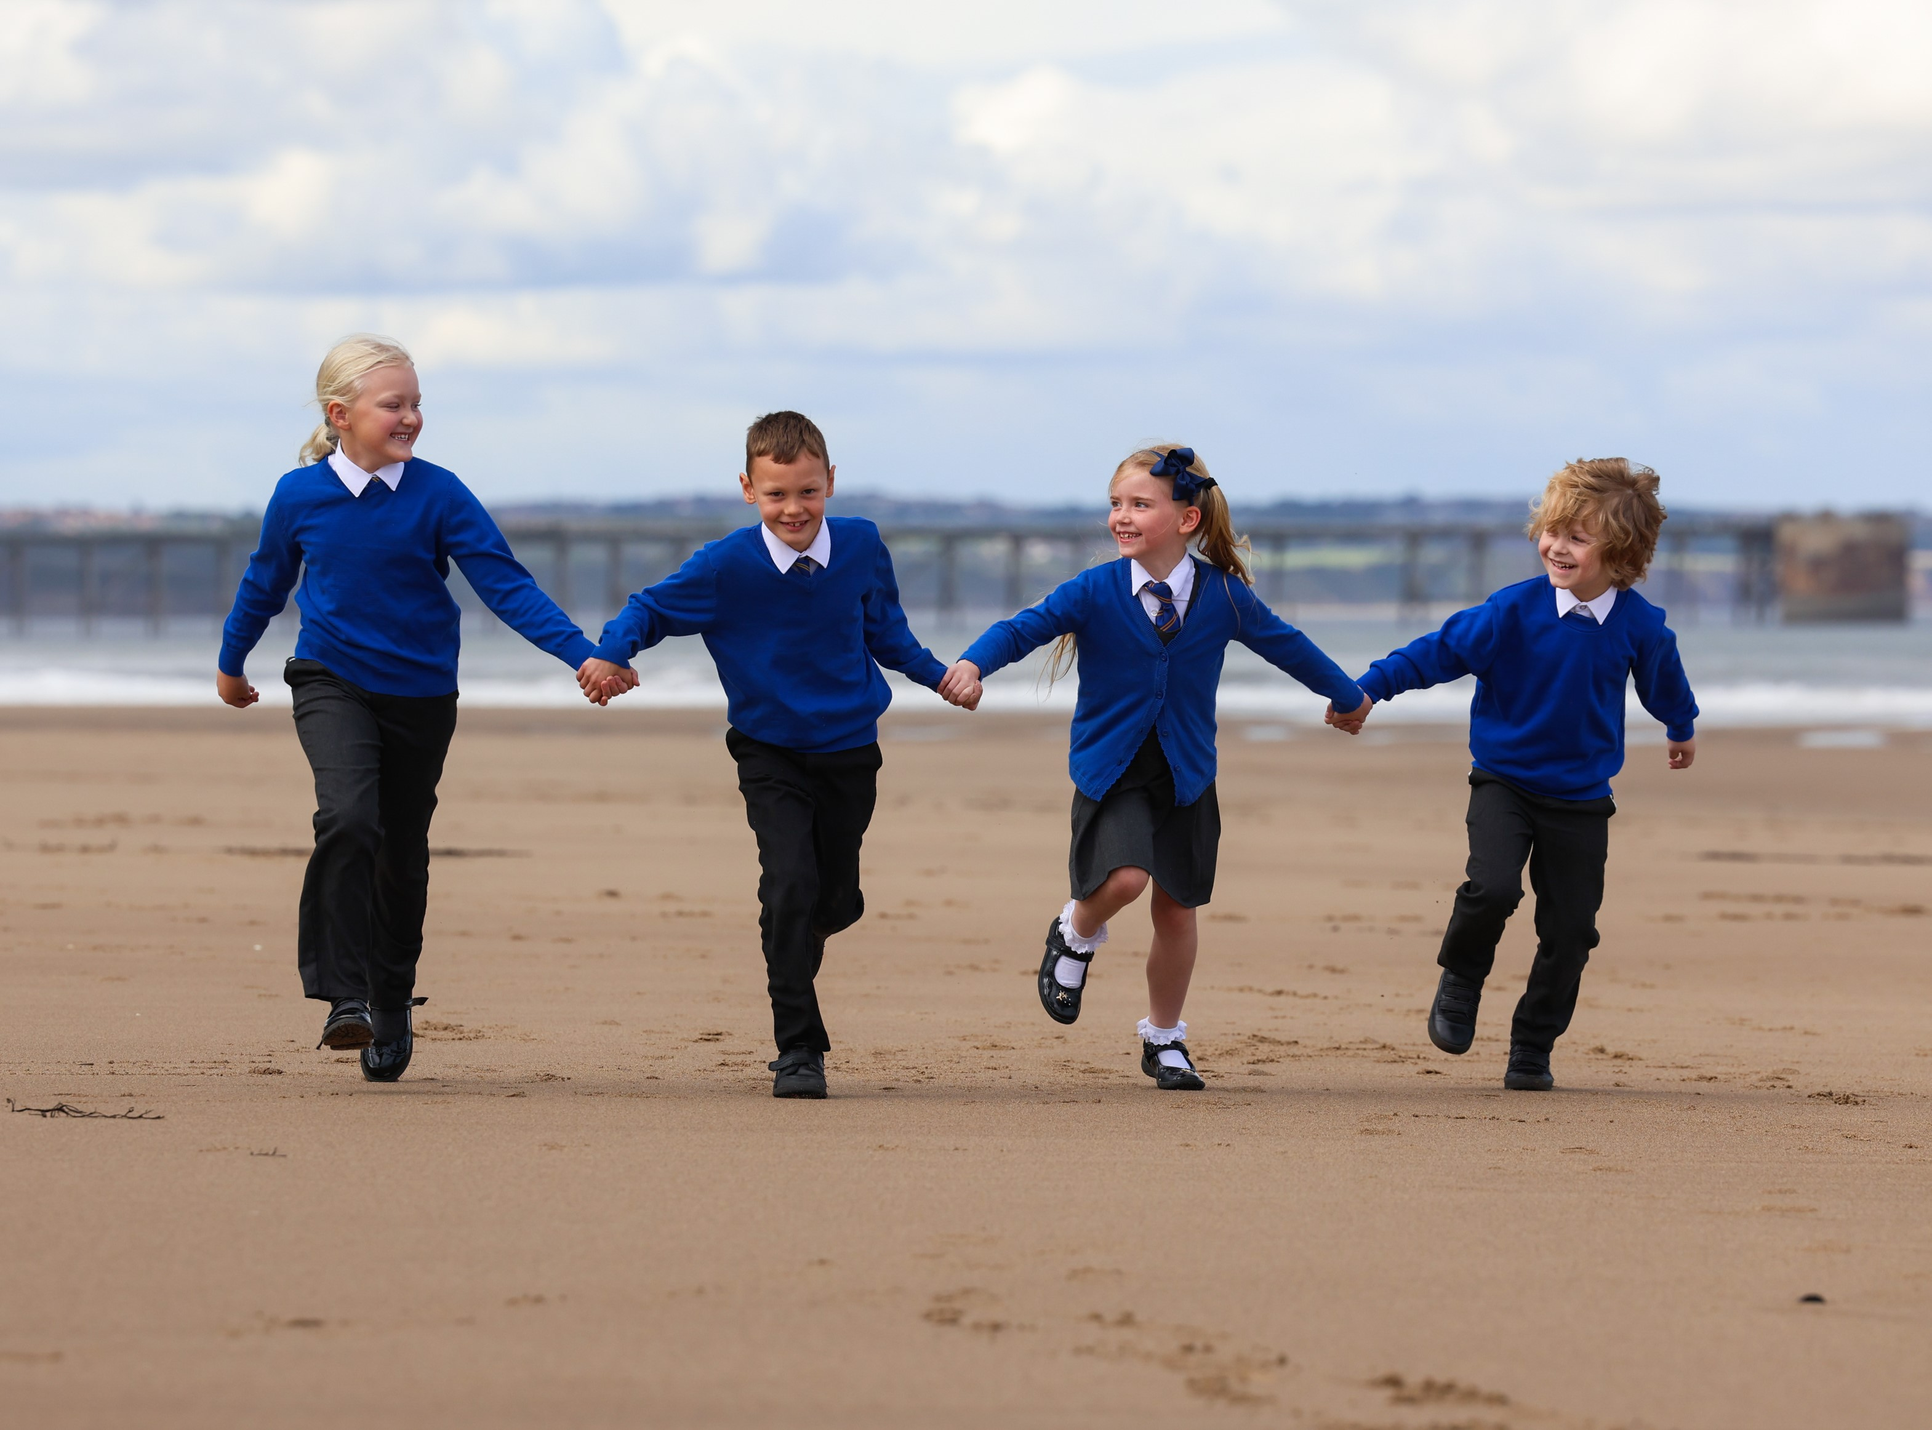
CURRICULUM: GEOGRAPHY
ST. BEGA’S
Catholic Primary School

Slide 2



CURRICULUM NARRATIVE
Curriculum Sequence 2024/25
** discrete teaching
North America
Tsunami / Desert Biomes**
Year 6
Rivers / Europe
Climate Change
Year 4-5
Rainforest Biomes
Rivers
Year 3-4
Planet Earth
Exploring the world.
Beside the seaside.
Where I live.
People and places and the world we live in: In EYFS children begin to develop their geographical knowledge by exploring features of their school and nursery. They begin to compare and contrast different places and environments using maps and atlases.
Christ at the Centre, Children at the Heart

Slide 3





CURRICULUM NARRATIVE
Why do geographers read?
To find out specific information about places To interpret data To learn about past and future Events To help recognise their own impacts on the world
Write like a geographer
Cause - the human physical processes Consequence - the social, economic and environmental impacts Change and continuity - Global, national and local Similarity and difference - A place you have studied to support your writing Correctly use geographical key terms Use labels and annotations on diagrams
Threshold Concepts
 | LOCATION & PLACE KNOWLEDGE Name, locate and identify places on a global, national and local scale GEOGRAPHICAL TECHNIQUES Use geographical terms and vocabulary. Use geographical skills, including maps and graphical methods PHYSICAL FEATURES & PROCESSES Describe the formation and changes of natural landscapes over time HUMAN INTERACTION WITH THE ENVIRONMENT Identify land use. Discuss the relationships between human activity and places. Recognise how the environment is managed
The Geography curriculum aims to inspire students with curiosity and fascination about the world around them. Our curriculum aims to equip students with knowledge and give them an understanding about natural and human environments, diverse places, people and
resources, including the Earth’s key physical and human processes. The study of geography should give students an understanding of their place in World.
The Journey Begins…
In EYFS pupils will begin to develop their understanding of the world around them. They will know where they are placed and will begin to recognise that there are other places around them. During the course of these units, they will become familiar with the unique historic coastal location of their home and school; learn about the name of the street they live on as well as the name of their local town or city. They will be introduced to geographical techniques such as map literacy by creating maps of their immediate environment, making links to literacy through labelling. They will begin to differentiate between physical features and human features.
As they move into Key Stage 1, pupils gain a greater understanding of the world around them, studying their unique historic coastal local area in greater detail, the Seaside, Explorers and Planet Earth. Their locational and place knowledge will deepen as they begin to look more closely at their immediate environment but also earth as a whole. They will identify the types of housing and weather patterns as well as be able to name the countries within the UK, the seven continents and five oceans. They will begin to understand why different locations have different climates and will be able to compare and contrast opposing environments, using geographical vocabulary. Pupils will become more aware of how humans interact with the environment in different parts of the earth. They will study different types of map and will broaden their own understanding of maps and graphicacy by creating more detailed maps using symbols and keys.
In Lower Key Stage 2, pupils study the UK in more detail, they learn specific locational facts such as capital city names, landmarks and flags. They also begin to develop an understanding of human geography by studying population and distribution. They look at physical features of the UK by contrasting rural and urban areas and gain an understanding of migration and tourism. Pupils are provided with many opportunities to develop a greater understanding of the physical processes that take place on earth by delving into the natural world and its resources, they will understand how volcanoes form, how and why earthquakes occur and will study rivers and coasts – completing case studies as they go.
As they progress to Upper Key Stage 2, pupils continue explore the human world, enabling them to see links to their unique historic coastal physical geography. They will study settlements and land use, natural resources and their use, biomes and North America. They will continue to deepen their geographical skills and knowledge through studying many different types of maps and graphs. They will understand the difference between labelling and annotating and will be able to analyse different types of data using these geographical techniques. They will complete extended pieces of writing demonstrating their understanding, using subject specific vocabulary. This curriculum prepares them with high quality skills and knowledge needed for Key Stage 3 and beyond.
Christ at the Centre, Children at the Heart

Slide 4
CURRICULUM NARRATIVE
Curriculum Sequence 23.24
(* denotes 2023 curriculum)
2023.24 |  |  | 2024.25
Class 6 (Y5 – 6) | Class 5 (Y4-5) | Class 4 (Y3-4) | Class 6 (Y6) | Class 5 (Y4-5) | Class 4 (Y3-4)
Japanese Tsunami | Desert-Biomes* | Coasts/Seaside Rocks | North America* | Rivers* | Coasts*
Migration | Tsunami* | Angry Earth * | Climate Change* | Climate Change* | Biomes-Rainforest*
2023.24 |  | 2024.25
Year 2 | Year 1 | Year 2 | Year 1
Planet Earth* | Where I Live | Planet Earth* | Where I Live
Explorers* | Beside the Seaside* | Explorers* | Beside the Seaside*
Christ at the Centre, Children at the Heart

Slide 5
CURRICULUM NARRATIVE
Knowledge of Places:
It is important our pupils learn about places in an appropriately nuanced and complex way. They should encounter the same places at different times and in different contexts throughout units of work. Throughout these units of work, pupils will develop not only knowledge of their unique historic home of the Headland and Hartlepool but of the North East and the United Kingdom. They will also use comparative skills to develop their knowledge of Australia and South America. As they move into Year 5, they will develop an understanding of North America which will continue into Year 6.
Geography Skills and Fieldwork:
Throughout the units of work geography skills and fieldwork opportunities have been built into the curriculum. Geography skills within the units include using maps, atlases and digit mapping to locate countries, as well as using compasses, symbols and keys. Fieldwork opportunities include observing, measuring, recording and presenting, which includes labelling and sketching maps. It is important to remember fieldwork does not always mean going out of school. It can involve collecting date within the school and the classroom and presenting and analysing data that has been given to them.
Progression through the Threshold Concepts
Within geography, there are 4 key threshold concepts, which when combined, ensure that our students can access a deep understanding of the subject. The threshold concepts relate to core aspects of disciplinary knowledge and substantive knowledge. For example, when ‘thinking like a geographer’, students need a deep understanding of place, knowledge and geographical skill to enable their understanding of physical and human geography. As students progress through the curriculum narratives, so should their understanding of the threshold concepts:
Location and Place Knowledge
Location and place knowledge is not simply about knowing where a place is in the world. It includes:
• Location Knowledge: world countries, regions, environments, continents, physical features (rivers and mountains)
• Physical Knowledge: similarities and differences between places (physical and human), cultures, cities, capitals
• Map Literacy: latitude, longitude, equator, northern hemisphere, southern hemisphere, the Tropics of Cancer and Capricorn, Arctic and Antarctic Circle, the Prime/Greenwich Meridian and time zones
Geographical Techniques
The use of geographical techniques such as fieldwork, but also the use of terminology and geographer traits, such as:
• Map literacy, Ordinance Survey maps, grid references, latitude and longitude, atlases, globes, GIS (Google maps), aerial photos.
• Numeracy and graphicacy, manipulating data, interpreting graphs and tables, constructing graphs.
• Literacy skills using key terminology, constructing and writing arguments, writing persuasively.
• Annotating diagrams/photos, using case studies, causes, effects, responses, processes leading to landforms, inferring information and making judgements.
Physical Features and Processes
Looking at the natural landscapes, features and the processes which create them. This is done in two stages:
1. Characteristics (describe) What does the feature look like? What makes it unique? What are its dimensions?
Observations (figures, photos, diagrams).
2. Processes (explain) Why does the feature/event occur? Step-by-step formation, directly link how the processes
create the characteristics.
Human Interaction with the Environment
Humans interact in a number of ways including:
• Land use, types of settlement, economic activity including trade links, distribution of natural resources.
• Human impacts on the natural environment, human induced hazards, impacts of natural hazards on people.
• Human responses to natural hazards and to human induced hazards.
Christ at the Centre, Children at the Heart

Slide 6




CURRICULUM NARRATIVE
“The study of geography is about more than just memorising places on a map. It's about understanding the complexity of our world, appreciating the diversity of cultures that exists across continents.”
Barack Obama
Curriculum Coverage 2024- 25
KS2 | Y6 |  | North America |  | ******
 | Y4-5 |  | Rivers/ Europe |  | Climate change
Lower KS2 | Y3-4 |  | Rainforest Biomes |  | Rivers
KS1 | Y2 |  | Planet Earth |  | Exploring the world.
 | Y1 |  | Where I live |  | Beside the seaside
Intent
At St. Bega's our intention is that every child will be an interested and inquisitive learner of Geography. We follow the National Curriculum programmes of study for each year group, aiming to create the very best geographers, well equipped to continue their studies in Geography as they move throughout their education. We challenge pupils to think, act and speak like those working in the field would, by developing a consistent approach across all year groups. Substantive knowledge and disciplinary knowledge are explicitly taught. By substantive knowledge we mean the people, events and developments from the past that children will learn about. By disciplinary knowledge, we mean all the various processes that children need to develop if they are to get better at a subject. This can both refer to a process of doing something (e.g. interpreting a source) but also a thought process in order to understand big concepts such as change, continuity and consequence.
High quality Geography teaching in primary school is our ultimate goal. This forms part of a larger progressive curriculum from EYFS to Year 6 and into KS3 and KS4. The Geography curriculum will inspire a curiosity and fascination about our unique location on the Headlan, the world and its people. It will equip pupils with knowledge about diverse places, people, resources and natural and human environments, together with a deep understanding of the Earth’s key physical and human processes. This includes:
• Locational knowledge of globally significant places;
• Have opportunities to experience physical geography and human geography throughout the learning journey;
• Have opportunities to experience geography outside the classroom, where pupils will have the geographical skills. to be competent in:
- fieldwork to observe, measure record and present the human and physical features in the local area;
- using a range of sources of geographical information, including maps, diagrams, globes, aerial photographs and
Geographical Information Systems (GIS);
- communicate geographical information in a variety of ways, including through maps, numerical skills and writing
at length.
Christ at the Centre, Children at the Heart

Slide 7
CURRICULUM NARRATIVE
Implementation
At St. Bega's the key threshold concepts across the Geography curriculum are taught throughout the units to develop
geographically knowledge and skills. This forms part of a larger progressive curriculum from EYFS to Year 6 and into KS3 and KS4. The curriculum is designed for progression and built around the threshold concepts (with content
structured as a narrative over time) to ensure essential knowledge is learned, applied and accessible for all pupils. The curriculum narrative is led by the four threshold concepts:
• Location and place knowledge;
• Geographical skills and communication;
• Physical processes and landscapes;
• Human interaction with the environment.
Research about cognitive science is used to help pupils learn and remember more. Understanding is checked through spaced retrieval exercises. Throughout units of work teachers will make links and encourage pupils to make links between past learning
and geographical knowledge or skills being taught.
Geographical knowledge will be built upon in a structured, sequential and progressive way. Geography will be taught starting from pupil’s immediate geography especially using our unique location, then to our local geography, the geography of the UK, and finally geography of the wider world. Teachers will ensure that lessons are planned in sequences that provide pupils with the opportunities to review, remember, deepen and apply their understanding. Tasks and activities relate to pupil’s own experiences and are then furthered to the wider world in developmental steps.
Impact
Pupils develop contextual knowledge of the location of globally significant places including their defining physical and human characteristics and how these provide a geographical context for understanding the actions of processes. They understand the processes that give rise to key physical and human geographical features of the world, how these bring about change over time. Pupils are competent in the geographical skills needed to collect, analyse and communicate with a range of data gathered through experiences of fieldwork that deepen their understanding of geographical processes. They interpret a range of sources of geographical information, including maps, diagrams, globes, aerial photographs and Geographical Information Systems (GIS). They communicate geographical information in a variety of ways, including through maps, numerical and quantitative skills and writing at length in a subject specific way.
Pupil dialogue and work in books shows a high standard of geography being taught. Pupils are able to talk and are able to demonstrate their learning with geographical language and vocabulary. They can make links and connections to what they have been taught previously. Geographical learning and enjoyment is visible. Pupils will have experienced a wide breadth of study and cultural capital, be able to think, reflect upon, write and debate about geography. They will have an in-depth, long-lasting knowledge of geographical concepts and be able to think like geographers, ready for KS3 and the wider world.
Christ at the Centre, Children at the Heart

Slide 8
CURRICULUM CONTINUITY – EYFS TO KS1
A team of Primary teachers and Secondary Heads of Department within BHCET have worked together to produce high quality units, following the threshold concepts. An effective geography curriculum must cover all four of these concepts and within one lesson, at least three of these concepts should be covered. Writers of these units have worked to identify sufficient breadth of content and ensure that pupils learn in sufficient depth. The units are written for Year 1 pupils up to Year 6. This document captures the progression from EYFS into Key Stage One and gives suggested texts that could be explored with Early Years pupils to support the geography threshold concepts.
Threshold Concepts
How does the Early Years Framework fit within the four threshold concepts?
Location and Place Knowledge | Physical features and processes | Human interaction with the environment | Geographical Techniques
Understanding the World, People, Culture and Communities
Explain some similarities and differences between life in this country and life in other countries, drawing on knowledge from stories, non-fiction texts rhymes and poems. Know that there are different countries in the world and talk about the differences they have experienced, seen in photos or read about. Begins to ask questions and can compare features of different environments. Develop an understanding of the position of other countries in the world. Observe and compare features in the environment by pointing/looking closely. Naming simple features eg. trees, wall, grass, road. Using some descriptive vocabulary to describe features eg. tall trees. | Understand that the weather changes with the seasons (linked to walks in school/local area). Make observations of plants and weather in their environment and talk about changes. Enrich and widen children’s vocabulary through the use of geographical language: forest, sea, ocean, river, road. Design and build small world areas. | Know there are different types of housing. Make observations about their local environment eg. park, school, home. Introduce vocabulary to help express opinions e.g. busy, quiet, pollution Begin to make marks to represent buildings, roads and trees. Show an awareness of the different shapes of buildings when drawing. Design and build small world areas. | Describe their immediate environment using knowledge from observation, discussion, stories, non-fiction texts and maps; Draw information from a simple map. Visits to the local park, high street, church etc and local area walks to notice features of the geographical environment. Use a camera or iPad to take still and moving images of the local environment. Add detail to a map of a familiar place – bedroom, classroom, local area. Use positional language through stories e.g. Rosie’s Walk Describe their relative position e.g. next to, behind. Can follow positional instructions. Using stories as a basis, draw simple maps to show journey taken eg. Red Riding Hood. Use road mats for small world play. Show an interest in maps eg. treasure maps, road maps Use a simple map with a programmable toy. Design and build small world areas. Use road mats for small world play.
Christ at the Centre, Children at the Heart

Slide 9
CURRICULUM CONTINUITY – SEND
The BHCET Geography curriculum has been designed to be delivered to the whole class. However, to ensure high quality teaching, the tasks are adapted by class teachers to meet the needs of individual children. To ensure all our pupils with SEND achieve well, they must be exposed to the same learning as their peers, but the way they evidence their learning through the tasks can be adapted.
Through scaffolding, tasks can be adapted to ensure all learners access and evidence the same threshold concepts and learning objectives as their non-SEND peers. Scaffolding strategies can include providing sentence starters, a writing frame, vocabulary banks, sorting and matching cards or visual prompts. Reactive or proactive adaptations can make our curriculum accessible and achievable for all. Other strategies of adaptation are outlined through the EEF’s Five-a-Day principles which include explicit instruction, metacognitive strategies, flexible grouping and the use of technology:
Scaffolding
‘Scaffolding’ is a metaphor for temporary support that is removed when it is no longer required. Initially, a teacher would provide enough support so that pupils can successfully complete tasks that they could not do independently. This requires effective assessment to gain a precise understanding of the pupil’s current capabilities.
Examples: Support could be visual, verbal, or written. Writing frames, partially completed examples, knowledge organisers, sentence starters can all be useful. Reminders of what equipment is needed for each lesson and classroom routines can be useful. Scaffolding discussion of texts: promoting prediction, questioning, clarification and summarising
Explicit instruction
Explicit instruction refers to a range of teacher-led approaches, focused on teacher demonstration followed by guided practice and independent practice. Explicit instruction is not just “teaching by telling” or “transmission teaching”
One popular approach to explicit instruction is Rosenshine’s ‘Principles of Instruction’.
Examples: Worked examples with the teacher modelling self-regulation and thought processes is helpful. A teacher might teach a pupil a strategy for summarising a paragraph by initially ‘thinking aloud’ while identifying the topic of the paragraph to model this process to the pupil. They would then give the pupil the opportunity to practise this skill. Using visual aids and concrete examples promotes discussion and links in learning.
Cognitive and metacognitive strategies
Cognitive strategies are skills like memorisation techniques or subject specific strategies like methods to solve problems in maths. Metacognitive strategies help pupils plan, monitor and evaluate their learning.
Examples: Chunking the task will support pupils with SEND – this may be through provision of checklists, instructions on a whiteboard or providing one question at a time. This helps reduce distractions to avoid overloading working memory.
Prompt sheets that help pupils to evaluate their progress, with ideas for further support.
Flexible grouping
Flexible grouping describes when pupils are allocated to smaller groups based on the individual needs that they currently share with other pupils. Such groups can be formed for an explicit purpose and disbanded when that purpose is met.
Examples: Allocating temporary groups can allow teachers to set up opportunities for collaborative learning, for example to read and analyse source texts, complete graphic organisers, independently carry out a skill, remember a fact, or understand a concept. Pre-teaching key vocabulary, using the Frayer Model is a useful technique here.
Use technology
Technology can assist teacher modelling. Technology, as a method to provide feedback to pupils and/ or parents can be effective, especially when the pupil can act on this feedback.
Examples: Use a visualizer to model worked examples. Technology applications, such as online quizzes can prove effective.
Speech generating apps to enable note-taking and extended writing can be helpful.
Christ at the Centre, Children at the Heart

Slide 10
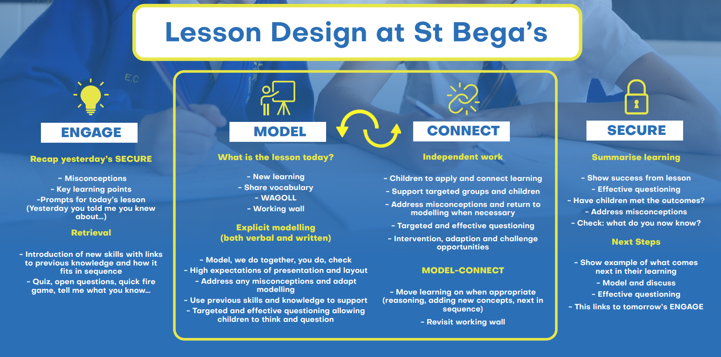
Lesson design
Pedagogy: Our Method And Practice Of Teaching
Exceptional teaching, leads to outstanding learning outcomes.
All have a responsibility to deliver lessons where teaching and learning is of the highest quality and where learning needs are met.
The single most important factor in how a child learns in the classroom is how well a teacher teaches.
Icons, from our lesson design, are used when planning and teaching, as reminders about the type of learning.
Christ at the Centre, Children at the Heart

Slide 11
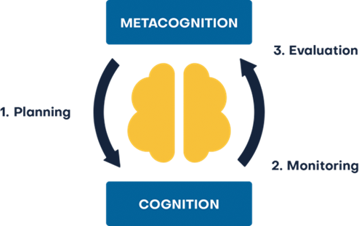
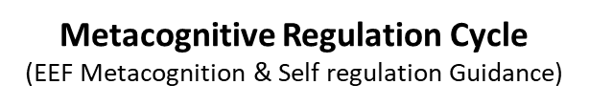
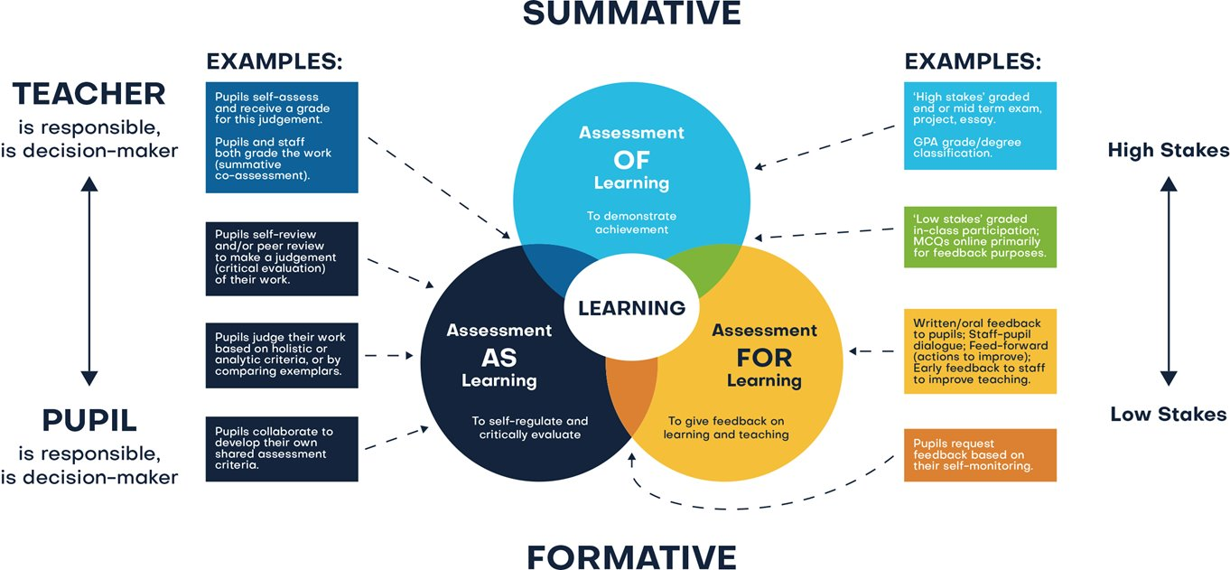
Assessment
Assessment comprises two linked processes:
Formative Assessment: provides Assessment for Learning. Is a continuous process and an integral part of teaching and learning; informal observations, dialogue/effective use of questioning, consolidation activities, low stakes quizzing, routine marking; and pupil/peer assessment all contribute to the developing profile of progress. When pupils make changes and consider actions to their work, based on the activity, they are ‘self-regulating’ their work. Self-regulating activities can be termed Assessment as Learning. Self-regulated learners are aware of their strengths and weaknesses, and can motivate themselves to engage in, and improve, their learning. Pupils start by planning how to undertake a task, working on it while monitoring the strategy to check progress, then evaluating the overall success.
Summative Assessment: provides Assessment of Learning and is a judgement of attainment at key points throughout the year- using past knowledge to measure attainment and progress. Examples of this are standardised tests, tasks and end of term/annual assessments which include a sample of pupil’s prior learning.
Assessment is a continuous process which is integral to teaching and learning and:
Enables an informed judgement to be made about a pupil’s understanding, skills, attitude to learning and successful acquisition of knowledge as they move through the curriculum.
Incorporates a wide range of assessment techniques to be used in different contexts/purposes.
Is accompanied by clear assessment criteria that enables effective marking and feedback, a reliable progress evaluation to be given and demonstrates clearly what a pupil must do to improve.
Provides feedback recognising achievement, increasing pupil confidence/motivation.
Supports learning by making clear to pupils: what they are trying to achieve; what they have achieved; what the learning gaps and misconceptions are and what the next steps in learning are.
Allows regular subject specific extended writing and access to high quality text/ reading.
Should be moderated and standardised to ensure purposeful, meaningful, and timely feedback.
Includes feedback to pupils to help them understand what they need to improve, challenging them to achieve their target rather than a grade.
Allows leaders and staff to make timely adaptations to the curriculum.
Christ at the Centre, Children at the Heart

