Slide 1

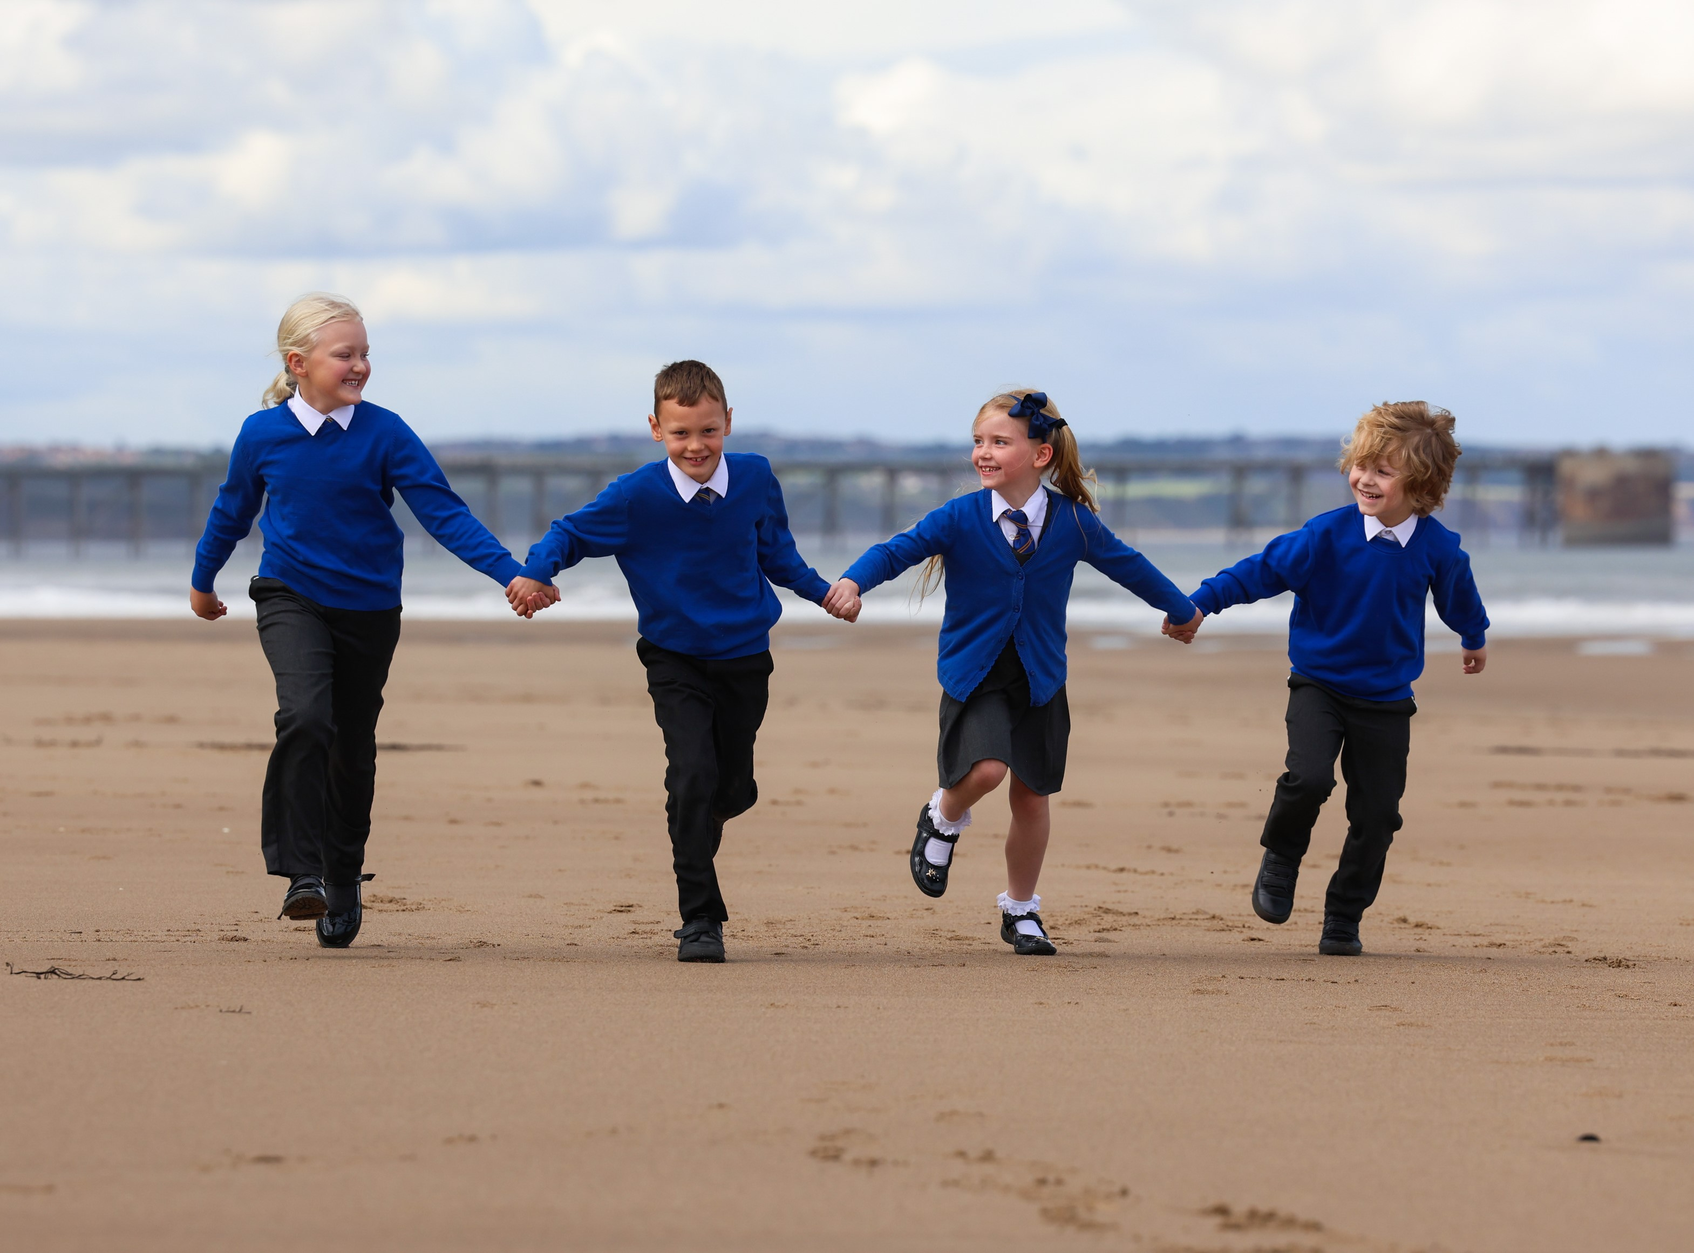
CURRICULUM: PSHE
St Bega's
Catholic Primary School
Love one another as I have loved you

Slide 2








CURRICULUM NARRATIVE
RELATIONSHIPS
Understanding our relationship with God, our family and our friends. Understanding the cycle of life and growing up in the body given to us by God.
Love one another as I have loved you

Slide 3





CURRICULUM NARRATIVE
STAYING SAFE
Concepts of bullying, abuse, sexual harassment, online safety and road safety.
Love one another as I have loved you

Slide 4









CURRICULUM NARRATIVE
HEALTH & WELLBEING
Healthy eating, importance of exercise, alcohol, harmful substances. first aid, mental health and developmental changes.
Sun Safety
Love one another as I have loved you

Slide 5



CURRICULUM NARRATIVE
LIVING IN THE WIDER WORLD
Understanding technology, careers, financial capability, being part of a community and being stewards of God’s world.
Love one another as I have loved you

Slide 6



CURRICULUM NARRATIVE
Careers
Through clear direction within PSHE and RSE, children are exposed to a range of careers. They learn about jobs within the community, public sector and other more specialised job roles. Children have opportunities to reflect on a career they aspire for and the skills they might need to reach their goals.
Virtues
Our character virtues of respect and responsibility, justice and compassion, confidence and resilience, honesty and self-belief, run through our PSHE curriculum and are designed to help children develop their sense of self and be ready to move with confidence onto their next chapter. Through learning about mental health and being safe, the children develop a sense of resilience, responsibility and confidence. Parliament, stewardship and British Values education enables children to develop their sense of justice. Overall, the PSHE curriculum, alongside the character virtues supports pupils in becoming ready for the wider world in secondary school and as adults.
Threshold Concepts
 | Relationships Understanding our relationship with God, our family and our friends. Understanding the cycle of life and growing up in the body given to us by God. Health and Wellbeing Healthy eating, importance of exercise, first aid, mental health and developmental changes. Living in the Wider World Understanding technology, careers, financial capability and being stewards of God’s world. Staying Safe Concepts of bullying, abuse, sexual harassment, online safety and road safety.
The study of PSHE and RSE is a vital part of children’s development and wider understanding of the world we live in. Within PSHE, children will recognise that every individual is unique and made in the image and likeness of God. Through PSHE, children will gain the knowledge they need to make informed choices and therefore make positive contributions to the wider community.
The Journey Begins…
In EYFS, PSHE includes learning about feelings, the body and the basic concept of having rules for their body. Children will learn about making safe choices online, and for crossing the road. They will also explore different family set ups, and recognise all families are different.
In KS1, these concepts are developed and built upon. In Year 1, children start to learn about financial capability and the concept of handling money. They start to learn about abuse in the form of physical contact. They begin to develop an understanding of online safety, by exploring online image and identity. Year 1 children learn some basic first aid skills and start to understand the impact of harmful substances. In Year 2, children learn about girls and boys bodies, how to be clean and healthy and they will continue to understand being safe online. They explore financial capability and learn how to save money. They explore mental health and feelings, including the theme of death.
In KS2, many themes are built upon in greater detail than in KS1. Online safety is taught in all year groups and children explore how to recognise and deal with cyberbullying. Mental health is taught in every term in KS2, as is financial capability. Children learn about sexual harassment and abuse, so that they can recognise negative relationships and situations that are not safe. There are many opportunities for learning about family, feelings and the community in which children explore a range of protected characteristics.
Love one another as I have loved you

Slide 7
CURRICULUM NARRATIVE
Intent
Our PSHE curriculum is purposeful, progressive and empowering for all pupils. The curriculum provokes curiosity and excitement for all. Gospel Values, Trust Character Virtues and British Values are threaded throughout. The PSHE and RSE curriculum build on the statutory content outlined in the National Curriculum with the aim to provide pupils with the knowledge and understanding they need to make informed choices and to be a positive influence in the communities that they belong to. It gives pupils the knowledge, skills and attributes they need to keep themselves healthy and safe, and to prepare them for life and work in modern Britain. We intend that all pupils will recognise and value that every individual is special and unique in the image and likeness of God.
Implementation
The curriculum has been designed to provide opportunities for pupils to develop the skills, knowledge and understanding they need to grow into independent and respectful members of society, by addressing topics most relevant in this current climate. The Ten:Ten RSE programme has been followed as well as being supplemented with additional resources and programmes that provide pupils with a spiral, coherent PSHE and RSE curriculum. Topics that are covered across the different year groups include safeguarding; sexual harassment; child on child abuse; protected characteristics; financial capability; mental health; and online safety. The sequence of the long-term plan ensures that themes are taught intentionally as opposed to incidentally.
Teachers will deliver lessons, which teach children the steps they can take to protect and support their own and others’ health, safety, and happiness. Learning is reflected through the active role our children play in our community, and books show independent work, group work and evidence of role play or group activities.
All children have the opportunity to express themselves, talk about relevant matters, and learn without judgement. We ensure that our children have a voice during learning walks, and at regular meetings for each pupil’s voice group. When delivering PSHE, our priority is ensuring that all parents understand and can support their children at home, in the hope of extending and building on the learning children do at school. Parents are consulted on and have a voice in how and what their children learn.
Schools should be aware of the ‘Key Decisions’ as advised by Ten:Ten and make these decisions how they see fit for their children and families. The long-term plan using Ten:Ten may then be altered accordingly for schools who make different decisions. Parents should have access to the PSHE curriculum and can request to see any resources used. Parents have the right to request that their child be withdrawn from some or all of sex education delivered as part of statutory RSE.
Impact
Pupils will be able to effectively manage their relationships and make informed lifestyle choices. They will be able to apply their learning to real life situations and make positive contributions to the wider community in which they live and beyond. Attitudes and behaviour demonstrates respect tolerance and high aspirations of themselves. The PSHE curriculum provides pupils with the knowledge, skills and understanding they need for their next step in their education and adulthood.
Children will leave us ready for their next step into Secondary school and are armed with skills, knowledge and understanding that they can take forward into adulthood. Our children leave us prepared for life in an ever-changing modern Britain. They have the tools they need to succeed, keep themselves safe and thrive.
We measure impact by the triangulation of lesson observations, work scrutiny and pupil voice, as well as this we carry our yearly subject leader/ teaching staff discussions – where areas for development are discussed, and for which targets for the year are collaboratively developed.
Love one another as I have loved you

Slide 8

















CURRICULUM ICONS
Safeguarding
Road Safety
–Mental Health
Sexual Harassment
Child on Child Abuse
Online Safety
Bullying
Financial Capability
Protected Characteristics:
Disability
Age
Race
Gender
Sexual Orientation
Pregnancy & Maternity
Marriage and Civil Partnership
Gender Reassignment
Love one another as I have loved you

Slide 9
SUPPLEMENTARY LONG-TERM PLAN
Curriculum Coverage
Phase | Year | Autumn | Spring | Summer
Early Years |  | Story Sessions – Handmade with Love (M1 U1) I am Me (M2 U2) Heads, Shoulders, Knees and Toes (M2 U2) Ready Teddy? (M2 U2) Health, Wellbeing and Lifestyle THINK – Stepping Stones to Road Safety Healthy Eating and Table Manners | I Like, You Like, We All Like! (M1 U3) All the Feelings (M1 U3) Let’s Get Real (M1 U3) Growing Up (M1 U4) Managing Online Information Privacy and Security THINK – Be Bright, Be Seen | God is Love (M3 U1) Loving God, Loving Others (M3 U1) Me, You, Us (M3 U2) What is the Internet? Playing Online Copyright and Ownership THINK – Road Rangers NSPCC PANTS (Sexual Harassment) Being Safe in the Sun
KS1 | Year 1 | Online Safety (Computing) Story Sessions – Let the Children Come (M1 U1) God Loves You (M2 U1) Special People (M2 U2) Self-image and Online Identify Money Matters Dental Hygiene and Healthy Eating Courtesy and Manners | Treat Others Well…and Say Sorry (M2 U2) Real Life Online Good and Bad Secrets (M2 U4) Physical Contact M2 U4 Online Relationships Online Reputation Where Money Comes From Looking After Money | Harmful Substances (M2 U4) Can You Help Me? Part 1 and 2 (M2 U4) Three in One (M3 U1) Who is my Neighbour? (M3 U1) The Communities We Live In (M3 U2) Online Bullying THINK – Safety First NSPCC PANTS (Sexual Harassment)
 | Year 2 | Online Safety (Computing) Story Sessions – Let the Children Come (M1 U1) I am Unique (M1 U2) Girls and Boys (M1 U2) Clean and Healthy (M1 U2) Managing Online Information Health, Wellbeing and Lifestyle Spend or Save Understanding Mental Health Healthy Eating | Feelings, Likes and Dislikes (M1 U3) Feeling Inside Out (M1 U2) Super Susie Gets Angry (M1 U2) The Cycle of Life (M1 U4) Beginnings and Endings (M1 U4) NSPCC PANTS (Sexual Harassment) Privacy and Security Want or Need Emotions and Feelings Mental Health Problems – Causes and Signs | God Loves You (M2 U1) Three in One (M3 U1) Who is my Neighbour? (M3 U1) The Communities We Live In (M3 U2) Rules to Help Us (M2 U3) Real Life Online (M2 U3) Copyright and Ownership THINK – Roads away from home THINK – Road Safety Warriors Going Shopping Looking after our mental health Sun safety
Love one another as I have loved you

Slide 10
SUPPLEMENTARY LONG-TERM PLAN
Curriculum Coverage
Phase | Year | Autumn | Spring | Summer
LKS2 | Year 3 | Online Safety (Computing) Story Sessions – Get up! (M1 U1) The Sacraments (M1 U1) Story Sessions – Jesus, my Friend (M2 U1) Friends, Family and Others (M2 U2) Self-image and Online Identify Where Does Money Come From Understanding Mental Health Dental Hygiene and Healthy Eating Bullying and Friendship | When Things Feel Bad (M2 U2) Sharing Online (M2 U3) Chatting Online (M2 U3) Safe in my Body (M2 U4) Drugs, Alcohol, Tobacco (M2 U4) First Aid Heroes (M2 U4) NSPCC PANTS (Sexual Harassment) Online Relationships Ways to Pay Talking about Mental Health Mental Health Problems – Impact | A Community of Love (M3 U1) What is the Church? (M3 U1) How Do I Love Others? (M3 U2) Online Reputation Online Bullying THINK – Road Safety Reasons to Borrow Looking After Our Mental Health Courtesy and Manners
 | Year 4 | Online Safety (Computing) Story Sessions – Get Up! (M1 U1) The Sacraments (M1 U1) We Don’t Have To Be The Same (M1 U2) Respecting Our Bodies (M1 U2) What is Puberty? (M1 U2) Managing Online Information Spending Decisions Understanding Mental Health Bullying and Mental Wellbeing | Changing Bodies (M1 U2) What Am I Looking At? (M1 U3) I am Thankful (M1 U3) Lifecycles (M1 U4) A Time for Everything (M1 U4) NSPCC PANTS (Sexual Harassment) Health, Wellbeing and Lifestyle Privacy and Security Advertising Emotions and Feelings Mental Health Problems – Loneliness | What am I Feeling? (M1 U3) A Community of Love (M3 U1) Who is the Church? (M3 U1) How Do I Love Others? (M3 U2) Copyright and Ownership Keeping Track Looking After Our Mental Health Healthy Sleeping
KEY |  | Relationships and Sex Education – some RSE lessons include the following themes: Protected Characteristics* Safeguarding* (including Road Safety) Mini Medics – Mental Health Sexual Harassment Child on Child Abuse* Online Safety* Bullying Financial Capability *PREVENT Strategy included
Love one another as I have loved you

Slide 11
SUPPLEMENTARY LONG-TERM PLAN
Curriculum Coverage
Phase | Class | Autumn | Spring | Summer
UKS2 | Year 5 | Online Safety (Computing) Story Sessions – Calming the Storm (M1 U1) God is Calling You (M2 U1) Under Pressure (M2 U2) Do You Want a Piece of Cake? (M2 U2) Self-Talk (M2 U2) Online Reputation Look After It Understanding Mental Health Courtesy and Manners | Sharing Isn’t Always Caring (M2 U3) Cyberbullying (M2 U3) Types of Abuse (Abuse including Sexual Abuse) (M2 U4) Impacted Lifestyles (M2 U4) Making Good Choices (M2 U4) Giving Assistance (M2 U4) NSPCC PANTS (Sexual Harassment) Online Bullying Critical Consumers Talking about Mental Health Mental Health Problems – Feeling Worried | The Holy Trinity (M3 U1) Catholic Social Teaching (M3 U1) Reaching Out (M3 U2) Self-Image and Online Identify Online Relationships Money in the Wider World Looking After Our Mental Health Bullying and Stereotypes Health and Allergies
 | Year 6 | Online Safety (Computing) Story Sessions – Calming the Storm (M1 U1) Gifts and Talents (M1 U2) Girls’ Bodies (M1 U2) Boys’ Bodies (M1 U2) Spots and Sleep (M1 U2) Build Others Up (M2 U2) Managing Online Information Value for Money and Ethical Spending Understanding Mental Health | Body Image (M1 U3) Peculiar Feelings (M1 U3) Emotional Changes (M1 U3) Seeing Stuff Online (M1 U3) Hope Beyond Death (M1 U4) NSPCC PANTS (Sexual Harassment) Health, Wellbeing and Lifestyle Privacy and Security Budgeting Emotions and Feelings Mental Health Problems – Feeling Unhappy | Making Babies - Part 1 and 2 (Pt 2 may be omitted) (M1 U4) Menstruation (M1 U4) The Holy Trinity (M3 U1) Catholic Social Teaching (M3 U1) Reaching Out (M3 U2) AI, Copyright and Ownership Money and Emotional Wellbeing Looking After Our Mental Health
KEY |  | Relationships and Sex Education – some RSE lessons include the following themes: Protected Characteristics* Safeguarding* (including Road Safety) Mini Medics – Mental Health Sexual Harassment Child on Child Abuse* Online Safety* Bullying Financial Capability *PREVENT Strategy included
Love one another as I have loved you

Slide 12
SEND
The BHCET PSHE curriculum has been designed to be delivered to the whole class. However, the tasks are adapted by class teachers to meet the needs of individual children. To ensure pupils with SEND achieve well, they should be exposed to the same learning as their peers; however, the way they evidence their learning through the tasks can be adapted.
Through scaffolding, tasks can be adapted to ensure all learners can access and evidence the same threshold concepts and learning objectives as their non-SEND counterparts. Scaffolding strategies can include providing sentence starters, a writing frame, vocabulary banks, sorting and matching cards or visual prompts. Reactive or proactive adaptations can make the BHCET curriculum accessible and achievable for all.
Other strategies of adaptation are outlined through the EEF’s Five-a-Day principles, which include explicit instruction, metacognitive strategies, flexible grouping and the use of technology:
Scaffolding
‘Scaffolding’ is a metaphor for temporary support that is removed when it is no longer required. Initially, a teacher would provide enough support so that pupils can successfully complete tasks that they could not do independently. This requires effective assessment to gain a precise understanding of the pupil’s current capabilities.
Examples: Support could be visual, verbal, or written. Writing frames, partially completed examples, knowledge organisers, sentence starters can all be useful. Reminders of what equipment is needed for each lesson and classroom routines can be useful. Scaffolding discussion of texts: promoting prediction, questioning, clarification and summarising.
Explicit Instruction
Explicit instruction refers to a range of teacher-led approaches, focused on teacher demonstration followed by guided practice and independent practice. Explicit instruction is not just “teaching by telling” or “transmission teaching” One popular approach to explicit instruction is Rosenshine’s ‘Principles of Instruction’.
Examples: Worked examples with the teacher modelling self-regulation and thought processes is helpful. A teacher might teach a pupil a strategy for summarising a paragraph by initially ‘thinking aloud’ while identifying the topic of the paragraph to model this process to the pupil. They would then give the pupil the opportunity to practise this skill. Using visual aids and concrete examples promotes discussion and links in learning.
Cognitive and Metacognitive Strategies
Cognitive strategies are skills like memorisation techniques or subject specific strategies like methods to solve problems in maths. Metacognitive strategies help pupils plan, monitor and evaluate their learning
Examples: Chunking the task will support pupils with SEND – this may be through provision of checklists, instructions on a whiteboard or providing one question at a time. This helps reduce distractions to avoid overloading working memory.
Prompt sheets that help pupils to evaluate their progress, with ideas for further support.
Flexible Grouping
Flexible grouping describes when pupils are allocated to smaller groups based on the individual needs that they currently share with other pupils. Such groups can be formed for an explicit purpose and disbanded when that purpose is met
Examples: Allocating temporary groups can allow teachers to set up opportunities for collaborative learning, for example to read and analyse source texts, complete graphic organisers, independently carry out a skill, remember a fact, or understand a concept. Pre-teaching key vocabulary, is a useful technique.
Use of Technology
Technology can assist teacher modelling. Technology, as a method to provide feedback to pupils and/ or parents can be effective, especially when the pupil can act on this feedback.
Examples: Use a visualizer to model worked examples. Technology applications, such as online quizzes can prove effective. Speech generating apps to enable note-taking and extended writing can be helpful.
Love one another as I have loved you

Slide 13
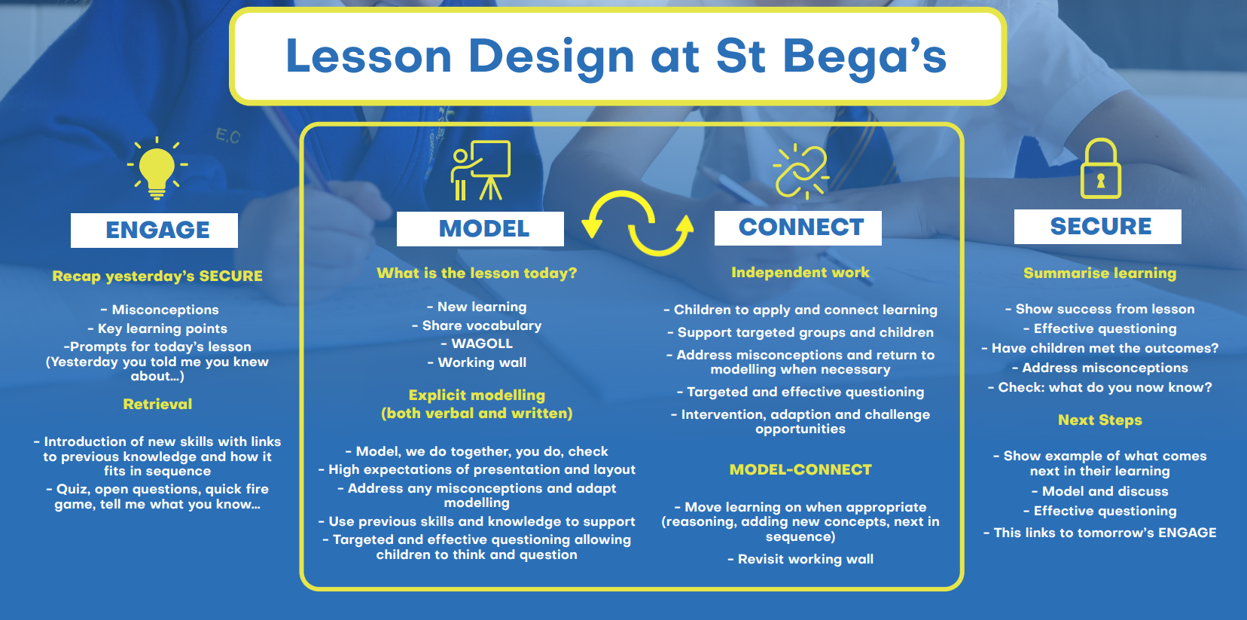
LESSON DESIGN
Pedagogy: Our Method And Practice Of Teaching
Exceptional teaching, leads to outstanding learning outcomes.
All have a responsibility to deliver lessons where teaching and learning is of the highest quality and where learning needs are met.
The single most important factor in how a child learns in the classroom is how well a teacher teaches.
Icons, from our lesson design, are used when planning and teaching, as reminders about the type of learning.
Love one another as I have loved you

Slide 14
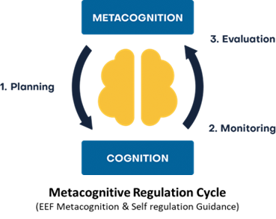
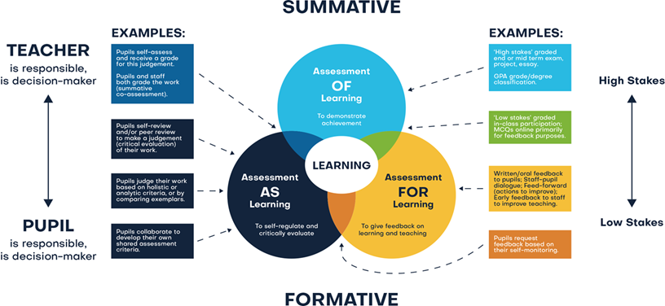
ASSESSMENT
Assessment comprises two linked processes:
Formative Assessment: provides Assessment for Learning. Is a continuous process and an integral part of teaching and learning; informal observations, dialogue/effective use of questioning, consolidation activities, low stakes quizzing, routine marking; and pupil/peer assessment all contribute to the developing profile of progress. When pupils make changes and consider actions to their work, based on the activity, they are ‘self-regulating’ their work. Self-regulating activities can be termed Assessment as Learning. Self-regulated learners are aware of their strengths and weaknesses, and can motivate themselves to engage in, and improve, their learning. Pupils start by planning how to undertake a task, working on it while monitoring the strategy to check progress, then evaluating the overall success.
Summative Assessment: provides Assessment of Learning and is a judgement of attainment at key points throughout the year- using past knowledge to measure attainment and progress. Examples of this are standardised tests, tasks and end of term/annual assessments which include a sample of pupil’s prior learning.
Assessment is a continuous process which is integral to teaching and learning and:
•Enables an informed judgement to be made about a pupil’s understanding, skills, attitude to learning and successful acquisition of knowledge as they move through the curriculum.
•Incorporates a wide range of assessment techniques to be used in different contexts/purposes.
•Is accompanied by clear assessment criteria that enables effective marking and feedback, a reliable progress evaluation to be given and demonstrates clearly what a pupil must do to improve.
•Provides feedback recognising achievement, increasing pupil confidence/motivation.
•Supports learning by making clear to pupils: what they are trying to achieve; what they have achieved; what the learning gaps and misconceptions are and what the next steps in learning are.
•Allows regular subject specific extended writing and access to high quality text/ reading.
•Should be moderated and standardised to ensure purposeful, meaningful, and timely feedback.
•Includes feedback to pupils to help them understand what they need to improve, challenging them to achieve their target rather than a grade.
•Allows leaders and staff to make timely adaptations to the curriculum.
Love one another as I have loved you

