Slide 1

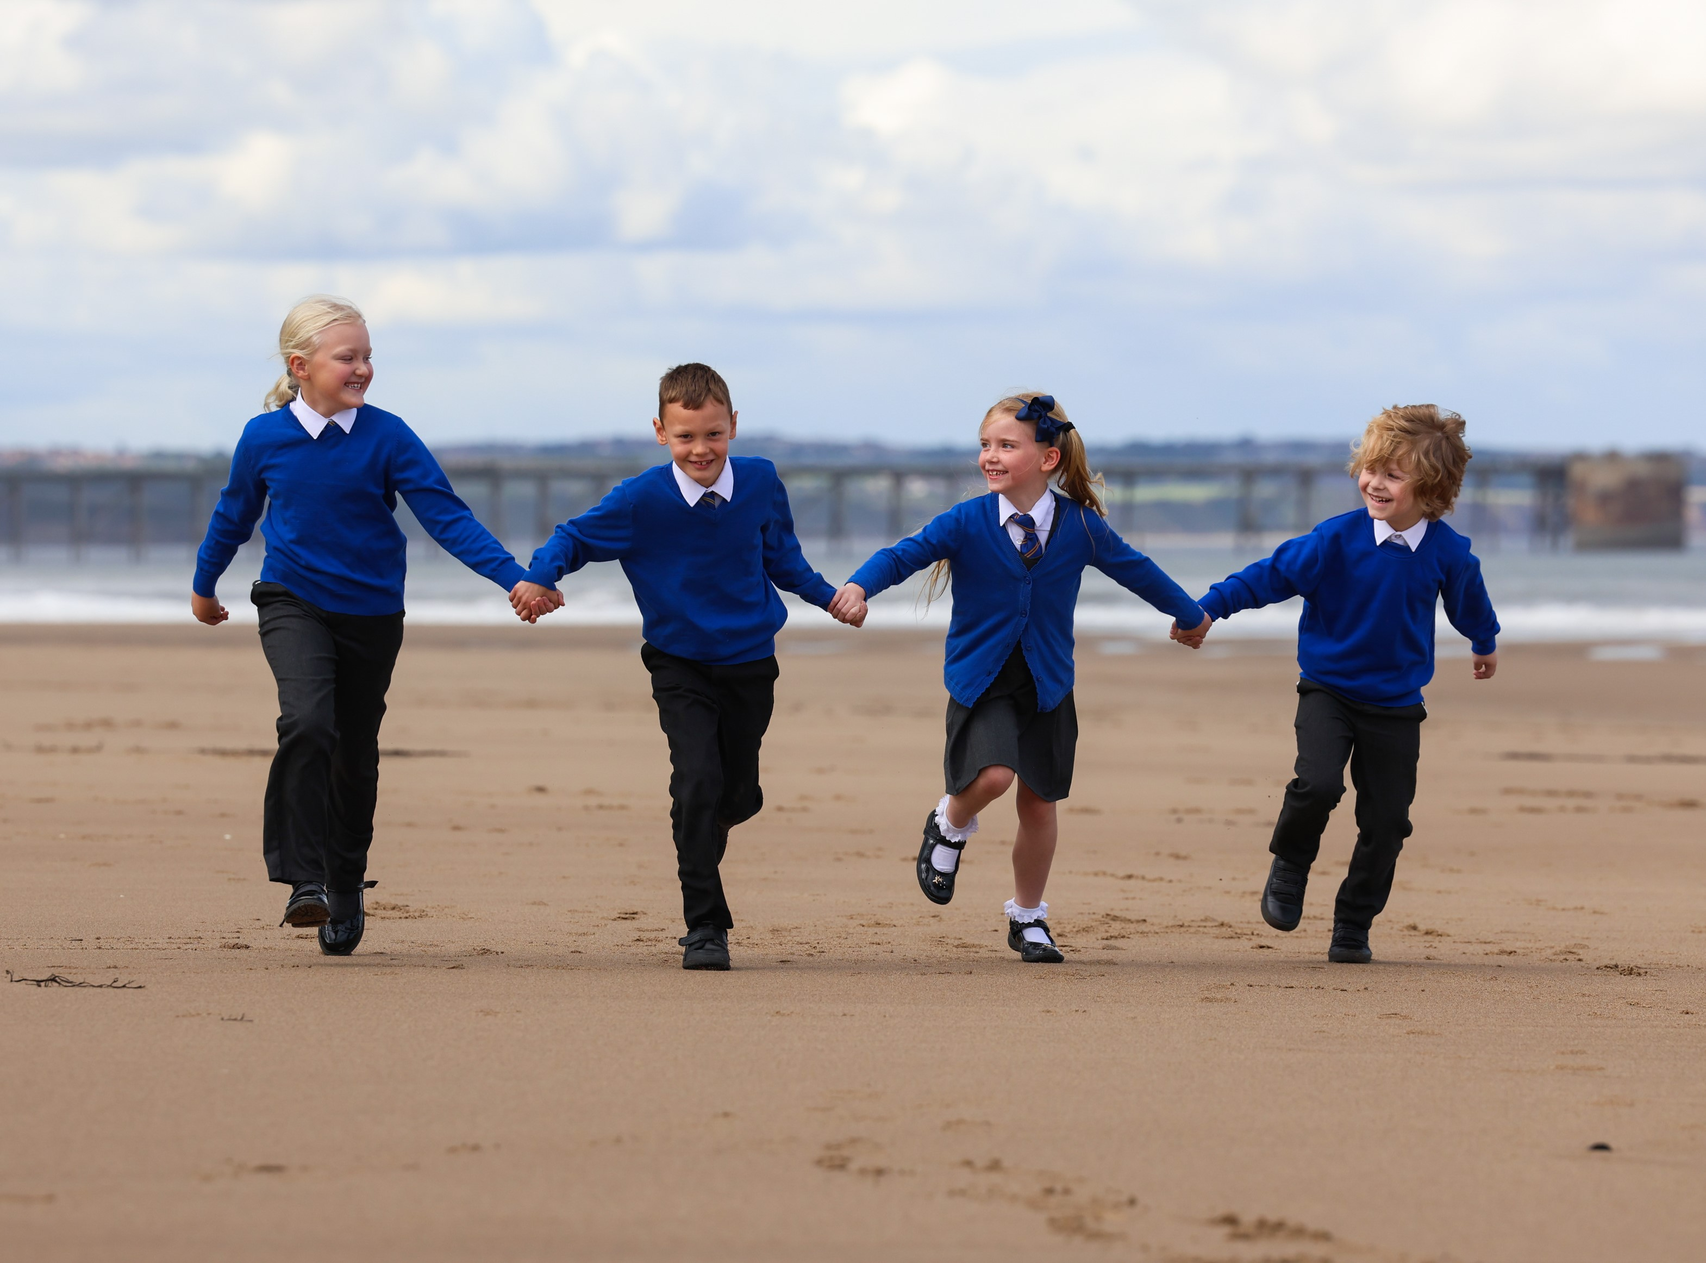
CURRICULUM: SCIENCE
St Bega's
Catholic Primary School

Slide 2

































CURRICULUM NARRATIVE
Biology, Chemistry and Physics
Children at the expected level of development will: Explore the natural world around them, making observations and drawing pictures of animals and plants; Know some similarities and differences between the natural world around them and contrasting environments, drawing on their experiences and what has been read in class; Understand some important processes and changes in the natural world around them, including the seasons and changing states of matter.
Christ at the Centre, Children at the Heart

Slide 3















CURRICULUM NARRATIVE
Biology
Children at the expected level of development will: Explore the natural world around them, making observations and drawing pictures of animals and plants; Know some similarities and differences between the natural world around them and contrasting environments, drawing on their experiences and what has been read in class; Understand some important processes and changes in the natural world around them, including the seasons and changing states of matter.
Christ at the Centre, Children at the Heart

Slide 4





CURRICULUM NARRATIVE
Chemistry
Children at the expected level of development will: Explore the natural world around them, making observations and drawing pictures of animals and plants; Know some similarities and differences between the natural world around them and contrasting environments, drawing on their experiences and what has been read in class; Understand some important processes and changes in the natural world around them, including the seasons and changing states of matter.
Past and Present: Pupils talk about and describe familiar people, including, members of their family and community. They comment on familiar past events. They compare characters from the past, using story books.
Christ at the Centre, Children at the Heart

Slide 5














CURRICULUM NARRATIVE
Physics
Children at the expected level of development will: Explore the natural world around them, making observations and drawing pictures of animals and plants; Know some similarities and differences between the natural world around them and contrasting environments, drawing on their experiences and what has been read in class; Understand some important processes and changes in the natural world around them, including the seasons and changing states of matter.
Past and Present: Pupils talk about and describe familiar people, including, members of their family and community. They comment on familiar past events. They compare characters from the past, using story books.
Christ at the Centre, Children at the Heart

Slide 6










CURRICULUM NARRATIVE
Science Yearly Overview
EYFS | Children at the expected level of development will: Explore the natural world around them, making observations and drawing pictures of animals and plants; Know some similarities and differences between the natural world around them and contrasting environments, drawing on their experiences and what has been read in class; Understand some important processes and changes in the natural world around them, including the seasons and changing states of matter.
Area of Science | Learning Focus |  | Year One | Year Two | Year Three | Year Four | Year Five | Year Six
Biology | Plants |  | Unit 1 | Unit 2 | Unit 3
 | Living Things |  |  | Unit 1 |  | Unit 2 | Unit 3 | Unit 4
 | Animals & Humans |  | Unit 1 | Unit 2 | Unit 3 | Unit 4 | Unit 5 | Unit 6
 | Evolution & Inheritance |  |  |  |  |  |  | Unit 1
Chemistry | Materials |  | Unit 1 | Unit 2 |  | Unit 3 | Unit 4
Physics | Movement, Forces & Magnets |  | Unit 1 |  | Unit 2 |  | Unit 3
 | Earth & Space |  | Unit 1 |  | Unit 2 |  | Unit 3
 | Light & Seeing |  |  |  | Unit 1 |  |  | Unit 2
 | Sound & Hearing |  |  |  |  | Unit 1 | Unit 2
 | Electricity |  |  | Unit 1 |  | Unit 2 |  | Unit 3
Christ at the Centre, Children at the Heart

Slide 7






CURRICULUM NARRATIVE
Threshold Concepts in Science
 | Animals, humans and plants are made up of complex interacting systems in order to function.
 | Organisms require a supply of energy for organisms to carry out the basic functions of life and to grow.
 | The earth is a complex of interacting rock, water, air and life.
 | The particle theory of matter is the abstract idea that helps us to develop an understanding of why materials behave as they do.
 | Energy is a powerful and unifying abstract idea which is difficult to define.
 | Forces change the state of rest or motion of a body. They hold matter together and interplay between all objects.
Christ at the Centre, Children at the Heart

Slide 8

CURRICULUM NARRATIVE
Read like a Scientist
Why do scientists read: To situate their research To interpret others' data and critique their findings. To find specific information to support their own investigations. To learn about others' procedures and experiments. Helps them to understand what has already been discovered.
Write like a Scientist
Avoid using the first person in your writing (third person is usually used) Be clear when starting scientific observations. Be succinct and precise. Use labelled diagrams to help explain your points. Correctly use scientific vocabulary.
Threshold Concepts
 | COMPLEX SYSTEMS Animals, humans and plants are made up of complex interacting systems in order to function. ENERGY SUPPLY Organisms require a supply of energy for organisms to carry out the basic functions of life and to grow. THE EARTH The earth is a complex of interacting rock, water, air and life. PARTICLE THEORY The particle theory of matter is the abstract idea that helps us to develop an understanding of why materials behave as they do. ENERGY Energy is a powerful and unifying abstract idea which is difficult to define. FORCES Forces change the state of rest or motion of a body. They hold matter together and interplay between all objects.
Science is key to providing the foundation for understanding of the changing world. Pupils can develop a sense of excitement and curiosity about natural phenomena. In the EYFS, science is included within “Understanding of the World”, where pupils learn about science by undertaking activities that help children to develop working scientifically skills and critical thinking. It is introduced, often indirectly, through activities that encourage every child to explore, problem solve, observe, predict, think, make decisions and talk about the world around them. At KS1 and KS2 the curriculum is underpinned by 6 threshold concepts which are regularly revisited and developed over time. The units are taught in a carefully sequenced manner; ensuring that pupils build knowledge, understanding and enquiry skills, which offer them the firm foundation as they make the transition to secondary school to continue their studies further. The topics studied are hierarchical, increasing in challenge as pupils progress from Y1-6.
The Journey Begins…
In every topic studied throughout a pupil’s time in Primary school, there are aspects of Mathematics and English that underpin the science curriculum; we believe this is key to pupils’ success in science. The quality and variety of language pupils hear and speak are key factors in developing their scientific vocabulary and presenting scientific justifications, evaluations, conclusions or arguments. Pupils are assisted in making their thinking clear, both to themselves and others, ensuring secure foundations are built by using discussion to probe and remedy misconceptions. We also like to highlight the importance of STEM, discuss the varied nature of scientific careers and embed working scientifically skills into our subject curriculum, emphasizing how science can be put into context within the wider world.
Christ at the Centre, Children at the Heart

Slide 9
CURRICULUM NARRATIVE
Biology
Animals, humans and plants are made up of complex interacting systems to function.
Organisms require a supply of energy for organisms to carry out the basic functions of life and to grow.
The two threshold concepts in Biology are taught across the following 3 topics: Plants, Animals & Humans and Living things & their habitats. The concepts stem from the idea that all living organisms are made from cells. Most organisms are multicellular - the organism needs to contain sophisticated systems to carry out the various life processes, which require energy. Pupils start by identifying a variety of common animals, describing and comparing their structure. This then leads to pupils grouping common animals into carnivores, herbivores and omnivores as well as identifying the major parts of the human body. Over time, pupils will explore in more depth the major body systems in humans, linked also to the concept of organism requiring energy. We take the opportunity to study the human digestive, circulatory, respiratory and skeletal systems as well as the importance of nutrition, a balanced diet and the impact of lifestyle choices to build on this concept in humans. It is also explored using food chains, habitats, competition as well as in plants, whereby plant structure, transport of materials, substances required for growth and the life cycle of a flowering plant are studied. We take the opportunity to study flowers, trees and plant growth in the spring and summer months, when use of the outdoor area in school can be maximised to support learning. Organisms also require energy to reproduce; this is explored in plants and animals whereby lifecycles, sexual and asexual reproduction are studied. We teach evolution and inheritance towards the end of Year 6. This is due to the topic being more conceptually difficult and students can use the knowledge they have gained in the other aspects of Biology to help build on the idea that plants and animals are classified which links to evolution. A good grounding in reproduction also aids pupil understanding of inheritance.
Chemistry
The Earth is a complex of interacting rock, water, air and life.
The particle theory of matter is the abstract idea that helps us develop an understanding of why materials behave as they do
The two threshold concepts in Chemistry are taught across the Materials topic. The concepts stem from the idea that all materials are made from atoms/particles and everyday materials behave in different ways, which can relate to simple physical properties and the arrangement of particles. The concept is more complex and increasingly abstract over the course of the curriculum, which prepares students for Chemistry at secondary school. Other aspects of chemistry that are developed using the concept that earth’s resources can occur because of natural phenomena. Pupils start by distinguishing between an object and the materials from which it is made, identifying everyday materials, describing their physical properties, being able to group materials based their properties and comparing the suitability of everyday materials for uses. The opportunity is then taken to look at the physical properties of rocks and rock, fossil and soil formation which links with the concept that earth is a complex of interacting rock water, air and life. As the topic progresses pupils look at the particle model of solids, liquids and gases and what happens to materials when heated or cooled and how evaporation and condensation are related to the water cycle. In Year 5 pupils begin to explore the nature of physical and chemical reactions as well as separating simple mixtures.
Physics
Energy is a powerful and unifying abstract idea which is difficult to define
Forces change the state of rest or motion of a body. They hold matter together and interplay between all objects
The two concepts in Physics are taught across a range of topics including Light, Sound, Electricity, Earth & Space and Forces & Magnets. Energy is a fundamental concept of physics that enables the explanation and prediction of many phenomena and contributes to the unification of the various branches of physics. Energy is a difficult concept to understand and master, which is why physics is usually taught from Year 3 onwards. We provide pupils with foundation lessons in earth & space and electricity in Years 1 and 2 to aid in the preparing pupils for this highly abstract concept. The curriculum explores different forms of energy stores including electricity, sound and hearing and light and seeing. Pupils explore light, reflections and shadows before then being able to explain how we see things using ideas about light and its properties. Pupils in Year 4 learn how sounds are made, features of sound waves including pitch, amplitude, and dissipation. Electricity includes common electrical appliances, constructing simple series circuits, common conductors and insulators, recognising components from circuit diagrams and investigating components in series circuits.
Force is a useful idea because it is the key to explaining changes in the motion of an object or in its shape. Understanding forces help us to predict and control the physical world around us. The idea of forces stem from the idea that essentially a force is a push or pull acting upon an object because of its interaction with another object. Pupils study contact and non-contact forces including magnetism and magnetic materials. Contact forces are explored through air and water resistance. Levers, gears and pulleys also look how forces can be useful in everyday contexts.
Earth and Space adopts both concepts, since it involves the force of gravity, which influences many dynamic processes within the earth’s interior, on and above its surface. Energy is transferred from the sun to Earth via electromagnetic waves, or radiation. Most of the energy that passes through the upper atmosphere and reaches Earth’s surface. The topics studied include the movement of the earth and other planets relative to the sun and its solar system, movement of the moon and explaining day and night. We also take the opportunity to study earth and space in the winter months when nights are longer, and children can participate in observing the moon and stars at a reasonable time at home.
Christ at the Centre, Children at the Heart

Slide 10
CURRICULUM NARRATIVE
Intent
At St. Bega's our intention is that every child will be an interest and inquisitive learner of Science. The basis of our curriculum is based on the National Curriculum program of study for each year group, with the aim to develop the very best scientists, well equipped to continue their studies in Science as they throughout their education. We challenge pupils to think, act and speck like those working in the field would, by developing a consistent approach across all year groups.
We intend that all pupils will develop their natural curiosity and confidence to question the world around them and to develop a passion for science and its application in past, present and future technologies. Pupils should be provided with a wide range of opportunities to think scientifically and develop their scientific skills to make predictions, plan fair tests and draw conclusions.
Implementation
Scientific skills are progressive, which are taught across sequences of lessons and units. Pupils are given a range of practical opportunities to develop and master these. The use of outdoor learning, educational visits and visits from those working in the field are encouraged to enable pupils to gain first-hand experiences to enrich their learning, understanding and cultural capital. Science can be enriched by meaningful links to other subjects within the curriculum, such as reading, writing, recording and interpreting results in mathematics and application of computing skills.
Impact
Pupils develop a knowledge of Science and can ask questions and reach answers through investigations. They can theorise, plan fair tests and have the skills to conduct science investigation, recording their results, identifying patterns and drawing conclusions.
Pupil dialogue and work in books shows a high standard of Science being taught. Pupils can talk and can demonstrate their learning with scientific language and vocabulary about a particular topic. They can make links and connections to what they have been taught previously. Scientific learning and enjoyment is visible. Pupils will have experienced a wide breadth of study and cultural capital, be able to think, reflect upon, write and investigate. They will have an in-depth, long-lasting knowledge of scientific concepts and be able to think, write and read like scientists, ready for KS3 and beyond.
Christ at the Centre, Children at the Heart

Slide 11
SEND
Our Science curriculum has been designed to be delivered to the whole class. However, the tasks are adapted by class teachers to meet the needs of individual children. To ensure pupils with SEND achieve well, they should be exposed to the same learning as their peers; however, the way they evidence their learning through the tasks can be adapted. ​
​
Through scaffolding, tasks can be adapted to ensure all learners can access and evidence the same threshold concepts and learning objectives as their non-SEND counterparts. Scaffolding strategies can include providing sentence starters, a writing frame, vocabulary banks, sorting and matching cards or visual prompts. Reactive or proactive adaptations can make the BHCET curriculum accessible and achievable for all. ​
​
Other strategies of adaptation are outlined through the EEF’s Five-a-Day principles, which include explicit instruction, metacognitive strategies, flexible grouping and the use of technology:​
Scaffolding​
‘Scaffolding’ is a metaphor for temporary support that is removed when it is no longer required. Initially, a teacher would provide enough support so that pupils can successfully complete tasks that they could not do independently. This requires effective assessment to gain a precise understanding of the pupil’s current capabilities.​
Examples: Support could be visual, verbal, or written. Writing frames, partially completed examples, knowledge organisers, sentence starters can all be useful. Reminders of what equipment is needed for each lesson and classroom routines can be useful. Scaffolding discussion of texts: promoting prediction, questioning, clarification and summarising. ​
​
Explicit Instruction​
Explicit instruction refers to a range of teacher-led approaches, focused on teacher demonstration followed by guided practice and independent practice. Explicit instruction is not just “teaching by telling” or “transmission teaching” One popular approach to explicit instruction is Rosenshine’s ‘Principles of Instruction’.​
Examples: Worked examples with the teacher modelling self-regulation and thought processes is helpful. A teacher might teach a pupil a strategy for summarising a paragraph by initially ‘thinking aloud’ while identifying the topic of the paragraph to model this process to the pupil. They would then give the pupil the opportunity to practise this skill. Using visual aids and concrete examples promotes discussion and links in learning.​
​
Cognitive and Metacognitive Strategies​
Cognitive strategies are skills like memorisation techniques or subject specific strategies like methods to solve problems in maths. Metacognitive strategies help pupils plan, monitor and evaluate their learning​
Examples: Chunking the task will support pupils with SEND – this may be through provision of checklists, instructions on a whiteboard or providing one question at a time. This helps reduce distractions to avoid overloading working memory.​
Prompt sheets that help pupils to evaluate their progress, with ideas for further support.​
​
Flexible Grouping​
Flexible grouping describes when pupils are allocated to smaller groups based on the individual needs that they currently share with other pupils. Such groups can be formed for an explicit purpose and disbanded when that purpose is met​
Examples: Allocating temporary groups can allow teachers to set up opportunities for collaborative learning, for example to read and analyse source texts, complete graphic organisers, independently carry out a skill, remember a fact, or understand a concept. Pre-teaching key vocabulary, is a useful technique.​
​
Use of Technology​
Technology can assist teacher modelling. Technology, as a method to provide feedback to pupils and/ or parents can be effective, especially when the pupil can act on this feedback. ​
Examples: Use a visualizer to model worked examples. Technology applications, such as online quizzes can prove effective. Speech generating apps to enable note-taking and extended writing can be helpful.
Christ at the Centre, Children at the Heart

Slide 12




Lesson Design
 | Recap yesterday’s session – any misconceptions/key learning points. Recall relevant key learning (can be recent or previous years) connecting to today? Where does the learning fit in the sequence? What will it connect to in future learning?
 | Introduce learning for this lesson. Model concept/skill making expectations of layout, presentation etc explicit. Guided practice (I do, you do) Stop and check – where are the children in their understanding? Effective questioning.
 | Children’s opportunity to apply and connect what they have learnt i.e., independent work, group work, teacher led groups. Stop and check – where are the children in their understanding? Live marking Effective questioning Immediate intervention (addressing misconceptions/gaps in understanding)
 | Summarise learning from lesson (effective questioning) Stop and check – Where are the children in their understanding? How does this impact on next lesson(s)?
Christ at the Centre, Children at the Heart

Slide 13
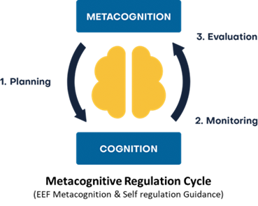
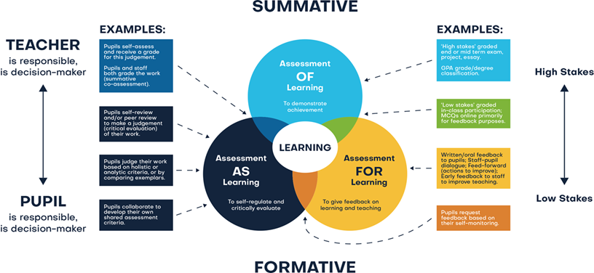
ASSESSMENT
Assessment comprises two linked processes:
Formative Assessment: provides Assessment for Learning. Is a continuous process and an integral part of teaching and learning; informal observations, dialogue/effective use of questioning, consolidation activities, low stakes quizzing, routine marking; and pupil/peer assessment all contribute to the developing profile of progress. When pupils make changes and consider actions to their work, based on the activity, they are ‘self-regulating’ their work. Self-regulating activities can be termed Assessment as Learning. Self-regulated learners are aware of their strengths and weaknesses, and can motivate themselves to engage in, and improve, their learning. Pupils start by planning how to undertake a task, working on it while monitoring the strategy to check progress, then evaluating the overall success.
Summative Assessment: provides Assessment of Learning and is a judgement of attainment at key points throughout the year- using past knowledge to measure attainment and progress. Examples of this are standardised tests, tasks and end of term/annual assessments which include a sample of pupil’s prior learning.
Assessment is a continuous process which is integral to teaching and learning and:
•Enables an informed judgement to be made about a pupil’s understanding, skills, attitude to learning and successful acquisition of knowledge as they move through the curriculum.
•Incorporates a wide range of assessment techniques to be used in different contexts/purposes.
•Is accompanied by clear assessment criteria that enables effective marking and feedback, a reliable progress evaluation to be given and demonstrates clearly what a pupil must do to improve.
•Provides feedback recognising achievement, increasing pupil confidence/motivation.
•Supports learning by making clear to pupils: what they are trying to achieve; what they have achieved; what the learning gaps and misconceptions are and what the next steps in learning are.
•Allows regular subject specific extended writing and access to high quality text/ reading.
•Should be moderated and standardised to ensure purposeful, meaningful, and timely feedback.
•Includes feedback to pupils to help them understand what they need to improve, challenging them to achieve their target rather than a grade.
Allows leaders and staff to make timely adaptations to the curriculum.
Christ at the Centre, Children at the Heart

