Slide 1

A big welcome and Introduction
Early Years Lead: MR GAMBON

Slide 2
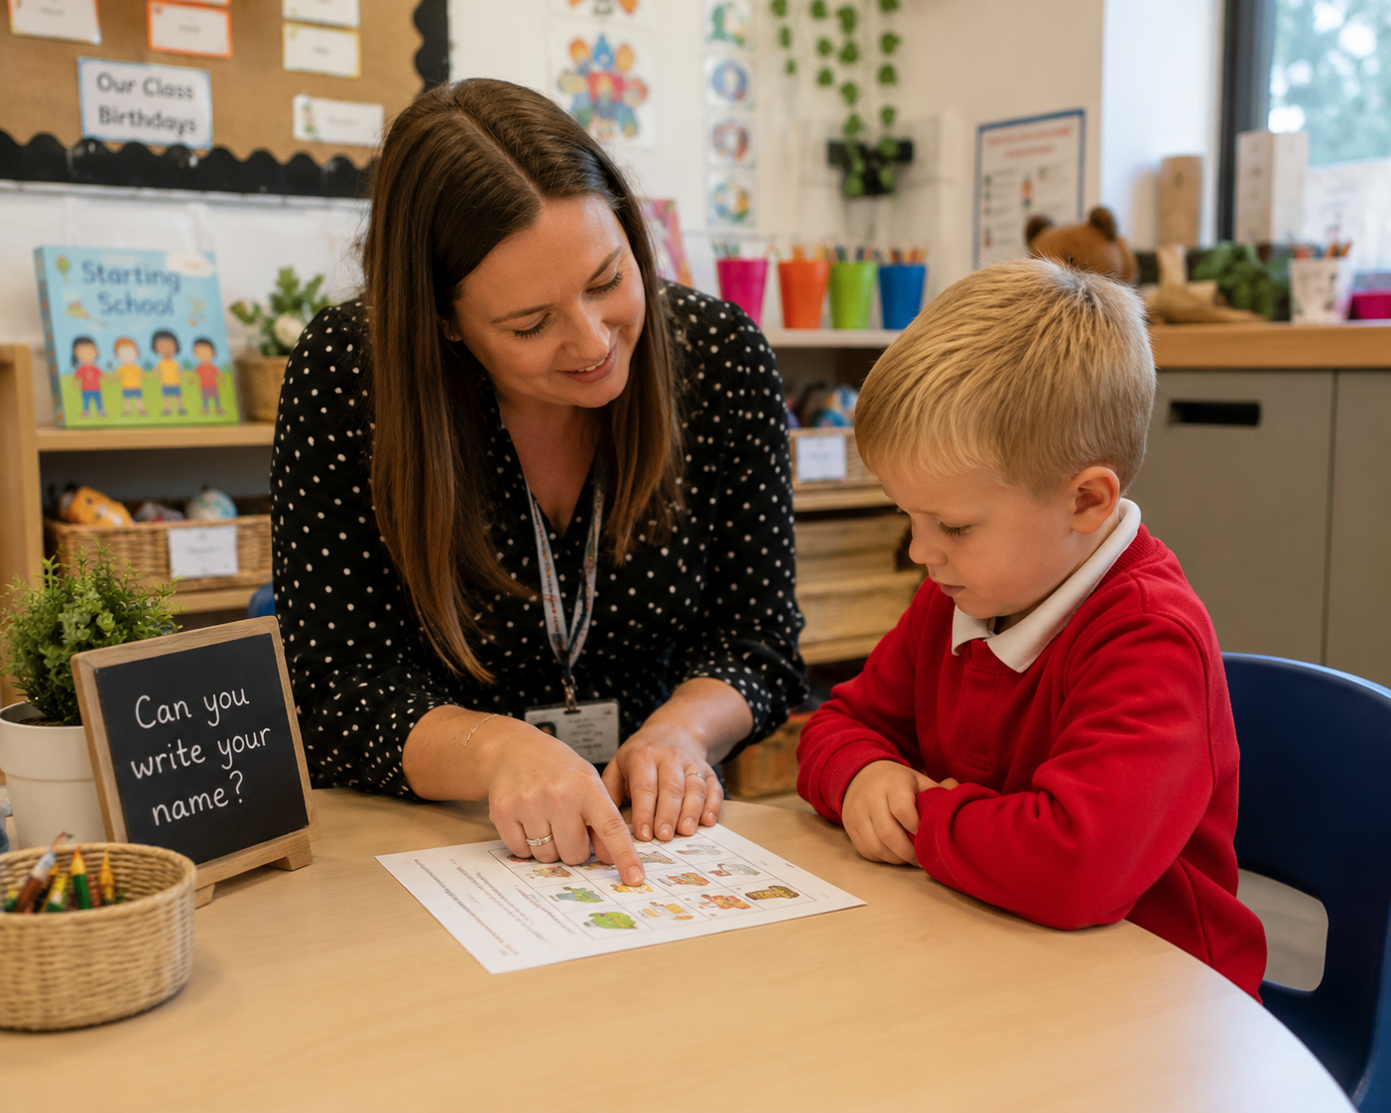
Smooth Transitions
Smooth and seamless transitions
are essential in settling children
into school.
This year through the welcome
meeting, stay and play and Nursery
visits, the children will be introduced
to their new teachers.
Communication between school and home is essential for children to flourish in new surroundings and they are recommended to help your child settle in well.

Slide 3
Smooth Transitions
To support children to settle and ‘hit the ground running’ we have put together a transition plan enabling them to have a smooth transition to school.
On the 2nd September 2026 → school begins and children's transition.

Slide 4
Dates for Diary
Dates | Details
17th June 2026 5pm-6pm | Meet The Teacher– an opportunity to meet your child's new teacher and to discuss information for your child starting in September. This will also give you a chance to ask any questions you may have.
23rd / 25th July 2026 | Mornings Stay & Play session. An opportunity to bring your child to visit the school and play in their new classrooms and get to know the adults your children will be working with.
Week Commencing 22nd June 2026 | Nursery visits – your child’s class teacher will visit your child at their Nursery.
2^{nd/} 3rd September 2026 | Children begin transition into school. 90min session.
4th September 2026 | Children in till 1pm to have lunch.
7th September 2026 | Children start a full day and full week

Slide 5

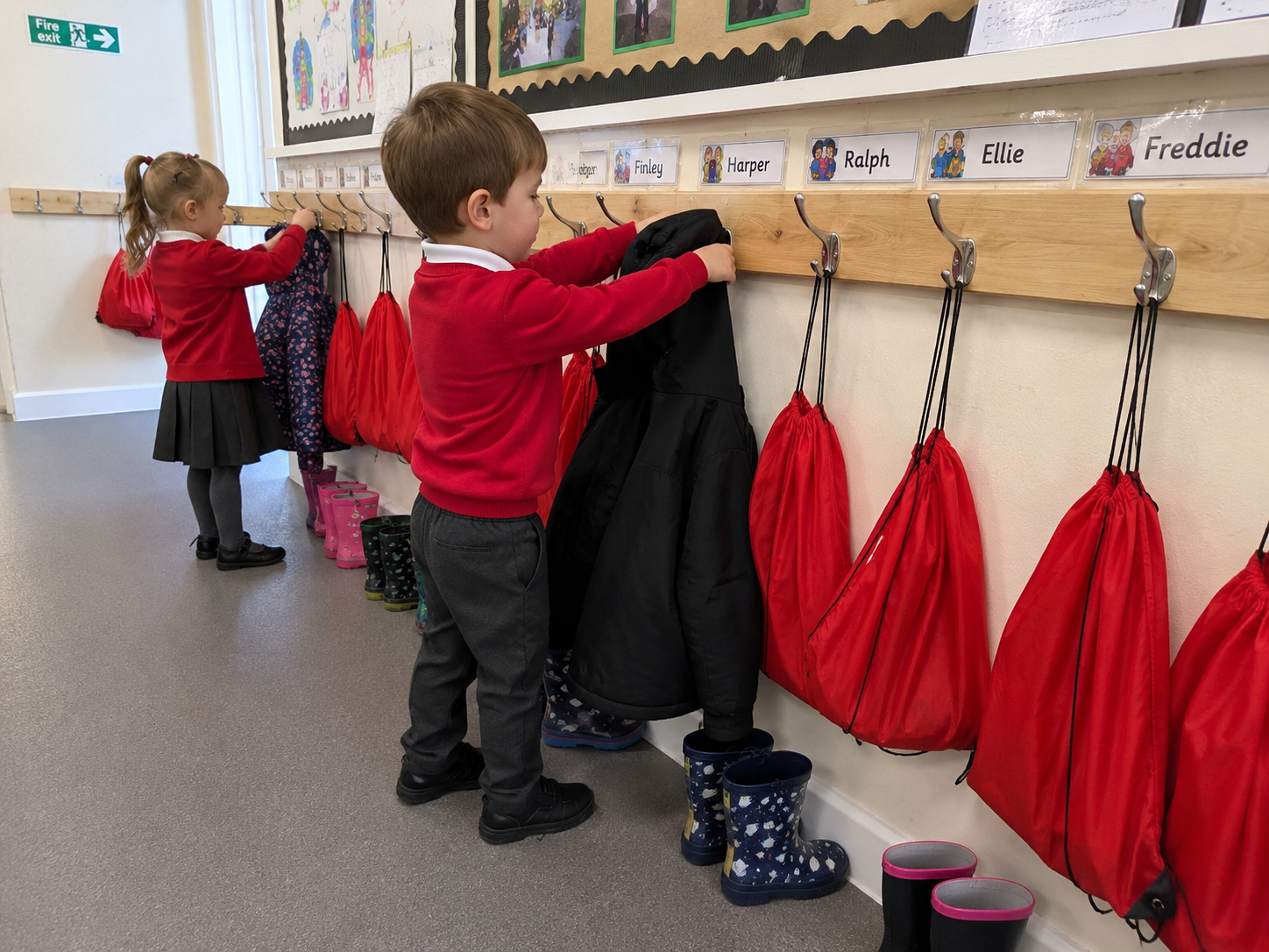
Uniform and Clothing
We encourage children to wear school uniform. We require children to wear a red jumper or cardigan, preferably with the school logo on. These can be bought from.
Uniform and bags need to be clearly
labelled with names please!
30 jumpers and 30 t-shirts all look
the same when we are getting changed.
Each child will have their own coat peg.
Please provide a spare set of clothes
that can be left in a bag on their peg.
We go outside in all weathers therefore your child will need wellies and waterproofs. Please ensure your child’s things are clearly named.
Available from
Top One in the St. John’s Centre,
Bang Bang on Lancaster Road &
Uniform & Leisurewear in Kirkham.

Slide 6
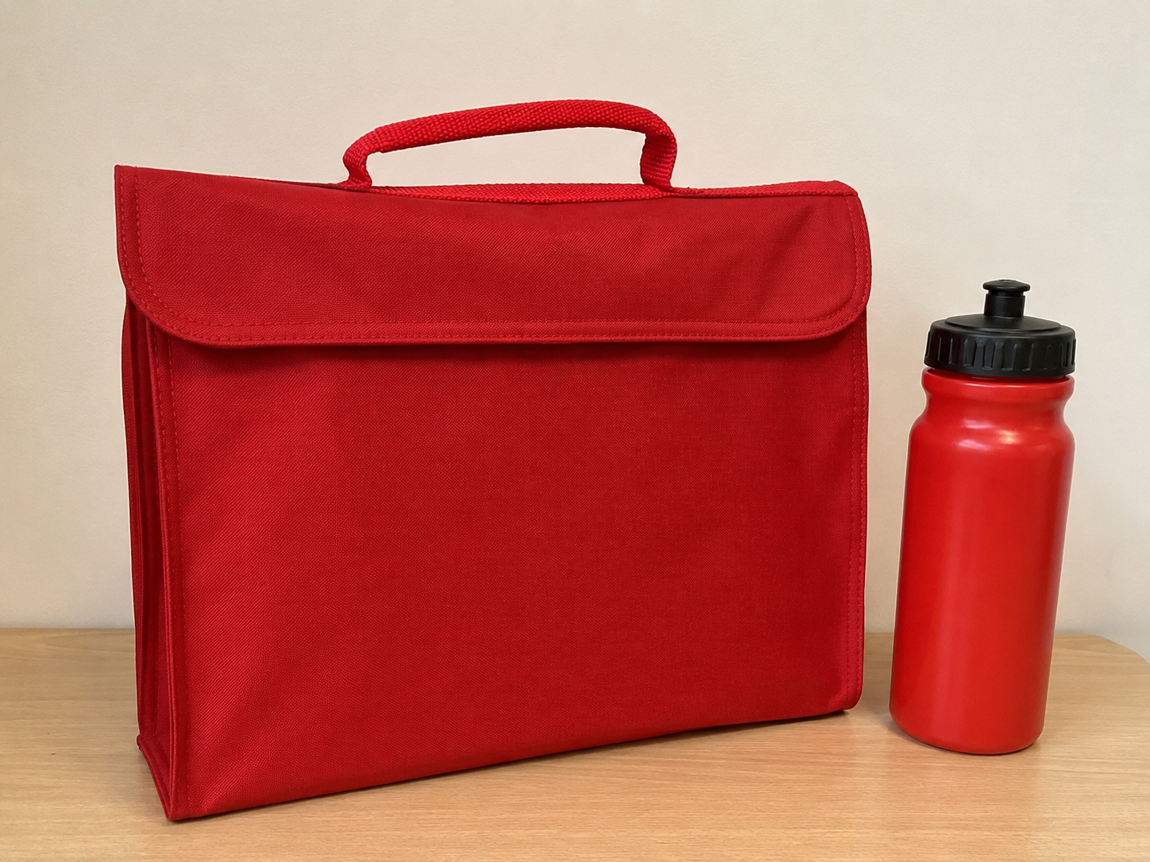
What does your child need at school?
Coat – waterproof safe
Wellies – please leave these in school (named)
Spare clothes – does not have to be uniform in a kit bag.
Book bag – please bring everyday so they can take their creations home safely!
Water bottle – No juice please ☺ (named)
School Book Bags & Water Bottles
can be purchased from Arbor school shop.

Slide 7
Key Staff
Mr Turner – Headteacher
Miss Clayton – Deputy Headteacher
Mr Gambon – Early Years Lead and Reception Teacher
Mrs Holden – Bursar
Mrs Burrows – Pastoral Manager
Mrs Rahman – Class Practitioner

Slide 8
The School Day
Breakfast Club opens at 7:30 am
School day: 8:40am -3:10pm
After School Club closes at 6:00 pm
St. Bernard's Extra is our "Before & After" Wrap Around Care for children from 3 years.
Bookings can be made in advance through the Arbor.
Charges:
Breakfast club £4.00 (from 7:30 am includes breakfast)
Drop off £1.50 (from 8:20 am)
After School Club £7.50 (until 6:00 pm & includes snack)
Pick up £3.00 (up to 4:10 pm).

Slide 9
The Beginning
In September, we will be phasing children into school with the transition plan below:
Wednesday 2nd September | 9:00 am – 10:30 am 1:00pm - 2:30pm
Thursday 3rd September | 9:00 am – 10:30 am 1:00pm - 2:30pm
Friday 4th September | 9:00 am – 12:30 pm * (including lunch)
Monday 7th September | 8:40 am – 3:10 pm
*From 7th September, your child will be staying for lunch.

Slide 10
First Few Steps
Starting school is a big step and every child settles at their own pace.
Some children may:
Settle immediately
Feel excited and confident
Become tired more easily
Feel worried at separation
Need reassurance
This is completely normal.
Our priority during the first few weeks is to help children:
Feel safe
Build relationships
Learn routines
Develop independence
Gain confidence
We kindly ask parents to allow time for their child to settle into school life.

Slide 11
The EYFS
SPECIFIC AREAS
Mathematics
Understanding the World
Expressive Arts and Design
Literacy
The Early Years Foundation Stage (EYFS) at St Bernards – A Learning Community provides children with the opportunities to experience the best possible start to their education and future years at school. Through grasping opportunities in child-initiated learning, as well as direct teaching, children build a solid foundation to build on as they progress through their journey in KS1 education and beyond.
Learning and Teaching is planned using the Early Years Foundation Stage curriculum, taking place both indoors and outdoors.
Development Matters - Seven areas of learning
Characteristics of effective Learning
PRIME AREAS
Physical Development
Personal, Social and Emotional Development
Communication and Language

Slide 12
Typical day
Planned short adult-led sessions daily:
Lancashire Red Rose Phonics sessions.
Writing and Sentence building (based around a book or activity).
Or White Rose Maths sessions using concrete resources, pictorial representations and abstract ideas (a mastery approach). To separate out these sessions.
In the afternoon Topic sessions, we plan the environment around topics and interests of the children, where we encourage exploration and play, then ‘hop on’ to opportunities to develop and deepen understanding during child-initiated learning & independent learning.
The PE session Will be on Friday of each week (This may change time to time). Please ensure NO earing are worn and long hair is tide up.

Slide 13
Lunch Times
School universal free school meals are available for Reception and Key Stage 1 children.
Packed lunches may be provided by parents based on the needs of the individual child (Please speak with me).
Please note we are a nut free school, so please do not provide your child with any snacks or food containing nuts.

Slide 14


Safer Eating

Slide 15
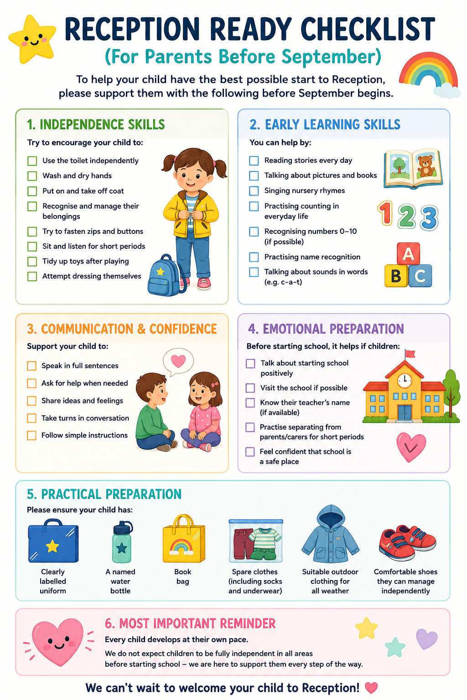



School Readiness

Slide 16
Additional Support & Inclusion
If you have any SEN concerns or feel your child needs any additional support,
Please speak with myself and or our SENCO Mrs. Terry.
cterry@stbernards.mecmat.org
01772 728153.

Slide 17
Safeguarding
The safety, Health and wellbeing of all children is our highest priority.
Designated Safeguarding Lead: Mr R Turner (Headteacher)
Deputy Designated Safeguarding Lead: Miss M Clayton, Miss D. Mooney
If you have any safeguarding concerns, please contact a member of the safeguarding team.

Slide 18
Attendance & Punctuality
Everyday counts
Good attendance is essential for learning and friendships.
Please:
Arrive on time
Inform school of absences.
Avoid holidays during term time where possible.
If your child is absent, please contact: The school office and keep in contact during child sickness period.

Slide 19
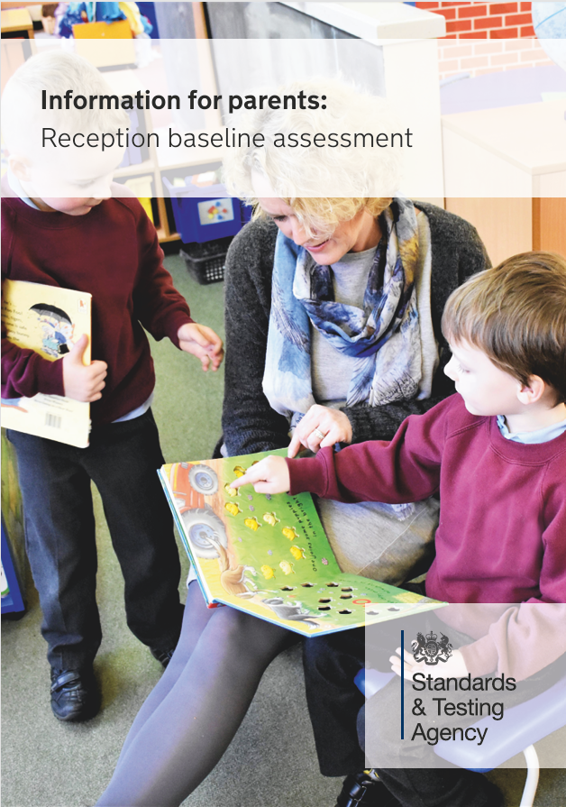
Reception Baseline Assessment

Slide 20
Supporting your child
Sharing learning through observations and photos using Seesaw and Class Dojo from home.
Here are some things that you can do together?
Play!
Share books daily
Sing songs and rhymes
Encourage independence when using the toilet
Take time to listen and talk
Answer and ask questions
Let children help you with the everyday jobs

Slide 21
The Importance of being involved
You can also help by:
Reading with your child daily using school books and record book.
Attending theme based Stay and Play sessions once a half term.
Supporting Volunteering in school, as a reader, on visits and outings.
Home Learning Packs sent out each half term: Please ensure these are completed as part of our school agreement.
A Must! one hour Workshops: As part of our school agreement.
30 mins with Teacher / 30 minutes with children.
  Reading and Phonics
  Reading for pleasure
  Handwriting – Letter formation
  Mathematics.

Slide 22
Class Dojo & Arbor Communication
Please sign up to class dojo.
Class dojo is a great way of communicating with you.
We share important class and whole school information
It has a translate function
Pick up your QR code from the teachers or if your child attends our nursery you will be invited to the new class
Sign up to Arbor - you will receive an email link in September - clubs, trips and more.
Read our weekly Newsletters
Have a chat with me at the end of the day.

Slide 23
Any Questions?
We’re here to help!

Slide 24
Before you go…
Please make sure you have;
✓ Return your child’s Induction Pack
✓ Have a look around our Classroom
✓ Take and complete ‘All About Me’ docs
✓ Ensure Nursery visit for your child is booked in with myself.

