Slide 1
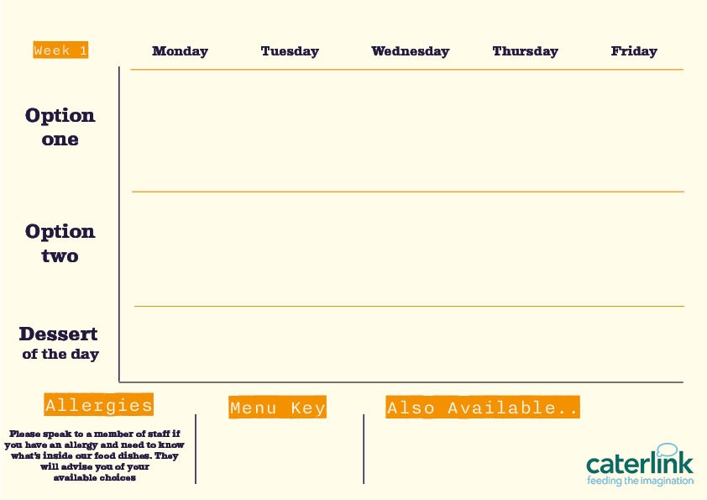






Spring Summer Menu 2026
Smokey Beef Chilli Tacos and Wedges
with Fresh Tomato, Pineapple and Cucumber Salsas
Roast Chicken with all the Trimmings
with Roast Potatoes, Stuffing, Carrots, Broccoli and Gravy
Fishfinger Sandwich
with Chips, Peas and Tartare Sauce
Chicken Shawarma
with Tabouleh, Tomato Salad, Pickles and Dips
Chicken
Biryani
with Sambals
Butternut & Feta Quesadilla and Wedges
with Fresh Tomato, Pineapple and Cucumber Salsas
Quorn Roast with all the Trimmings
with Roast Potatoes, Stuffing, Seasonal Veg and Gravy
Delhi Hound Dog
with Mango Chutney, Served with Chips
Falafel Bowl
with Tabouleh, Tomato Salad, Pickles and Dips
Vegetable Biryani
with Sambals
Sticky Toffee Apple Crumble
with Custard
Pineapple Upside Down Cake
Chocolate Brownie
Jam & Coconut Sponge
Oaty Flapjack
Vegan option
Our hot and cold grab & go selection alongside soup of the day and filled jacket potatoes
Added plant protein
Source of wholemeal

Slide 2


Spring Summer Menu 2026
Battered Fish or Salmon Fishcake
and Chips with Garden Peas
BBQ Pulled Pork Slider
with Paprika Wedges and Slaw
Mac and Cheese with Toppings
Croutons, Pepperoni Pieces, Crispy Onions, Spring Onions, Barbecue Beans
Chicken Tikka Masala
with 50/50
Rice and
Sambals
Original Spice Chicken
with Spicy Rice and Rainbow Slaw
Summer Broccoli and Feta Quiche
with Summer Salad and Chips
Burrito Bowl
with Rice, Charred Corn Salad, Salsa and
Sour Cream
Sweet Potato, Chickpea & Spinach Tikka
with 50/50 Rice
and Sambals
Smokey Bean
Burger
with Spicy Rice and Rainbow Slaw
Chocolate Orange Cookie
Cherry Apple Crumble
with Custard
Peach Upside Down Cake
with Custard
Fruit
Muffins
Chocolate Swirl
Vegan option
Our hot and cold grab & go selection alongside soup of the day and filled jacket potatoes
Added plant protein
Source of wholemeal

Slide 3



Spring Summer Menu 2026
Classic Beef Lasagne
with Garlic Bread and Chunky Roasted Summer Veg
Chip Shop Fish or Sausage
with Chips, Mushy Peas and Gravy or Curry Sauce
Gochujang Sticky Chicken
with Rice and Cucumber Shaker Salad
Chicken Souvlaki
with Seasoned Potatoes, Tzatziki and Greek Salad
Jerk Chicken Thighs
with Rice & Peas, Broccoli and Spiced Pineapple Slaw
Yakisoba Soya
Noodles
Stir Fry with Edamame Beans
Tuscan Chickpea Pasta
with Garlic Bread
and Chunky Roasted Summer Veg
Chip Shop Vegan Sausage
with Chips, Mushy Peas and Gravy or Curry Sauce
Curried Squash & Butterbeans
with Rice & Peas, Broccoli and
Pineapple Slaw
Spanakopita
With Seasoned Potatoes, Tzatziki and Greek Salad
Sticky Toffee Apple Crumble
with Custard
Chocolate Crunch Cake
Eton Mess
Apple Pie
with Custard
Iced Sponge Cake
Vegan option
Our hot and cold grab & go selection alongside soup of the day and filled jacket potatoes
Added plant protein
Source of wholemeal

Slide 4
Spring Summer Menu 2026
SECB5 SECMK6/ SECMK13 SECMK12 SECMK7-MK9
Smokey Beef Chilli Tacos and Wedges with Fresh Tomato, Pineapple & Cucumber Salsas
SECCH19 SECSD45 SECSD46 SECSD47 SECSD48
Chicken Shawarma
with Tabouleh, Tomato Salad, Pickles & Dips
SECCH13 SECSD21 SECSD49 SECSD7 SECSD5 SECSD28
Roast Chicken
with Roast Potatoes, Stuffing, Carrots, Broccoli & Gravy
SECF8 SECSD4 SECSD6 SECSD36
Fishfinger Sandwich
with Chips, Peas & Tartare Sauce
SECCH18 SECSR8-SR12
Chicken Biryani
with Sambals
SECV55 SECMK12 SECMK7-MK9
Butternut and Feta Quesadilla and Wedges
with Fresh Tomato, Pineapple & Cucumber Salsas
SECV35 SECSD21 SECSD49 SECSD7 SECSD5 SECSD28
Roast Quorn
with Roast Potatoes, Stuffing, Carrots, Broccoli & Gravy
SECHD16 SECHD6 SECSD4
Delhi Hound Dog
with Mango
Chutney & Chips
SECV56 SECSD45 SECSD46 SECSD47 SECSD48
Falafel Bowl
with Tabouleh, Tomato Salad, Pickles & Dips
SECV51 SECSR8-SECSR12 Vegetable Biryani
with Sambals
SECD20 SECD28 Sticky Toffee Apple Crumble
with Custard
SECD42
Pineapple Upside Down Cake
SECD6
Chocolate Brownie
SECD35
Jam &
Coconut Sponge
SECD40
Oaty
Flapjack
Vegan option
Our hot and cold grab & go selection alongside soup of the day and filled jacket potatoes
Added plant protein
Source of wholemeal

Slide 5
Spring Summer Menu 2026
SECMC1 SECMC2- MC6
Mac and Cheese with Toppings
Garlic Croutons, Pepperoni Pieces, Crispy Onions, Spring Onions, Barbecue Beans, Roasted Vegetables and Red Pesto
SECCH20 SECSF11 SECPEC13
Original Spice Chicken
with Spicy Rice and Rainbow Slaw
SECP6 SECSD19 SECSD44
BBQ Pulled Pork Slider
with Paprika Wedges and Charred Corn Salad
SECSR14 SECSD39
SECSR8-SR12 Chicken Tikka Masala
with 50/50 Rice
and Sambals
SECF7 SECF1 SECSD4 SECSD6
Battered Fish or Salmon Fishcakes
with Chips and Garden Peas
SECV14 SECSD18 SECSD19 SECPEC13 Smokey Bean Burger
with Cajun Wedges and Rainbow Slaw
SECV57 SECSD15 SECSD44 SECMK9 SECMK11
Burrito Bowl
with Rice, Charred Corn Salad, Salsa and
Sour Cream
SECSR5 SECSD39 SECSR8-SR12 Sweet Potato, Chickpea & Spinach Tikka
with 50/50 Rice
and Sambals
SECV58 SECSD4 SECFE8
Broccoli and Feta Quiche
with Summer Salad and Chips
SECD41
Chocolate Orange
Cookie
SECD16 SECD28
Cherry Apple Crumble
with Custard
SECD51 SECD28 Peach Upside Down Cake
with Custard
SECD50 Chocolate Swirl
SECD8
Fruit Muffins
Vegan option
Our hot and cold grab & go selection alongside soup of the day and filled jacket potatoes
Added plant protein
Source of wholemeal

Slide 6
Spring Summer Menu 2026
SECCH21 SECSD15 SECSD50 Gochujang Sticky Chicken
with Rice and Cucumber Shaker Salad
SECY1 SECY8 SECY11 SECY6 SECY7 SECSD42
Chicken Souvlaki
with Tzatziki, Seasoned Potatoes and Greek Salad
SECB3 SECSD23 SECFE8
Classic Beef Lasagne
with Garlic Bread
and Chunky Roasted Summer Veg
SECCC4 SECC10 SECSD5 SECCC11
Jerk Chicken Thighs with Rice & Peas, Broccoli and Spiced Pineapple Slaw
SECF7 SECP4 SECSD4 SECSD31 SECSD8 SECSD29 Fish/ Sausage
with Chips, Mushy Peas & Gravy or Curry Sauce
SECY4 SECY11 SECY6 SECY7 SECSD42
Spanakopita
with Tzatziki, Seasoned Potatoes and Greek Salad
SECV59 SECSD23 SECFE8
Tuscan Chickpea Pasta
with Garlic Bread
and Chunky Roasted Summer Veg
SECCC2 SECC10 SECSD5 SECCC11
Squash and Butterbean Stew
with Rice & Peas, Broccoli and Spiced Pineapple Slaw
SECV19 SECSD4 SECSD31 SECSD8 SECSD29
Vegan Sausage
with Chips, Mushy Peas & Gravy or Curry Sauce
SECV52
Yakisoba Soya Noodles
SECD20 SECD28 Sticky Toffee Apple Crumble
with Custard
SECD33 Chocolate Crunch Cake
SECD5 SECD28
Apple Pie
with Custard
SECD37
Iced Sponge Cake
SECD52
Eton Mess
Vegan option
Our hot and cold grab & go selection alongside soup of the day and filled jacket potatoes
Added plant protein
Source of wholemeal

