Slide 1


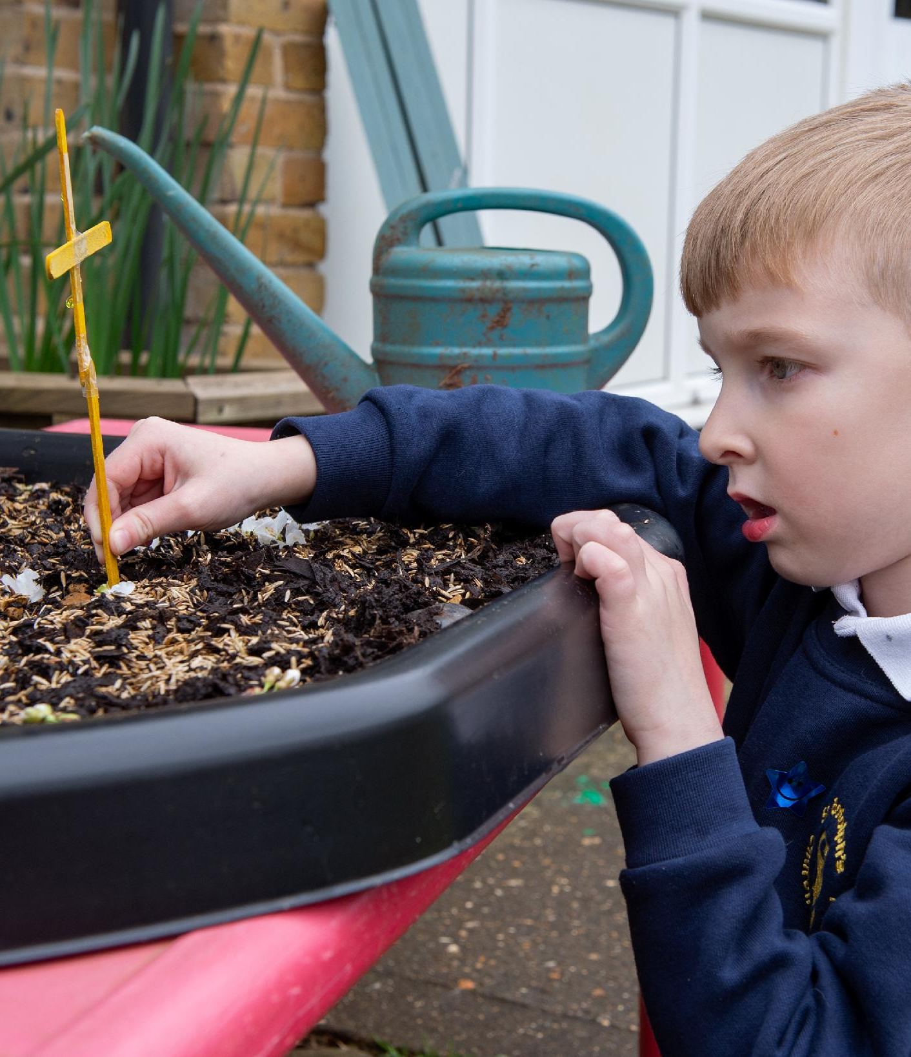
St Botolph’s C of E Primary School
SEND Information Report
Reviewed July 2026
Next Review July 2027
Headteacher: Mrs R Rayner
SENCo: Mr A Knightley

Slide 2
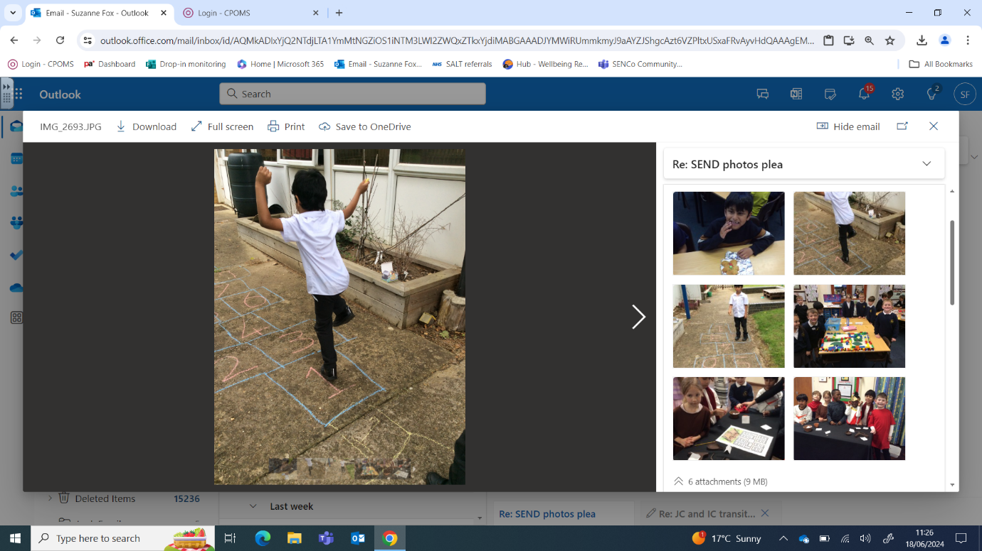
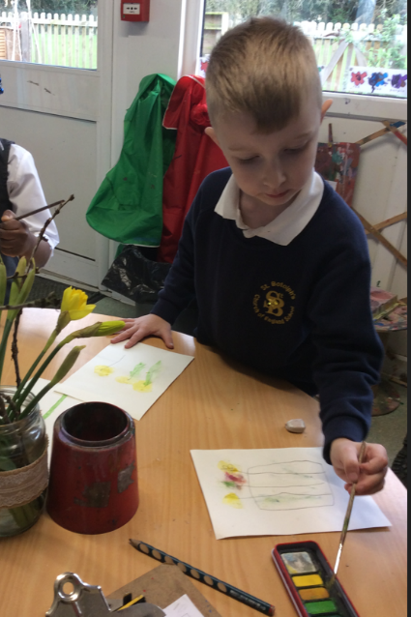
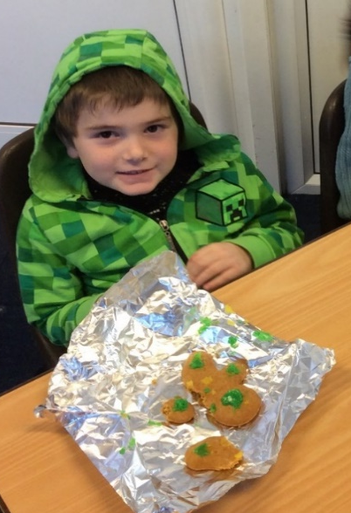
“Leaders quickly identify pupils with special educational needs and/or disabilities (SEND). Working with external specialists, leaders provide useful guidance and direction for staff.
Staff use leaders’ guidance well to adapt teaching for these pupils. Leaders also put in place specialist provision for pupils with SEND. This helps these pupils to learn about themselves and develop strategies to overcome the challenges they face.”
Ofsted January 2023
‘Every teacher is a teacher of Special Educational Needs’ (SEND code of practice, 2014)
DEMAT Principles of Inclusion
All DEMAT children are entitled to a knowledge-rich curriculum where knowledge is valued, specified, well-sequenced and taught to be remembered.
Where necessary, through robust and rigorous assessment processes, we make intentional decisions to adapt and make reasonable adjustments ensuring that all DEMAT pupils receive this entitlement because their identified needs are addressed.
In DEMAT schools, everyone is responsible for the culture of ambitious aspirations and high expectations for all pupils recognising that each child is unique, complex and valued.
These high expectations are for our pupils’ academic outcomes, their personal conduct, and their contribution as members of the communities to which they belong in order that they may flourish now and in the future.
The behaviour curriculum is taught proactively with consistent expectations, approaches to the learning environment and routines set to ensure that all children receive their entitlement to the education they deserve.
We work in partnership with parents, carers and professionals so there is a shared understanding of the evidence-informed inclusive practice.
The Local Authority and the Diocese of Ely Multi-Academy Trust are committed to principles of inclusion for all pupils, regardless of their specific needs, making the best possible progress in their educational setting which, wherever possible and with the agreement of the family or young person, will be in a mainstream setting. The mission of our academy trust family DEMAT, is to deliver a high-quality education for children and young people of all faiths and none, underpinned by our Christian distinctiveness.
All Peterborough’s schools have a similar approach to meeting the needs of pupils with special educational needs and disabilities. Maintained schools have access to a range of professional services provided by the Local Authority which include the Educational Psychology Service, the Autism Advisory Teaching Service, the physical and sensory support service and the specialist advisory teacher for pupils with ADHD. Academies and Free Schools within the city also have access to these services though the funding mechanisms differ to those in place for maintained schools.
At the Diocese of Ely Multi-Academy Trust, ‘Every teacher is a teacher of Special Educational Needs’ (SEND code of practice, June 2014), so CPD is available for all our teachers, focused on teaching approaches and pedagogy that helps them ensure all learners can access the curriculum effectively.
Our inclusive universal offer for all children includes a wide range of activities, opportunities and approaches provided to meet a range of needs. However, where a need is identified that requires additional or different support, schools will provide support and intervention in a graduated approach following an ASSESS-PLAN-DO-REVIEW cycle.
To help us ensure that we are meeting pupils’ needs using the most appropriate and effective approaches we are building a network of professionals, who are recognised as leaders and innovators within their field, to provide expert and highly specialised advice and training for staff, pupils, parents and carers.
As a trust, we have in place a graduated approach which is shared and supports everyone to understand the expectations and know what the next steps are.

Slide 3

Our approach to compiling this report
Our SEND report is compiled in collaboration with staff, children and parents:
Staff
Staff voice is consulted via training with an enhanced focus on an inclusive learning environment, daily teaching and learning tasks in order to strengthen curriculum accessibility for all.
They play an active role in identifying additional needs; planning and actioning appropriate interventions. Furthermore, staff ensure that lessons are inclusive so all learners can participate by providing appropriate adaptations/scaffolds. This forms our ordinarily available provision.
Children
Children's’ views were sought through a child friendly questionnaire completed with staff and the SEND Governor led some small focus group sessions with a range of SEND children from across the school. Children’s views are also captured every time ASSESS-PLAN-DO-REVIEW cycles are reviewed. Additionally, a yearly updated single-page Pupil Profiles were completed with staff at the beginning of the academic year and shared with parents.
Parents/carers
Parent/carer views are formally sought and recorded at termly ASSESS-PLAN-DO-REVIEW cycle meetings led by class teachers, and in the end of year SEND questionnaire.
What is a Special Educational Need?
The SEND Code of Practice defines a child or young person as having a special educational need if:
They have a significantly greater difficulty in learning than the majority of others of a similar age
They have a disability which prevents or hinders them from making use of the educational facilities of a kind generally provided for others of the same age in mainstream schools
(Code of Practice 2015, Introduction xiv)

Slide 4

“Staff quickly identify when pupils misunderstand or have forgotten what has been taught. When this happens, staff provide effective support that ensures pupils do not fall behind.”
Ofsted 2023
The Whole School Approach for SEND at St Botolph’s C of E Primary
Ordinarily available provision offered to every child at St Botolph’s
At St Botolph’s we run a SEND first approach because what is good for SEND is good for every pupil.
High quality teaching, curriculum for all and additional interventions are the foundations of our provision management approach. For example, our highly structured phonics programme allows us to pinpoint exactly what children have learned and what they need to learn next. Interventions are taught by teachers who are trained to deliver the phonics programme.
Teachers routinely break learning down into small steps and scaffold learning where needed. Vocabulary is explicitly identified and taught to the whole class. This allows all children to access learning within the class.
Teaching environments have communication friendly aspects to them such as pictures to illustrate behaviour expectations and working walls are built up over time to enable all children to recap prior learning that might be needed today.
Teachers ensure that learning spaces have minimal distractions but include helpful prompts such as the visual timetable.
We regularly review and record what we offer EVERY child in our care (ordinarily available) and what we offer additionally (targeted and specialist). These discussions also serve to embed our high expectations among staff about quality first teaching and the application of scaffolded adjustments to teaching and learning.
Underpinning ALL our provision at St Botolph’s is the graduated response cycle of: Assess, Plan, Do, Review.
What do we offer additionally?
In addition to scaffolded adjustments, provision may include short-term time bound interventions to overcome any barriers to or gaps in learning. This is also part of our ordinarily available provision and is recorded on a Class Provision Map.
All additional provision is based on an agreed outcomes approach after consultation with the child and their parents.
What are the main areas of SEND?
Children and young people’s special education needs are generally thought of in the following 4 areas of need:
Communication and Interaction
Cognition and Learning
Social, Emotional and mental Health
Sensory and/or Physical
Targeted Provision
A child identified as having SEND will have provision made for them that is different from and additional to that of their peers. This is our targeted provision and is when children will be added to the SEND register.
With targeted support a child is at School Support. Specialist support is for the children with the most complex needs for whom an Education, Health and Care plan has been requested and agreed
To read our accessibility plan please click here

Slide 5
Autism
Attention Deficit Hyperactivity Disorder
Identified sensory needs
Fine and gross motor difficulties
Speech, language and communication needs
Diagnosed with dyslexia or exhibiting strong traits of dyslexia
Specific writing difficulties
Attachment disorder
Social, Emotional and Mental health difficulties
Hearing impairment
SEND Learners at St Botolph’s C of E Primary School
Current areas of need for learners with SEND at our school
Access to the learning
Teachers use scaffolds and adaptation to ensure that their classrooms and the curriculum are inclusive. These may include:
Individual workstations
Displaying signs and personal timetables
Using prompt cards
Use of technology to aid learning e.g. interventions, apps
Different ways of recording work including using technology
Instructions as a checklist or in visual form
Use of a larger font and icons for worksheets
Writing aids: sloping boards, pencil grips
Sensory aids, including fiddle toys and sensory cushions
Adaptations for hearing and visual impairments
Easy access into and around school for any physical disabilities
‘Wobble and sit’ cushions and wobble stools
Reception
3
Year 1
5
Year 2
6
Year 3
4
Year 4
5
Year 5
10
Year 6
9
12
Number of children with EHCPs
3.7%

Slide 6

All the things [I need] are in my pot on my table.
What helps us with our learning at school?
You can do SLANT to make sure that you’re listening – if you don’t listen you won’t know what to do!
The board sometimes has writing on from my teacher.
The classroom toolbox
Teachers and the adults
Closing my book if I feel cross then I can have a break and come back after.
Looking at the walls around the classroom
Our Young People Share Their Voice
Counters and cubes
A 100 square
“When you listen to the teacher, it helps you figure it out.”
The SENCo led two focus groups with children from Rec to Yr 6 in July ’26 to gain the SEND pupil voice. All the children willingly shared their views. Pupils enjoy spending time with their friends, swimming and PE, phonics and maths best. They enjoy getting house points. They appreciate the teachers and adults who help them and do not have concerns about asking for help. They use peers and classroom boards to support them too.
Children say they like to know how they are getting on and worry when they are unsure. This year children were specifically asked about movement breaks. Most found this a helpful strategy but recognised it needed to be structured and brief otherwise they miss important points of learning. A few children struggled with what they felt to be unkindnesses by other pupils and playtimes and lunchtimes were cited as times of overwhelm because of how busy and unstructured they are.
Children who responded would like to have better activities at playtimes and attend more trips and visits.

Slide 7
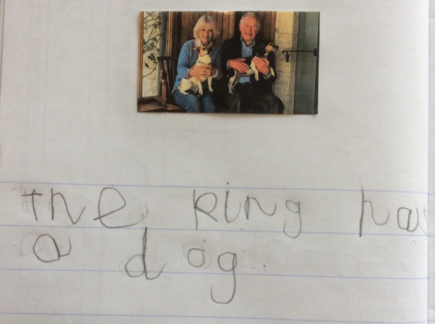
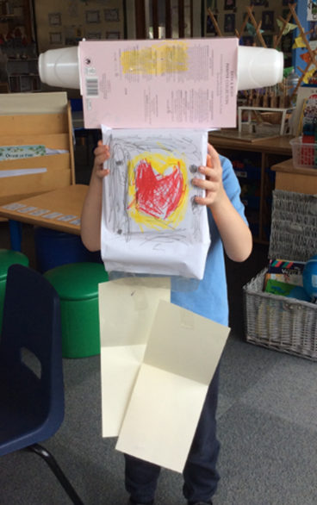
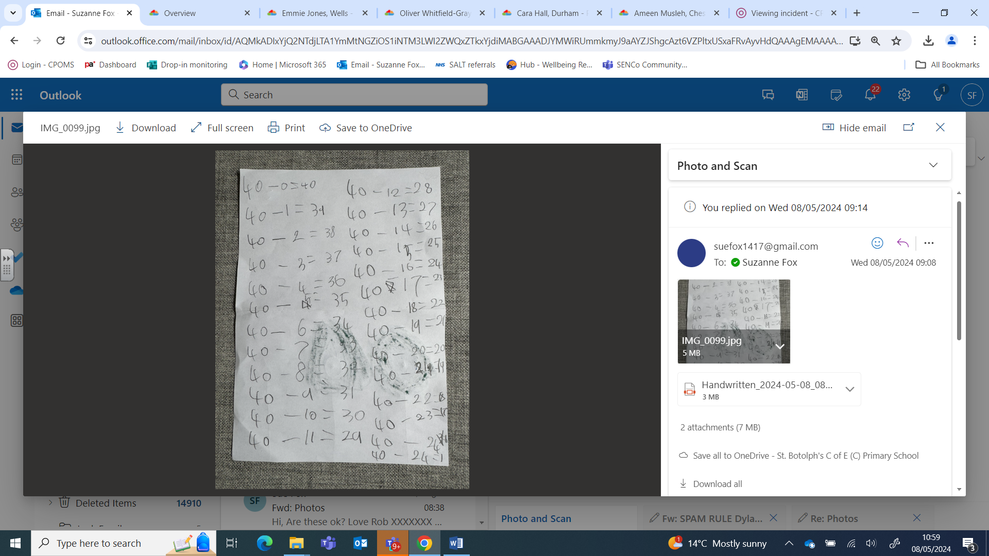
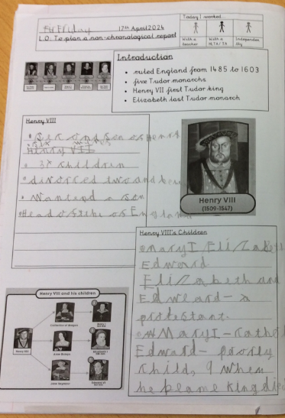
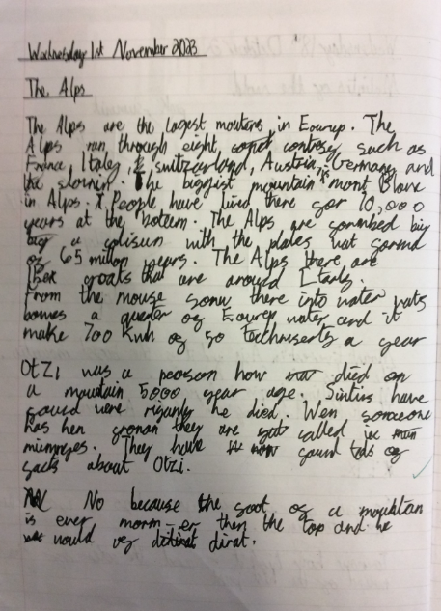
Work our children with SEND are proud of
My writing about the king
Y1 child
My writing about the Alps
Y5 child
My robot I made
Reception child
Maths is my favourite thing to do
Y2 child
My writing about Henry VIII
Y2 child

Slide 8
Identification
How we identify children with SEND
How can parent/carers raise concerns?
Who is responsible for teaching children with SEND?
Who else might work with your child?
Via regular meetings with parent focussed on progress and prior attainment
During observations of the child in classroom and playground
Formative classroom assessments
Evidence from work produced
School tracking data for reading, writing and maths
Structured discussions with class teachers and TAs to help focus on the particular needs and strengths of a child
Recorded sensory difficulties
Behaviour patterns
Advice from outside agencies
All teachers are responsible for every child in their care, including those with special educational needs.
All teachers will plan for and work with the SEN children in their class with guidance and support from the Special Educational Needs Co-ordinator (SENCo).
SENCo | Mr Knightley
Teacher for children with additional needs | Mr Knightley
Speech and Language Assistant | Mrs Musleh
Learning Mentor | Mrs Wootton
Teaching Assistants/Higher Level Teaching Assistants | Either 1:1 or in a group
Staff from outside agencies | If a child’s needs require specialised support
Via discussion with the class teacher during parent/carer consultation meetings
Through informal discussions before and/or after school
By making an appointment for a confidential talk with the Class Teacher, SENCo, Head Teacher or SEND Governor via telephone or email to the school office
In a Home/School Communication Book if it is felt necessary and appropriate for your child

Slide 9

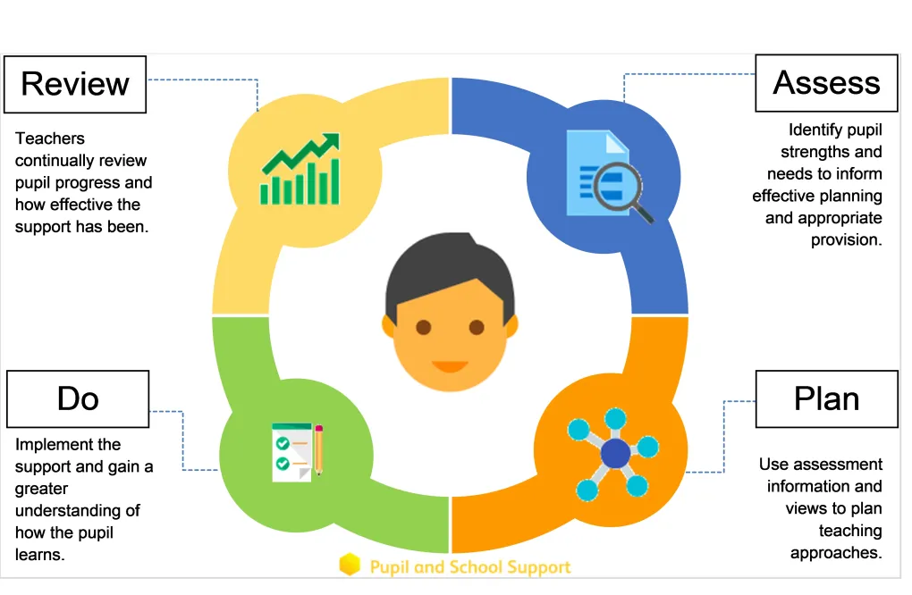
How do we involve young people with SEND and their families in their education?
Monitoring the support
The SENCo monitors the targets set and progress made on the Assess Plan Do Review plans, she also monitors the adaptations made to check they are impactful. She works with teachers to ensure that targets are appropriate and ambitions yet realistic.
The SENCo is a member of SLT and outcomes of monitoring are fed back to senior leaders who also may have insight into the needs of that child.
SENCo and SLT monitor teaching and learning via drop ins, work scrutiny, pupil voice and planning reviews.
The SEND governor meets with the SENCo half termly to discuss the findings of monitoring and any actions taken as a result. A report is made to each Local Governing Body Meeting.
The SENCo and SLT seek feedback from children and their families in the following ways
Discussion with Class Teacher, SENCo, Phase Lead, Head Teacher
Telephone or email to the Class Teacher, SENCo, Phase Leader, Deputy Head Teacher, Head Teacher
Written feedback after Parent Consultations on Parent View website
Written feedback after Open Sessions
Regular questionnaires
Once a child is identified as needing additional or different to our ordinarily available provision then school professionals work with our young people and their families to ensure that they get the support needed.
This is done via the Assess – Plan – Do review process which teachers and the SENCo oversee.
How we listen to the contributions of young people and their families
Families
Additional appointments with the Class Teacher, SENCo, Head Teacher, Deputy Head Teacher
SENCo available for consultations
Longer Parent Consultation meetings
Holding early annual reviews if necessary for children with Education, Health and Care plans
In these formal and informal discussions with the Class Teacher and SENCo, the parents will be asked their views at every stage of the SEND process. They will be asked to give information about:
Their child’s strengths and weaknesses
Successful strategies they use at home
The areas they feel the child needs the most support with
The long-term outcomes they want for their child
Young people
One-page Pupil Profile created with the teacher at the beginning of an academic year and shared with all relevant staff and parents
Discussion with children during and at the end of intervention programmes
Creating a personal pathway if they have an EHC plan
Verbal discussions in class
Talk partners in lessons
Surveys and pupil voice activities

Slide 10
Professionals who can advise
Our SENCo is Mr Ashley Knightley
Mr Knightley carries out his SENCo role Wednesdays and Thursdays. He works for the Trust on Fridays.
He can help you by:
Offering advice about how to identify if your child has any special educational needs
Suggesting ways to support your child at home
Making referrals to outside agencies
Leading multi-agency meetings to make sure your child’s needs are met in school
Providing advice on any family needs and suggest who can help
Should you wish to speak or meet with him then please ring the school office or speak with a member of our office staff to make an appointment. Alternatively, you can email the SEND team with any queries at the address below.
Our school access the following services and support
Specialist teaching service – Autism and ADHD Advisory Teaching Service
Early Years Teaching Service
Educational Psychology Service
Peterborough SEND Hubs
School Nurse
Children’s Speech and Language Therapy Service (SALT)
Occupational Therapy Service
Centre 33
Younited
CAMHS – Child and Adolescent Mental Health Services
Behaviour and Inclusion Team
Emotional Health and Wellbeing Service
Support for Learning
Peterborough Integrated Neurodevelopmental Service
Multi-Agency support group (MASG) assess need and coordinate support from appropriate agencies through Early Help
Mrs Rachel Rayner our Head Teacher
Mrs Alia Musleh our Speech and Language Assistant
Mrs Amelia Wootton our Learning Mentor
Call the school office on 01733 231313 or email informus@st-botolphs.peterborough.sch.uk to make an appointment.
Mrs Jade Fitt is the Inclusion Lead for the Trust.

Slide 11
Training for staff
What training have staff recently attended?
Training from outside providers has included:
Virtual courses run by SEND Hubs including focus on supporting children with sensory needs
Communication partner training – supporting children to use AAC (Alternative and Augmentative Communication)
Grace Schools SENCo forums
PINs Partnership in Schools Programme
In house training has included:
Child Protection and safeguarding
SEND induction training for new staff
Reviewing how to write SMART targets for SSP cycles
Gestalt learners and how to support them
Attention Autism Progression
Phonics
Captivating attention and choral response
Training we intend to undertake
To enhance SEND provision in our school next year and to meet the increase in children starting at St Botolph’s with increasing speech and language and increasing sensory needs, we are planning training in the following areas:
OPAL training for lunchtimes (inclusion)
Communication and language development
Speech and language barriers
Are our quiet children hiding communication difficulties?
Training needs are reviewed and addressed each term.
Alongside training for staff we also support families with our cafes
Settling and meltdowns
Anxiety and friendships
Managing transitions
Online safety and social media
Transitions
Family voice PINS coffee mornings
All of our teaching staff have QTS and degree level qualifications.

Slide 12

Transitions
How do we help children and their parents/carers to make a successful transfer to our setting?
Starting School:
Pre-school/nursery will normally inform us if a child joining our school has special educational needs and /or disability and then:
SENCo visits pre-schools/nurseries
The Class Teacher makes home visits
The child visits the school with parents/carers
The child makes extra visits to the school with pre-school keyworker
Information gathering from all professionals involved with the child
Transition meetings with the parents
When appropriate, a photograph book of the school and all adults who will be involved with the child will be created and given to the family as a point of reference during the weeks preceding the start of school
New to the school:
Parent and child visits are arranged before the child begins
Pupil information is passed on from the previous school
SENCo contacts the previous school to discuss particular needs and support the child has received
Transition meeting with the parents if appropriate
Child may be assigned a ‘buddy’ to support them initially
How do we prepare children to make their next move?
From class to class
The child may meet the teacher and be taken round the new classroom before the ‘Move Up’ session in school
A Social Story may be written outlining details of the new teacher, classroom and routines
Children will spend two days with their new class and teacher by attending ‘Move Up’ days
The current teacher liaises with the new teacher to pass on relevant information and successful strategies that have been used
The SENCo provides background information on the child’s particular special need
Training is given, if needed, to inform the new staff of a child’s particular area of need
A photograph book about the new year group and staff is provided to children for families to share over the summer holiday.
Children who would benefit from meeting the teacher and seeing their new classroom again before they start back, are offered the chance to visit with their families on teacher training days.
Going to secondary school:
EHCP transition reviews invite SENCo from identified secondary placement if known
SENCo shares successful strategies with SENCo from secondary
Staff from the secondary school will visit the children here
Extra visits to the new school may be arranged for SEND children if necessary
SENCo will provide the new school with all relevant information
All records pertaining to the child will be sent to the new school
Preparation for Adulthood:
We commit to increasing children’s awareness of different career pathways through our wider curriculum
SEND children are represented on School Councils and in roles of responsibility such as Peer Mentors and School Ambassadors

Slide 13
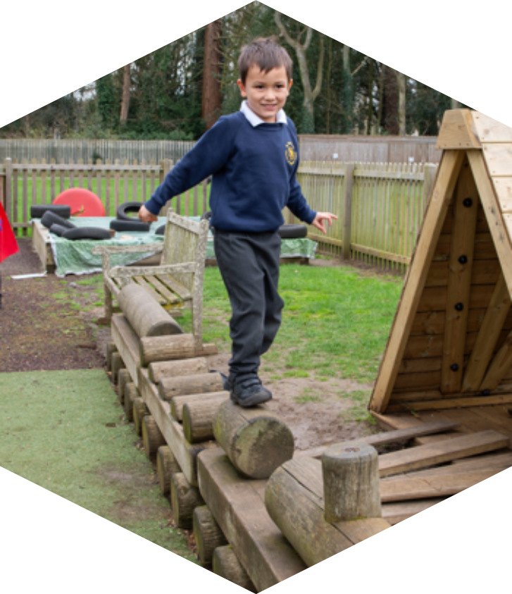

Family support in the Locality
The Peterborough Local Offer
The Local Offer gives children and young people with special educational needs or disabilities (SEND) and their families information about support and services in Peterborough.
Please click on the link below to view the Local Offer.
https://www.peterborough.gov.uk/residents/special-educational-needs/local-offer/
Send Partnership Service:
The SEND Partnership Service offers information, impartial advice and support to parents/carers of and children/young people who have SEND from 0 – 25 years. SEND Partnership Service (Local Offer) | Peterborough Information Network
Family Voice Peterborough:
Family Voice Peterborough is a local registered charity who are actively seeking to improve services in all areas of the lives of children and young people with disabilities or additional needs. They support parents and carers of children and young people aged 0—25 years with a disability or additional needs.
St Botolph’s Church of England Primary School
Oundle Road, Peterborough.
PE2 7EA
Phone: 01733 231313
Email: informus@st-botolphs.Peterborough.sch.uk
Web: stbotolphs.demat.org.uk

