Slide 1

96% of students and 98% of parents rated our revision preparation as ‘invaluable’ in 2023
In 2023, we celebrated the best ever exam results in our history
‘I felt prepared and I knew what to do to be successful’ – Y11 student
‘It took all the pressure off. Take advantage’ – Y11 student
‘I am so grateful for everything you have offered and having the tasks to check off each night has helped my son so much’ – Y11 parent
‘We did this together’ – Y11 parent
‘Your after school revision is a massive help to our family. There is something on every night’ – Y11 parent

Slide 2
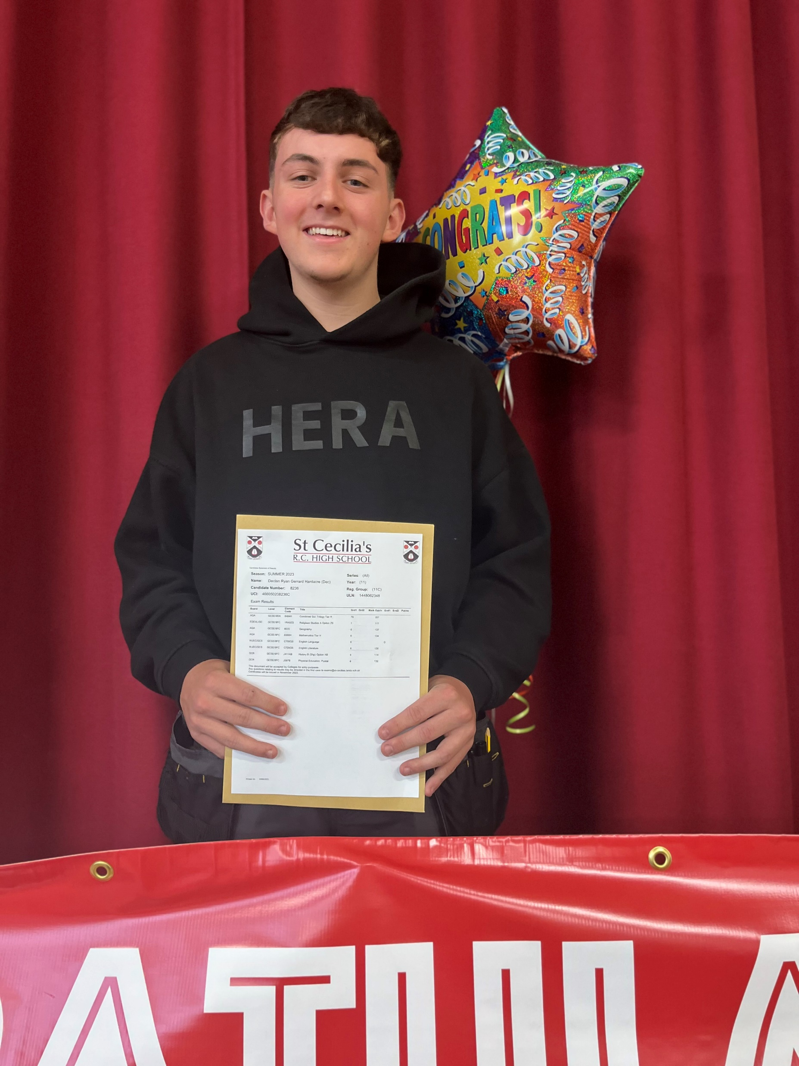


Results 2023 - Progress 8 +0.14
(Pupils make on average 0.14 grades more progress per subject than the same ability children do nationally )
17/54 for highest Attainment 8 in Lancashire
English and Maths 4+ 67%
English and Maths 5+ 41%
English 4+ 81%
Maths 4+ 71%
English 5+ 62.4%
Maths 5+ 48.4%
RE 4+ 68%
2 x Science 4+ 71%
2 x Science 5+ 40%
5 standard passes inc. E&M 61.3%
Notes:
Intake 40/68

Slide 3
Why a Revision Plan…
Pupils unsure how to revise
Expert input from teachers
Task base revision
Improve upon initial answers
Structure plan revision
Clear structure to offer support around
Knowing minimum
Avoiding cramming
Staggers the retrieval learning
Knowing what is to be completed
Proof that learning is improving
Work collaboratively to see success

Slide 4
This programme of revision work has been created specifically for you by your teachers and sets out the work that you must complete between Monday, 19th February, and Sunday 30th April.
Obviously, not all the blocks will apply to you, and you should only revise for the subjects you study.
As this replaces your homework timetable, we expect you to complete the revision work that is set out in your plan. Plan ahead and do not fall behind. Your subject teachers will ask for proof of completion in each lesson and you will improve your work.
To minimise damage/loss of this plan, you do not need to bring it into school with you, just the work itself.
Additionally, Parents/carers will sign each allocated day on your ‘revision record card’ once they have seen evidence of each day’s revision completion. This is the small card you have been issued today.
Each morning your form teacher will check for the signature on your revision record card.
We will contact parents/guardians of pupils who miss signatures over the revision period.
Please note that this is intended to supplement existing revision and should not be seen as the only revision necessary. Use your timetable and the subject revision grid to explore additional resources to revise

Slide 5
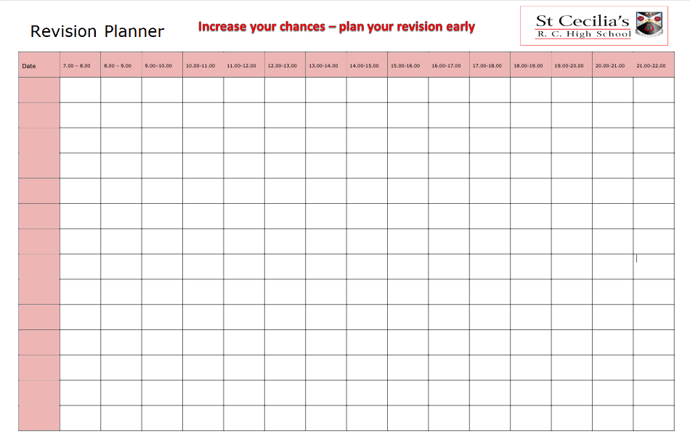

Slide 6
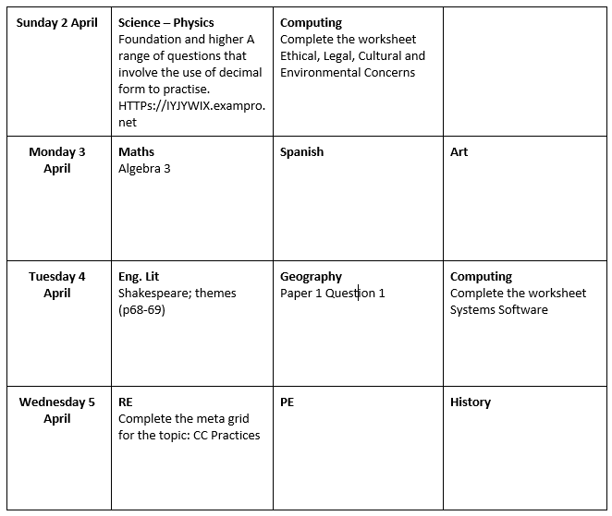

Slide 7
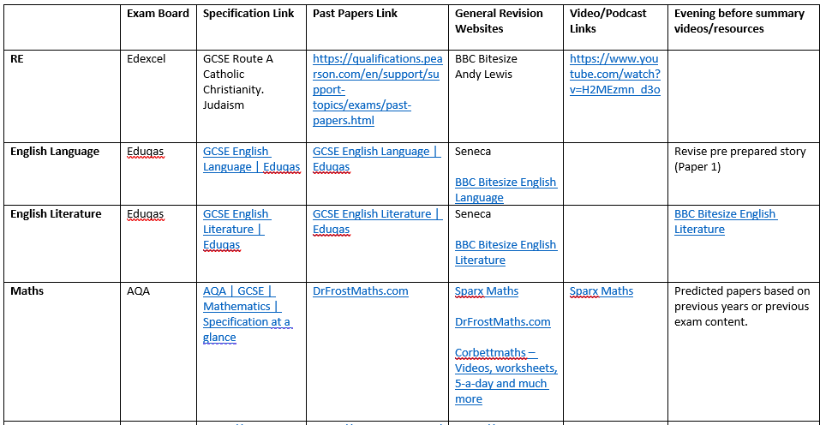

Slide 8
12th February
Half term preparation. Families discuss revision plan, revision timetable etc and draw up their own way of working through the next 12 weeks, including when tasks will be completed, how it will be checked, when the blue card will be signed and what after school sessions will be attended.
Design and technology day 1 in school
13th February
Design and technology day 2 in school
18th February
12-week revision plan begins.
Tasks are ‘doing tasks’ that can be corrected/improved in class.
Before, during and after school revision continues.
Revision plan tasks should be supplemented with personal revision where possible (see links grid in this guide)
28th February
Y11 final predicted grades are collated.
Intervention phone calls and meetings arranged with some parents/carers.
10th, 11th and 12th
Easter holiday revision days in school (more information to follow).
8th May
Collapsing of P5 lessons to allow Y11 attend the following day’s AM exam subject.
Revision continued after school.
9th May
Exams begin.
AM breakfast warmups begin for AM exams– 8am.
Collapsing of P3 lessons to allow Y11 to attend this day’s PM subject.

Slide 10
Attendance is directly related to achievement
>98 7.4 +1.35
>95 6.1 +0.22
>90 4.1 -0.33
>85 2.2 -2.33
An attendance of 95% = 48 hours of learning lost
An attendance of 90% = 95 hours of learning lost

Slide 11
As parents, you can support the achievement of your child by…
Being engaged, interested, determined and ‘pushy’
Encouraging attendance each day
Encouraging attendance to revision after school
Setting up a routine where you check the work completed each night and sign the blue card
Removing phones, consoles and other distractions from areas of revision and study
Establishing a bedtime routine where phones, internet, consoles, TVs are not a temptation

Slide 12
TIME | LOCATION
3:45pm | SCHOOL HALL | Introducing the Y11 revision plan with Mr Nelson and Mr Hall followed by the revision plan handed to parents/carers.
4:00pm- 5:00pm | SUBJECT ROOMS | Time to visit each subject room and all staff to discuss their elements of their subject within the revision plan, revision strategies and resources.
4:00pm-5:00pm | LIBRARY | Drop in to visit Mrs Canavan to discuss general revision fundamentals, strategies and structure.
4:00pm-5:00pm | MR NELSON’S OFFICE | Meet with Mr Nelson and Mr Hall to discuss general progress if applicable.
5:00pm | SCHOOL HALL | Introducing the Y11 revision plan with Mr Nelson and Mr Hall followed by the revision plan handed to parents/carers. (repeated from 3.40pm)

