Slide 1

Staff in Year 4 are Mrs Harling, Mrs Hattersly, Mrs Prickett and
Mr Sabatel.
We are very much looking forward to working with and getting to know your children this year.

Slide 2

Our school Mission Statement:
'Guided by Jesus Christ, our teacher, we journey together, learning to dream, believe and achieve'

Slide 3

If you have any queries, questions or concerns throughout the year, please contact me via the school app, send me an email (s.harling@st-clares.manchester.sch.uk), see me after school when you are picking your child up, or make an appointment to see me.
I am here to support your child, but as a school we want to support families too wherever we can. Please get in touch.

Slide 4

READING
Please read with your child every night. We cannot stress how important it is as reading crosses all curricular areas in school.
Your child should be reading for 20 minutes every night.
Reading records will be checked every day and monitored to make sure all children are reading at home. You will need to sign their reading record when they have read with you.
If a child is not reading regularly then I will ask the reason why and a discussion will need to be organised about how best to support the child.
Books will be changed in class or in the library regularly.

Slide 5

We want your child to develop a love of reading. Take time to sit with them and share a book, a poem, a comic, a magazine, a football programme – anything that involves reading.
As your child reads, their minds are opened up to new information, new experiences, new dreams…
We do not want children to race through their reading books. It is really important that the children understand what they are reading and new vocabulary that they will be exposed to.
Discuss this with your child as they read.
In Key Stage 2, children are rewarded with 2 raffle tickets when they get 100% on a quiz and 1 ticket if they pass the quiz. They should be aiming for 100 every time!
Each week, in assembly, someone receives a reading prize.
Vouchers are given to children when they have read a millions words.

Slide 6
HOMEWORK
As well as reading every night, your child will be given:
Spellings – these are given out on Fridays and there will be a test the following Thursday.
Homework will be given every Friday and will be expected to be returned the following Wednesday.
Every week, the children will be given a times tables test to prepare for the Year 4 Multiplication Tables Check at the end of the year.
Please practise times tables at home either by chanting, singing songs, playing games or accessing your child’s Times Table Rock Star account. Each child should have their own log-in details – please ask if you do not know your child’s details.

Slide 7

During the first half term (Autumn 1), we will start our swimming lessons, which will be on Wednesday morning.
Children should come into school with their swimwear underneath their school uniform and bring a towel and clean underwear to change into.
Children with long hair (past their ears) will need to bring a swimming cap.
During the second half term (Autumn 2), our PE lessons will be on Monday and Thursday. Your child will need to come into school wearing their school PE kit. Please see the school website for details on our uniform. Make sure that all uniform is clearly labelled with your child’s name on it please.

Slide 8
Lessons
Maths and English are taught every day.
As a Catholic school, we teach 2.5 hours of RE each week. We follow the Come and See scheme of work.
We have 2 PE lessons per week or 1 PE lesson and a swimming lesson.
In addition to this, we also teach a whole host of other foundation subjects.
Please see the yearly curriculum overview for more details – this document (along with lots more information) is available on the class page on the school website. Our website is a useful source of information.

Slide 9
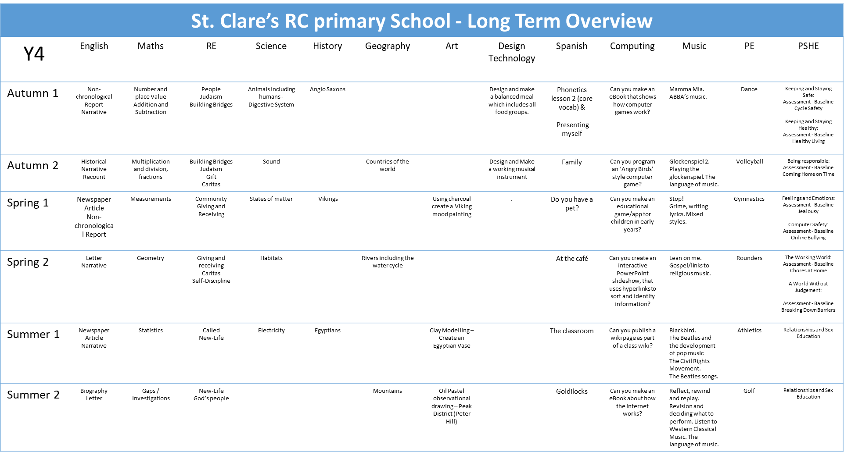

Slide 10
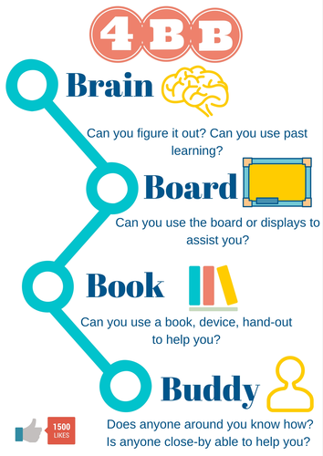
We are working hard to build children’s resilience in school. We want them to try their best and attempt their work before asking for help.
Children need to know that it is okay to make mistakes and that every mistake is a learning opportunity.
We encourage collaborative learning with ‘partners’ in class. They will be sat on tables of 4 and will need to work together as a team on certain tasks.
Children are encouraged to use 4 Before Me:
Brain
Book
Board
Buddy

Slide 11
Working together with you and your child, I know that we will have a great year!
Do you have any questions about routines, expectations or the curriculum in Year 4?

