Slide 1
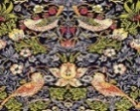
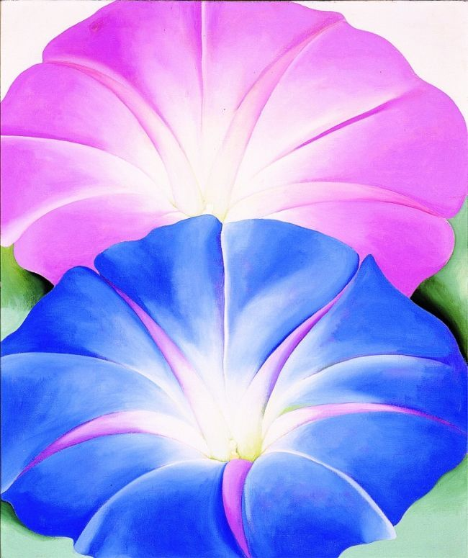
Art | Nursery | Reception | Year 1 | Year 2 | Year 3 | Year 4 | Year 5 | Year 6
Autumn 1 |  | Me & My World |  |  | DRAWING |  | SCULPTURE
 |  | Self Portraits using Oil Pastels |  |  | Draw a volcano in the style of Hokusai |  | Greek vase sculpture with a clay coil
Autumn 2 | My 5 Senses | Let’s Celebrate! | COLLAGE | PAINTING/PRINTING |  | PAINTIING |  | SCULPTURE
 | Autumn Leaf collage | Clay Diva Lamps | Make collage art using newspapers /magazines in the style of Romero Britto | William Morris art – printing using different media e.g. flowers/foods – design your own wallpaper. |  | Observational paintings of reflections in rivers (oil pastels) Focus on the Peak District (Peter Hill). |  | Clay Heart - Sculpture
Spring 1 | My World & Beyond |  |  | SCULPTURE |  | DRAWING |  | DRAWING
 | Junk modelling habitats |  |  | Sculpting clay rural Zambian huts with thatched roof |  | Viking art mood drawings using charcoal. |  | LS Lowry – Oil Pastel War Scene Drawings
Spring 2 |  | Fee, Fi, Fo Fum! | PAINTING |  | PAINTING |  | PAINTING
 |  | Van Gogh – painting sunflowers | Georgia O’Keeffe – Artist Water Colour plants |  | Create a weather painting with a background wash using a range of different paint brushes – In the style of Monet |  | Astro Art- Water colour/ acrylic space art in the style of David Hardy.
Summer 1 | All creatures great & small |  |  | DRAWING/COLOUR MIXING | SCULPTURE | SCULPTURE
 | Animal-themed dances |  |  | Using secondary colours to create a picture of Florence Nightingale in the style of Rene Magritte. | Design and make a Roman mosaic. | Sculpture- create a traditional Egyptian vase using papier mache
Summer 2 |  | Seasons | DRAWING |  |  |  | DIGITAL ART | PAINTING
 |  | Andy Goldsworthy natural sculptures | Draw and paint a self portrait in the style of Amy Sherald |  |  |  | Banksy Art- Research and create digital graffiti artwork in the style of Banksy. | Painting depictions of different emotions
Artist to Study During the Year. |  | Van Gogh, Andy goldsworthy | Georgia O’Keeffe, Amy Sherald, Romero Britto | Rene Magritte, William Morris | Claude Monet, Hokusai, Sosus of Pergamom | Peter Hill | Banksy, Clarice Cliff, David Hardy | Jacob Lawrence, LS Lowry

Slide 2
ART Y1 | AUTUMN | AUTUMN | SPRING | SPRING | SUMMER | SUMMER
FOCUS |  | Collage |  | Painting with watercolours |  | Drawing Self Portraits
KEY KNOWLEDGE AND SKILLS |  | I can cut, roll and coil materials. I can select, cut, assemble, tear, stick and collage different materials. I can describe what can be seen and give an opinion about the work of an artist. I can ask questions about a piece of art. I know that a collage is artwork created by lots of different materials to create a new image. I know Romero Britto used lots of bright colours to portray different animals and people. I know Romero Britto’s work was a style of Pop Art. I know that to achieve smoother textures, I can use smooth materials that fit seamlessly together. |  | I can name the 3 primary colours I can paint using watercolours I can wash my brush and add water to change the translucence of paint I can describe and give an opinion about the work of Georgia O’Keeffe I can ask questions about a piece of Georgia O’Keeffe’s artwork I can select and use a variety of brushes I know which colours are Primary I know Georgia O’Keeffe was an American artist who was famous for her close up paintings of flowers I know that watercolour paint is thinned with water, giving a more transparent colour |  | I can draw a picture of something I can see. I can name the primary colours. I can describe what I can see and like in the work of another artist. I can ask sensible questions about a piece of art. I know that Amy Sherald created portraits in a Realism style. I know which colours are Primary. I know I can use my sketchbook to practice my sketches/drawings and reflect on my work.
ARTIST |  | Romero Britto |  | Georgia O’Keeffe |  | Amy Sherald

Slide 3
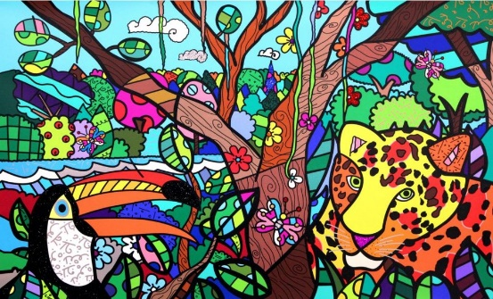
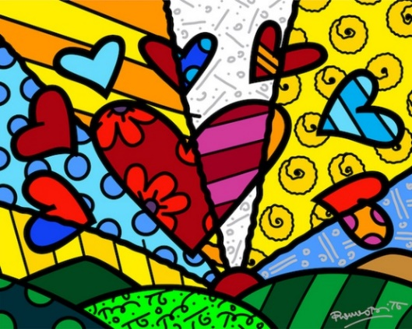
Year 1: Collage Knowledge Mat
Subject Specific Vocabulary |  | Sticky Knowledge: | Artist Inspiration
Collage | A piece of art made by sticking various different materials such as photographs and pieces of paper or fabric on to a backing. | A collage is artwork created by using lots of different materials to create a new image. Romero Britto used many bright colours to portray different animals and people. Romero Britto’s work was a style of Pop Art. Smooth materials that fit together can be used to make a smooth texture. | Romero Britto
Texture | Texture is the way something feels to the touch, or looks to the eye. Words like rough, silky, shiny and dull help writers describe the texture of an object.
Pop Art | An art movement that emerged in the 1950s and flourished in the 1960s in America and Britain, drawing inspiration from sources in popular culture.
 |  | Skills
Overlay | To cover with a coating or a layer, or to set one thing on top of another.
 |  | I can cut, roll and coil materials I can select, cut, assemble, tear, stick and collage different materials I can describe what can be seen and give an opinion about the work of an artist I can ask questions about a piece of art
Layering | A layer can consist merely of one material or can involve multiple overlays covering the whole surface.
Resources Scissors Glue stick or PVA glue Scrap magazines/newspapers etc. Pencils Rubbers A4 white paper

Slide 4
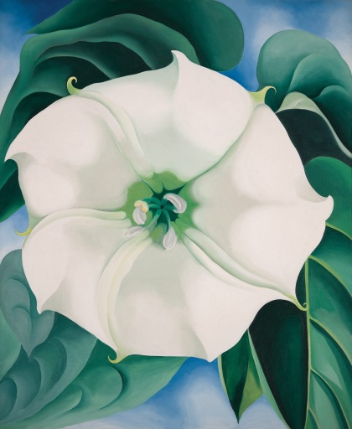
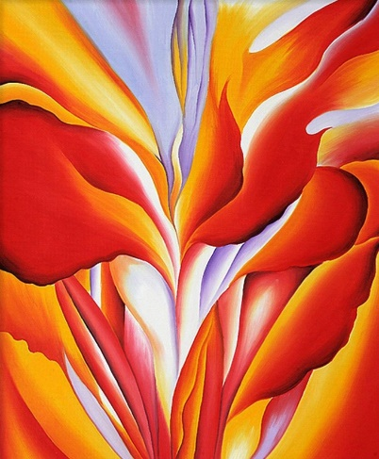
Year 1: Painting with Watercolours Knowledge Mat
Subject Specific Vocabulary |  | Sticky Knowledge: | Artist Inspiration
Watercolour | Paint which is thinned with water rather than oil, giving a transparent colour. | Primary Colours are red, yellow and blue. Georgia O’Keeffe was an American artist who was famous for her close up paintings of flowers Watercolour paint is thinned with water, giving a more transparent colour | Georgia O’Keeffe
Layering | A layer can consist merely of one small dab of paint, or can involve thick overlays covering the whole surface.
Blending | The process of gently intermingling two or more colors to create a gradual transition or to soften lines.
Tonal | Tonal Colors are different shades of colors of same main color group. Different tones of a color e.g. light purple and dark purple. | Skills
Resources Watercolour Paint Watercolour Paintbrushes Pencils Rubbers Water Pots A4 white card |  | I can paint using watercolours I can wash my brush and add water to change the translucence of paint I can describe and give an opinion about the work of Georgia O’Keeffe I can ask questions about a piece of Georgia O’Keeffe’s artwork I can select and use a variety of brushes

Slide 5
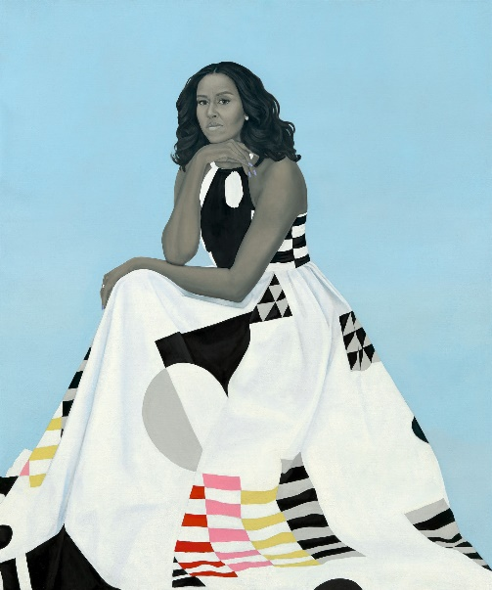
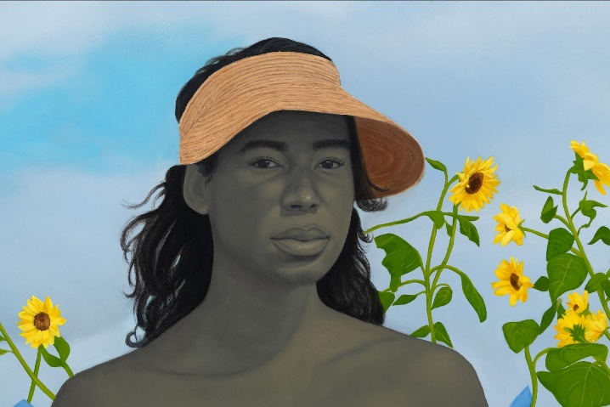
Year 1: Drawing Self-Portraits Knowledge Mat
Subject Specific Vocabulary |  | Sticky Knowledge: | Artist Inspiration
Portrait | A portrait is a representation of a particular person. A self-portrait is a portrait of the artist by the artist. | Amy Sherald created portraits in a Realism style. Primary Colours are red, yellow and blue. A sketchbook is used to practice my sketches/drawings and reflect on my work. | Amy Sherald
Sketching | A rough type of drawing that an artist might make in preparation for either a painting or a more formal drawing.
Primary Colours | Primary colours are red, yellow and blue.
Realism | Artworks painted in a realistic almost photographic way. | Skills
Resources Poster paint Paintbrushes Paint Pots Paint palette Pencils Rubbers Rulers A4 white paper |  | I can draw a picture of something I can see. I can use soft pencil strokes to sketch a portrait I can describe what I can see and like in the work of another artist. I can ask sensible questions about a piece of art.

Slide 6
ART Y2 | AUTUMN | AUTUMN | SPRING | SPRING | SUMMER | SUMMER
FOCUS |  | Printing using paint | Sculpting clay Zambian huts |  | Painting Surreal Portraits
KEY KNOWLEDGE AND SKILLS |  | I can describe the differences and similarities between pieces of Morris’s work and make links with my own work. I can create a repeating pattern with print. I can create rubbings (from a print or textured surface). Printing is when you transfer an image onto another surface. Texture can be changed by using different amounts of paint to create a thick or thin layer. William Morris is a fabric designer who used repeating patterns for wallpapers and textiles. William Morris was an important and famous person in the Art and Craft Movement. | I can experiment with, construct and join materials. I can explore how 2D can become 3D, using drawing as a basis for design. I can explore modelling and shaping with clay I can use my sketchbook to design a sculpture |  | I can create surreal drawings to communicate emotions e.g. draw an animal that makes you scared/sad in your portrait I can develop sketching using different grades of pencil I can add texture and shape using shading I can use painting to develop and share my ideas in response to an artist I can describe the differences and similarities between Magritte’s artworks and can make links to my own work. I can create tints with paint by adding white. I can create tones with paint by adding black I can mix paint to make all the secondary colours. I know the Primary and Secondary colours I know if you add white to any colour, it will make the colour some shades lighter. This is called making a tint. I know if you add black to a colour, it will make the colour some shades darker. Rene Magritte is a famous Belgian surrealist artist. Magritte’s Surrealism paintings showed usual objects in unusual places.
ARTIST |  | William Morris |  |  | Rene Magritte

Slide 7
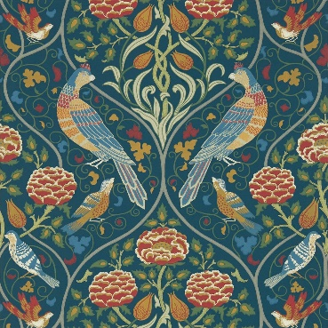
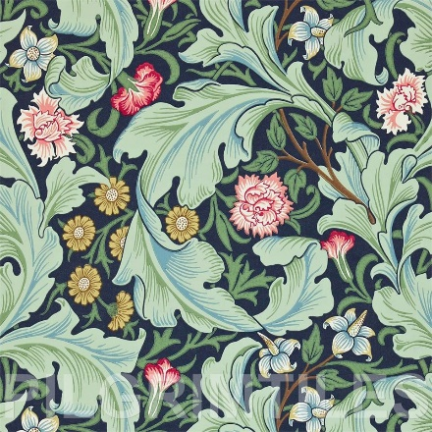
Year 2: Printing with Paint Knowledge Mat
Subject Specific Vocabulary |  | Sticky Knowledge: | Artist Inspiration
Printing | Transferring an image onto another surface. | Printing is when you transfer an image onto another surface. Texture can be changed by using different amounts of paint to create a thick or thin layer. William Morris is a fabric designer who used repeating patterns for wallpapers and textiles. William Morris was an important and famous designer in the Art and Craft Movement. | William Morris
Texture | Texture is the way something feels to the touch, or looks to the eye.
Media | The material and tools used by an artist, composer or designer to create a work of art, (pen and ink).
 |  | Skills
Resources Paint palette Paint Paintbrushes Leaves, flowers, sponges, vegetables etc. – any media you want to use for printing Pencils Rubbers A4 white paper |  | I can describe the differences and similarities between pieces of Morris’s work and make links with my own work. I can create a repeating pattern with print. I can create rubbings (from a print or textured surface).

Slide 8
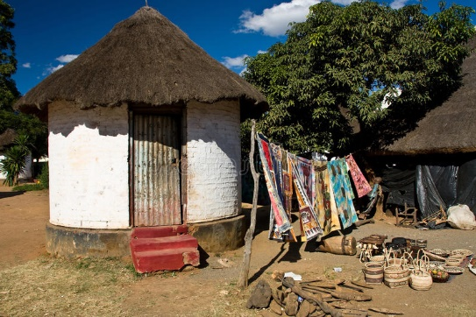
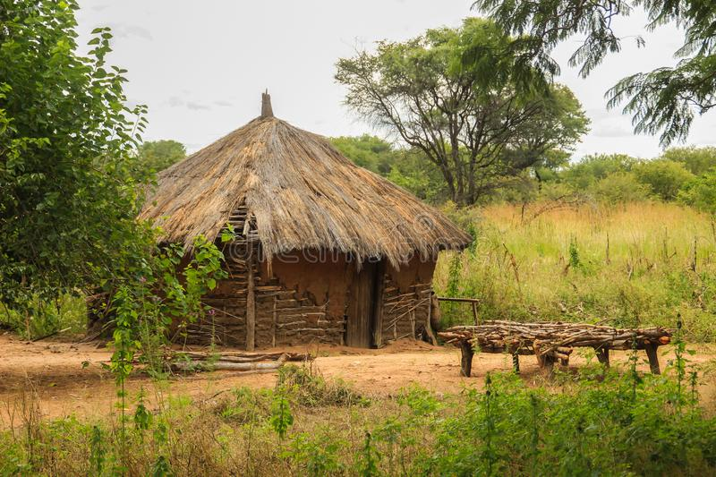
Year 2: Sculpting Clay Zambian Huts Knowledge Mat
Subject Specific Vocabulary |  | Sticky Knowledge: | Art Inspiration
Clay | Modelling clay is used in art and handicraft for sculpting. Clays are used for making pottery, and construction products e.g. bricks. | Clay is a malleable material used in art for sculpting. Different types of clay can be used for making pottery and construction products e.g. bricks. Sculpture is a type of 3D artwork made using carving, modelling, casting and/or constructing. To carve is to decorate a sculpture by cutting into it to change the shape or design. To assemble is to collect something together/to fit the different parts together. African huts can be built using mud, bricks or grass in some cases. | Zambian Huts
Sculpture | 3-D artwork made by one of four basic processes: carving, modelling, casting, constructing.
Model | To make something out of a particular material.
Carving | To decorate or form something by cutting into it.
Assembling | To collect something together/to fit the different parts together. | Skills
Resources Clay Straw/Grass/Hay Pencils Rubbers Sketchbooks |  | I can experiment with, construct and join materials. I can explore how 2D can become 3D, using drawing as a basis for design. I can explore modelling and shaping with clay I can use my sketchbook to design a sculpture

Slide 9
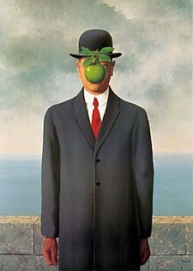
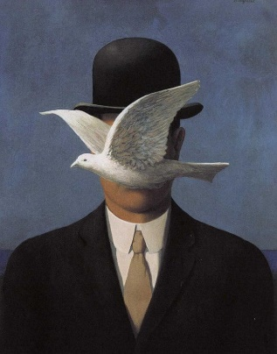
Year 2: Drawing Surreal Portraits & Colour Mixing Knowledge Mat
Subject Specific Vocabulary |  | Sticky Knowledge: | Artist Inspiration
Colour Blocking | Using colours from opposite ends of the colour wheel/chart and pairing them together to make interesting colour combinations. | Secondary colours are made from mixing primary colours. Red + Yellow = Orange, Blue + Yellow = Green, Red + Blue = Purple Adding white to any colour, will make the colour some shades lighter. This is called making a tint. Adding black to a colour will make the colour some shades darker. Rene Magritte is a famous Belgian surrealist artist. Magritte’s Surrealism paintings showed everyday objects in unusual places. | Rene Magritte
Surrealism | An artistic movement developed in Europe after WW1. Surrealism turns familiar things into images you've never seen before, often depicting dreamlike scenes and ideas.
Tint | When adding white to a colour it creates a tint.
Texture | The physical appearance of a drawing which can be seen through bumps, ridges, grooves and other physical details. Created using lines and shading.
Secondary Colours | Secondary Colours include orange, purple and green. | Skills
Tone | When adding black to a colour it creates a darker tone. | I can create surreal drawings to communicate emotions e.g. draw an animal that makes you scared/sad in your portrait I can develop sketching using different grades of pencil I can add texture and shape using shading I can describe the differences and similarities between Magritte’s artworks and can make links to my own work. I can create tints with paint by adding white. I can create tones with paint by adding black I can mix paint to make all the secondary colours.
Resources A4 white paper Paint (red, blue, yellow, white, black) Paint palette Paintbrushes (thin and thick) Pencils of varied grade Rubbers

Slide 10
ART Y3 | AUTUMN | AUTUMN | SPRING | SPRING | SUMMER | SUMMER
FOCUS | Drawing volcanoes |  |  | Watercolour Landscapes | Architecture - Roman mosaics
KEY KNOWLEDGE AND SKILLS | I can explore the work and disciplines of a range of artists working in different times and cultures I am starting to identify elements that inspire me from the work of artists I can explore observational drawing using different grades of pencil to create variation in tone I can experiment with cross-hatching to create texture with my pencil I can make notes in my sketchbook of which pencil grades worked well for certain parts of my drawing |  |  | I can create a background using a watercolour wash I can use a range of brushes to create different effects in painting natural objects e.g. rocks, mountains, sea I can explore work and draw inspiration from other artists such as Claude Monet. I know how to gently blend different colours to soften lines. I know why watercolours give a transparent effect. I know Monet was a key figure in the Impressionist Art movement. | I can name some famous mosaics by a mosaic artist I can talk about how an artist’s work has influenced others that came afterwards I can work with others to create a larger piece I can create different pictures using a range of mosaic templates I can use my research about mosaics to help me create my own geometric pattern I can use different media to experiment with colour and shape I can use my designs to create a final mosaic. I can use my knowledge of Roman culture to convey an image in my mosaic e.g. fish were often used for bathroom designs – will you be using a design linked to water/the sea? I can describe what worked well in my artwork and what I would change if I were to do it again. I can recognise when art comes from other cultures or historical periods and talk about its influence.
ARTIST | Hokusai |  |  | Monet | Sosus of Pergamom

Slide 11
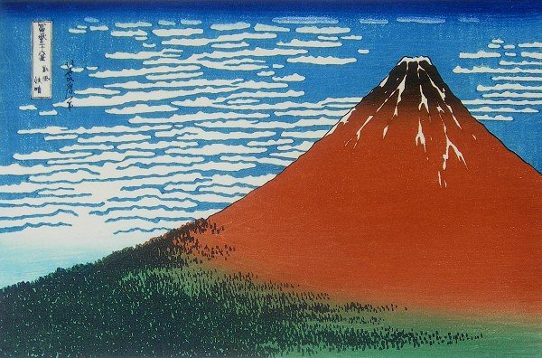
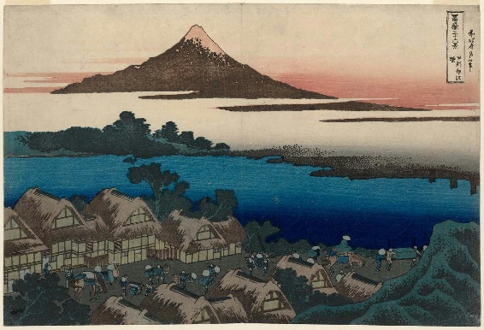
Year 3: Drawing Volcanoes Knowledge Mat
Subject Specific Vocabulary |  | Sticky Knowledge: | Artist Inspiration
Cross-hatching | A drawing technique that can be used to create texture, and the illusion of light. | I know Hokusai is best-known for his series ‘36 Views of Mount Fuji’ which includes the iconic image Fine Wind, Clear Morning. | Hokusai
Observing | Watching or noticing something.
Scale | The size of an object in relation to another.
Placement | The area in which you position sketched or painted aspects on a page. | Skills
Landscape | A visible area made up of natural/man-made features. | I can use cross-hatching to create texture in my drawing. I can explore observational drawings using different grades of pencil to create variation in tone. I can plan, refine and alter drawings as necessary. I can draw for an increasingly sustained period of time.
Resources Different grades of pencils e.g. 2B, HB Different drawing media e.g. crayons, pastels, felt tips, charcoal and ballpoint Sketchbooks

Slide 12
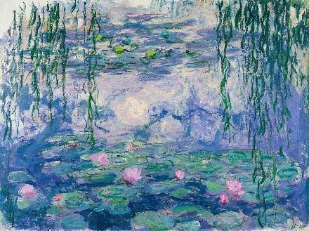
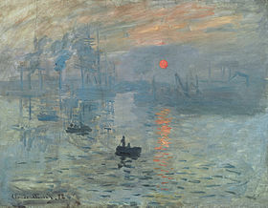
Year 3: Painting Watercolour Landscapes Knowledge Mat
Subject Specific Vocabulary |  | Sticky Knowledge: | Artist Inspiration
Blending | The process of gently intermingling two or more colors to create a gradual transition or to soften lines. | Watercolours give a transparent effect due to the differing pigmentation. Monet was a key figure in the Impressionist Art movement. | Claude Monet
Watercolour | Paint which is thinned with water rather than oil, giving a transparent colour. | Skills
Landscape | A landscape is the visible features of an area of land, its landforms, and how they integrate with natural or man-made features. | I can create a background using a watercolour wash I can use a range of brushes to create different effects in painting natural objects e.g. rocks, mountains, sea I can gently blend different colours to soften lines. I can explore work and draw inspiration from other artists such as Claude Monet.
Impressionism | Life-like subjects painted in a broad, rapid style, with obvious brushstrokes and bright colours.
Resources Paint palette Paint Water pots Paintbrushes (thin and thick) Watercolour brush Paper Pencils Rubbers

Slide 13
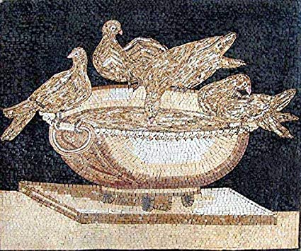
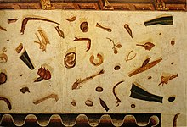
Year 3: Architecture: Roman Mosaics Knowledge Mat
Subject Specific Vocabulary |  | Sticky Knowledge: | Art Inspiration
Architecture | The art or practice of designing and building structures. | Romans used mosaic in their buildings as a form of decoration and functionality. Mosaics are made up from lots of different pieces to create a larger image. Mosaic is a form of Roman architecture. | Sosus of Pergamom
Pattern | A repeated decorative design.
Mosaic | A picture or pattern produced by arranging together small pieces of stone, tile, glass, etc. | Skills
Geometric | Created or decorated with regular lines and shapes.
Resources Sketchbook Different shapes of coloured paper/card cut up Tiles Poster paint PVA glue Photographs of Roman Mosaics |  | I can use sketches to create a final piece of art. I can work as a group creating individual pieces before creating something new together. I can experiment with the mosaic method in order to create a pattern or picture. I can use my sketchbook effectively when in the designing and annotating process of creating my artwork.

Slide 14
ART Y4 | AUTUMN | AUTUMN | SPRING | SPRING | SUMMER | SUMMER
FOCUS |  | Painting landscapes using oil pastels | Creating mood by drawing with charcoal |  | Egyptian inspired vases using papier mache
KEY KNOWLEDGE AND SKILLS |  | Can they show reflections? Can they identify and draw simple landscapes, and use marks and lines to produce texture? Knowledge of how to improve their mastery of art and design techniques, including drawing with oil pastels Can they experiment with different styles that artists have used? Do they learn about the work of others by looking at artists’ work in books, the internet, visits to galleries and other sources of information? | Can they use their sketch books to express mood in Viking style drawings? Can they suggest improvements to their work by keeping notes in their sketch books? Can they use line, tone and shape to represent figures? Do they successfully use shading to create mood and feeling? |  | Can they sculpt with papier mache? Can they improve their mastery of sculpture techniques, including sculpture with papier mache? Do they experiment with and combine materials and processes to design and make 3D form?
Artist |  | Peter Hill

Slide 15
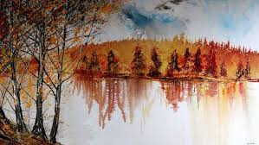
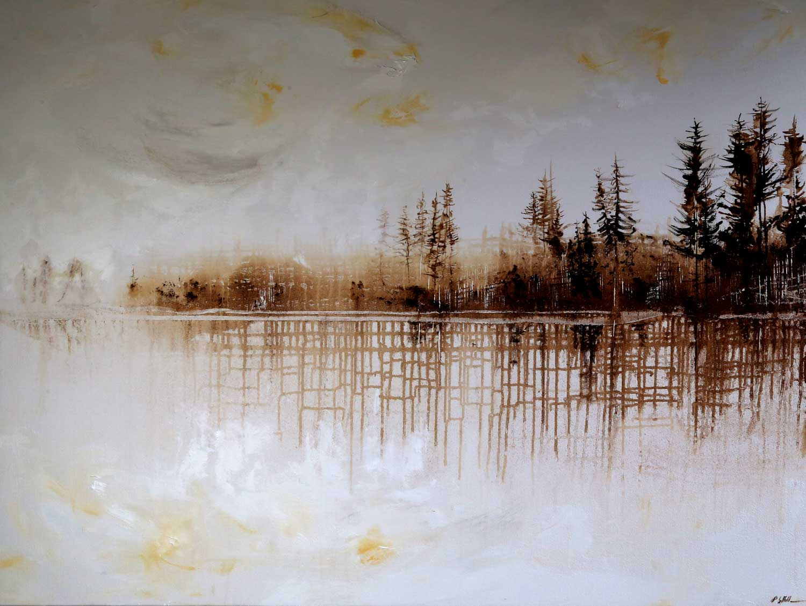
Year 4: Painting using oil pastels Knowledge Mat
Subject Specific Vocabulary |  | Sticky Knowledge: | Artist Inspiration
Heavy and Light Pressure Blending | Pressing heavily or gently on the page with an oil pastel creating a block of colour. Whether you apply heavy or light pressure, it will affect how much the colours blend together. | There are 5 types of lines in art: curved, diagonal, horizontal, vertical and zig-zag. When applying heavy or light pressure to the page, it will affect how much the pastel colours blend together. A landcape painting is a visible area of natural and man-made features. | Peter Hill Artist Peter Hill was born in Kent in 1965. He moved to Sheffield when he was a child, on the edge of the Peak District. He draws landscapes influenced by the Peak and Lake district.
Texture | Conveys the visual texture of a surface. E.g. Texture examples: smoothness, softness, rough,
Landscape | A visible area made up of natural and man-made features. EG the Peak District
Scumbling | The technique of scrubbing a lighter colour on an area to add a new texture. | Skills
Stippling | A drawing technique in which areas of light and shadow are created using dots.
Resources Pencils Sketch books Oil pastels |  | I can show reflections using oil pastels I can use a stippling effect in order to create light and shadow. I can identify and draw simple landscapes, and use marks and lines to produce texture I can experiment with different styles that artists have used I can use heavy and light pressure blending with oil pastels. I can learn about the work of others by looking at artists’ work in books, the internet, visits to galleries and other sources of information

Slide 16
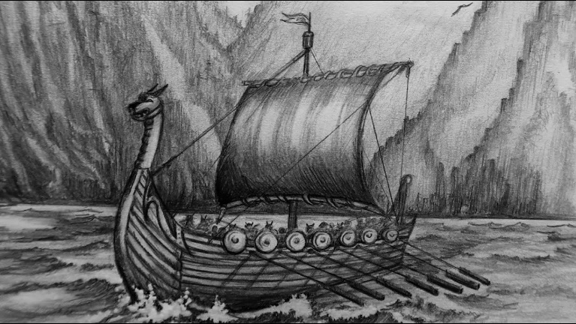
Year 4: Creating mood by Drawing with charcoal Knowledge Mat
Subject Specific Vocabulary |  | Sticky Knowledge: | Artist Inspiration
Mood/ feeling | Colour represents the mood; vibrant colours may be energetic, exciting, stimulating. Whereas dull colours maybe described as boring, dull and lifeless. | Vikings used colour pigments from charcoal and ochre Tone is created by using light and dark colours
Lines | Straight or curved lines on a background with no gradations of colour or shade. The 5 types of line art: Curved, Diagonal, Horizontal, Vertical and Zig-Zag.
 |  | Skills
Tone | We build tone using value scale: white being the lightest, black offering the darkest and grey for in between. This conveys the visual texture of a surface
 |  | I can use sketch books to express mood in Viking style paintings I can choose which colours will be best used to achieve a certain mood, and whether or not to use lighter or darker shading to achieve said mood. I can suggest improvements to my work by keeping notes in my sketch books I can create shapes using charcoal to portray figures, landscapes or shadows to further the visual texture of the surface. I can use line, tone and shape to represent figures and forms in movement I can choose colours to reflect mood in my drawing I can use shading to create mood and feeling
Shape | Created through lines, textures, colours or an area enclosed by other shapes such as triangles, circles, and squares.
Resources Pencils Rubbers Sketch books Charcoal

Slide 17
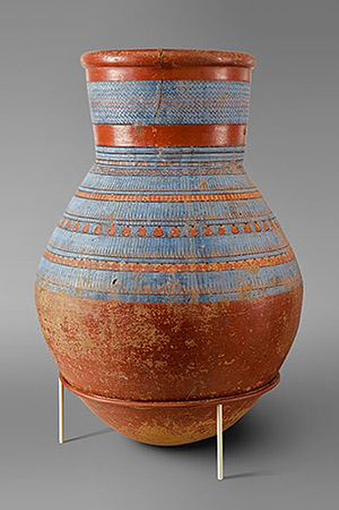
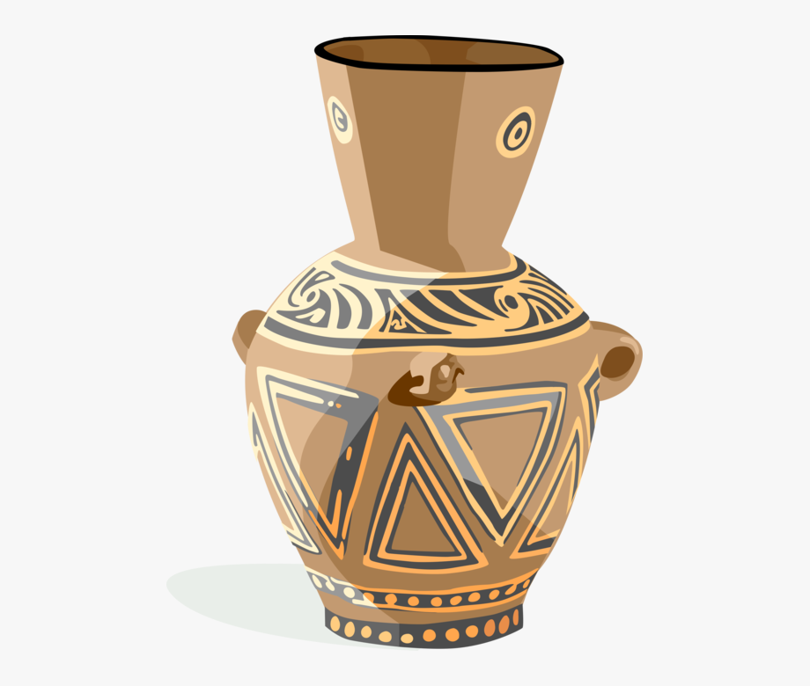
Year 4: Sculpting Egyptian vases using Papier Mache Knowledge Mat
Subject Specific Vocabulary |  | Sticky Knowledge: | Artist’s Interpretation
Sculpt | Create or represent (something) by carving, casting, or other shaping techniques | Egyptian vases had different uses such as storage, cooking and tomb offerings that held ritually purified water. The designs on the pottery often depicted scenes from everyday life, as well as religious and mythological themes | Egyptian Pottery
Papier Mache | A composite material consisting of paper pieces or pulp, sometimes reinforced with textiles, bound with adhesive such as glue
3D Form | Form is a three dimensional shape, such as a cube, sphere or cone. Sculpture and 3D design are about creating forms.
Pattern | A design that is created by repeating lines, shapes, tones or colours. The design used to create a pattern is often referred to as a motif. | Skills
Resources Newspaper Glue Plastic bottles cut to shape Poster paint |  | I can sculpt with papier mache to create a vase. I know how to improve my mastery of sculpture techniques I can experiment with and combine materials and processes to design and make 3D form I can decorate my vase using paint

Slide 18
ART Y5 | AUTUMN | AUTUMN | SPRING | SPRING | SUMMER | SUMMER
FOCUS | Sculpting Greek vases using a clay coil |  |  | Space Art paintings |  | Digital Art
QUESTION
KEY KNOWLEDGE AND SKILLS | I know what Mod Roc is and how it can be used to effectively create sculpture I am familiar with the work of famous ceramic artists such as Clarice Cliff. I can scrunch paper to create different shapes and forms I can use Mod-Roc to solidify and bind different shapes and forms I can learn about the work of others by looking at artists’ work in books, the internet, visits to galleries or other sources of information I can reflect on the techniques we have learnt and express opinions |  |  | I can identify and draw objects and use marks and lines to produce texture I can research the work of David Hardy and use his work to replicate a style. I can explain why I have chosen water colour/acrylic to paint with I can create all the colours I need using black or white I can experiment with different styles that Hardy has used I can learn about the work of others by looking at artists’ work in books, the internet, visits to galleries or other sources of information |  | I can create a piece of art work which includes the integration of digital images I have taken I can combine graphics and text based on research I can scan images and take digital photos, and use software to alter them, adapt them and create work with meaning. I can use images which I have created, scanned and found, altering them where needed to create art. I can research the work of Banksy and use his work to replicate a style. I know about experimentation and how to gain an increasing awareness of different kinds of art, craft and design e.g. digital art.
ARTIST | Clarice Cliff |  |  | David Hardy |  | Banksy

Slide 19
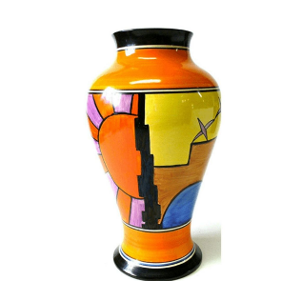
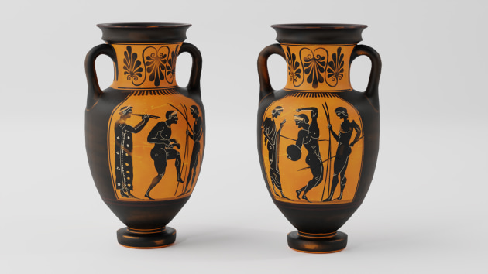
Year 5: Sculpting Greek Vases using clay coils Knowledge Mat
Subject Specific Vocabulary |  | Sticky Knowledge: | Art Inspiration
Clay | A type of fine-grained natural soil material containing clay minerals . Used for construction and sculpting, and will provide good coverage on most surfaces. 3D models can easily be made by applying the moulding the clay to the desired shape before drying and hardening. | Clarice Cliff is regarded as one of the most influential ceramics artists of the 20th Century and her work is collected, valued and admired the world over. | Clarice Cliff
Coil | A frame created by a sculptor to support a figure that is being modeled. Clay is rolled into a sausage shape and wound round like a spring, gradually increasing the height.
Pattern | A design that is created by repeating lines, shapes, tones or colours. The design used to create a pattern is often referred to as a motif. | Skills | Greek Vases
Resources Clay Sketchbooks Pencils Black felt tips/sharpies Paint |  | I can roll clay to create a coil I can use clay to solidify and bind different shapes and forms I can learn about the work of others by looking at artists’ work in books, the internet, visits to galleries or other sources of information I can reflect on the techniques we have learnt and express opinions

Slide 20
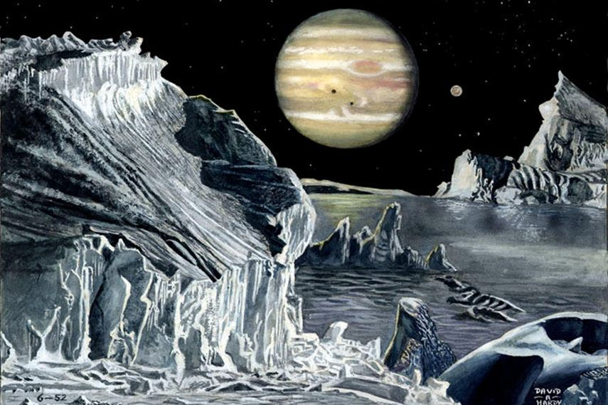
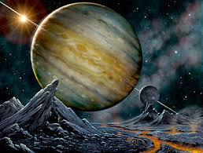
Year 5: Painting Space Art using watercolour/acrylic Knowledge Mat
Subject Specific Vocabulary |  | Sticky Knowledge: | Artist’s Interpretation
Watercolours | Paint mixed with water, to create a thin watery consistency. This method of painting allows the colours to merge together more fluidly. | Acrylic paint is water resistant and dries quickly Watercolour paint allows colours to easily merge together Some paintbrushes will work better with different types of paint David Hardy works with a number of different media to create his artwork including acrylic and watercolour paints, photography and digital art. | David Hardy David Hardy works with watercolours, acrylics, photography and digital art. He creates work that focuses on the depth, tone & texture without the distraction of colour.
Acrylic | Is waster resistant, dries quickly, often, acrylic can easily peel or scrape from a surface. On card, it offers vibrant colour and works well.
Texture/Tone | Are the building blocks of composition in art. We build tone using value scale: white being the lightest, black offering the darkest and grey for in between. This conveys the visual texture of a surface. | Skills
Resources Water colours Acrylic paints Paintbrushes Paint Pots Paint palette Pencils Rubbers Rulers A4 white paper David Hardy information text/ PowerPoint |  | I can use hue, tint, tone, shades and mood I can explore the use of texture in colour I can identify and draw objects and use marks and lines to produce texture I can research the work of David Hardy and use his work to replicate a style.

Slide 21
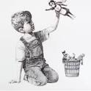
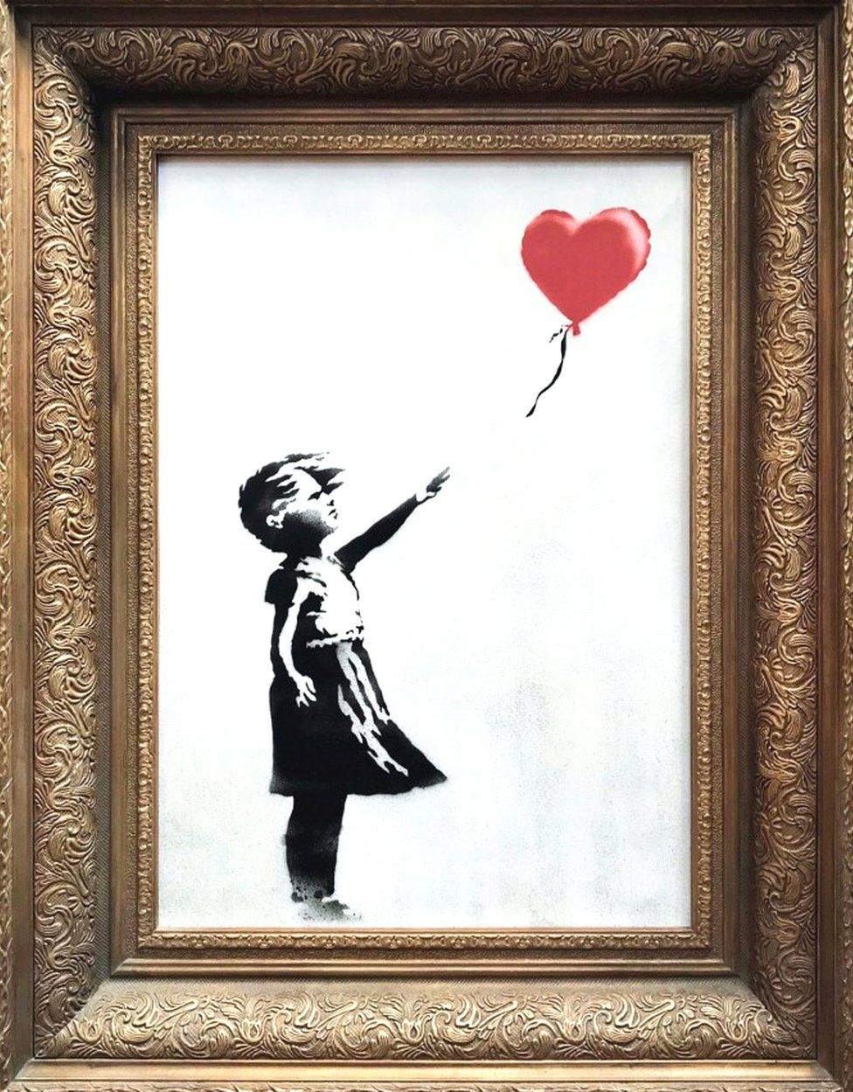
Year 5: Banksy inspired Digital Art Knowledge Mat
Subject Specific Vocabulary |  | Sticky Knowledge: | Artist’s Interpretation
Stencilling | Stencil is a from of graffiti that is used to decorate and is made to from paper, cardboard and other media to create an image that is easily reproducible. It creates unique effects and finishes with a range of stencils | Banksy’s art sparks political conversations and aims to make a statement. Banksy has been a famous British graffiti artist since the 1990s. Stenciling is used to create images that are easily replicated. | Game changer- 2020 Love Is in the Bin- 2006
Spray-paint | Spray-paint is paint held in an aerosol can for spraying on surfaces. It is versatile and can be used on many surfaces: plastic, metal, wood, ceramic, plaster, concrete, canvas, particle board, laminate, glass,
Digital Art | Digital art is creative work that uses digital technology, including digital painting. | Skills
Resources brush, dabber, sponge, or roller Tape or Spray Adhesive. Acrylic paint, chalk paint, Paint Tray: to hold paint, blend and create custom colours. Paper towels: To offload the paint before stencilling. https://www.bbc.co.uk/bitesize/clips/zsghdmn -Example of Banksy style-stencilling Digital Software: Wacom Intuos Pro Paper Edition. Clip Studio Paint EX. Wacom MobileStudio Pro. iPad |  | I can use images which I have created, scanned and found, altering them where needed to create art. I can combine graphics and text based on my research and replicate a style of Banksy I can experiment with and gain an increasing awareness of different kinds of art, craft and design e.g. digital art. I can use art in a way that can represent something important to me e.g. values or sense of identity.

Slide 22
ART Y6 | AUTUMN | AUTUMN | SPRING | SPRING | SUMMER | SUMMER
FOCUS |  | Sculpting Clay Hearts | Draw a WW2 scene using oil pastels |  |  | Cubism Paintings
KEY KNOWLEDGE AND SKILLS |  | I can create models on a range of scales I can include technical aspects in their work, e.g. 3D design I can improve my mastery of art and design techniques, including sculpture with clay. I can explain why I have used different tools to create art. I can use feedback to make amendments and improvements to my art. | I am learning about the work of LS Lowry by looking at his work in books, the internet, visits to galleries and other sources of information My drawings communicate emotions and a sense of self with accuracy and imagination I can explain why I have used oil paint to create my art I can explain why they have chosen specific drawing techniques I can use feedback to make amendments and improvements to my art. I can explain the style of my work and how it has been influenced by a famous artist. |  |  | I can experiment with different styles that Lawrence has used I can compare the artwork of Jacob Lawrence with other cubist artists such as Pablo Picasso. My paintings communicate different emotions I know to look for textures and colours that compliment each other to portray a certain image when used together. I know who Jacob Lawrence is and about his role in the segregated art world in the 1960s. I can comment on the work of Jacob Lawrence and name some of his pieces.
ARTIST |  | Gunther Von Hagens | LS Lowry |  |  | Jacob Lawrence

Slide 23
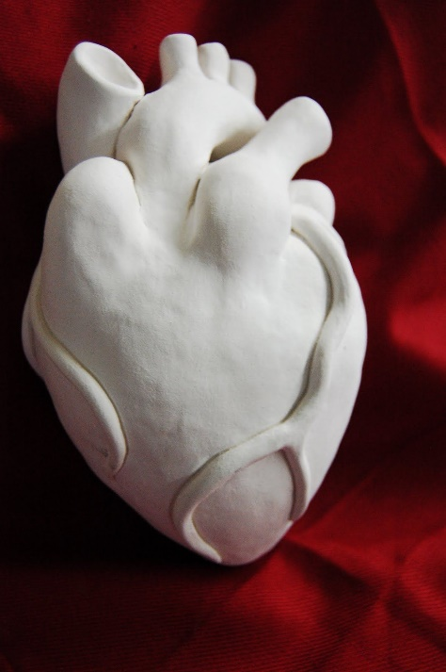
Year 6: Sculpting clay hearts Knowledge Mat
Subject Specific Vocabulary |  | Sticky Knowledge: | Art Interpretation
Realism | The accurate, detailed, unembellished depiction of nature or of contemporary life | Clay is a soft, loose, material that hardens as it dries. Clay is used for artistic purposes but also practical. Clay works well as a medium to convey finer details of 3D form (e.g. valves) due to the malleable nature of the material. Plastination is a technique or process used in anatomy to preserve bodies or body parts, first developed by Gunther von Hagens in 1977.
Compostition | A complete work of art and, the way in which all its elements work together to produce an overall effect
3D Form | Form is a three dimensional shape, such as a cube, sphere or cone. Sculpture and 3D design are about creating forms.
Plastination | A technique or process used in anatomy to preserve bodies or body parts, first developed by Gunther von Hagens in 1977. | Skills
Carve | The act of using tools to shape something from a material by scraping away portions of that material.
Resources Sculpting tools Newspapers or oilcloth to protect the work table. Clay Acrylic and/or poster paint |  | I can create models on a range of scales I can include technical aspects in my work, e.g. 3D design I can improve my mastery of sculpture with clay. I can explain why I have used different tools to create art. I can use feedback to make amendments and improvements to my art.

Slide 24
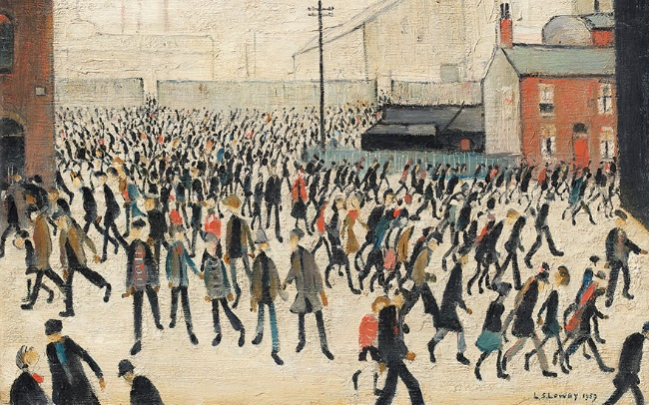
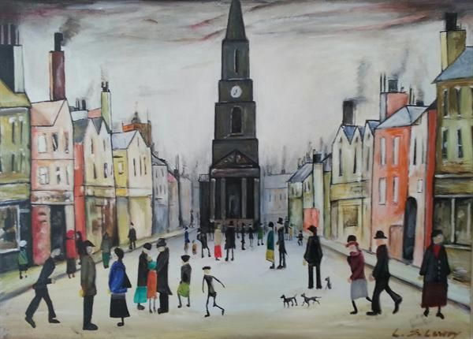
Year 6: Drawing a WW2 scene using oil pastels Knowledge Mat
Subject Specific Vocabulary |  | Sticky Knowledge: | Artist Inspiration
Lines | Straight or curved lines on a background with no gradations of colour or shade. The 5 types of line art: Curved Diagonal Horizontal Vertical Zig-Zag | LS Lowry spent much of his life in Salford and his work is strongly associated with the city of Manchester and the surrounding areas. LS Lowry focused mainly on industrial landscapes/cityscapes | LS Lowry
Mark-making | Mark-making can be done in an expressive way to represents mood, feeling and emotion.
Texture | Texture is the way something feels to the touch, or looks to the eye.
Landscape | A visible area made up of natural/man-made features. E.g. a town square | Skills
Resources Pencils Rubbers Oil pastels Sketch books |  | My drawings communicate emotions and a sense of self with accuracy and imagination I can clean oil pastels correctly I can use feedback to make amendments and improvements to my art. I can explain the style of my work and how it has been influenced by a famous artist.

Slide 25
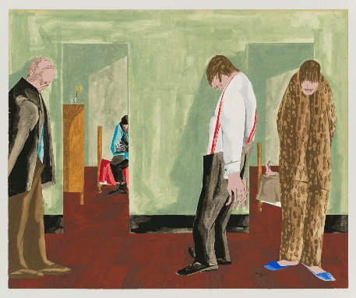
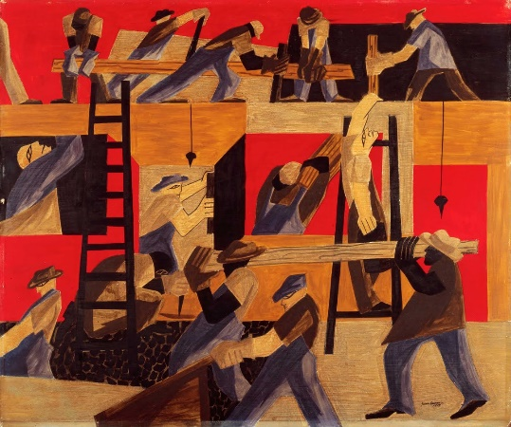
Year 6: Cubism Paintings Knowledge Mat
Subject Specific Vocabulary |  | Sticky Knowledge: | Artist Inspiration
Surrealism | Surrealism is a style in art and literature in which ideas, images, and objects are combined in a strange way, like in a dream. | Looking for textures and colours that compliment each other can portray a certain image when used together. Jacob Lawrence broke a racial barrier by becoming the first African American artist whose work was acquired by The Museum of Modern Artis | Jacob Lawrence
Texture | Texture is the way something feels to the touch, or looks to the eye.
Contrasting | A principle of art that refers to the arrangement of opposite elements in a piece so as to create visual interest, excitement and drama.
Cubism | A style of painting that was developed in the early 1900s. Cubist paintings show objects from many angles at once. | Skills
Resources Paint Paint palette Pencils Rubbers |  | I can experiment with different styles that Lawrence has used I can compare the artwork of Jacob Lawrence with other cubist artists such as Pablo Picasso. My paintings communicate different emotions

