Slide 1
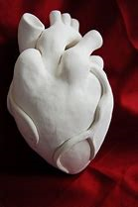
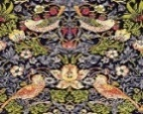
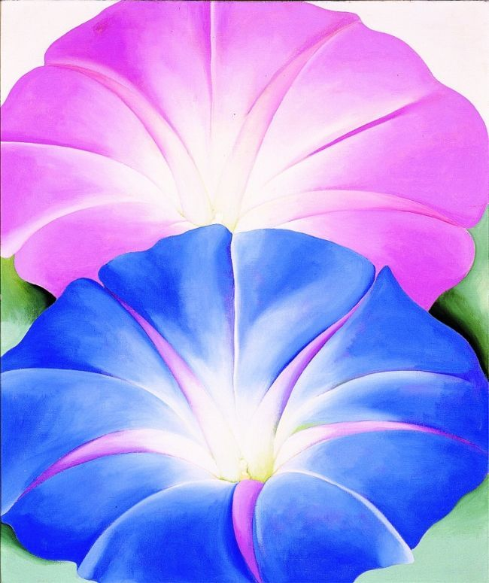
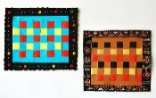
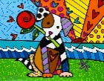
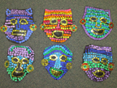
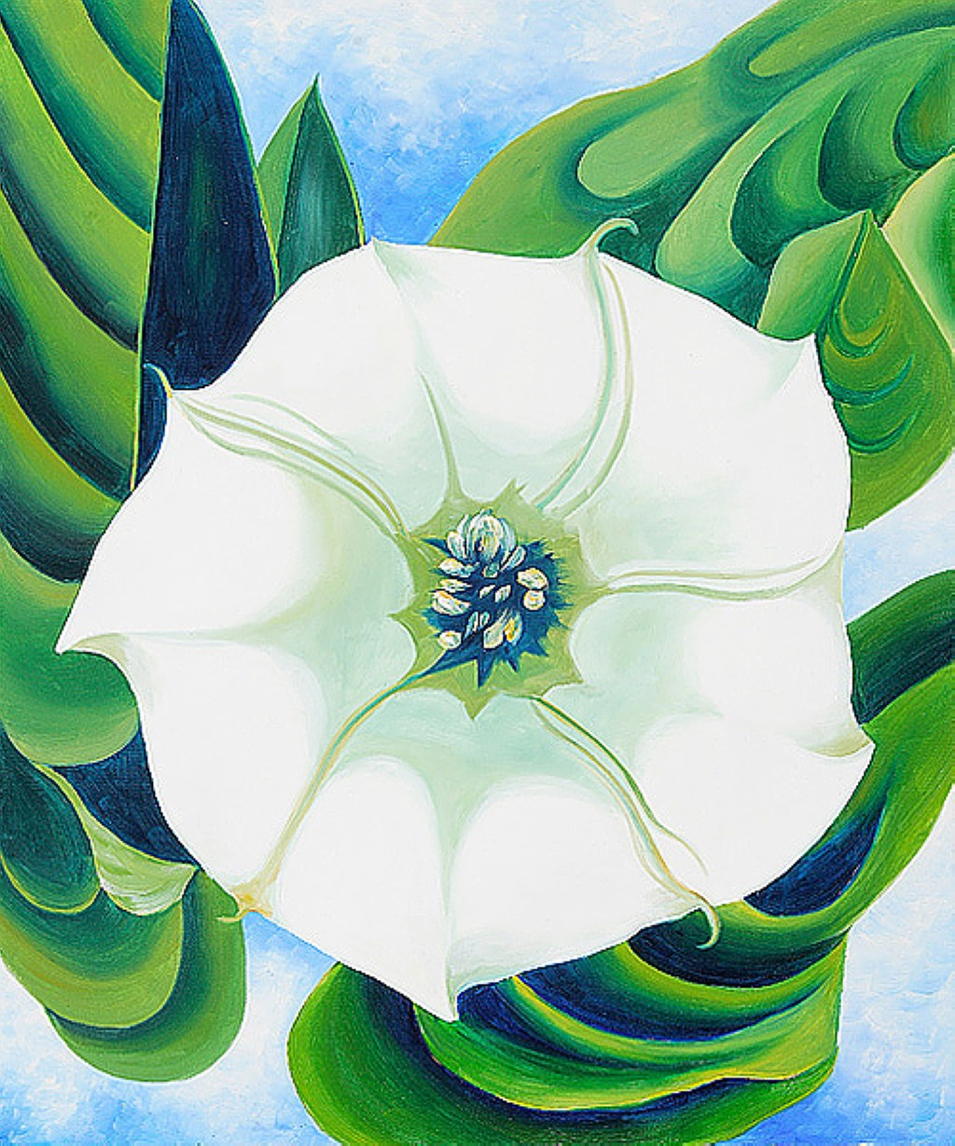
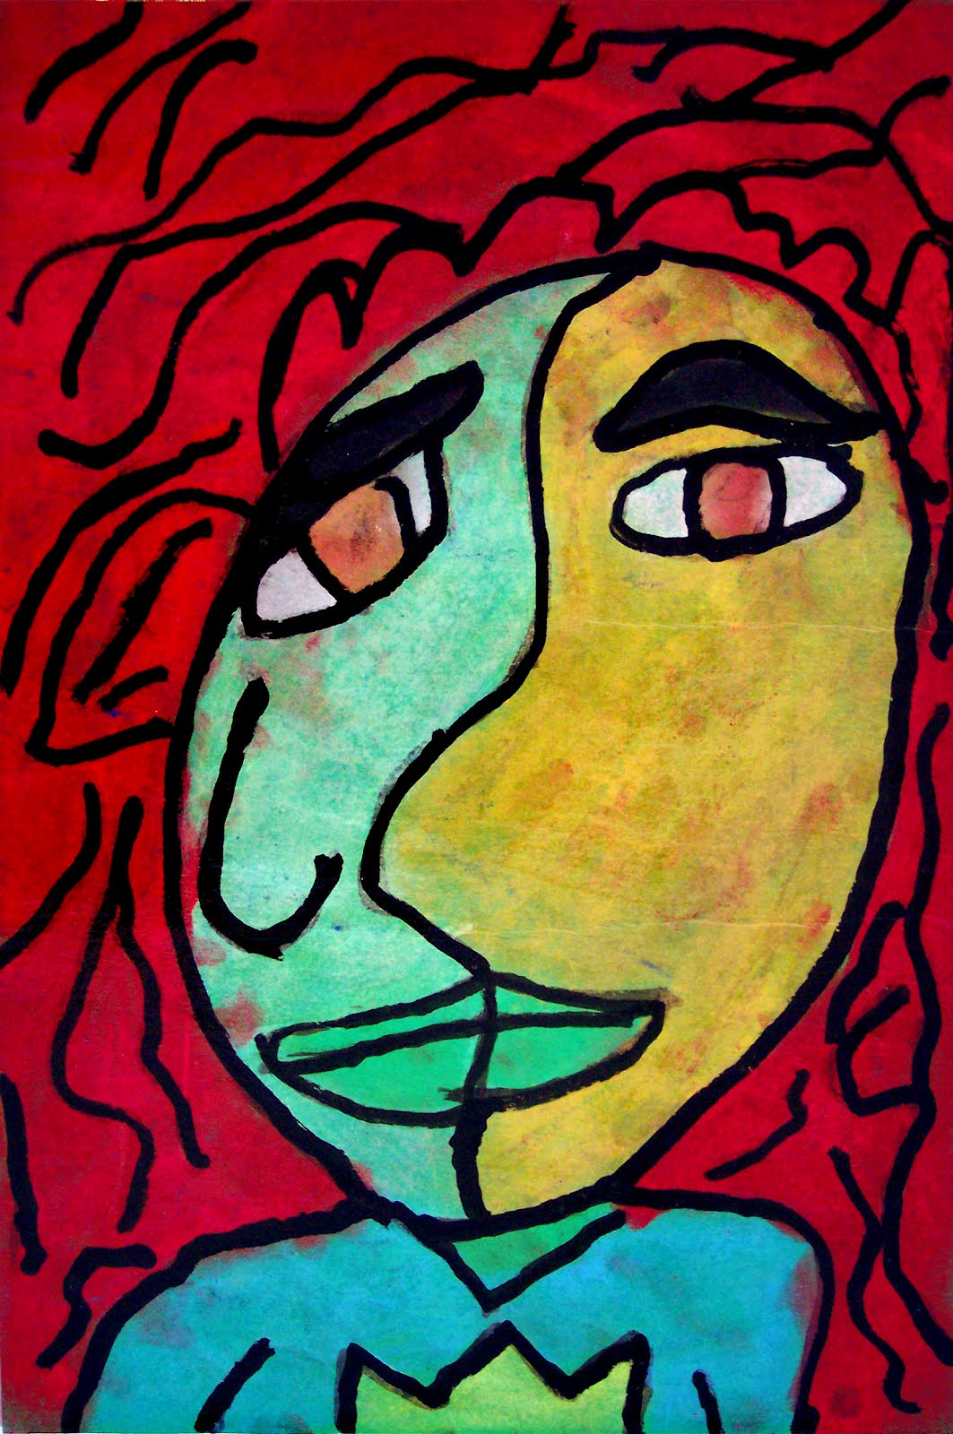
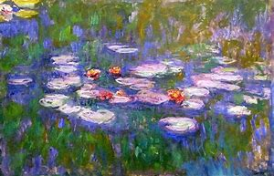
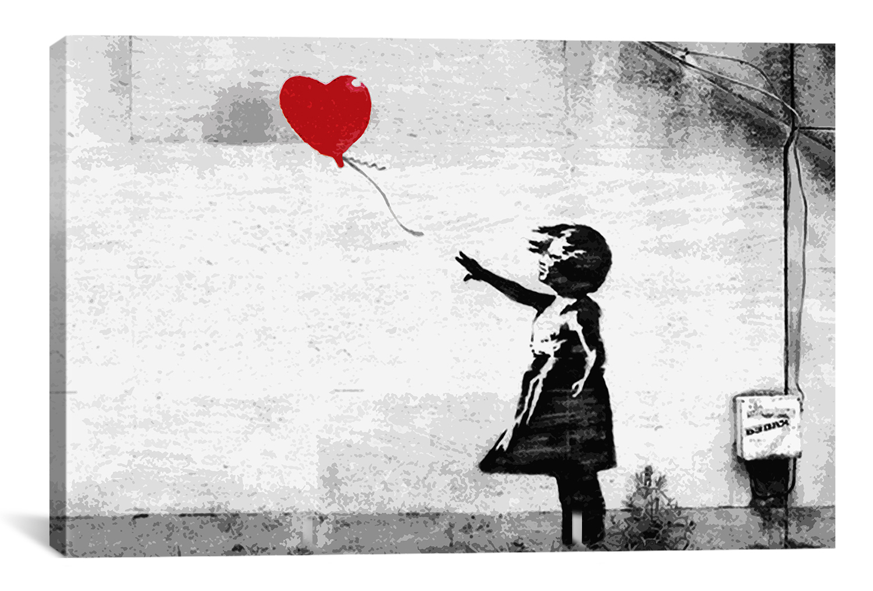
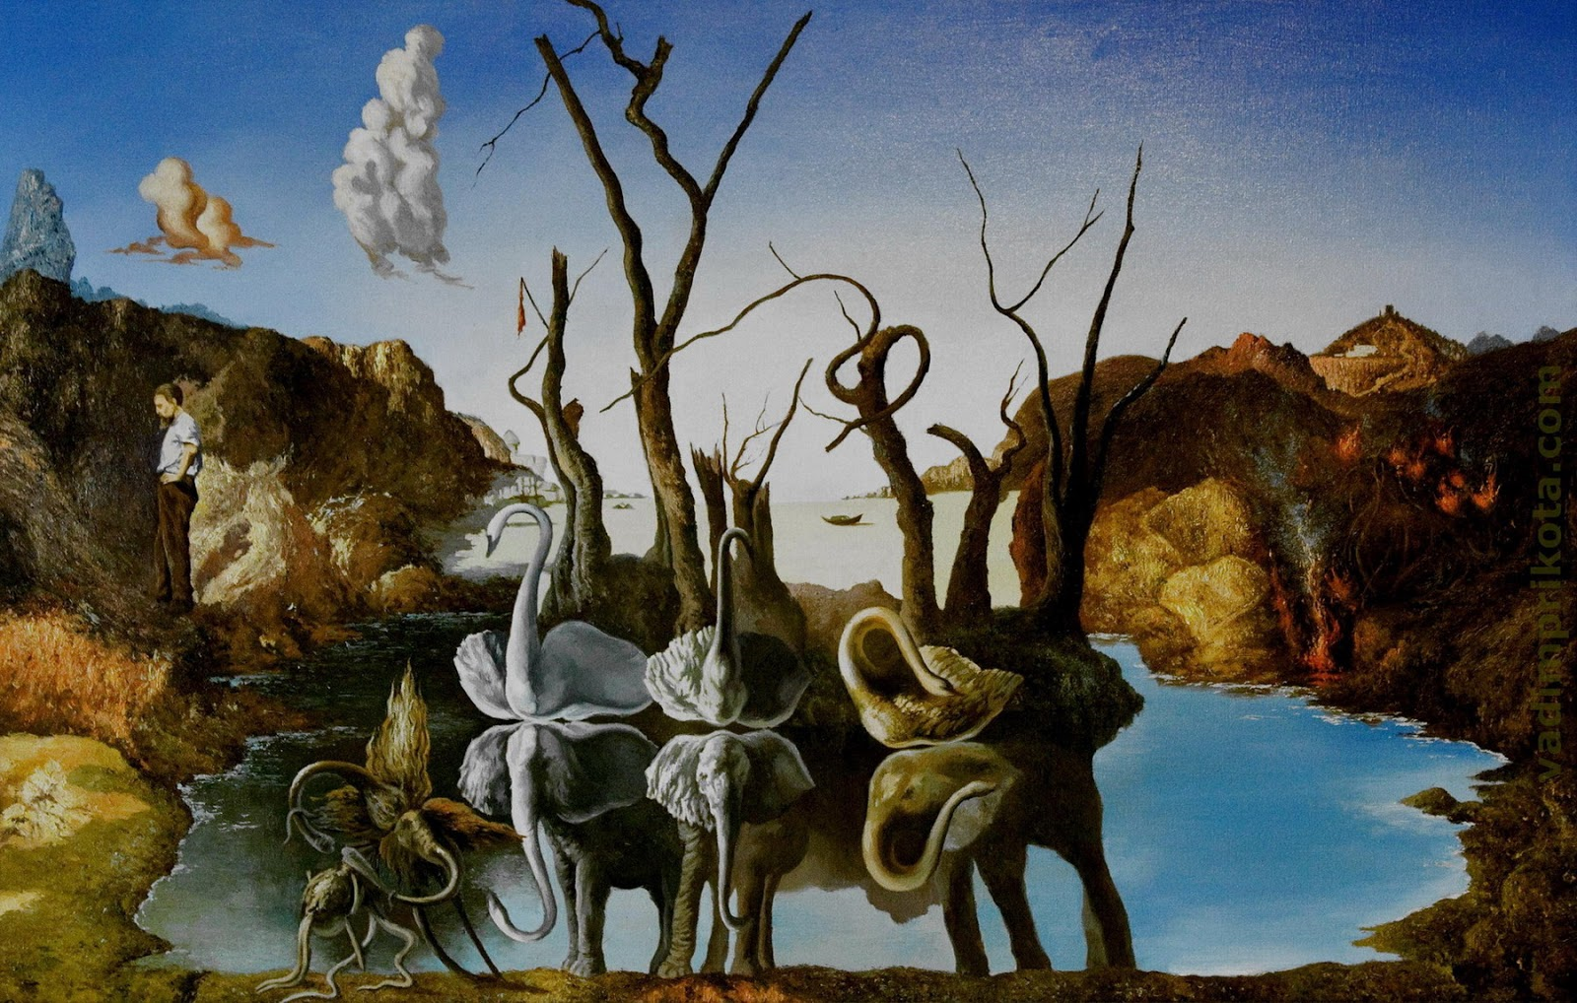
Art | Year 1 | Year 2 | Year 3 | Year 4 | Year 5 | Year 6
Autumn 1 | ANDY WARHOL |  | Rocks |  | BANKSY
 | Pop art portraits, poster paint colour block x4 on A4 paper. |  | Create a 3D model of a volcano adding texture using different media. |  | Banksy Art- Research and create digital graffiti artwork in the style of Banksy.
Autumn 2 |  | VICTORIANS | Natural Disasters |  |  | Circulatory System
 |  | William Morris art – printing using different media e.g. flowers/foods – design your own wallpaper. | Create a weather painting with a background wash using a range of different paint brushes – In the style of Monet |  |  | Clay Heart - Sculpture
Spring 1 | PLANTS | KENYA |  | Anglo Saxons and Vikings | FORCES | WW2 MANCHESTER
 | Georgia O’Keeffe – Artist Water Colour | African weaving art – use coloured paper weaving to make a whole class patchwork pattern/wall tapestry |  | Viking art mood paintings in sketch books using charcoal. | Using line, tone, shade to represent figures and movement using a range of pencils. | LS Lowry – Oil War Paintings
Spring 2 | Romero Britto/Collage |  |  |  | EARTH AND SPACE
 | Make collage art using newspapers/magazines in the style of Brazillian Artist Romero Britto |  |  |  | Astro Art- Water colour/ acrylic space art in the style of David Hardy.
Summer 1 |  | Florence Nightingale | ROMANS | Egyptians |  | MAYAN MASKS
 |  | A Colour Wheels Experiment with/mix paint to make secondary colours to create a picture of Florence Nightingale in the style of Picasso | A Sketch a Roman mosaic pattern. Combine hand drawn work with IT media . | Clay modelling- create a traditional Egyptian vase using clay. |  | Papier Mache
Summer 2 |  |  |  | Rivers and Mountains | Animals including Humans | Salvador Dali
 |  |  |  | Observational drawings of reflections in rivers using oil pastels. Focus on the Peak District (Peter Hill). | Use line, tone and shape to represent figures in movement. Use a range of sketching pencils. | Surrealism collage
Artist to Study During the Year. | Georgia O’Keeffe | Pablo Picasso | Claude Monet | Peter Hill | Banksy | Salvador Dali

Slide 2
ART Y1 | AUTUMN | AUTUMN | SPRING | SPRING | SUMMER | SUMMER
FOCUS | Andy Warhol |  | Plants | Brazil
QUESTION
KEY KNOWLEDGE AND SKILLS | Can they communicate something about themselves in their drawing? Can they communicate something about themselves in their painting? Can they paint a picture of something they can see? Can they name the primary and secondary colours? Can they describe what they can see and like in the work of another artist? Can they ask sensible questions about a piece of art? |  | Knowledge of the work of a Georgia O’Keeffe, describing the differences and similarities between different practices and disciplines, and making links to their own work. Can they paint a picture of plants they can see? I can name the primary and secondary colours I can describe what features of plants I see and give an opinion about the work of an artist linked to this subjects. I can ask questions about a piece of Georgia O’Keeffe’s artwork. | Knowledge of how to develop collage techniques in using colour, pattern, texture, shape to use a range of materials creatively to design and make products I can cut and glue materials Create moods in art work
TEXT

Slide 3
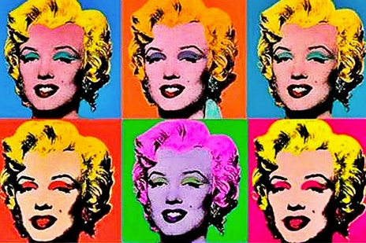
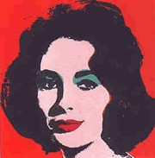
Year 1: Andy Warhol (painting portraits) Knowledge Mat
Subject Specific Vocabulary |  | Sticky Knowledge: | Artist Inspiration
Portrait | Portrait painting is a genre in painting, where the intent is to represent a specific human, creature or character subject. The term 'portrait painting' can also describe the actual painted portrait. | The primary colours are red, blue and yellow. You can mix these to make green, orange and purple. Adding white or black to a colour will make it lighter or darker respectively. Take time to sketch the outline of your chosen portrait that is being copied before you use paint. | Andy Warhol
Colour Blocking | The process of using colours from opposite ends of the colour wheel/chart and pairing them together to make interesting and complimentary colour combinations.
Printing | Making a copy of an image you have created and transferring the image onto another surface. | Skills
Resources Poster paint Paintbrushes Paint Pots Paint palette Pencils Rubbers Rulers A4 white paper |  | Can I paint a picture of something I can see? Can I name the primary and secondary colours? Can I describe what I can see and like in the work of another artist? Can I ask sensible questions about a piece of art?

Slide 4
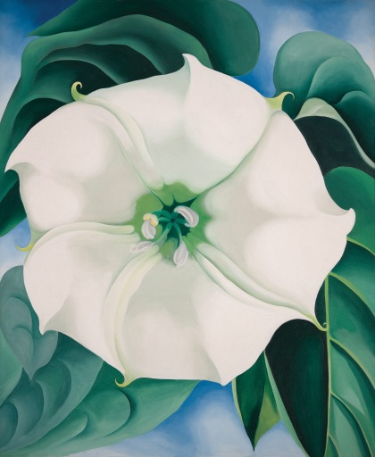
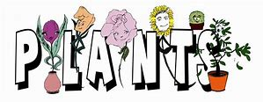
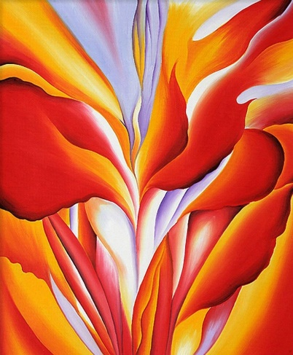
Year 1: Plants (watercolour) Knowledge Mat
Subject Specific Vocabulary |  | Sticky Knowledge: | Artist Inspiration
Watercolour | Paint which is thinned with water rather than oil, giving a transparent colour. | When using watercolours, dip the brush in water and then twirl it on the colour of choice. Dip again for a lighter and more watery colour. Always rinse the brush well in a water pot between different colour applications. | Georgia O’Keeffe
Layering | A layer can consist merely of one small dab of paint, or can involve thick overlays covering the whole surface.
Blending | The process of gently intermingling two or more colors to create a gradual transition or to soften lines.
Tonal | Tonal Colors are different shades of colors of same main color group. Different tones of a color e.g. light purple and dark purple. | Skills
Landscape | A landscape is the visible features of an area of land, its landforms, and how they integrate with natural or man-made features. | I can paint a picture of plants I can see I can name the primary and secondary colours I can describe what features of plants I see and give an opinion about the work of an artist linked to Plants I can ask questions about a piece of Georgia O’Keeffe’s artwork
Resources Poster paint Paintbrushes Paint Pots Paint palette Pencils Rubbers Rulers A4 white paper

Slide 5
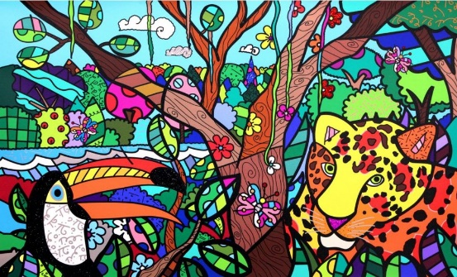
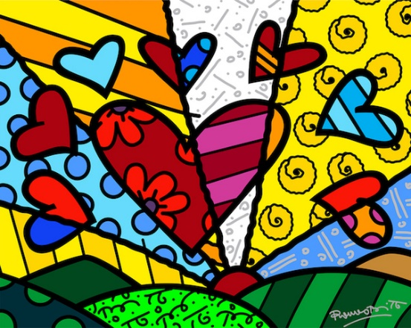
Year 1: Brazil (collage) Knowledge Mat
Subject Specific Vocabulary |  | Sticky Knowledge: | Artist Inspiration
Collage | A piece of art made by sticking various different materials such as photographs and pieces of paper or fabric on to a backing. | When collaging, look for textures and colours that compliment each other to portray a certain image when used together. Using overlapping with your materials will help you to achieve a rough texture,. To achieve smoother textures, you can use smooth materials that fit seamlessly together. | Romero Britto
Texture | Texture is the way something feels to the touch, or looks to the eye. Words like rough, silky, shiny and dull help writers describe the texture of an object.
Contrasting | A principle of art that refers to the arrangement of opposite elements (light vs. dark colors, rough vs. smooth textures, large vs. small shapes, etc.) in a piece so as to create visual interest, excitement and drama.
Layering | A layer can consist merely of one material or can involve multiple overlays covering the whole surface. | Skills
Resources Scissors Glue stick or PVA glue Scrap magazines/newspapers etc. Paint palette Pencils Rubbers A4 white paper |  | I know how to develop collage techniques in using colour, pattern, texture and shape to use a range of materials creatively to design and make products I can cut and glue materials I can create moods in artwork

Slide 6
ART Y2 | AUTUMN | AUTUMN | SPRING | SPRING | SUMMER | SUMMER
FOCUS |  | Victorians | Kenya |  | Picasso
QUESTION
KEY KNOWLEDGE AND SKILLS |  | Knowledge of how to develop a range of printing techniques in using colour, pattern and texture using different media Knowledge about the work of a range of artists, craft makers and designers, describing the differences and similarities between different practices and disciplines, and making links to their own work. I can create brown with paint I can create tints with paint by adding white. I can create tones with paint by adding black I can create a piece of art in response to the work of another artist. | Knowledge of how to use a paper creatively to design and make a wall tapestry. Knowledge of how to develop weaving techniques in using colour and pattern I can join materials together to create a new product |  | Knowledge of how to use painting to develop and share their ideas in response to an artist Knowledge about the work of Picasso, describing the differences and similarities between different practices and disciplines, and making links to their own work. I can create tints with paint by adding white. I can create tones with paint by adding black I can suggest how Picasso has used colour pattern and shape. I can mix paint to make all the secondary colours.
TEXT

Slide 7
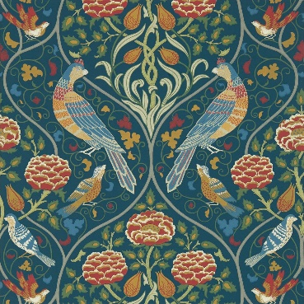
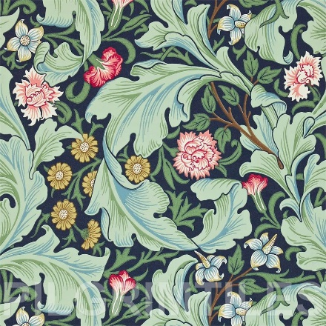
Year 2: Victorians (printing) Knowledge Mat
Subject Specific Vocabulary |  | Sticky Knowledge: | Artist Inspiration
Printing | Making a copy of an image you have created and transferring the image onto another surface. | When printing, if you want to achieve a thicker or heavier effect on your chosen surface, apply more paint to your chosen media you are printing with. Alternatively, lightly cover your printing media with paint to achieve a thinner, lighter effect on the surface. | William Morris
Texture | Texture is the way something feels to the touch, or looks to the eye. Words like rough, silky, shiny and dull help writers describe the texture of an object.
Media | The material and tools used by an artist, composer or designer to create a work of art, for example, "pen and ink" where the pen is the tool and the ink is the material. | Skills
Resources Paint palette Paint Paintbrushes Leaves, flowers, sponges etc. – any media you want to use for printing Pencils Rubbers A4 white paper |  | I know about the work of William Morris and can describe the differences and similarities between his pieces and can make links to my own work. I can create brown with paint I can create tints with paint by adding white. I can create tones with paint by adding black

Slide 8
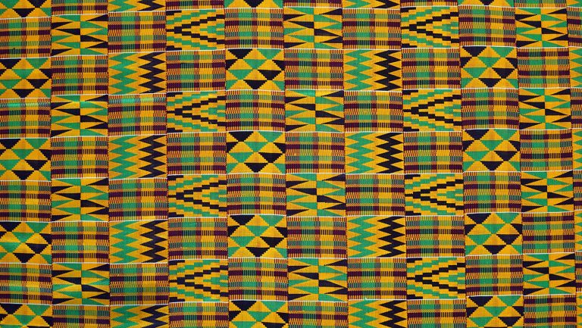
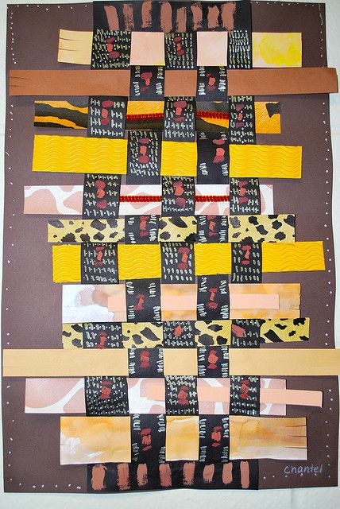
Year 2: Kenya (weaving) Knowledge Mat
Subject Specific Vocabulary |  | Sticky Knowledge: | Art Inspiration
Weaving | Weaving is a method of textile production in which two distinct sets of material are interlaced at right angles to form a fabric or cloth | When weaving with paper, make sure the end of the two strips of paper have already been decorated. Secure the two strips, corner to corner on a right angle, one facing vertically, one horizontally, their ends meeting into a corner. Take a third strip to attach to the vertical strip. Repeat this until you have strips of paper going across and strips going down, in a criss-cross pattern. You can now take your first strip and weave it under and over, under and over until it reaches the end. | Kente Cloth Weaving
Texture | Texture is the way something feels to the touch, or looks to the eye. Words like rough, silky, shiny and dull help writers describe the texture of an object.
Layering | A layer can consist merely of one material or can involve multiple overlays covering the whole surface. | Skills
Resources Sugar paper (different colours) Paint (to decorate) Paintbrushes scissors Pencil crayons (to decorate) Felt tips (to decorate) Pencils (to decorate) Rubbers |  | I know how to use paper creatively to design and make a wall tapestry. I know how to develop weaving techniques in using colour and pattern I can join materials together to create a new product

Slide 9
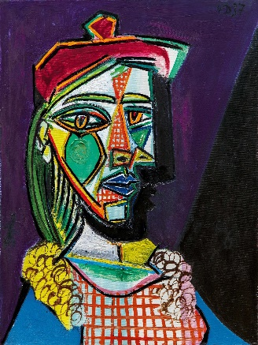
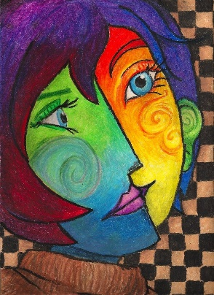
Year 2: Picasso (mixing colours) Knowledge Mat
Subject Specific Vocabulary |  | Sticky Knowledge: | Artist Inspiration
Primary Colours | Primary colours include Red, Blue and Yellow. | Red and Blue mix together to make Purple. Red and Yellow mix together to make Orange. Blue and Yellow mix together to make Green. If you add white to any colour, it will make the colour some shades lighter. If you add black to and colour, it will make the colour some shades darker. | Picasso
Secondary Colours | Secondary colours include Green, Orange and Purple.
Colour Blocking | The process of using colours from opposite ends of the colour wheel/chart and pairing them together to make interesting and complimentary colour combinations. | Skills
Resources A4 white paper Paint Paint palette Paintbrushes (thin and thick) Pencils Rubbers |  | I know how to use painting to develop and share my ideas in response to an artist I know about the work of Picasso, describing the differences and similarities between different practices and disciplines, and can make links to my own work. I can create tints with paint by adding white. I can create tones with paint by adding black I can suggest how Picasso has used colour pattern and shape. I can mix paint to make all the secondary colours.

Slide 10
ART Y3 | AUTUMN | AUTUMN | SPRING | SPRING | SUMMER | SUMMER
FOCUS | Rocks | Natural Disasters |  |  | Romans
QUESTION
KEY KNOWLEDGE AND SKILLS | Knowledge of how to improve their mastery of sculpture with a range of materials [for example, charcoal, paint, clay.] Can they add onto their rock to create texture and shape? Can they add texture to a piece of work? I can use a range of brushes to create different effects in painting the rocks. | Knowledge of how to improve their mastery of art and design techniques, including drawing and painting with a pencil and paint I can create a background using a wash I can use a range of brushes to create different effects in painting the rocks. Can they explore work from other artists (Monet)? |  |  | Can they use different grades of pencil to shade and show different tones and textures? Can they use digital images and combine with other media? Can they use IT to create art which includes their own work and that of others?
TEXT

Slide 11
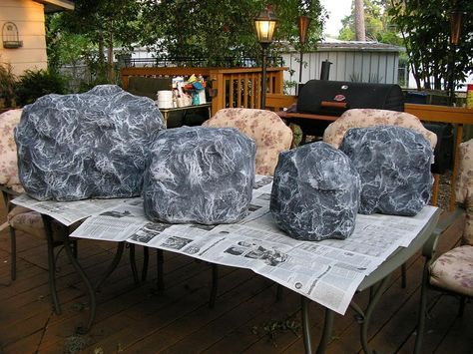
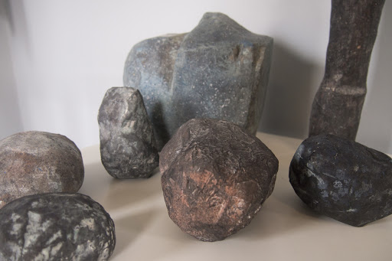
Year 3: Rocks (creating texture) Knowledge Mat
Subject Specific Vocabulary |  | Sticky Knowledge: | Art Inspiration
Texture | Texture is the way something feels to the touch, or looks to the eye. Words like rough, silky, shiny and dull help writers describe the texture of an object. | I know that if I use different media and combine them when building a model, I will achieve a new texture. I can alter a texture to look shinier by using reflective materials. I can make a texture appear rough by using papier mache | Papier Mache rocks
Layering | A layer can consist merely of one material or can involve multiple overlays covering the whole surface.
Media | The material and tools used by an artist, composer or designer to create a work of art, for example, "pen and ink" where the pen is the tool and the ink is the material. | Skills
Resources Newspaper Papier mache Paint palette Paint Paintbrushes (thin and thick) Charcoal Oil pastels |  | I know how to improve my mastery of sculpture with a range of materials [for example, charcoal, paint, clay.] I can add onto my rock to create texture and shape I can add texture to a piece of work I can use a range of brushes to create different effects in painting the rocks.

Slide 12
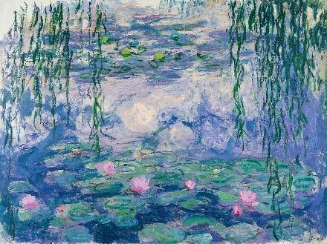
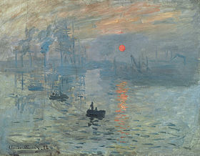
Year 3: Natural Disasters (watercolour background wash) Knowledge Mat
Subject Specific Vocabulary |  | Sticky Knowledge: | Artist Inspiration
Blending | The process of gently intermingling two or more colors to create a gradual transition or to soften lines. | When using watercolours, dip the brush in water and then twirl it on the colour of choice. Dip again for a lighter and waterier colour. Always rinse the brush well in a water pot between different colour applications. | Claude Monet
Watercolour | Paint which is thinned with water rather than oil, giving a transparent colour. | Skills
Landscape | A landscape is the visible features of an area of land, its landforms, and how they integrate with natural or man-made features. | I know how to improve my mastery of art and design techniques, including drawing and painting with a pencil and paint I can create a background using a watercolour wash I can use a range of brushes to create different effects in painting natural objects e.g. rocks, mountains, sea I can explore work and draw inspiration from other artists such as Claude Monet.
Resources Paint palette Paint Water pots Paintbrushes (thin and thick) Watercolour brush Paper Pencils Rubbers

Slide 13
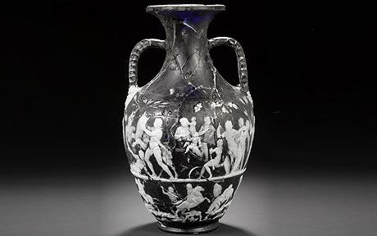
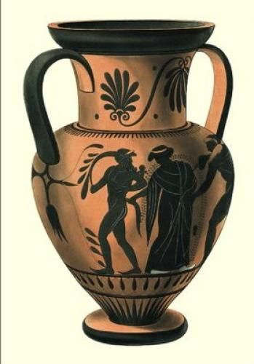
Year 3: Romans (texture with sewing) Knowledge Mat
Subject Specific Vocabulary |  | Sticky Knowledge: | Art Inspiration
Texture/Tone | Are the building blocks of composition in art. We build tone using value scale: white being the lightest, black offering the darkest and grey for in between. This conveys the visual texture of a surface. E.g. Texture examples: smoothness, softness, rough | I know how to use different grades of pencil to shade and to show different tones and texture. I can recognise when art is from different historical periods and cultures. I can compare the work of different artists. I know how to identify the techniques used by different artists. | Roman Vases
Media | The material and tools used by an artist, composer or designer to create a work of art, for example, "pen and ink" where the pen is the tool and the ink is the material.
Sketch | traditionally a rough drawing or painting in which an artist notes down his preliminary ideas for a work that will eventually be realized with greater precision and detail. | Skills
Resources Sketchbook A Range of pencils (3B, 2H, 8B) Computer/iPad/Laptop Photographs of Roman vases |  | I know how to use sketches to create a final piece of art. I know how to use digital images and combine with other media I can use IT to create art which includes my own work and that of others

Slide 14
ART Y4 | AUTUMN | AUTUMN | SPRING | SPRING | SUMMER | SUMMER
FOCUS |  |  | Anglo Saxons and Vikings |  | Egyptians | Rivers and Mountains
QUESTION
KEY KNOWLEDGE AND SKILLS |  |  | Can they use their sketch books to express mood in Viking style paintings? Can they suggest improvements to their work by keeping notes in their sketch books? Can they use line, tone and shape to represent figures and forms in movement? Do they successfully use shading to create mood and feeling? |  | Can they sculpt clay and other mouldable materials? Knowledge of how to improve their mastery of sculpture techniques, including sculpture with clay. Do they experiment with and combine materials and processes to design and make 3D form? Can they begin to sculpt clay and other mouldable materials? | Can they show reflections? Can they identify and draw simple landscapes, and use marks and lines to produce texture? Knowledge of how to improve their mastery of art and design techniques, including drawing with oil pastels Can they experiment with different styles that artists have used? Do they learn about the work of others by looking at artists’ work in books, the internet, visits to galleries and other sources of information?
TEXT

Slide 15
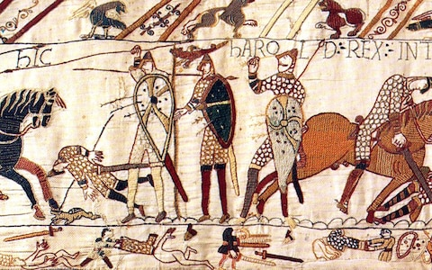
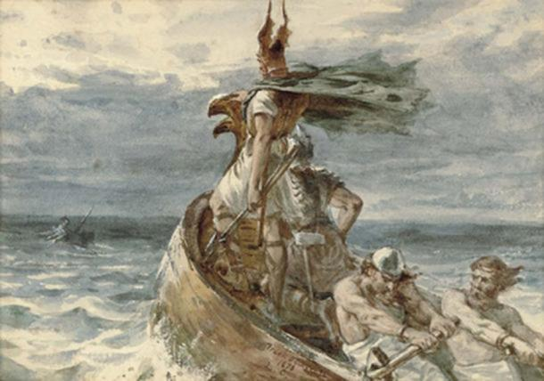
Year 4: Anglo Saxons and Vikings (creating mood with charcoal) Knowledge Mat
Subject Specific Vocabulary |  | Sticky Knowledge: | Artist Inspiration
Mood/ feeling | Colour represents the mood- vibrant colours may be Energetic, exciting, stimulating. Where as, dull colours maybe describes as boring, dull and lifeless. | I know which colours will be best used to achieve a certain mood, and whether or not to use lighter or darker shading to achieve said mood. I can create shapes using charcoal to portray figures or landscapes, and can create shadows to further the visual texture of the surface.
Line | Lines can be vertical, horizontal, diagonal, or curved.
Tone | We build tone using value scale: white being the lightest, black offering the darkest and grey for in between. This conveys the visual texture of a surface
Shape | Created through lines, textures, colours or an area enclosed by other shapes such as triangles, circles, and squares. | Skills
Resources Pencils Rubbers Sketch books Charcoal |  | I can use sketch books to express mood in Viking style paintings I can suggest improvements to my work by keeping notes in my sketch books I can use line, tone and shape to represent figures and forms in movement I can choose colours to reflect mood in my drawing I can use shading to create mood and feeling

Slide 16
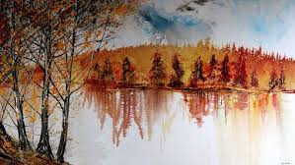
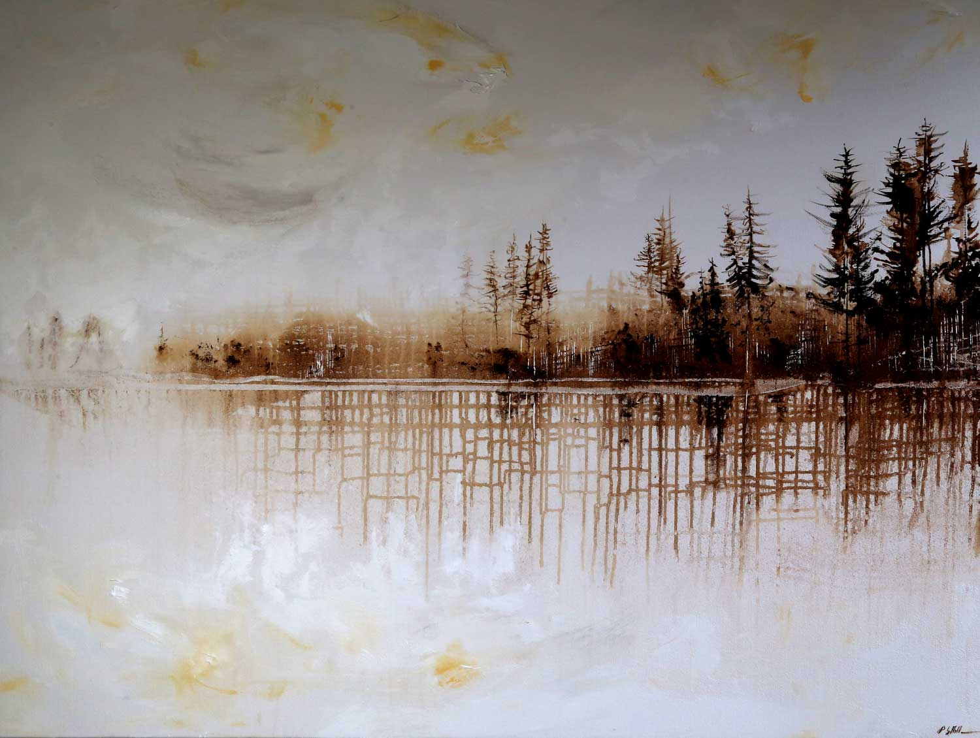
Year 4: Rivers and Mountains (oil pastels) Knowledge Mat
Subject Specific Vocabulary |  | Sticky Knowledge: | Artist Inspiration
Lines | Straight or curved lines on a background with no gradations of colour or shade. The 5 types of line art: Curved Diagonal Horizontal Vertical Zig-Zag | How to improve their mastery of art and design techniques, including drawing with oil pastels- model on IWB. How to use oil pastels correctly: Heavy Pressure Blending- generously add oil pastel in one direction onto your paper. ... Light Pressure Blending- Lightly add oil pastels on paper with little pressure. ... Color Mixing. Stippling. Scumbling. Ensure children are aware that oil pastels never fully dry because their binder is a non-drying oil. However, it does fix and harden to reduce smudging. | Peter Hill Artist Peter Hill was born in Kent in 1965. He moved to Sheffield when he was a child, on the edge of the Peak District. He draws heavily on the extraordinary landscapes that surround his National Park Galleries in Derbyshire and the Lake District.
Mark-making | Mark-making can be done in an expressive way to represents mood, feeling and emotion.
Texture | Conveys the visual texture of a surface. E.g. Texture examples: smoothness, softness, rough,
Landscape | A visible area made up of natural and man-made features. EG the Peak District | Skills
Resources Pencils Sketch books Oil pastels |  | I can show reflections using oil pastels I can identify and draw simple landscapes, and use marks and lines to produce texture? I can experiment with different styles that artists have used? I can learn about the work of others by looking at artists’ work in books, the internet, visits to galleries and other sources of information

Slide 17
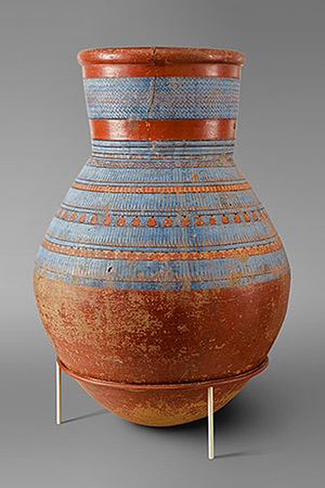
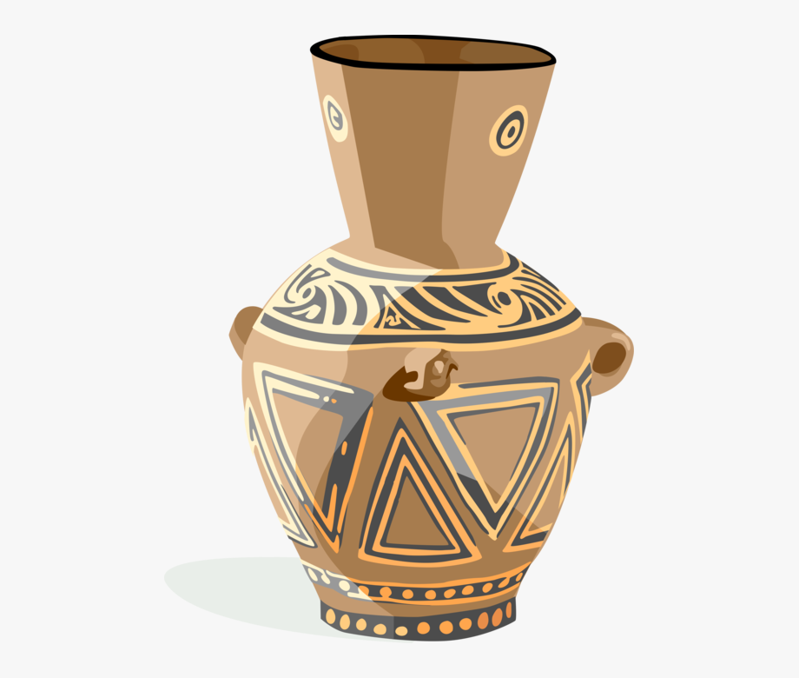
Year 4: Ancient Egyptians (sculpture) Knowledge Mat
Subject Specific Vocabulary |  | Sticky Knowledge: | Artist’s Interpretation
Sculpt | Create or represent (something) by carving, casting, or other shaping techniques | White clay will display paint best (acrylic paint. Poster paint will work too). | Egyptian Pottery
Clay | Clay is a soft, loose, earthy material made up of tiny particles of rock. When wet it is very soft which then hardens as it dries. Clay is used to make bricks, potteries, and ceramics. It is also used to make sculptures and decorative patterns and designs. .
3D Form | Form is a three dimensional shape, such as a cube, sphere or cone. Sculpture and 3D design are about creating forms.
Pattern | A design that is created by repeating lines, shapes, tones or colours. The design used to create a pattern is often referred to as amotif. Motifs can be simple shapes or complex arrangements. | Skills
Resources Sculpting tools: knife, stick and a wire modeller (as illustrated) newspapers or oilcloth to protect the work table. Clay Acrylic and/or poster paint |  | I can sculpt clay and other mouldable materials to create a vase. I know how to improve my mastery of sculpture techniques, including sculpture with clay. I can experiment with and combine materials and processes to design and make 3D form I can begin to sculpt clay and other mouldable materials

Slide 18
ART Y5 | AUTUMN | AUTUMN | SPRING | SPRING | SUMMER | SUMMER
FOCUS | BANKSY/DIGITAL ART |  | ANIMALS INCLUDING HUMANS | EARTH AND SPACE
QUESTION
KEY KNOWLEDGE AND SKILLS | Can they create a piece of art work which includes the integration of digital images they have taken? Can they combine graphics and text based on their research? Can they scan images and take digital photos, and use software to alter them, adapt them and create work with meaning. Use images which I have created, scanned and found, altering them where needed to create art. I can research the work of Banksy and use his work to replicate a style. Knowledge of experimentation and to gain an increasing awareness of different kinds of art, craft and design e.g. digital art. |  | Can they organise line, tone, shape and colour to represent figures and forms in movement? Do they keep notes in their sketch books as to how they might develop their work further? Do they use their sketch books to compare and discuss ideas with others? Can they explain why they have chosen specific sketching pencils to draw with? | I can identify and draw objects and use marks and lines to produce texture I can research the work of David Hardy and use his work to replicate a style. Can they explain why they have chosen water colour/acrylic to paint with? Can they create all the colours they need? Can they experiment with different styles that Hardy has used? Do they learn about the work of others by looking at artists’ work in books, the internet, visits to galleries or other sources of information?
TEXT

Slide 19
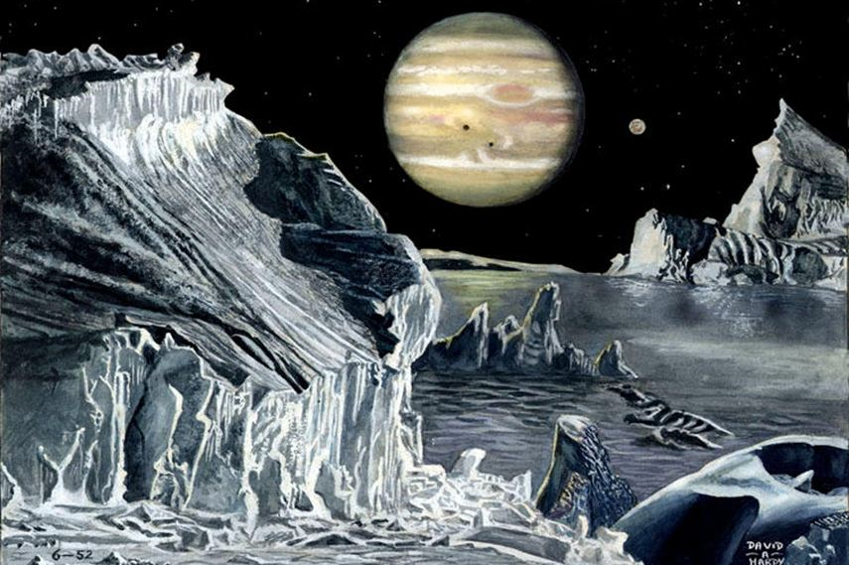
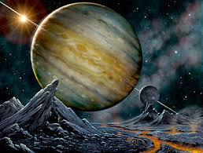
Year 5 Astro Art (watercolour/acrylic) Knowledge Mat
Subject Specific Vocabulary |  | Sticky Knowledge: | Artist’s Interpretation
Watercolours | Paint mixed with water, to create a thin watery consistency. This method of painting allows the colours to merge together more fluidly, as the added water helps the colours to mix easily and can create a gradient effect. | When using watercolours, dip the brush in water and then twirl it on the colour of choice. Dip again for a lighter and more watery colour. Always rinse the brush well in a water pot between different colour applications | David Hardy David Hardy works with watercolours, acrylics, photography and digital art. He creates work that focuses on the depth, tone & texture without the distraction of colour.
Acrylic | Is waster resistant, dries quickly, often, acrylic can easily peel or scrape from a surface. On card, it offers vibrant colour and works well.
Texture/Tone | Are the building blocks of composition in art. We build tone using value scale: white being the lightest, black offering the darkest and grey for in between. This conveys the visual texture of a surface. Eg Texture examples: smoothness, softness, rough, | Skills
Resources Water colours Acrylic paints Paintbrushes Paint Pots Paint palette Pencils Rubbers Rulers A4 white paper David Hardy information text/ PowerPoint |  | I can use hue, tint, tone, shades and mood I can explore the use of texture in colour I can colour for purposes I can identify and draw objects and use marks and lines to produce texture I can research the work of David Hardy and use his work to replicate a style.

Slide 20
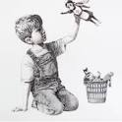
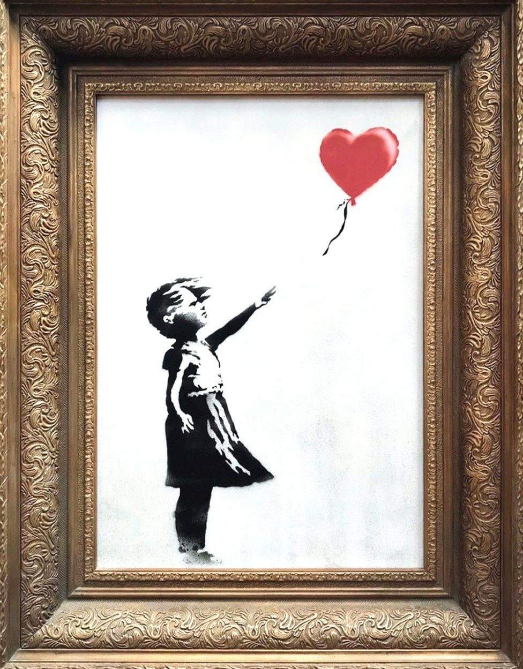
Year 5: Banksy (Digital Art) Knowledge Mat
Subject Specific Vocabulary |  | Sticky Knowledge: | Artist’s Interpretation
Stencilling | Stencil is a from of graffiti that is used to decorate and is made to from paper, cardboard and other media to create an image that is easily reproducible. It creates unique effects and finishes with a range of stencils | Can they create a piece of art work which includes the integration of digital images they have taken? Can they scan images and take digital photos, and use software to alter them, adapt them and create work with meaning Awareness of different kinds of art, craft and design e.g. digital art | Game changer- 2020 Love Is in the Bin- 2006 Banksy - A famous British graffiti artist (born in 1974) since the 1990s.
Spray-paint | Spray-paint is paint held in an aerosol can for spraying on surfaces. It is versatile and can be used on many surfaces: plastic, metal, wood, ceramic, plaster, concrete, canvas, particle board, laminate, glass,
Digital Art | Digital art is creative work that uses digital technology, including digital painting. Besi digital art software: Wacom Cintiq touch. Clip Studio Paint EX. ... Wacom MobileStudio Pro. ... iPad Pro & Apple Pencil Clip Studio Paint EX for iOS | Skills
Resources brush, dabber, sponge, or roller tape or Spray Adhesive. Acrylic paint ( matte), chalk paint, stencil creme. Paint Tray: to hold paint, blend and create custom colours. Paper towels: To offload the paint before stencilling. https://www.bbc.co.uk/bitesize/clips/zsghdmn -Example of Banksy style-stencilling Digital Software: Wacom Intuos Pro Paper Edition. Clip Studio Paint EX. Wacom MobileStudio Pro. iPad Pro & Apple Pencil. |  | Use images which I have created, scanned and found, altering them where needed to create art. I can combine graphics and text based on my research and replicate a style of Banksy Knowledge of experimentation and to gain an increasing awareness of different kinds of art, craft and design e.g. digital art.

Slide 21
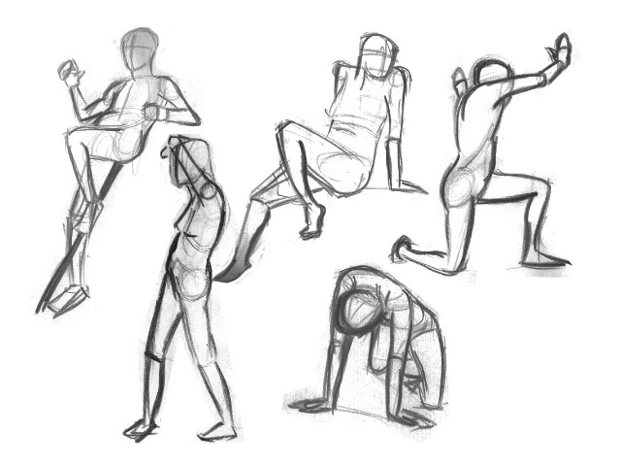
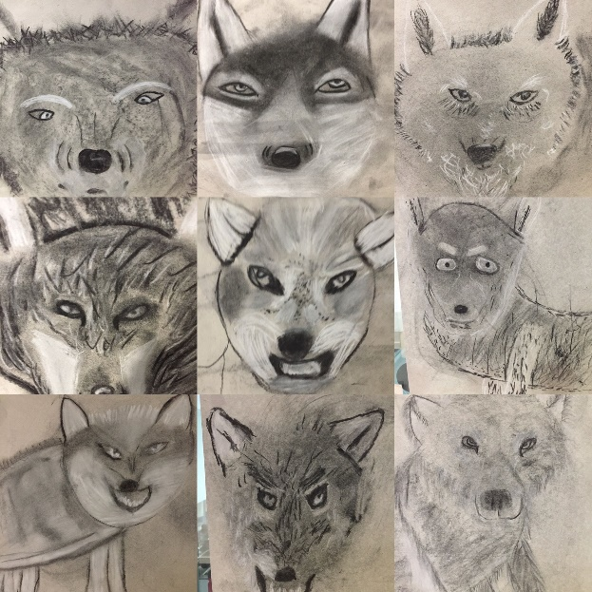
Year 5: Animals including humans (Sketching) Knowledge Mat
Subject Specific Vocabulary |  | Sticky Knowledge: | Art Interpretation
Line | Straight or curved lines on a background with no gradations of colour or shade. The 5 types of line art: Curved Diagonal Horizontal Vertical Zig-Zag | I know that my sketch book is to be used as a tool for practise, research, making notes and developing my work. It is not just for a finished product, it is to show the process of my ideas. Sketching is a rough form of drawing, with no solid lines, but many softer ones.
Tone | We can use tone to create atmosphere and mood as well as to define form. Experimenting with tones: We make lighter tones or tints by adding white to a colour, and we make darker tones or shades by adding black
Shape | created through lines, textures, colours or an area enclosed by other shapes such as triangles, circles, and squares.
Colour | Primary (red, blue and yellow)and secondary (purple, orange and green)colours used to create the mood/atmosphere. Colour has 3 main characteristics: Hue, brightness, saturation. | Skills
Resources Specific sketching pencils Sketch books Rubbers |  | I can organise line, tone, shape and colour to represent figures and forms in movement I can keep notes in my sketch book as to how I might develop my work further I can use my sketch book to compare and discuss ideas with others I can explain why I have chosen specific sketching pencils to draw with

Slide 22
ART Y6 | AUTUMN | AUTUMN | SPRING | SPRING | SUMMER | SUMMER
FOCUS |  | CIRCULATORY SYSTEM | WW2 |  | MAYANS | SALVADOR DALI
QUESTION
KEY KNOWLEDGE AND SKILLS |  | Can they create models on a range of scales? Can they include technical aspects in their work, e.g. 3D design? to improve their mastery of art and design techniques, including sculpture with clay. I can explain why I have used different tools to create art. Use feedback to make amendments and improvements to my art. | Do they learn about the work of LS Lowry by looking at his work in books, the internet, visits to galleries and other sources of information? Do their drawings communicate emotions and a sense of self with accuracy and imagination? Can they explain why they have used oil paint to create their art? Can they explain why they have chosen specific drawing techniques e.g. oil paintings? Use feedback to make amendments and improvements to my art. Explain the style of my work and how it has been influenced by a famous artist. |  | Can they include both visual and tactile elements in their work? Explain why I have chosen specific techniques to create my art. Use feedback to make amendments and improvements to my art. Explain why I have used different tools to create art. | To explain why I have used different tools (e.g. scissors, glue) to create art. To develop skills including their control of scissors and their use of materials, with creativity, experimentation and an increasing awareness of collage. Can they experiment with different styles that Dali has used? Do they learn about the work of Salvador Dali by looking at artists’ work in books, the internet, visits to galleries and other sources of information?
TEXT

Slide 23
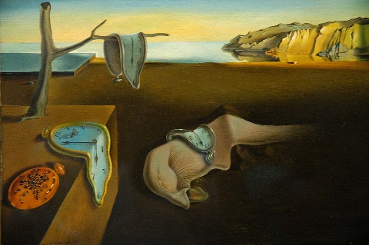
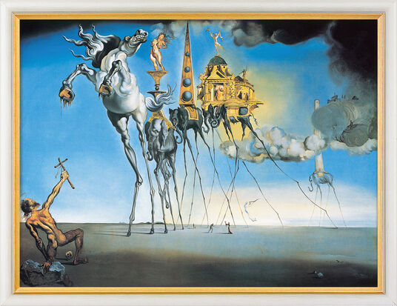
Year 6: Salvador Dali (surrealism collage) Knowledge Mat
Subject Specific Vocabulary |  | Sticky Knowledge: | Artist Inspiration
Collage | A piece of art made by sticking various different materials such as photographs and pieces of paper or fabric on to a backing. | Developed skills including their control of scissors and their use of materials, with creativity, experimentation and an increasing awareness of collage. When collaging, look for textures and colours that compliment each other to portray a certain image when used together. Using overlapping with your materials will help you to achieve a rough texture. To achieve smoother textures, you can use smooth materials that fit seamlessly together. | Salvador Dali
Texture | Texture is the way something feels to the touch, or looks to the eye. Words like rough, silky, shiny and dull help writers describe the texture of an object.
Contrasting | A principle of art that refers to the arrangement of opposite elements (light vs. dark colors, rough vs. smooth textures, large vs. small shapes, etc.) in a piece so as to create visual interest, excitement and drama.
Surrealism | a 20th-century avant-garde movement in art and literature which sought to release the creative potential of the unconscious mind, for example by the irrational juxtaposition of images. | Skills
Resources Scissors Glue stick or PVA glue Scrap magazines/newspapers etc. Paint palette Pencils Rubbers A4 white paper |  | I can explain why I have used different tools (e.g. scissors, glue) to create art. I can experiment with different styles that Dali has used I have learned about the work of Salvador Dali by looking at his work in books, the internet, visits to galleries and other sources of information

Slide 24
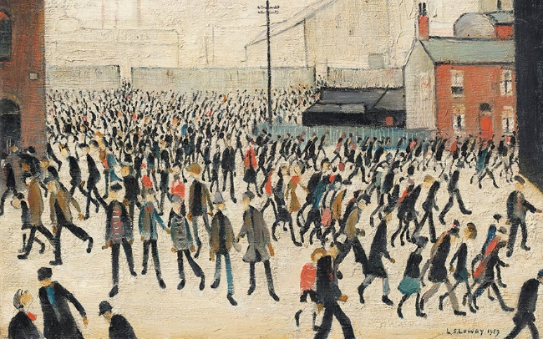
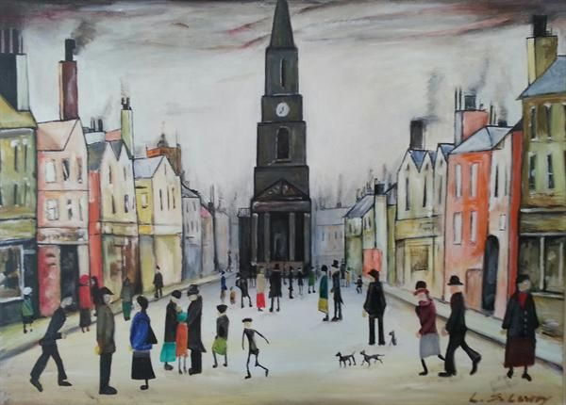
Year 6: WW2 (oil paintings) Knowledge Mat
Subject Specific Vocabulary |  | Sticky Knowledge: | Artist Inspiration
Lines | Straight or curved lines on a background with no gradations of colour or shade. The 5 types of line art: Curved Diagonal Horizontal Vertical Zig-Zag | How to improve their mastery of art and design techniques, including using oil paintings How to clean oil paints correctly: When washing your brush, water alone will not clean it; squeeze the excess paint off your paint brush with a paper towel, then wash your brush in soapy water. Lather rinse and repeat until you brush is clean to dip in a new colour. | LS Lowry
Mark-making | Mark-making can be done in an expressive way to represents mood, feeling and emotion.
Texture | Conveys the visual texture of a surface. E.g. Texture examples: smoothness, softness, rough,
Landscape | A visible area made up of natural and man-made features. E.g. a town square | Skills
Resources Pencils Rubbers Oil paint Paint palette Paintbrushes (thick and thin) Sketch books |  | I have learned about the work of LS Lowry by looking at his work in books, the internet, visits to galleries and other sources of information My drawings communicate emotions and a sense of self with accuracy and imagination I can use feedback to make amendments and improvements to my art. I can explain the style of my work and how it has been influenced by a famous artist.

Slide 25
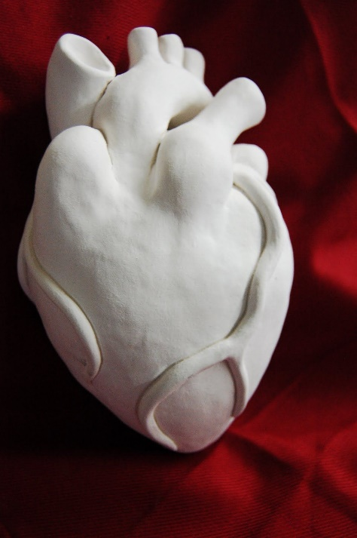
Year 6: Circulatory System (sculpture) Knowledge Mat
Subject Specific Vocabulary |  | Sticky Knowledge: | Art Interpretation
Sculpt | Create or represent (something) by carving, casting, or other shaping techniques | White clay will display paint best (acrylic paint. Poster paint will work too).
Clay | Clay is a soft, loose, earthy material made up of tiny particles of rock. When wet it is very soft which then hardens as it dries. Clay is used to make bricks, potteries, and ceramics. It is also used to make sculptures and decorative patterns and designs. .
3D Form | Form is a three dimensional shape, such as a cube, sphere or cone. Sculpture and 3D design are about creating forms.
Pattern | A design that is created by repeating lines, shapes, tones or colours. The design used to create a pattern is often referred to as amotif. Motifs can be simple shapes or complex arrangements. | Skills
Resources Sculpting tools: knife, Stick and a wire modeller newspapers or oilcloth to protect the work table. Clay Acrylic and/or poster paint |  | I can create models on a range of scales I can include technical aspects in my work, e.g. 3D design I can improve my mastery of art and design techniques, including sculpture with clay. I can explain why I have used different tools to create art. I can use feedback to make amendments and improvements to my art.

Slide 26
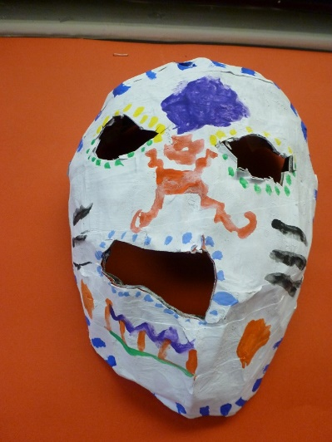
Year 6: Mayans (working with Papier Mache) Knowledge Mat
Subject Specific Vocabulary |  | Sticky Knowledge: | Art Inspiration
Texture | Texture is the way something feels to the touch, or looks to the eye. Words like rough, silky, shiny and dull help writers describe the texture of an object. | I know that if I use different media and combine them when building a model, I will achieve a new texture. I can alter a texture to look shinier by using reflective materials. I can make a texture appear rough by using Papier Mache | Papier Mache masks
Layering | A layer can consist merely of one material or can involve multiple overlays covering the whole surface.
Media | The material and tools used by an artist, composer or designer to create a work of art, for example, "pen and ink" where the pen is the tool and the ink is the material. | Skills
Resources Newspaper Papier mache Paint palette Paintbrushes (thin and thick) Acrylic paint Oil pastels |  | I know how to improve my mastery of sculpture with a range of materials [for example, charcoal, paint, clay.] I can add onto my mask to create texture and shape I can add texture to a piece of work I can use a range of brushes to create different effects in painting the rocks.

