Slide 1
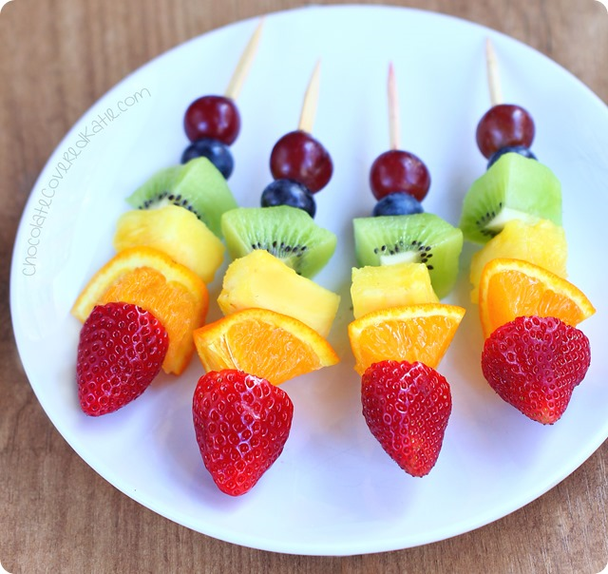
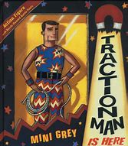
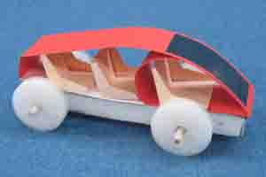
Design Technology | Year 1 | Year 2 | Year 3 | Year 4 | Year 5 | Year 6
Autumn 1 | Seasonal Changes | Materials |  | Digestive System
 | Design and make a fruit kebab. | Design your own Traction Man |  | Nutrition – Design and make a balanced meal including all food groups.
Autumn 2 |  |  |  | Sound | Reversible and Irreversible changes
 |  |  |  | Design and make a musical instrument using junk modelling. | Investigate reversible and irreversible changes through cooking.
Spring 1 | Toys |  | Stone Age/ Iron Age
 | Design and Make a Toy |  | Design a stone age house. Look at different materials and structures.
Spring 2 |  | Healthy Eating | Animals including humans | Shell Structures |  | Light
 |  | Design and Make fruit salads with a range of fruits. | Seasonal food and food groups. Design a springtime meal. | Design and build a strong box to hold biscuits using the net of a 3D shape. |  | Create a papier mache lamp with a working circuit.
Summer 1 | Materials |  |  |  | Rainforests | South America
 | Design and make a space ship with moving parts to take Beegu back to space. |  |  |  | Research sustainable materials that could be used in clothing to help tackle climate change (t-shirts). | Create a South American style salad, looking at how to grow different vegetables and how food should be stored.
Summer 2 |  | Habitats | Light |  | Frame Structures
 |  | Design and make a mini greenhouse. | Use scrap materials to create a decorative light box. |  | Design and build a frame structure, focusing on how to strengthen it.

