Slide 1
KS1 Parent Maths Workshop

Slide 2
Aims of the session:
To understand what Mastery is and the benefits of it
Explain how we teach maths at St Clare’s
Place value and the four operations: addition, subtraction, multiplication and divsion
Apps and resources for you to support your children at home.

Slide 3
Has Maths Changed?
We are still teaching most of the same methods that you and I were taught at school but we now look at different representations of the maths to make sure children have a deeper understanding rather than just memorising a method without understanding what they are doing.
For example, we spend a lot of time now on place value at the start of the year to make sure children really understand what numbers represent. If they have a solid understanding of the basics they can access more difficult concepts more easily.
We use the mastery approach which focuses on depth rather than acceleration, ensuring that key concepts are fully grasped before moving on.

Slide 4
Stages of Mastery
Fluency in Maths happens when children can answer questions accurately using recall of Mathematical facts.
Reasoning is when a child can explain what they have done and why, or prove that something is or isn’t correct.
Problem solving is applying their knowledge and understanding to multi-step problems.

Slide 5
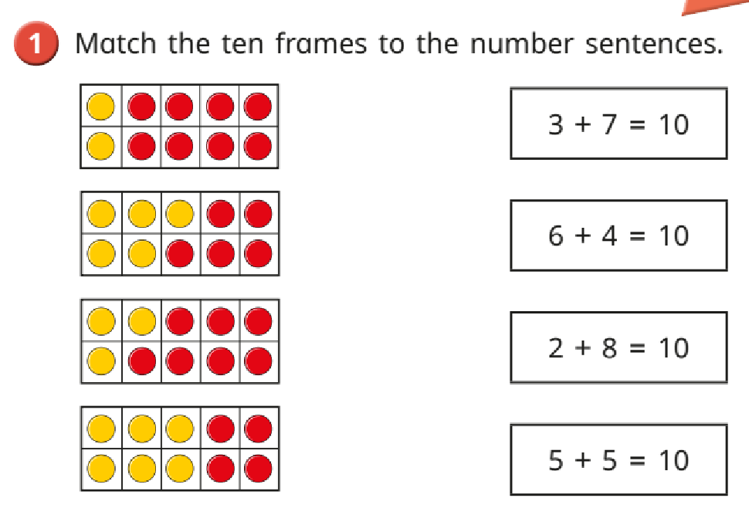
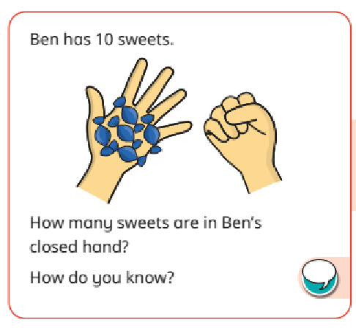
Fluency Reasoning Problem solving

Slide 6
Stages of Teaching
Maths learning should follow a process, moving through each stage when children are ready.
If children are moved too quickly through the concrete and pictorial stage of their learning, this could affect understanding in later years.
Concrete
Pictorial
Abstract

Slide 7
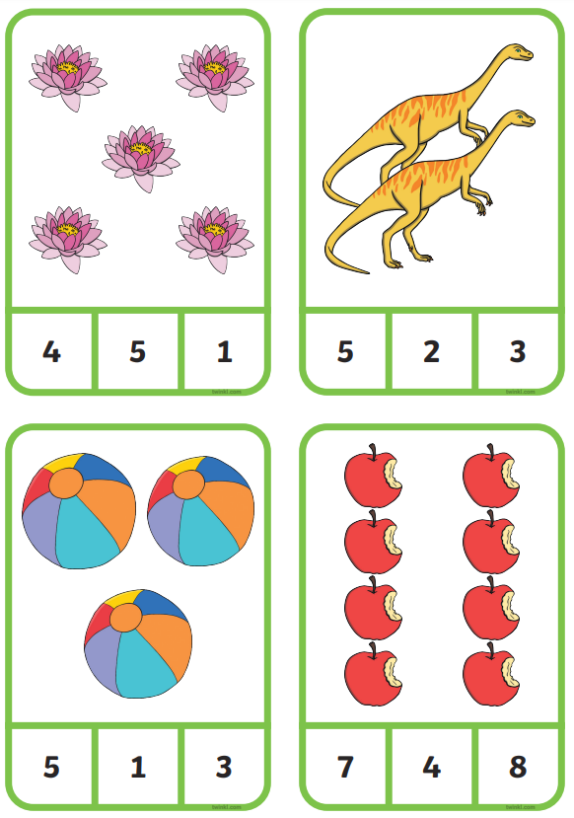
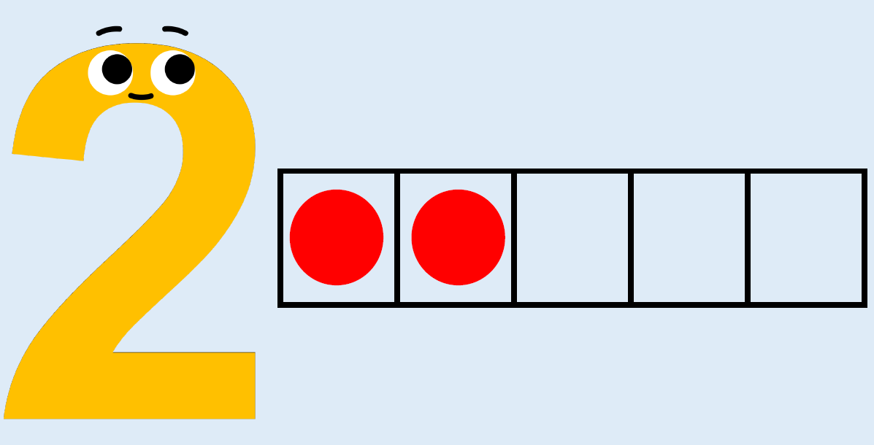
Place value - EYFS
Nowadays children spend a lot more time on place value as it builds the foundations for everything else.
EYFS
Counting
Subitising
Number recognition
Number formation
Composition

Slide 8
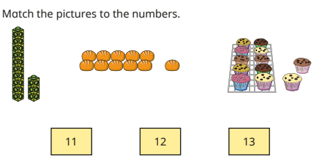
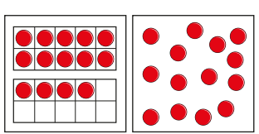
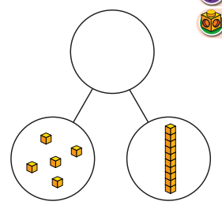
Place value – year 1

Slide 9
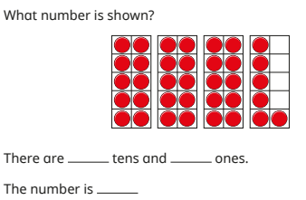
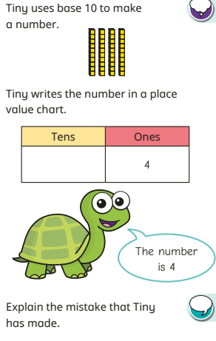
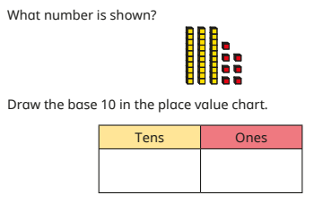
Place value – year 2

Slide 10
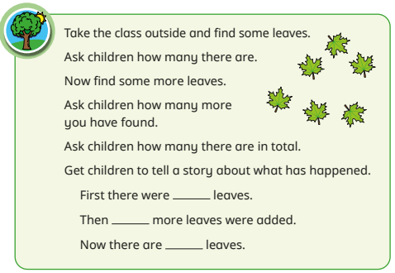
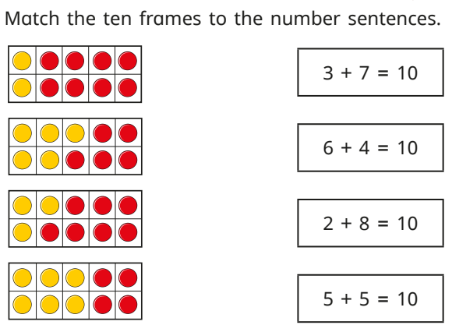
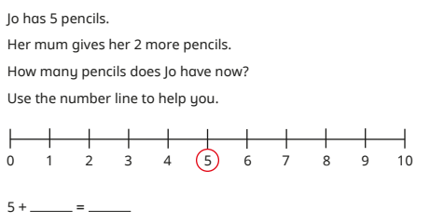
Addition - Year 1
Concrete
Pictorial
Abstract
5 + 2 =

Slide 11
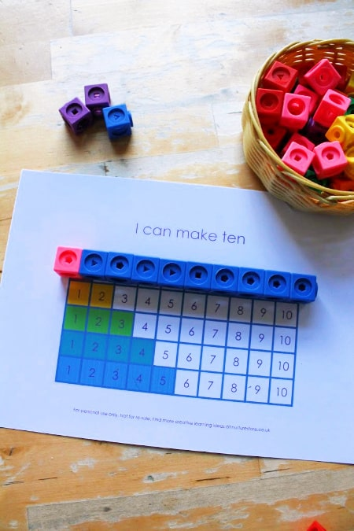
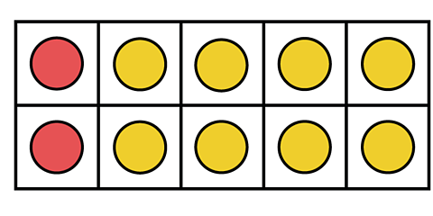
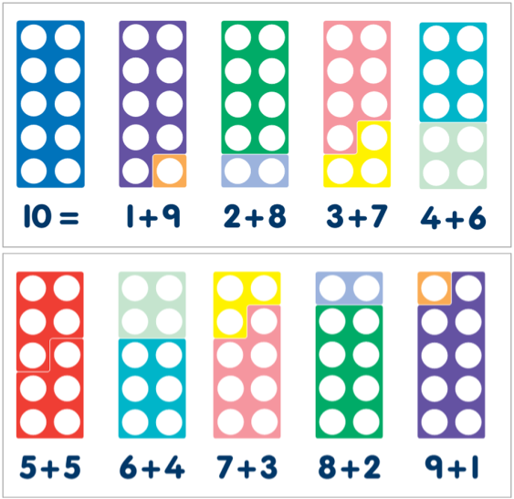
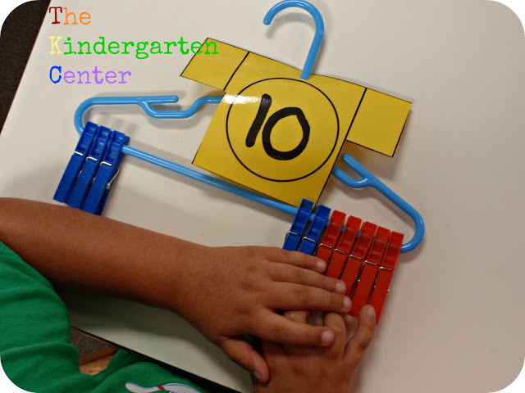
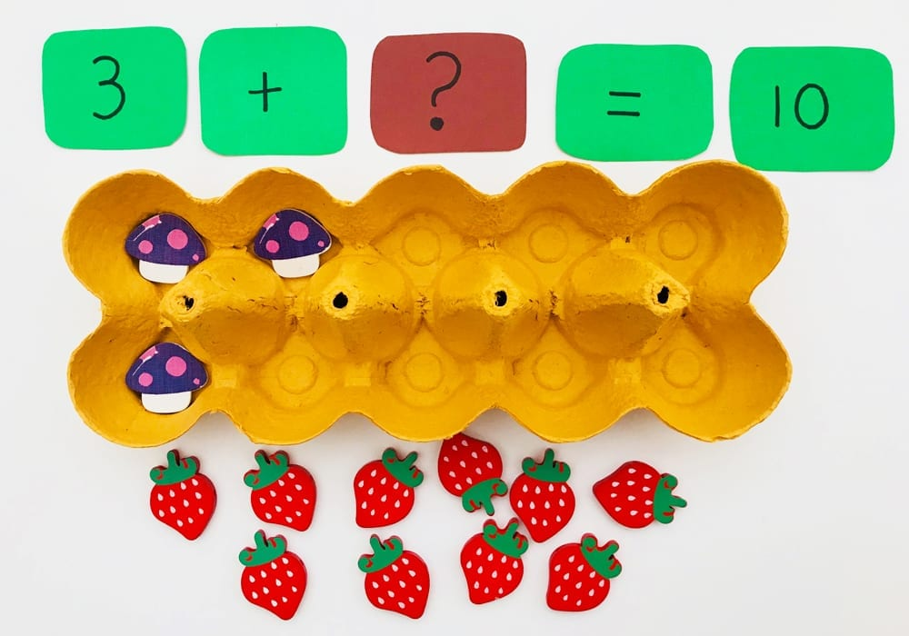
Addition – Number bonds to 10
Instant recall of number bonds to ten

Slide 12
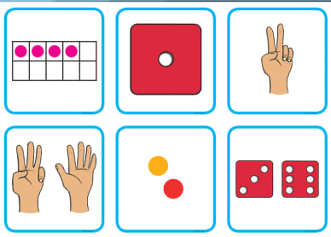
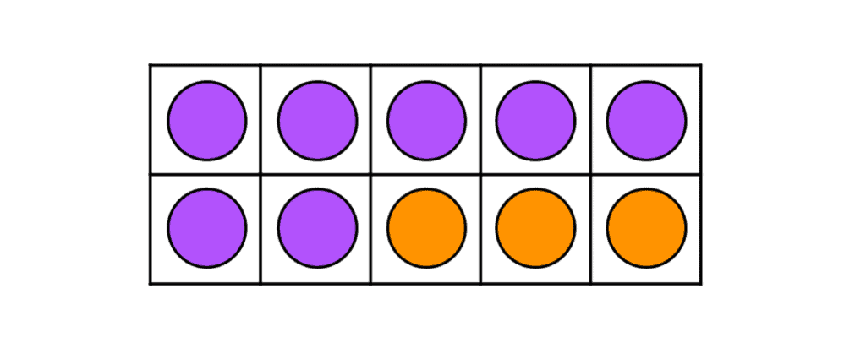
Addition – Subitise with ten frames
Subitise: the ability to instantly recognise how many objects are in a small group without having to count them.

Slide 13
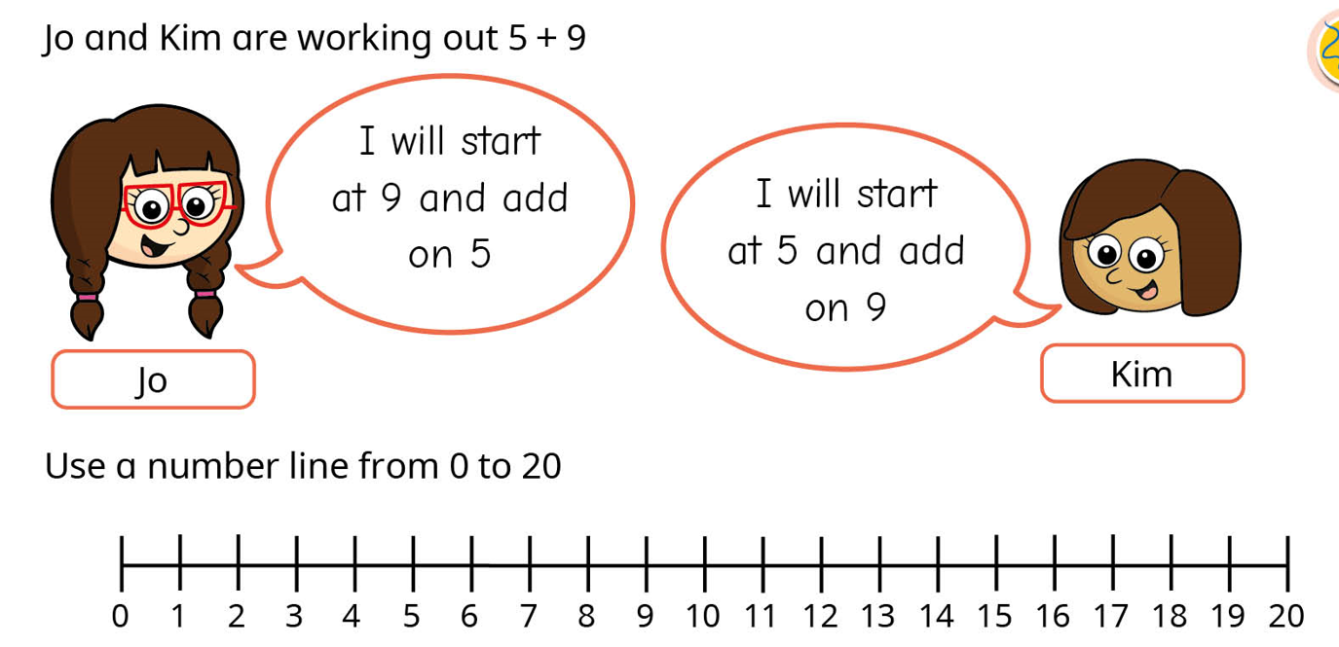
Addition – counting on

Slide 14
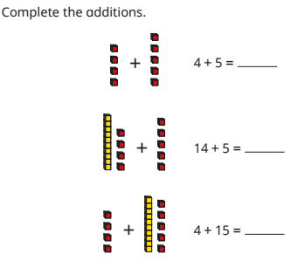
Addition – apply number bonds

Slide 15
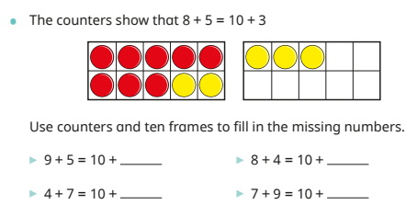
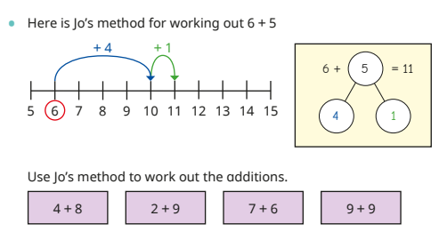
Addition – Year 2

Slide 16
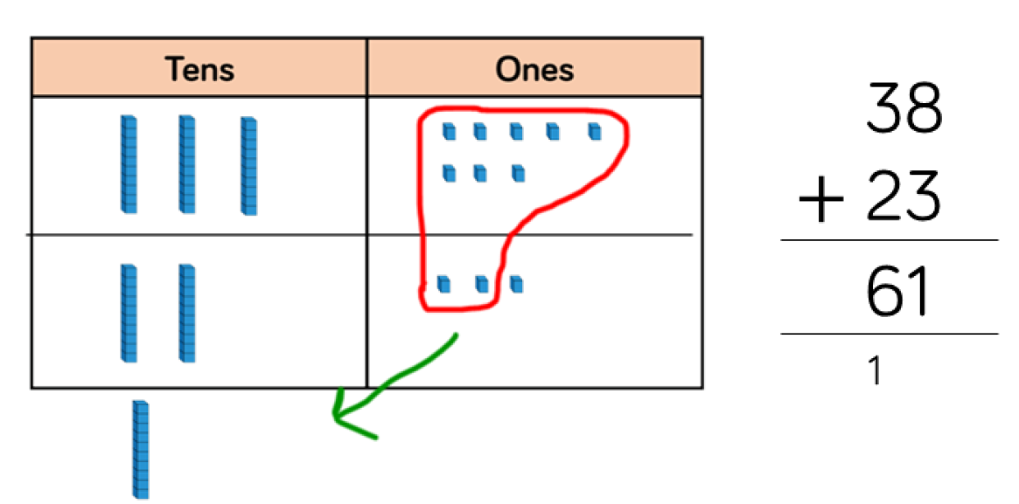
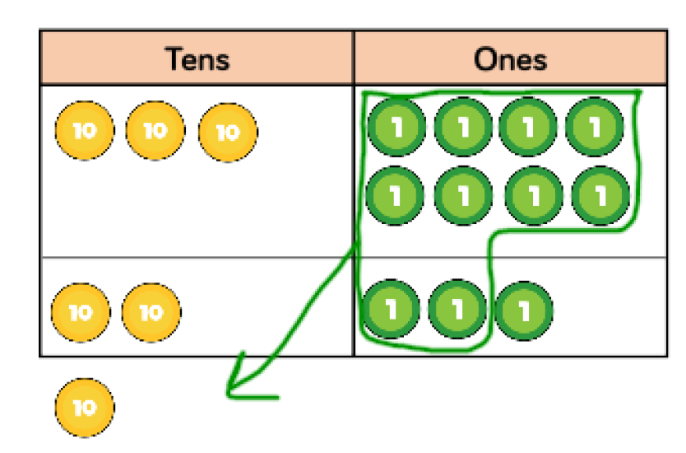
Addition – year 2

Slide 17
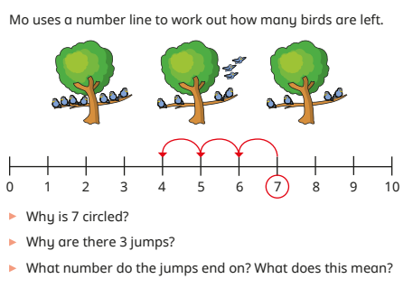
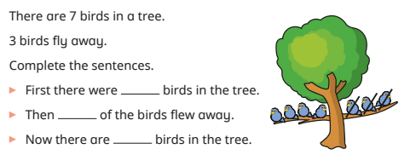
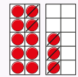
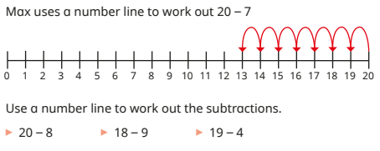
Subtraction – year 1

Slide 18
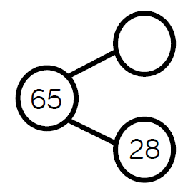
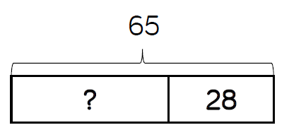
Subtraction – year 2

Slide 19
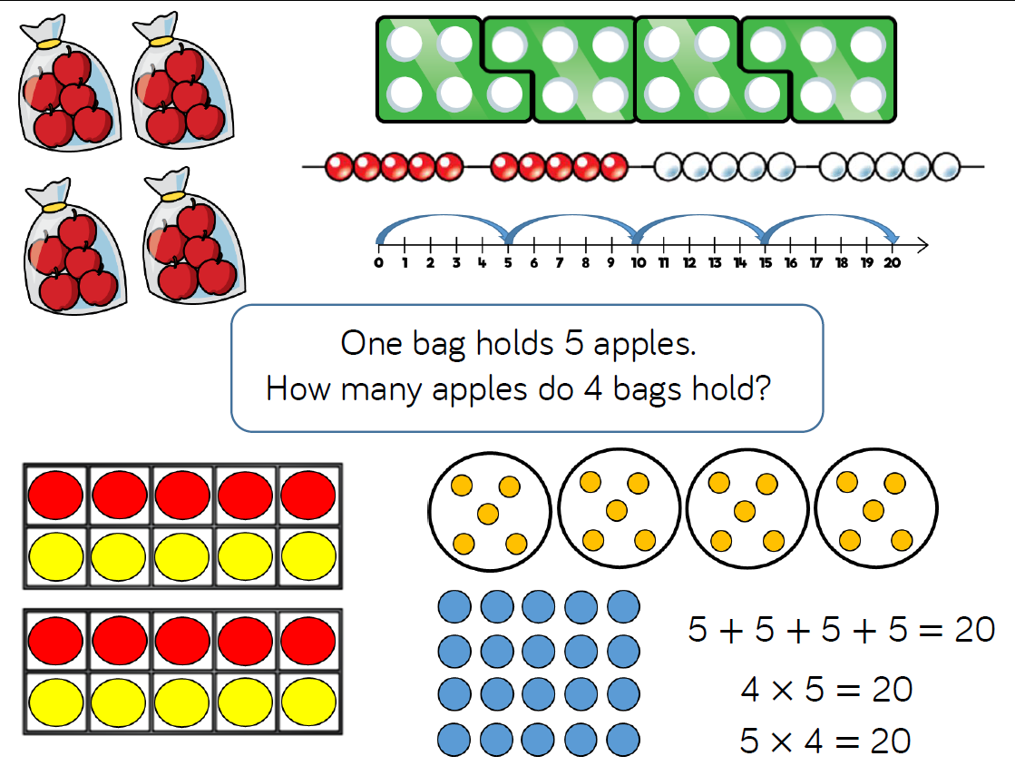
Multiplication - year 1 (groups of)

Slide 20
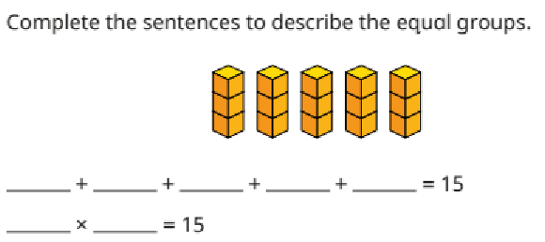
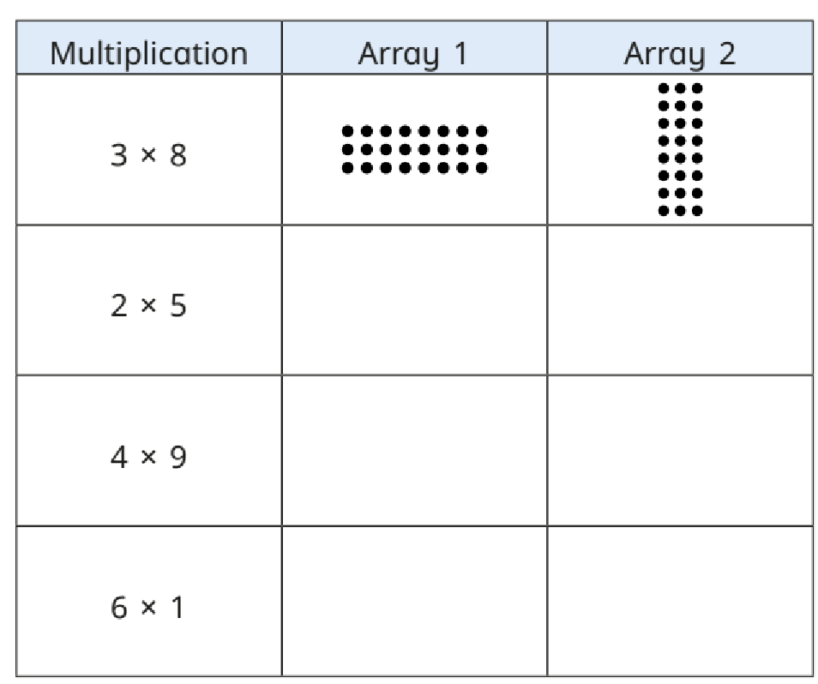
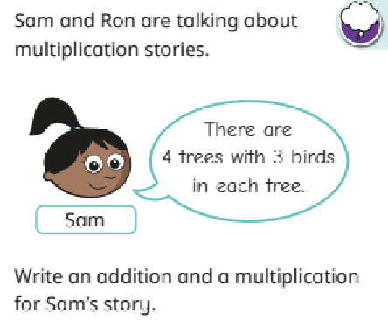
Multiplication - year 2

Slide 21
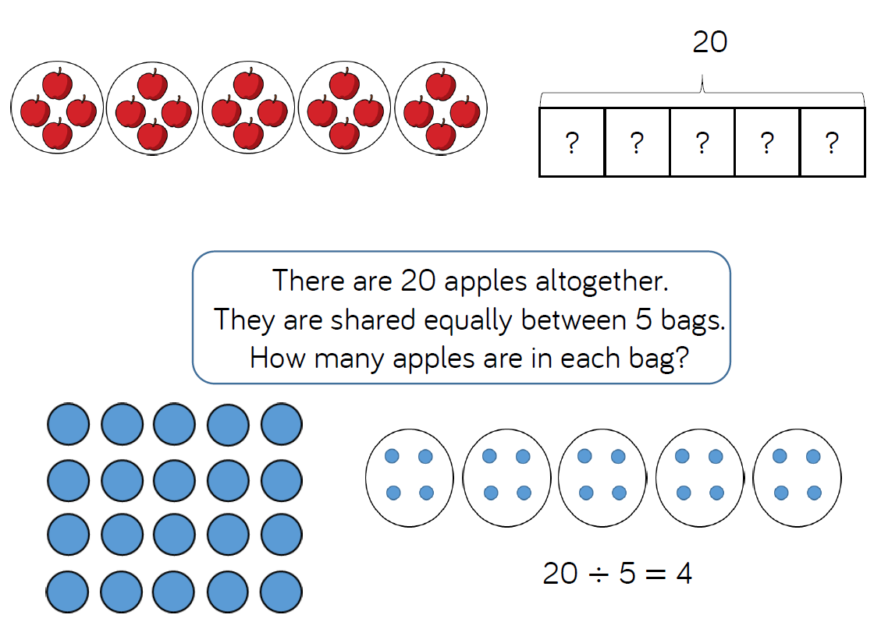
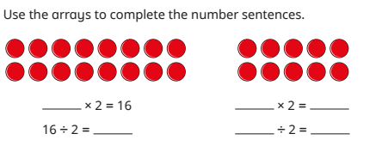
Division

Slide 22
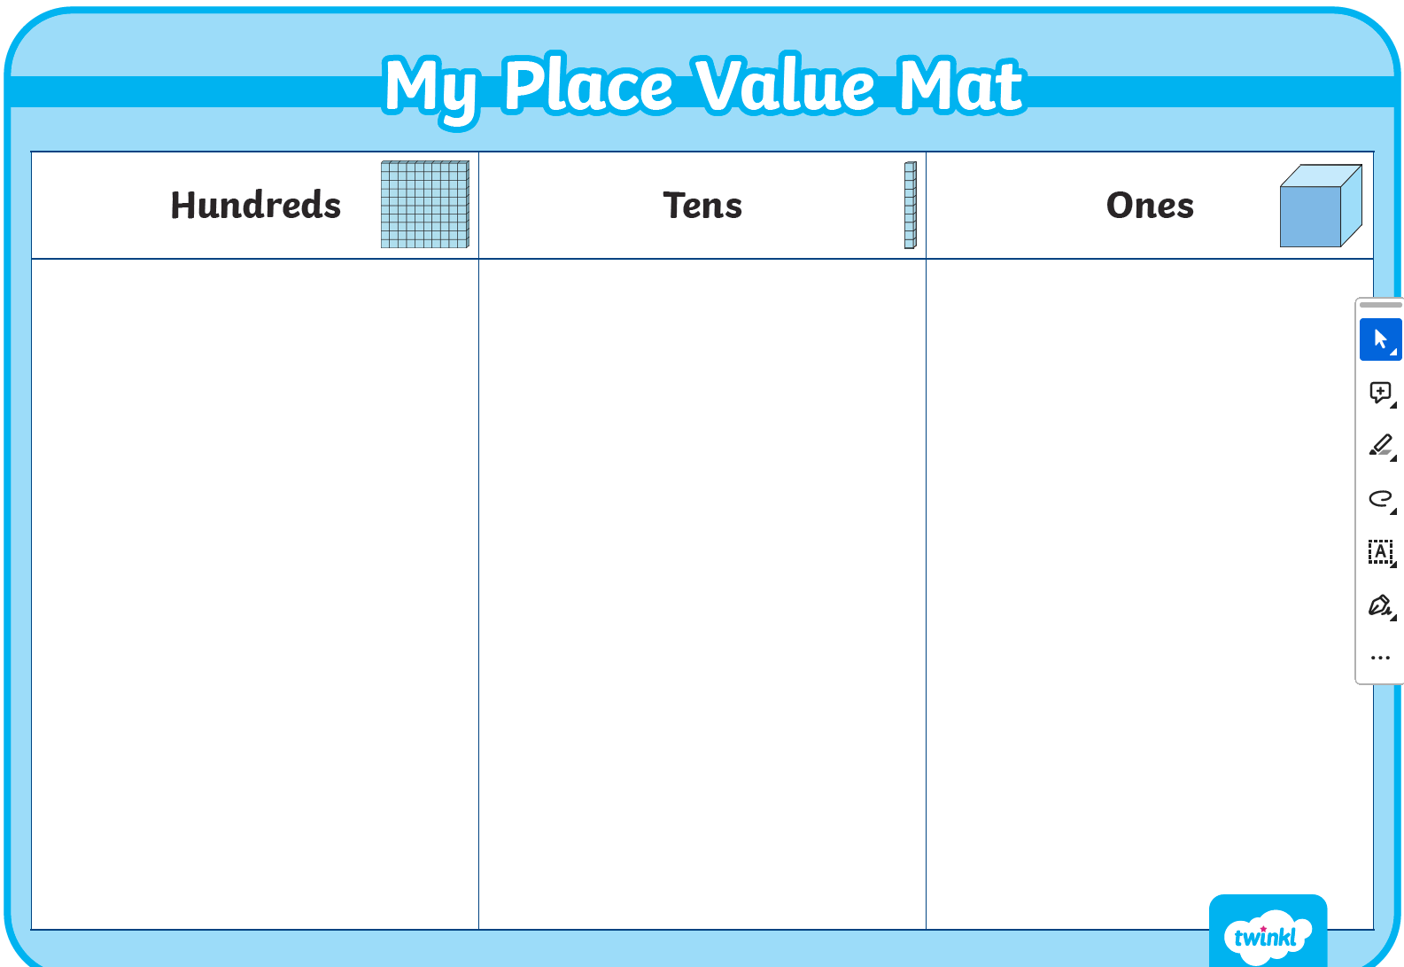
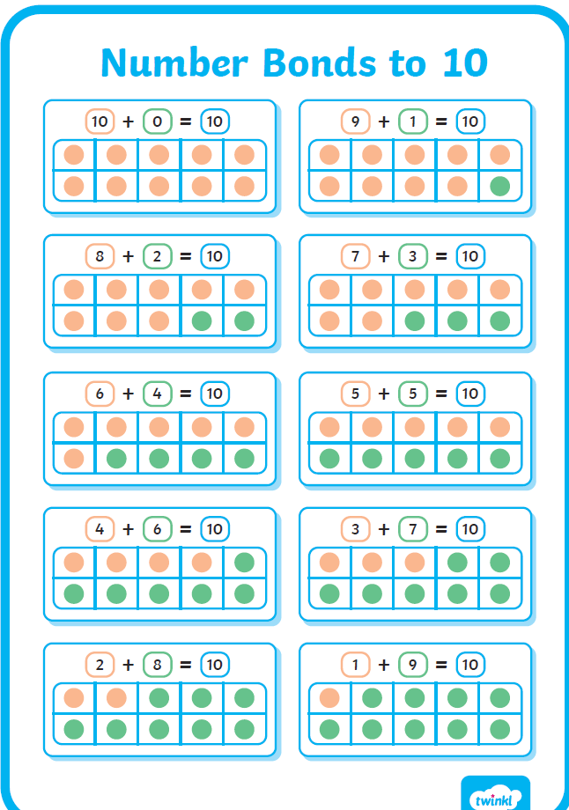
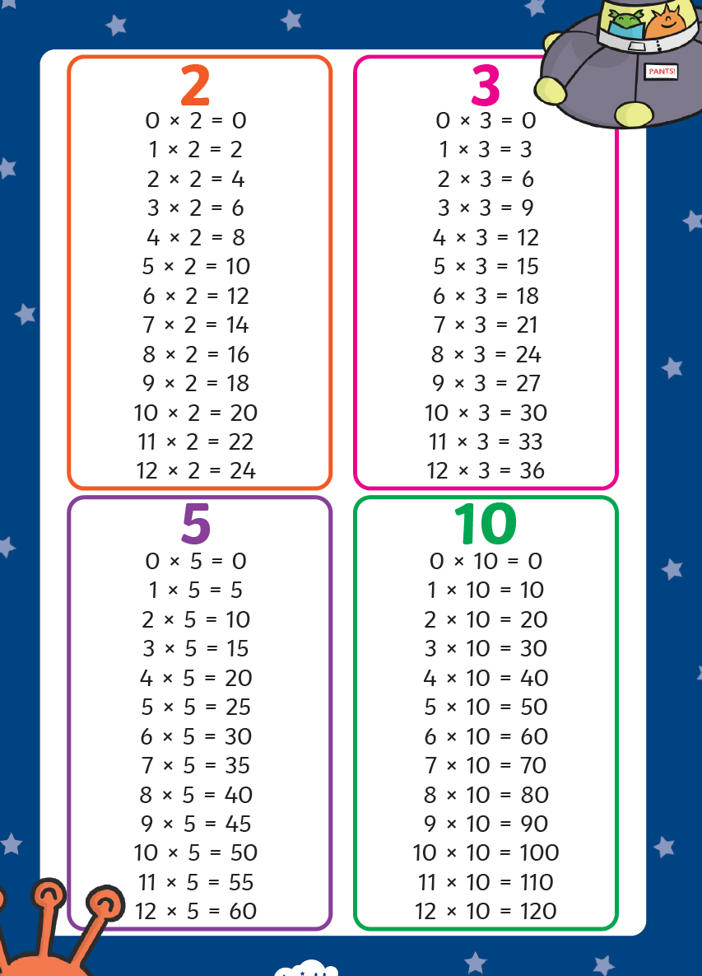
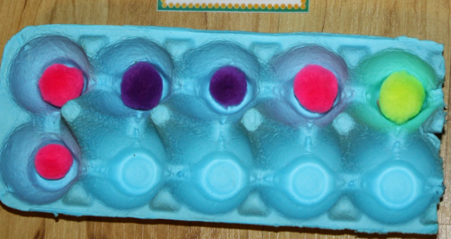
Supporting your children at home

Slide 23
Supporting your children at home
Whiterose Maths Website:
Home learning videos
Parent workbooks
Digital tools
Times Tables Rockstars (year 2)
Hit the button website

