Slide 1
KS2 Parent Maths Workshop

Slide 2
Aims of the session:
To understand what Mastery is and the benefits of it
Explain how we teach maths at St Clare’s
Methods for the four operations: addition, subtraction, multiplication and division
Apps and resources for you to support your children at home.

Slide 3
Has Maths Changed?
We are still teaching most of the same methods that you and I were taught at school but we now look at different representations of the maths to make sure children have a deeper understanding rather than just memorising a method without understanding what they are doing.
For example, we spend a lot of time now on place value at the start of the year to make sure children really understand what numbers represent. If they have a solid understanding of the basics they can access more difficult concepts more easily.
We use the mastery approach which focuses on depth rather than acceleration, ensuring that key concepts are fully grasped before moving on.

Slide 4
Stages of Mastery
Fluency in Maths happens when children can answer questions accurately using recall of Mathematical facts.
Reasoning is when a child can explain what they have done and why, or prove that something is or isn’t correct.
Problem solving is applying their knowledge and understanding to multi-step problems.

Slide 5
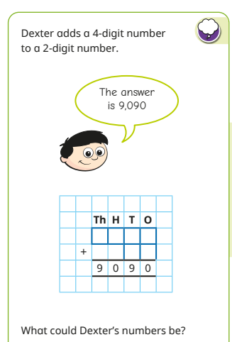
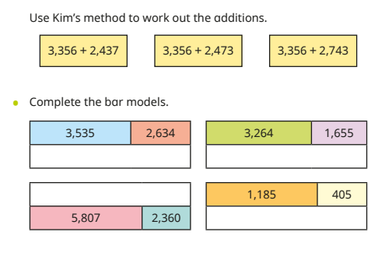
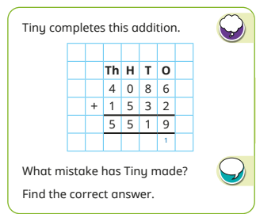
Fluency Reasoning Problem solving

Slide 6
Stages of Teaching
Maths learning should follow a process, moving through each stage when children are ready.
If children are moved too quickly through the concrete and pictorial stage of their learning, this could affect understanding in later years.
Concrete
Pictorial
Abstract

Slide 7
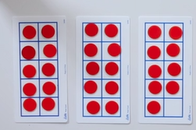
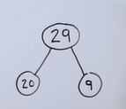
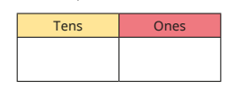
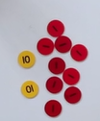
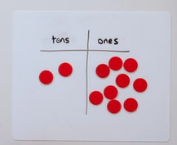
Place value
Nowadays children spend a lot more time on place value as it builds the foundations for everything else.
Concrete
Pictorial
Abstract

Slide 8
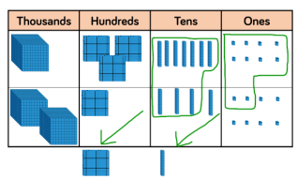
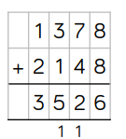
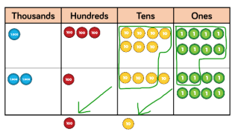
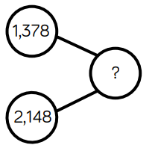
Addition (year 4)
Concrete
Pictorial
Abstract

Slide 10
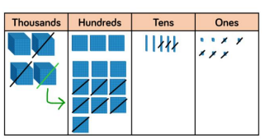
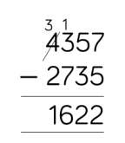
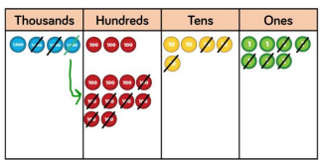
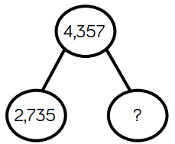
Subtraction (year 4)
Concrete
Pictorial
Abstract

Slide 11
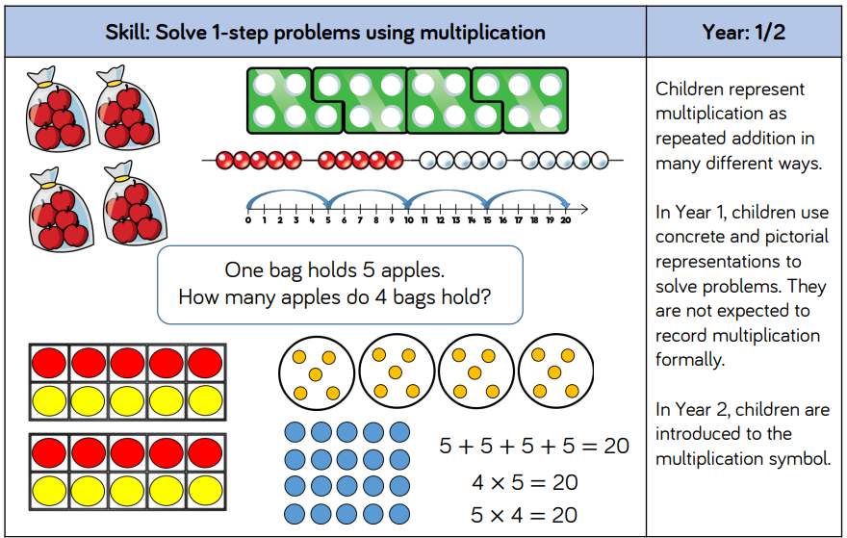
Multiplication

Slide 12
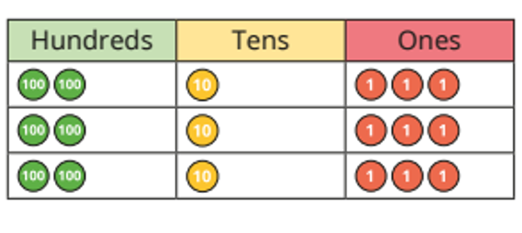
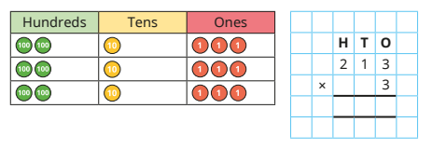
Multiplication Children from Y4 onwards should know all of their times tables.
Concrete
Pictorial
Abstract

Slide 13
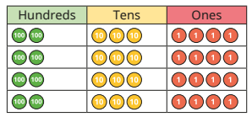
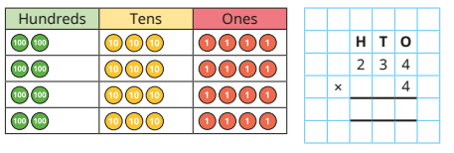
Multiplication
Concrete
Pictorial
Abstract

Slide 14
Multiplication
Concrete
Pictorial
Abstract

Slide 15
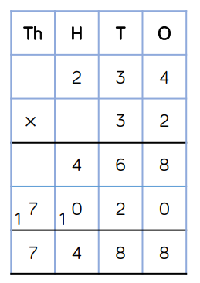
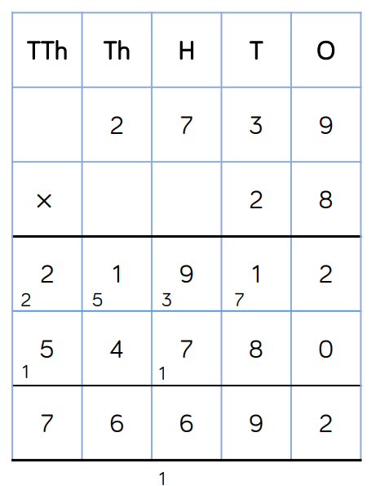
Multiplication (Year 5/6)

Slide 16
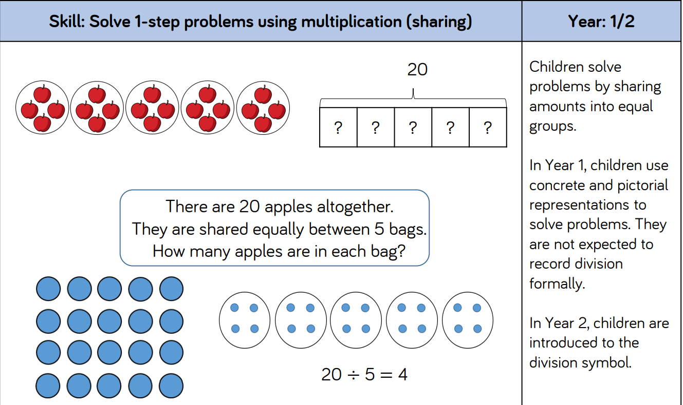
Division Children from Y4 onwards should know all of their times tables.

Slide 17
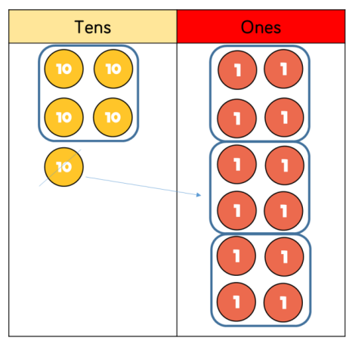
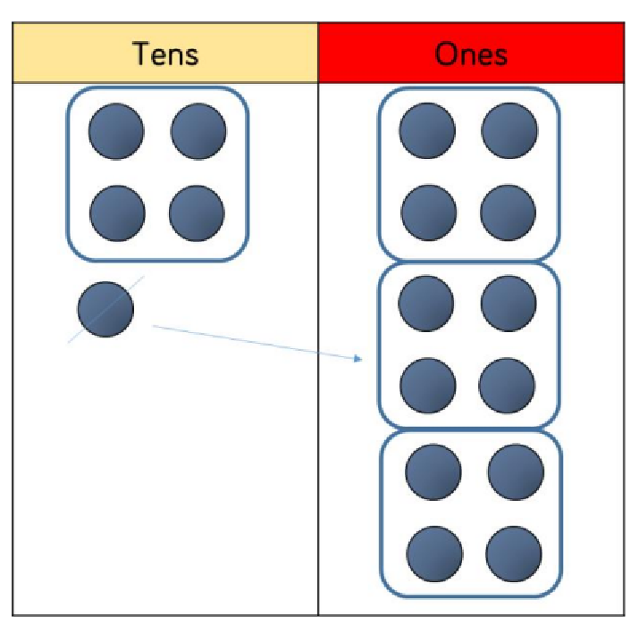
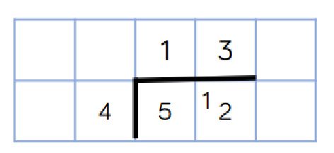
Division Children from Y4 onwards should know all of their times tables.
Concrete
Pictorial
Abstract

Slide 18
Division (Year 6)

Slide 19
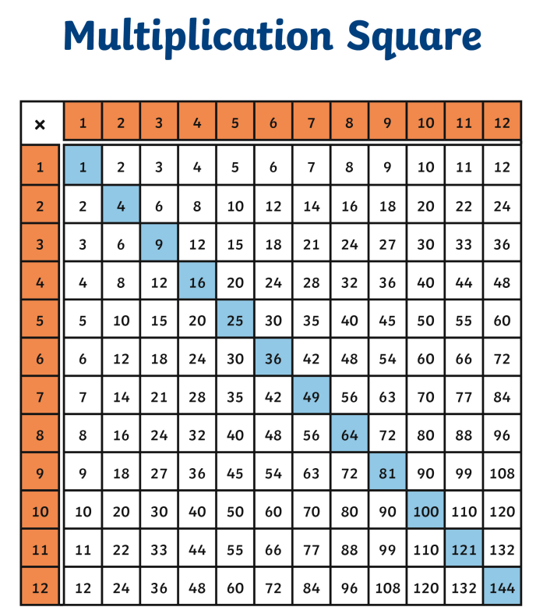
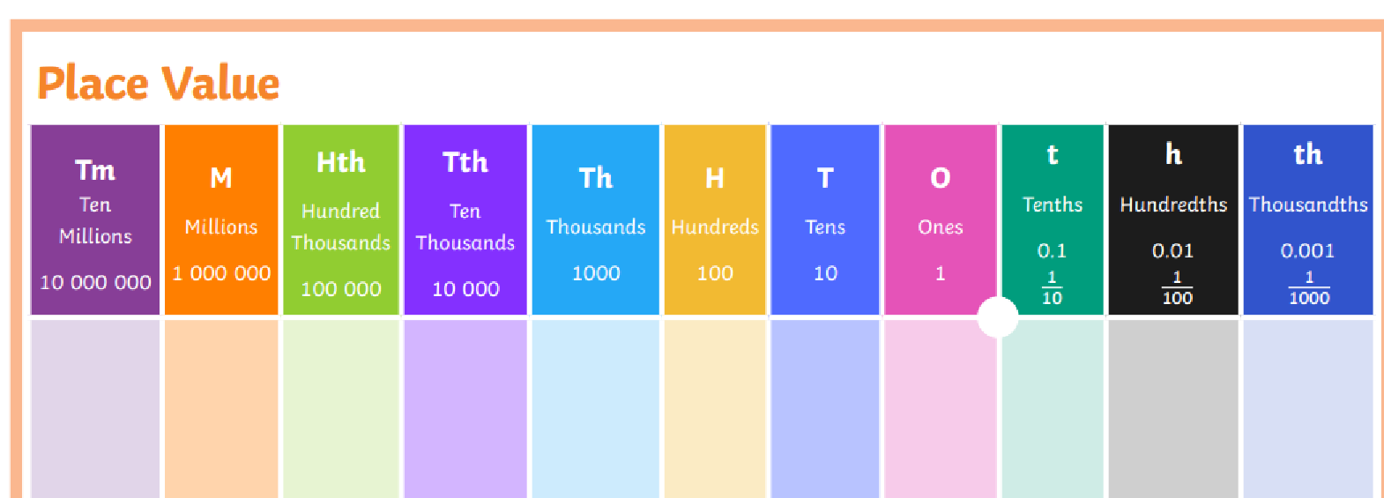
Supporting your children at home

Slide 20
Supporting your children at home
Whiterose Maths Website:
Home learning videos
Parent workbooks
Digital tools
Times Tables Rockstars
Hit the button website
BBC Bitesize – KS2 Maths (everything)

