Slide 1
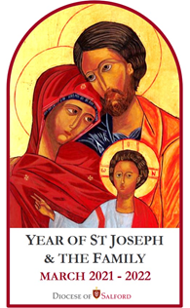
Why a Year for St Joseph?
What can you remember about St Joseph?
Can you remember why we are celebrating a year for St Joseph?
From what we heard last time, has St Joseph inspired you? How?
Notes:
More of a reflection slide than asking children for actual answers.

Slide 2
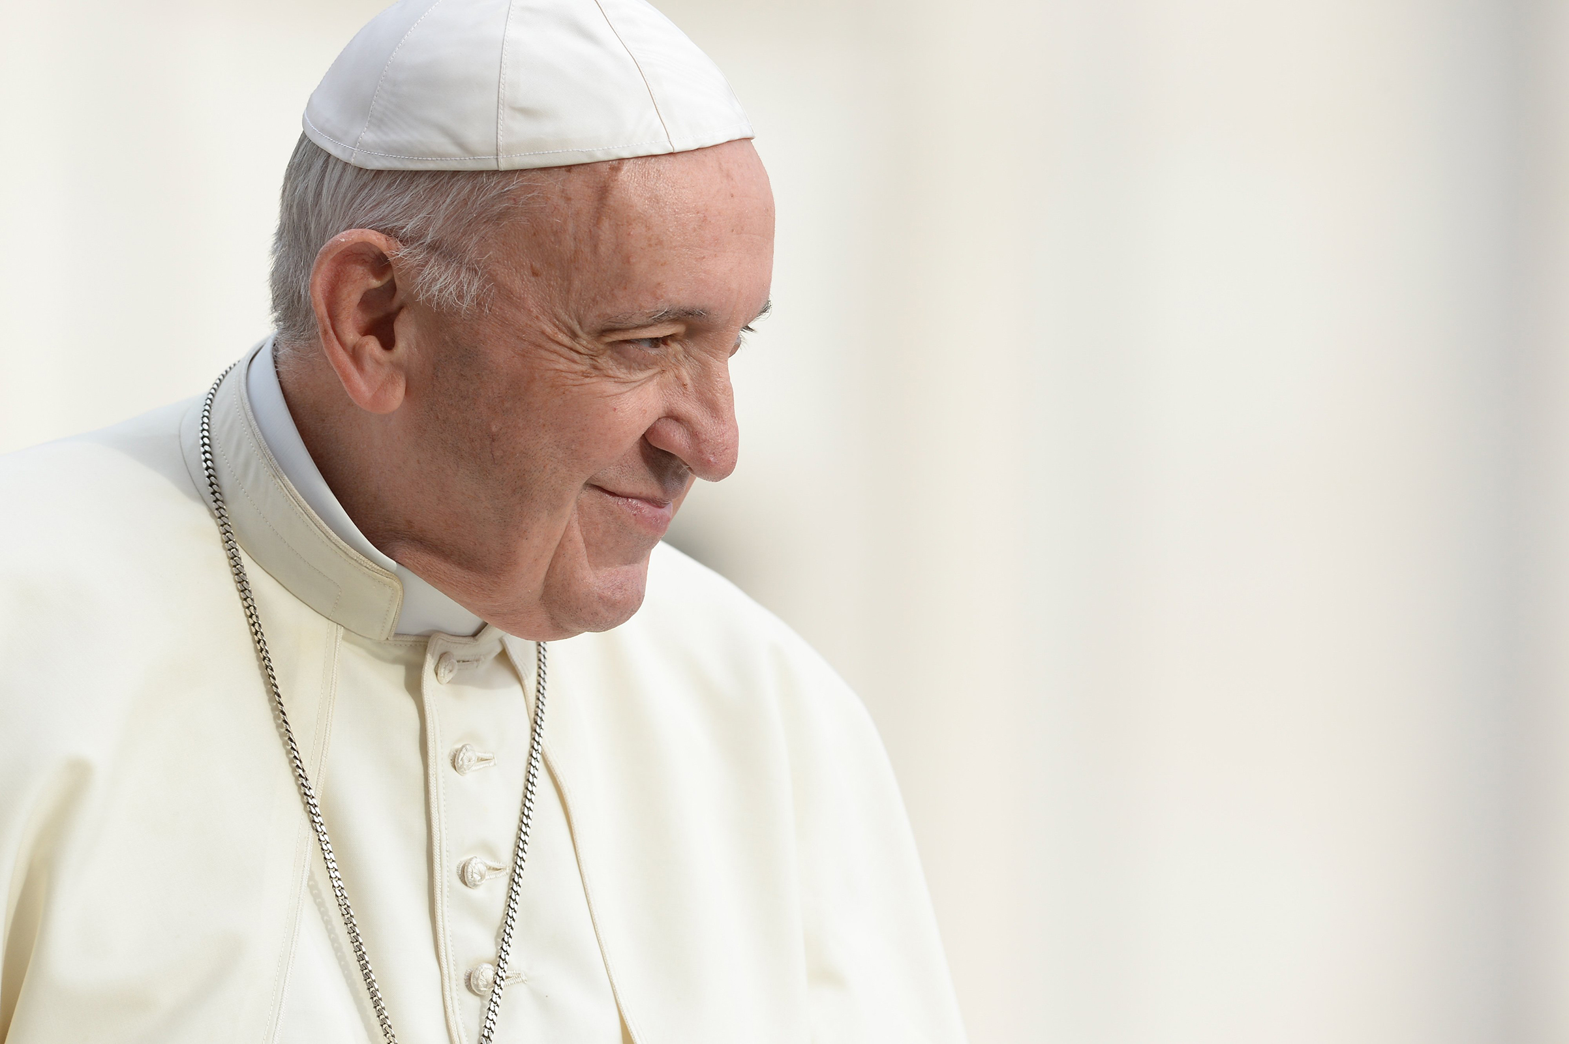
Why a Year for St Joseph?
Pope Francis has written a letter to the World. He announced that in 2021 we are celebrating the ‘Year of St Joseph’.
During the Coronavirus pandemic, Pope Francis has been inspired by people with everyday jobs who have supported others in extraordinary ways.
Pope Francis has said that we can learn from St Joseph how to be caring, humble, faithful, and listen carefully to God and each other.
Notes:
You may not want to include this slide – a quick recap on why we are celebrating a Year for St Joseph.

Slide 3
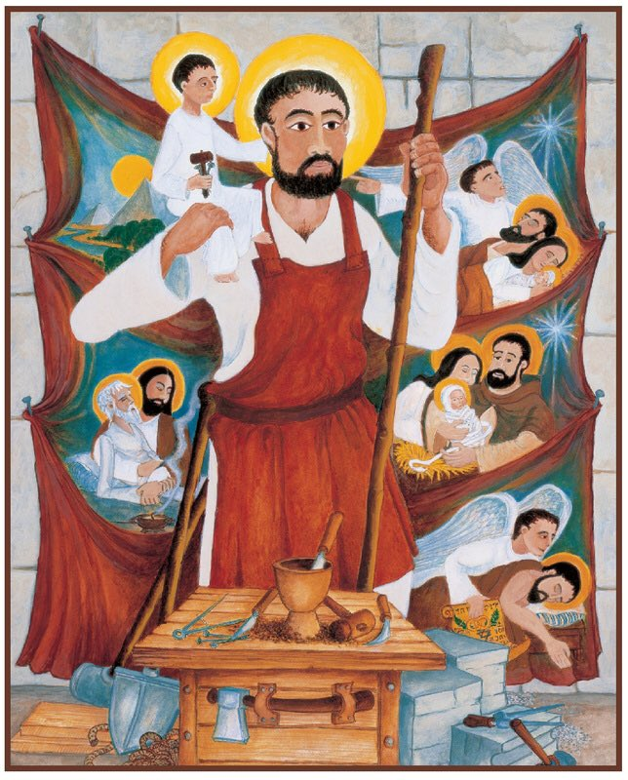
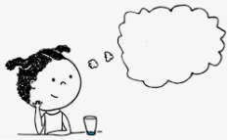
Reflecting on the seven joys of St Joseph.
joys
We are thinking about the of St Joseph – reflecting on some of the big moments in Joseph’s life that brought
We are thinking about care this month.
Think about ways people show care.
We will listen to a Gospel story that we would normally hear in the season of Christmas.
joy.
Notes:
Discuss the image, can anyone recognise any of the events in the life of Joseph shown in the image. What clues are we given about St Joseph from the image?

Slide 4
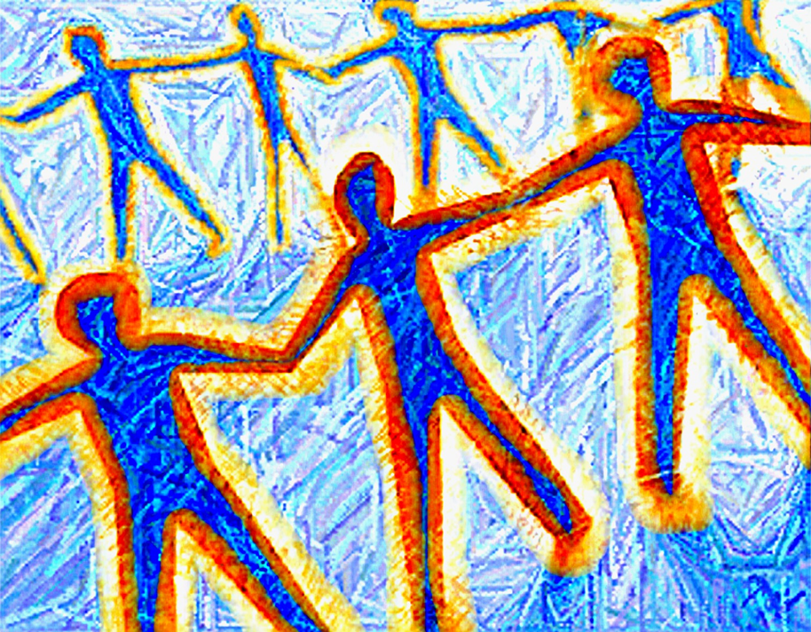
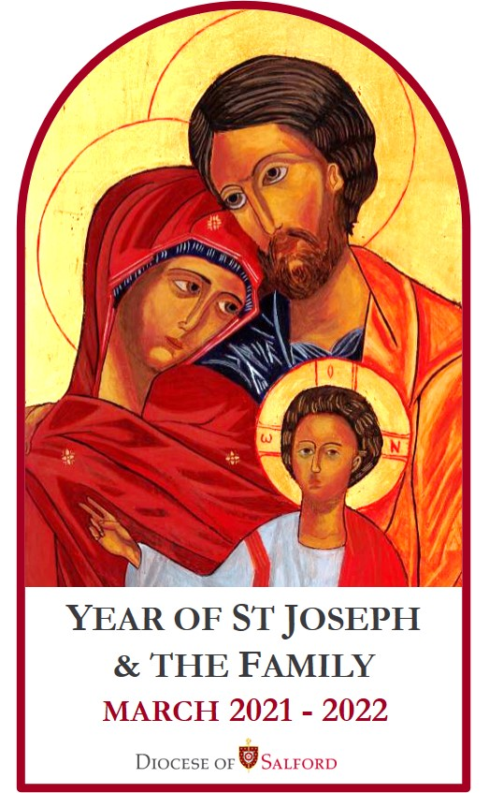
Welcome – Gather.
As we gather and prepare for our liturgy listen carefully to the
words of the song, you may want to join in with the chorus.
Isn’t this just a wonderful world
A wonderful world that we live in
And whoever made this wonderful world
Is someone that I can believe in
In the name of the Father, and of the Son, and of the Holy
Spirit. Amen
©Stephen Fischbacher Fischy Music 1997
Notes:
You may want to select a different gather hymn that you are concentrating on at this time. The one used for this gather is Wonderful World by Fischy Music

Slide 5
Word.
A reading from the Holy Gospel according to Luke (based on Luke 2: 1 -20 taken from God’s Story 3)
Glory to you Lord.
Caesar Augustus, the Roman emperor, gave the order for a census to be taken over the whole Roman Empire. This was
the first time that this had been done. Everyone had to go to his or her family town to be registered. So Joseph set out
from Nazareth in Galilee and travelled to Judea’ to Bethlehem, the town of David, because he was of the family of David
and Mary went with him.
She was expecting her baby and while they were there the time came for her baby to be born. She wrapped him in
swaddling clothes and put him in a manger because there was no room for them in the house.
That night when Jesus was born, there were some shepherds in a field nearby looking after their sheep. Suddenly the sky
became light and a messenger from God appeared. The shepherds were terrified, but the messenger of God said,
“Don’t be afraid, God has sent me to bring you news of great joy. This is a special night for everyone on earth.
Tonight a baby called Jesus has been born in Bethlehem. He is Christ the Lord. You will find him warmly wrapped up and
lying in a manger.”
When the messenger had finished speaking, the shepherds could hear the sound of many voices
praising God. “Glory to God in the highest and peace to God’s people on earth.” The shepherds were very excited
and said to one another, “Let us go to Bethlehem to see all this.” So they hurried away and found Mary and
Joseph, and the baby lying in the manger. They told everyone what had happened and everyone was
amazed. Mary listened to their story and remembered it and thought about it often. The shepherds went back
praising and thanking God for all they had seen and heard.
The Gospel of the Lord,
Praise to you, Lord Jesus Christ
Notes:
You may want to use a simpler version of this reading for KS1 pupils. You may want to discuss when we might hear this piece of scripture at Christmas – and why at this time. If possible read from the Bible rather than on screen. You may want to welcome the reading with an Alleluia – Gospel acclamation.

Slide 6
Reflect on the Word.
Notes:
Thank you to Father Michael Deas for his reflection on the Second Joy of St Joseph. The video is just under 4 mins in length

Slide 7
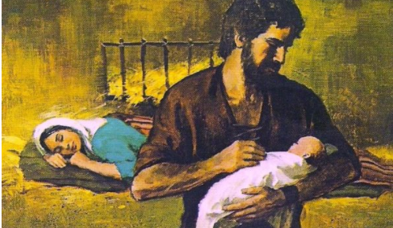
Response to the Word.
Joseph showed care, care to Mary and Jesus. This care continued throughout the life of Mary and Jesus. It began when Joseph said ‘Yes’ to God, then on Christmas night when Jesus was born and through the rest of their lives.
Over the next few months and of St Joseph we will learn
more about how Joseph showed this care.
Let us pray:
We pray our family prayer together, Our Father…….
We are in the month of May and May is Mary’s month,
we pray the Hail Mary.
You may want to pray using the signing Hail Mary
Dear St. Joseph,
God trusted you to care for his Son, Jesus, and Mary, your wife.
Blessed Joseph, we ask you to be like a father to us.
Guide us and ask God to give us hope and courage,
and to keep us safe from harm.
St Joseph, pray for us.

Slide 8
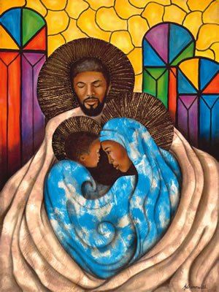
Prayer to St Joseph.
We pray to Saint Joseph.
You inspire us to do the right thing in what we say and do.
Help us to learn how to put the needs of others before our own
and use our skills to do extraordinary things.
Through Christ our Lord.
Amen.
Notes:
This could be a prayer to put up in your classroom and make part of your daily prayer in this Year of St Joseph and the family.

Slide 9
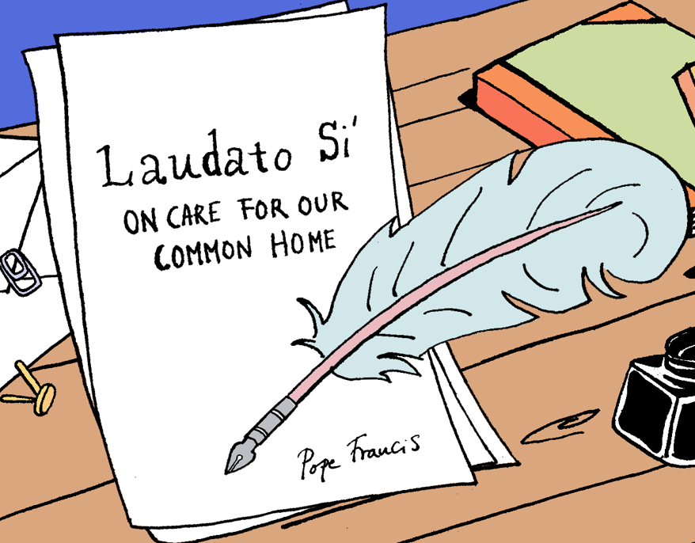
Mission – Witness.
Joseph showed care.
God has given us the earth as our home. It’s our common home
because we share it with everyone.
We are a family, and like every family we need to work
together to look after our home.
Remember the letter Pope Francis wrote called Laudato Si’ ?
It was addressed to everyone, asking us all to take care of our common home. The letter reminds us that we need to look after the world.
The earth is God’s gift to us, full of beauty and wonder. It belongs to everyone.
Share some ways we can care for our common home this
month. Try to do this for a few days, weeks or months!
Help us to work together to take care of each other and our home, so that no one suffers
Lord in your Mercy…Hear our prayer

Slide 10
Notes:
You may wish to include the hymn for St Joseph in your liturgy.

