Slide 1
Staff in Year Five are :
Miss Gibson and Mrs Matti
Mr Willis, Mrs Vickers and Mrs Entwistle in 5W
We are very much looking forward to working with and getting to know your children this year.

Slide 2
Our school Mission Statement:
'Guided by Jesus Christ, our teacher, we journey together, learning to dream, believe and achieve'

Slide 3
If you have any queries, questions or concerns throughout the year, please contact me via j.gibson@st-clares.manchester.sch.uk
You can also see me after school when you are picking your child up, or make an appointment to see me.
I am here to support your child, but as a school we want to support families too wherever we can.

Slide 4
READING
Please read with your child every night. I can not stress how important it is as reading crosses all curricular areas in school.
Your child should be reading for 40 minutes every night.
We will check reading diaries on a regular basis and will check how many words have been read on accelerated reader once a week (Friday).
It is children’s responsibility to let us know if they need to change their book and we will allow them time during the day to go to the library.

Slide 5
We want your child to develop a love of reading. Take time to sit with them and share a book, a poem, a comic, a magazine, a football programme – anything that involves reading.
As your child reads, their minds are opened up to new information, new experiences, new dreams…
We do not want children to race through their reading books. It is really important that the children understand what they are reading and new vocabulary that they will be exposed to.
Discuss this with your child as they read.
Please take a VIPERS poster for support with different questions you can ask your child.

Slide 6
In Key Stage 2, children are rewarded with raffle tickets when they complete a quiz (1 ticket for 60-90% and 2 tickets for 100%) or if they read enough over the week.
Each week, in assembly, the raffle is drawn and someone receives a reading prize.
Vouchers are given to children when they have read a millions words.

Slide 7
HOMEWORK
As well as reading every night, your child will be given…..
Maths / English Homework – given out on Friday and Handed in on Wednesday
Homework may be a worksheet to complete or something they can do online.
Occasionally for children who prefer to use technology for their learning, homework may be set on Purple Mash which the children should know their log in for. Children can access purple mash on ipads, computers or tablets. I will always provide a paper copy of the homework as well as the online version.

Slide 8
Spellings – given out on Monday and Handed in on Friday
Children will be given a spellings sheet to take home to learn and will also be assigned an online activity on Purple Mash.
In Year 5 your child is expected to know all time tables off by heart. This also includes their associated division facts. Please practise these at home either by chanting, singing songs, playing games or accessing your child’s Times Table Rock Star account. Each child should have their own log-in details – please ask if you do not know your child’s details.
Please take a multiplication grid if you would like to support your child with this.

Slide 9
P.E
During the autumn term, our PE lessons will be on Wednesday (indoor) and Thursday (outdoor).
Your child will come into school wearing their school PE kit on those days. Please see the school website for details on our uniform.
Make sure that all uniform is clearly labelled with your child’s name on it please.

Slide 10
Lessons
Maths and English are taught every day.
As a Catholic school, we teach 2.5 hours of RE each week.
We follow the Come and See scheme of work.
We have 2 PE lessons per week.
In addition to this, we also teach a whole host of other foundation subjects.
Please see the yearly curriculum overview for more details – this document (along with lots more information) is available on the class page on the school website. Our website is a useful source of information.

Slide 11
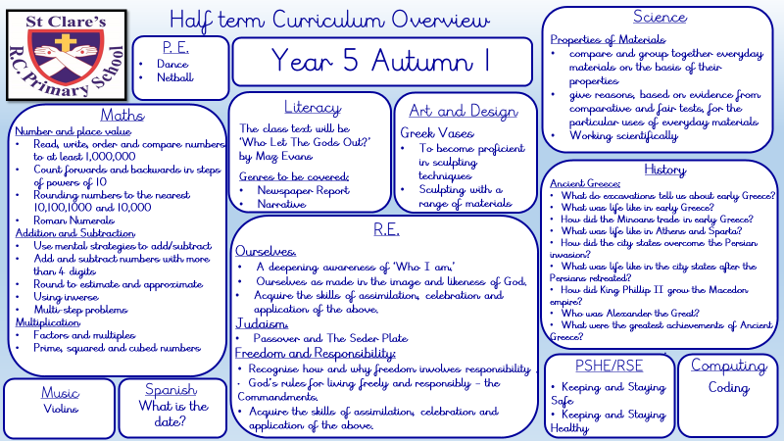

Slide 12
We are working hard to build children’s resilience in school. We want them to try their best and attempt their work before asking for help.
Children need to know that it is okay to make mistakes and that every mistake is a learning opportunity. We teach the children about having a GROWTH MINDSET
We encourage collaborative learning with ‘partners’ in class.
Children are encouraged to use 4 Before Me:
Brain
Book
Board
Buddy

Slide 13
Working together with you and your child, I know that we will have a great year.
Do you have any questions about routines, expectations or the curriculum in Year 5?

