Slide 1

PRAYER
PROGRESSION

Slide 2


Slide 3
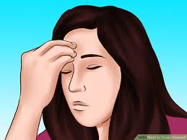
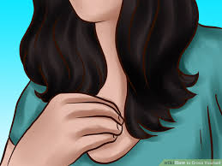
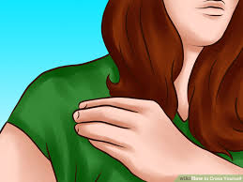
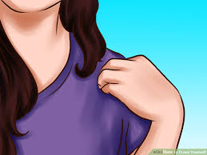
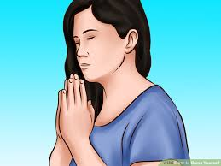
In the name
of the Father
And of the Son,
And of the Holy
Spirit,
Amen.

Slide 4

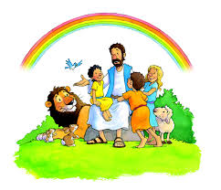
Morning Prayer
Father in Heaven, you love me,
You are with me night and day.
I want to love you always,
In all I do and say.
I’ll try to please you, Father.
Bless me through the day.
Amen

Slide 5

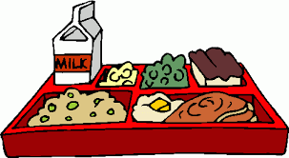
Lunch Time Prayer
Bless us, O God, as we sit together,
Bless the food we eat today.
Bless the hands that make the food.
Bless us, O God,
Amen.

Slide 6
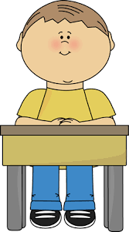

Prayer After Lunch
Thank you, God, for the food we have eaten.
Thank you, God, for all our friends.
Thank you, God, for everything.
Thank you, God.
Amen.

Slide 7
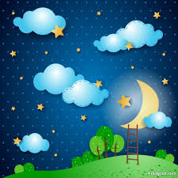
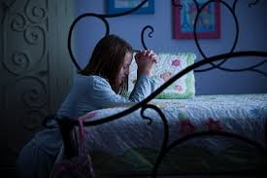
Home Time Prayer
God our Father, we come to say,
Thank you for your love today.
Thank you for my family,
And all the friends you give to me.
Guard me in the dark of night
And in the morning, send your light.
Amen.

Slide 8
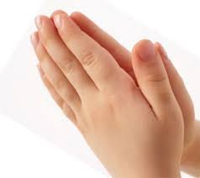
Mass response:
Amen

Slide 9


Slide 10
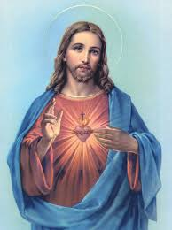
Our Father
Our Father, who art in Heaven
Hallowed be thy name.
Thy kingdom come, thy will be done
On Earth as it is in Heaven.
Give us this day our daily bread
And forgive us our trespasses
As we forgive those who trespass against us,
And lead us not into temptation
but deliver us from evil,
Amen.

Slide 11
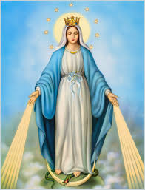
Hail Mary
Hail Mary, full of grace,
The Lord is with Thee.
Blessed art thou amongst women
And blessed is the fruit of thy womb, Jesus.
Holy Mary, Mother of God,
Pray for us sinners now and
at the hour of our death,
Amen

Slide 13
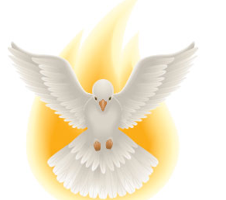
Mass response:
The Lord be with you.
And with your spirit.

Slide 14


Slide 18
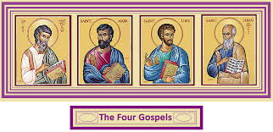
Mass response:
A reading from the Holy Gospel according to _____.
Glory to you, O Lord

Slide 19


Slide 22
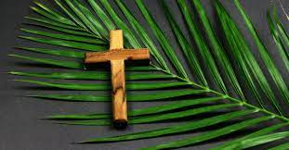
Mass:
Holy, Holy, Holy Lord God of hosts.
Heaven and earth are full of your glory.
Hosanna in the highest.
Blessed is he who comes in the name of the Lord.
Hosanna in the highest.

Slide 23


Slide 25
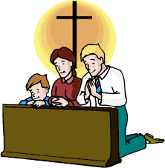
Penitential Act
I confess to almighty God,
and to you, my brothers and sisters,
that I have greatly sinned through my thoughts and in my words,
in what I have done, and in what I have failed to do;
through my fault, through my fault, through my most grievous fault; therefore I ask blessed Mary ever-Virgin,
all the Angels and Saints, and you, my brothers and sister,
to pray for me to the Lord our God.

Slide 26


Slide 27
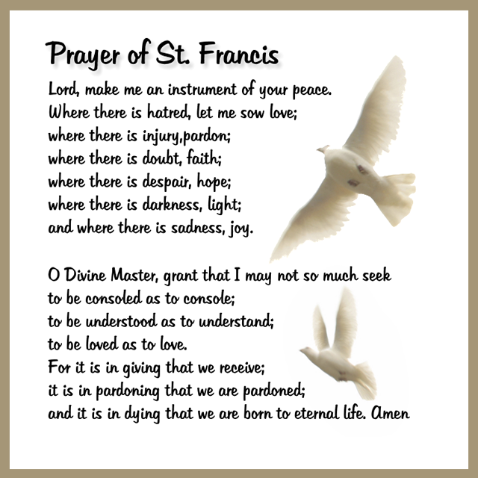

Slide 28
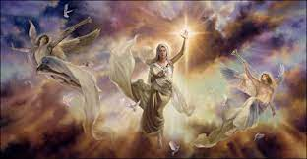
THE GLORIA
Glory to God in the highest,
and on earth peace to men of good will.
We praise You.
we bless You.
we adore you.
we glorify You.
we give You thanks for Your great glory.
Lord God, heavenly King,
O God, almighty Father.
Lord Jesus Christ, the Only Begotten Son.
Lord God, Lamb of God, Son of the Father:
you Who take away the sins of the world,
have mercy on us.
You Who take away the sins of the world,
receive our prayer.
You are seated at the right hand of
the Father, have mercy on us.
For you alone are the Holy One.
You alone are the Lord.
You alone are the Most High Jesus Christ.
with the Holy Spirit
in the glory of God the Father. Amen.

Slide 29


Slide 31
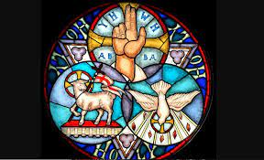
The Nicene Creed
I believe in one God, the Father almighty,
maker of heaven and earth,
of all things visible and invisible.
I believe in one Lord Jesus Christ,
the Only Begotten Son of God,
born of the Father before all ages.
God from God, Light from Light,
true God from true God,
begotten, not made, consubstantial with the Father;
through him all things were made.
For us men and for our salvation
he came down from heaven,
and by the Holy Spirit was incarnate
of the Virgin Mary,
and became man.
For our sake he was crucified under Pontius Pilate,
he suffered death and was buried,
and rose again on the third day
in accordance with the Scriptures.
He ascended into heaven
and is seated at the right hand of the Father.
He will come again in glory
to judge the living and the dead
and his kingdom will have no end.
I believe in the Holy Spirit,
the Lord, the giver of life,
who proceeds from the Father and the Son,
who with the Father and the Son
is adored and glorified,
who has spoken through the prophets.
I believe in one, holy, catholic and apostolic Church.
I confess one Baptism for the forgiveness of sins
and I look forward to the resurrection of the dead
and the life of the world to come. Amen.

