Slide 1

Staff in Year 2 are:
Miss Dodman ( Class Teacher)
Miss Bennet ( Teaching Assistant )
We are very much looking forward to working with you and getting to know your children this year.

Slide 2

Our school Mission Statement:
'Guided by Jesus Christ, our teacher, we journey together, learning to dream, believe and achieve'

Slide 3

If you have any queries, questions or concerns throughout the year, please contact me via the school app / email. Please note that on the school app, I cannot respond directly to you.
My email address is :
l.dodman@st-clares.manchester.sch.uk
– This can also be found on the school website.
Please see me after school when you are picking your child up, or make an appointment to see me if required.
I am here to support your child, but as a school we want to support families too wherever we can.
Please get in touch.

Slide 4
READING
As a school, we ask that you please read with your child every night. Reading crosses all curricular areas in school and being a fluent reader will really help with all other subjects.
We recommend reading for around 10 minutes every night if possible. Once they have read, please sign their reading record.
Your child will be sent home with two RWI books, usually on a Thursday. We change RWI books on this day every week, so please ensure you have read and brought them back with you for then. Phonics sounds may also be sent home for you to practice at your convenience.

Slide 5

We want your child to develop a love of reading, so in addition to the RWI books, we will have a weekly slot (Monday) in the library where the children will be able to choose a book to bring home. This should be returned before our slot the following week, so that we can sign out a new book. Please take the time to share a book, a poem, a comic, a magazine, a football programme – anything that involves reading.
As your child reads, their minds are opened up to new information, new experiences, new dreams…
We do not want children to race through their reading books. It is really important that the children understand what they are reading and new vocabulary that they will be exposed to. You can help this by discussing things with your child as they read.

Slide 6

All children are rewarded with raffle tickets for every day they have their record signed. These are drawn each week, in assembly and someone receives a reading prize.
We also have a reading reward chart in our classroom where the children will move up when their records are signed. At the end of the half term, those at the top will get a prize.

Slide 7

HOMEWORK
As well as reading every night, your child will be given…..
Spellings – These will be given out on a Friday and the children will have a spelling test the following Friday.
Maths / English Homework – This will be given out on a Friday and should be returned by Wednesday please.

Slide 8


P.E
During the Autumn term, our PE lessons will be on Monday (Indoor) and Thursday (Outdoor)
Your child can come into school wearing their school PE kit on those days. Black shorts/jogging bottoms, white t-shirt with trainers/pumps. Please see the school website for details on our uniform if you need more information.

Slide 9
Lessons
Maths and English are taught every day.
In EYFS and KS1, we have daily phonics lessons too following the Read Write Inc phonics scheme.
As a Catholic school, we teach 2 hours of RE each week. We follow the Come and See scheme of work.
We have 2 PE lessons per week.
In addition to this, we also teach a whole host of other foundation subjects.
Please see the yearly curriculum overview for more details – this document (along with lots more information) is available on the class page on the school website. Our website is a useful source of information.

Slide 10
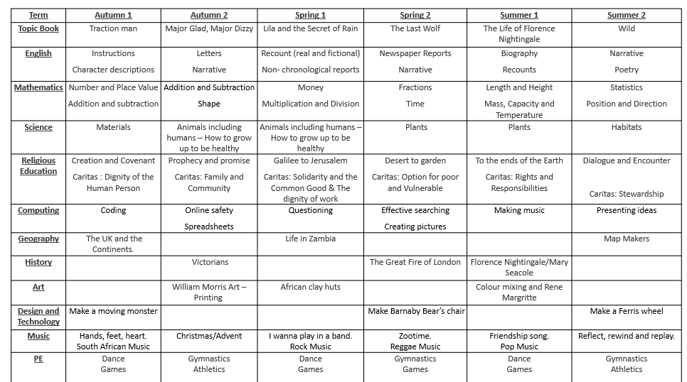

Slide 11

We are working hard to build children’s resilience in school. We want them to try their best and attempt their work before asking for help.
Children need to know that it is okay to make mistakes and that every mistake is a learning opportunity.
We encourage collaborative learning with ‘partners’ in class.
Children are encouraged to use 4 Before Me:
Brain
Book
Board
Buddy
BOSS

Slide 12
Working together with you and your child, I know that we will have a great year.
Do you have any questions?

