Slide 1

Staff in Year 3H are:
Mrs Harrison, Mrs Mitchell, Mrs Entwistle and Mrs Elliott.
We are very much looking forward to working with and getting to know your children this year.

Slide 2


Our school Mission Statement:
'Guided by Jesus Christ, our teacher, we journey together, learning to dream, believe and achieve.'

Slide 3

If you have any queries, questions or concerns throughout the year, please contact me via school email, see me after school when you are picking your child up, or make an appointment to see me.
I am here to support your child, but as a school we want to support families too wherever we can. Please do get in touch.

Slide 4

READING
Please read with your child every night. I can not stress how important it is as reading crosses all curricular areas in school.
Your child should be reading for 20 minutes every night.
Reading diaries will be checked on a daily basis – rewards will be given for children who read every night!
Books will be changed when a quiz is completed - based on the book that they have just read.

Slide 5

We want your child to develop a love of reading. Take time to sit with them and share a book, a poem, a comic, a magazine, a football programme – anything that involves reading.
As your child reads, their minds are opened up to new information, new experiences, new dreams…
We do not want children to race through their reading books. It is really important that the children understand what they are reading and new vocabulary that they will be exposed to.
Discuss this with your child as they read.
In Key Stage 2, children are rewarded with raffle tickets when they achieve 80%+ on a book quiz.
Each week, in assembly, someone receives a reading prize.
Vouchers are given to children when they have read a millions words.

Slide 6

HOMEWORK
As well as reading every night, your child will be given homework tasks to complete.
Spellings, maths and English will be handed out on a Friday, to be handed in the following Friday. The spellings will be tested on a Friday.
Children that hand in homework on time will be given tokens. Children who do not hand in homework will have the opportunity to complete it during break time on a Friday.
In Year 3 your child is expected to know the 3, 4 and 8 time tables off by heart. This also includes their associated division facts and will often be given as maths homework.
Please practise these at home either by chanting, singing songs, playing games or accessing your child’s Times Table Rock Star account.
Each child should have their own log-in details – please ask if you do not know your child’s details.

Slide 7

PE
During the Autumn term, our PE lessons will be on Tuesdays and Wednesdays.
Your child will come into school wearing their school PE kit on those days.
Black shorts or tracksuit bottoms and a plain white T-Shirt. (They may wear their school jumper over the top).
Make sure that all uniform is clearly labelled with your child’s name on it please.

Slide 8
LESSONS
Maths and English are taught every day.
As a Catholic school, we teach 2.5 hours of RE each week.
We are trialling a new scheme this year called Lighting the Path.
We have 2 PE lessons per week. One indoor, which will be dance or gymnastics and one outdoor, which will be games or athletics.
In addition to this, we also teach a whole host of other foundation subjects.
Please see the yearly curriculum overview for more details – this document (along with lots more information) is available on the class page on the school website.
Our website is an extremely useful source of information.

Slide 9
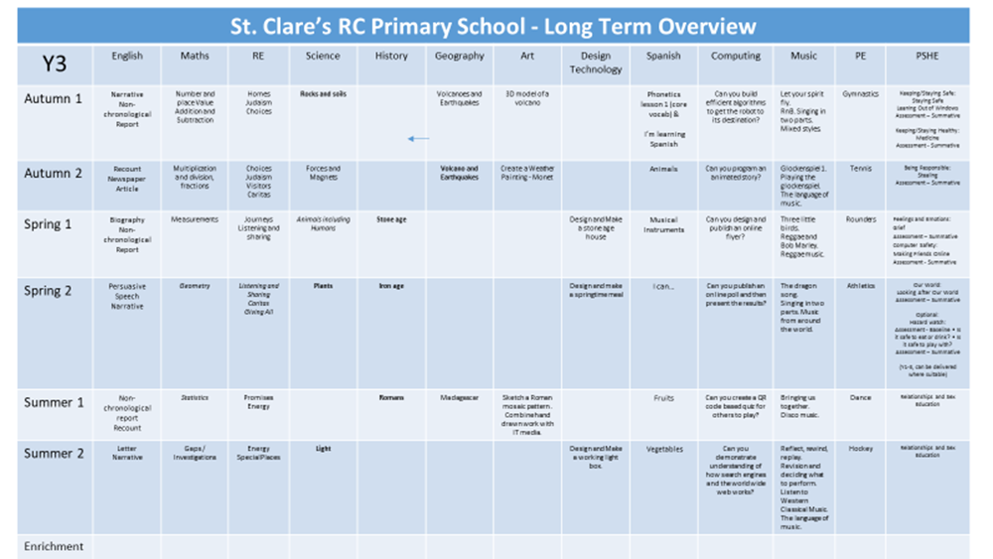

Slide 10
We are working hard to build children’s resilience in school.
We want them to try their best and attempt their work before asking for help.
Children need to know that it is okay to make mistakes and that every mistake is a learning opportunity.
We encourage collaborative learning with ‘partners’ in class.
Children are encouraged to use “4 Before Me”
1) Brain
2) Book
3) Board
4) Buddy
(Then, the BOSS!)

Slide 11
Class 3H (Mrs Harrison)
Teacher email: j.harrison@st-clares.manchester.sch.uk
P.E days: Tuesdays and Wednesdays
Reading expectation: 20 minutes per night.
Homework: Given out on Friday, in for following Friday
Spellings: Given out onFriday, tested on the following Friday.

Slide 12
Working together with you and your child, I know that we will have a great year!
Do you have any other questions about routines, expectations or the curriculum in Year 3?

