Slide 1


Slide 2
Staff in Year 6 are:
Mrs Salza
Mr Willis
Mrs Vickers
Mr Dale
Mr Sabatel
Mrs Miley
Ms Hudson
We are very much looking forward to working with and getting to know your children this year.

Slide 3

Our school Mission Statement:
'Guided by Jesus Christ, our teacher, we journey together, learning to dream, believe and achieve'

Slide 4

If you have any queries, questions or concerns throughout the year, please contact me via the school app, see me after school when you are picking your child up, or make an appointment to see me.
I am here to support your child, but as a school we want to support families too wherever we can. Please get in touch.

Slide 5

READING
Please read with your child every night. I can not stress how important it is as reading crosses all curricular areas in school.
To help with their reading understanding and vocabulary your child should be reading for 30 minutes every night.
I check reading records every morning, and for those children that have read and had their reading record signed, they will receive a raffle ticket for the weekly reading reward during assembly.
Children are to change their books independently after they have quizzed, there are books are the back of our classroom for the children to access.

Slide 6

We want your child to develop a love of reading. Take time to sit with them and share a book, a poem, a comic, a magazine, a football programme – anything that involves reading.
As your child reads, their minds are opened up to new information, new experiences, new dreams…
We do not want children to race through their reading books. It is really important that the children understand what they are reading and new vocabulary that they will be exposed to.
Discuss this with your child as they read.
In Key Stage 2, children are rewarded with raffle tickets when they quiz on their reading books, have their reading record signed, or read with an adult in school. 2 raffle tickets are given for a score of 100% on their quiz.
Each week, in assembly, someone receives a reading prize.
Vouchers are given to children when they have read a millions words.

Slide 7

As well as reading every night, your child will be given…..
Spellings – these are handed out each Monday, and tested on Friday.
Homework – Will be handed out on a Friday to be completed by the following Wednesday.
In Year 6 your child is expected to know the 1-12 time tables off by heart. This also includes their associated division facts. Please practise these at home either by chanting, singing songs, playing games or accessing your child’s Times Table Rock Star account. Each child should have their own log-in details – please ask if you do not know your child’s details.

Slide 8

During the Autumn 1, our PE lessons will be on Monday and Thursday.
Your child will come into school wearing their school PE kit on those days. Please see the school website for details on our uniform.
Make sure that all uniform is clearly labelled with your child’s name on it please.

Slide 9
Lessons
Maths and English are taught every day.
As a Catholic school, we teach 2.5 hours of RE each week. We follow the Come and See scheme of work.
We have 2 PE lessons per week.
In addition to this, we also teach a whole host of other foundation subjects.
Please see the yearly curriculum overview for more details – this document (along with lots more information) is available on the class page on the school website. Our website is a useful source of information.

Slide 10
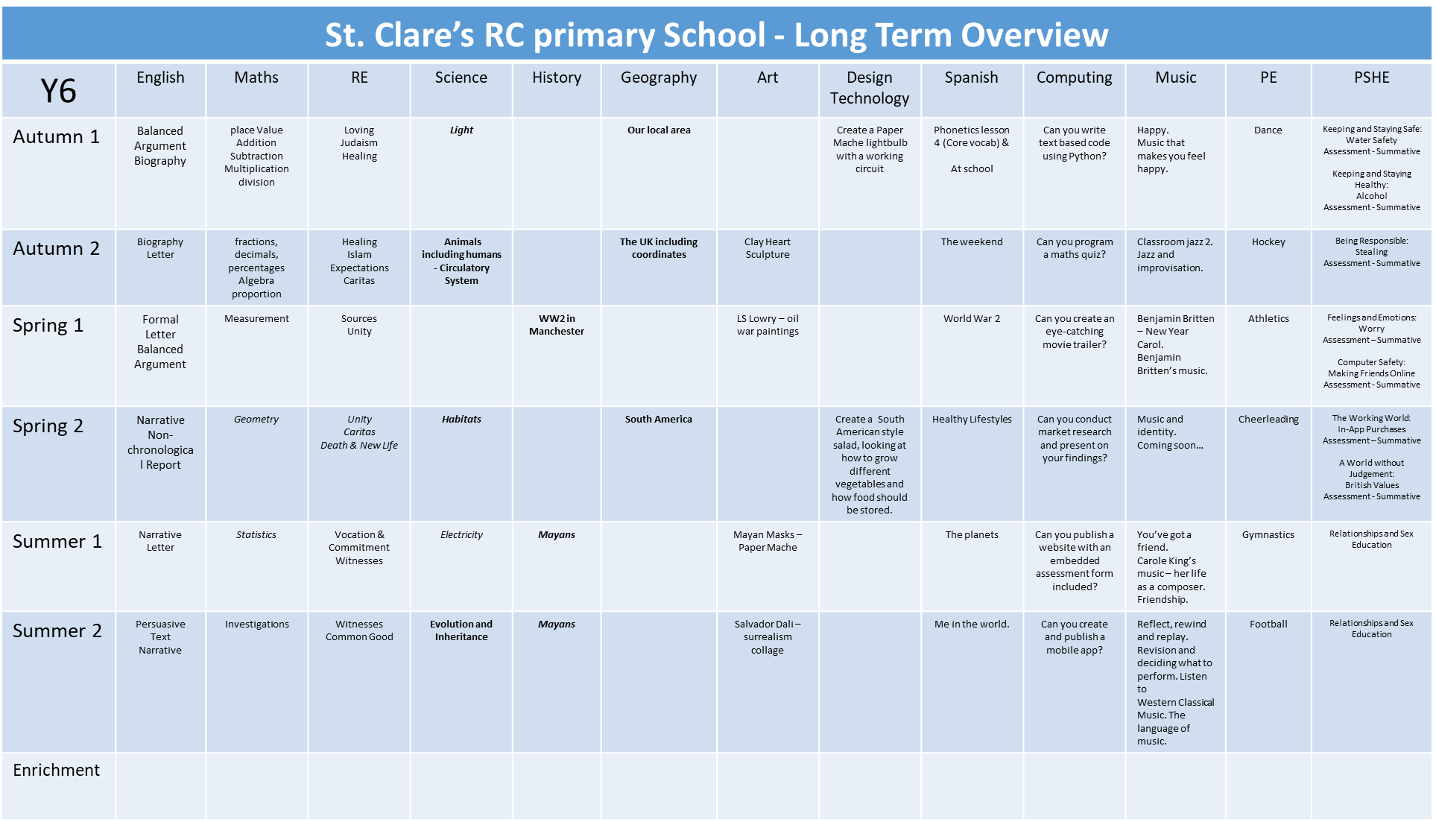

Slide 11
We are working hard to build children’s resilience in school. We want them to try their best and attempt their work before asking for help.
Children need to know that it is okay to make mistakes and that every mistake is a learning opportunity.
We encourage collaborative learning with ‘partners’ in class.
Children are encouraged to use 4 Before Me:
Brain Book Board Buddy

Slide 12
Working together with you and your child, I know that we will have a great year.
Do you have any questions about routines, expectations or the curriculum in Year 6?

