Slide 1
Year 1: Materials Knowledge Mat – What is the best material?
Subject Specific Vocabulary |  | Prior Knowledge |  | Sticky Knowledge
materials | What something is made of, e.g. wood or plastic. | 1. 2. | Foundation Stage: Knowledge of similarities and differences in relation to objects and materials (eg; clothes they wear in winter) Objects feel and look different based on the material they are made from. | 1 | Glass is used for …
wood | The material that comes from a tree. It varies in hardness. |  |  | Windows in houses and cars to see through. Mirrors – to see yourself – reflection.
plastic | A ‘man-made’ material that can be shaped or moulded to any shape.
metal | A tough and strong material which can be heated and shaped into anything. |  |  | 2 | Metal is used for …
 |  |  |  | Strength –in construction of planes, cars and trains and especially tall buildings.
glass | hard brittle usually transparent substance commonly made from sand
 |  | Investigate
man made | things that are created by people | How are materials similar / different to each other? Can you sort natural materials from man-made materials? How are materials similar / different to each other? What is the best material for…… |  | 3 | Wood is used for …
 |  |  |  | Doors – most doors are made from wood. Furniture – most furniture is made of wood, often special wood.
natural | things that exist in nature and are not made by people
stretch | A stretchy material is one that is like elastic.
stiff | A stiff material is firm and hard and not flexible.
 |  |  |  | 4 | Plastic is moulded or shaped …
bend | A bendy material is one that can be twisted and is flexible.
 |  |  |  | to form any shape from buckets to animal jelly casts.
waterproof | A material that does not allow water or liquid through.
shiny | A shiny material is sparkly or glossy and sometimes glittery.

Slide 2
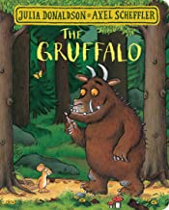
Year 1: Animals Knowledge Mat – Am I an animal?
Subject Specific Vocabulary |  | Prior knowledge | Sticky Knowledge about animals
fish | A fish is a scaly skinned creature with a spine that swims in water and breathes using gills. | The names of some common animals. The parts of the human body and how they are associated with each sense.
 |  |  | What are vertebrates? •Vertebrates are animals that have a backbone. There are five groups of vertebrates: mammals, fish ,birds, reptiles, amphibians
amphibians | All amphibians begin their life in water with gills and tails. Examples are frogs and newts.
 |  |  | What are mammals? •They give birth to live young, usually have hair or fur, warm-blooded, cannot breathe underwater. Some common mammals are pets such as dogs, cats, hamsters; farm animals such as cows, sheep and horses; wild animals such as foxes, hedgehogs, lions and giraffes and humans.
reptiles | Are animals that are cold-blooded. Most lay eggs and their skin is covered with hard, dry scales.
birds | Birds have feathers and wings. They lay eggs and are warm-blooded animals. | Investigate
 |  |  | What are fish? •They have fins and scales; breathe underwater using gills; lay eggs in water and are cold-blooded. Some common fish are salmon, cod and tuna.
mammals | Mammals are also warm blooded animals. They breath air and have a backbone. some common mammals are: pets such as dogs, cats, hamsters farm animals such as cows, sheep and horses wild animals such as foxes, hedgehogs, lions and giraffes humans | use observations in the local environment to compare animals or through videos and photographs describe how to identify and group animals group animals according to what they eat research how to take care of animals taken from the local environment and how to return them safely
 |  |  | What are birds? •They are warm-blooded; have wings and beaks; have feathers and lay eggs. Some common birds are ducks, chickens, penguins and pigeons.
 |  |  | What are reptiles? •They are cold-blooded; lay eggs; have scales and cannot breathe underwater. Some common reptiles are snakes and lizards.
carnivore | A carnivore is a meat-eating animal that gets its food from killing other animals.
herbivore | A herbivore eats plants. |  | What are amphibians? •They are cold-blooded; lay eggs; live on land and water and can breathe underwater through gills. Some common amphibians are frogs and toads.
omnivore | An omnivore eats plants and meat.
vertebrates | Vertebrates are animals that have a backbone. There are five groups of vertebrates:
 |  |  | What are invertebrates? •Invertebrates are animals that do not have a backbone such as flies, ladybirds and bees; arachnids such as spiders and molluscs such as snails .
Invertebrates | Invertebrates are animals that do not have a backbone.

Slide 3
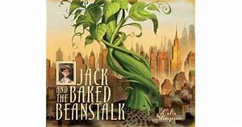
Year 1: Plants Knowledge Mat - Are all leaves the same?
Subject Specific Vocabulary |  | Prior Knowledge | Sticky Knowledge about plants
seed | the small, hard part from which a new plant grows | Make observations of plants and know that plants grow Talk about how plants can change
 |  |  | The names of some common garden plants • People may grow plants in their gardens and care for them. • They may grow flowering plants which are beautiful to look at or beans and seeds to grow plants for food. • When plants are grown for food, this may be called a herb garden or vegetable patch. • Common garden plants such as roses, poppies and sunflowers
bulbs | The resting stage of a plant that is usually formed underground.
deciduous | Deciduous is the name given to trees that lose their leaves in autumn and are bare in the winter.
evergreen | Evergreen is the name of trees that have leaves all year round.
trunk | the large main stem from which the branches grow | Investigate! | The names of some common wild plants • A wild plant will grow by itself. • It does not need to be cared for. • If it grows somewhere unwanted, it may be a weed. •Common wild plants such as dandelions, daisies, buttercups and nettles.
roots | the parts of a plant that grow under the ground
 |  | Plant a bean or a seed and watch it grow. Record your observations in a diary. Go on a wild plant hunt! Create a tally chart to show how many of each plant you have found and then use the information to answer questions. Go on a tree hunt around the School grounds - what types of trees can you see? Collect fallen leaves and identify which tree they came from using pictures to help you. Sort the leaves between deciduous and evergreen trees.
leaf/leaves | the parts of a tree or plant that are flat, thin, and usually green
 |  |  | Deciduous and evergreen trees • Deciduous trees lose their leaves in the autumn every year. Their leaves are generally broad, flat and have veins running through them. • Evergreen trees have green leaves all year round. Their leaves are generally thick, waxy and narrow like needles.
flowers | the part of a plant which is often brightly coloured and grows at the end of a stem
petal | thin coloured or white parts which form part of the flower
garden | a piece of land next to a house, with flowers, vegetables, other plants, and often grass
 |  |  | What are the parts of common trees and plants?
wild | plants that live or grow in natural surroundings and are not looked after by people
vegetable | A vegetable is a plant or part of a plant which is used as food, for example cabbage or potato.
weed | a wild plant that grows in garden and prevents the plants that you want from growing properly

Slide 4
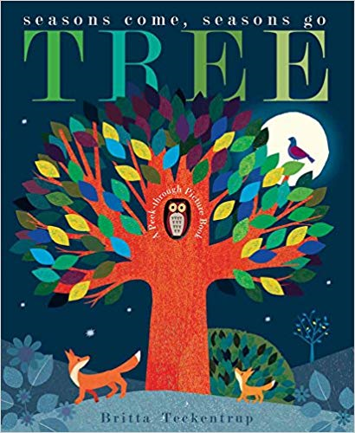
Year 1: Seasonal Change Knowledge Mat
Subject Specific Vocabulary |  | Prior Knowledge | Sticky Knowledge about seasonal change
Autumn | The time of year between September and November. Many leaves fall off the trees. | They talk about the features of their own immediate environment and how environments might vary from one another. They can talk about the changes that happen in these environments
Spring | The time of year between March and May. There is usually lots of signs of new growth in Spring.
 |  |  | In the UK we have four seasons: spring, summer, autumn and winter. Summer is the hottest season and winter the coldest.
Summer | The hottest season in the UK. It happens between June and August. The longest day is June 21st.
 |  |  | Spring starts when the day and night are the same length (usually 21st March. However, many say that Spring starts on March 1^{st)}.
Winter | The coldest season in the UK. We can have snow in this season. It occurs between December and February. | Investigate
seasons | The seasons are four different times during the year with different types of weather. | Go on a wild plant hunt and observe the changes in each season Go on a tree hunt in the school grounds and identify the colour and shape of the leaves in the different seasons.
 |  |  | In summer the longest day of the year is around June 21st and in winter the shortest day of the year is usually December 21st.
weather | Weather is what the sky and the air outside are like, such as cold and cloudy.
temperature | It is measurement of hot or cold that can be measured using a thermometer.
 |  |  | When we have our summer it is winter in the southern hemisphere. When we have our winter Australia has its summer.
thermometer | This is the instrument that measures the temperature.
weather symbol | These are signs used to help us understand more about our daily weather. |  | In the USA and many other countries the season ‘Autumn’ is known as the ‘Fall’. This is because so many leaves fall from the trees in Autumn.
day | the part of a day when it is light; the time between sunrise and sunset
night | the time after sunset and before sunrise while it is dark outside (no sunlight is visible). |  | Seasons change throughout the year because of the way the Earth travels around the Sun.

