Slide 1

Year 4 Multiplication Tables Check 2023 Presentation for Parents, Carers & Guardians

Slide 2
What is today’s meeting about?
The Multiplication Tables Check (MTC)
The National Curriculum for Mathematics states that children should know their times tables up to x12 by the end of year 4.
The MTC was introduced by the Department of Education as a way of measuring if year 4 pupils are fluent in their times tables.
The check was postponed during COVID until last year when it was first rolled out in all primary schools in England.

Slide 3
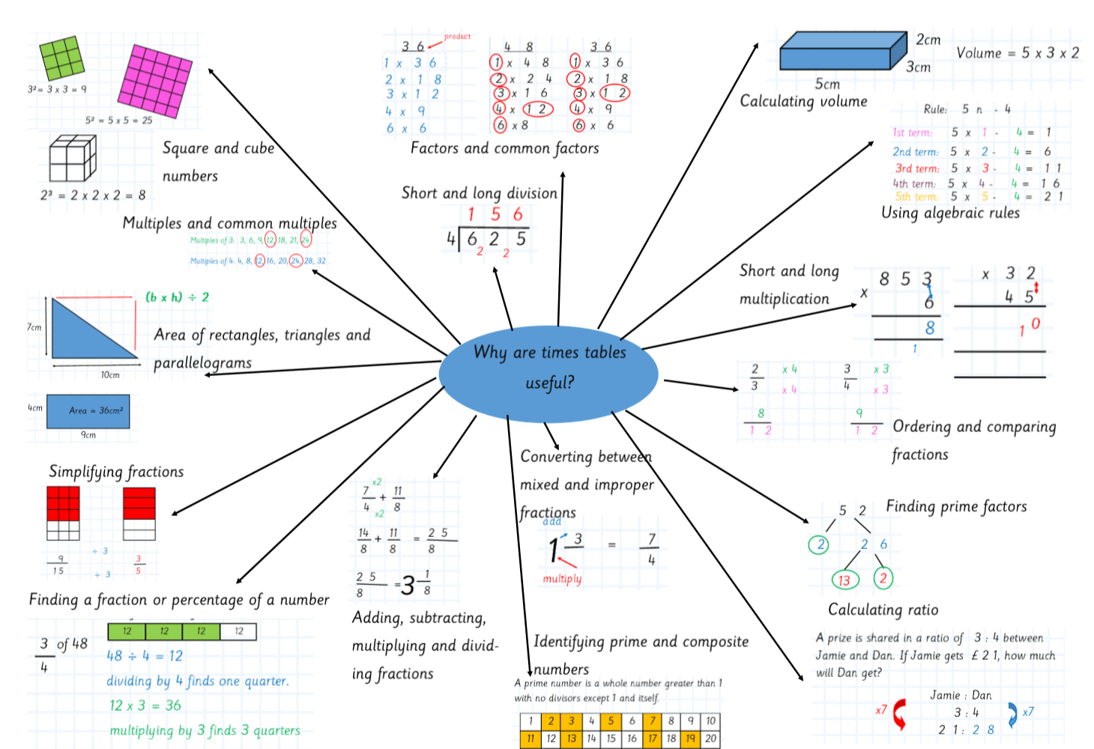
Why are times tables so important?

Slide 4
Important information about multiplication tables check (MTC)
The MTC determines if Year 4 children can fluently recall their multiplication tables.
They are designed to help schools identify which children require more support to learn their times tables.
There is no ‘pass’ rate or threshold which means that, unlike the Phonics Screening Check, children will not be expected to re-sit the check.
The Department for Education (DfE) will create a report about the overall results across all schools in England, not individual schools.
Notes:
The test is designed to identify pupils who need support, not as a diagnostic tool to assess the times tables children struggle with.

Slide 5
When the check will take place
There will be a 3 week window from Monday 6th June to Friday 24th June 2022 for schools to administer the check.
There is no set day to administer the check and children are not expected to take the check at the same time.
All eligible Year 4 children in England will be required to take the check.
Notes:
It is up to individual schools to decide how the check is administered – some schools will administer individually while others will take small groups out or administer to the whole class.
A list of pupils who should not take the test can be found in the administration guidance of the MTC documentation.

Slide 6
How the check is carried out
The check will be fully digital.
Answers will be entered using a keyboard, by pressing digits using a mouse or using an on-screen number pad.
Usually, the check will take less than 5 minutes for each child.
The children will have 6 seconds from the time the question appears to input their answer.
There will be a total of 25 questions with a 3 second pause in-between questions.
There will be 3 practice questions before the check begins.
Notes:
Some children will be eligible for additional support (detailed in the next slide).
6 seconds per answer means that children must be able to read, recall and enter their response within that time. Whatever is written in the answer box at the end of 6 seconds will be counted as the answer i.e. if the student intends to write 144 and only 14 is typed when the timer ends, their recorded answer is 14.
Children are allowed to practise before taking the check.
https://mathsframe.co.uk/en/resources/resource/477/Multiplication-Tables-Check example showing how quick the questions are/ types of questions.

Slide 7
Specific arrangements for the check
Some children will be eligible for specific arrangements:
Colour contrast;
Font size adjustment;
‘Next’ button (alternative to 3-second pause);
Removing on-screen number pad;
An adult to input answers;
Audio version;
Audible time alert.
Notes:
Children eligible for access arrangements are:
Children with an EHC plan
Children who have provisions made in school using the SEND support system.
Children with behavioural, emotional or social difficulties
Children with EAL
Schools do not need to request permission to use access arrangements. The support should be based on the support provided in school and should not advantage or disadvantage individual children.
A child can be assigned more than one access arrangement, if required.

Slide 8
The check questions
Each child will be randomly assigned a set of questions
There will only be multiplication questions in the check, not division facts.
The 6, 7, 8, 9 and 12 times tables are more likely to be asked.
Reversal of questions (e.g. 8 x 6 and 6 x 8) will not be asked in the same check.
Children will not see their individual results when they complete the check.
Notes:
Some questions will be repeated across different checks, but no more than 30% of questions will be repeated in any two checks. This means that if the check gets interrupted and children need to re-start it, they will only have a minimal advantage.
During the check pupils may be able to restart if certain conditions are met (e.g. a fire alarm).
The results will be sent to the schools when all the checks have been completed but it is then up to the school if they report the results or not.
There won’t be questions from the 1 times tables (although they might be included in the 3 practice questions).
There will be a maximum of 7 questions from the 2, 5 and 10 times tables.
There is a focus on the 6, 7, 8, 9 and 12 times tables as they are the ‘most difficult’ multiplication tables.

Slide 9
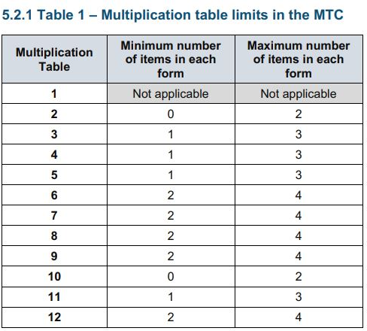
More information about the questions
The Standards and Testing Agency (STA) state that they are classifying the multiplication tables by the first number in the question. For example, 8 x 3 would fall within the 8 times table.
Notes:
The table shows the minimum/ maximum number of questions from each times table that will be asked.

Slide 10
Will I find out my child’s score?
Your child’s teacher will share your child’s score with you as they would with all national curriculum assessments. There is no pass mark for the check.

Slide 11
How we teach times tables for understanding in school
Count and look for patterns.
Understand that multiplication is repeated addition.
Remember that multiplication is commutative.
Remember that multiplication is the inverse of division.
Recall and utilise number families.
Use different representations to represent multiplication, such as:
Concrete manipulatives suck as multilink cubes or counters.
Create pictorial representations such as arrays.

Slide 12


Multiplication is commutative
3 x 2 is the same as 2 x 3
Children need to understand that multiplication can be completed in any order to produce the same answer. Sometimes this link needs to be made explicit.
3 lots of 2 = 6
2 lots of 3 = 6
Notes:
Children build on their existing understanding using arrays, turning the arrays around to show that you now have 2 groups of 3 and they will still total 6. This can then be linked to recalling multiplication facts, e.g. if they know their 2 times table as facts but not their 3 times table, they can use 2 x 3 to work out 3 x 2.

Slide 13

Using known facts
4 x 6 = ?
I know 4 x 5 = 20
Therefore, 20 + 4 = 24
By using known facts from ‘easier’ times tables, children should be able to find answers with increasing speed.
+

Slide 14
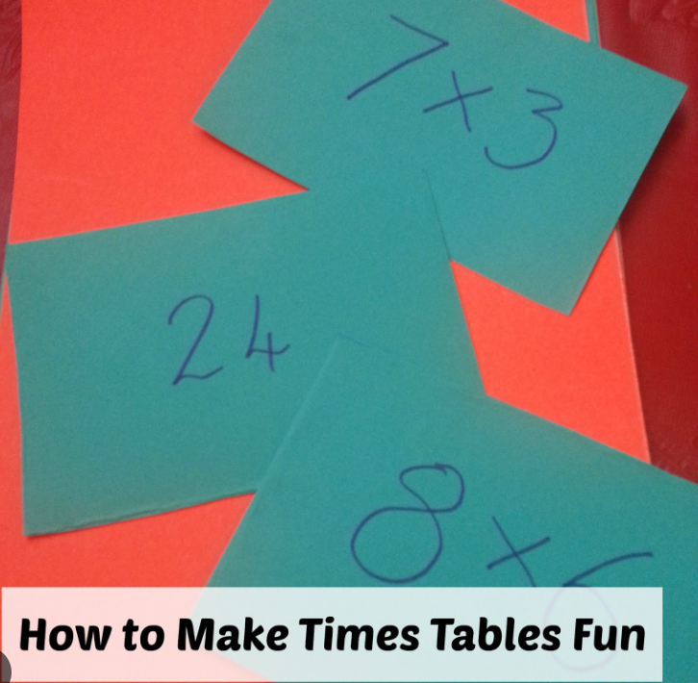
How you can help at home
We practice our times tables regularly in school and we would love for your children to practise with you at home so they feel confident when completing the test.
One of the easiest ways to practise is to quiz your child. 8x6 is?
Other things to try:
Display a poster with all the time table facts on at home.
Get active: climb the stairs, star jumps etc counting in multiples.
Make flashcards with your children and let them play with friends, siblings, grandparents. They could write the answer on the back and test themselves.

Slide 15
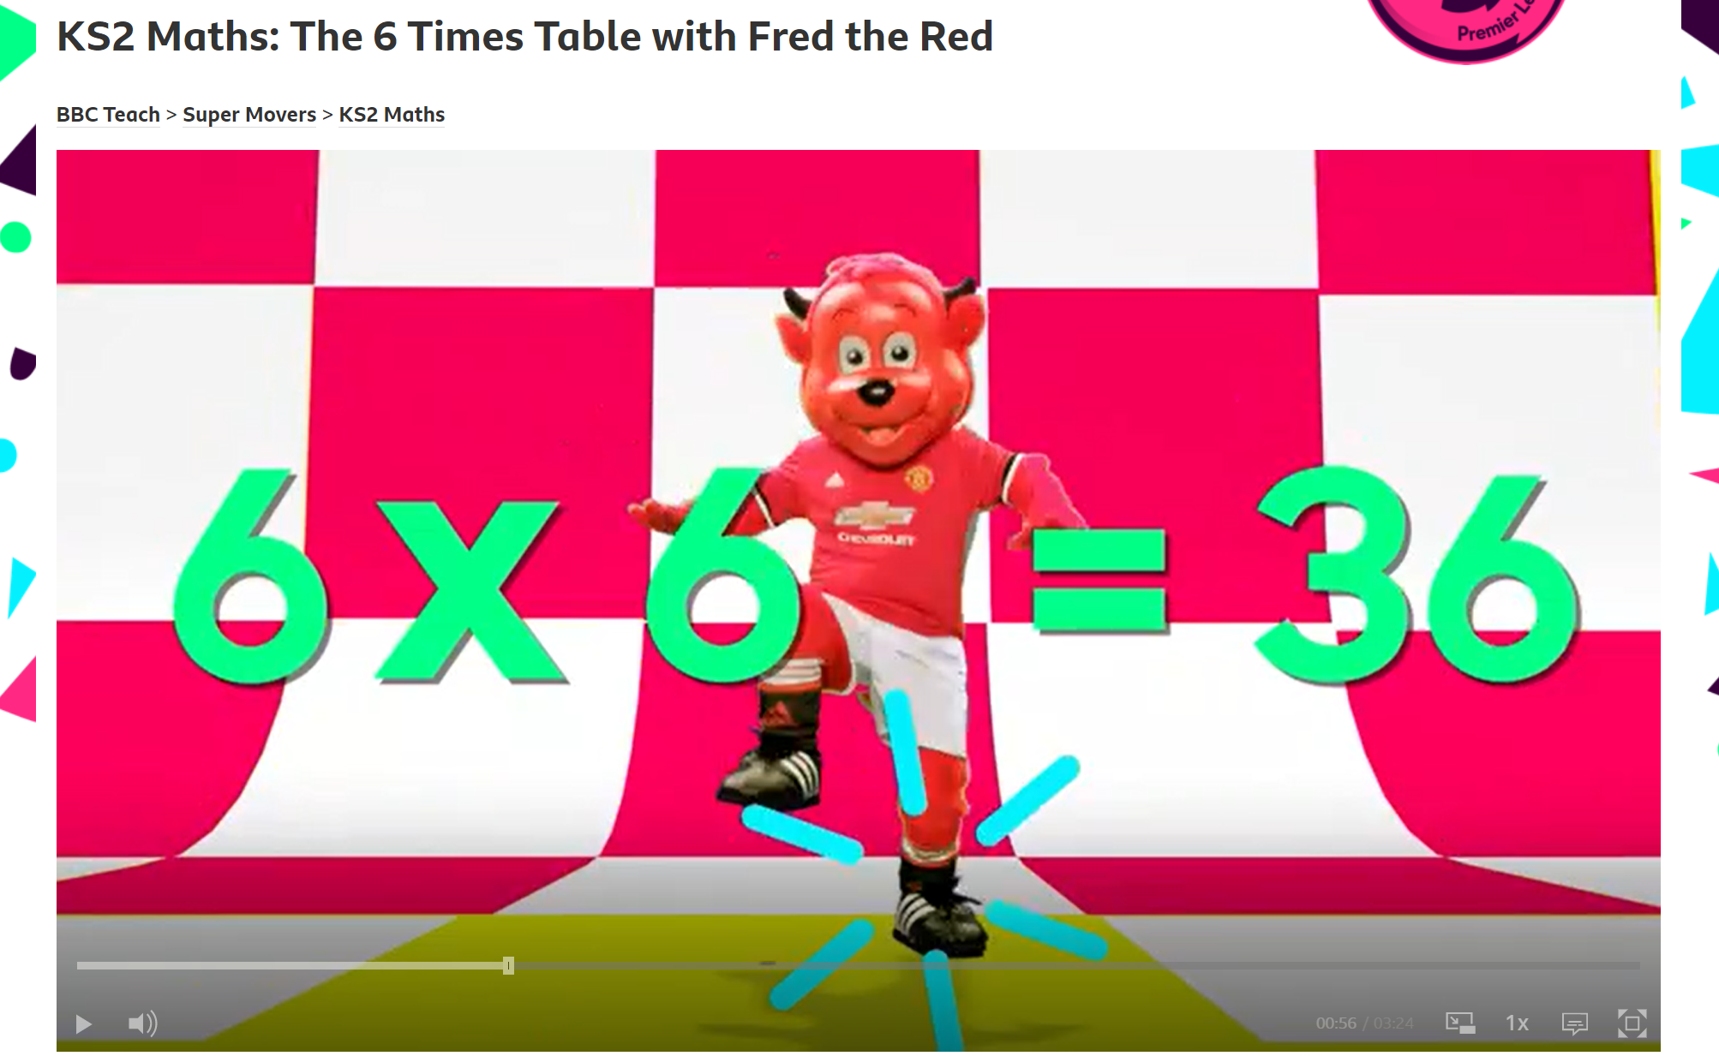
Songs
We use lots of songs to teach times tables in school – there are lots on youtube!
BBC Supermovers also has some times tables songs that children may be familiar with from practicing in class.

Slide 16

TTRockstars
We use the website Times Tables Rockstars in school and children are often given opportunities to engage both online and through paper based activities in school.
We have a TTRS leader board and children are rewarded for their efforts in our weekly celebration assembly.
We have found this to be an excellent tool in motivating children to improve their times tables recall and it would be great if you get involved with this at home too!
Children can access TTRS on the app or on the website.
Notes:
Parents Guide to TTRS: https://www.youtube.com/watch?v=WqPIa17hKLA

Slide 17
Any times tables practise that the children can do at home will really support them to become proficient in their times tables and help them with their every day maths learning.
Thank you for your support and for taking the time to come today!
Please help yourself to a times tables poster and parent guide to TTRockstars.

