Slide 1
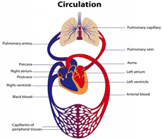
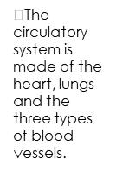
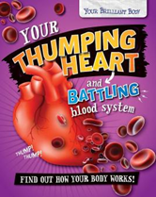
Year 6: Circulatory System Knowledge Mat – Why is the heart the most important muscle and organ?
Subject Specific Vocabulary |  | Prior Knowledge | Sticky Knowledge about the circulatory system
circulatory system | The system responsible for circulating blood through the body, that supplies nutrients and oxygen to the body and removes waste products such as carbon dioxide. | •The different parts of the human body and what they do. •The basic needs of animals for survival (water, food, air) •The importance of exercise, hygiene and a balanced diet. •Animals get nutrition from what they eat. •The different ways in which humans are healthy. •Some animals have skeletons for support, protection and movement. •The basic parts of the digestive system. •The different types of teeth in humans. •Respiration is one of the seven life processes. •The life cycle of a human and how we change as we grow.
 |  |  | What is the circulatory system? •Blood is what is used to transport oxygen, waste, nutrients, and more throughout the body. •Arteries carry oxygenated blood from the heart to the rest of the body. •Veins carry deoxygenated blood from the body to the heart. •The heart sends the deoxygenated blood to the lungs. Here, the blood picks up oxygen and disposes of carbon dioxide. •Nutrients, oxygen and carbon dioxide are exchanged via the capillaries. •How often your heart pumps is called your pulse.
circulation | To stay alive, animals need to move oxygen, food and waste around their bodies; this is circulation. These substances are often carried in the blood
heart | A powerful, muscly organ found in the chest that constantly pumps blood around the body.
blood | A mixture of different cells floating in a liquid that has many jobs to do: transport oxygen, nutrients and waste around the body; fight germs and heal wounds,
blood vessels | Narrow tube-like structures that carry blood through the tissues and organs of the body. There are three types.
arteries | Blood vessels that lead away from the heart, transporting oxygenated blood to the rest of the body.
veins | Blood vessels that transport deoxygenated blood back to the heart from the rest of the body.
capillaries | The smallest blood vessels, which connect arteries and veins to cells in the body. They have thin walls so oxygen, nutrients and waste can easily pass through them.
 |  | Investigate
pulse | The regular beating of the blood pumping through your body can be felt where blood vessels are closest to skin.
 |  | How does your pulse change with exercise? What is the most efficient way of presenting this data? Analyse line graphs that show the change in heart rate over time before, during and after exercise. Which exercise produces the fastest pulse? How would you make this a fair test? Identify the parts of the circulatory system and explain their functions Create a presentation to show how our blood is pumped around the body. Explore the work of William Harvey
 |  |  | What choices can harm the circulatory system? •Because your heart is crucial to your survival, it’s important to keep it healthy. •Lifestyle choices like a healthy diet and exercise help keep the heart healthy but some choices, such as smoking and drinking alcohol can be harmful to our health. • Tobacco can cause short-term effects such as shortness of breath, difficulty sleeping and loss of taste and long-term effects such as lung disease, cancer and death. • Alcohol can cause short-term effects such as addiction and loss of control and long-term effects such as organ damage, cancer and death.
lungs | Spongy organs inside your chest which fill with air when you breathe in. They separate the oxygen from the rest of the gases and pass it into nearby capillaries.
respiration | Process of respiring: breathing; inhaling and exhaling air.
oxygenated | Blood that contains oxygen, transporting it to the tissues and organs in the body that need it.
deoxygenated | Blood that does not contain oxygen because it has already been transferred to the rest of the body.
drug | A substance containing natural or man-made chemicals that affects the way the body works. Can be harmful.
alcohol | A drug produced from grains, fruits or vegetables when they are put through a process called fermentation.
nicotine | A chemical drug found in the tobacco plant. It’s smoked through cigarettes or cigars and gets sent to the lungs.
 |  |  | Why is exercise and diet important? Exercise can: tone our muscles and reduce fat; increase fitness; strengthen the heart and improve lung function.
addiction | When you have an uncontrollable urge to have something, even if it’s harmful. Many drugs are addictive.

Slide 2
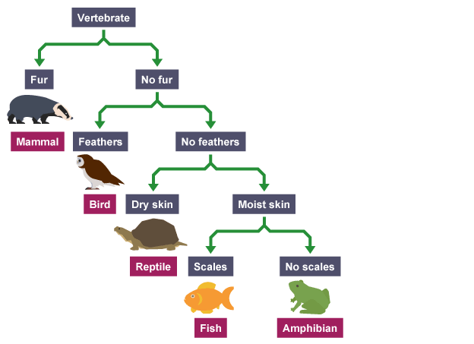
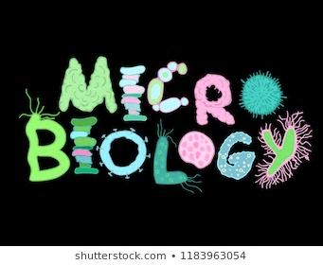
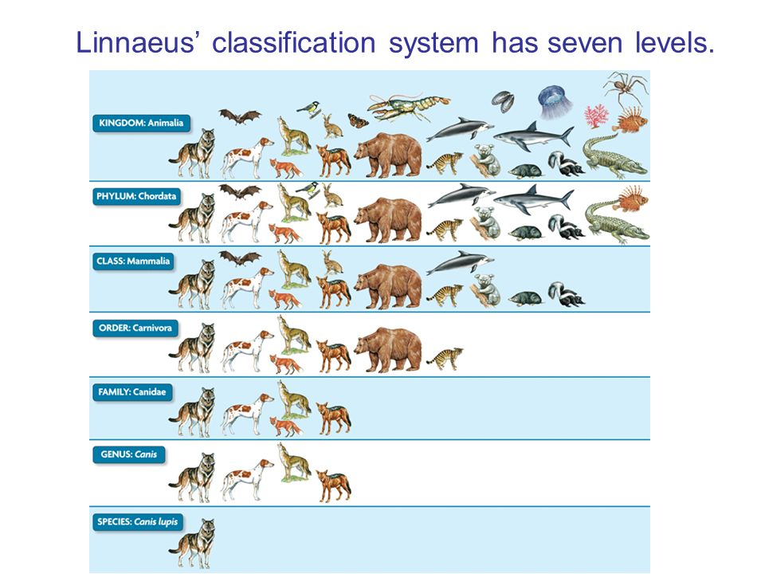
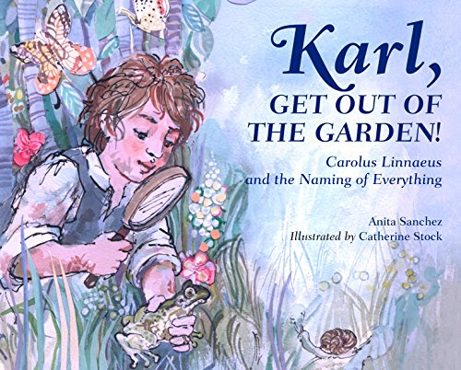
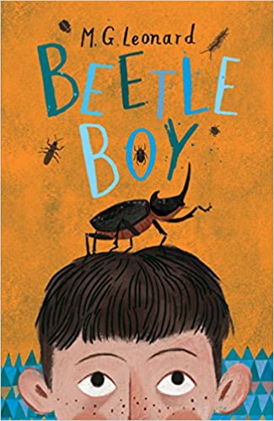
Year 6: Animal Classification Knowledge Mat – What type of organism am I?
Subject Specific Vocabulary |  | Prior Knowledge | Sticky Knowledge about Classification of animals
organism | Another name for a living thing. | •Animals can be grouped into carnivores, herbivores and omnivores. They can also be grouped into vertebrates and invertebrates. •Organisms can be classified and we can use a classification key to identify them. •Examples of habitats (including microhabitats) and the organisms that can be found there. •Living things depend on each other to survive. •How environments are changing. •The relationships between predators and prey. •Food chains demonstrate the direction in which energy travels. •How organisms have adapted and evolved over time.
 |  |  | What are vertebrates and invertebrates? •Vertebrates have backbones and tend to be much more intelligent than invertebrates. •There are five types of vertebrate; reptiles, mammals, birds, fish and amphibians so they can be warm-blooded or cold-blooded. •Invertebrates do not have a backbone and are cold blooded. •Invertebrates can be classified into those with soft squishy bodies (Jellyfish and molluscs) and those with hard bodies or exoskeletons (arthropods and annelids)
micro-organism | Micro-organisms are tiny living things. They are so small they can only be seen with a microscope.
vertebrates | A vertebrate animal is one that has a backbone. There are five main types of vertebrate.
invertebrates | An invertebrate animal does not have a backbone and 97% of creatures belong to this group.
characteristics | The qualities or features that belong to them and make them recognisable.
species | A group of plants, animals or other organisms that share the same characteristics and can reproduce with each other. |  | What is classification? •Grouping living things based on different criteria (where they live, what type of organism they are, what features they have). •A classification key is a tool that is used to group living things to help us identify them using recognisable characteristics.
classification | Grouping things into categories (sometimes called classes) based on their characteristics.
Linnaean system | A system created by scientist Carl Linnaeus that groups living things into different categories according to their characteristics.
habitats | The natural environment in which an micro-organism, animal or plant normally lives or grows
microhabitats | Small-scale environments within habitats where micro-organisms, animals or plants can survive. | Investigate | What is the Linnaean System? •The Linnaean system, named after Carl Linnaeus, has different levels where the number of living things in each group gets smaller and smaller, until there will just be one type of animal in the species group.
viruses | The smallest of all organisms and only alive when inside a living thing. They can be harmful and cause illnesses. | •Sort vertebrate and invertebrate animals into groups and use a classification key to identify which group of vertebrates animals belong to and then create your own. •Explore the different ways in which invertebrates can be classified. •Describe some organisms that may be difficult to classify and explain why. •Investigate where microorganisms might be helpful (e.g. yeast in baking) or harmful; (e.g. infectious diseases). •Research unfamiliar organisms from a broad range of other habitats and decide where they belong in the classification system.
bacteria | Bacteria are tiny little organisms that live everywhere around us. Some are useful but others cause illnesses.
protozoa | Single cell organisms that eat smaller organisms such as bacteria. Some can cause diseases such as malaria.
algae | A single or multi-cellular organism that has no roots, stems or leaves; can make its own food and is often found in water or damp places.
fungi | Simple organisms that aren’t plants, animals or bacteria. They grow in dark, damp organisms and feed off other living things or rotting things. |  | What are micro-organisms? •Microorganisms are very tiny organisms (dust mites, bacteria, fungi) where a microscope has to be used to see them. •Some microorganisms can be helpful in certain situations. Others can be harmful, and their spread needs to be controlled or contained.
mould | Simple, tiny fungi that look furry or fuzzy and grow in masses called colonies on rotting food or damp places
toadstool | or mushroom; general names for fungi that grow a fleshy cap on a stalk and make or spread tiny spores.
•The different levels of classification are: kingdom, phylum, class, order, family, genus and species

Slide 3
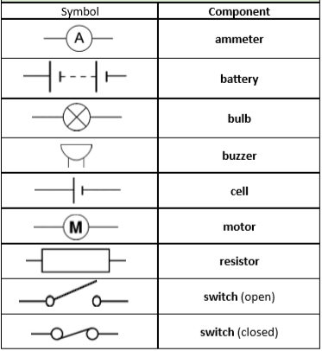
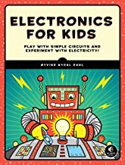
Year 6: Electricity Knowledge Mat – How bright is your bulb?
Subject Specific Vocabulary |  | Prior Knowledge | Sticky Knowledge about Electricity
electricity | The flow of tiny particles called electrons and a form of energy that can be carried by wires and in used for heating and lighting, and to provide power for devices | •Electricity is a form of energy that can be carried by wires and is used for heating and lighting, and to provide power for devices. •Sources of light and sound may need electricity to work. •Where electricity cones from. •Which appliances need electricity. •What a circuit is, the components of a circuit and how it works. •What electrical conductors and insulators are. •What happens when a switch is added to a circuit. •What forces and resistance are.
 |  |  | What are the symbols for the components?
electrons | Tiny particles that can travel around an electrical circuit and have a negative electric charge.
cell | A device that is used to generate electricity, or one that is used to make chemical reactions possible by applying electricity. A cell is a single unit.
battery | A collection of cells that is a power source. It is a store of chemical potential energy that can power a circuit.
terminals | These are the two ends of a power source and the current flows between them. The positive terminal attracts electrons towards it and the negative terminal pushes the electrons away from it.
current | The flow of electrons around a circuit, pushed around by the power source and measured in amps.
 |  |  | How does a series circuit work? •This type of circuit has only one route for the current to take. •If more bulbs or buzzers are added, the power has to be shared and so they will be dimmer or quieter. •If just one part of this series circuit breaks, the circuit is broken and the flow of current stops so when a bulb is unscrewed, all the bulbs will go out.
amps | How electric current is measured. An ammeter can measure the current in a circuit. | Investigate
voltage | The force that makes the electric current move through the wires. The greater the voltage, the more current will flow. | •Predict, then investigate what happens when more batteries are added to a circuit. Explain why this happens. •Predict, then investigate what happens when more bulbs and/or motors are added to a circuit. Explain why this happens. •Systematically identify the effect of changing one component at a time in a circuit. •Investigate what happens when the voltage of the battery changes. •Investigate what happens when the length of the wires changes. •Investigate what happens when you add a resistor to a circuit. •Design and make a set of traffic lights, a burglar alarm or some other useful circuit.
resistance | The difficulty that the electric current has when flowing around a circuit due to this force.
circuit | A complete pathway or route that an electric current can flow around.
series circuit | A series circuit is one that has more than one resistor, but only one path through which the electricity (electrons) flows. |  | How do the different components function? •More batteries or a higher voltage create more power to flow through the circuit. •Shortening the wires means the electrons have less resistance to flow through. •Fewer batteries or a lower voltage give less power to the circuit. •More buzzers or bulbs mean the power is shared by more components. •Lengthening the wires means the electrons have to travel through more resistance
components | Parts of an electrical circuit such as bulbs, motors, buzzers and switches that do something when electricity flows through them.
switches | A part of a circuit that can be easily opened or closed to control the flow of electric current.
fuses | A safety devices which is a strip of wire that melts and breaks an electric circuit if it goes over a safe level.
 |  |  | What about voltage? •The voltage is equally distributed among all of the bulbs in a series circuit. •Increasing the voltage increases the brightness of the bulb.
conductor | Some materials let electricity pass through them easily. These materials are known as electrical conductors.
insulator | Some materials do not let electricity to pass through them easily. These materials are known as electrical insulators.

Slide 4
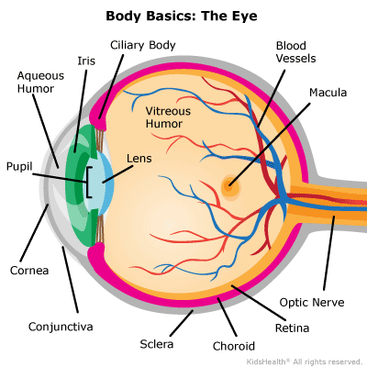
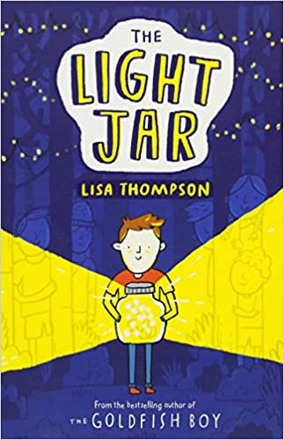
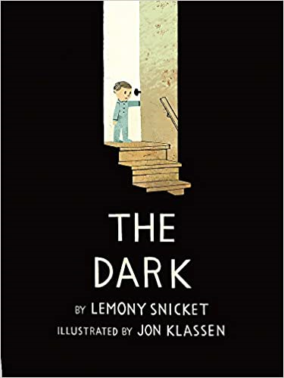
Year 6: Light Knowledge Mat – How do we see things?
Subject Specific Vocabulary |  | Prior Knowledge | Sticky Knowledge about Light
light wave | A property of light is that it behaves like a wave and can be defined by its wavelength and frequency (how fast the waves vibrate up and down). | •Certain things produce light, usually by burning (e.g. the Sun) or electricity (e.g. street lights) •Shiny materials do not make light but do reflect it. •Shadows are caused when certain materials block light. •Light travels in straight lines. When light is blocked by an opaque object, a dark shadow is formed. •The further away the light source is, the smaller the shadow is. The closer the source of the light, the bigger the shadow.
 |  |  | How does light travel? •Light travels as waves from a light source. •Light will travel in a completely straight line until it hits an object that will reflect it. •Reflection is when light bounces off a surface - this changes the direction in which the light travels. •Light doesn’t travel as fast when it has to pass through mediums that are different, such as air, water or glass. •Light does not need a medium to travel through which means it can travel through a vacuum (a completely airless space).
light source | Something that gives off light when it is heated or burned, or chemicals inside it react with each other. There are different sources of light such as the sun, candles, bulbs etc
reflect | When light bounces off a surface at the same angle it hits it and changes the direction the light waves are travelling in.
transparent | Transparent materials let light pass through them, so you can clearly see through it to what is on the other side.
translucent | Translucent materials let some light pass through them but the light is scattered in different directions so you can’t see clearly through them as they blur the detail.
 |  |  | How do we see? •Light travels from a light source in a straight line and hits an object. •The ray of light is reflected off the object and travels in a straight line to the eye, enters the cornea of the eye and passes the pupil. •Light is refracted as it passes through the convex lens. This causes the image that hits the retina to be reduced in size •The lens then focuses the light on to the retina which gathers information (light, dark, colour, movement) and sends this information to the optic nerve.
opaque | Opaque materials block light so it can’t pass through which means you can’t see through them. | Investigate
shadow | A dark shape where light doesn’t shine because it has been blocked. The size and shape depend on the position of the light source and how far the object is from it. | What happens when light is reflected from different surfaces? What happens when light is reflected from a mirror? What happens when the angle of the mirror (or light source changes?) Design an experiment to measure shadow length by changing a variable. Show the relationship between distance of light source and shadow length. Create shadow puppets to show how light travels and to demonstrate that a shadow has the same shape as the object that casts them. Make a periscope and explain how it works. Use the idea that light appears to travel in straight lines to explain how it works. Research how mirrors are used in different contexts (e.g. rear view mirrors, on a dangerous bend) and explain why and how they work. Explain why objects look bent in water Explore different contexts in which light travels including rainbows, colours on soap bubbles and coloured filters.
visible light | Light that you can see, also described as white light but is in fact made up of seven different colours called a spectrum.
refract | When light bends or changes direction as it passes from one medium to another e.g. from air to water
disperse | When you shine white light through a prism and it splits into separate colours.
rainbow | Rainbows happen when beams of sunlight hit water droplets in the air. As the sunlight passes through the droplets, it splits into different colours.
filter | A transparent material that absorbs some colours and allows others to pass through.
lens | This can be concave (curves inwards) or convex (curves outwards) and is designed to refract light in a specific way.
retina | Found at the back of your eye and it has light-sensitive cells called rods and cones. |  | What is the relationship between light sources and shadows? •Because light travels in straight lines, when there is an opaque object blocking the light, a shadow is formed. •These shadows always have the same shape as the objects that cast them. •The size of a shadow changes as the light source moves. It is bigger when the object is closer to the light source.
cornea | It is thin, clear and covers your eye. It's important because it helps you see by focusing light as it enters the eye.
iris | The coloured part of the eye that controls the amount of light that enters the eye by opening or closing the pupil.
pupil | A hole in the middle of the eye, surrounded by the iris, that widens and narrows to let in different amounts of light.

Slide 5
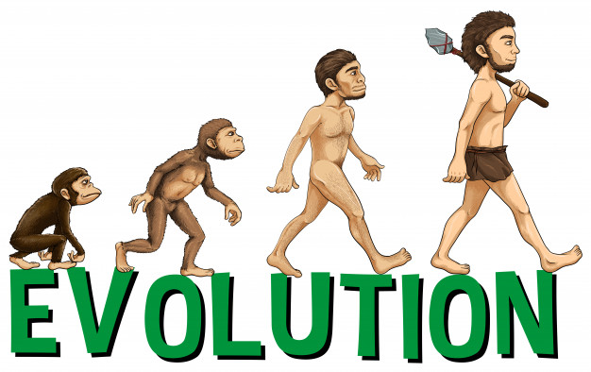
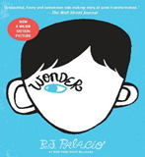
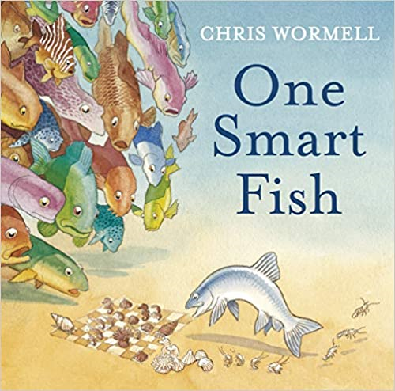
Year 6: Evolution & Inheritance Knowledge Mat – Who am I?
Subject Specific Vocabulary |  | Prior Knowledge | Sticky Knowledge about Evolution & Inheritance
reproduction | The way different plants and animals make new plants and animals that are similar to the parent. The reproduction system differs in plants and animals. | •Which things are living and which are not. •Identifying animals and plants using classification keys •Animals that are carnivores, herbivores and omnivores. •Animals have offspring which grow into adults. •The basic needs of animals for survival (water, food, air) •Some animals have skeletons for support, protection and movement. •Food chains, food webs and the role of predators and prey. •Features of habitats and the animals and plants that exist there. •The life cycle of some animals and plants •Sometimes environments can change and this has an effect on the plants and animals that exist there •Living things breed to produce offspring which grow into adults. This is called reproduction. •The features of some rocks and the role they play in the formation of fossils.
 |  |  | What is evolution? •Evolution is a process of change that takes place over many generations, during which species of animals, plants, or insects slowly change some of their physical characteristics. This is because offspring are not identical to their parents. •It occurs when there is competition to survive. This is called natural selection. •Difference within a species (for example between parents and offspring) can be caused by inheritance and mutations. •Inheritance is when characteristics are passed on from generation to the next. •Mutations in characteristics are not inherited from the parents and appear as new characteristics.
offspring | The young plant or animal that is produced by the reproduction of that species. When living things reproduce they pass on characteristics to their young, but normally offspring are not identical to their parents.
inheritance | When living things reproduce they pass on characteristics to their offspring. This is known as inheritance.
characteristics | The qualities or distinguishing features that are specific to a particular species and make them recognisable.
species | A group of plants, animals or other organisms that share the same characteristics and can reproduce with each other.
variation | The differences between individuals within a species.
mutation | Characteristics that are not inherited from the parents or ancestors and appear as new characteristics.
 |  |  | How do we know about evolution? •Evolution is a scientific theory used by biologists. It explains how living things changed over a long time, and how they have come to be the way they are. •Evidence of evolution comes from fossils - when these are compared to living creatures from today, palaeontologists can compare similarities and differences. •Other evidence comes from living things - comparisons of some species may reveal common ancestors. •Charles Darwin was an English scientist who studied nature. He is known for his theory of evolution.
ancestor | An early type of animal or plant from which a later, usually dissimilar, type has evolved
adaptation | A change in structure or function that improves the chance of survival for an animal or plant within a given environment
evolution | A process of change that takes place over many years and generations, during which species of animals, plants, or insects slowly change some of their physical characteristics.
environment | Contains many habitats and includes everything living and non-living. Living things rely on non-living parts of the environment to survive.
 |  | Investigate
biodiversity | A wide variety of animal and plant species living within their natural environment. | •Research the work of Charles Darwin, Mary Anning, Alfred Wallace. •Observe local animals and how they are adapted to their environment. •Compare how some living things are adapted to survive in extreme conditions, •Investigate and analyse the advantages and disadvantages of specific adaptations.
 |  |  | What is adaptation? •Adaptation is when animals and plants have evolved so that they have adapted to survive in their environments. For example, polar bears have a thick layer of blubber under their fur to survive the harsh cold. •Some environments provide challenges yet some animals and plants have adapted to survive there. •Sometimes adaptations can be disadvantageous. One example of this can be the dodo which became extinct. • When adaptations are more harmful than helpful, these are called maladaptations.
natural selection | A process by which species of animals and plants that are best adapted to their environment survive and reproduce, while those that are less well adapted die out.
fossils | The hard remains or imprint of a prehistoric animal or plant that are found embedded inside a rock and preserved.
extinct | Species of living things are considered extinct when there are no more of them alive. Species classified as endangered are at risk of becoming extinct.
palaeontologist | Someone studying the life of past geological periods, as known from fossil remains. They study fossils in order to classify organisms and study their interactions in their environments.

