Slide 1

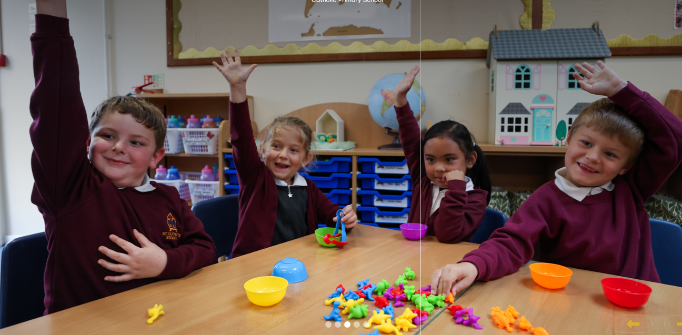
CURRICULUM: HISTORY
St Cuthbert’s Catholic
Primary School

Slide 2














CURRICULUM NARRATIVE
Past and Present: Pupils talk about and describe familiar people, including, members of their family and community. They comment on familiar past events. They compare characters from the past, using story books.
Christ at the Centre, Children at the Heart

Slide 3





CURRICULUM NARRATIVE
Why do historians read?
To find evidence and gather Information To learn about past events To analyse and make Predictions
Write like a historian
Cause - This relates to the art of causal reasoning: how or why events or states of affairs occurred or emerged. Consequence - This relates to the consequences of an event or development. Change and continuity - This relates to historical analysis of the pace, nature and extent of change. Similarity and difference - This relates to historical analysis of the extent and type of difference between people, groups, experiences or places usually in the same historical period. Significance - This focuses on how and why historical events, trends and individuals are ascribed historical significance.
Threshold Concepts
 | CHRONOLOGY Place historical periods in time and discussing their chronology on a timeline in relation to other time periods. INVESTIGATING THE PAST Understand and evaluate how the past is constructed using contemporary source material. COMMUNICATING HISTORY Use historical terms and vocabulary, ask and answer questions, construct argument and reach a conclusion. THINKING LIKE A HISTORIAN Explain change and continuity, cause and consequence, similarity and difference and the significance of events and people.
The study of history can bring pupils into a rich dialogue with the past and with the traditions of historical enquiry. Through history, pupils come to understand their place in the world, and in the long story of human development. The study of history challenges pupils to make sense of the striking similarities and vast differences in human experiences across time and place. Pupils learn how historians and others construct accounts about the past.
The Journey Begins…
In EYFS, history is included within “Understanding of the World”, where pupils learn about history through the Early Learning Goal ‘Past and Present’. Pupils are encouraged to talk about members of their immediate family and community, name and describe people who are familiar to them, comment on images of familiar situations in the past and compare and contrast characters from stories including figures from the past. This helps pupils to develop awareness of the past, which is then built upon in Year 1 when pupils’ understanding of the past starts to develop into an awareness of a chronological framework in which people and events can be placed. They do this through looking at changes within and beyond living memory in Toys Past and Present and continue enhancing their understanding of transport and changes beyond living memory through investigating the life of George Stephenson . Pupils’ chronological framework is further enhanced in Year 2 when they study key events such as the Great Fire of London, building upon their understanding of how we find out about the past by asking and answering questions. Pupils also build upon their studies of famous people in history by Comparing Monarchs which allows them to develop the skill of identifying similarities and differences between periods to an even greater degree than in Year 1.
Key Stage 2 is sequenced chronologically, to help pupils build a rich understanding of change and continuity in British, local and world
history. Pupils study local and British history, and a history of the wider world in parallel. Starting with a study of the Stone and Iron Age in Year 3, leading on to the impact that the Roman Empire had on the island in Year 4, and changes under the Anglo-Saxon and Vikings in Year 5. This allows pupils to understand the history of these islands as a coherent, chronological narrative. Throughout Key Stage 2, pupils also study ancient civilisations and aspects of the wider world starting in Year 3 with Comparing Ancient Civilisations, including Greece and Egypt, and this links with the Roman Empire which is explored in Year 4. In Year 4 pupils move back in time on to Early Islamic Civilisation. Following the Romans, pupils go on to study a non-European society that contrasts with British History. In Year 5, pupils will extend their chronological knowledge beyond 1066 by studying a significant turning point in British History, the Home Front during World War II. In Year 6, pupils complete thematic studies of Changing Power of the Monarchy and Victorian Britain and the Industrial Revolution which allows them to establish clear narratives across the periods studies, and note connections, contrasts and trends over time.
Christ at the Centre, Children at the Heart

Slide 4
CURRICULUM NARRATIVE
Progression through the Threshold Concepts
Within history, there are 4 key elements, which combined, ensure that our pupils can access a deep understanding of the subject. Pupils make progress in history by developing their knowledge about the past (this knowledge is often described as ‘substantive knowledge’) and their knowledge about how historians investigate the past, and how they construct historical claims, arguments and accounts (often described as ‘disciplinary knowledge’). The threshold concepts relate to different aspects of disciplinary knowledge, and substantive knowledge is vital to all of them.
Chronology
Developing pupils’ chronological understanding underpins the sequencing of the history curriculum, as indicated above. Pupils develop their understanding of the past as a concept in EYFS, by placing people and events in a historical framework in Key Stage 1. This historical framework becomes more comprehensive at Key Stage 2 where pupils develop a chronologically secure knowledge and understanding of the broad characteristics and features of British, local and world history from the Stone Age to beyond 1066.
Thinking like a Historian
Progressing from understanding themselves and their families at EYFS, at Key Stage 1 pupils start to ask questions about historical events and people. Through this pupils learn about and understand key features of events in the past. Consequently, they are also then able to compare aspects of life in different historical periods through significant individuals in the past. This evolves at Key Stage 2 into pupils developing their understanding of the disciplinary concepts of cause, consequence, change and continuity, similarity and difference, and historical significance. Pupils learn how to explain how or why events happen, their consequences, the extent, nature and pace of historical change, similarities and differences between people, groups, experiences or places, and why historical events and individuals are significant.
Investigating the Past
This Threshold Concept is concerned with how historians investigate the past. Through EYFS and Key Stage 1 pupils will understand some of the ways in which we find out about the past and identify different ways it is represented. As pupils progress to Key Stage 2 they will develop an understanding of how interpretations of the past are constructed, making inferences about the past through analysis of contemporary historical sources and conducting historical enquiry about the reliability of sources. Pupils will identify the difference between a source and an interpretation, and recognise how historians use sources as evidence to construct, challenge or test claims about the past. While making inferences about the past from sources, pupils will use their contextual knowledge to support inferences and analyse and evaluate the reliability/usefulness of sources based on their provenance and the pupils’ knowledge of the context. Pupils will also learn the idea of misconceptions about sources and evidence.
Communicating History
This Threshold Concept is concerned with how to write about the past. This includes using historical terms and vocabulary; in EYFS pupils will use common words and phrases to describe the past and the passing of time. In Key Stage 1 pupils will begin to use a wide range of vocabulary of everyday historical terms and be able to select sources to recall events of the past. Through Key Stage 2 pupils will select historical terms appropriately, including tier 2 and tier 3 vocabulary, as well as use abstract terms. Pupils will ask and answer questions and construct arguments and reach conclusions.
Christ at the Centre, Children at the Heart

Slide 5







CURRICULUM NARRATIVE
Common Threads
The curriculum has been developed with key threads underpinning the different units. These threads run through the different units to ensure children build an in-depth knowledge and can compare different periods of time, events and significant people.
Locality
Transport
Significant People
Religion and Beliefs
Housing and Settlements
Empire and Rulers
Roles of Women, Men and Children
The threads that are commonly woven through the Key Stage One units are locality, transport and significant people. Religion and beliefs, housing, empire and rules and the roles of women, men and children are commonly woven throughout the Key Stage Two units.
Christ at the Centre, Children at the Heart

Slide 6
CURRICULUM NARRATIVE
Curriculum Coverage
Upper KS2 | Y6 |  | Changing Power of the Monarchy |  | Victorian Britain and the Industrial Revolution
 | Y5 |  | Anglo Saxon and Viking Britain |  | Home Front
Lower KS2 | Y4 |  | Roman Empire and its impact on Britain* |  | Early Islamic Civilisation
 | Y3 |  | Stone Age to Iron Age |  | Comparing Ancient Civilisations
KS1 | Y2 |  | Comparing Monarchs |  | Great Fire of London and the Great Fire of Gateshead
 | Y1 |  | Toys Past and Present |  | George Stephenson
To address the local context of St Cuthbert’s Catholic Primary School, Stockton-on-Tees, our curriculum includes opportunities to make links to local history where we can.
Early Years
History in the Foundation Stage is taught under the umbrella of ‘Understanding of the World’ from the EYFS. The children are supported in developing the knowledge, skills and understanding that helps them to make sense of the world. The pupils are encouraged to talk about their families and past and present events in their lives. They are beginning to gain knowledge and understanding of the world through:
Photographs
Listening to stories and memories of older people
Role play activities
Discussing events in the past and their own personal lives
Sequencing events to gain a sense of time
“Studying history helps children to understand their place in the world, and in the long story of human development. And it challenges them to make sense of the similarities and differences in human experiences across time and place.”
- Amanda Spielman
Christ at the Centre, Children at the Heart

Slide 7
CURRICULUM NARRATIVE
Intent
At St Cuthbert’s Catholic Primary School, our History curriculum aims to offer a high-quality history education that will help all pupils, including those with SEND needs, develop confidence, a passion for learning and gain a coherent knowledge and understanding of Britain’s past and that of the wider world.
History is all around us; in our families with their unique backgrounds, cultures and traditions and in our local and wider communities. Our intent, when teaching history, is to stimulate pupil’s curiosity about the past, encourage respect for the past, and to develop children’s knowledge, skills and understanding of why people interpret the past in different ways. We want interested and inquisitive learners of History. We follow the National Curriculum programmes of study for each year group, aiming to create the very best historians, well equipped to continue their studies in history as they move throughout their education. We challenge pupils to think, act and speak like those working in the field would, by developing a consistent approach across all year groups. Substantive knowledge and disciplinary knowledge are explicitly taught. By substantive knowledge we mean the people, events and developments from the past that children will learn about. By disciplinary knowledge, we mean all the various processes that children need to develop if they are to get better at a subject. This can both refer to a process of doing something (e.g. interpreting a source) but also a thought process in order to understand big concepts such as change, continuity and consequence.
High quality history teaching in primary school is our ultimate goal. This forms part of a larger progressive curriculum from EYFS to Year 6 and into KS3 and KS4. Our units are cohesive and sequential, accounting for prior knowledge and key skills for meaningful progression. We recognise it is fundamental that pupils develop chronological knowledge, both in terms of sequencing periods of history and of having a clear sense of the characteristics of a particular period. Linking learning within and across key stages is essential to developing the bigger picture of history. In order to communicate their understanding, key historical terms are taught well and in context. The explicit teaching of the precise and subtly changing meanings of vocabulary linked to each topic has been developed over time with careful planning and revisiting allowing for long-term retention.
Historical concepts need to be rooted in the study of actual historical people, events, and development, which allows for the flow of the immediate narrative of learning and brings it to life and serves to build up an unseen and almost instinctive layer that forms our longer-term knowledge. It is this that underpins all future learning, giving us a chronological framework, historical terms and key concepts that enhance our learning across the curriculum.
Implementation
The planning of each unit has been rooted in the four key concepts of: Chronology, Communicating History, Investigating the past and Thinking like a Historian. High quality input from experts and educational resources, including detailed CPD, complement the delivery of specialist learning, just as high-quality teaching responds to the needs of children. Collaborative planning created by both Primary and Secondary colleagues, provides units of work, rooted in historical content, which focus on embedding challenge, metacognition, retrieval and practice. Our curriculum has been designed to ensure clear progression, in the acquisition of knowledge and for key skills, building on pupil’s prior learning. The curriculum units of work have clearly identified minimum knowledge ‘end points,’ and have been sequenced to ensure that pupils know more and remember more as they move through primary school and transfer into KS3.
Research around cognitive science is used to help children learn and remember more. Understanding is checked through spaced retrieval exercises. Throughout units of work teachers will make links and encourage children to connect past learning and historical knowledge and skills. Lessons are clearly linked to the threshold concepts of the National Curriculum and are planned in sequences that provide children with the opportunities to review, remember, deepen and apply their understanding. Formative assessments are used within lessons to gain understanding and shape teaching and learning. Wider opportunities are provided to enhance children’s experiences both inside and outside the classroom.
Christ at the Centre, Children at the Heart

Slide 8
CURRICULUM CONTINUITY – EYFS TO KS1
Impact
When pupils leave our school, pupil will know more, remember more and understand more about History. Pupils develop knowledge of History over time and explore their own locality through local history topics. They investigate and interpret the past, recognising that our understanding of the past comes from an interpretation of the available evidence. They build an overview of world history with an appreciation of the characteristic features of the past and that these features are similar and different across time periods and for different sections of society. Pupils understand chronology, how to chart the passing of time and how some aspects of history happened at similar times in different places. They can communicate historically using historical vocabulary and techniques to convey information about the past.
Pupil dialogue and work in books shows a high standard of history being taught. Pupils are able to talk and are able to demonstrate their learning with historical language and vocabulary about a particular period. They can make links and connections to what they have been taught previously. Historical learning and enjoyment is visible. Pupils will have experienced a wide breadth of study and cultural capital, be able to think, reflect upon, write and debate about the past. They will have an in-depth, long-lasting knowledge of historical people and periods and be able to think like historians, ready for KS3 and the wider world.
Threshold Concepts
A team of Primary teachers and Secondary Heads of Department within BHCET have worked together to produce high quality units, following the threshold concepts. An effective history curriculum must cover all four of these concepts and within one lesson, at least three of these concepts should be covered. Writers of these units have worked to identify sufficient breadth of content and ensure that pupils learn in sufficient depth. The units are written for Year 1 pupils up to Year 6. This document captures the progression from EYFS into Key Stage One and gives suggested texts that could be explored with Early Years pupils to support the history threshold concepts.
How does the Early Years Framework fit within the four threshold concepts?
Chronology | Investigating the Past | Communicating History | Thinking Like a Historian
Understanding the World, Past and Present
Know some similarities and differences between things in the past and now, drawing in on their experiences and what has been read in class. Appreciate the difference between old and dirty or worn. Know the difference between old and new. Know the difference between long ago and now Compare old and new objects/ artefacts be able to put up to two artefacts or events in order. Begin to appreciate that their life is different to the lives of people in the past. Use words like yesterday, last week, old and new. | Begin making sense of their own life-story and family’s history. Talk about the lives of the people around them and their roles in society. Ask questions or make remarks about illustrations in a book they are reading which may be set in the past. Begin to recognise that characters in a book they know acted as they did because it was a long time ago. | Understand the past through settings, characters and events encountered in books read in class and storytelling. Talk about the lives of people around them and their roles in society. Talk, draw and write to show ideas/communicate understanding. Begin to sequence pictures to show time order. | Comment on images of familiar situations in the past. Compare and contrast characters from stories, including figures from the past. Give a reason for why something has changed between now and the past. Look at or touch objects from the past and comment on appearance. Recognise that the past is different from today.
Christ at the Centre, Children at the Heart

Slide 9
CURRICULUM CONTINUITY – EYFS TO KS1
What are the Key Stage One Historical Skills?
Chronology | Investigating the Past | Communicating History | Thinking Like a Historian
Sequence artefacts and events that are close together in time. Order dates from the earliest to latest on simple timelines. Sequence pictures from difference periods. Describe memories and changes that have happened in their own lives. Use words and phrases (such as old, new, earliest, latest, past, present, future, century, new, newest, old, oldest, modern, before and after) to show the passing of time. | Start to compare two versions of past events. Start to understand that there can be different versions of the same event from the past. Observe and use pictures, photographs and artefacts to find out about the past. Start to use stories or accounts to distinguish between fact and fiction. Observe or handle evidence to ask simple questions about the past. Observe or handle evidence to find answers to simple questions about the past on the basis of simple observations. Sort some objects/artefacts into new and old and then and now. Identify old and new things across periods of time through pictures, photographs and objects. | Talk, write and draw about things from the past. Use historical vocabulary to retell simple stories about the past. Know and recount episodes from stories and significant events in history. Describe significant individuals from the past. Talk and write about things from the past using some historical vocabulary. | Continuity and Change: Begin to identify old and new things across periods of time through pictures, photographs and objects. Being to understand that some things change and some things stay nearly the same. Cause and Consequence: Understand that a cause makes something happen and that historical events have causes. Explain that historical events are causes by things that occurred before them. Understand that a consequence is something that happens as a result of something else. Historical Significance: Explain reasons why someone might be significant. Talk about why a person was importance. Talk about why the events was important and what happened.
Christ at the Centre, Children at the Heart

Slide 10
CURRICULUM COVERAGE
 | National Curriculum Statement | BHCET History Unit
Key Stage One | Changes within living memory. Where appropriate, these should be used to reveal aspect of change in national life. | Toys Past and Present
 | Events beyond living memory that are significant nationally or globally. | The Great Fire of London and the Great Fire of Gateshead and Newcastle
 | The lives of significant individuals in the past who have contributed to national and international achievements. Some should be used to compare aspects of life in different periods. | Comparing Monarchs
 | Significant historical events, people and places in their own locality. | George Stephenson and the Railway
Key Stage Two | Changes in Britain from the Stone Age to Iron Age | Stone Age to Iron Age
 | The Roman Empires and its impact on Britain | Roman Empire and its Impact on Britain
 | Britain's settlement by Ango-Saxons and Scots | Ango-Saxon and Viking Britain
 | The Viking and Anglo-Saxon struggle for the Kingdom of England to the time of Edward the Confessor | Ango-Saxon and Viking Britain
 | A local history study | Roman Empire and its Impact on Britain Anglo-Saxon and Viking Britain Victorian Britain & the Industrial Revolution
 | A study of an aspect or theme in British history that extends pupils' chronological knowledge beyond 1066. | Changing Power of the Monarchy Home Front Victorian Britain & the Industrial Revolution
 | The achievements of the earliest civilisations – an overview of where and when the first civilisations appeared and a depth study of one of the following: Ancient Sumer,; the Indus Valley; Ancient Egypt; The Shang Dynasty of Ancient China | Comparing Ancient Civilisations
 | Ancient Greece – a study of Greek life and achievements and their influence on the western world. | Comparing Ancient Civilisations
 | A non-European society that provides contrasts with British history. | Early Islamic Civilisation
Christ at the Centre, Children at the Heart

Slide 11
CURRICULUM CONTINUITY – SEND
The BHCET History curriculum has been designed to be delivered to the whole class. However, the tasks are adapted by class teachers to meet the needs of individual children. To ensure pupls with SEND achieve well, they should be exposed to the same learning as their peers; however, the way they evidence their learning through the tasks can be adapted.
Through scaffolding, tasks can be adapted to ensure all learners can access and evidence the same threshold concepts and learning objectives as their non-SEND counterparts. Scaffolding strategies can include providing sentence starters, a writing frame, vocabulary banks, sorting and matching cards or visual prompts. Reactive or proactive adaptations can make the BHCET curriculum accessible and achievable for all.
Other strategies of adaptation are outlined through the EEF’s Five-a-Day principles, which include explicit instruction, metacognitive strategies, flexible grouping and the use of technology:
Scaffolding
‘Scaffolding’ is a metaphor for temporary support that is removed when it is no longer required. Initially, a teacher would provide enough support so that pupils can successfully complete tasks that they could not do independently. This requires effective assessment to gain a precise understanding of the pupil’s current capabilities.
Examples: Support could be visual, verbal, or written. Writing frames, partially completed examples, knowledge organisers, sentence starters can all be useful. Reminders of what equipment is needed for each lesson and classroom routines can be useful. Scaffolding discussion of texts: promoting prediction, questioning, clarification and summarising
Explicit instruction
Explicit instruction refers to a range of teacher-led approaches, focused on teacher demonstration followed by guided practice and independent practice. Explicit instruction is not just “teaching by telling” or “transmission teaching”
One popular approach to explicit instruction is Rosenshine’s ‘Principles of Instruction’.
Examples: Worked examples with the teacher modelling self-regulation and thought processes is helpful. A teacher might teach a pupil a strategy for summarising a paragraph by initially ‘thinking aloud’ while identifying the topic of the paragraph to model this process to the pupil. They would then give the pupil the opportunity to practise this skill. Using visual aids and concrete examples promotes discussion and links in learning.
Cognitive and metacognitive strategies
Cognitive strategies are skills like memorisation techniques or subject specific strategies like methods to solve problems in maths. Metacognitive strategies help pupils plan, monitor and evaluate their learning
Examples: Chunking the task will support pupils with SEND – this may be through provision of checklists, instructions on a whiteboard or providing one question at a time. This helps reduce distractions to avoid overloading working memory.
Prompt sheets that help pupils to evaluate their progress, with ideas for further support.
Flexible grouping
Flexible grouping describes when pupils are allocated to smaller groups based on the individual needs that they currently share with other pupils. Such groups can be formed for an explicit purpose and disbanded when that purpose is met
Examples: Allocating temporary groups can allow teachers to set up opportunities for collaborative learning, for example to read and analyse source texts, complete graphic organisers, independently carry out a skill, remember a fact, or understand a concept. Pre-teaching key vocabulary, is a useful technique.
Use technology
Technology can assist teacher modelling. Technology, as a method to provide feedback to pupils and/ or parents can be effective, especially when the pupil can act on this feedback. Examples:Use a visualizer to model worked examples. Technology applications, such as online quizzes can prove effective. Speech generating apps to enable note-taking and extended writing can be helpful.
Christ at the Centre, Children at the Heart

Slide 12
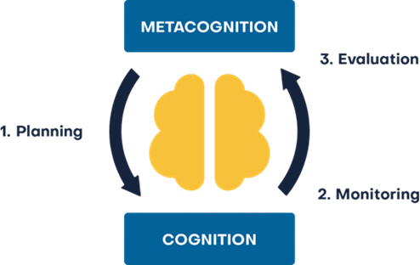
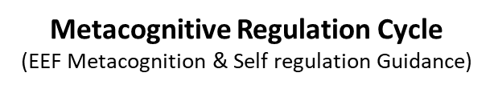
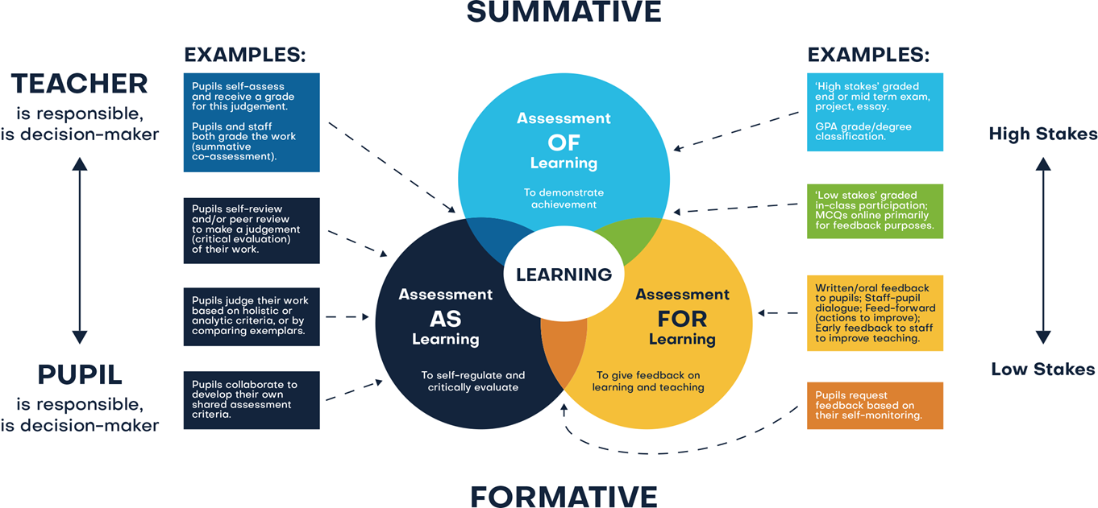
ASSESSMENT
Assessment comprises two linked processes:
Formative Assessment: provides Assessment for Learning. Is a continuous process and an integral part of teaching and learning; informal observations, dialogue/effective use of questioning, consolidation activities, low stakes quizzing, routine marking; and pupil/peer assessment all contribute to the developing profile of progress. When pupils make changes and consider actions to their work, based on the activity, they are ‘self-regulating’ their work. Self-regulating activities can be termed Assessment as Learning. Self-regulated learners are aware of their strengths and weaknesses, and can motivate themselves to engage in, and improve, their learning. Pupils start by planning how to undertake a task, working on it while monitoring the strategy to check progress, then evaluating the overall success.
Summative Assessment: provides Assessment of Learning and is a judgement of attainment at key points throughout the year- using past knowledge to measure attainment and progress. Examples of this are standardised tests, tasks and end of term/annual assessments which include a sample of pupil’s prior learning.
Assessment is a continuous process which is integral to teaching and learning and:
Enables an informed judgement to be made about a pupil’s understanding, skills, attitude to learning and successful acquisition of knowledge as they move through the curriculum.
Incorporates a wide range of assessment techniques to be used in different contexts/purposes.
Is accompanied by clear assessment criteria that enables effective marking and feedback, a reliable progress evaluation to be given and demonstrates clearly what a pupil must do to improve.
Provides feedback recognising achievement, increasing pupil confidence/motivation.
Supports learning by making clear to pupils: what they are trying to achieve; what they have achieved; what the learning gaps and misconceptions are and what the next steps in learning are.
Allows regular subject specific extended writing and access to high quality text/ reading.
Should be moderated and standardised to ensure purposeful, meaningful, and timely feedback.
Includes feedback to pupils to help them understand what they need to improve, challenging them to achieve their target rather than a grade.
Allows leaders and staff to make timely adaptations to the curriculum.
Christ at the Centre, Children at the Heart

