Slide 1

Curriculum Cafe
Year 3 and Year 4
Notes:
Activities for parents – Debbie Hepplewhite handwriting activity on entry
TTRS trial using iPads
Possibly spelling shed or reading plus as well

Slide 2
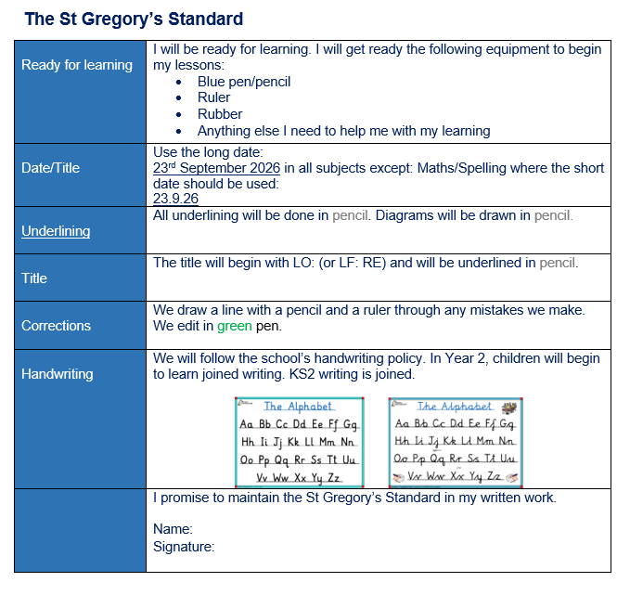
General information
The St. Gregory’s Standard
Each class at St. Gregory’s follows the St. Gregory’s standard (copies at your tables.)
Following the St. Gregory’s standard ensures that high expectations of presentation are reinforced throughout each year group and key stage.

Slide 3
General Information
The St. Gregory’s Way
In St. Gregory’s we adhere to three core principles in each class:
Be Ready, Be Respectful and Be Safe.
This is reinforced daily with our children in our morning meetings in class.

Slide 4
Maths
Our new maths scheme
This year, we are teaching maths through a new scheme called Ark Maths.
There are some key changes happening in the way we teach maths.

Slide 5
Maths
The six part maths lesson
Lessons in Ark Maths are separated into 6 key sections:
Do now
New learning
Talk activity
Develop learning
Independent task
Plenary

Slide 6
Maths
The six part maths lesson
Do now – the Do Now activity is a 5 minute activity involving recall and application of known facts. For example finding 10 or 100 more or less than a given number.
New learning - The new learning section is where the core idea of the lesson is taught through a combination of teacher modelling and explanation.
Talk Task – The talk task gives children an opportunity to test out their new learning by working on an activity with a partner using a script to talk about their learning. This is vital in improving children's mathematical vocabulary.
Develop Learning – The develop learning section reinforces the new learning and primes children for their independent activity.
Independent task – The focussed activity that children attempt which gives them an opportunity to apply what they have learned.
Plenary – An activity that the children do together as a class to consolidate their learning. It may involve explaining a concept taught in the lesson or correcting common errors.

Slide 7
Maths
Afternoon Maths Meetings
In order to improve recollection of mathematical facts and aid with arithmetic and fluency skills, each class takes part in a ‘Maths Meeting’ first thing after lunch.
This lesson lasts for approximately 15 minutes and is split into 4 parts. Each part will cover some aspect of mental arithmetic or recall of number facts, occasionally, concepts taught in morning sessions will be revisited to consolidate learning.

Slide 8

Times Tables Fluency
We use Times Tables Rock Stars in school to help children improve their maths fluency.
This program teaches new times tables facts at a pace appropriate for each learner, and allows children to practise for the MTC in Year 4 which takes place in June.

Slide 9
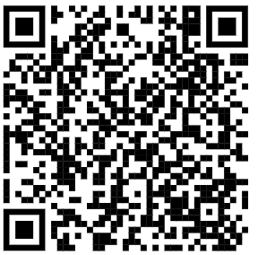
Times Tables Fluency
Your turn!
The best way to see how this program works is to try it yourself. Please use the iPad on your table to scan the QR code below.
Once you are on the login page use the following details to sign in:
User: gue1
Password: fyh

Slide 10

Addition and Subtraction support
TTRS also offers addition and subtraction support through Numbots, which can be accessed at home or at school.

Slide 11
Do you have any questions about the teaching of maths at St. Gregory’s?
Questions

Slide 12
English
Expectations in LKS2
Children in Year 3 and 4 are given the opportunity to write in pen. Children should try to write in joined-up handwriting at all times and to follow the St. Gregory’s Standard to present their work neatly.

Slide 13
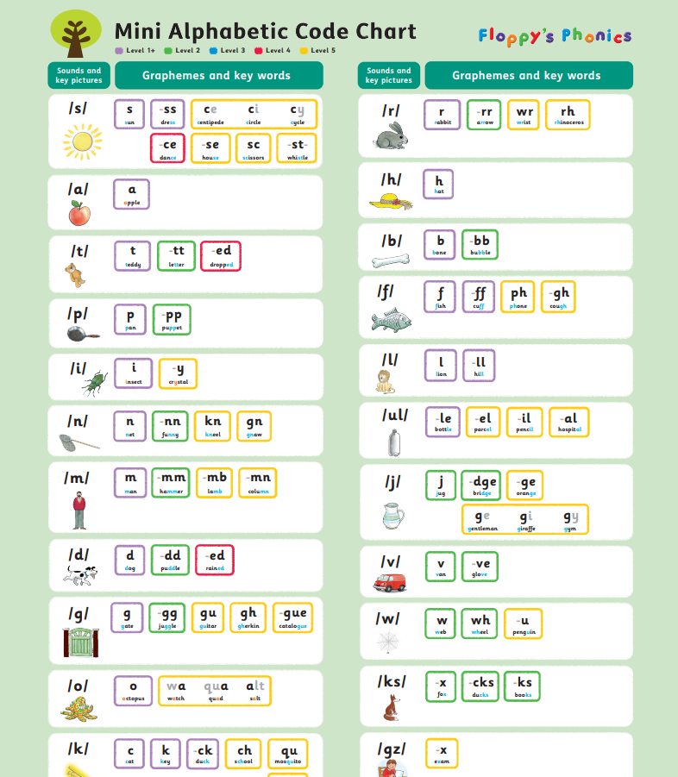
English
Our Targets this year:
Phonics
In school this year we are focussing on spelling and phonics.
We teach phonics using a scheme called Floppy’s Phonics (copies of the sound mats are on your tables)

Slide 14
English
Phonics as an adult?
Haikveetraim
Can you read this nonsense word?
How did you do it?

Slide 15

English
Our Targets this year:
Spelling
In school this year we are focussing on spelling and phonics.
We teach spelling using a scheme called Spelling Shed. There is a website and an app which can be accessed at home to help children practise their spelling.

Slide 16
English
When do we practise in school?
Spelling and handwriting are taught daily in our morning meetings in class.
Children are given their weekly spellings to practise and handwriting and letter formation is reinforced using a combination of adult support and modelling on the board and using our visualisers.

Slide 17
English
Reading
Children in Year 3 and Year 4 should be reading and being read to as regularly as possible.
Children are read to in school each day, from a variety of books making up our Year 3 and Year 4 Reading Spine.
We know a lot of our children read regularly at home and thank you for your support with this.

Slide 18

English
Reading Plus
Reading Plus is an effective tool to help develop reading fluency, comprehension skills and improve vocabulary.
Children will access Reading Plus twice weekly in school. They can practise at home as much as you would like them to. There are no limits on how many activities can be completed each week.

Slide 19
English
Questions
Do you have any questions about the teaching of phonics, spelling or reading at St. Gregory’s?

Slide 20
Additional important information
Homework:
Homework is given on a Friday and should be returned the following Wednesday
Swimming and PE:
Year 3 are currently having swimming lessons.
Year 4 will begin after Christmas.

