Slide 1

Curriculum Cafe
Year 5 and Year 6
Notes:
Activities for parents – Debbie Hepplewhite handwriting activity on entry
TTRS trial using iPads
Possibly spelling shed or reading plus as well

Slide 2
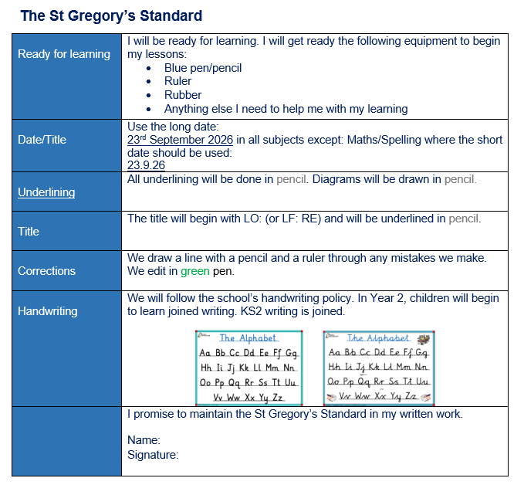
General information The St. Gregory’s Standard
Each class at St. Gregory’s follows the St. Gregory’s standard (copies at your tables.)
Following the St. Gregory’s standard ensures that high expectations of presentation are reinforced throughout each year group and key stage.

Slide 3
General Information The St. Gregory’s Way
In St. Gregory’s we follow St. Gregory’s way and the school mission:
We give thanks to God, work together and always try our best.
This is reinforced daily with our children in our morning meetings in class and through our pastoral care classes.

Slide 4
General Information Morning meetings
In St. Gregory’s we follow St. Gregory’s way and the school mission:
We give thanks to God, work together and always try our best.
This is reinforced daily with our children in our morning meetings in class and through our pastoral care classes.

Slide 5




Morning Activities
Year 6
We give thanks to God, work together and always try our best.
S
H
I
N
E

Slide 6
Today’s date is
Morning Prayers
St. Gregory’s morning prayer
Registration
Lunch choices
The Lord’s Prayer
Hail Mary
We give thanks to God, work together and always try our best.
S
H
I
N
E
.

Slide 7
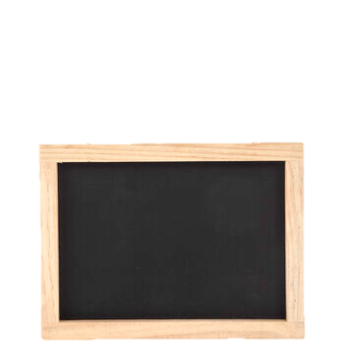
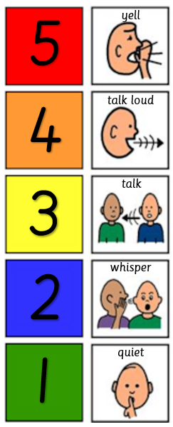
Good Morning
Today’s date is
Year Six
Spellings
Thi
The spelling pattern this week is:
Write out each word three times in your neatest handwriting.
1.
2.
3.
4.
5.
Tuesday words or extension
6.
7.
8.
9.
10.
.
We give thanks to God, work together and always try our best

Slide 8
Good Morning
Today’s date is
Year Six
Mental Maths
*T
We give thanks to God, work together and always try our best
6 x 3. 62 + ____ = 97
4. 36 + 25 = 41 + 4
3 x 9
7 x 5
6 x 6
Addition
239 + 71 =
184 + ___ = 215
172 = 88 + ___
375 = 125 + ___
5. ___ = 155 + 66
6. ___ = 175 + 82
7. 85 + 66 = 20 + ___
8. 55 + ___ = 80 + 54

Slide 9
Good Morning
Today’s date is
*
Year Six
SPAG
We give thanks to God, work together and always try our best
6 x 3. 62 See+ ____ = 97
4. 36 + 25 = 41 + 4
3 x 9
7 x 5
6 x 6
.

Slide 10

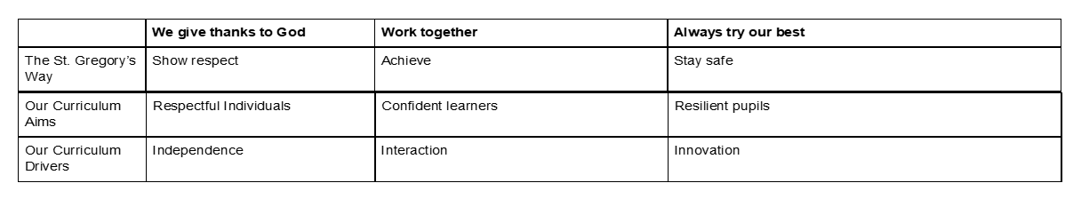
Good Morning
*
Year Six
Examen
St. Gregory’s Way
We give thanks to God, work together and always try our best
S
H
I
N
E
How to Pray The Five Finger Examen
Be still. Our thumb reminds us of what is important. Notice your breath, try to still your mind, and be present to God and yourself.
Be grateful. As our index finger points things out to people, reflect on your day and point out everything you’re grateful for.
Notice. Our middle finger is usually the longest and the one that stands out. What stood out to you yesterday? Where did you feel happy? Sad? Frustrated? Were there any challenges yesterday? Any victories?
Ask for help. Our ring fingers are where we put our wedding rings. Think about your responsibilities and promises you have made. What do you need God’s help with? Is there anything you need to say sorry for?
Look ahead. Our pinky finger is our smallest one. Sometimes a small change can make a big difference. Think about today. What do you hope for? Are there any little changes that you can make?
.

Slide 11
Maths Our new maths scheme
This year, we are teaching maths through a new scheme called Ark Maths.
There are some key changes happening in the way we teach maths.

Slide 12
Maths The six part maths lesson
Lessons in Ark Maths are separated into 6 key sections:
Do now
New learning
Talk activity
Develop learning
Independent task
Plenary

Slide 13
Maths The six part maths lesson
Do now – the Do Now activity is a 5 minute activity involving recall and application of known facts. For example finding 10 or 100 more or less than a given number.
New learning - The new learning section is where the core idea of the lesson is taught through a combination of teacher modelling and explanation.
Talk Task – The talk task gives children an opportunity to test out their new learning by working on an activity with a partner using a script to talk about their learning. This is vital in improving children's mathematical vocabulary.
Develop Learning – The develop learning section reinforces the new learning and primes children for their independent activity.
Independent task – The focussed activity that children attempt which gives them an opportunity to apply what they have learned.
Plenary – An activity that the children do together as a class to consolidate their learning. It may involve explaining a concept taught in the lesson or correcting common errors.

Slide 14
Maths Afternoon Maths Meetings
In order to improve recollection of mathematical facts and aid with arithmetic and fluency skills, each class takes part in a ‘Maths Meeting’ first thing after lunch.
This lesson lasts for approximately 15 minutes and is split into 4 parts. Each part will cover some aspect of mental arithmetic or recall of number facts, occasionally, concepts taught in morning sessions will be revisited to consolidate learning.

Slide 15

Times Tables Fluency
We use Times Tables Rock Stars in school to help children improve their maths fluency.
This program teaches new times tables facts at a pace appropriate for each learner. Times Tables is so important for all areas of maths. It really helps if children can learn all times tables not just for the Year Four Multiplication Tables Check.

Slide 16
Times Tables Fluency
We use Times Tables Rock Stars in school to help children improve their maths fluency.
This program teaches new times tables facts at a pace appropriate for each learner. Times Tables is so important for all areas of maths. It really helps if children can learn all times tables not just for the Year Four Multiplication Tables Check.

Slide 17
Year Six SATs
In Year Six your child will take the Math’s SATs papers.
This consists of three papers:
Paper One – Arithmetic 30 mins 36 questions (40 marks)
Paper Two – Reasoning 1 23 – 27 questions - 40 mins (30 marks)
Paper Three – Reasoning 2 40 mins
The children need to be fast with their calculations, know their times tables and be confident with written methods of addition, subtraction, multiplication and division.

Slide 18

Addition and Subtraction support
TTRS also offers addition and subtraction support through Numbots, which can be accessed at home or at school.
Year 6 have access to IXL to support maths.

Slide 19
Do you have any questions about the teaching of maths at St. Gregory’s?
Questions

Slide 20
English Expectations in LKS2
Children in Year 5 and 6 write in pen. Children should try to write in joined-up handwriting at all times and to follow the St. Gregory’s Standard to present their work neatly.

Slide 21
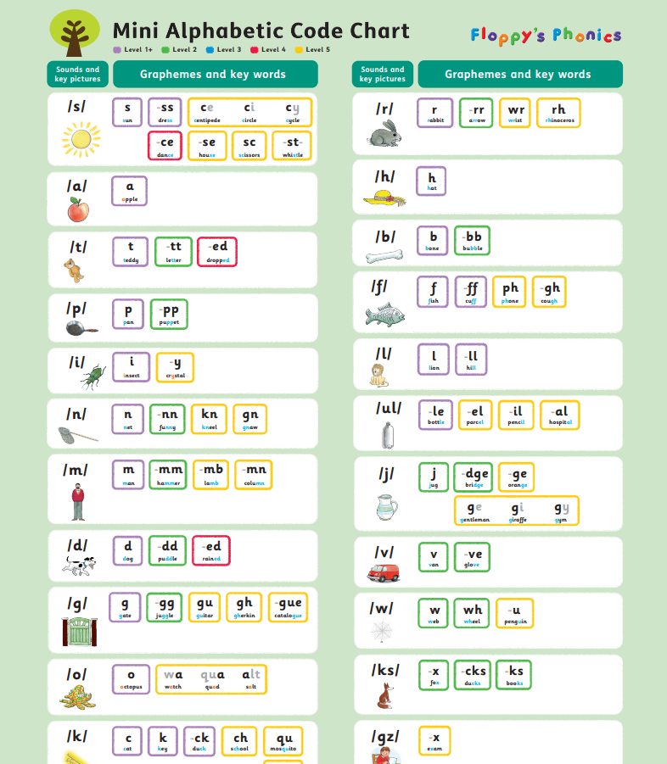
English Our Targets this year: Phonics
In school this year we are focussing on spelling and phonics.
We teach phonics using a scheme called Floppy’s Phonics (copies of the sound mats are on your tables)

Slide 22

English Our Targets this year: Spelling
In school this year we are focussing on spelling and phonics.
We teach spelling using a scheme called Spelling Shed. There is a website and an app which can be accessed at home to help children practise their spelling.

Slide 23
English When do we practise in school?
Spelling and handwriting are taught daily in our morning meetings in class.
Children are given their weekly spellings to practise and handwriting and letter formation is reinforced using a combination of adult support and modelling on the board and using our visualisers.

Slide 24
English Reading
Children in Year 5 and Year 6 should be reading and heard being read to as regularly as possible.
Children are read to in school each day, from a variety of books making up our Year 5 and Year 6 Reading Spine.
We know a lot of our children read regularly at home and thank you for your support with this.

Slide 25

English Reading Plus
Reading Plus is an effective tool to help develop reading fluency, comprehension skills and improve vocabulary.
Children will access Reading Plus twice weekly in school. They can practise at home as much as you would like them to. There are no limits on how many activities can be completed each week.
One half an hour session should ideally be accessed at home each week.

Slide 26
English SATs
In Year 6 the children will complete a Reading Paper and a SPAG paper.
The spelling paper covers spelling taught from Year Two so it is really important for children to be learning weekly spellings.
The reading paper consists of two stories (fiction) and a non fiction. The children have one hour to read and answer all questions so they need to be fluent readers with an understanding of the text read.

Slide 27
English Questions
Do you have any questions about the teaching of phonics, spelling or reading at St. Gregory’s?

Slide 28
Additional important information
Homework:
Homework is given on a Friday and should be returned no later than the following Wednesday
Questions

Slide 29
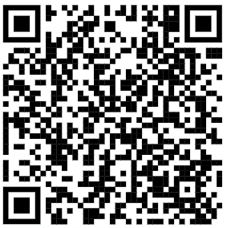
Times Tables Fluency
Your turn!
The best way to see how this program works is to try it yourself. Please use the iPad on your table to scan the QR code below.
Once you are on the login page use the following details to sign in:
User: gue1
Password: fyh

