Slide 1

BISHOP CHADWICK CATHOLIC EDUCATION TRUST
CALCULATION POLICY

Slide 2
INDEX

Slide 3
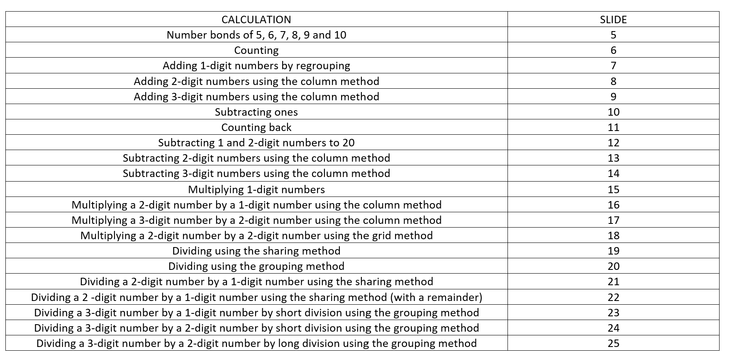
INDEX

Slide 4
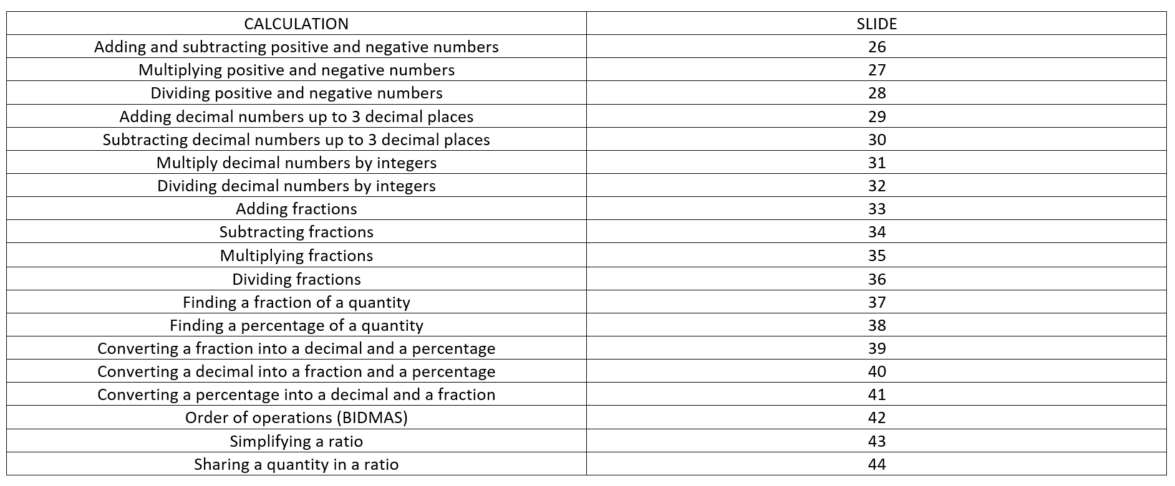
INDEX

Slide 5
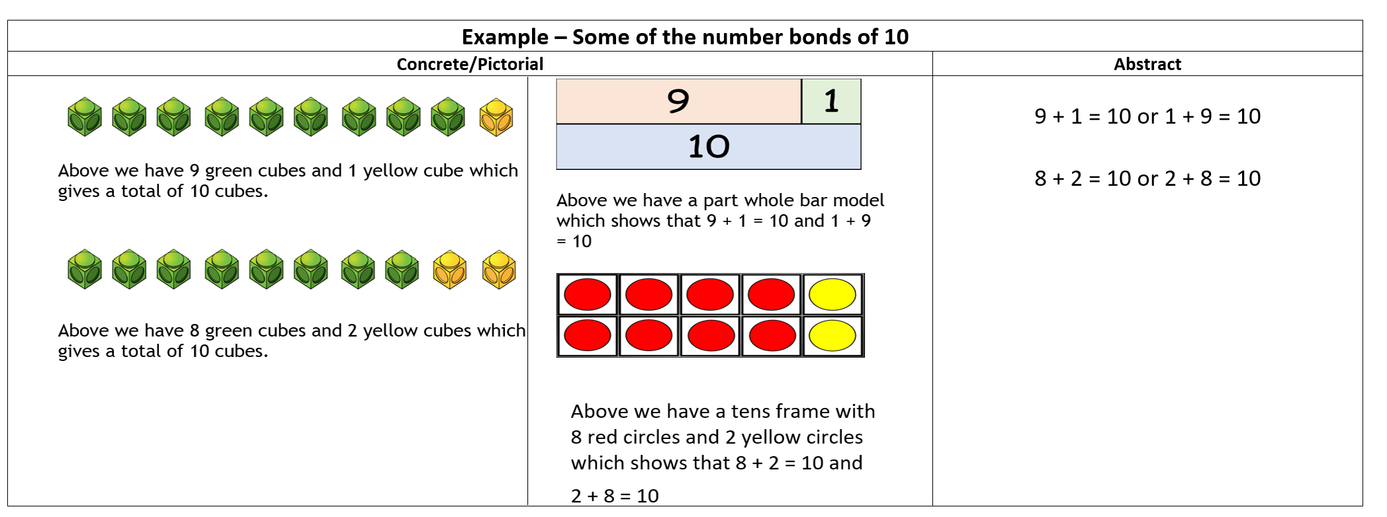
Number bonds of 5, 6, 7, 8, 9 and 10

Slide 6
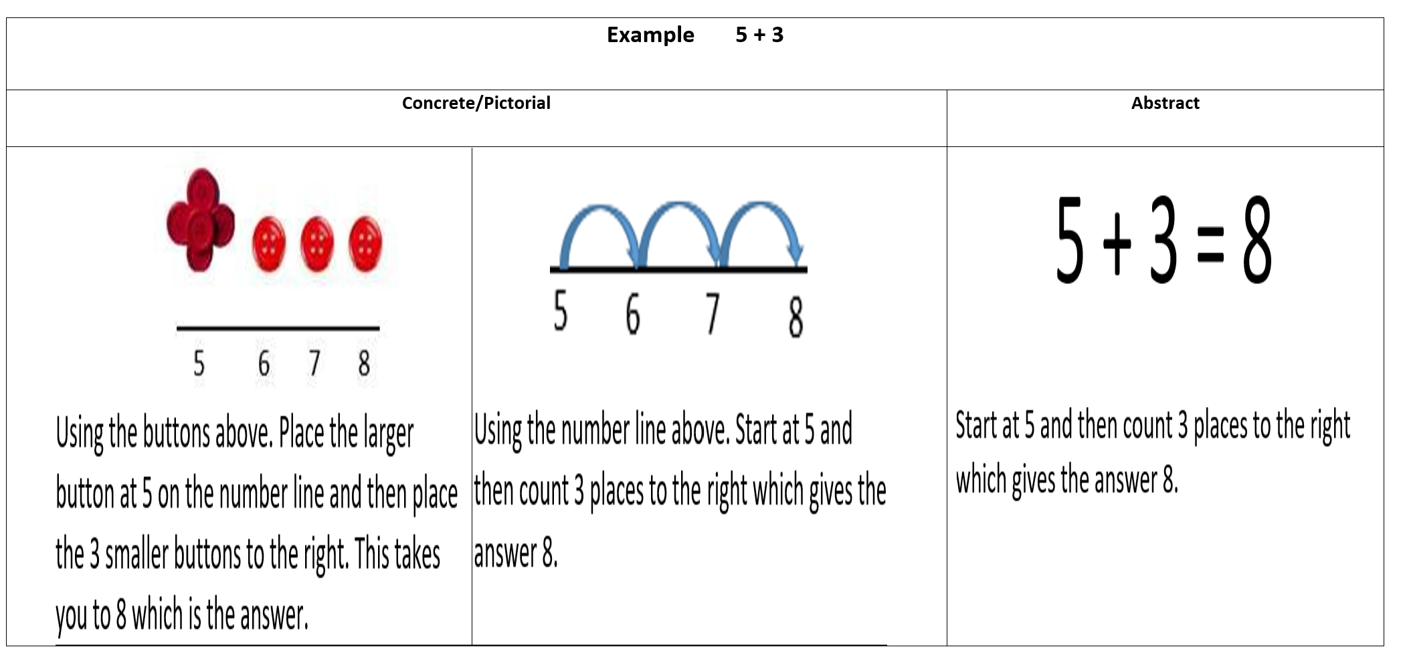
Counting

Slide 7
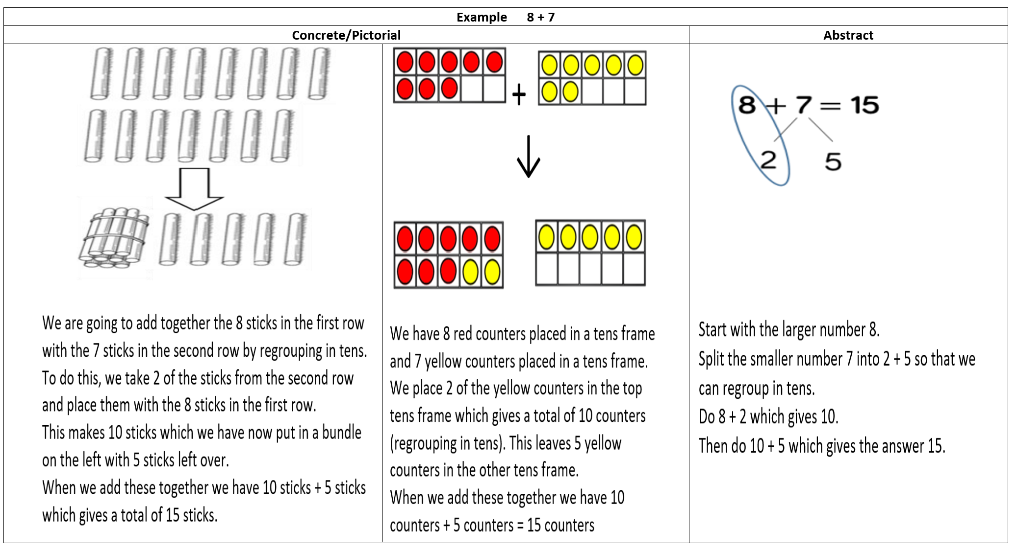
Adding 1-digit numbers by regrouping

Slide 8
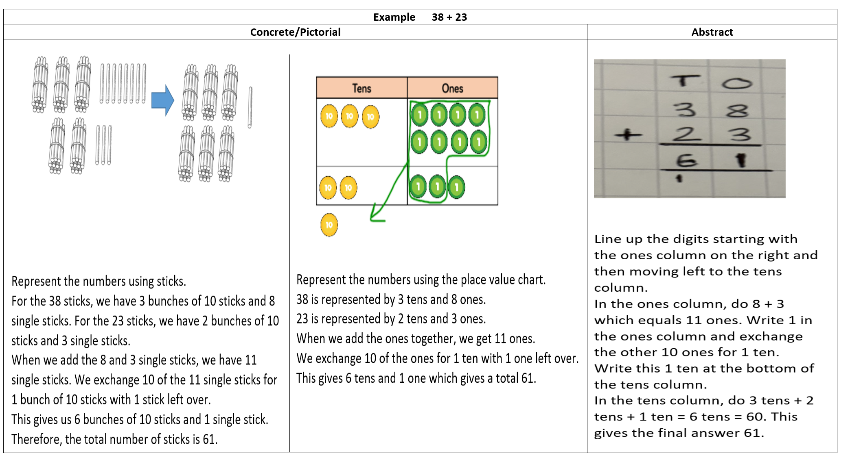
Adding 2-digit numbers using the column method

Slide 9
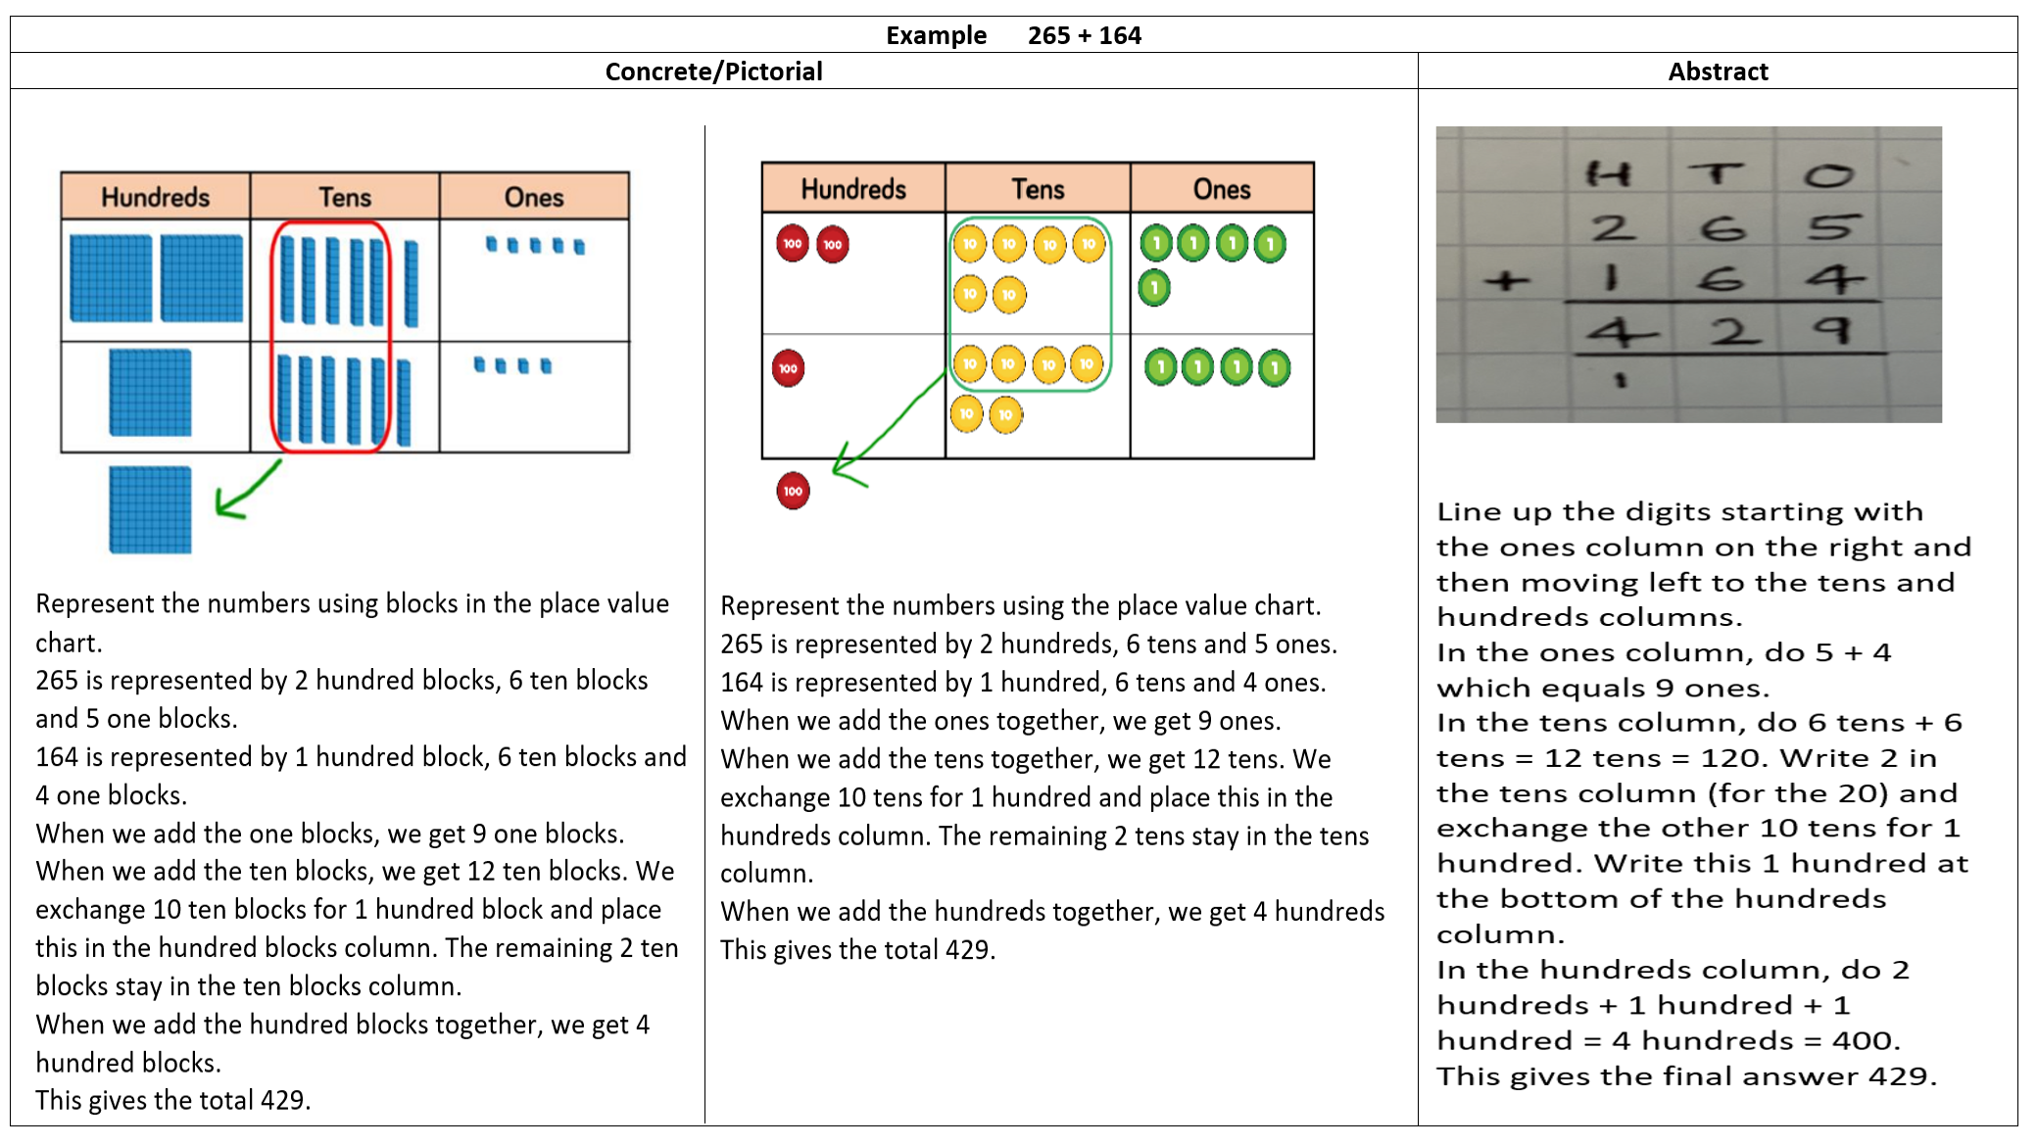
Adding 3-digit numbers using the column method

Slide 10
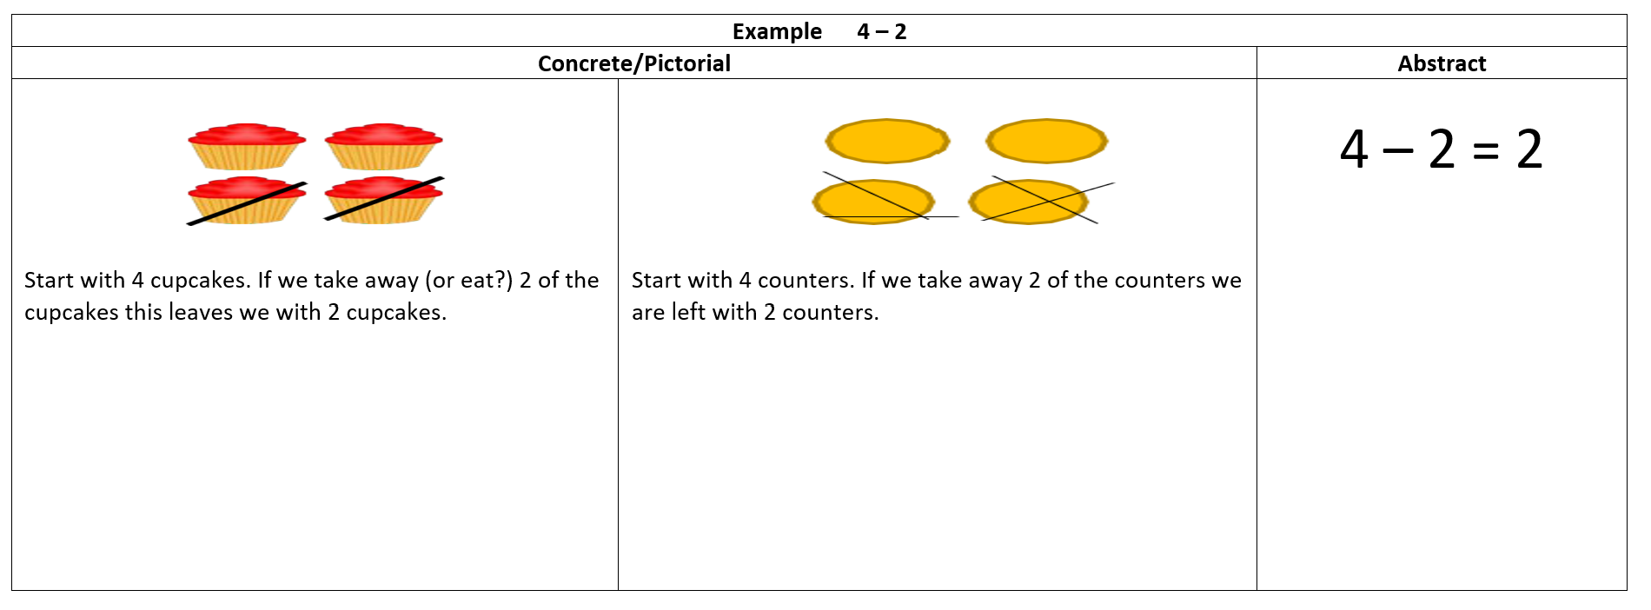
Subtracting ones

Slide 11
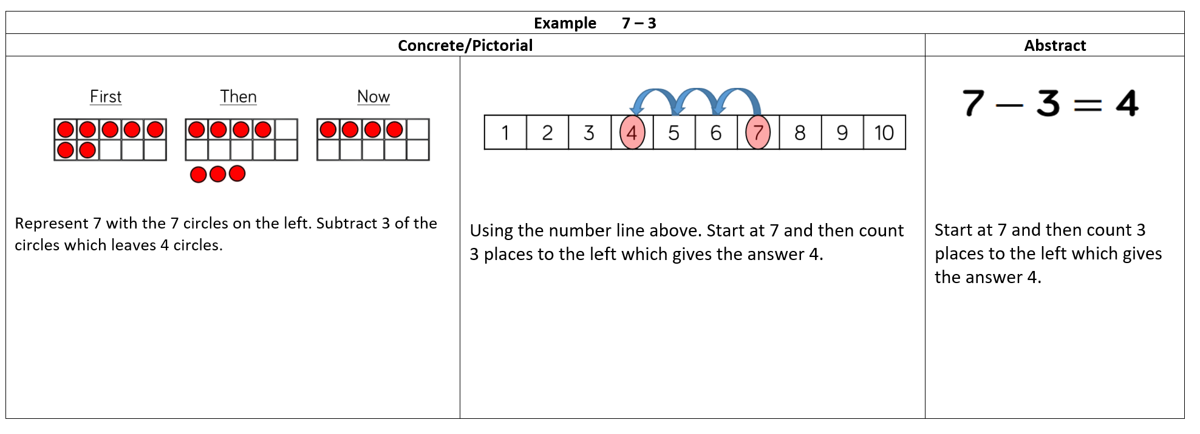
Counting back

Slide 12
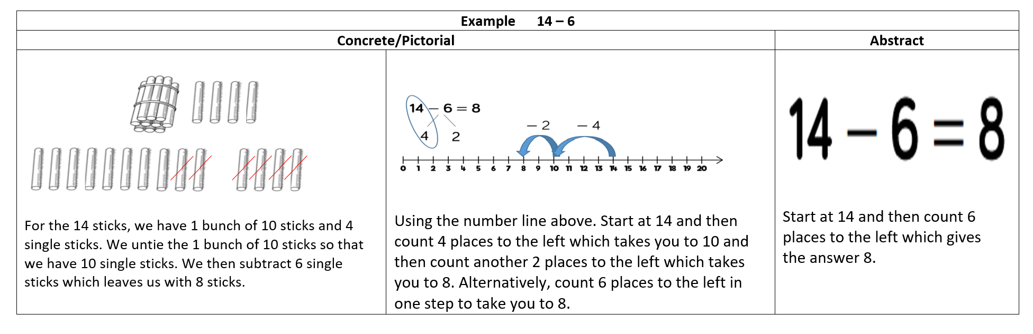
Subtracting 1 and 2-digit numbers to 20

Slide 13
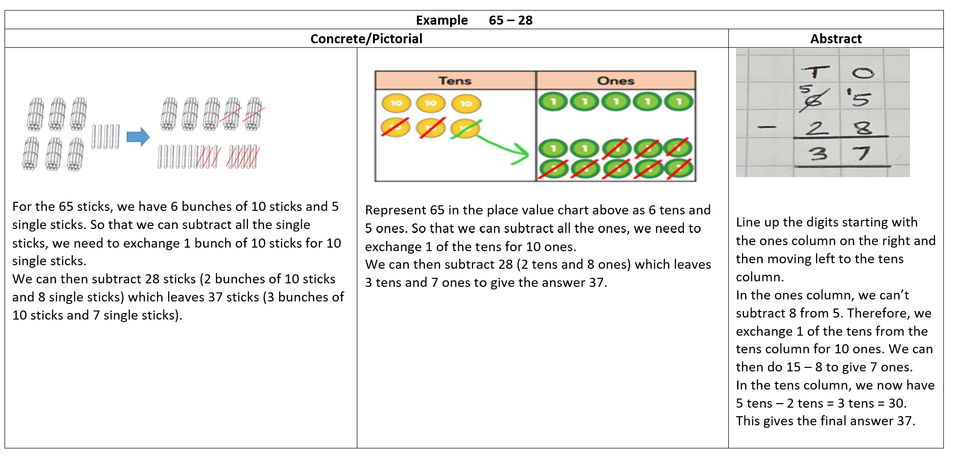
Subtracting 2-digit numbers using the column method

Slide 14
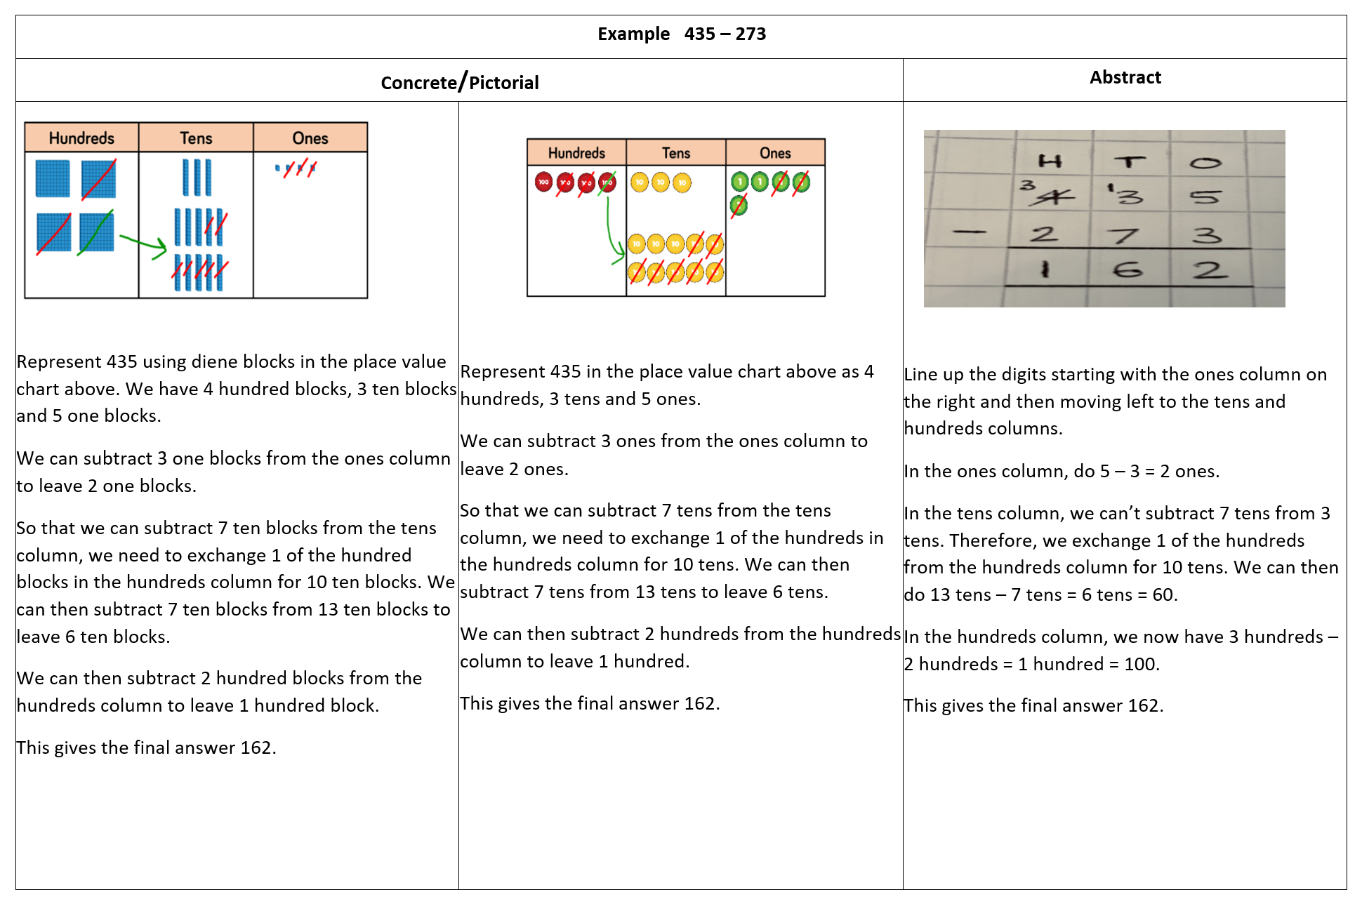
Subtracting 3-digit numbers using the column method

Slide 15
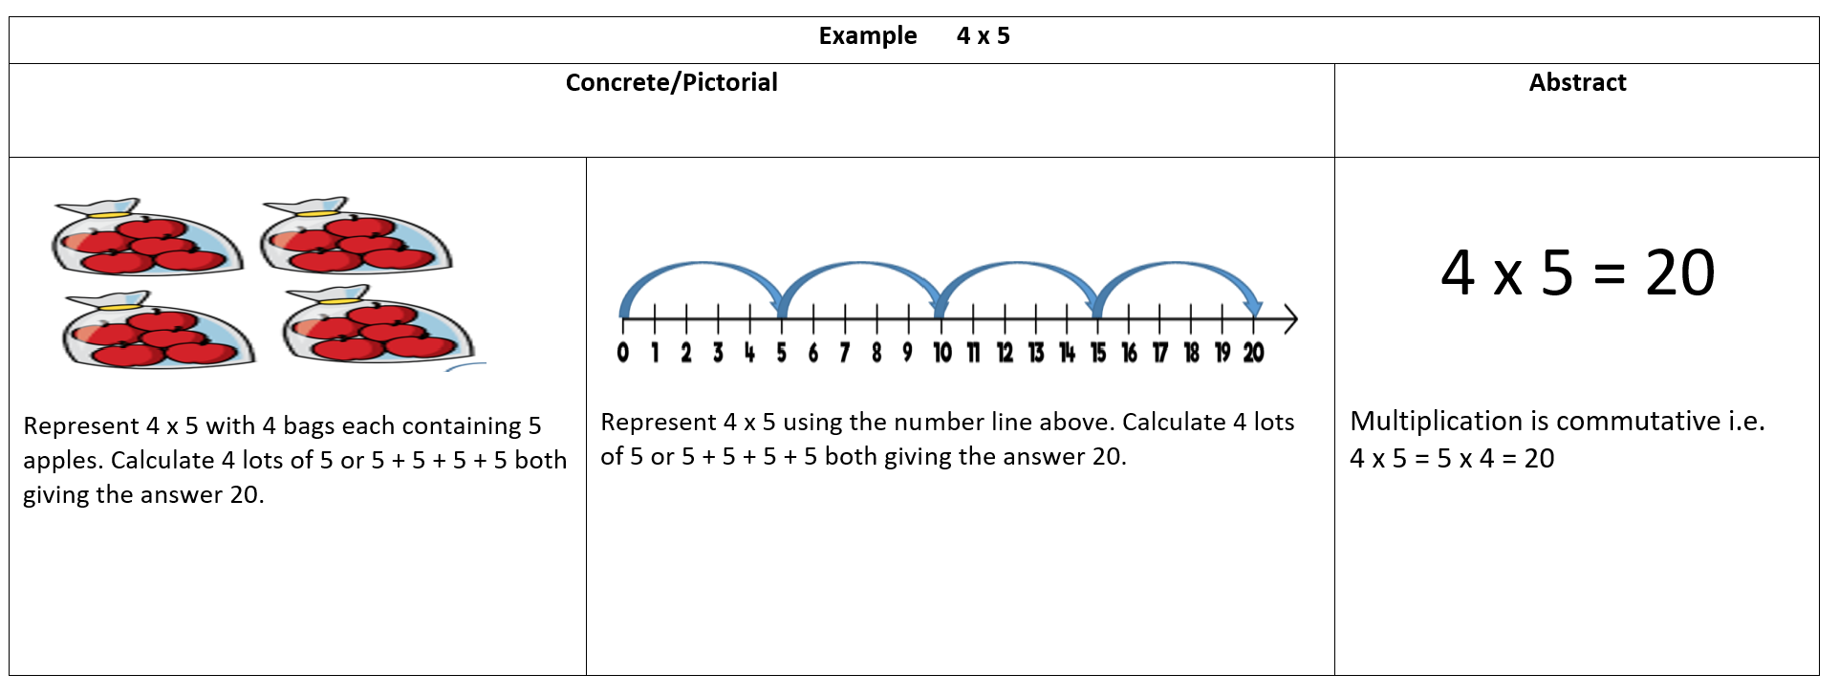
Multiplying 1-digit numbers

Slide 16
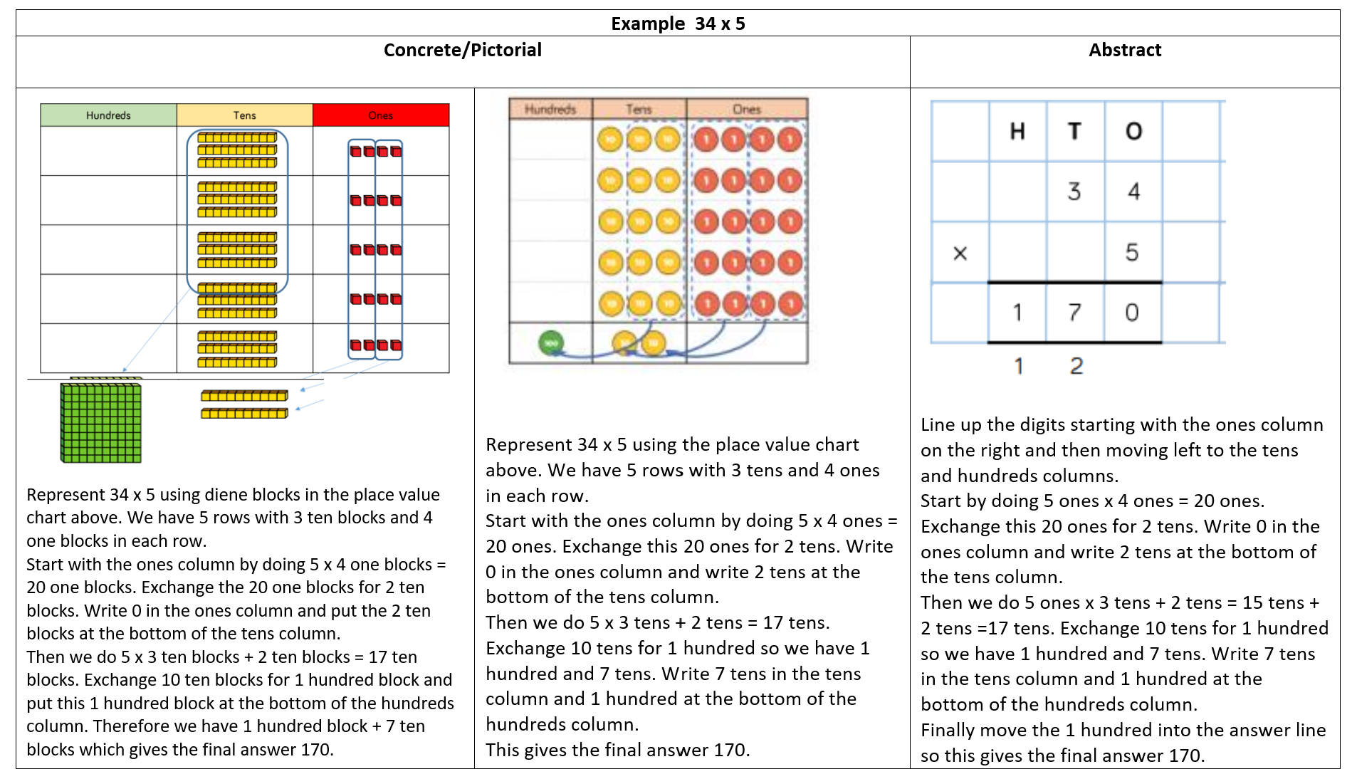
Multiplying a 2-digit number by a 1-digit number using the column method

Slide 17
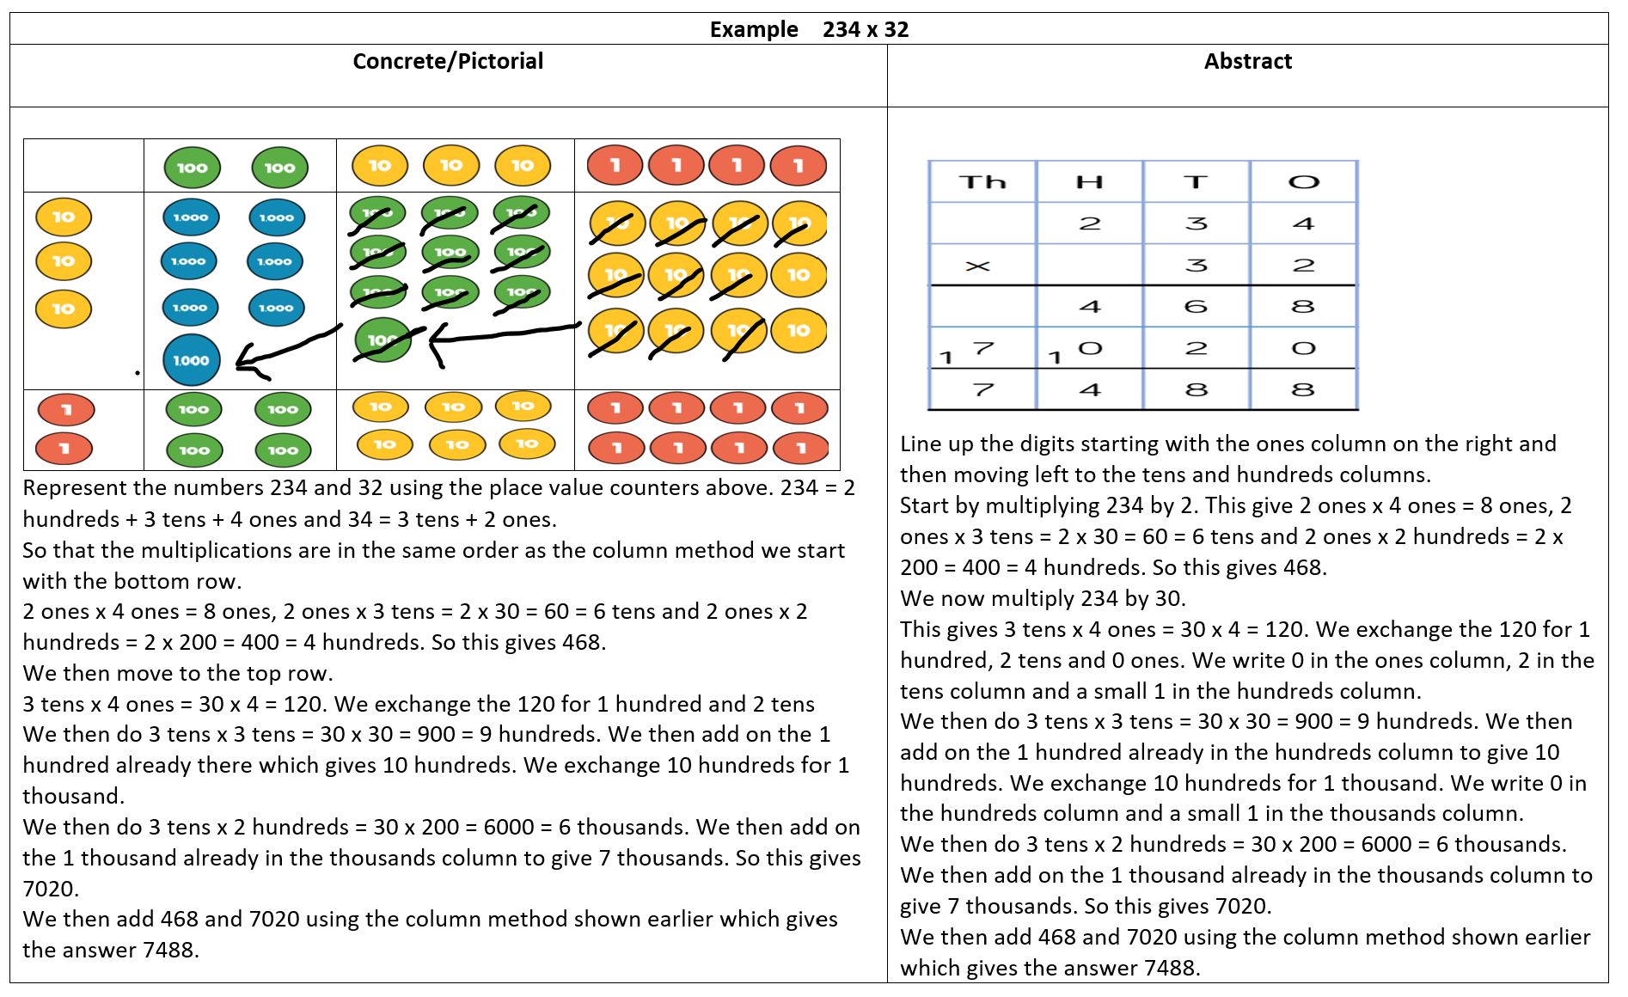
Multiplying a 3-digit number by a 2-digit number using the column method

Slide 18
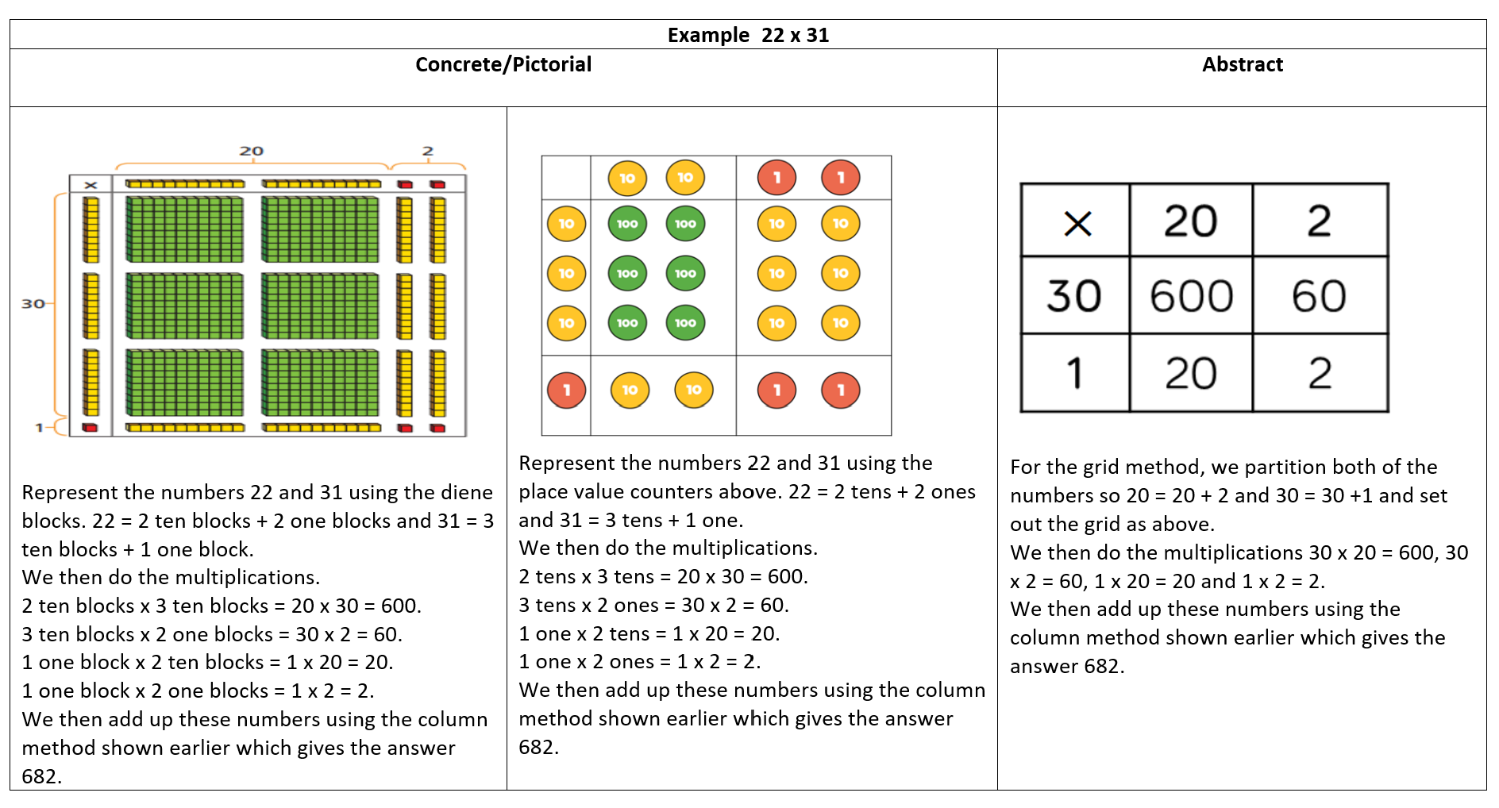
Multiplying a 2-digit number by a 2-digit number using the grid method

Slide 19
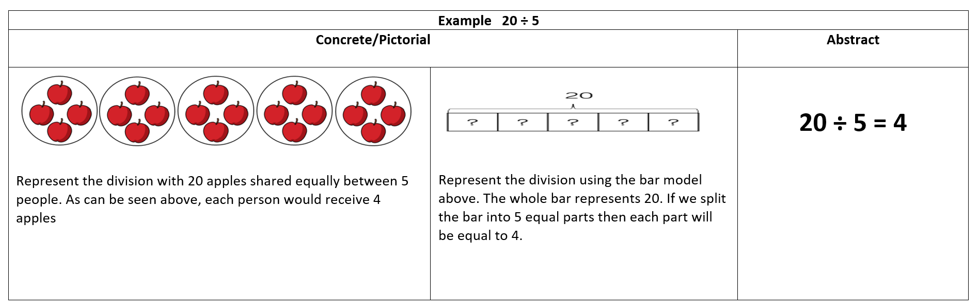
Dividing by using the sharing method

Slide 20
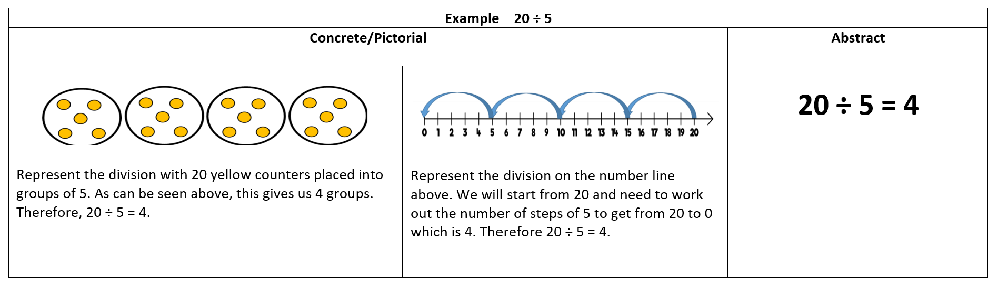
Dividing by using the grouping method

Slide 21
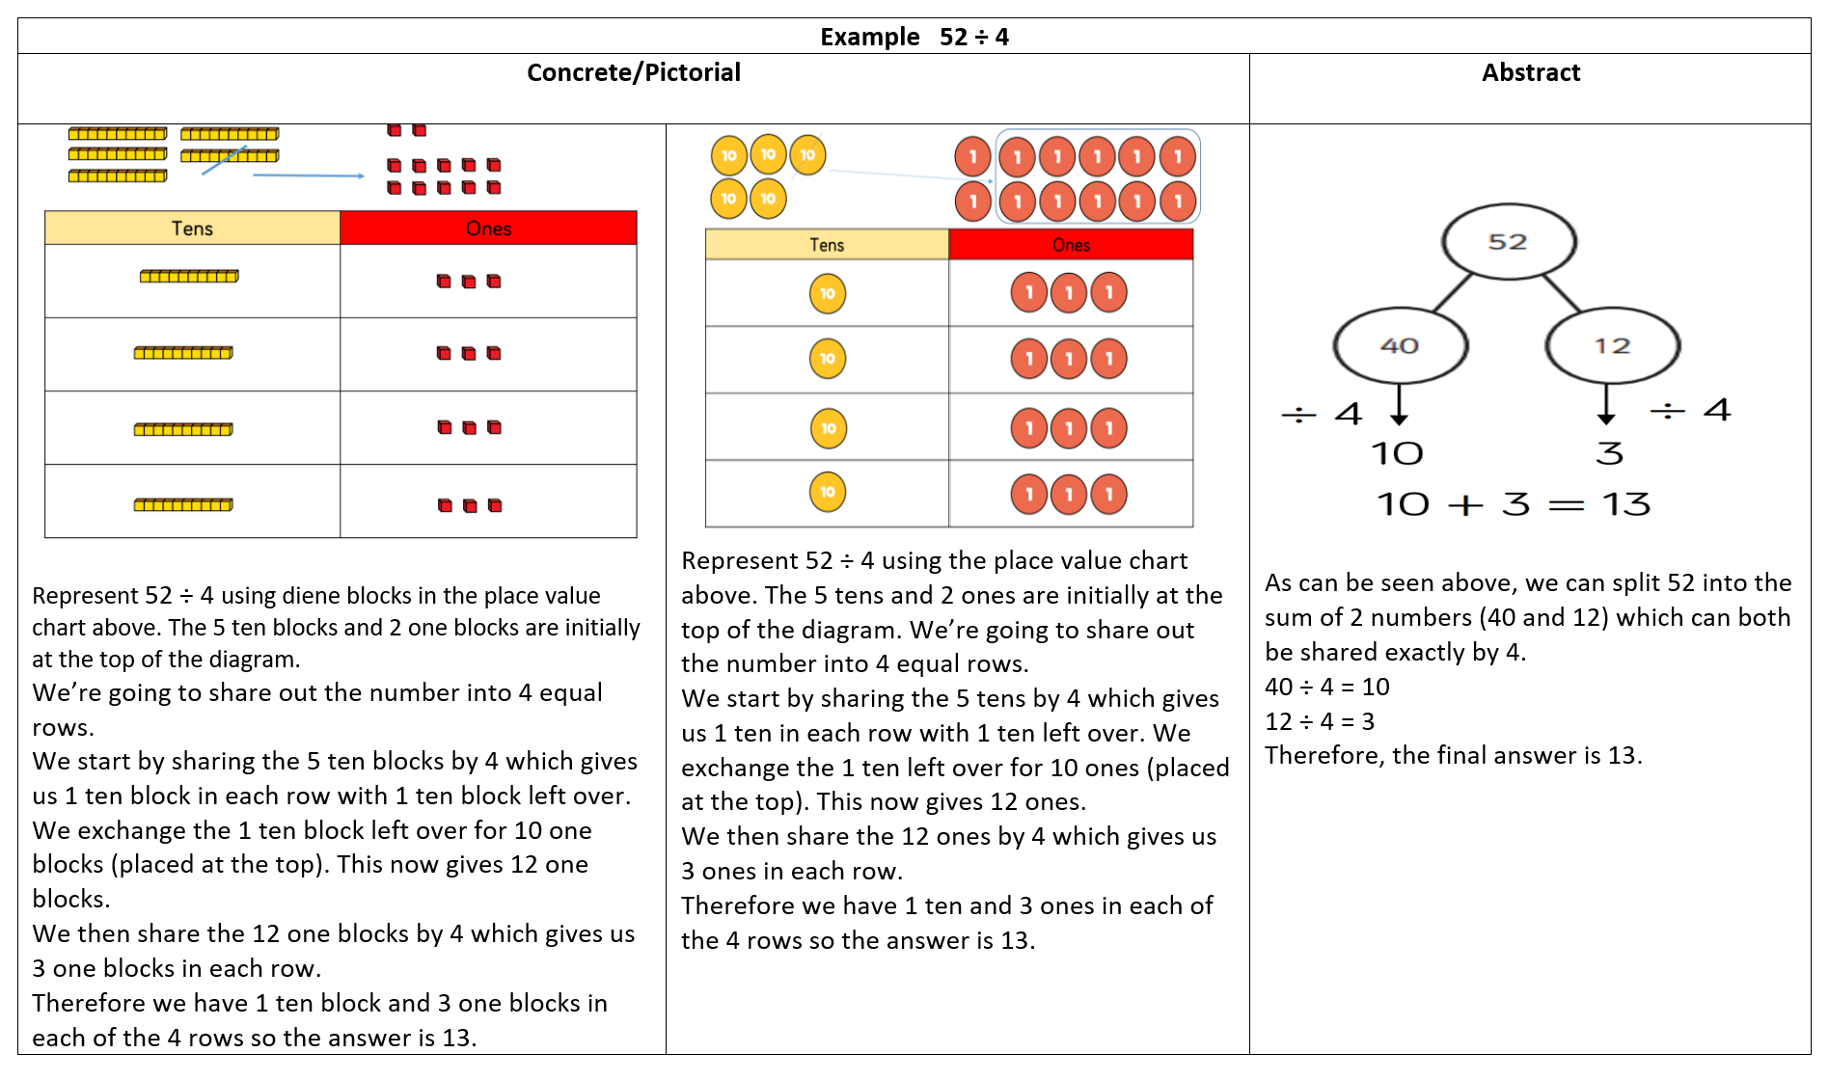
Dividing a 2-digit number by a 1-digit number using the sharing method

Slide 22
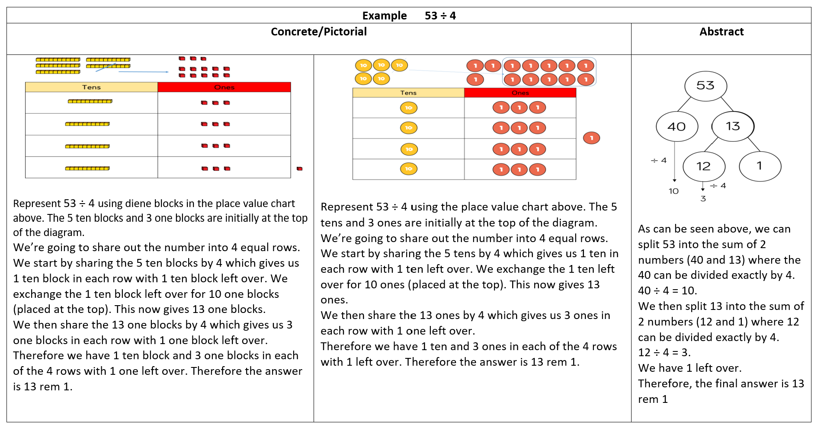
Dividing a 2 -digit number by a 1-digit number using the sharing method (with a remainder)

Slide 23
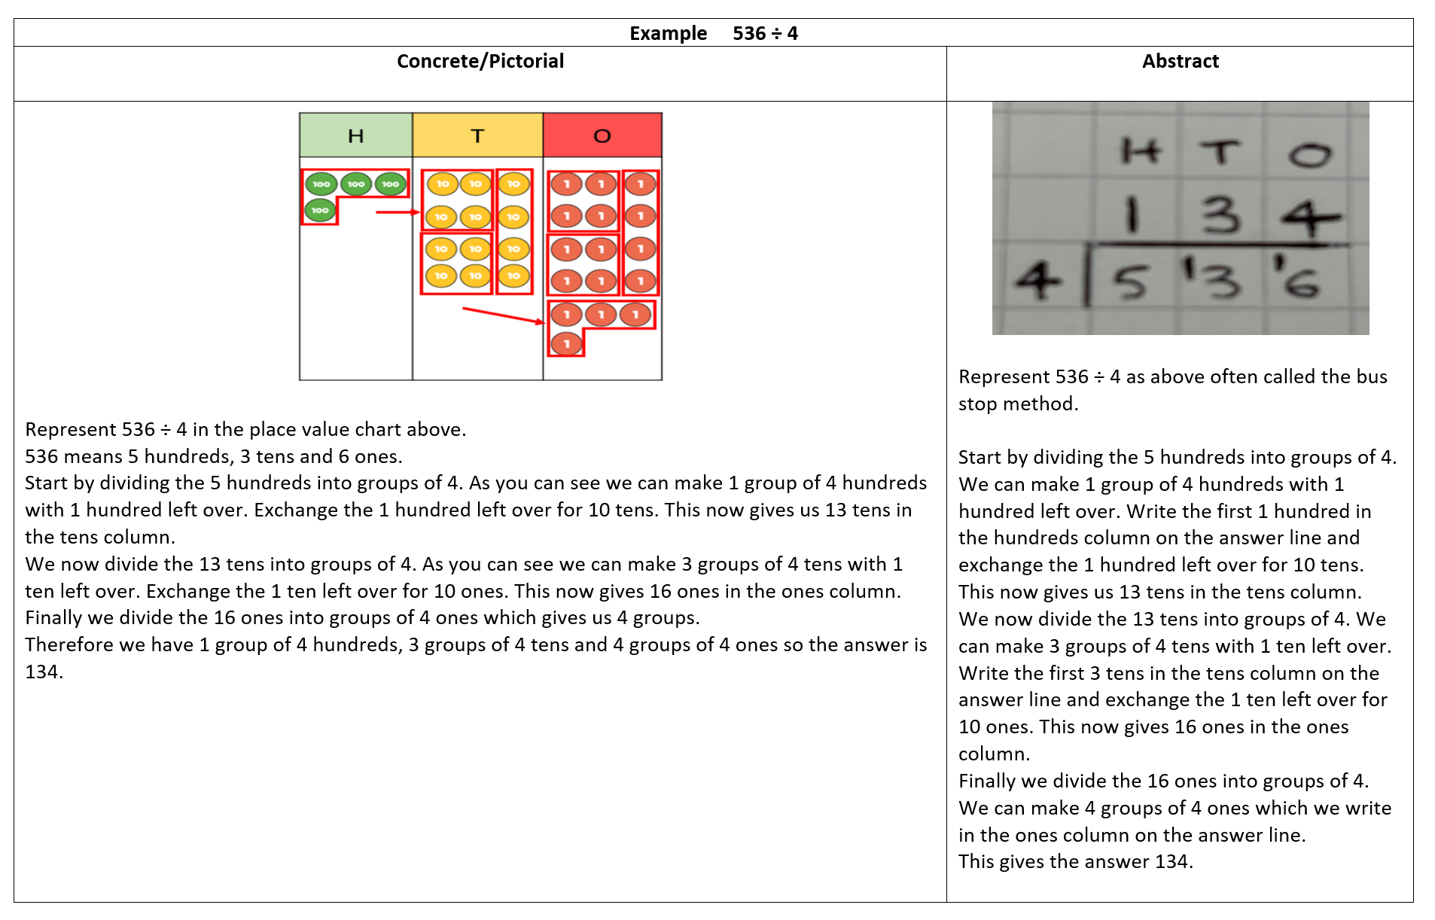
Dividing a 3-digit number by a 1-digit number by short division using the grouping method

Slide 24
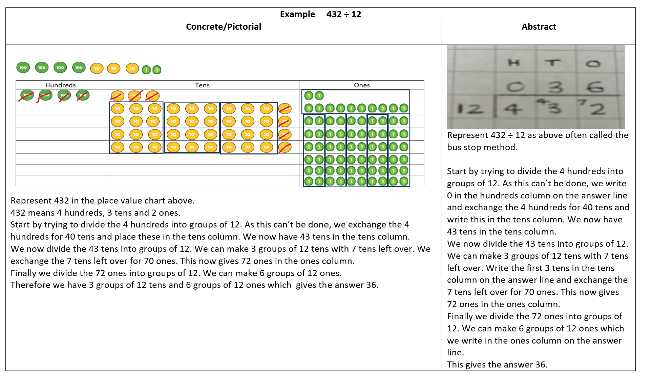
Dividing a 3-digit number by a 2-digit number by short division and using the grouping method

Slide 25
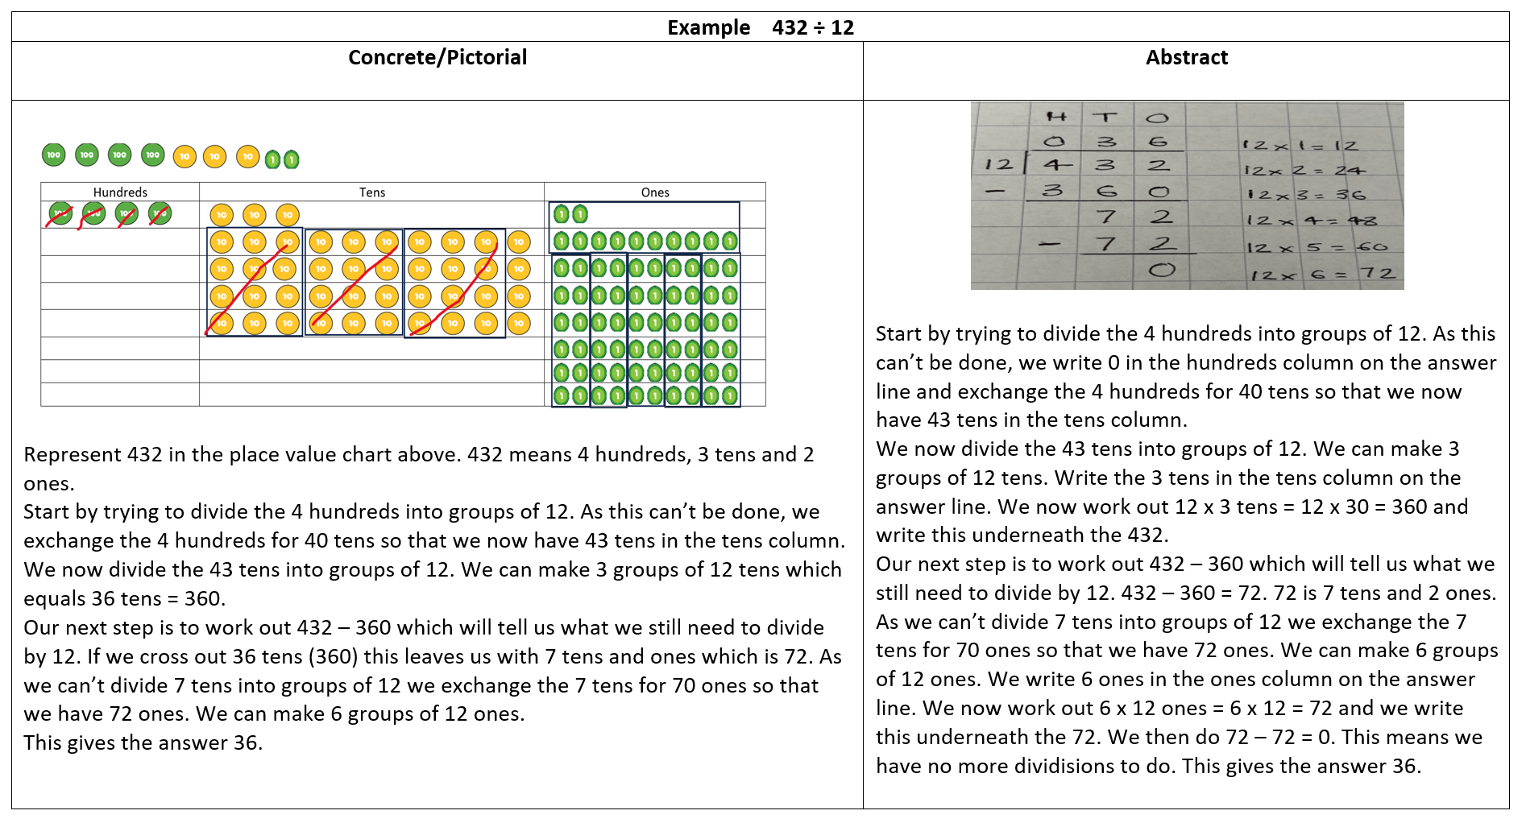
Dividing a 3-digit number by a 2-digit number by long division and using the grouping method

Slide 26
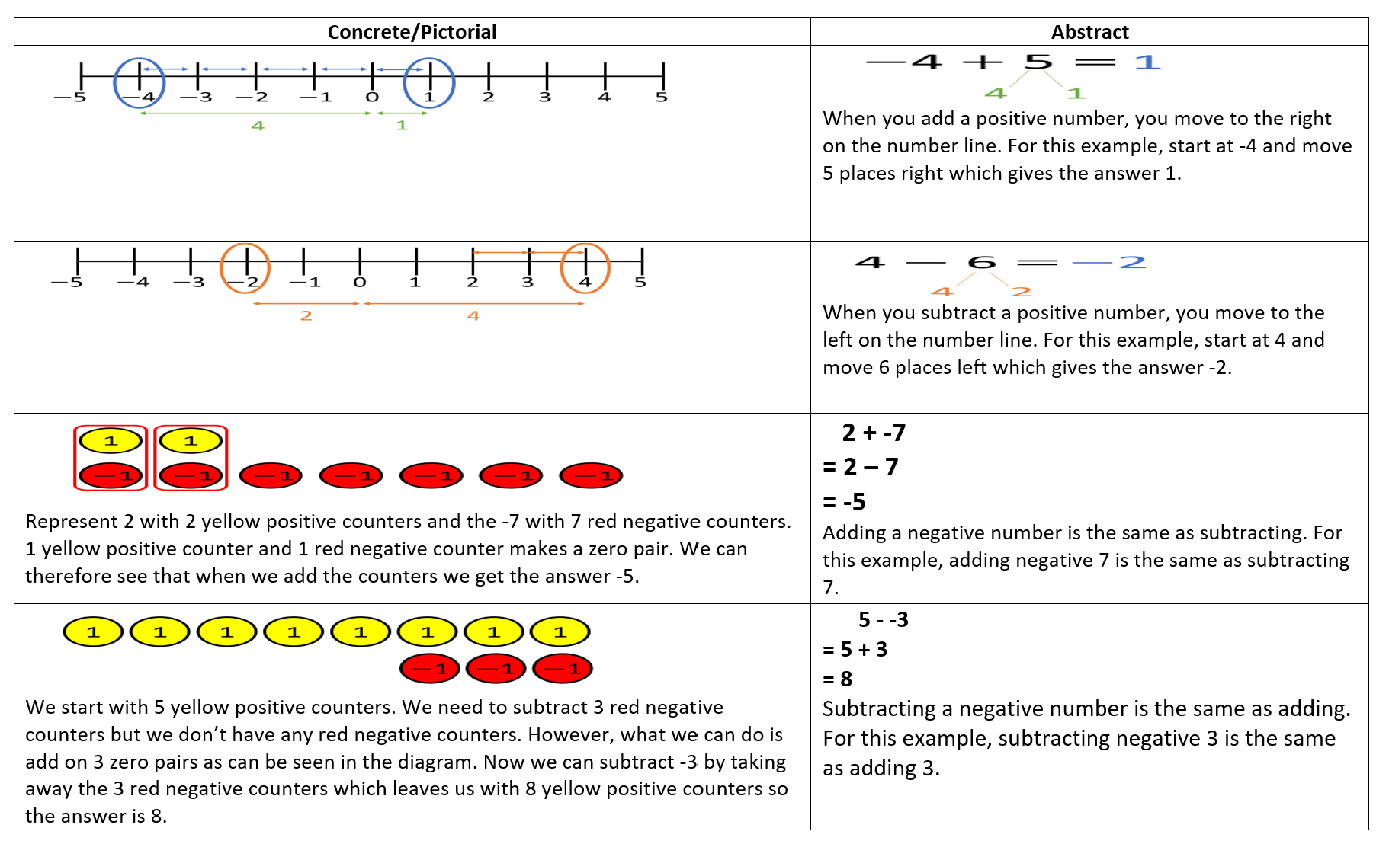
Adding and subtracting positive and negative numbers

Slide 27
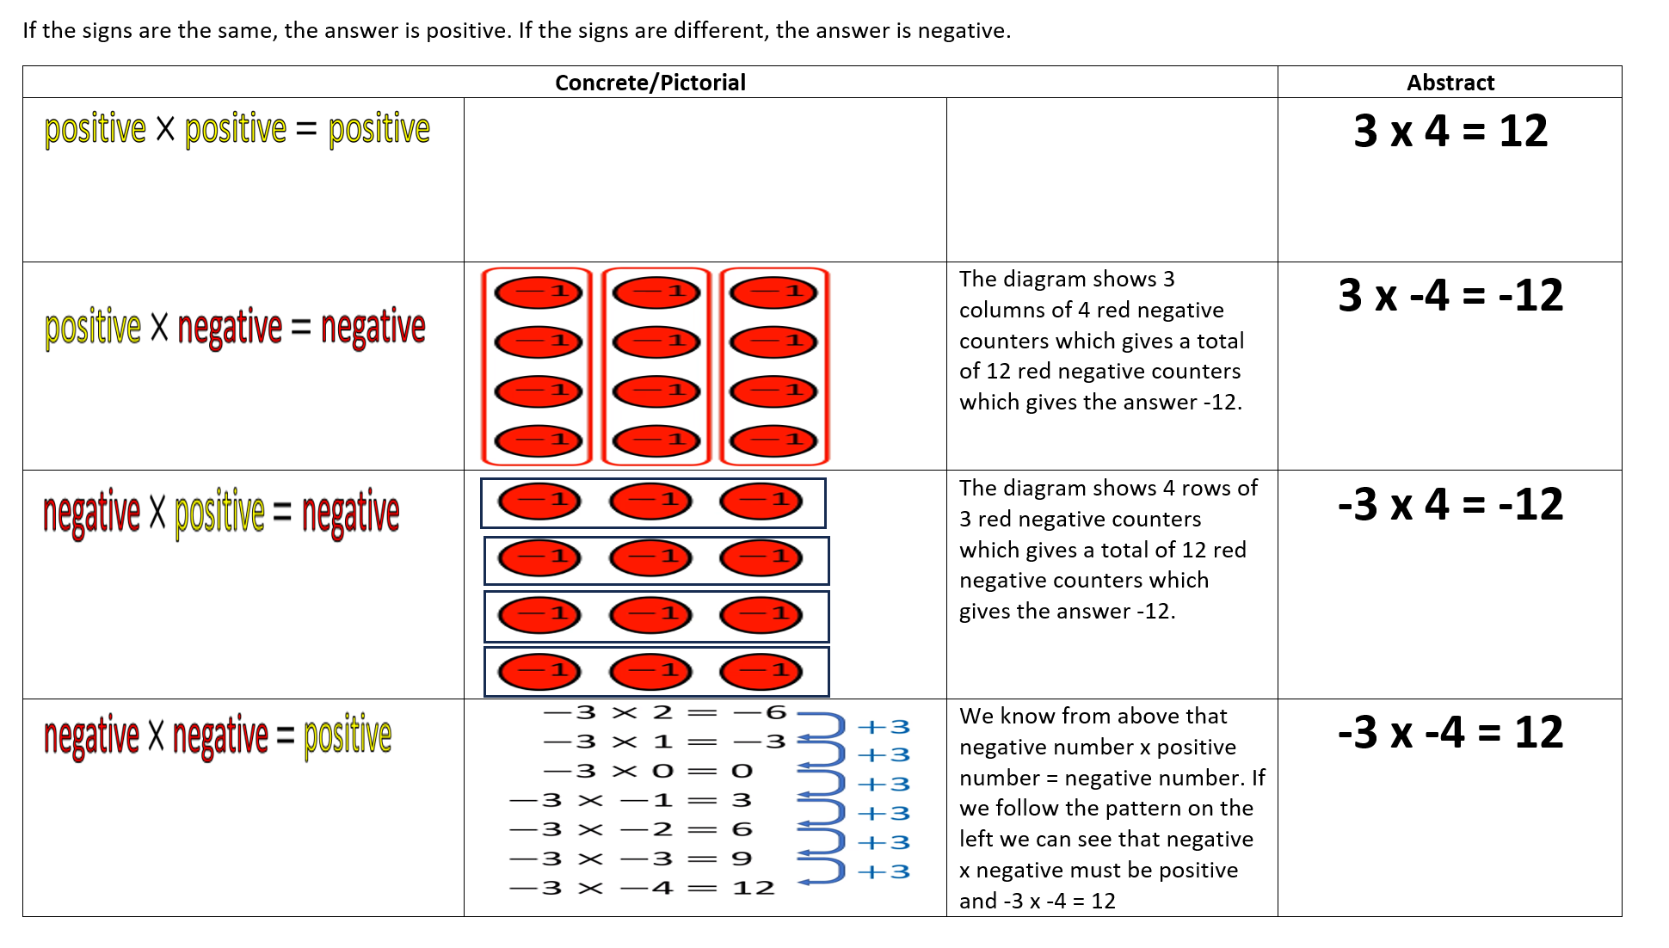
Multiplying positive and negative numbers

Slide 28
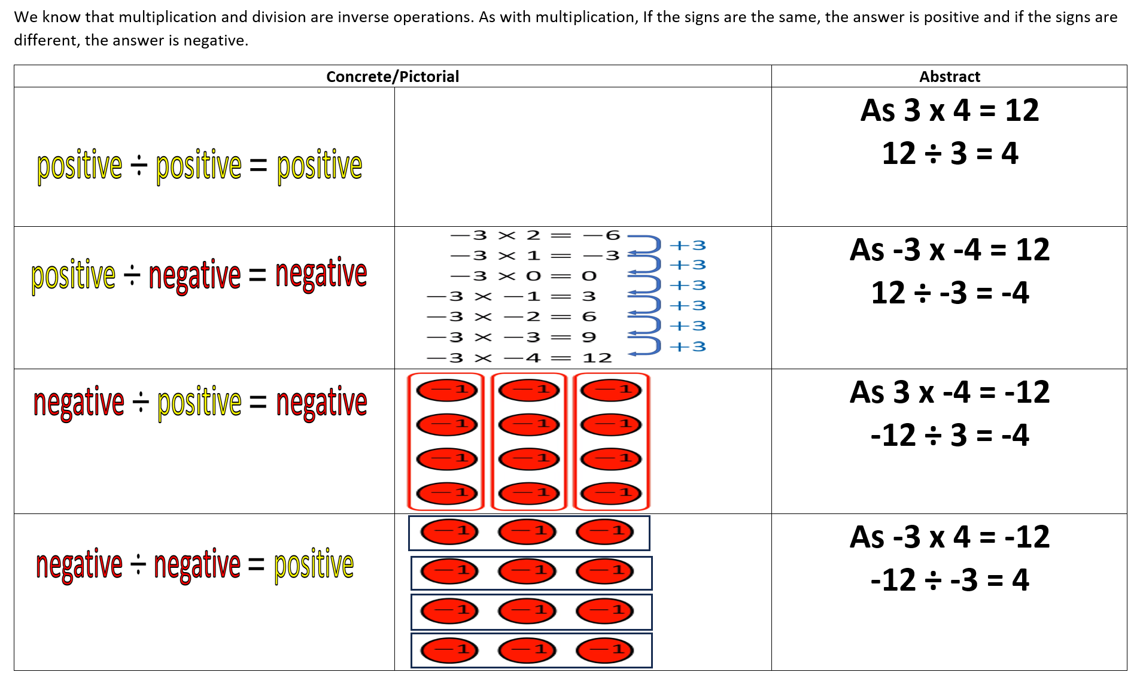
Dividing positive and negative numbers

Slide 29
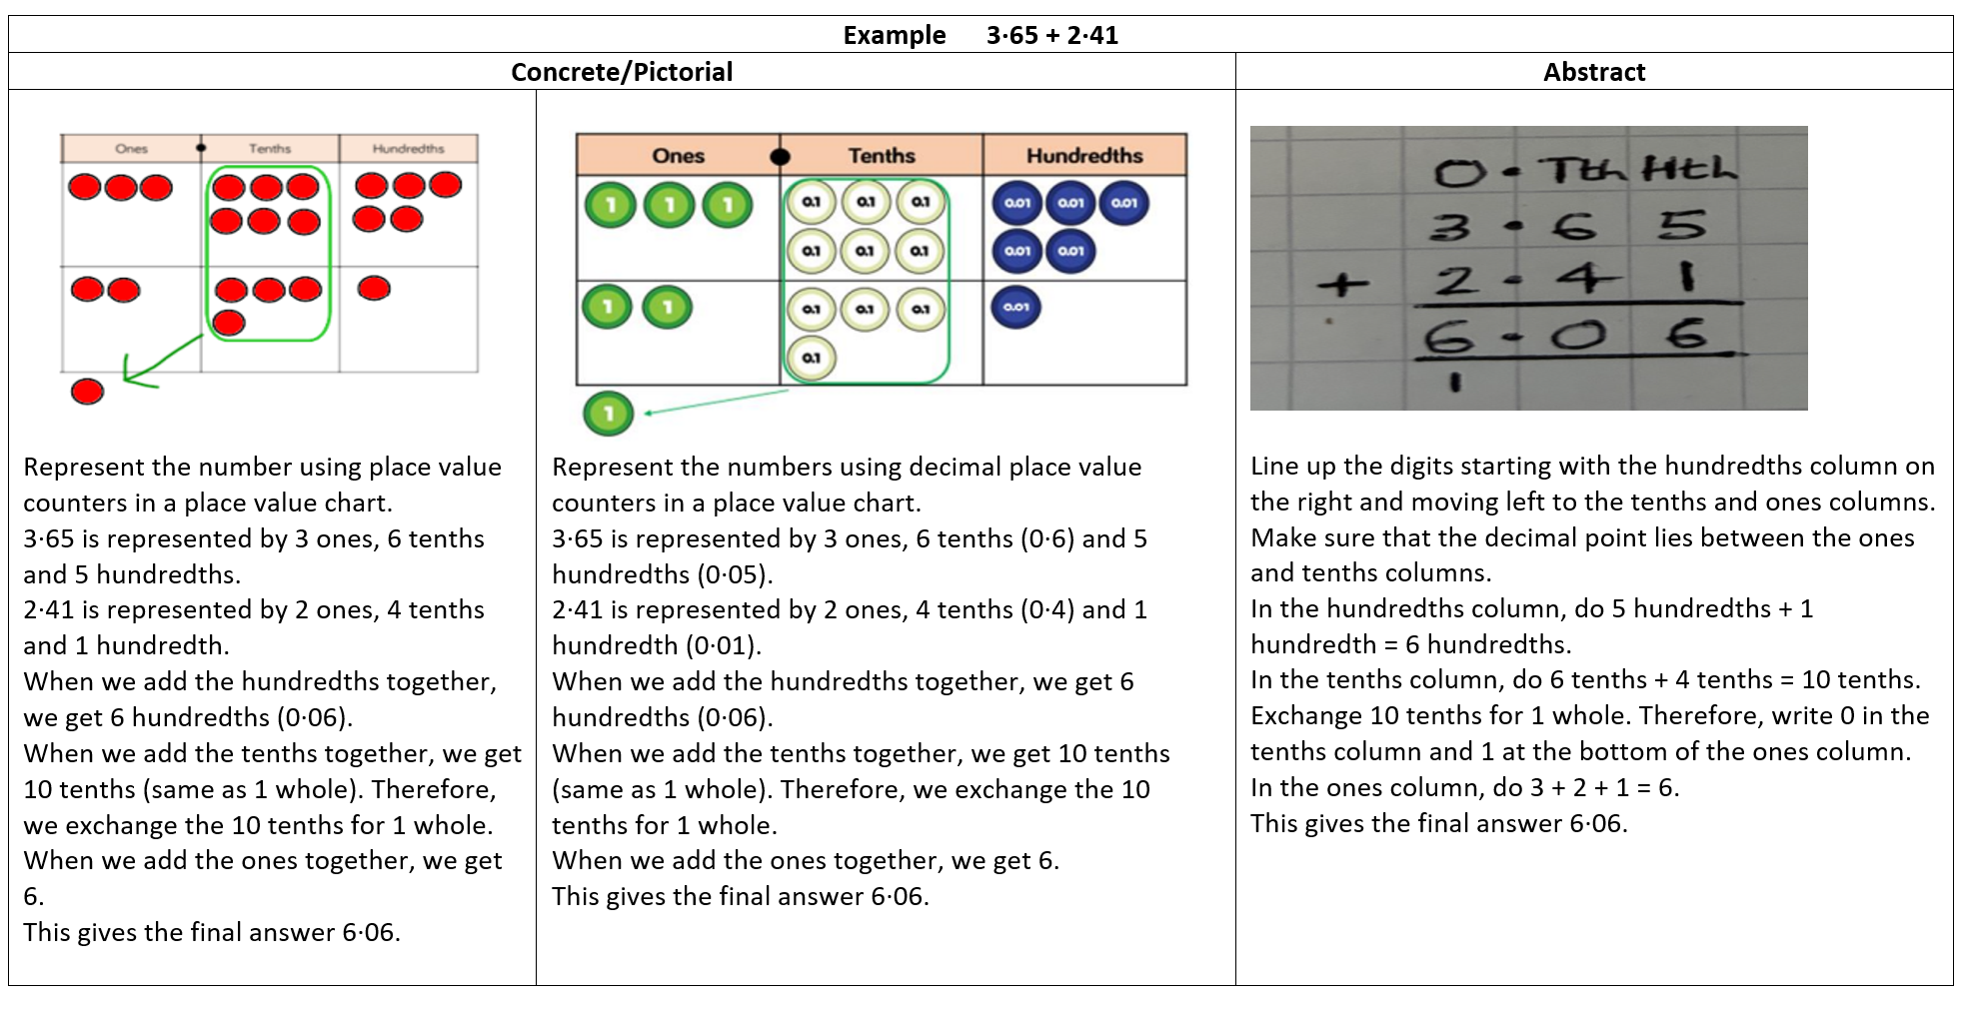
Adding decimal numbers up to 3 decimal places

Slide 30
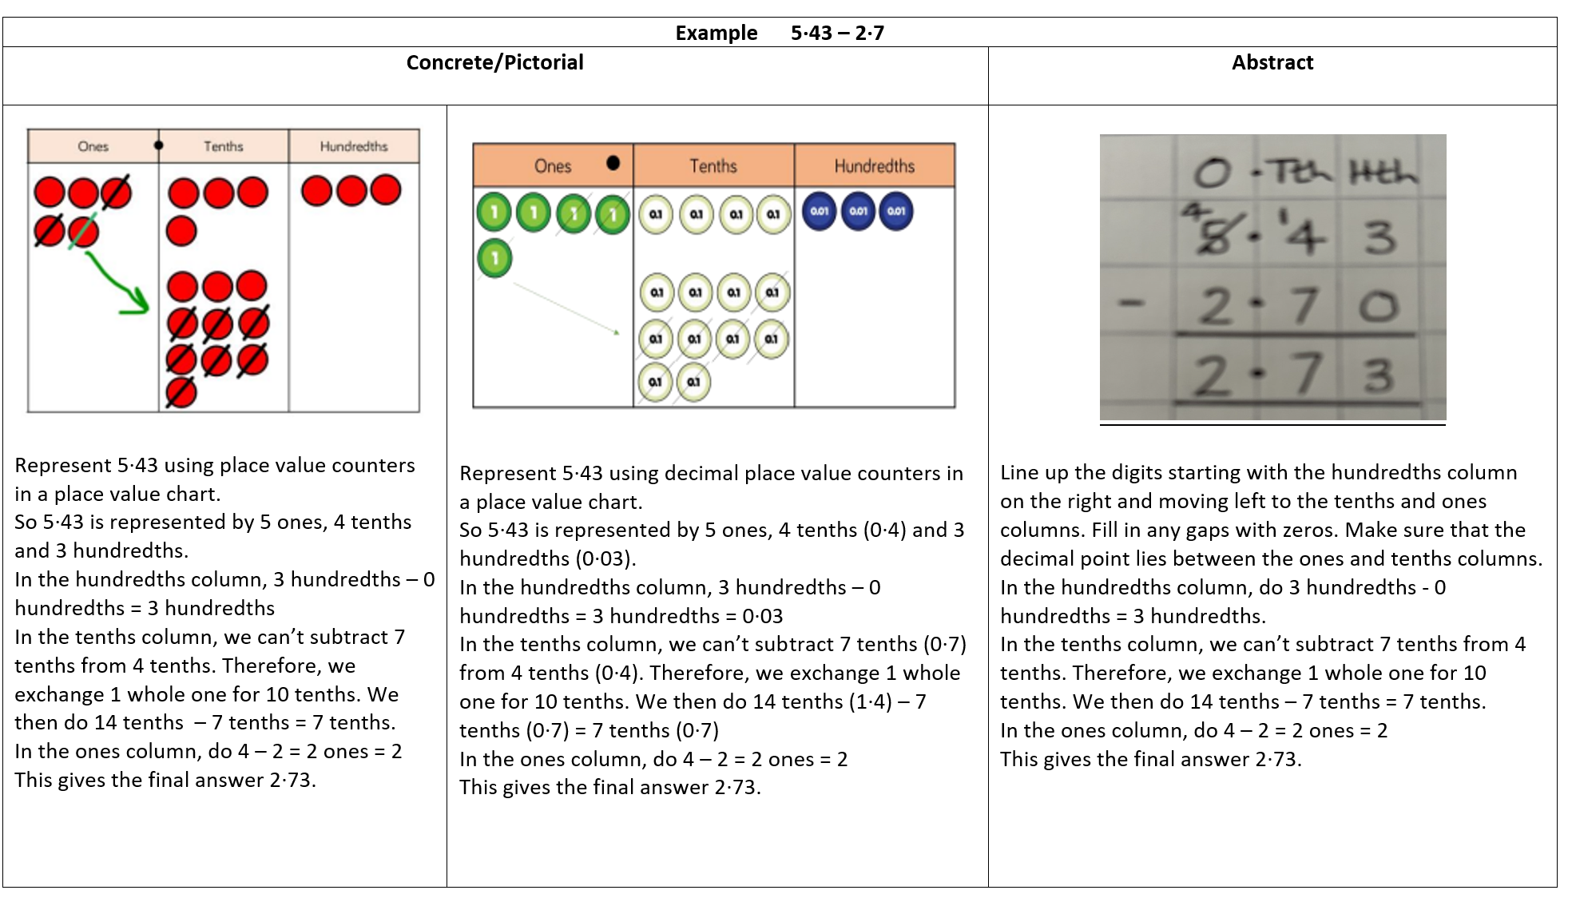
Subtracting decimal numbers up to 3 decimal places

Slide 31
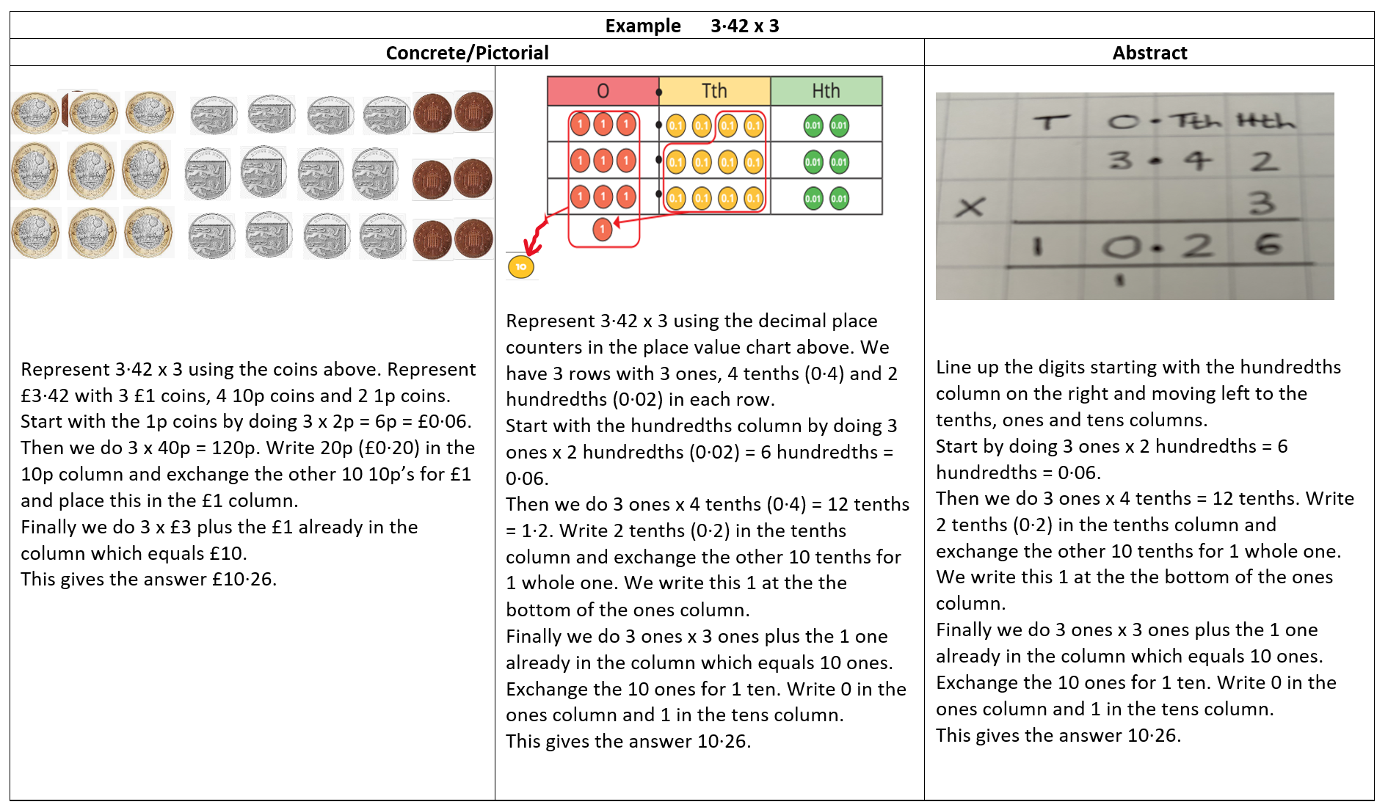
Multiplying decimal numbers by integers

Slide 32
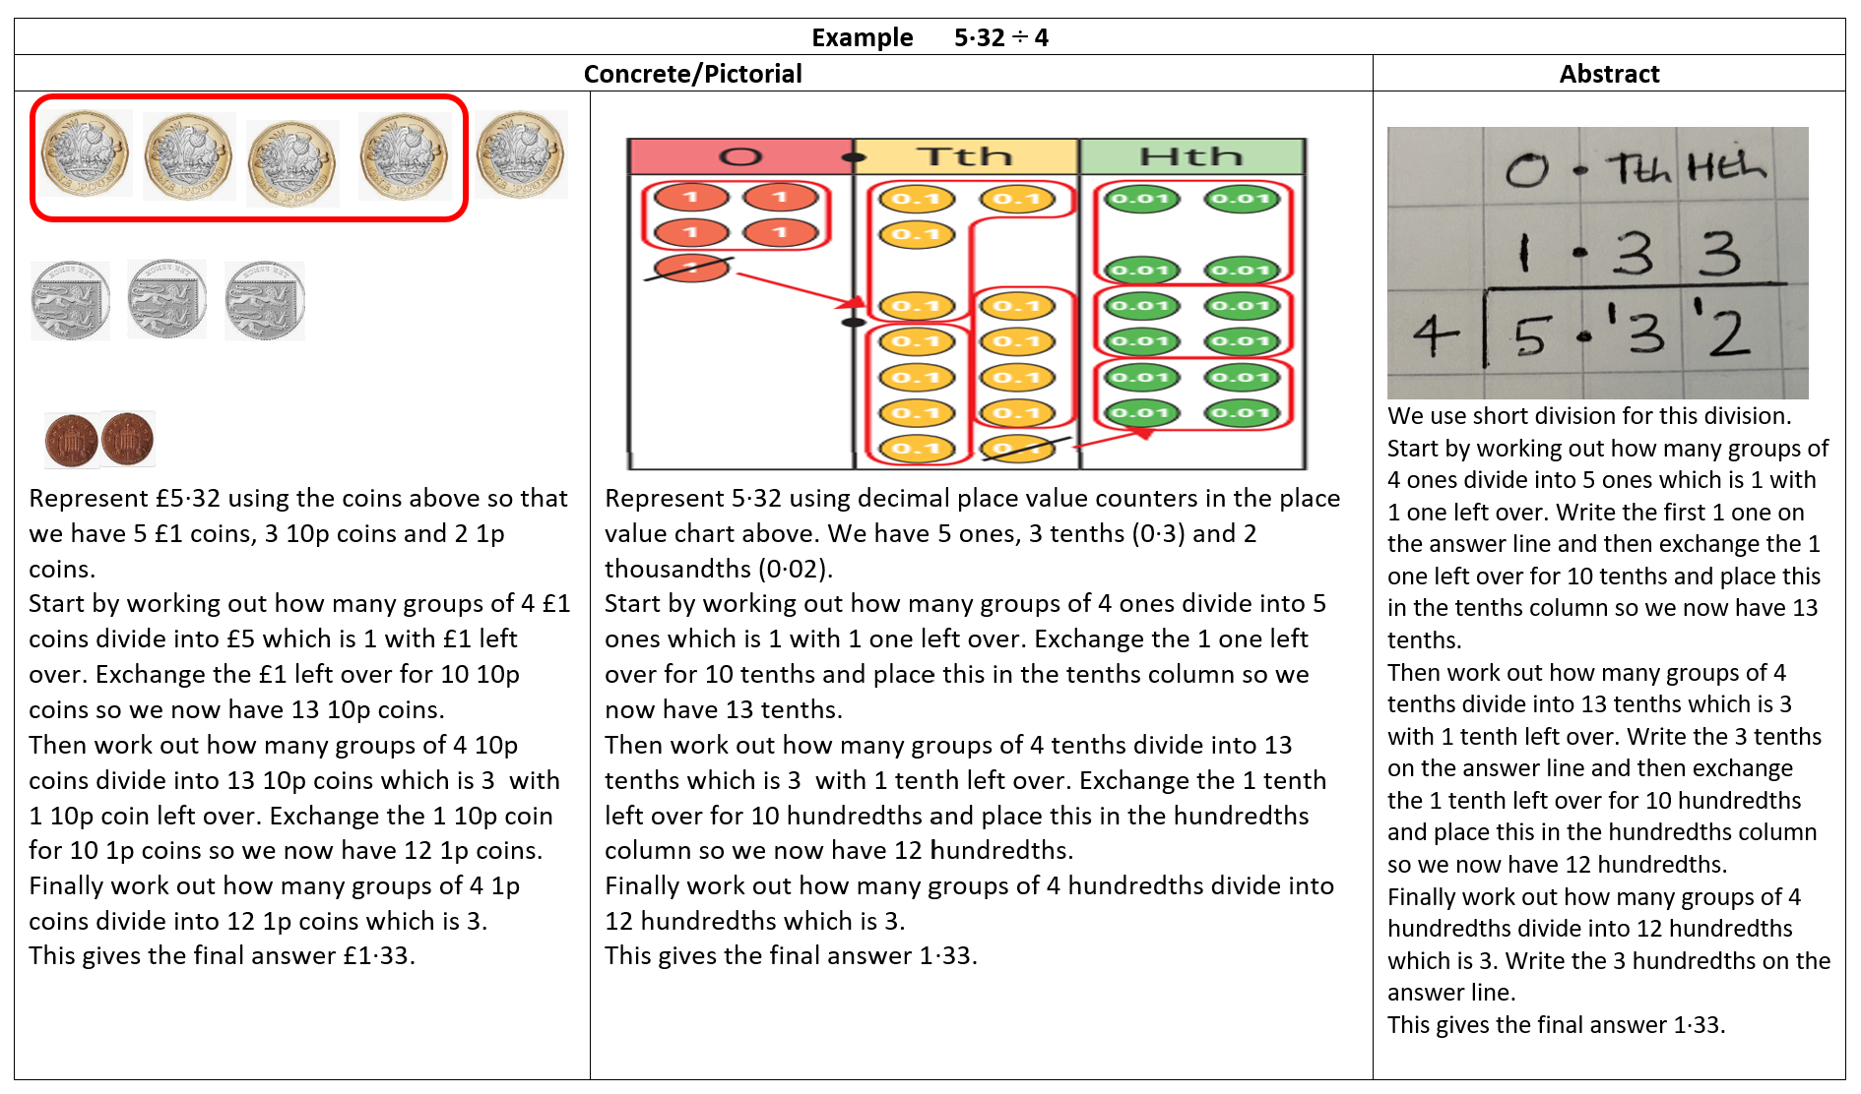
Dividing decimal numbers by integers

Slide 33
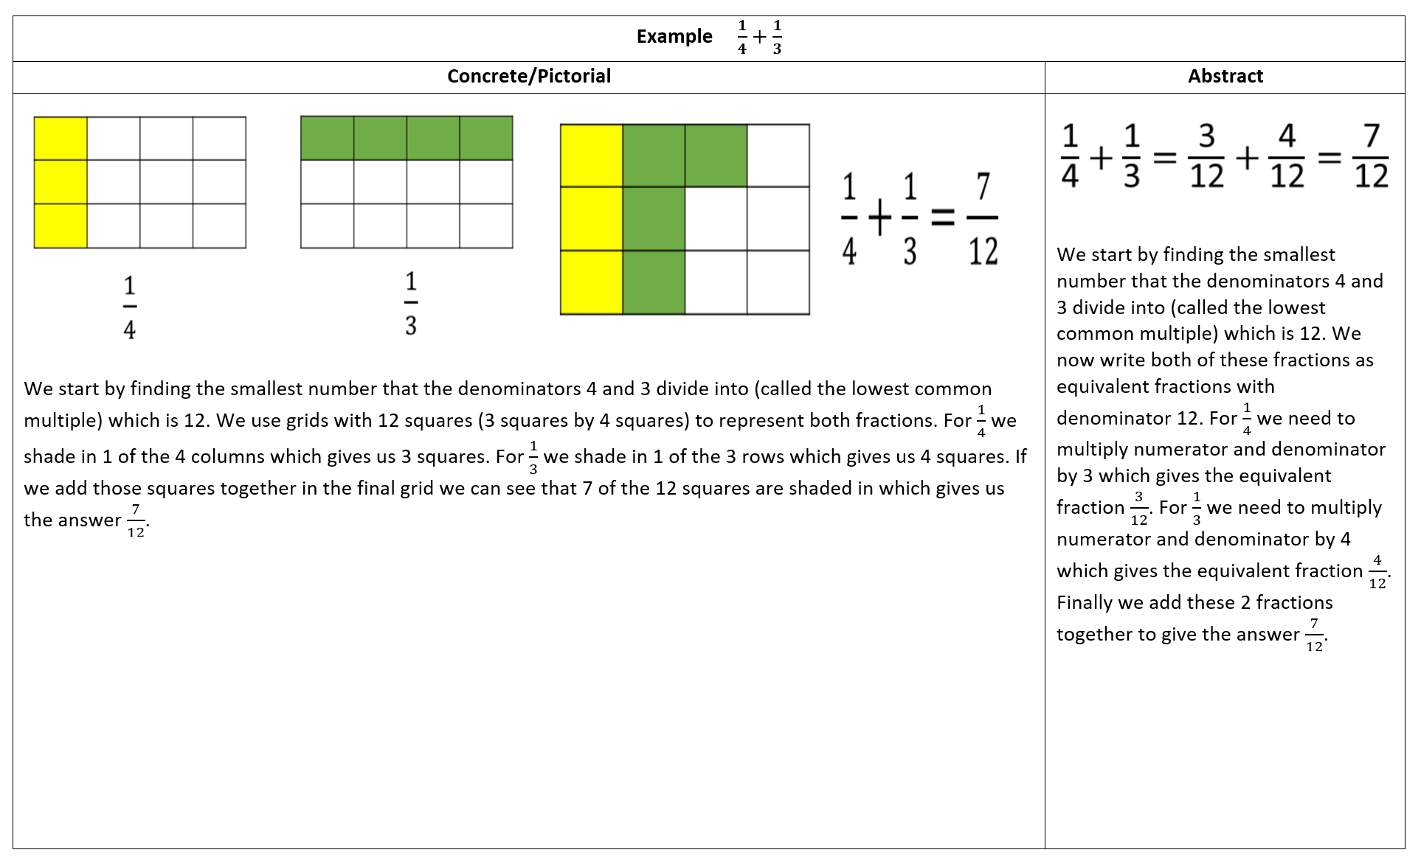
Adding fractions

Slide 34
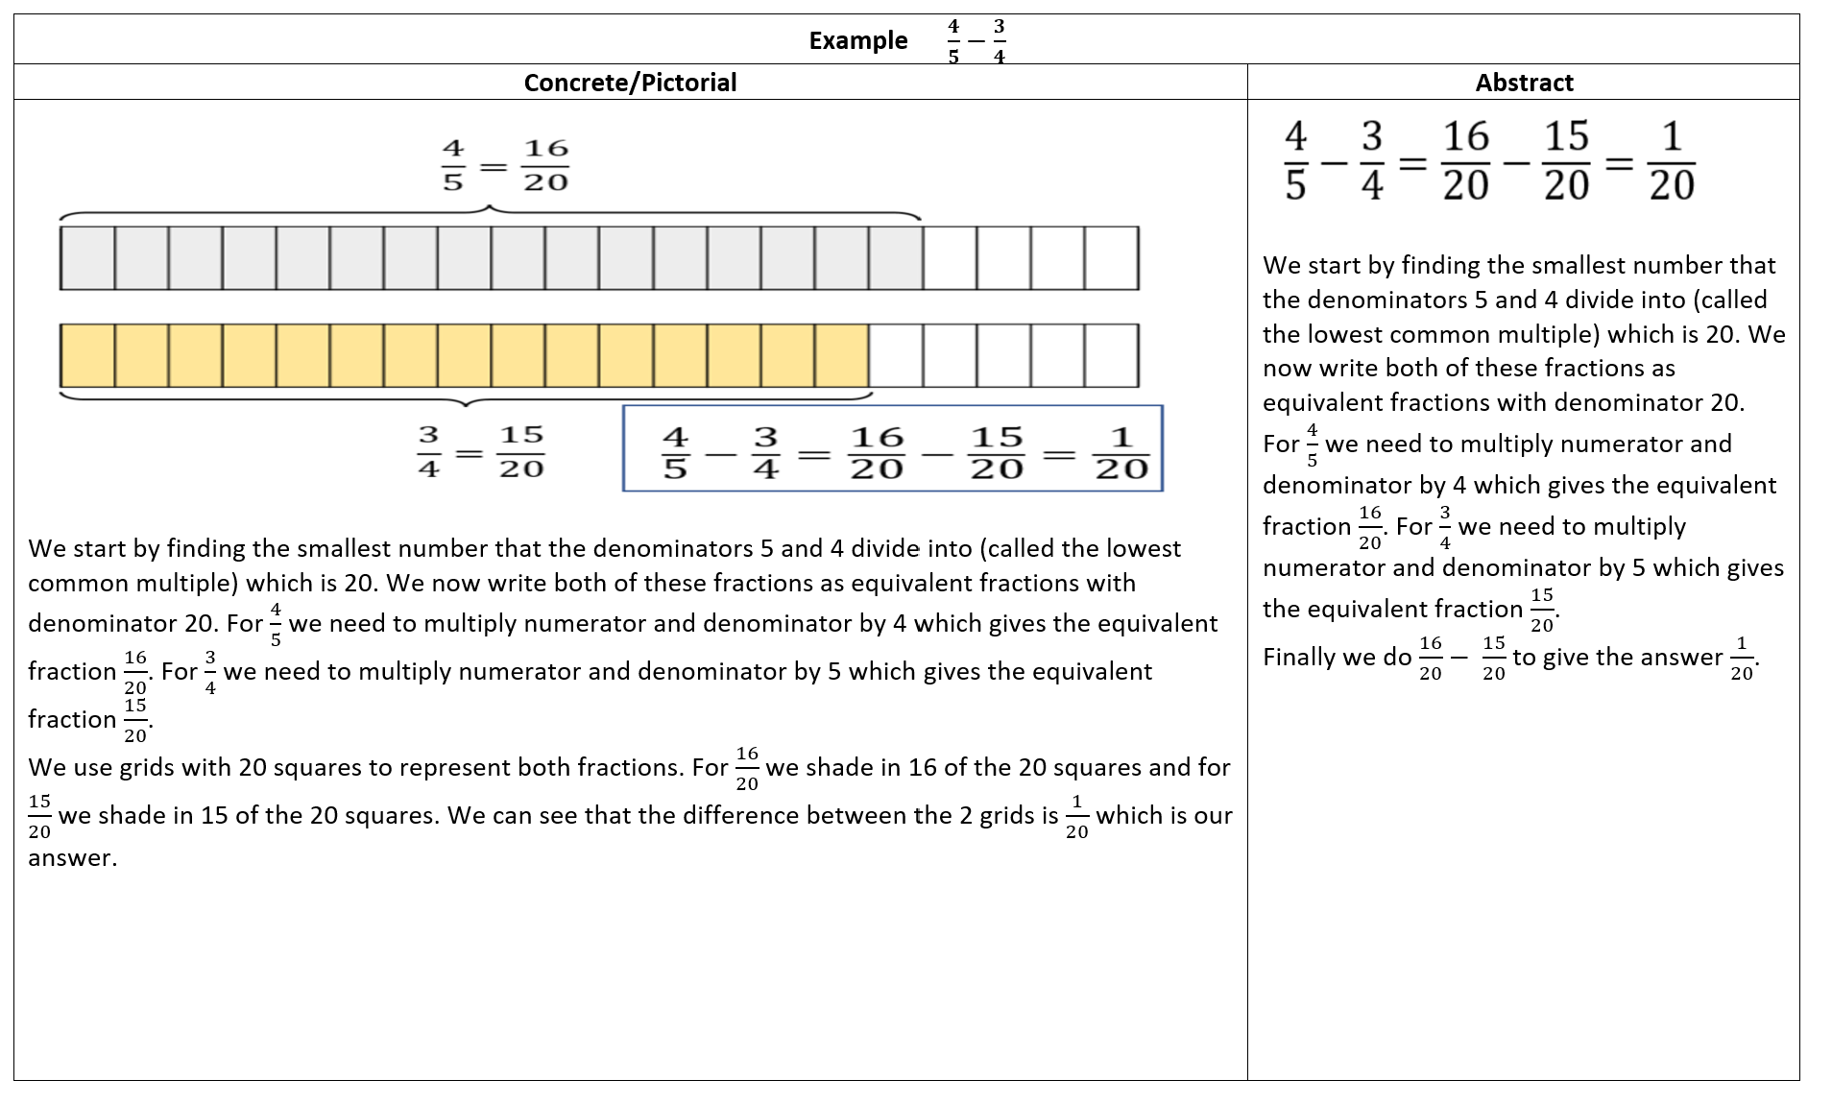
Subtracting fractions

Slide 35
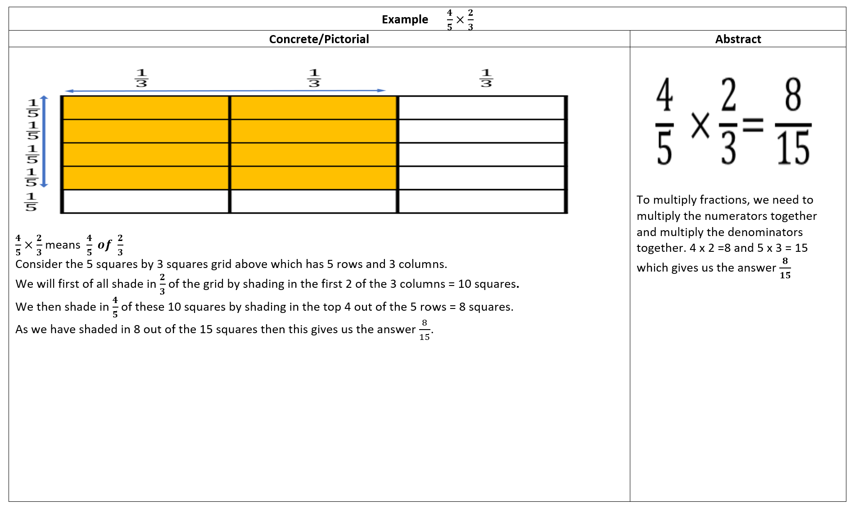
Multiplying fractions

Slide 36
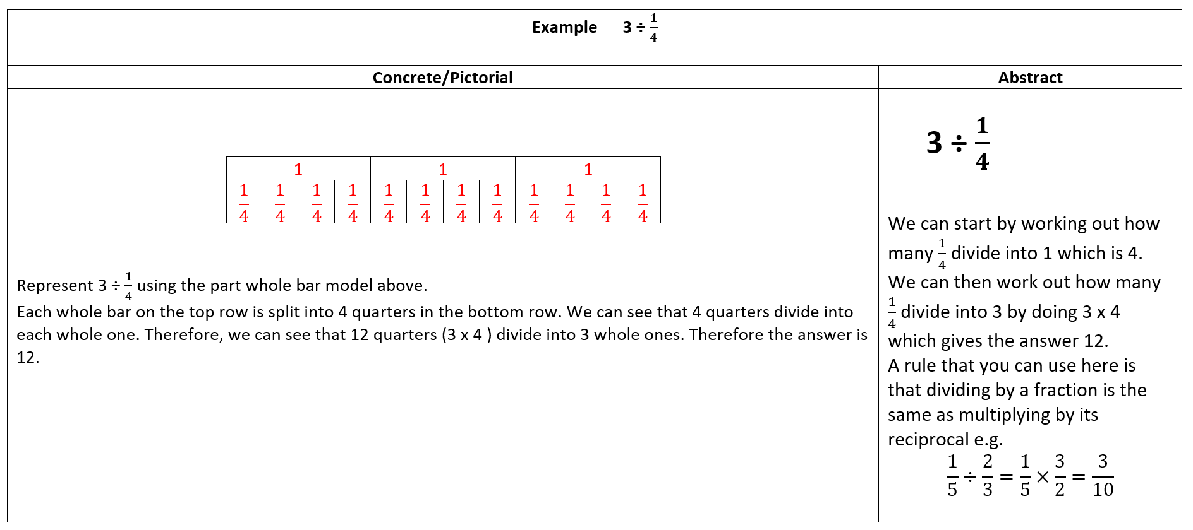
Dividing fractions

Slide 37
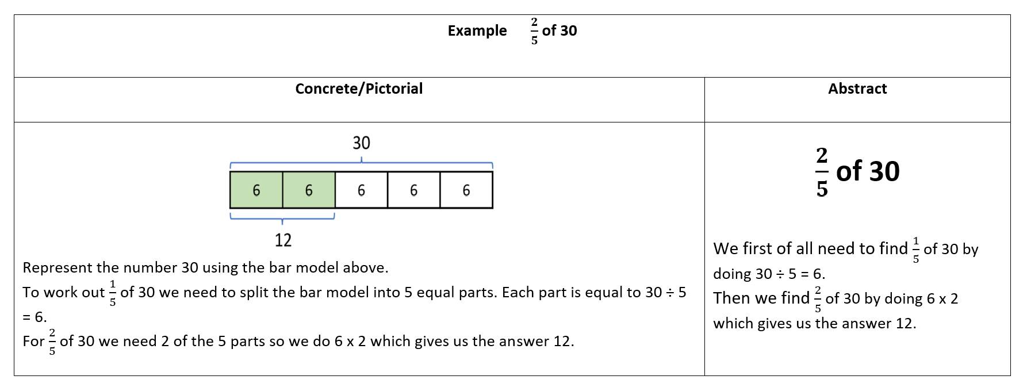
Finding a fraction of a quantity

Slide 38
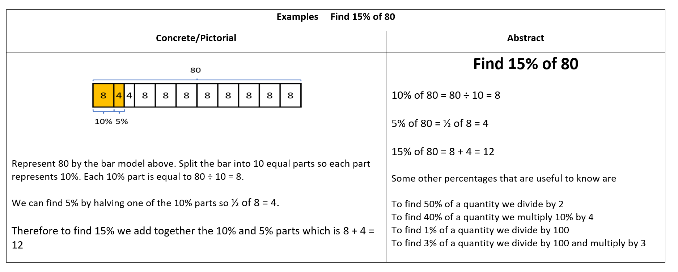
Finding a percentage of a quantity

Slide 39
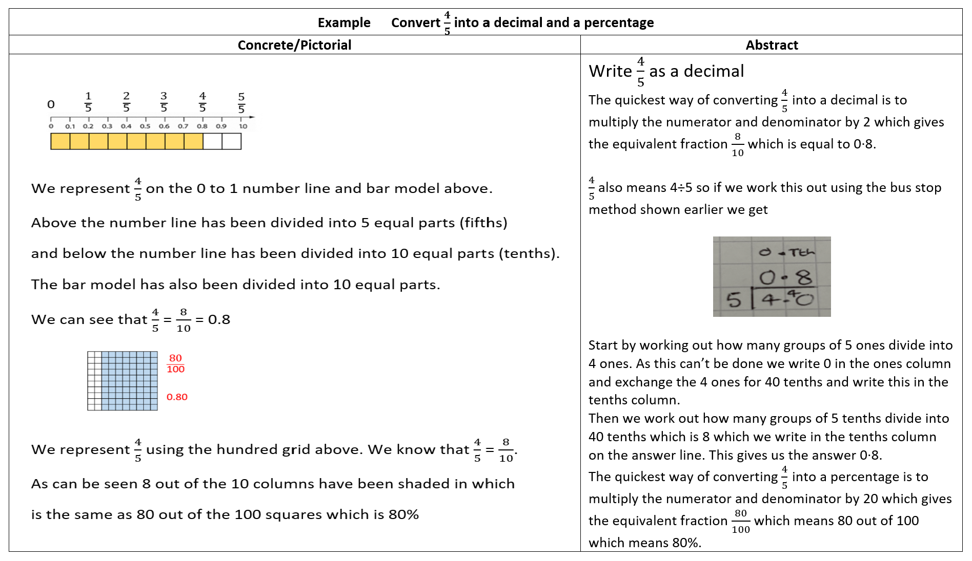
Converting a fraction into a decimal and a percentage

Slide 40
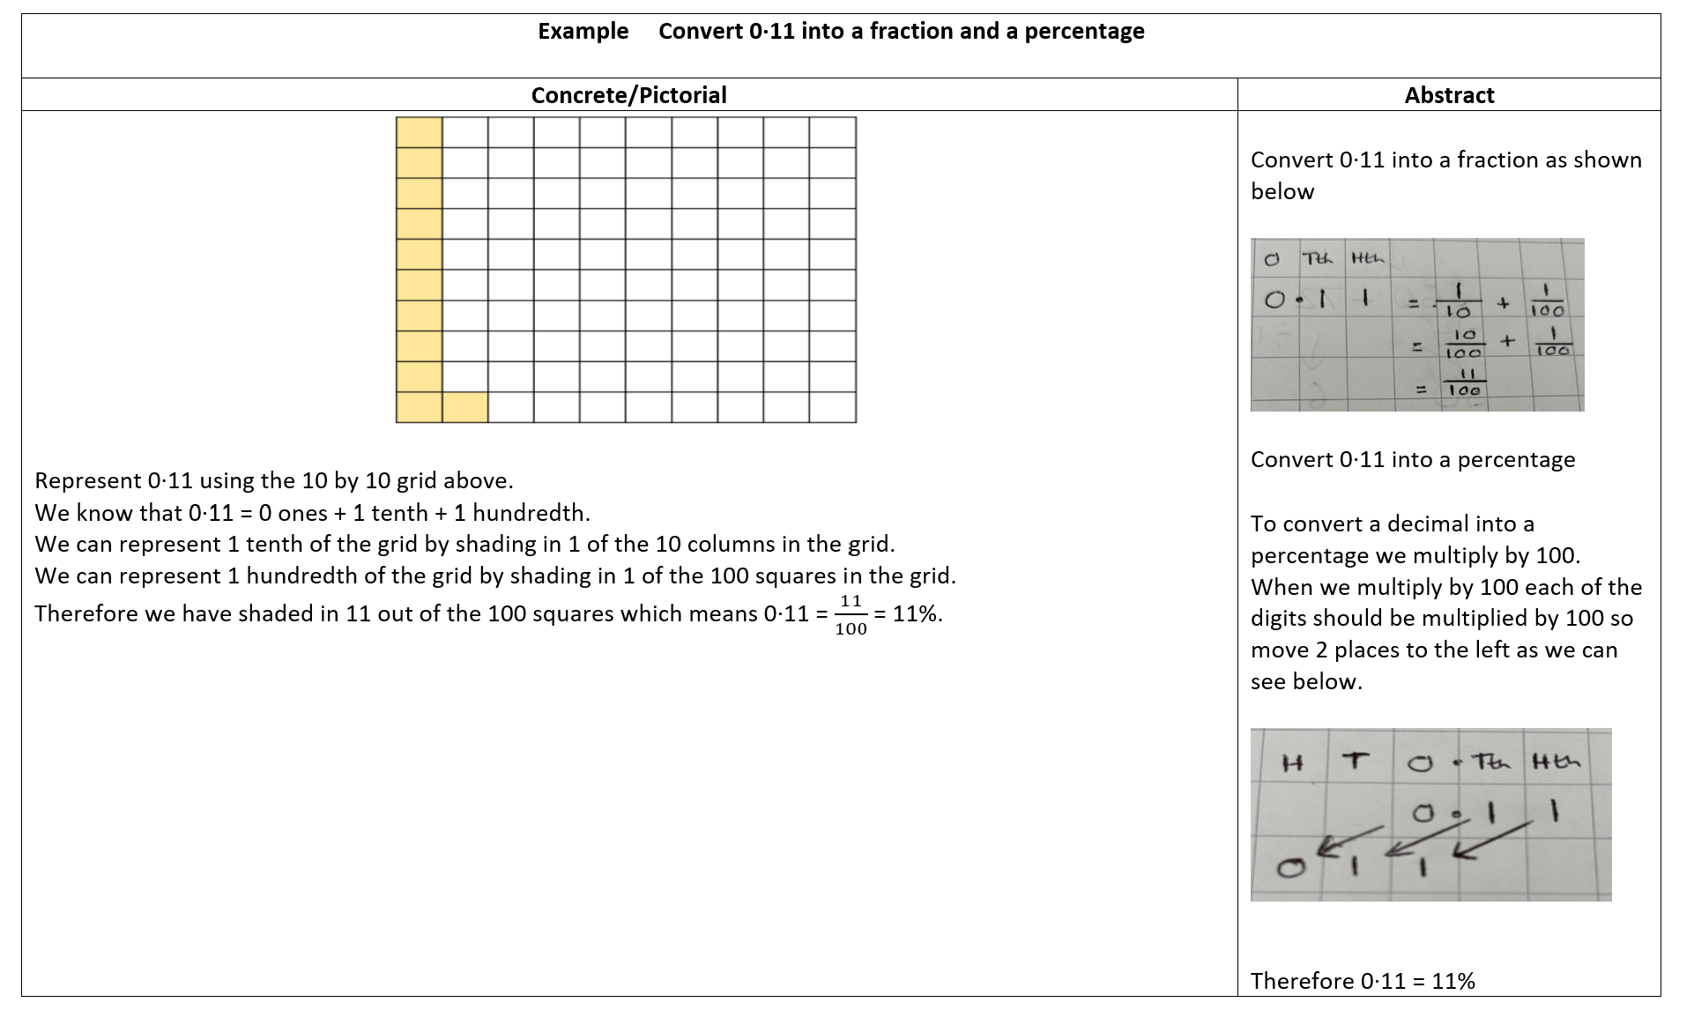
Converting a decimal into a fraction and a percentage

Slide 41
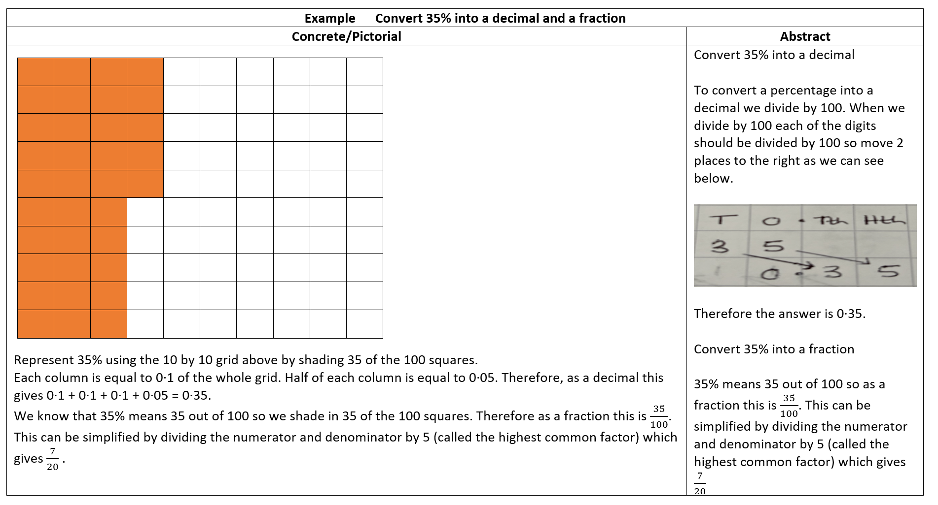
Converting a percentage into a decimal and a fraction

Slide 42
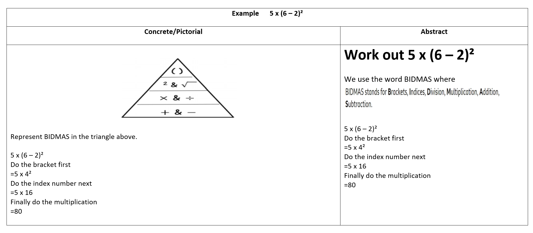
Order of Operations (BIDMAS)

Slide 43
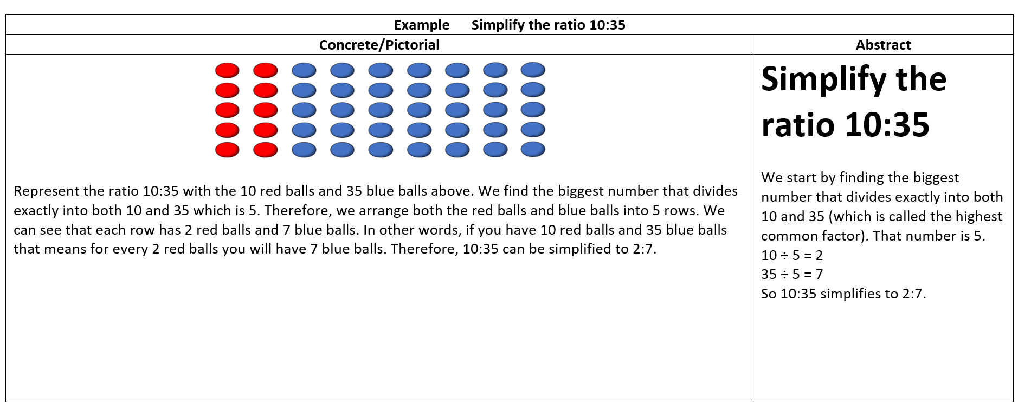
Simplifying a ratio

Slide 44
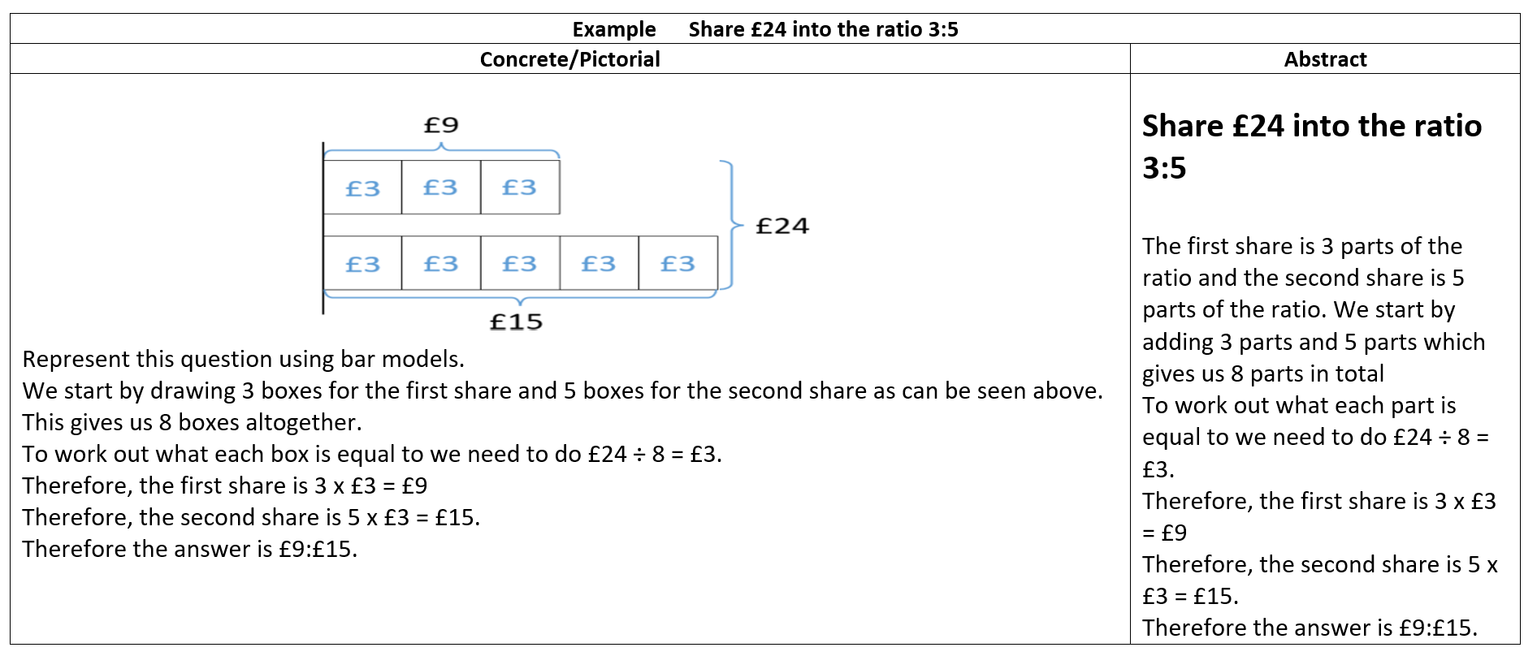
Sharing a quantity in a ratio

