Slide 1

CURRICULUM CAFÉ
CURRICULUM CAFÉ
Year 3 & Year 4
Working together to help every child shine
“We give thanks to God, work together and always try our best.
Shining in little ways for all to see.”

Slide 2




Welcome to our Curriculum Café
Our aim: confident learners who are curious, resilient and ready for the next step.
• A chance to see how learning is developed across
Lower Key Stage 2 – Years 3 and 4.
• Our approach to maths, handwriting, spelling and reading
• A glance at our wider curriculum
• Time to try some of the children’s learning tools
St Gregory’s Catholic Primary School • Curriculum Café

Slide 3
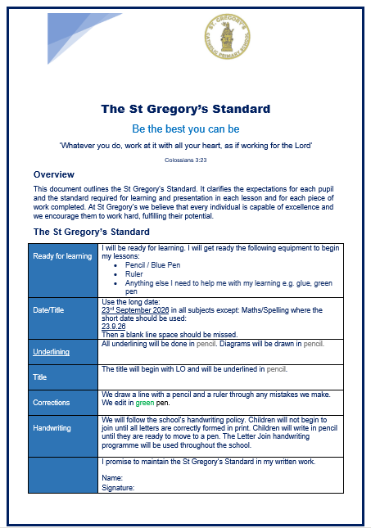
The St. Gregory’s Standard
Each class at St. Gregory’s follows the
St. Gregory’s standard (copies at your tables.)​
​Following the St. Gregory’s standard ensures that high expectations of presentation are reinforced throughout each year group and key stage.
St Gregory’s Catholic Primary School • Curriculum Café

Slide 4
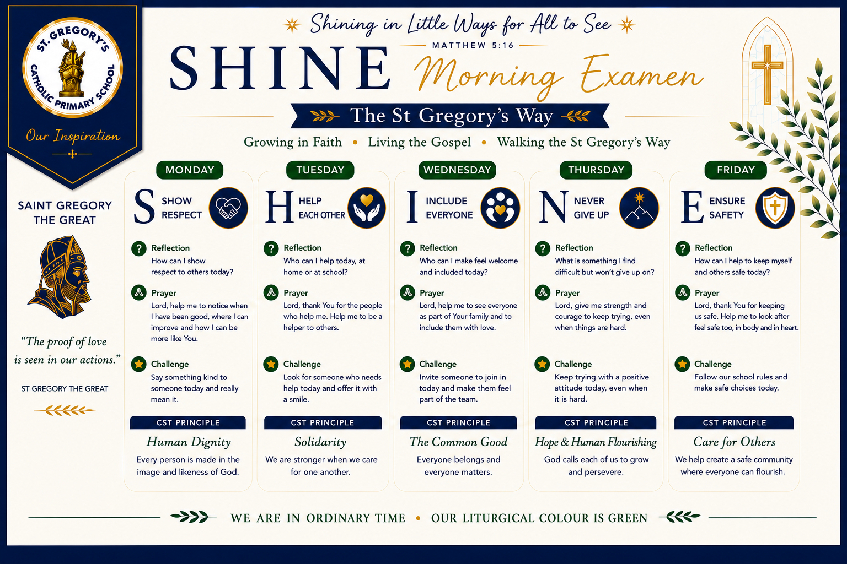
Our SHINE Values
Helping children reflect on how they learn and live together
Our SHINE school values are reinforced daily during morning meetings.
Each morning, children explore what the values mean and reflect on how they can put them into practice.
St Gregory’s Catholic Primary School • Curriculum Café

Slide 5

Maths: Ark Maths
Our maths scheme and approach
This year, we are continuing to teach a scheme called Ark Maths.
Each lesson follows a similar structure to ensure children are following a routine that ensures mathematical language taught through our star words.
inverse
place value
partition

Slide 6
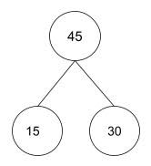
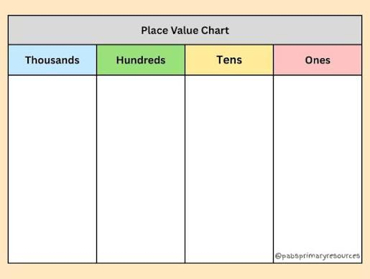
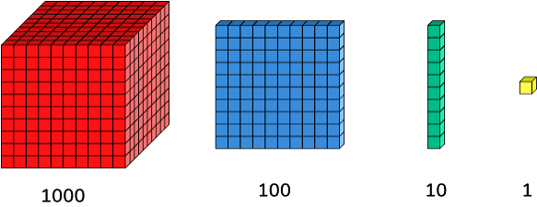
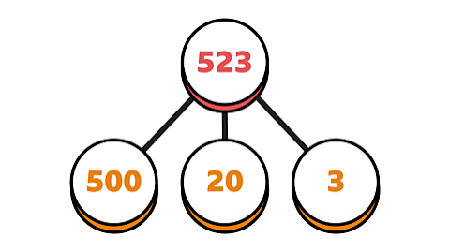
Maths: Ark Maths
Our maths scheme and approach
We use a range of different manipulatives and pictorial representations to support mathematical understanding.
part whole models
place value charts
dienes

Slide 7
Maths: The six-part lesson
A consistent structure for learning
Lessons in Ark Maths are separated into 6 key sections:
Do now – recall and identifying misconceptions
New learning – introduce our concept and mathematical vocabulary
Talk activity – time to explore and test out their learning
Develop learning – challenges their learning
Independent task – children apply their learning by themselves
Plenary – final consolidation of learning

Slide 8
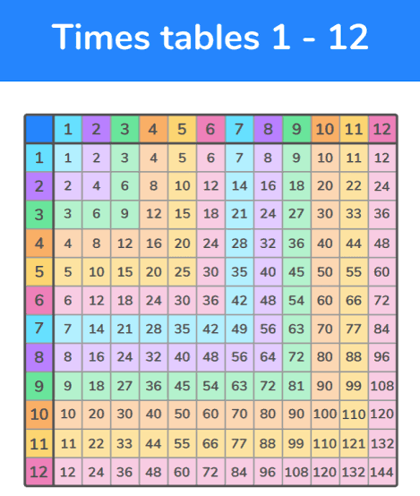
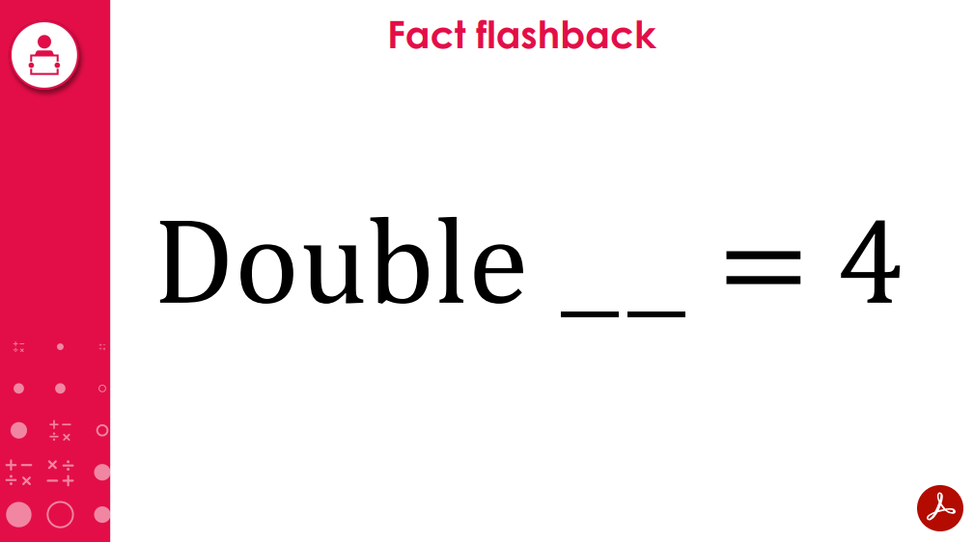
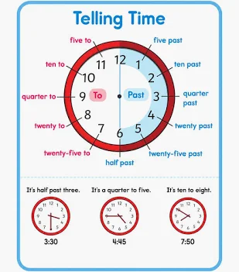
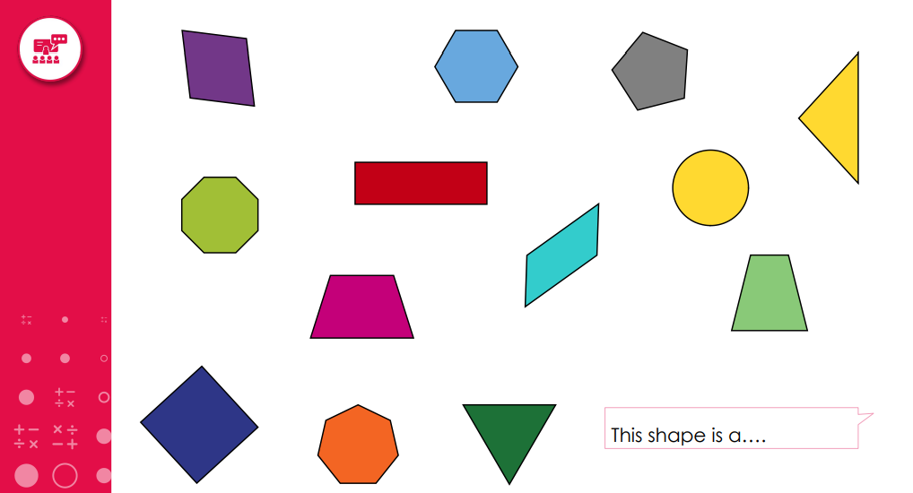
Maths Meetings
Building arithmetic and mathematical fluency
In order to improve arithmetic and fluency skills, each class takes part in a daily ‘Maths Meeting.’
This lesson lasts for approximately 10-15 minutes. The lesson varies depending on the needs of the class. This might be going over number facts, learning times tables or recalling prior knowledge from previous years.

Slide 9

Times Tables Fluency
Times Tables Rock Stars (TTRS)
• Times Table Rock Stars supports children to improve their maths fluency
• Facts are introduced at a pace appropriate for each learner
• Year 4 children practise for the Multiplication Tables Check (MTC) in June
• Garage is recommended: it builds a personal heat map based on facts known and response speed
St Gregory’s Catholic Primary School • Curriculum Café

Slide 10

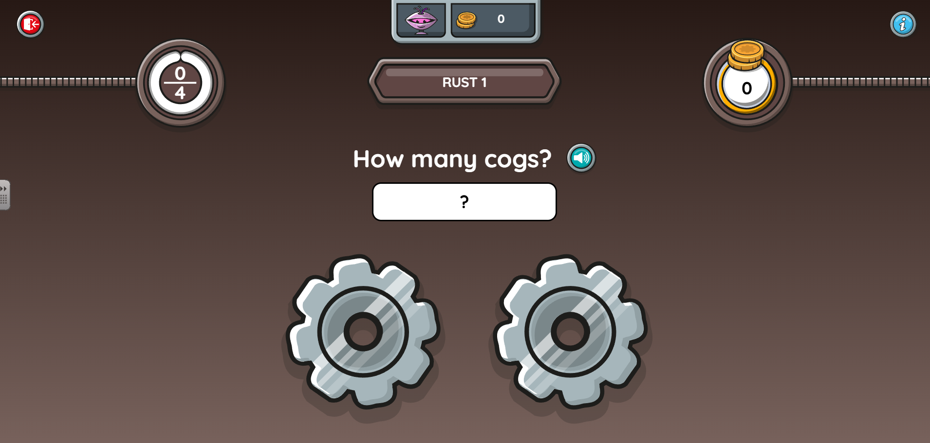
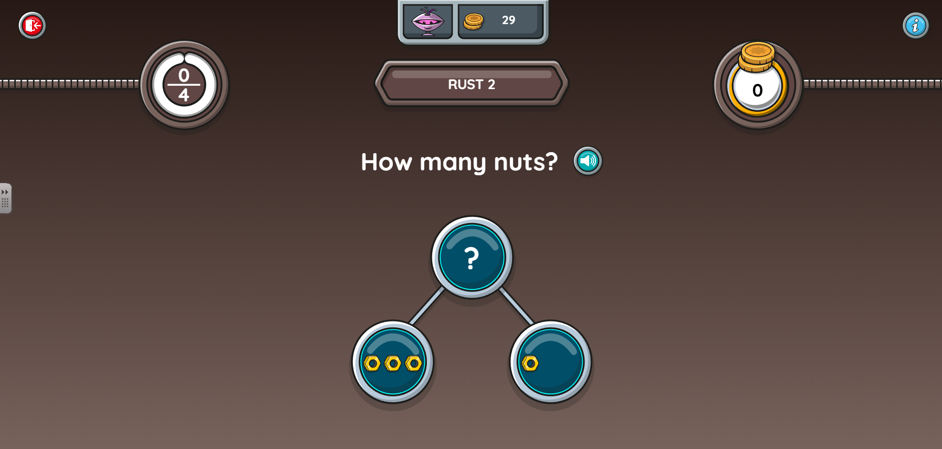
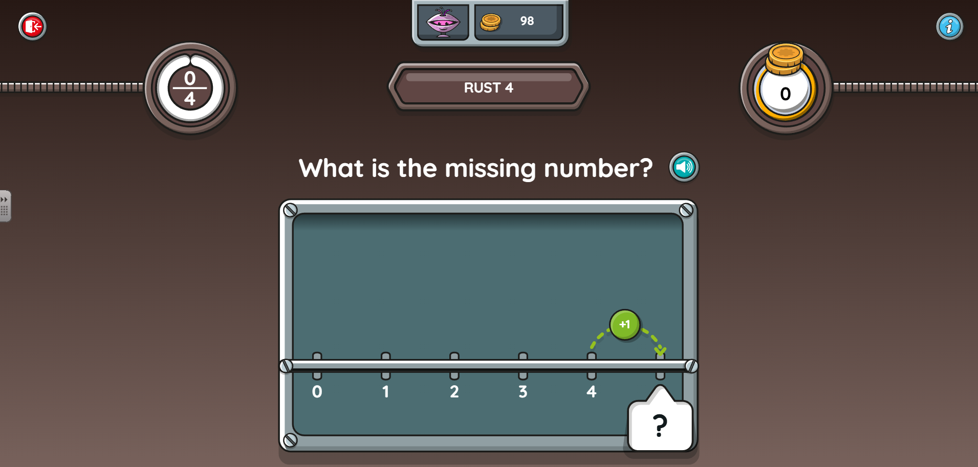
Addition and Subtraction Support
Numbots
TTRS also offers addition and subtraction support through Numbots.
Numbots can be accessed at home or at school using the same log in details as TTRS
St Gregory’s Catholic Primary School • Curriculum Café

Slide 11
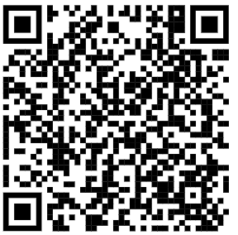

Times Tables Fluency
Your turn!
The best way to see how this program works is to try it yourself. When the children come in, please feel free to use the iPad on your table to scan the QR code.
Once you are on the login page use the following details to sign in:
User: gue1
Password: fyh

Slide 12
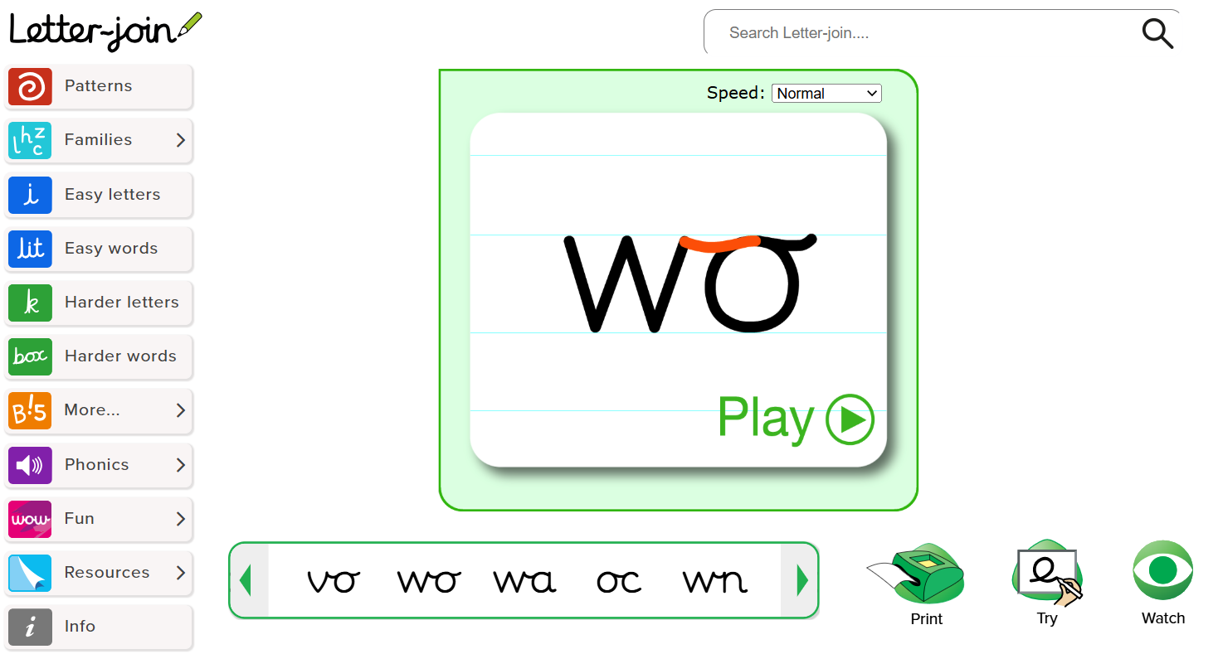
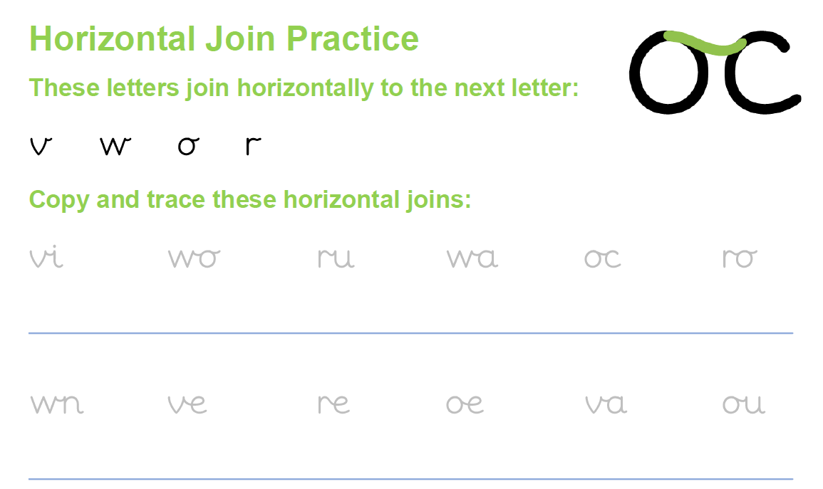
Handwriting: Letter-join
Expectations in Lower Key Stage 2
Handwriting is taught every day across the school.
We follow the programme Letterjoin to support us in the teaching of handwriting.
In Year 3, we have just started learning how to join some letters with diagonal and horizontal letter joins.
In Year 4, the children continue to consolidate and practise their joins.
Pens are given to children when they show consistent and accurate handwriting across subjects.

Slide 13
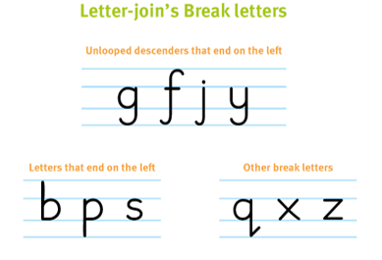

Handwriting: Letter-join
Expectations in Lower Key Stage 2
There are certain letters that we do not join. These are called letter breaks. They are:
We do not teach leading joins in Years 3 and 4.
This comes in Years 5 and 6.

Slide 14

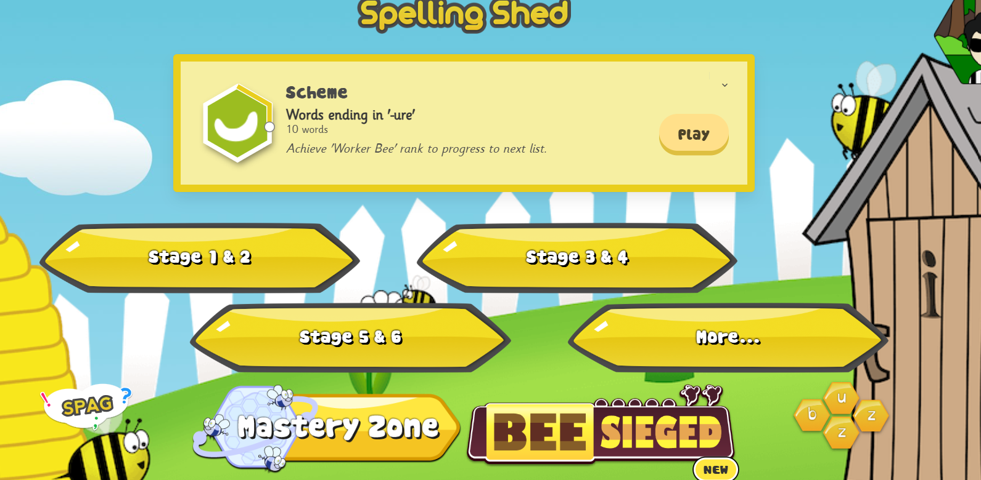
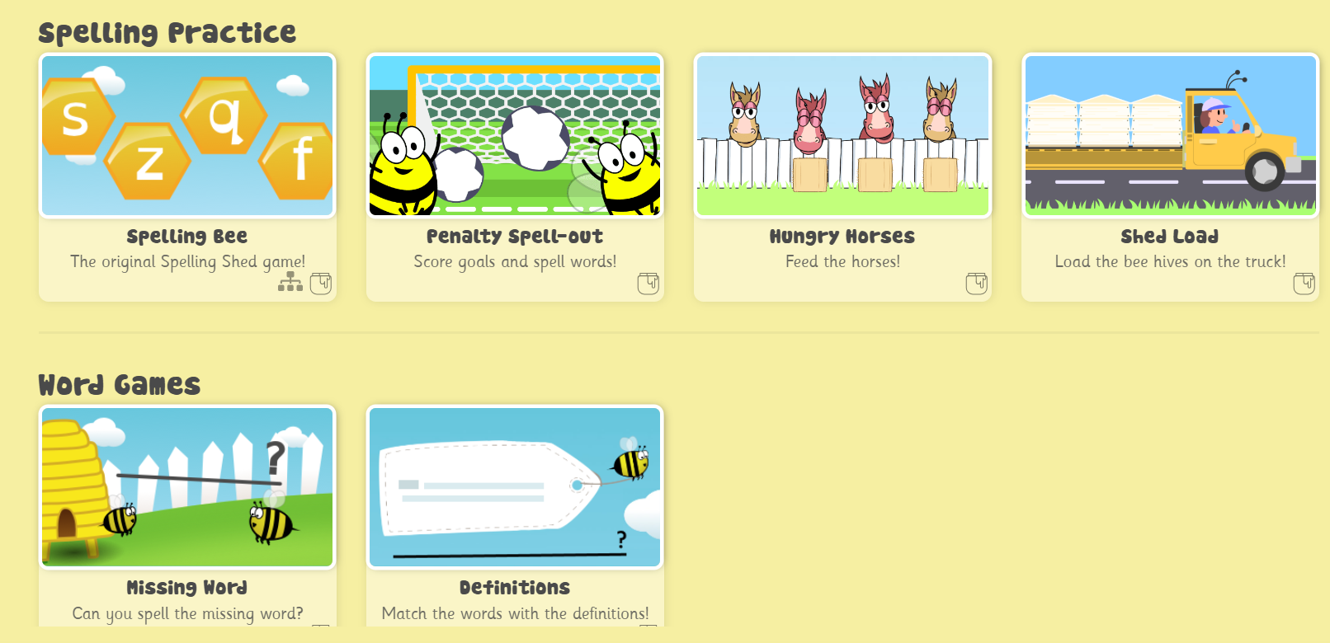
English: Spellings
Expectations in Lower Key Stage 2
We teach a spelling lesson each week using a scheme called Spelling Shed.
Spelling shed sheets are set weekly in the yellow homework books. These are the spellings we are teaching in class and are tested the following week.
There is a website and an app which can be accessed at home to help children practise their spelling which is set weekly as an optional homework.

Slide 15
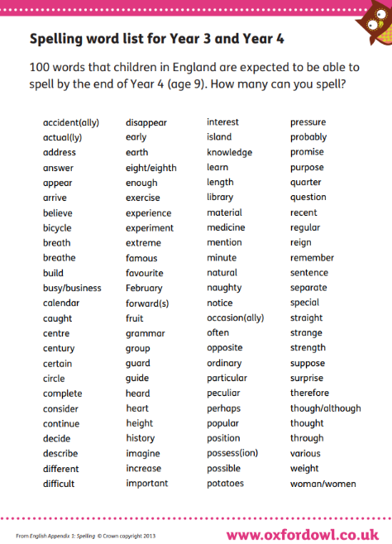
English: Spellings
Expectations in Lower Key Stage 2
The children also learn spellings from the Year 3 and 4 spelling list across both years.
These spellings do not follow a spelling rule.
They are introduced and taught in spelling lessons, but we will also do extra practice as early morning work.
Any extra practice of these at home is really helpful as we know they are very tricky!

Slide 16
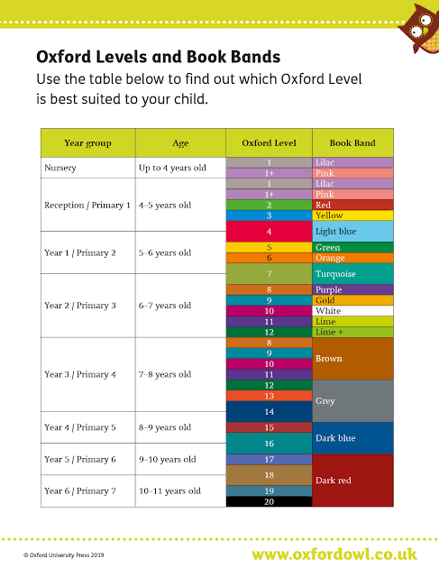
English: Reading
Expectations in Lower Key Stage 2
We would like the children to read 2/3 times a week with an adult at home. We know the children are also doing lots of reading on reading plus as part of their homework.
We ask an adult to sign and date the reading diary each time they hear them read. You are also welcome to include a brief comment about how your child has read.
Reading books and reading diaries should be brought into school everyday.
We know a lot of the children read regularly at home and thank you for your support with this.
St Gregory’s Catholic Primary School • Curriculum Café

Slide 17

English: Reading Plus
Expectations in Lower Key Stage 2
Reading Plus is an effective tool to help develop reading fluency, comprehension skills and improve vocabulary.
Children are asked to complete a Reading Plus activity at home for 30minutes for homework.
St Gregory’s Catholic Primary School • Curriculum Café

Slide 18
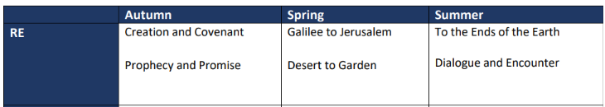
Our other subjects: RE in Year 3/4
St Gregory’s Catholic Primary School • Curriculum Café

Slide 19
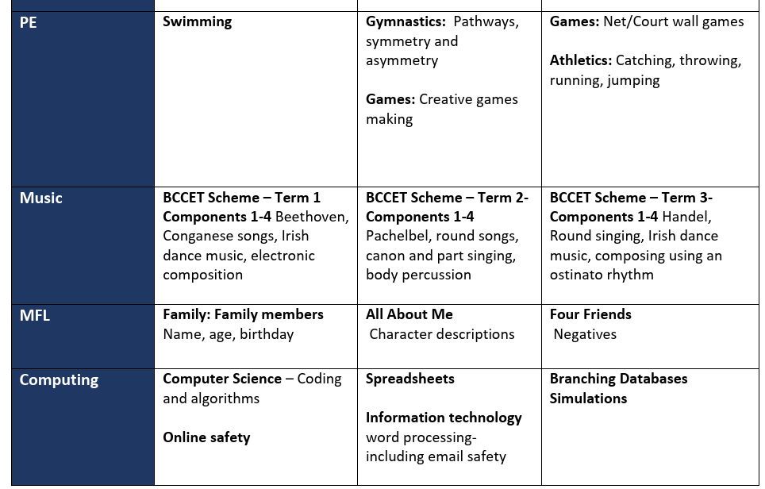
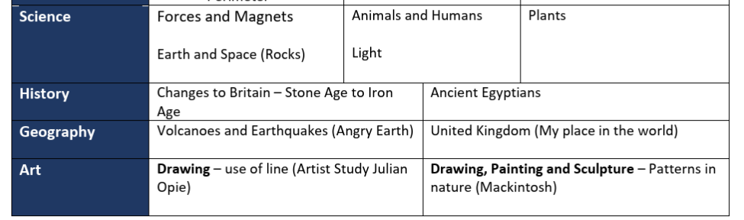
Our other subjects: Year 3
St Gregory’s Catholic Primary School • Curriculum Café

Slide 20
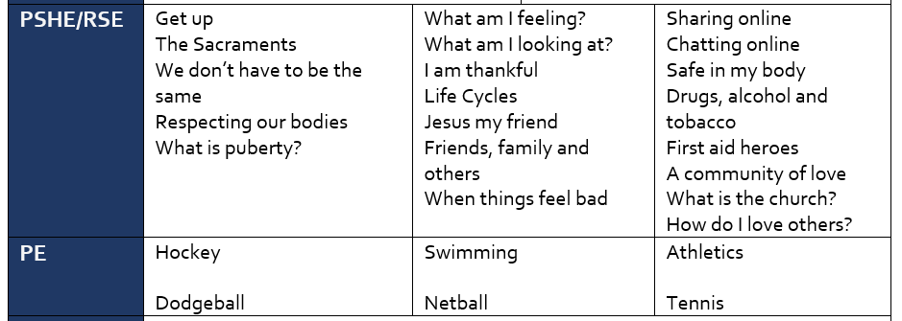
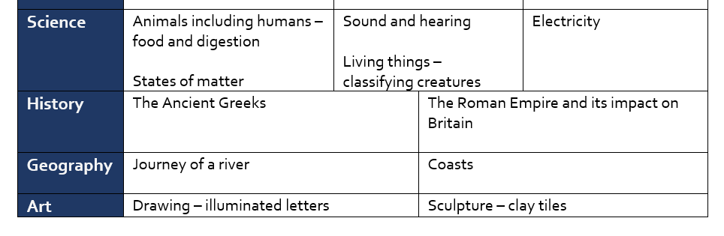
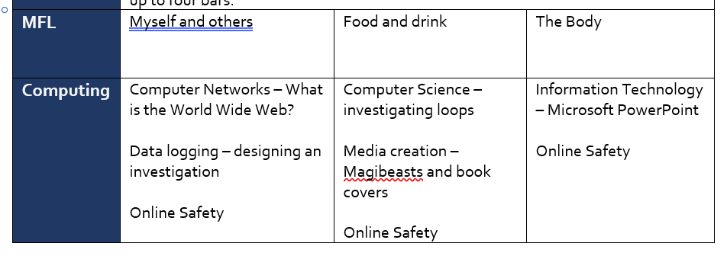
Our other subjects: Year 4
St Gregory’s Catholic Primary School • Curriculum Café

Slide 21
Additional important information
Homework:
Homework is given on a Friday and should be returned the following Wednesday.
How you can help at home:
Y3/4 spellings
Times tables practise
Reading – discussing what has happened in their book / what might happen next / asking them for their opinion
Swimming and PE:
Year 3 are currently having swimming lessons.
Year 4 will begin after Christmas.
St Gregory’s Catholic Primary School • Curriculum Café

Slide 22
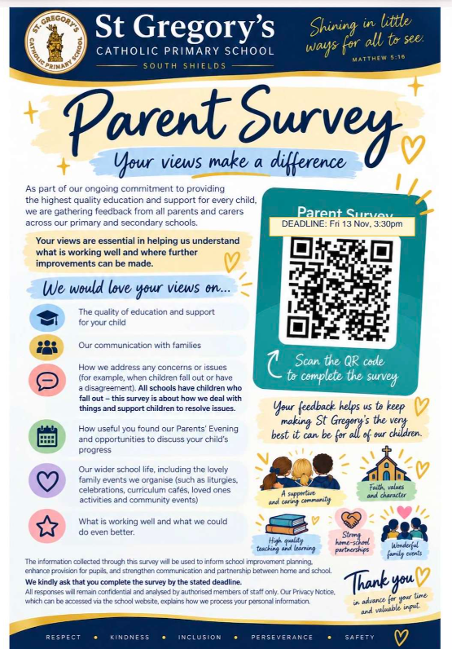
Parent survey
Please could you take a moment to fill in our Parent Survey.
Scan the QR code on the printout in front of you.
Please could we ask that all tea and coffee (and biscuits) are put away before the children come into the hall.
St Gregory’s Catholic Primary School • Curriculum Café

Slide 23
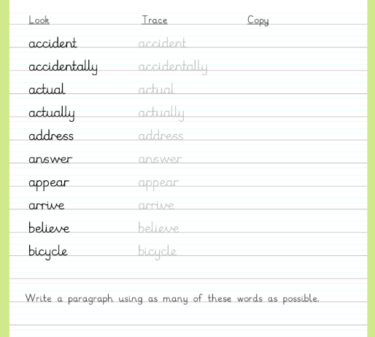
Table activities: Your turn to have a go!
Practise tracing some of our Year 3 and 4 spelling words using our handwriting sheets.
Can you write a sentence together using some of the words?
Make the 3 and 4-digit numbers with dienes. Then write the number in the place value chart – make sure to put the correct digit in each column.
Have a go on TTRS
Once you are on the login page use the following details to sign in:
User: gue1
Password: fyh
St Gregory’s Catholic Primary School • Curriculum Café

