Slide 1






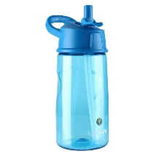
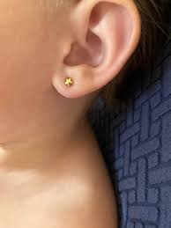

Our Uniform
PE
Blue school logo sweatshirt.
White school t-shirt.
Yellow polo shirt.
Black leggings, tracksuit bottoms or shorts.
Grey trousers or shorts.
Grey trousers, skirt or pinafore dress.
Trainers or pumps.
Black shoes.
Your child will need a PE kit.
This will be kept in school during the term and sent home to be washed during the holidays.
Water bottle
School bag with logo
School hoodies are available for PE days.
Please label all clothing, especially coats, bags, water bottle, jumpers and shoes.

