Slide 1

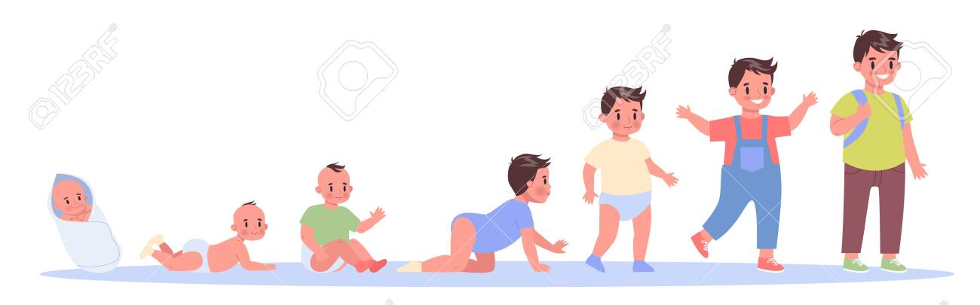
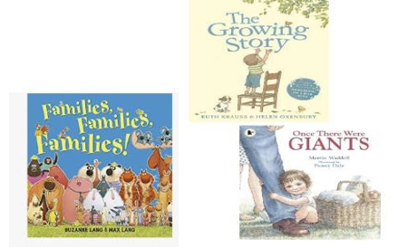
Y1 History Autumn 2 Look at me grow! – How have I changed? Key Concepts: Change and continuity/Chronology
Let’s Remember!
How have teddy bears changed?
How do plants grow and change?
How have I grown? Who is in my family?
Key Learning
How many years have I lived for?
How have I changed over time?
What notable events have we experienced in our lifetime?
Who are the members of my family? How old are they?
What are birthdays and how do we celebrate them?
Assessment Writing Task
How have I changed?
Key Vocabulary
Baby Toddler Adult Younger Older Teenager Parent Grandparent Child Children | Year Month Before After Now Then Growth Celebrate Party
Key Information
Everyone has their own unique age! It's the number that tells us how many years we have been alive for. Some people are younger, while others are older. To find out your age, we only need to know the month and the year you were born in.
As we grow older, we change in many ways. If you look at a photograph of you as a baby, you might notice that you were much smaller back then, with tiny hands and feet. You might have had less hair or even no teeth yet! But as time passes, we slowly grow taller, stronger, and start to look more like grown-ups. We also become better at doing things we couldn't do before, like walking, talking, and even riding a bike!
Birthdays celebrate the day we were born! Every year, on the date we were born, we get to have a special day just for us. We often celebrate birthdays by having parties with our family and friends. We give and receive presents, enjoy delicious food and cake, and sing the happy birthday song. It's a time to feel special and to cherish the people who care about us.

