Slide 1

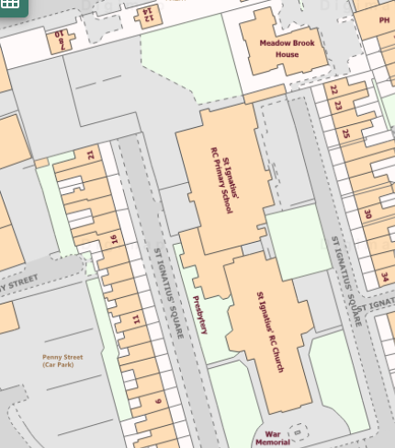
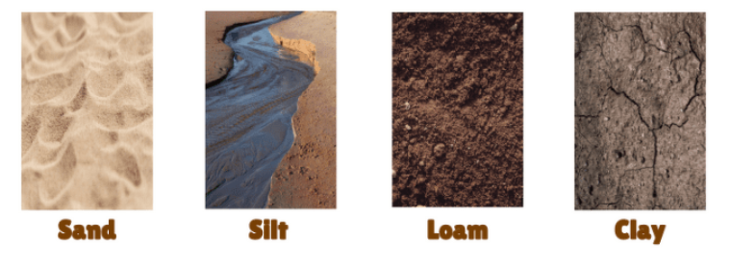
Y1 Geography Autumn 1 What can we improve about our school grounds? Key Concept: Environment
Let's Remember! Environment
Natural Materials are materials that are ‘naturally’ found around us. We may have to dig them out of the ground, grow them or take them from living things.
Manmade materials are materials that are changed by ‘humans’
Our school is in Preston.
Key Learning
What are the human and physical features of our school?
Where do plants live in our school? Sketch Map.
What are the different types of soil?
What do you like about our school and what would you change?
Assessment Writing Task
What can we improve about our school grounds?
Types of Soil
Silt: This soil feels smooth and powdery when it's dry. When it’s wet it feels smooth but not sticky.
Clay: This soil has lots of food that is good for plants but it doesn’t let much air or water through. It is smooth when it’s dry but sticky when wet.
Loam: This soil is a mixture of the other three types of soil. Clay soils and loam soils make good mud.
Sand: This soil has the largest particles and is usually found in hot places.
Key Vocabulary
Natural Manmade Physical Human School Plants Vegetation Buildings Soil Silt Clay Loam Sand
Map of Our School

