Slide 1

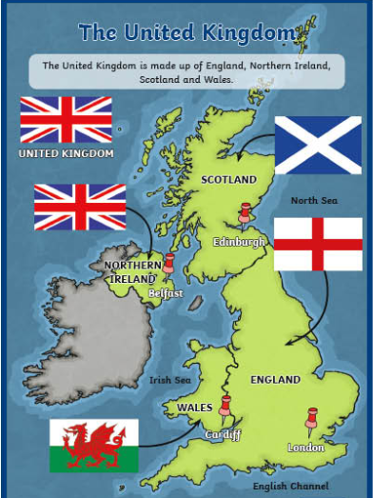
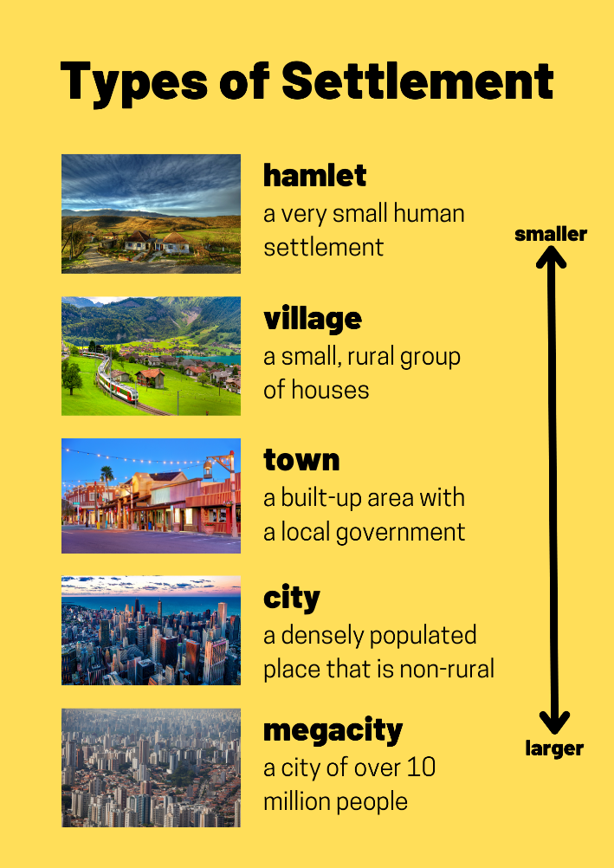
Y1 Geography Spring 2 What are the countries, capital cities and the characteristics of the UK? Key Concept: Scale
Let's Remember!
Our school is in Preston.
Preston is a city.
Key Learning
What are the different types of settlements?
Where is the UK on the globe? What are the countries in the UK and where are they?
What are the capital cities in the UK?
What are some of the UK’s famous landmarks?
Can I locate the surrounding seas?
Assessment Task
Label the countries, capital cities and surrounding seas of the UK.
Key Vocabulary
Village Town Hamlet City Megacity Countryside Globe United Kingdom Country Sea | Sea Ocean Scotland England Wales Northern Ireland Irish Sea North Sea English Channel

