Slide 1

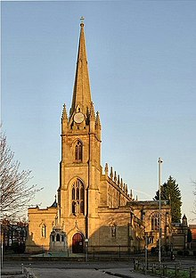
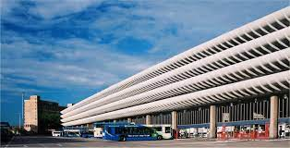
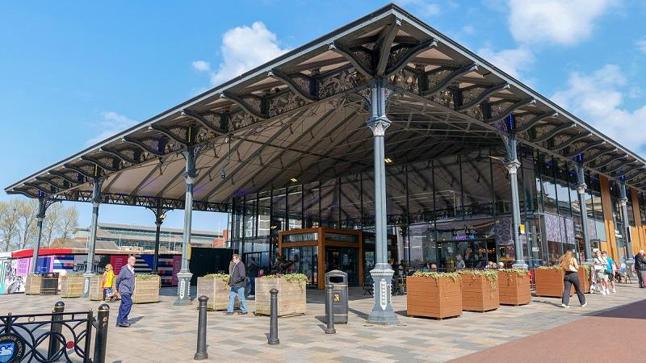
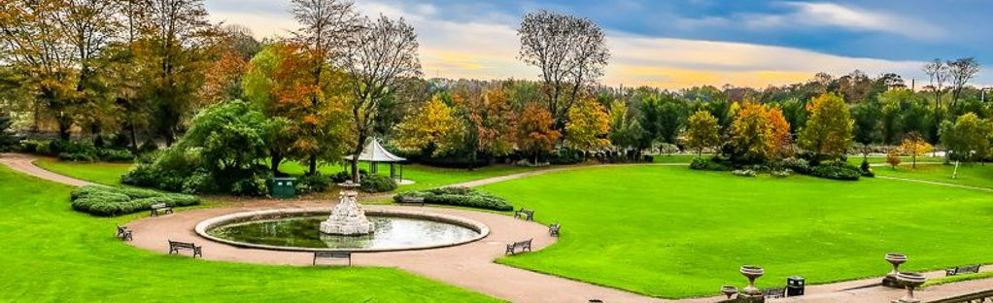
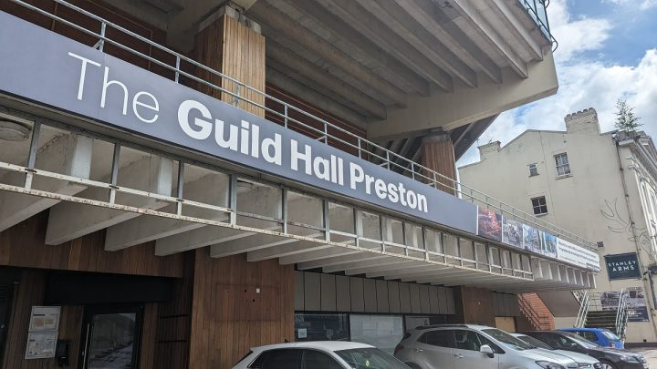
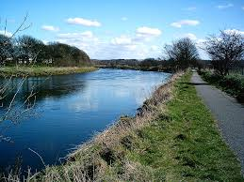
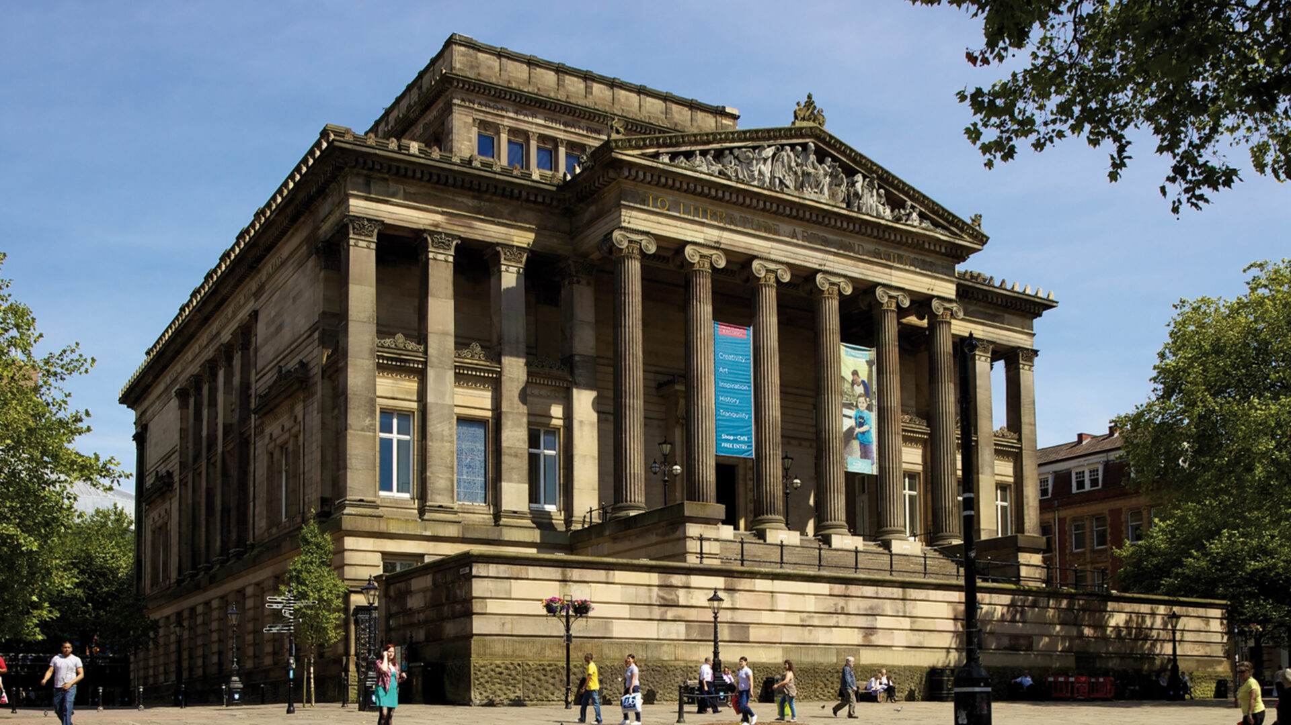
Y1 Geography Summer 2 What are the key features of Preston? Key Concept: Place
Let's Remember! Place
Our school is in Preston.
Preston is a city.
What is a human feature and what is a physical feature?
Key Learning
What are our local landmarks?
What are the human and physical features in our local park? Sketch Map and photographs.
What types of buildings does Preston have?
What are the physical features of Preston? River Ribble and where it leads to.
Assessment Writing Task
What are the key features of Preston?
Preston Bus Station
Preston Market Hall
Key Vocabulary
City Local Landmark Human Physical House Shop Office Factory River Ribble Docks Estuary
St Ignatius’ Church
Avenham Park
The River Ribble
The Guild Hall
Harris Museum

