Slide 1


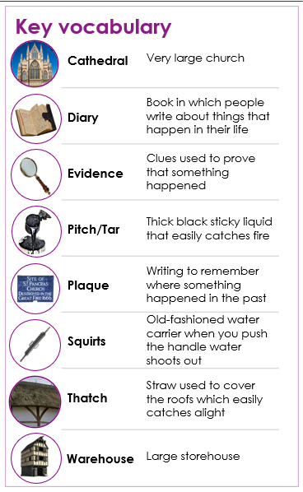
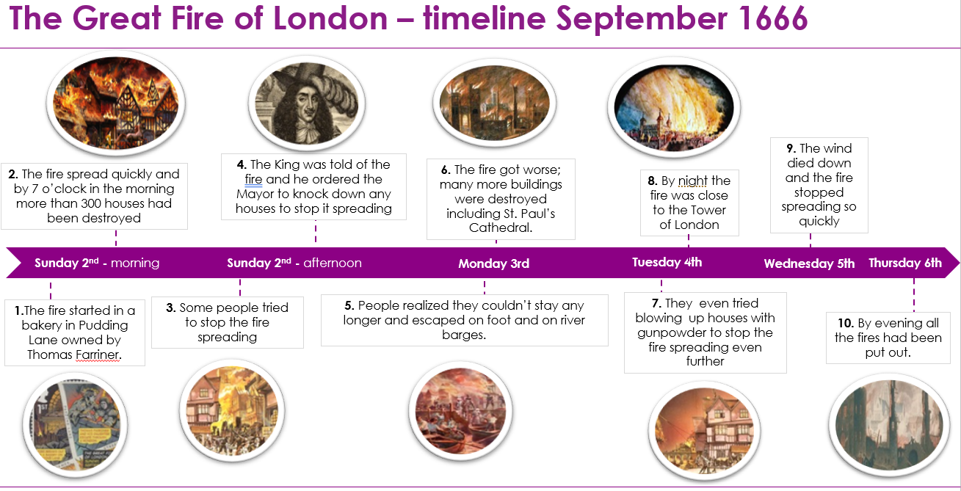
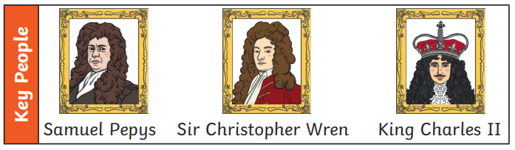
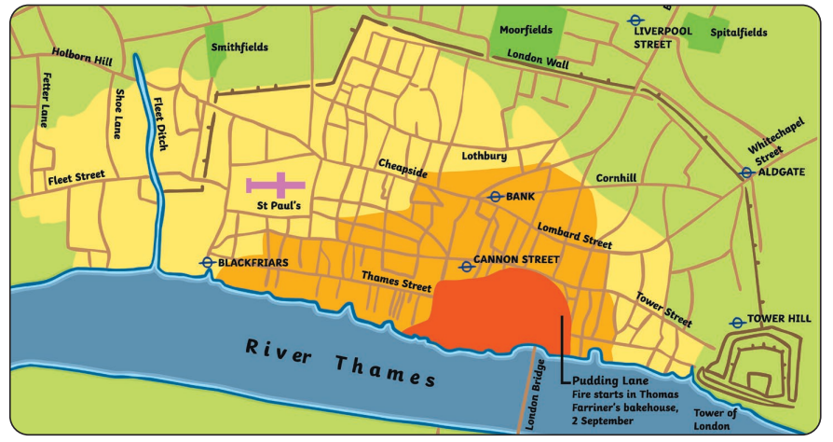
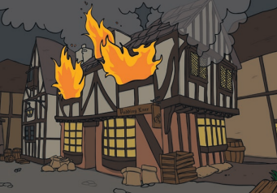
Y1 History Summer 1 Year 1 - CIVILISATIONS – The Great Fire of London – Why did it spread so quickly?? Key Concepts: Civilisation and Causes
Key Questions
1. 1. London in 17th Century – Introduction – What was the Great Fire of London and when was it? - Great Fire of London: how London changed - The National Archives – Wonderful sources to help build the story and chronology
2. What Flammable Materials were around in 17th Century London? - In a time of no electricity; light came from candles, central heating came from fires. Flammable materials like hay, pitch, tar and wood were everywhere – not to mention a great deal of gunpowder. Browse artefacts - The Great Fire of London
3. What was it about the buildings that made the fire spread? - A tinderbox city - Most of the buildings were made of timber with thatched roofs, and the streets were narrow, which sparked a domino effect as the fire spread.
4. What did the London Fire Brigade look like in 1666? – looking at the fire service, equipment, and the actions of the mayor. The Great Fire of London | London Fire Brigade (london-fire.gov.uk)
5. No water supply and the windy weather- As the fire reached London Bridge, the water supply was cut off, making it more difficult to fight the fire. What did the windy weather do?
6. Historical writing piece drawing all of the causes together – Why did it spread so quickly?
Assessment Writing Task
Why did it spread so quickly? Substantive knowledge Criteria to be evident in writing … Sentences about materials, buildings, the fire brigade and the weather. ?

