Slide 1

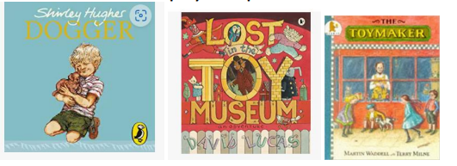
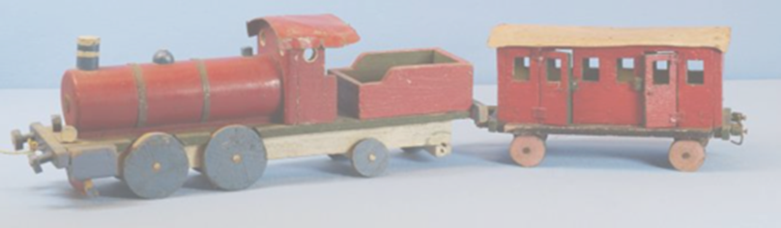
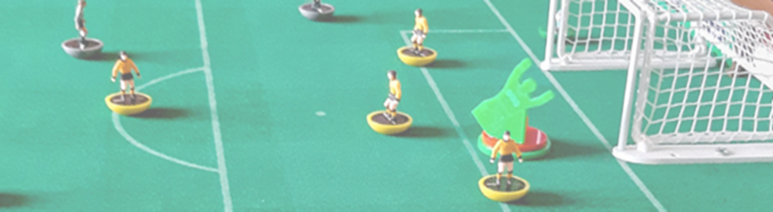
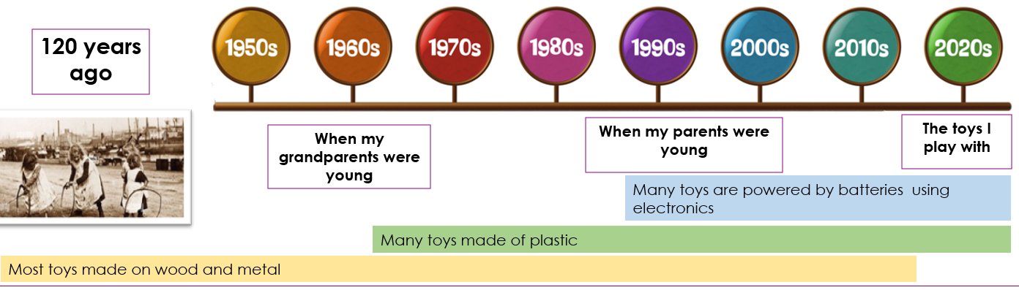
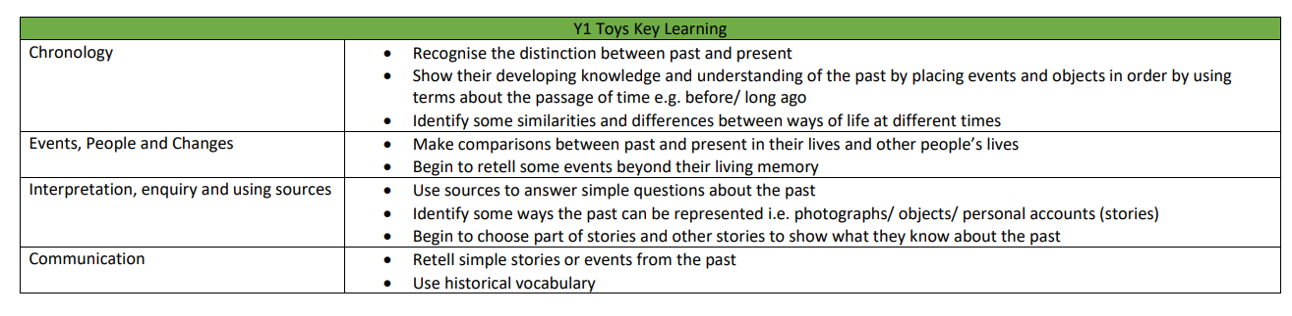
Y1 History Spring 1 Year 1 - Trade –How have toys changed from Victorian times to present day? Key Concepts: Trade and Similarities and Difference
Key Questions
1. What toys do I play with now and what toys do my friends play with now? What is my favourite toy and why?
2. What toys did I play with in the past and how are they different to the ones I play with now?
3. What did Victorian time look like in the past?
4. Children could construct questions to ask older relatives and where possible bring objects/photos in to create a class museum. Where possible use real life objects and sort into toys from the past and toys from now.
5.Who were the members of the Royal family? What toys did Royal Children play with?
6. End of unit writing piece – How have toys changed?
Assessment Writing Task
How have toys changed from Victorian times to present day?
Key Vocabulary
Toy Entertainment Object Material Owner Appearance Teddy Bears Console Battery Electronic Figurine Doll | Physical Activity Toys (e.g. hoops/skipping ropes) Mechanics lever cog Monarchy Royalty Queen King Prince Princess Throne

