Slide 1
Phonics and Early Reading
At St Ignatius, we want our children to have a love of reading that remains with them for life. The teaching of early reading and phonics is key to forming that love of reading.
Part 1 – information about how we teach phonics
Part 2 – information about how we teach reading

Slide 2
New DFE Guidance for Early Reading and Phonics
The journey to independent reading and writing begins with Phonics
littlewandlelettersandsounds.org.uk
Why Little Wandle?
-Excellent training for all staff to ensure consistency.
-Every aspect of phonics and reading included in a detailed, thorough and
systematic approach.
-Engaging resources without distracting from the learning.
-Comprehensive system for identifying and supporting children requiring
extra help and useful support for parents.
Notes:
Government changes mean a change (for the better) in how we teach phonics and reading at school - make sure there is consistency throughout
Early reading is the stage where children are learning to become fluent readers through the use of phonics

Slide 3
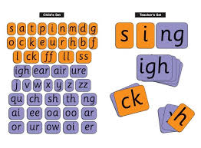
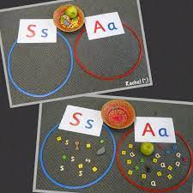
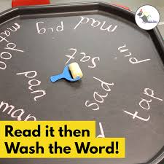
How we teach phonics
Daily short sessions
Specific order of teaching
Repeated practice
Correct pronunciation
is vital - Videos on LW
https://www.littlewandlelettersandsounds.org.uk/resources/for-parents/
Revisit previously
taught sounds at
start of each lesson
Practice makes
permanent

Slide 4
Notes:
Phonemes taught in order start to read words asap
LW has a picture pnemonic to help children remember the phoneme/grapheme

Slide 5
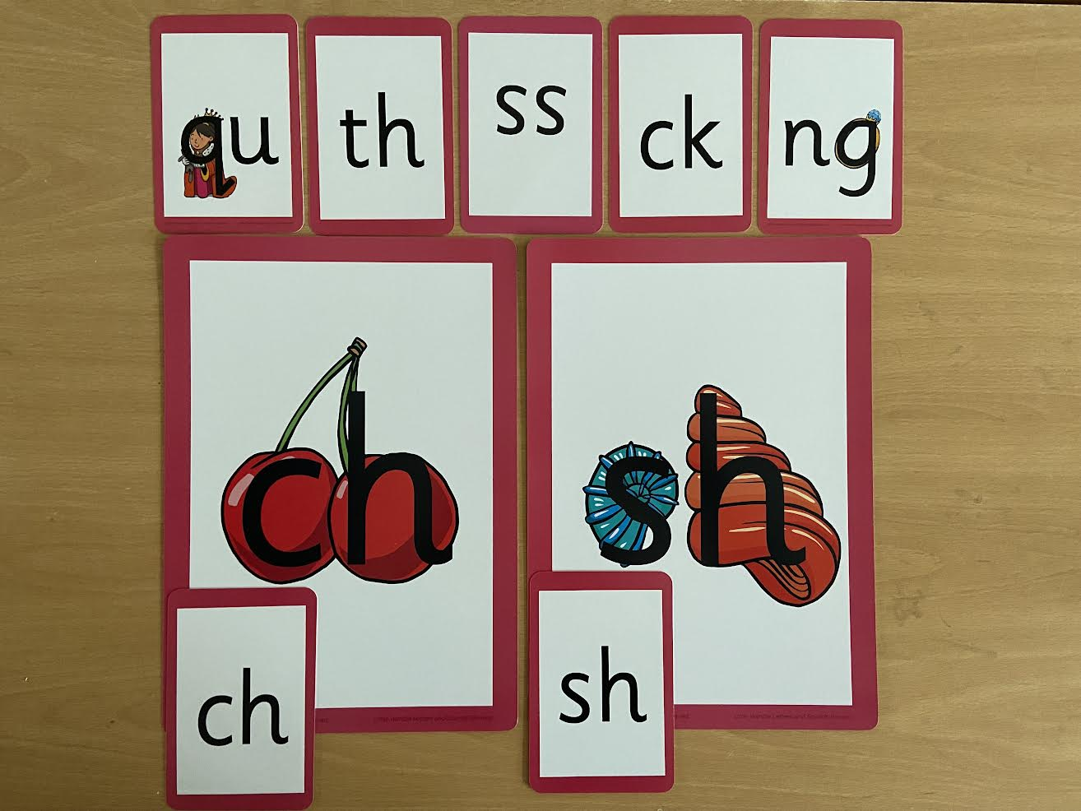
Notes:
Early digraphs mostly consonant digraphs – 2 letters 1 sound

Slide 6
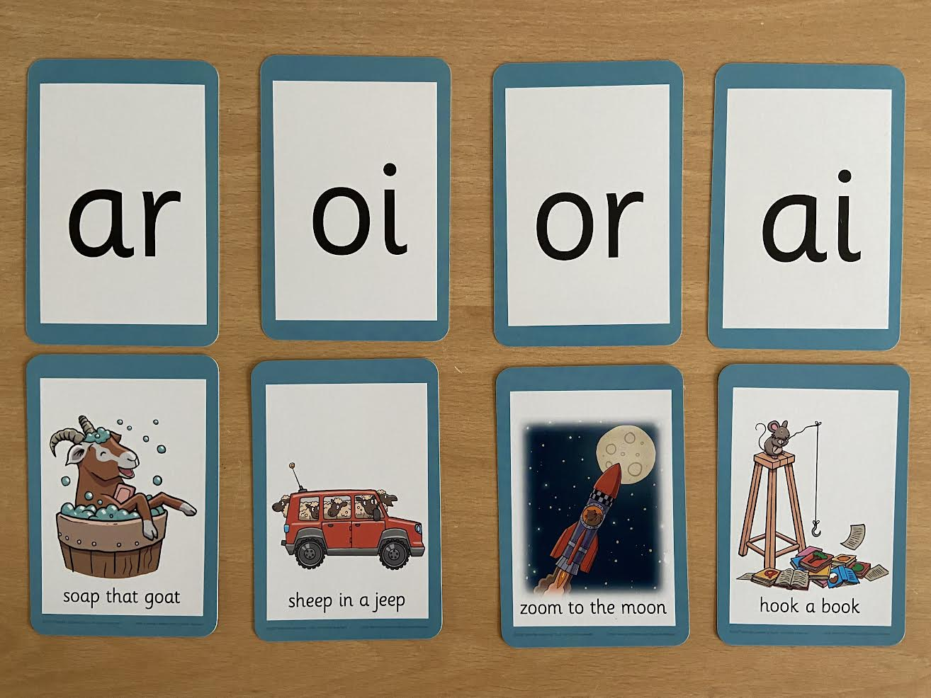
Notes:
Vowel digraphs taught with a short caption to help children remember
Also trigraphs igh, air

Slide 7
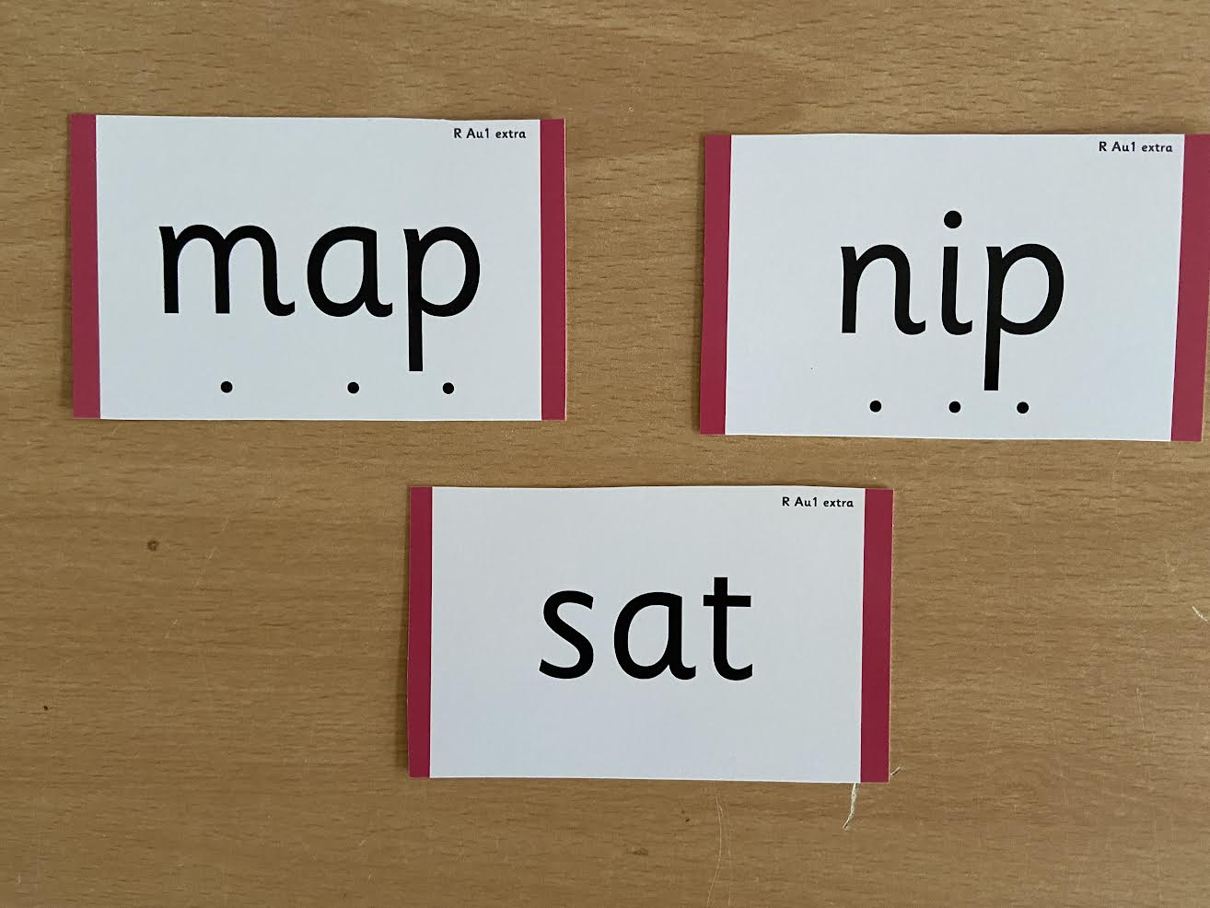
Notes:
During phonics lessons we use Sound buttons so we can sound talk and blend to read

Slide 8
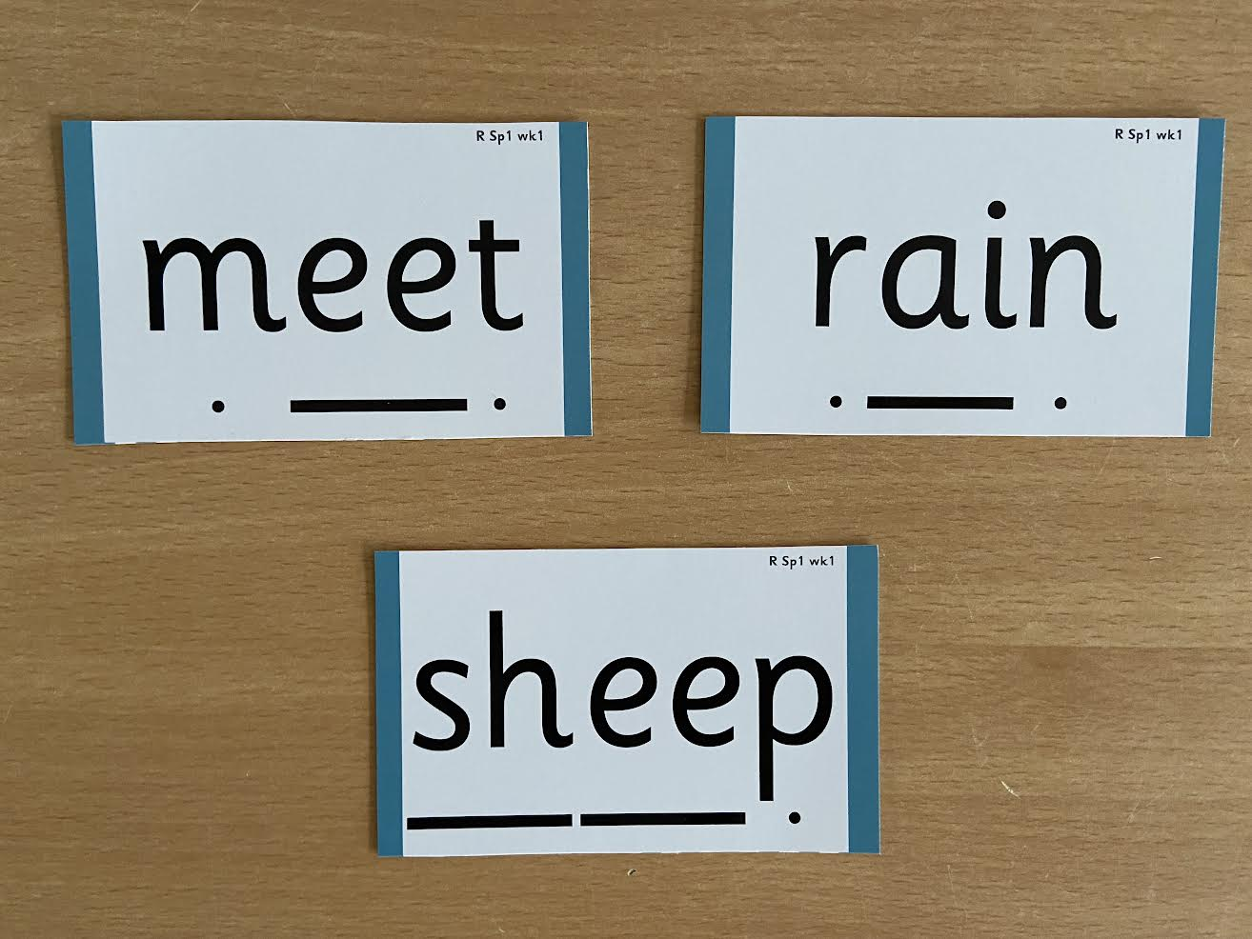
Notes:
Digraphs have a zip to sound talk and blend

Slide 9
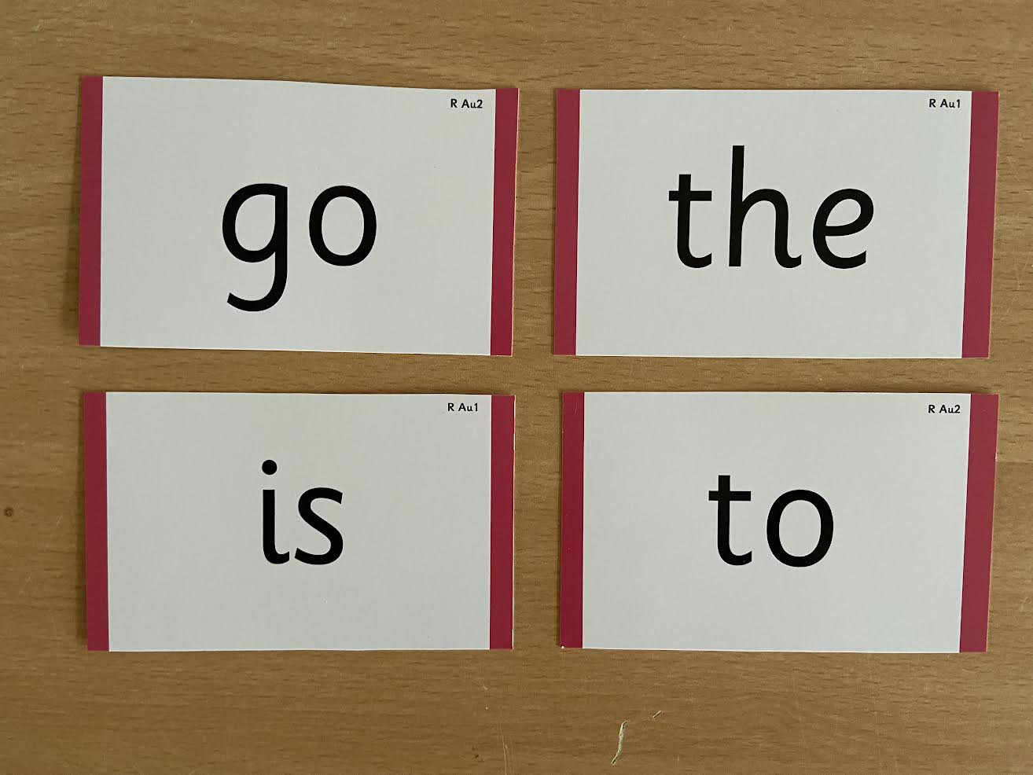
Notes:
Words that do not follow the rules and cannot be decoded – tricky words/ exception words
Chn are taught what part of the word is tricky

Slide 10
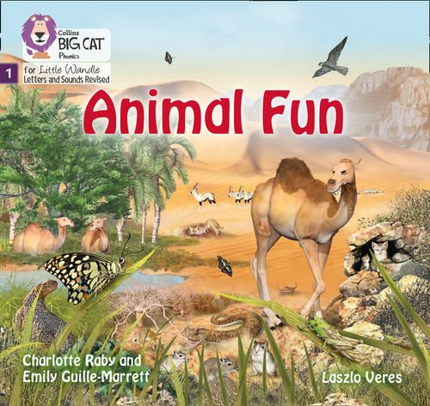
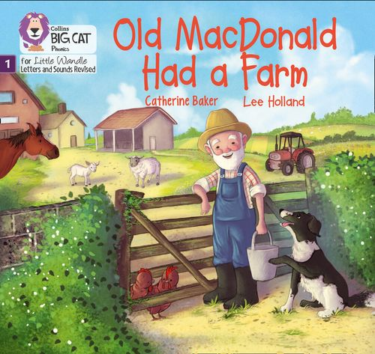
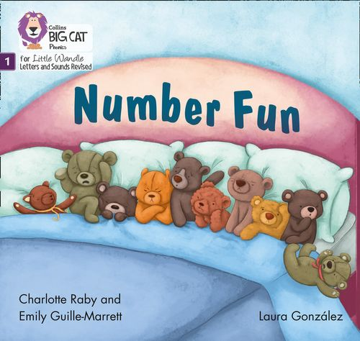
Once children have a secure knowledge of a number of
GPC’s (Grapheme Phoneme Correspondences)
and are confidently blending, they will be ready for
reading books.
Prior to this they may have wordless books which develop
great language skills and teach children the layout of books
and how to handle books.

Slide 11
Reading
We want children to
love reading
Learning to read should be
a positive experience
Reading should be
enjoyable
We want children to read
for pleasure
Reading underpins children’s access to the curriculum
and clearly impacts on their achievement
Notes:
We all know how important learning to read is and the impact it has on a childs success - it has to be a positive experience
Whats the reality? Reluctant to read because they find it hard
Frustration stress tears – that’s just the parents
Important to look at the big long term picture

Slide 12
How we teach reading
Reading practice sessions are :
Books are :
Matched to children’s
secure phonic knowledge
and word reading
Timetabled 3 times a week
Taught by trained teacher or
teaching assistant
Read three times
Taught in small groups
Sent home
Notes:
Quite a big difference to how reading was previously taught

Slide 13
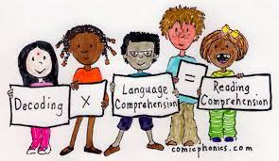
Reading Practice Books carefully matched so children can read
fluently and independently
3 Reads – each one begins with some quick sounds and words practice
Decoding
Prosody
(intonation, expression)
3. Comprehension
When children take their book home to read they should be 95% fluent
Please do not worry that a book is too easy – your child needs to develop
fluency and confidence in reading. Re-reading a book they have had before
helps develop fluency – this is the goal.
Celebrate their success!!!

Slide 14
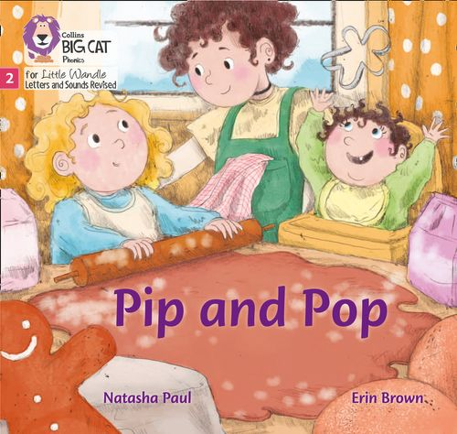
How will this work?
Children are assessed, then LW matches which books
Should be allocated for their secure phonic knowledge.
Children will be given a book which is the same book that
They have read in school (after reading it 3 times in school).
Teachers will let you know the days books go home and
when they need to be in school to be changed.
Celebrate, praise, talk about the book with you child.
Please make sure books are in book bags so that
we can reallocate books as required.
Please look after our books.
Notes:
Children will not be changing book multiple times a week as previously
Reading groups will be set up so you will be notified of when your book will be sent home/ need to be back in school
Groups will change!

Slide 15
Big Cat Collins Reading books are carefully matched to children’s
secure phonic knowledge
Notes:
To reiterate - Children will not have books containing GPC’s they have not learned and are not secure with
Look at inside cover

Slide 16
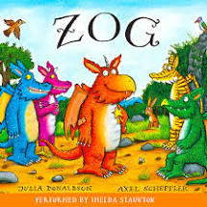
Sharing Book
Children will also bring home a ‘sharing book’ from our class library each week.
To become lifelong readers, it is essential that they read for pleasure.
Children may not be able to read this book independently but these books offer a wealth of opportunities for talking about the pictures and enjoying the story or information text.
Enjoy the book together and
foster a love of reading
“pair and share”.

Slide 17
What else can parents do?
Please look at the Little Wandle videos and guidance for parents
https://www.littlewandlelettersandsounds.org.uk/resources/for-parents/
Support children in learning the alphabetic code.
Let your child “show off” their reading to you and celebrate and praise all the way!
Share books with your children for pleasure.
Check on your class page for documents to support reading and phonics.

